Slide 1
Boronizations in W7-X
General Information
Properties of boronization layers in W7-X
Task and questions to be addressed
Thickness of boronization layers?
Homogeneity of boronizations in W7-X?
Oxygen gettering capacity?
Approach
Analysis of wall tiles after OP 1.2b and OP 2.1
Deliverable: PWIE-SP B.2.T-T004-D007
Status: ongoing
Facilities: Accelerator (7 days) + a few SEM days
Linked WP or TSVV: if applicable

Slide 2
Boronizations in W7-X
General Information
Properties of boronization layers in W7-X
Task and questions to be addressed
Thickness of boronization layers?
Homogeneity of boronizations in W7-X?
Oxygen gettering capacity?
Approach
Analysis of wall tiles after OP 1.2b and OP 2.1
Exposure of samples during individual boronizations
in OP 2.1 and 2.2 with MPM
Results
10 – 60 nm B after OP 1.2b on all tiles (3 boronizations)
5 – 15 nm B during individual boronization in OP 2.1
Oxygen gettering capacity 0.5 – 0.9 O/B
Deliverable: PWIE-SP B.2.T-T004-D007
Status: ongoing
Facilities: Accelerator (3 days) + a few SEM days
Linked WP or TSVV: if applicable

Slide 3
Boronizations in W7-X (2)
General Information
Sticking coefficient of boron radicals W7-X
Necessary for ITER modelling of boronizations
Task and questions to be addressed
Determine the sticking coefficient of H-B radicals
Comparable task also in AUG
Approach
Exposure of cavity samples during individual boronizations
in OP 2.2 with MPM
Results
First exposure on 18.10.2024
Some possibility of failure due to potenvery thin deposits
H-B
2.5 mm
15 mm
Deliverable: PWIE-SP B.2.T-T004-D007
Status: ongoing
Facilities: Accelerator (3 days)
Linked WP or TSVV: if applicable

Slide 4
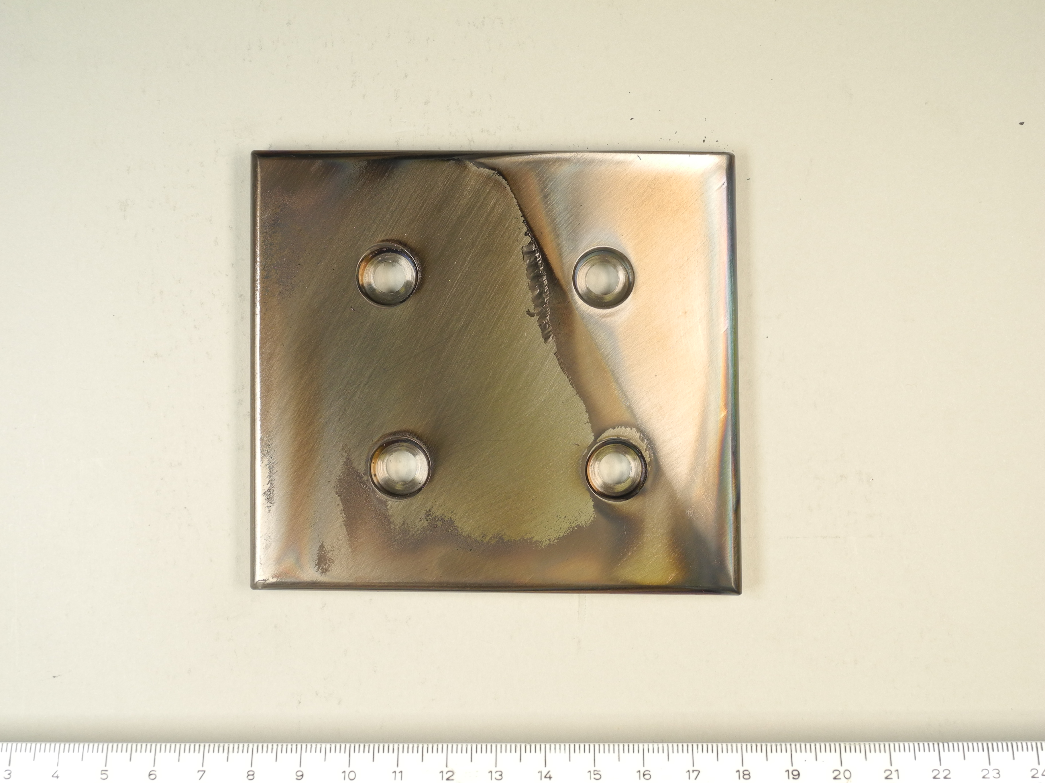
Deposits in W7-X after OP 2.1
General Information
Measure B/C deposition on wall and baffle tiles in W7-X
Task and questions to be addressed
Thickness, properties, locations of deposits
Approach
Analysis of wall and baffle tiles after OP 2.1
Results
Sometimes thick deposits >> 1 µm on baffle tiles
Only thin deposits on wall tiles
Data analysis ongoing
Deliverable: PWIE-SP B.2.T-T004-D007
Status: ongoing
Facilities: Accelerator (7 days) + a few SEM days
Linked WP or TSVV: if applicable

