Slide 1

WP PWIE: WEST analysis carried out in 2024
Mathilde Diez (CEA)
WP PWIE end-of-the-year meeting
October 17, 2024
Notes:
Please Indicate your subproject

Slide 2
Summary of WEST activities within PWIE SP.B
Work on the C1-C5 marker tiles
  Surface analysis on the entire tiles (MPG)
  Erosion/redeposition patterns using a LIBS/GDOES/SIMS comparative study (VTT,IAP,UT,IPPLM)
  Cross-analysis using ion beam characterization (JSI, Demokritos, IST, VR)
  Effect of the ripple on the erosion pattern on standard Gr tiles (MPG,IAP)
Investigation of helium-exposed PFCs (standard Gr tile + ITER-like PFU phase 1) (RBI,VTT,Aix Marseille Uni,CEA)
Investigation of deposits formed after the 2023 high particle fluence campaign (Aix Marseille Uni)
Analyses on ITER-like PFU phase 1
Surface analysis on the entire component (MPG)
  Samples cutting and radioprotection controls (CEA)
  Toroidal evolution of PWI on one MB (Demokritos)
Analyses on ITER-like PFU phase 2
Surface analysis on the entire component (MPG)
  Assessment of net erosion on the strike points (CEA)
Evaluation of erosion/redeposition on the poloidal gaps/side surfaces (MPG, ?)

Slide 3
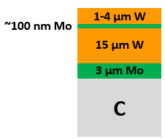
Surface analysis on the entire C1-C5 marker tiles
Monitor erosion/redeposition changes over WEST phase 1 (MPG)
Complete IBA & microscopy analyses on top surface – done in 2024
Effort to summarize and compare C3/C4/C5 results – done in 2024 (and presented during July meeting)
quantification of erosion → 2,5µm after C3
> 6µm after C5
quantification of deposition → 20 µm after C3
25 µm after C4
50 µm after C5
D, C, B content along ‘s’ coordinate
Clear idea of arcing phenomenon
results on the top surface mature enough to be published
D content
B content

Slide 4
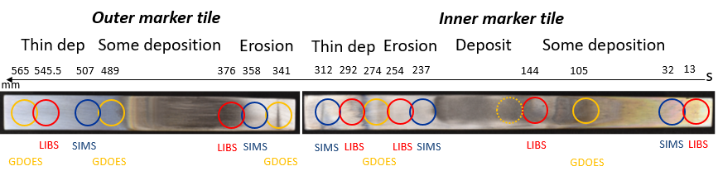
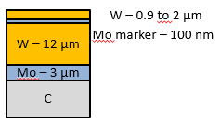
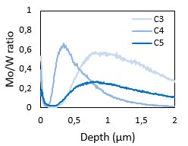
Erosion/redeposition patterns using a LIBS/GDOES/SIMS comparative study
 | C3 marker tiles | C4 marker tiles | C5 marker tiles
SIMS (VTT) | Done - 2021 | Done - 2022 | Done – 2023
GDOES (IAP) | Done – 2021 | Done - 2023 | Done in 2024
LIBS (UT) | Done - 2021 | Done - 2023 | X
Comparison between GDOES/LIBS/SIMS for depth profiles of different elements (IAP/UT/VTT)
Cross analysis with C3/C4/C5 tiles– made in 2024 (and presented during July meeting)
B content along ‘s’ coordinate measured by GDOES/SIMS/LIBS
D content along ‘s’ coordinate measured by SIMS
Erosion monitoring by SIMS
detection of He with LIBS at high laser fluence
I.Jogi et al., JNE 2023
Publication ?
LFS
HFS
GDOES
SIMS
ISP erosion area
Issues:
Contradiction between SIMS and GDOES on B content (because difference in beam size ? calibration problems with SIMS -> see Antti’email from 08/07?)
no LIBS on C5 marker tiles

Slide 5
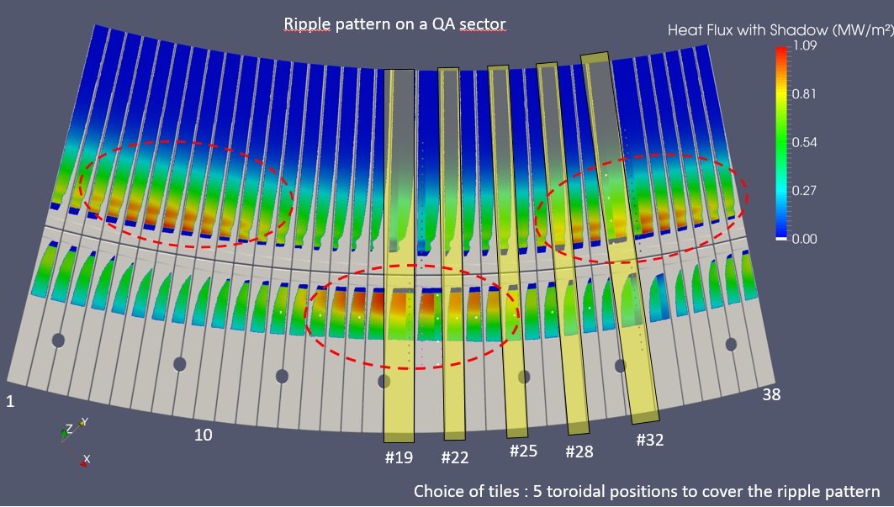
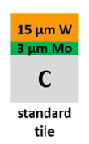
Study the effect of ripple on the erosion pattern
New activity in 2024 following July meeting on erosion makers
Analysis sequence agreed during the TE/PWIE workshop:
CEA sends tiles sent to MPG done in 2024
RBS on the whole tiles with legs (MPG) should be done in 2024
Mark the tiles on the lateral sides where the measurements have been/should be done (MPG)
Cut the legs (CEA or MPG ?)
GDOES on the whole tiles without legs (IAP)
Selection of 10 W/CFC tiles covering the ripple pattern on the lower divertor
→ No sample cutting foreseen

Slide 6
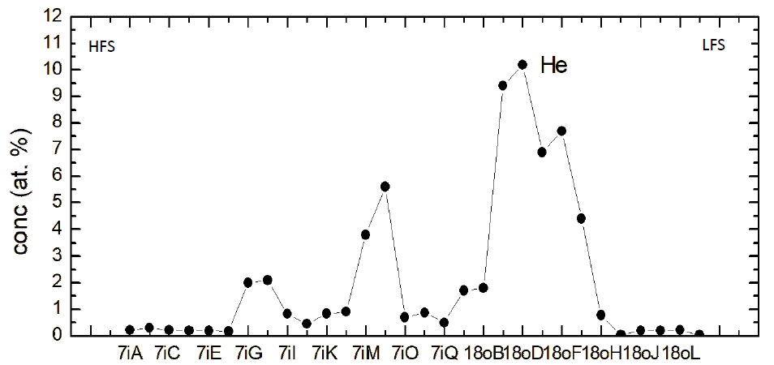
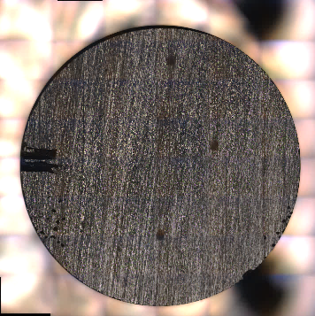
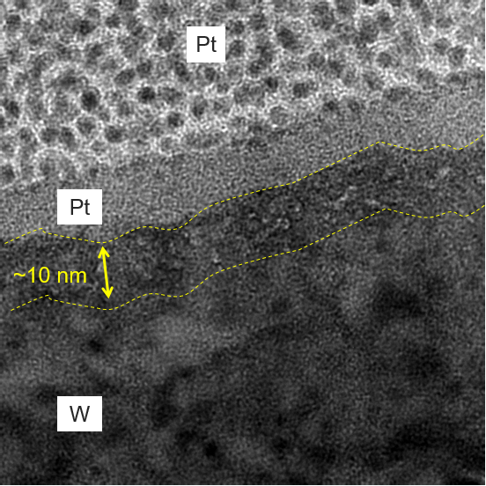
Investigation of helium-exposed PFCs
Helium campaign in WEST
Dedicated C4 campaign (2020) with He plasma to investigate W surface morphology changes
Characterization plan and results
Samples coring (VTT) - 2023
Erosion characterization by SIMS (VTT) - 2023
Assessment of He content by Tof-ERDA (RBI) - 2023 → max of 10at.% He on OSP
Surface analysis of OSP sample by confocal microscopy (Aix-Mar.Uni.) done in 2024
SEM / FIB / TEM analysis (Aix-Mar.Uni.) → evidence of He bubbles ! done in 2024
Standard C4 tiles
He bubbles
Assessment of He content on ITER-like PFU phase 1 by Tof-ERDA done in 2024
eroded area
Plans to be presented at PFMC 2025
deposition area

Slide 7

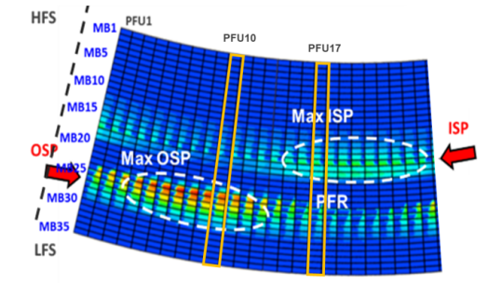



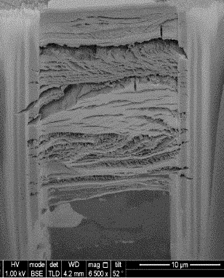
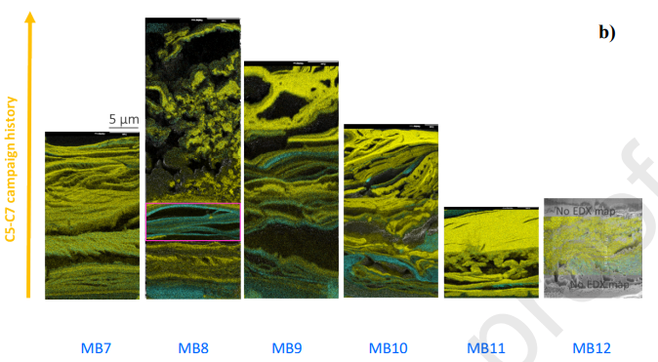
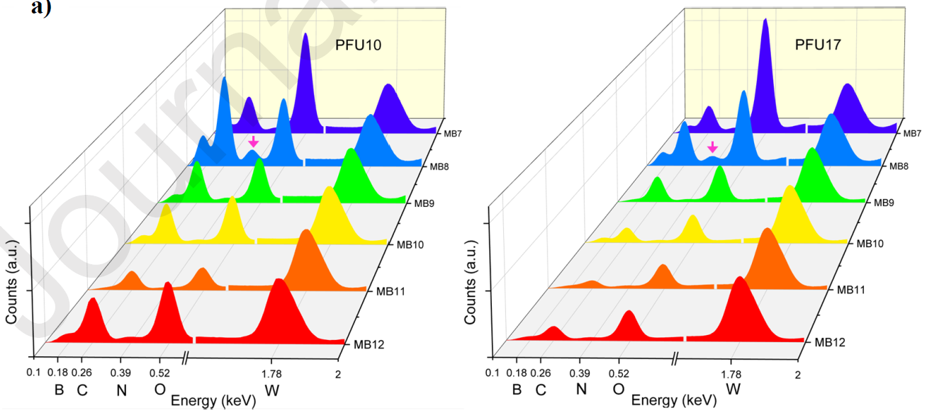
Investigation of deposits formed after the 2023 high particle fluence campaign
High fluence campaign in WEST (C7, 2023)
Dedicated to reach particle fluence of ITER shots (W erosion /migration expected)
Repetitive 1 min long discharges and up to 100s
5h30 cumulated plasma time
Characterization plan and results
In-situ collection of deposits on 2 PFUs using sticky pads (CEA) - 2023
Surface analysis of the pads using confocal microscopy (Aix Mars. Uni) - done in 2024
Morphology and composition of deposited layers using SEM/EDX/FIB (Aix Mars.Uni.) → W dense layers of 5-40µm thick - done in 2024
Publication C.Martin et al., 101764 NME 2024 - done in 2024 (PSI)
23 µm
Issues : limited analyses so far on PFUs phase 2
Entire PFUs available for characterization -> surface analysis at MPG ? Other labs ?

Slide 8
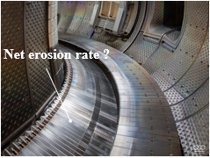
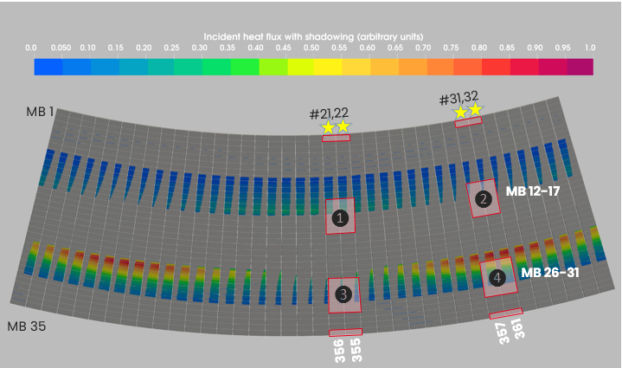
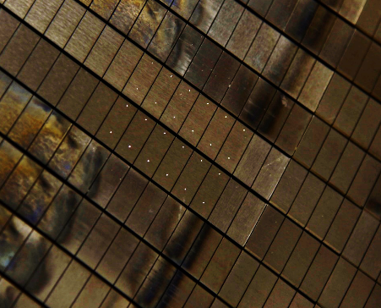
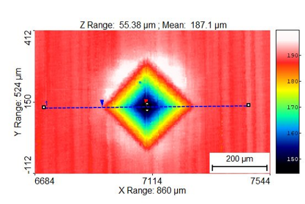
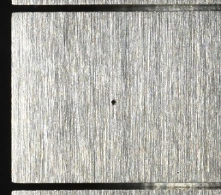
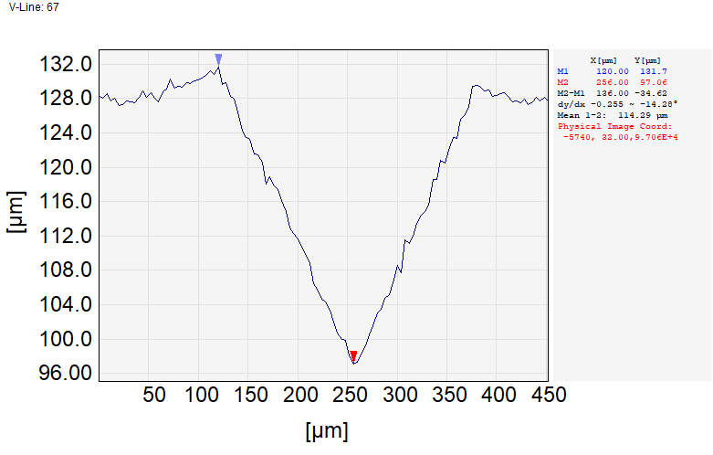
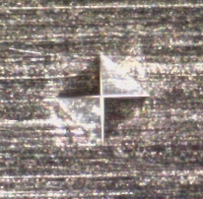
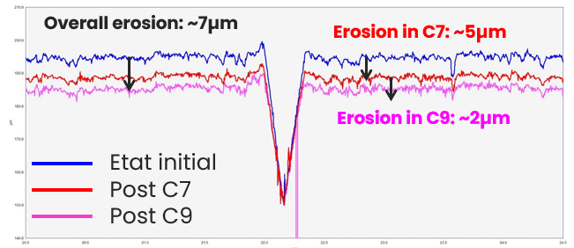
Assessment of net erosion of ITER-like PFUs phase 2
New activity in 2024 within PWIE (started in 2021 on internal funds though)
presented at SOFT 2024
Objective & method
develop a method to evacuate the net erosion of actively-cooled W ITER-like PFUs in a real tokamak environment with long plasma discharges over an integrated period of time
WEST phase 2, 2023
Characterization plan and results
Pre-characterization, installation of 4 PFUs in WEST - 2021
Monitoring of indents depth after C6/C7 campaign using confocal microscopy → erosion of 5µm in ISP– 2023
Monitoring of indents depth after C8/C9 campaign using confocal microscopy → erosion of 2µm on ISP – done in 2024
1 PFU removed from WEST, visual inspection and radiation controls – done in 2024
FIB on indents on full MB to confirm the results

Slide 9
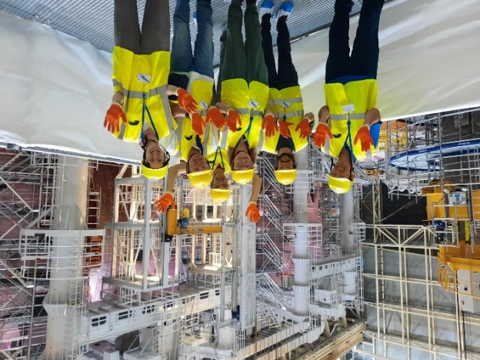
Conclusions
Technical meeting on erosion markers held in July 2024 at CEA, Cadarache
  Creation of a shared folder https://datashare.mpcdf.mpg.de/s/yXb4jwC0QsjQoI3/authenticate
  Effort to summarize work on C1-C5 erosion markers
  Identification of missing data, general problems, scientific questions (C5 LIBS, summary of IBA data)
  Identification of topics for 2025 publications / conferences
  New WEST activities within PWIE in 2024
  Effect of the ripple on the erosion of the lower divertor
  Evaluation of erosion of ITER-like PFU phase 2
ITER-like PFU phase 1
All samples cutting are done
All radiation controls are performed
A first batch of samples has been sent to RBI in August for helium inventory. Depending on the results, a second batch could be sent.
→ Overall, analyses on full PFU (no cutting) or on full MB are going faster… This will drive the characterization of ITER-like PFUs phase 2
question to VR : IBA on full MB possible ?

Slide 10
Thank you

Slide 11
²
12
 | Nb of boronization | Duration | Amount of boron injected | Number of anodes
C3 | 3 | 9,5 h | 30g | 6, 6, 5
C4 | 13 | 52 h | 130g | 6, 6, 6, 6, 6, 6, 4, 4, 4, 2, 2, 1, 1
C5 | 2 | 8 h | 20g | 6, 6
30
30

