Slide 1
Agenda
# | Title of contribution | Speaker
1 | TSVV13 updates (Next call for Marconi, E-TASC General Meeting, Feedback TSVV13$→$CWGM, etc.) | J. M. García Regaña (CIEMAT)
From now on, our regular meetings will take place on the second Monday of each month at 11:00 (CET) / 10:00 (UK), unless an event prevents it.
Next meetings:
November 11th (E-TASC General meeting) $⇒$ November 18th.
December 9th
J. M. García Regaña | TSVV-13 Meeting 19| Zoom | 13/5/2024 | Page 1

Slide 2
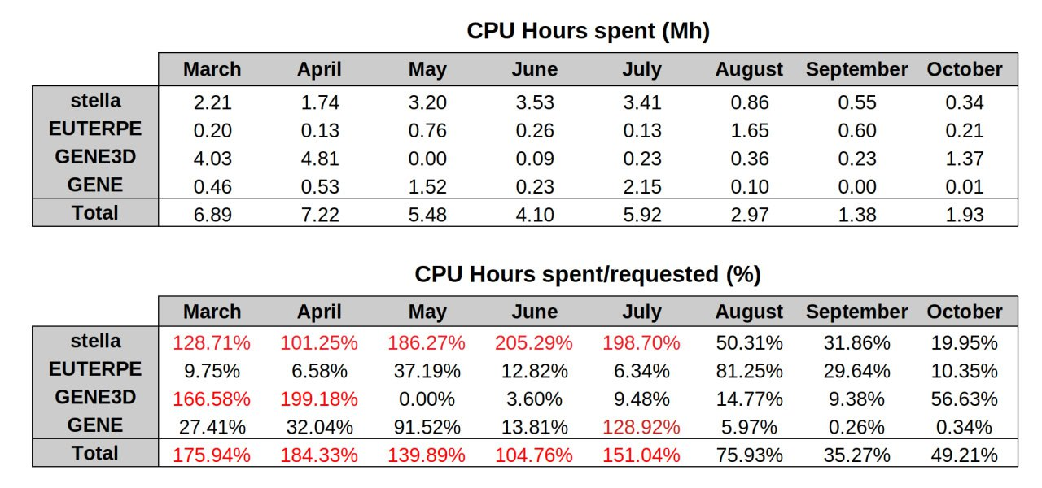
HPC Marconi resources
The usage of the TSVV/Marconi FUA38_STELTURB in March: 76.39 %
Re-evalution of resource allocation $⇒$
980502 ($\sim 47$ Mhours of CPU) node hours to run on the A3 conventional partition and 71752 node hours to run in the C1 "GPU" partition.
J. M. García Regaña | TSVV-13 Meeting 20 | Zoom | 15/10/2024 | Page 2

Slide 3
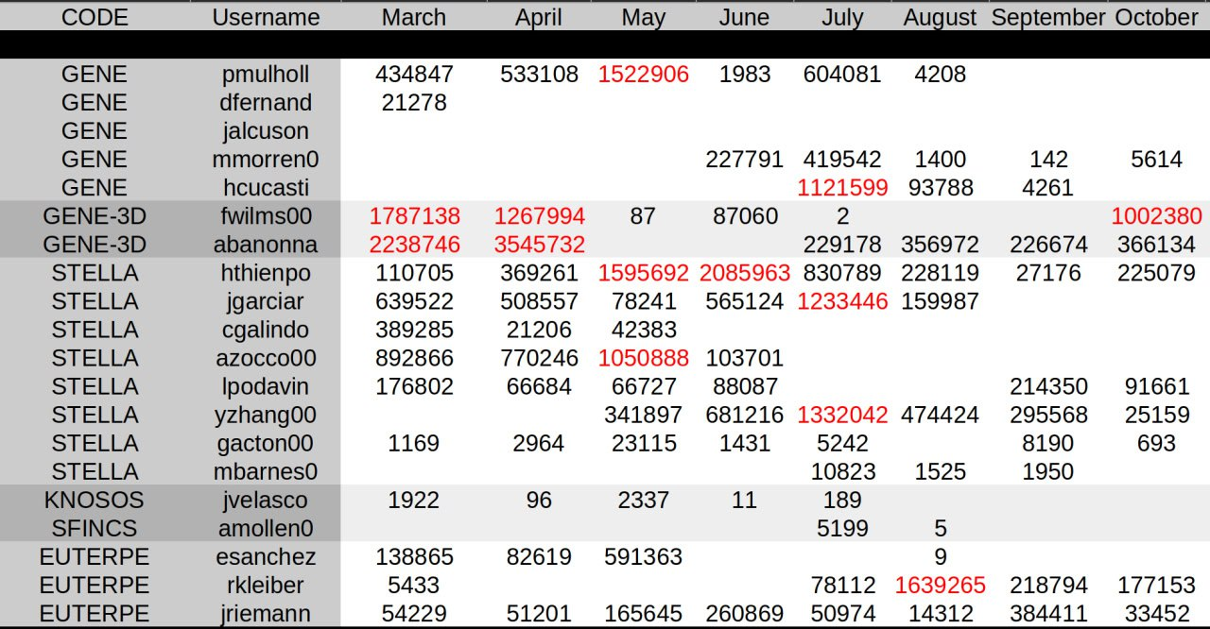
HPC Marconi resources
The usage of the TSVV/Marconi FUA38_STELTURB in March: 76.39 %
For the total yearly budget and monthly budget:
>saldo -b
To see how much each user used in e.g. month '6’:
> saldo -r -a FUA38_STELTURB -s 202406 -e 202406
-a = account
-s = start date
-e = end date
J. M. García Regaña | TSVV-13 Meeting 20 | Zoom | 15/10/2024 | Page 3

Slide 4
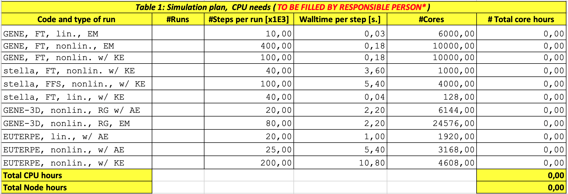
Call for participation in new HPC-Fusion (Pitagora)
Call for proposals for the use of the EUROfusion High Performance Computer (Marconi-Fusion) with deadline Monday, November 18.
I’ll ask for your contribution to be returned to me not later than Monday, November 4, in the usual form ($∼$ fill a table and provide description of physics plan and simulation plan):
J. M. García Regaña | TSVV-13 Meeting 20 | Zoom | 15/10/2024 | Page 4

Slide 5
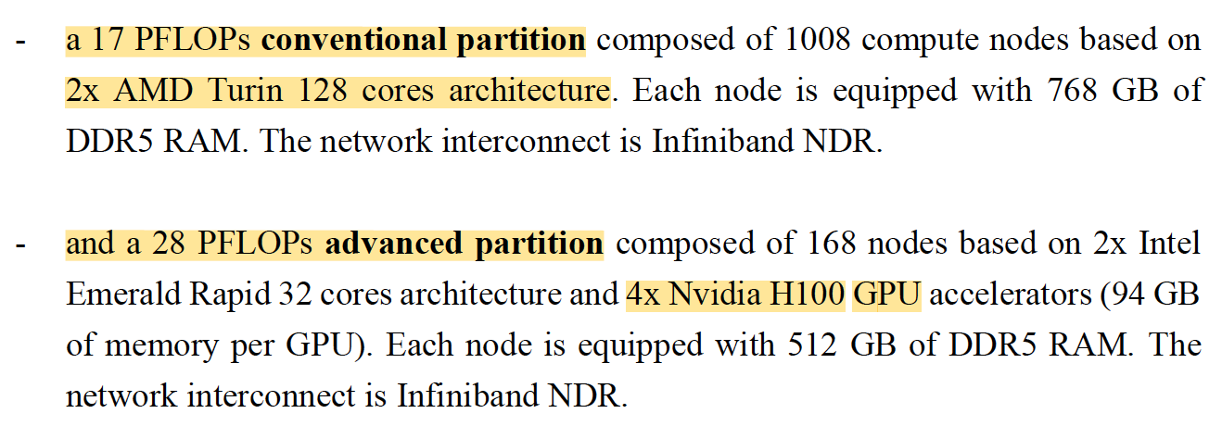
Call for participation in HPC-Fusion (Pitagora)
Consider that GPU nodes are available:
Maximum allocation considerably larger than in previous calls (128 CPUs/node):
$⇒$Maximum allocation: 256 million CPU hours! There is room to request more than what we have typically got allocated ($∼80−90$ million).
J. M. García Regaña | TSVV-13 Meeting 20 | Zoom | 15/10/2024 | Page 5

Slide 6
E-TASC General Meeting (11th to 15th November)
The E-TASC General Meeting is scheduled to take place from November 11th to 15th in Garching:
Enhancing networking across various TSVVs and Thrusts
Developing strategies to maximize the impact of ACHs
Guaranteeing the timely release and readiness of simulation tools by the end of 2025
Considering potential modifications to the TSVV/ACH objectives and portfolios after 2025
Poster to be presented by the TSVV leaders on the “Status and plans of the TSVVs (until the end of 2025 and beyond)”.
J. M. García Regaña | TSVV-13 Meeting 20 | Zoom | 15/10/2024 | Page 6

Slide 7
E-TASC General Meeting (11th to 15th November)
The E-TASC General Meeting is scheduled to take place from November 11th to 15th in Garching:
Enhancing networking across various TSVVs and Thrusts
Developing strategies to maximize the impact of ACHs
Guaranteeing the timely release and readiness of simulation tools by the end of 2025
Considering potential modifications to the TSVV/ACH objectives and portfolios after 2025
Poster to be presented by the TSVV leaders on the “Status and plans of the TSVVs (until the end of 2025 and beyond)”.
I’ll prepare the poster by November 1st, so I can get your feedback for any amendments, additions, etc.
J. M. García Regaña | TSVV-13 Meeting 20 | Zoom | 15/10/2024 | Page 7

