Slide 1
Reporting meeting WPPWIE SP-X 2024
Pavel Veis, Sahithya Atikukke, Sanath Shetty, Shweta Soni, Pavitra Bhat, Michal Stano, Matej Veis, Dhanada VS, Ivan Urbina et al.
Comenius University in Bratislava
PWIE-SP X.X1.T-T004-D003 | VUV OES hydrogen atom and molecule analysis of MAGNUM-PSI/UPP s H/H2 (CU) | Hennie van der Meiden | 31/12/2024 | 17 | Running

Slide 2
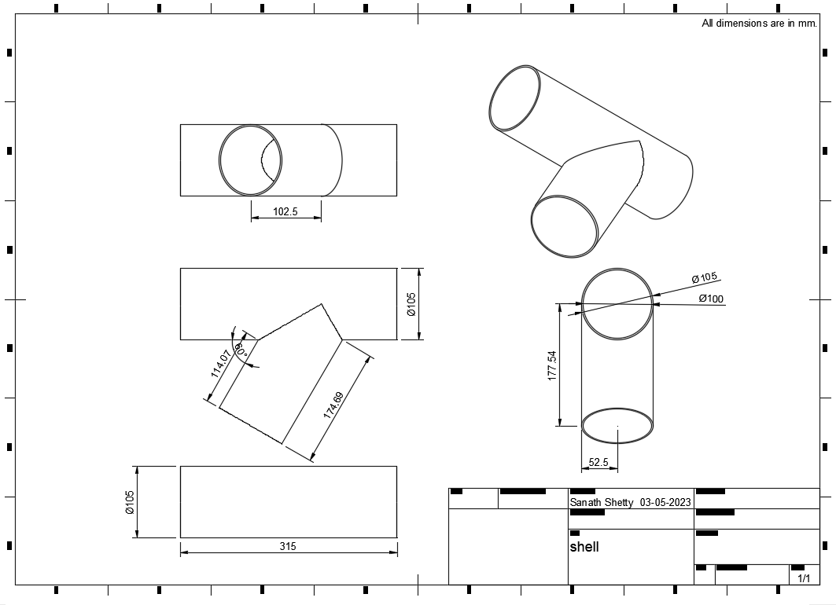
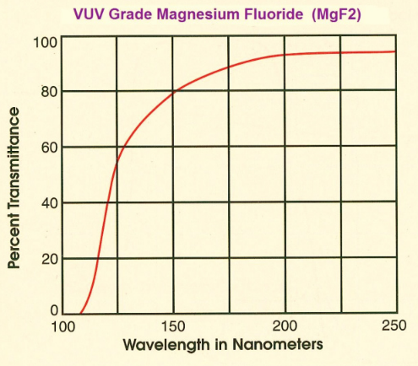
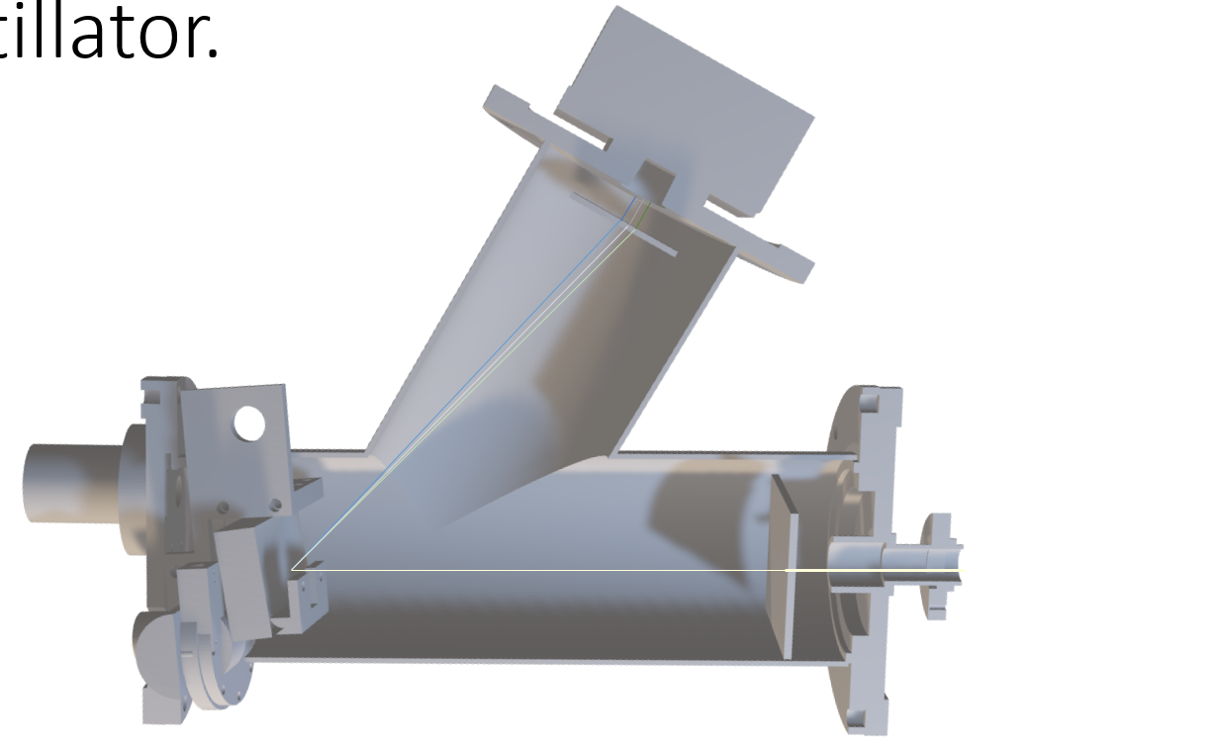
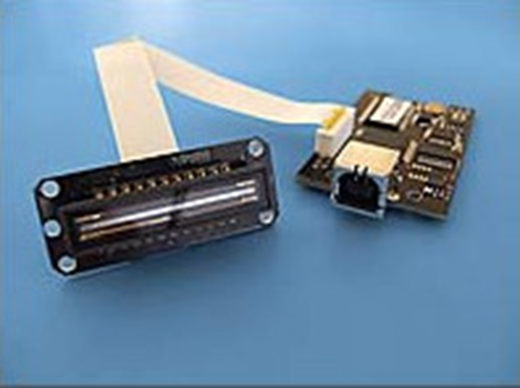
Design and testing of the VUV spectrometer for H plasma OES
The CAD designs were completed using Autodesk Fusion 360.
Usage of Toroidal grating with spectral and VUV grade Magnesium fluoride optical elements.
Testing Scintillator in combination with detector and optimisation – To get fluorescence from the VUV radiations.
OEM CCD from electronic devices is used as a detector. The CCD array (TCD1304AP) bears 3648 pixels, each pixel of size - 8𝜇𝑚 x 200 𝜇𝑚.
Initial setup was made and the CCD array was configured to operate with Windows 10/11.
Deliverable: PWIE-SP X.X2.T-T004-D006
Status: in progress
Facilities: or Modelling:
Linked WP or TSVV:

