Slide 1
D001: OES results H/H2, ne, Te and 2D distribution in JULE-PSI . VIS and VUV molecular and atomic spectroscopy in PSI-2 under ionising and recombining plamas (FZJ)
SP X monitoring Meeting 2024
Michael Reinhart, Rahul Rayaprolu, Oleksandr Marchuk, Marc Sackers, Gennady Sergienko
Institute of Fusion Energy & Nuclear Waste Management - Plasma Physics
Forschungszentrum Jülich

Slide 2
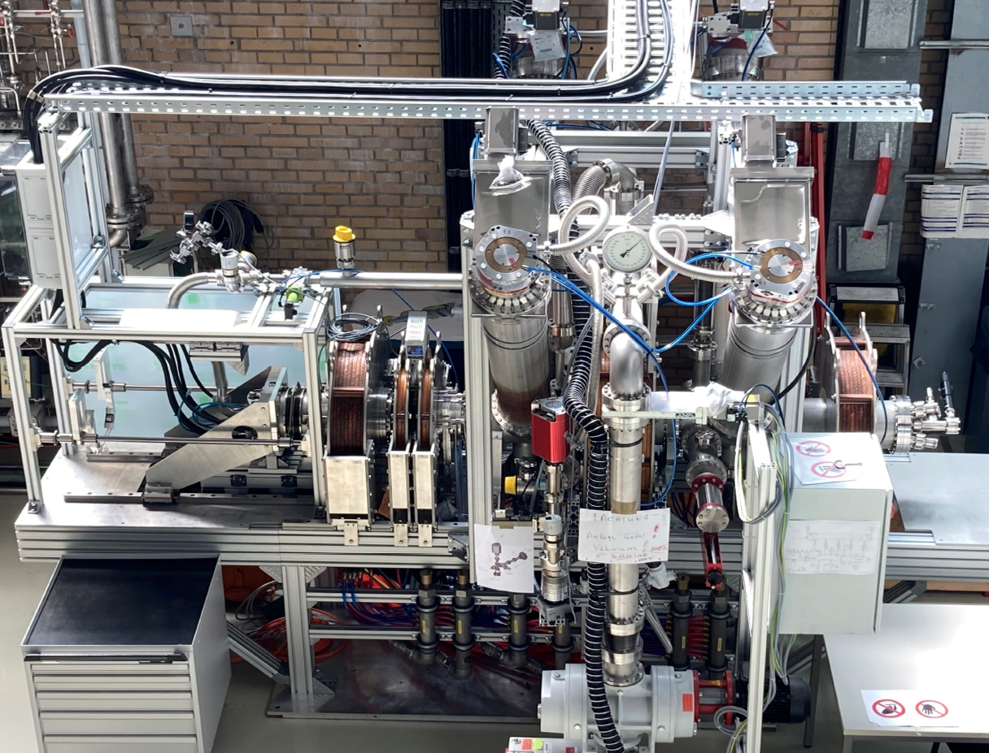
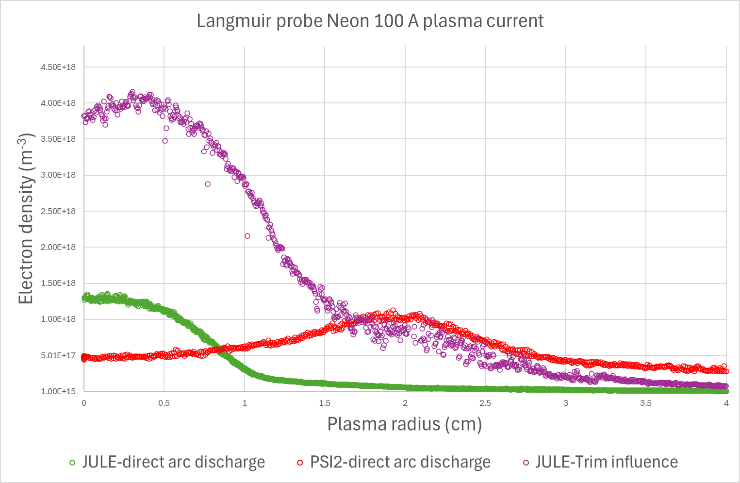
OES results H/H2, ne, Te and 2D distribution in JULE-PSI
Current Status:
Langmuir probe:
Spectrometer
Vacuum pumps
Langmuir Probe
Magnets
Aperture
Plasma source
Plasma dump
Hyperspectral camera
Anode cooling and shape has been improved
Tests with argon and neon plasma performed, main focus: Plasma performance, magnetic fieldline configuration
Cathode vacuum vessel cooling has also been updated and is currently being installed
Next steps: Operation with Helium (less erosion at dump and cathode) and hydrogen (pending permission)
Radial profiles of n_{e}, T_{e}, plasma flux
Plasma reaches higher peak values compared to PSI-2 at similar discharge power
Performance strongly depends on magnetic fieldlines in source area

Slide 3
OES results H/H2, ne, Te and 2D distribution in JULE-PSI
Optical Emission Spectroscopy:
Hyperspectral camera
Spectrometer
Vacuum pumps
Langmuir Probe
Magnets
Ne I
Aperture
Ne II
Plasma source
Plasma dump
Hyperspectral camera
Comparison of langmuir probe results with simple methods (Boltzmann plot, Line ratios) seems inconclusive, maybe also due to systematic problems (line-integrated signal, no spatial resolution, not same position as Langmuir Probe)
Upgrade to 2D-Spectrometer dismissed in favour of hyperspectral camera
Good for detecting plasma impurities
Pictures from the camera provide radial profiles of the plasma column at different wavelengths
Selection of wavelengths is limited due to low spectral resolution

Slide 4
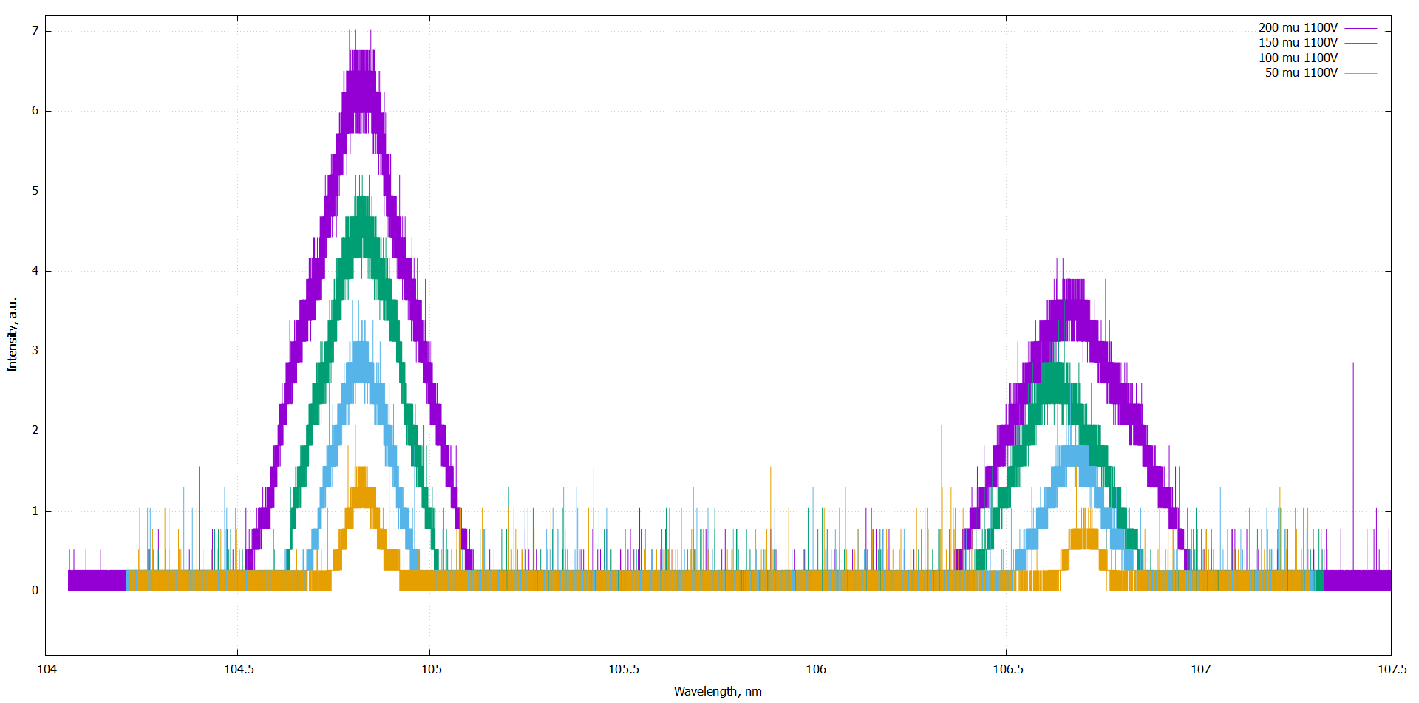
VIS and VUV molecular and atomic spectroscopy in PSI-2 under ionising and recombining plamas
Spectrometer is operational at test stand (with hollow cathode light source)
Parameters VUV Spectrometer:
McPherson Seya-Namioka ½ m
Grating: 1200 g/mm Blaze wavelength – 150 nm
Detector: PMT R6095 (Hamamatsu)
+ Scintillator (McPherson)
Spectral range: 104 nm – 300 nm
Scheduled to be installed at PSI-2 end of November
First measurements at PSI-2 scheduled for December
PSI-2 ready to provide ionizing and recombining plasmas
VUV spectrometer view is at the same plasma section as VIS spectrometer, for good comparability
104 105 106 107
Ar I lines (104.8 and 106.67 nm) at different entrance slit widths (50-200 µm)
Entrance slit (5mm x W)
DUV Parabolic Mirror, f = 8“
W = 20.. 50 m
to PSI-2 Plasma
(edmond optics)
DUV Mirror
(movable)
LiF window
(to supress 2nd order and protect DUV mirror)
Optics size~ 1“

Slide 5
Summary
JULE-PSI Plasma characterised (radial profiles of n_{e}, T_{e}, plasma flux) for Neon and Argon Plasmas
Optical emission spectroscopy and Hyperspectral camera are operational, goal is to substitute the Langmuir probe to reduce dependence on moving parts inside the hot cell
Hydrogen plasma was not yet tested due to pending permission
VUV Spectrometer for PSI-2 is operational
VUV Spectrometer will be mounted at PSI-2 and used for first measurements of ionizing and recombining plasmas, also in comparison with visible light spectrometer, in the next weeks

