Slide 1
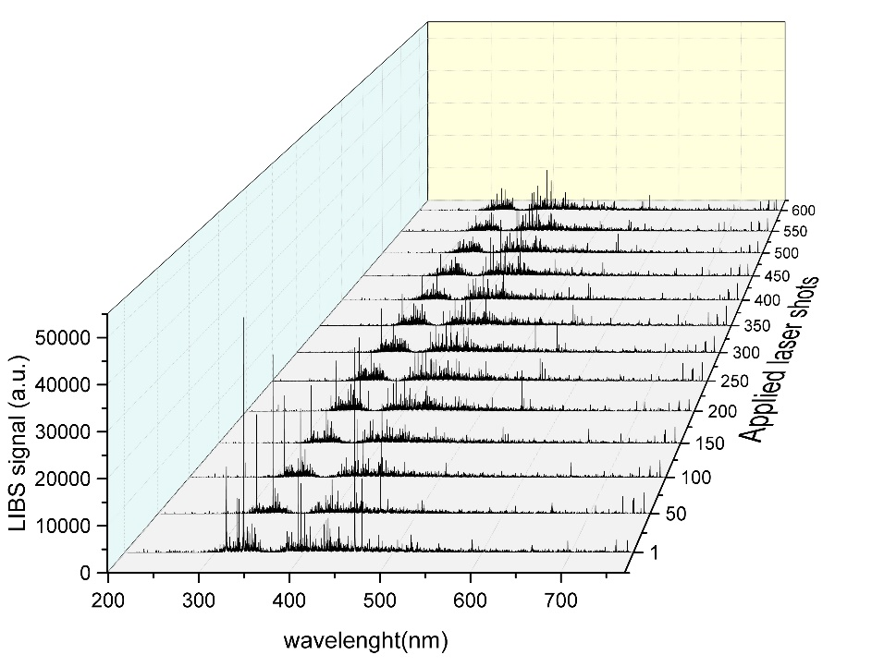
LIBS on Be-containing coatings with different type of fuel content (VTT)
General Information
LIBS experiments were made at VTT using conditions similar to JET- to support the activities under
PWIE-SP E.E1.T-T003-D007 before the actual commissioning of the LIBS tool for JET
Task and questions to be addressed
(CF-)LIBS on Be containing coatings with different type of fuel content
Approach
LIBS system at VTT was upgraded and JET samples from limiters and divertor tiles were analyzed
Results
Several JET divertor and limiter samples were successfully analyzed
Main spectral lines for H/D, Be, Mo and W were identified
Co-deposition of Be was observed on several samples
0
1
6a
3
4
JET sample 2IWG3A_6a
W lines
Be lines
Mo lines
Deliverable: PWIE-SP X.X2.T-T004-D009
Status: completed
Facilities: -
Linked WP or TSVV: WPTE

