Slide 1
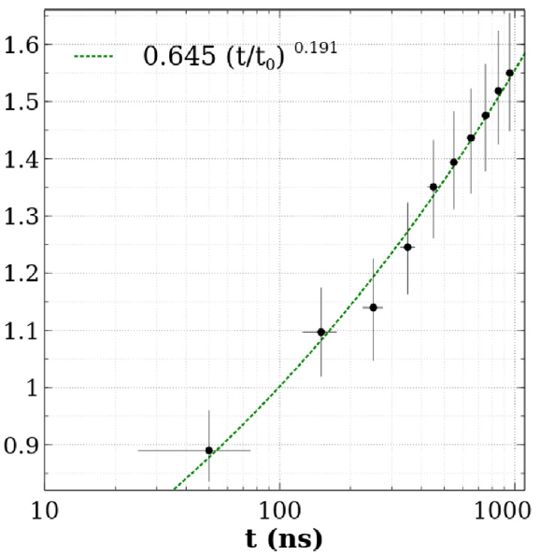
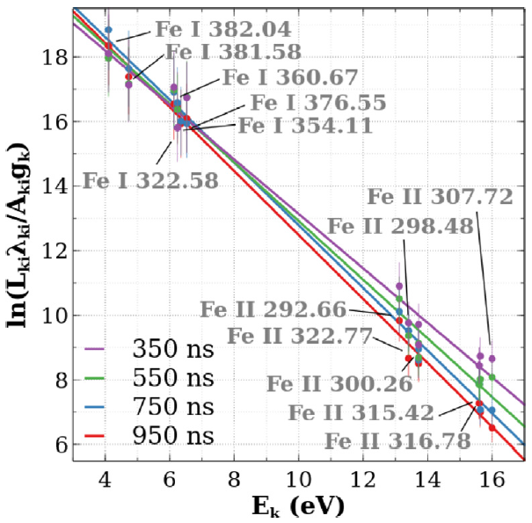
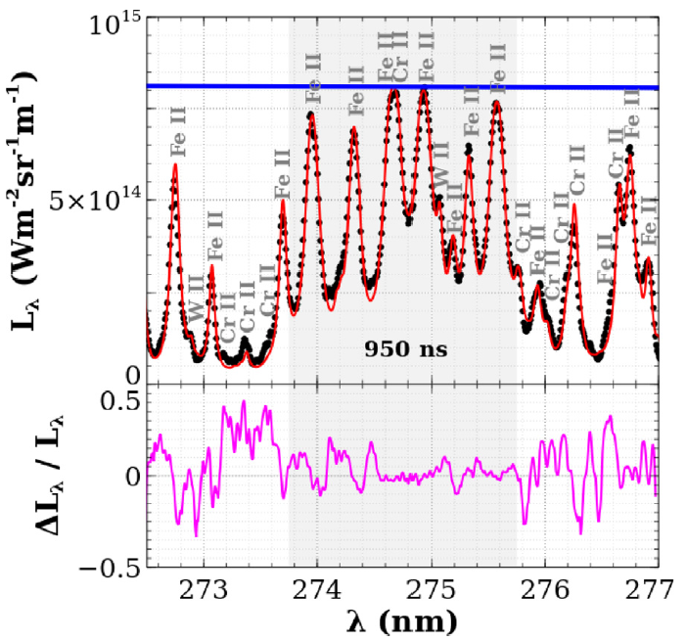
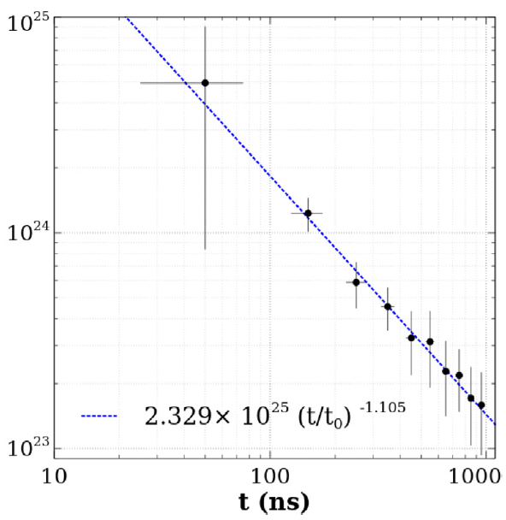
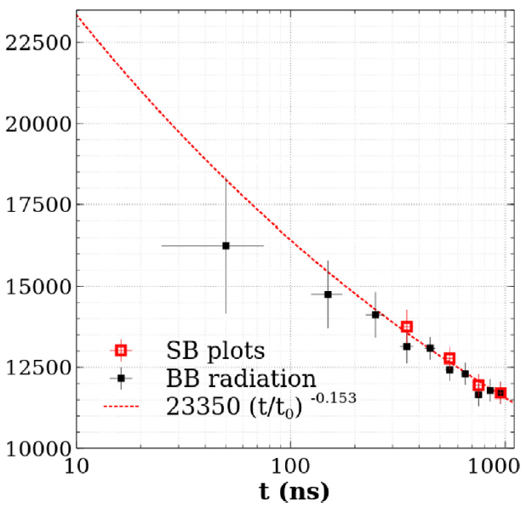
A. Bultel, A. Favre – Validation of the MERLIN code (spectra calculations)
On Eurofer97 containing
Fe, Cr, Cu, W, Na, Mn, V measured by XRF
At time t = 950 ns:
experimental spectrum
reconstruction by MERLIN
blackbody radiation
Plasma thickness (mm)
Saha-Boltzmann plot
t₀ = 10 ns
t₀ = 10 ns
t₀ = 10 ns
Spectral radiance
Electron density (m⁻³)
Temperature (K)
Spectral radiance
relative difference
A. Favre, A. Bultel et al. JQSRT 330 (2025) 109222
https://doi.org/10.1016/j.jqsrt.2024.109222

Slide 2
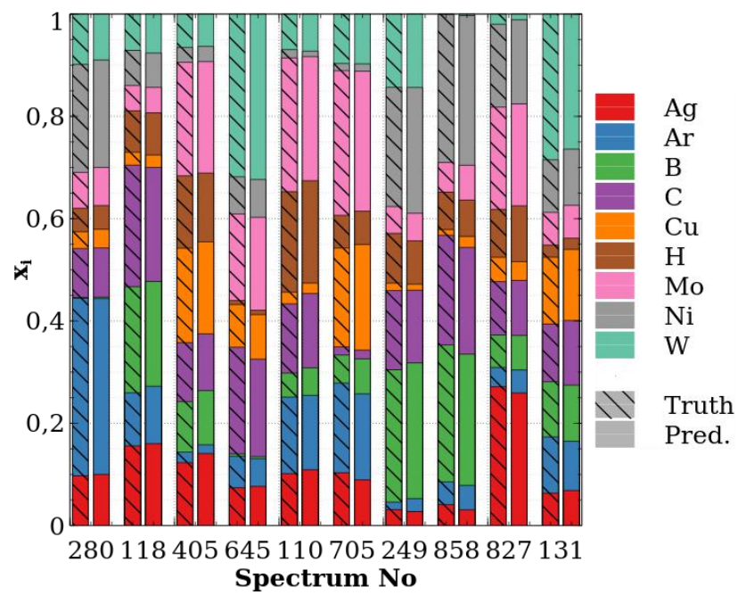
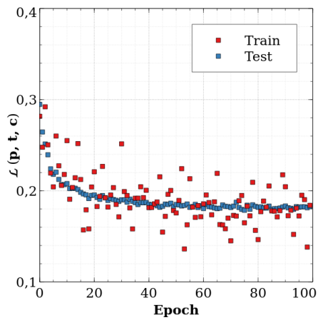
A. Bultel, A. Favre – Coupling between Machine Learning and MERLIN for real time CF-LIBS
x 6
Tests for the quantification:
Best prediction!
Lowest predicted value for H: $x_{H}=0,1 \%$
Input
MERLIN
$$λ, L_{λ}$$
(wavelength, spectral radiance)
DENSE + ReLU + DENSE
CONVOLUTION
DENSE + ReLU x5
RESIDUAL BLOC x4
MAX POOL
FLATEN
DENSE + ReLU + DENSE
DENSE + ReLU + Softmax
10⁵ spectra calculated by MERLIN with 12 parameters:
mole fraction $x$ in Ag, Ar, B, C, Cu, H, Mo, Ni, W
around the wavelength $λ_{c}$
at $\left(n_{e}, T\right)$
related to LIBS measurements performed in WEST
Multi-layer perceptrons: decision
Outputs:
9 mole fractions
$n_{e}, T, λ_{c}$
12 x $c_{i}$
Real time test of the whole procedure (1000 times):
Writing-reading of a spectrum
Calibration
Image treatment
Network response
$$τ=\left(0,0844±0,0075)\right) s$$
At 10 Hz: analysis at each laser shot
NORMALISATION
CONVOLUTION
ReLU
STACK
Learning  Loss function:
$$ℒ\left(p,t,c\right)=\sum_{1}^{12}{c_{i}^{2}{\left(p_{i}−t_{i}\right)}^{2}}+\sum_{1}^{12}{{\left(1−c_{i}\right)}^{2}}$$
where $p_{i}$ is the prediction, $t_{i}$ the target and $c_{i}$ the prediction confidence on the parameter $i$
Convolutional Neural Network: information extraction
A. Favre, A. Bultel et al. Phys. Scr. 99 (2024) 035609
https://doi.org/10.1088/1402-4896/ad2826
A. Favre… A. Bultel accepted in Spectrochim. Acta Part B

