Slide 1
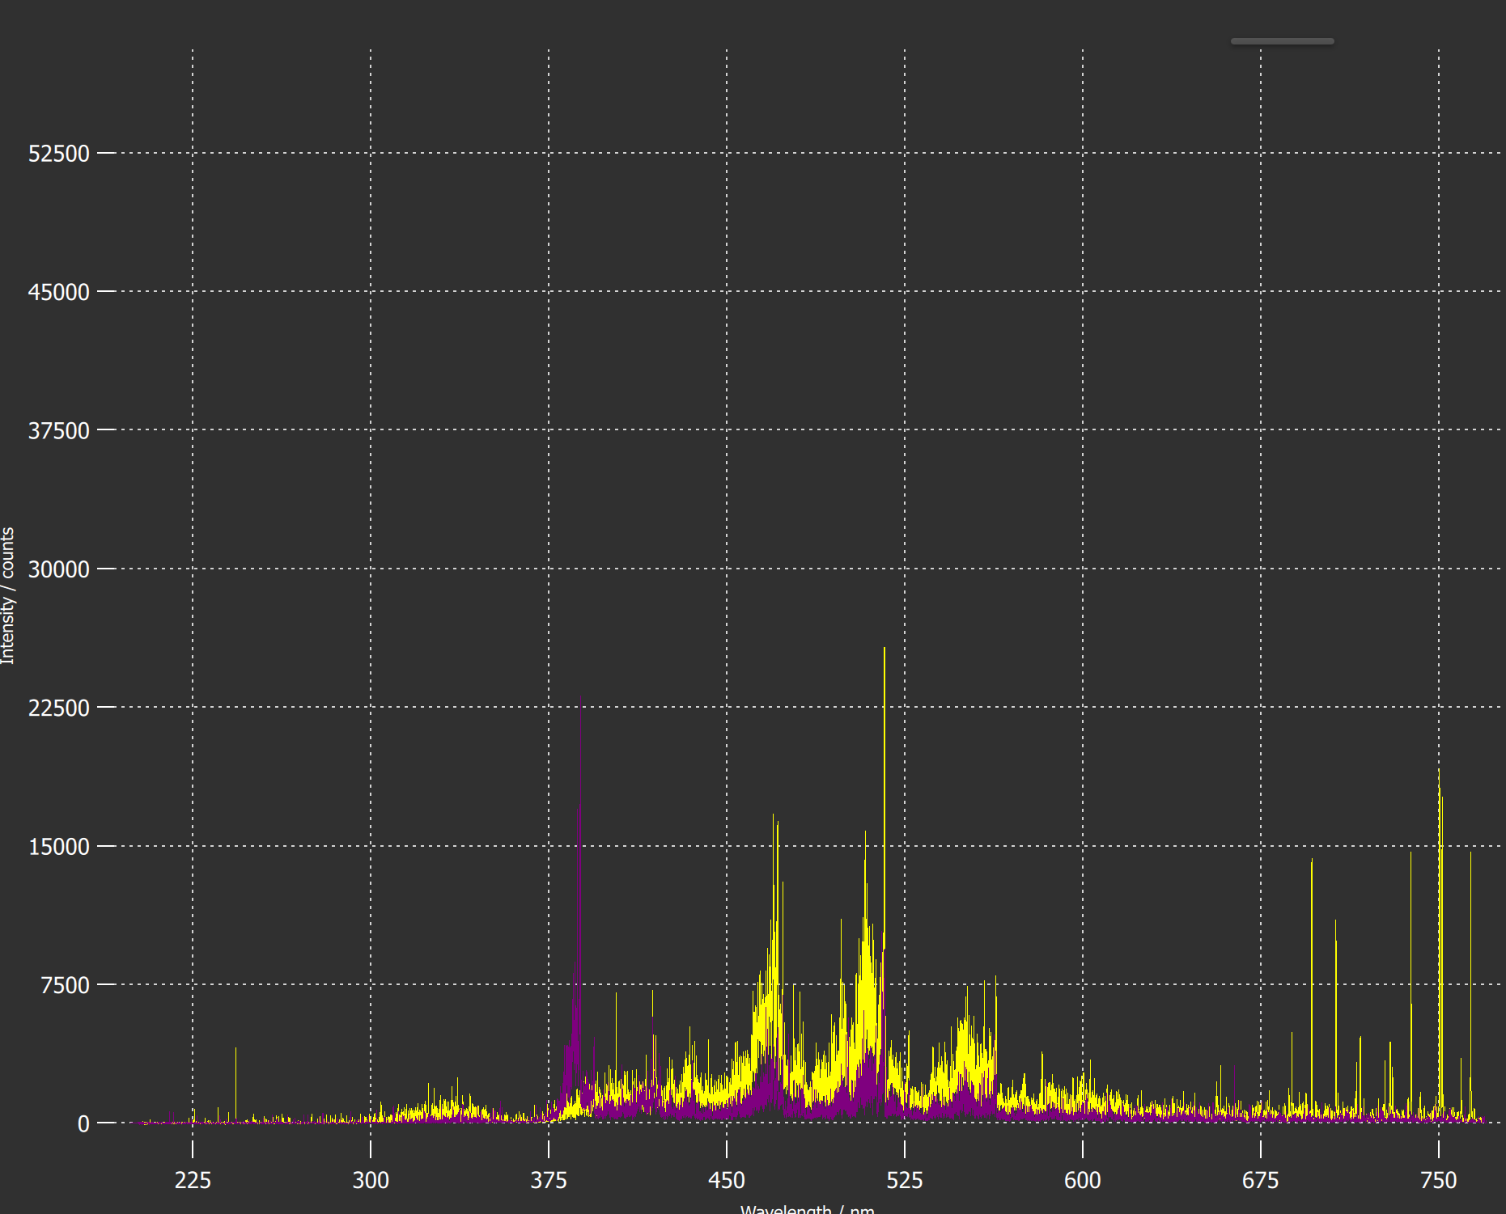
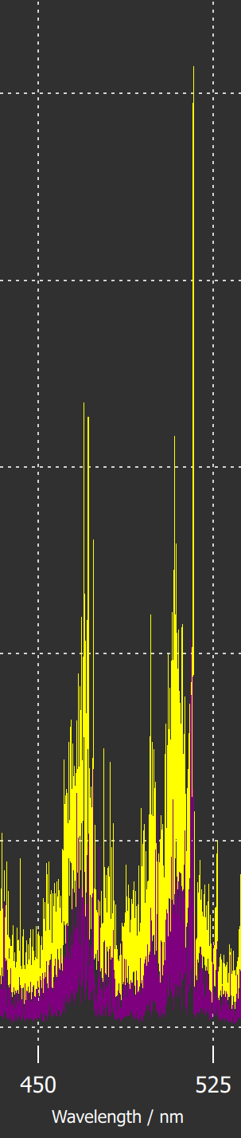
Your title here
General Information
The scope of this task is the optimization of laser-based techniques for the quantification of fuel content and material composition of PFCs (tungsten, boron, graphite) and deposits of those materials (oxygen, seeding and fuel species) in laboratory devices in view of in-operando operation in larger devices.
Task and questions to be addressed
Comparison SP vs. DP LIBS, or alternative LIBS signal enhancement methods: absolute fuel content in W samples and composition / (CF)-LIBS results He loaded samples and surface modifications
Approach
Use of argon as a background gas (instead of air) for the enhancement of the LIBS spectral signal.
Consider vacuum condition or low Ar pressures for the detection of implanted or redeposited He
Results
The use of argon as background gas (instead of air) for the enhancement of the LIBS signal proved to be effective when applied to the compact LIBS system used at JET mounted on the MASCOT robotic arm.
LIBS spectra acquired on He-enriched Be coatings in vacuum or at low Ar-pressure showed that He could be better detected by LIBS in vacuum or low pressure Ar conditions compared to air, mainly because of the large Stark broadening of the strongest He emission line at 587.56 nm
The development of specific sw for the application of the CF procedure on the LIBS spectral data is ongoing and will be applied to data from JET
LIBS under Ar flux
LIBS in air
*
He I @ 587.56 nm
Deliverable: PWIE-SP X.X2.T-T004-D003
Status: completed/ongoing
Facilities: MAGNUM-PSI, PSI-2
Linked WP or TSVV: PWIE-SP E
*Nuclear Materials and Energy 39 (2024) 101677

