Slide 1
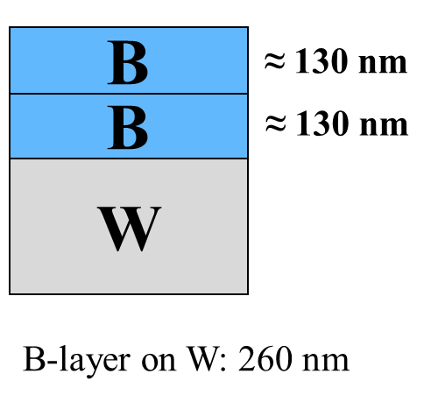
LIBS measurement of boron film on tungsten sample
General Information
Boronization has been considered as a wall conditioning method for full-W wall in ITER
There is no suitable technique to obtain the homogeneity and lifetime information of boron films in a real time.
The measurement of boron film on W can be performed by ps-LIBS in vacuum
Task and questions to be addressed
Feasibility study of boron film analysis by LIBS in vacuum :
Selection suitable spectral range for boron and tungsten detection
Optimisation of gate parameters for spectral acquisition
Approach
Tungsten samples were coated with boron layer of about 260 nm by magnetron sputtering
Single pulse LIBS (λ=355nm, 35 ps) in vacuum pressure 3 10⁻⁵ Pa
Results
Optimized gate parameters for spectral acquisition : delay 30 ns, width 1000 ns
Average ablation rate 66.98 ± 0.29 nm/pulse
Depth resolution of boron layer: ps-LIBS is better than ns-LIBS
Deliverable: PWIE-SP X.X2.T-T004-D004
Status: completed
Facilities: NA
Linked WP or TSVV: if applicable

Slide 2
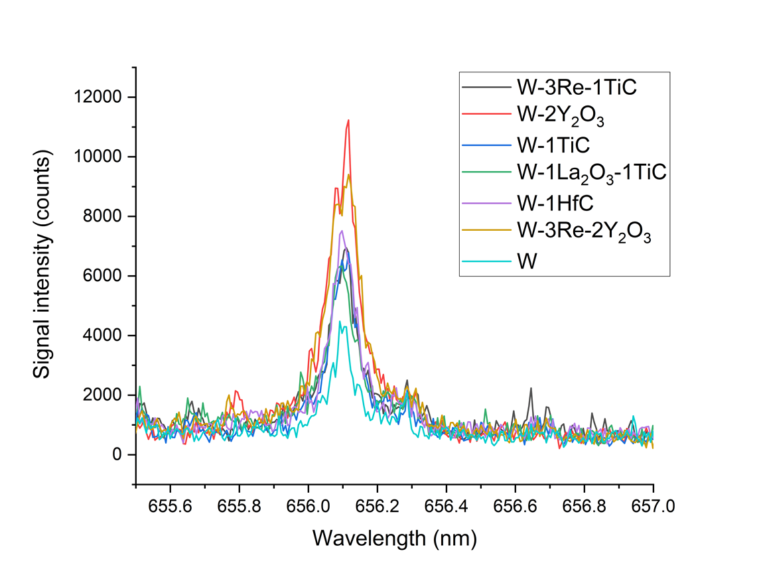
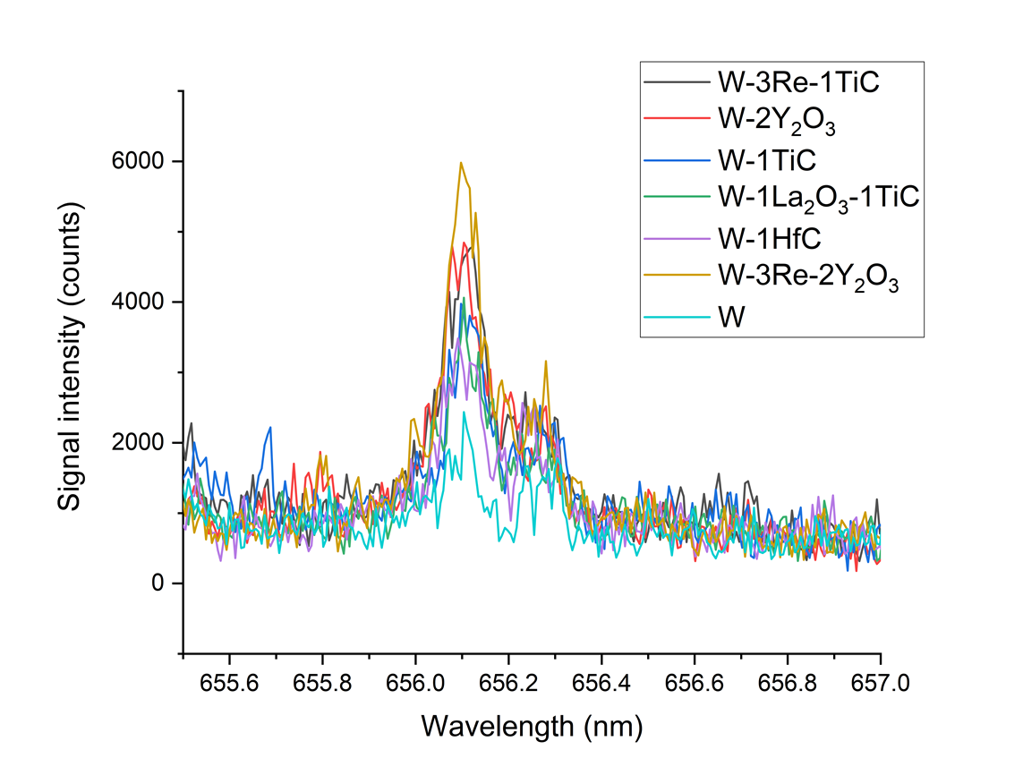
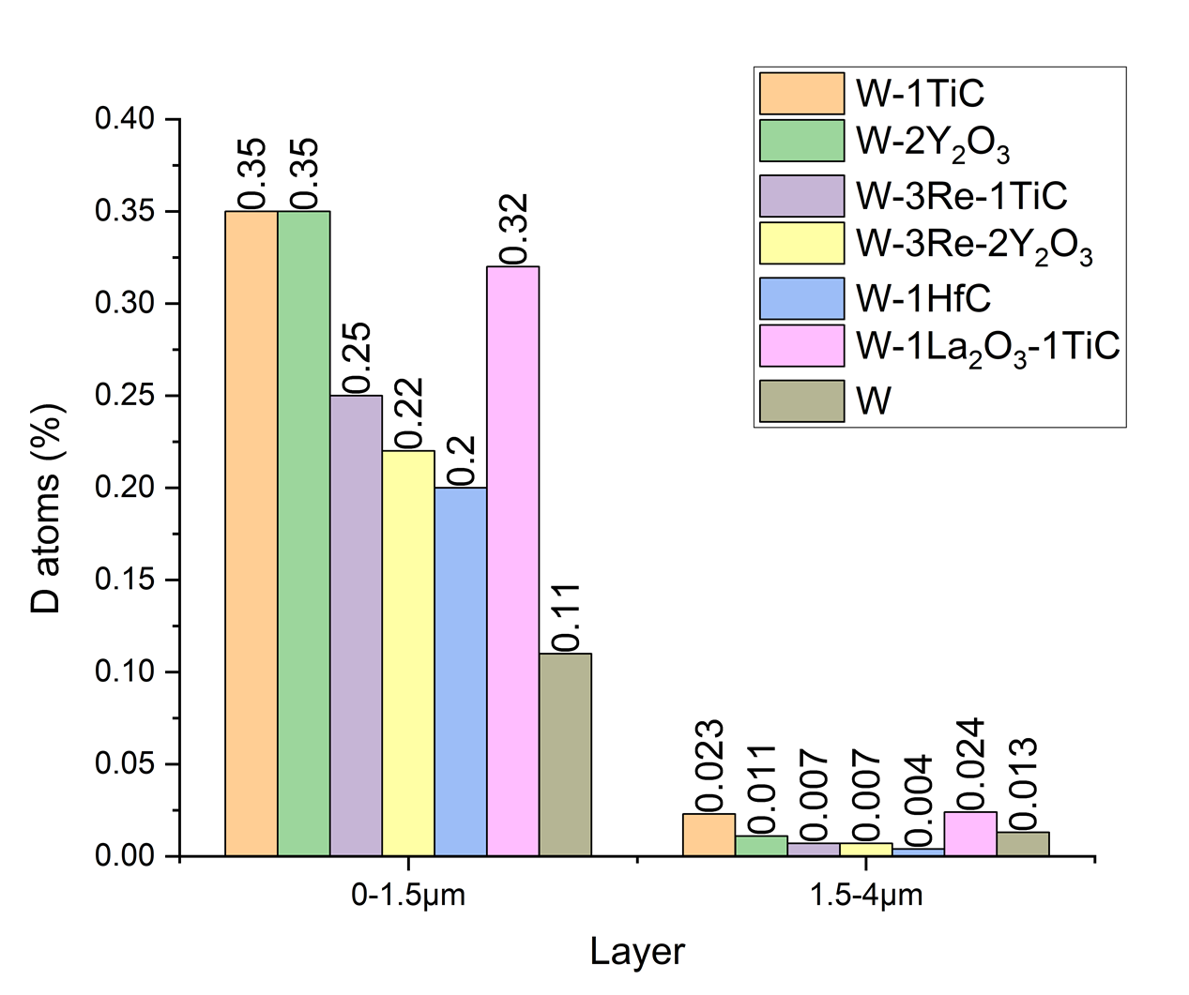
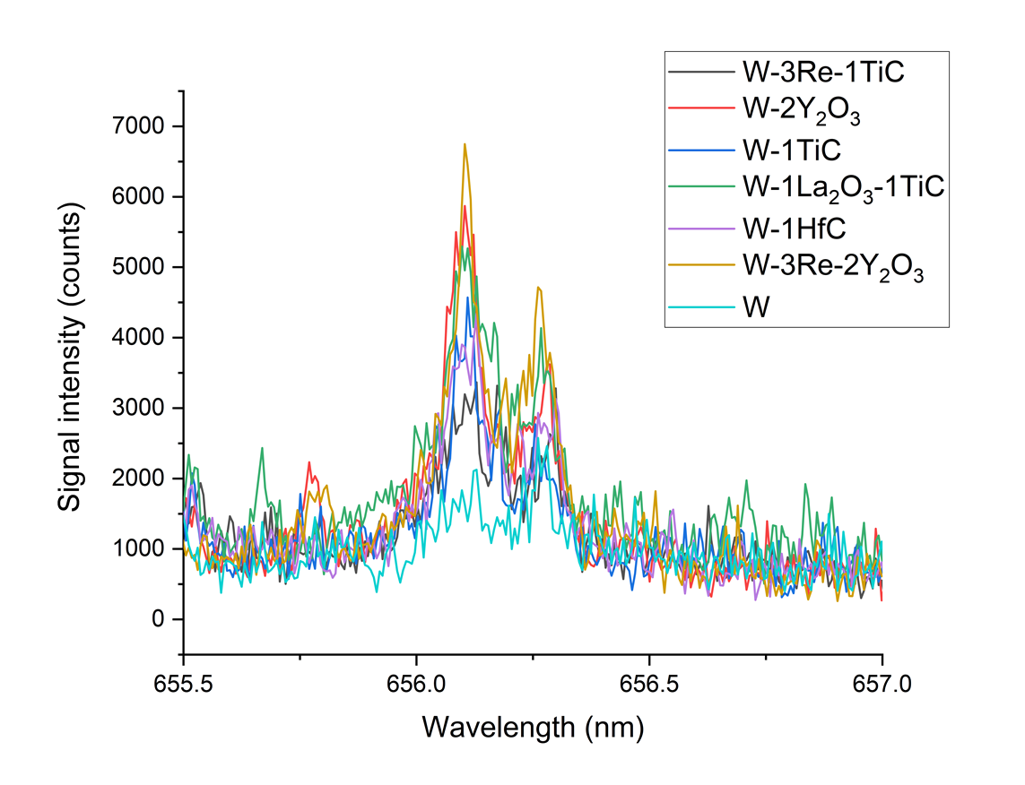
LIBS measurement of D retention in tungsten alloys
General Information
Tritium retention behavior in powder injection molding tungsten alloys should be investigated
Task and questions to be addressed
In situ measurement of dynamic deuterium retention in different tungsten alloys and ITER-grade tungsten by ns-LIBS in PSI-2 plasma facility
Long term deuterium retention mesurement by NRA, 6 moths after exosure
Approach
W-1TiC , W-2Y₂O₃ , W-3Re-1TiC , W-3Re-2Y₂O₃ , W-1HfC , W-1La₂O₃-TiC alloys samples were produced
SP LIBS (λ=1064 nm, 7 ns, 0.7 J, spot ∅ 0.8 mm) was applied for each sample (as well as ITER-grade tungsten sample) during and after (1 h and 20 h) deuterium plasma (50 min total exposure time) in PSI-2
During plasma
D_{α}
1 h after plasma
D_{α}
H_{α}
Results
Tungsten with Y₂O₃ have the highest deuterium dynamic retention, all other alloys showed a relatively similar retention
Most retention is in the first 1.5 μm near-surface layer
ITER-grade tungsten have the lowest overall D retention (long term lowest in the top 1.5 μm layer but highest in the deepest layer, except TiC containing alloys)
NRA measurements
20 h after plasma
D_{α}
H_{α}
Deliverable: PWIE-SP X.X2.T-T004-D004
Status: completed
Facilities: PSI2 (12 days)
Linked WP or TSVV: if applicable

Slide 3
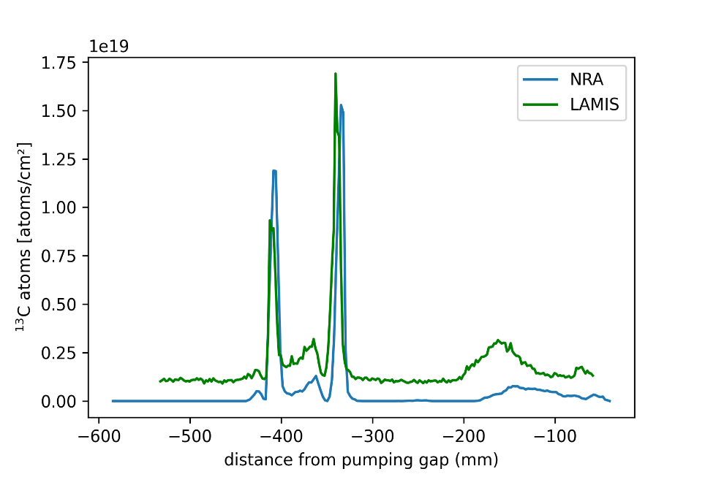
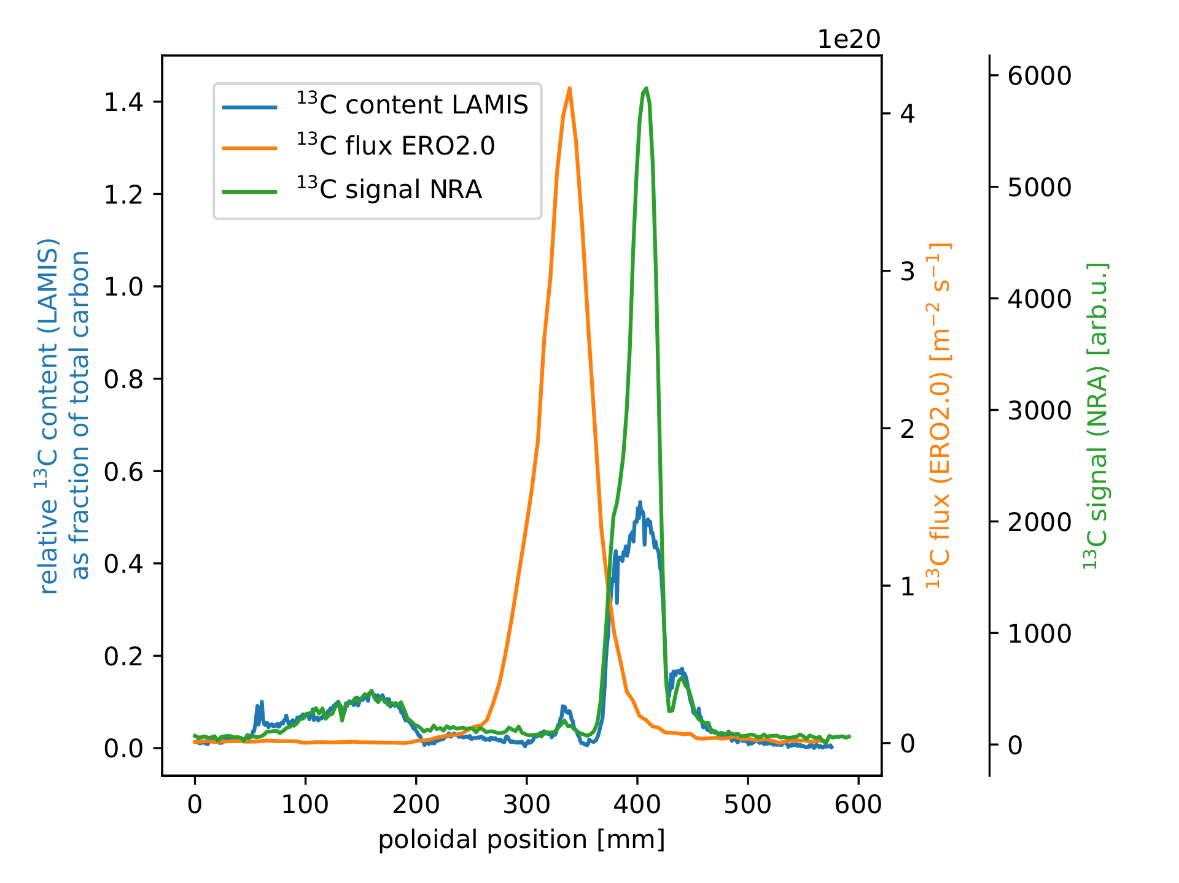
LAMIS measurements of ¹³C at the surface of W7-X divertor fingers
General Information
Carbon transport study in W7-X by local injection of ¹³CH₄ gas
Measurements of ¹³C/ ¹³C +¹²C ax situ by single pulse ps-LAMIS and double pulse ps-LAMIS
Task and questions to be addressed
LAMIS measurements of ¹³C content at the surface of W7-X divertor fingers
Comparison LAMIS results with NRA measurement and ERO2.0 simulation.
Approach
Local injection of ¹³CH₄ gas in W7-X during plasma discharge
Divertor fingers at the vicinity of the injection nozzle were removed from W7-X and were transported to FZJ in LIBS lab
The divertor fingers were analysed by SP&DP(collinear) ps-LAMIS (λ=355nm (1064nm), 35ps, ≈10 mJ, spot ∅ 0.7 mm) in 150 Pa N₂ to improve signal-to-noise ratio
Results
Both SP LAMIS and DP LAMIS provide ¹³C profiles similar NRA data at the areas with thin deposit.
At the area with thick deposit, which required several laser pulses for complete ablation, collinear DP LAMIS shows smaller ¹³C content in comparison with NRA data. This could be because second laser pulse did not absorbed in the deposit layer but mainly in the graphite substrate.
SP LAMIS
DP LAMIS
Deliverable: PWIE-SP X.X2.T-T004-D004
Status: completed
Facilities: NA
Linked WP or TSVV: if applicable

Slide 4
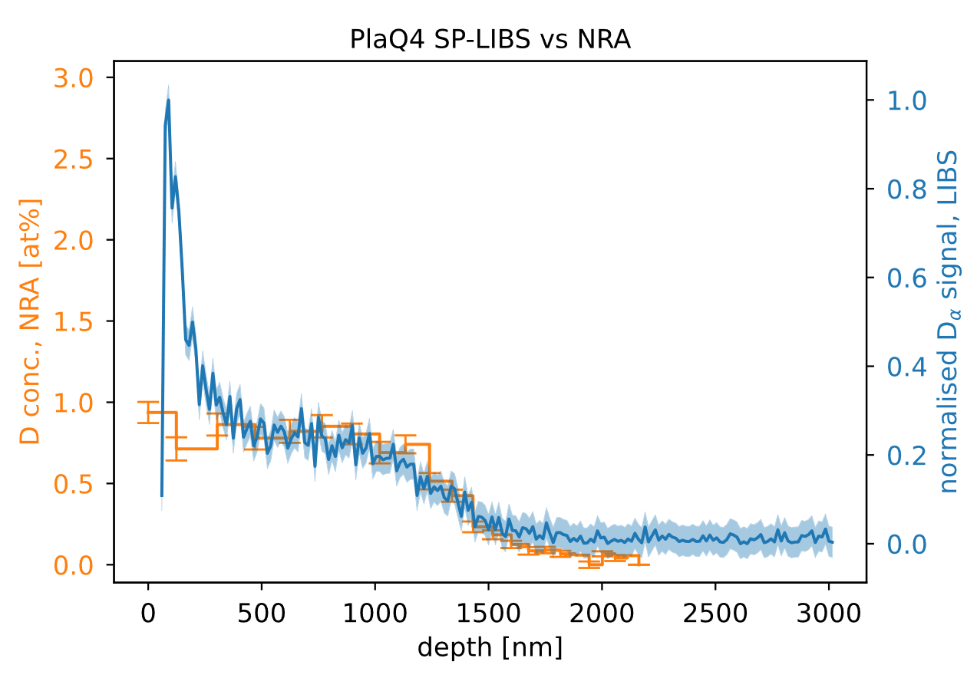
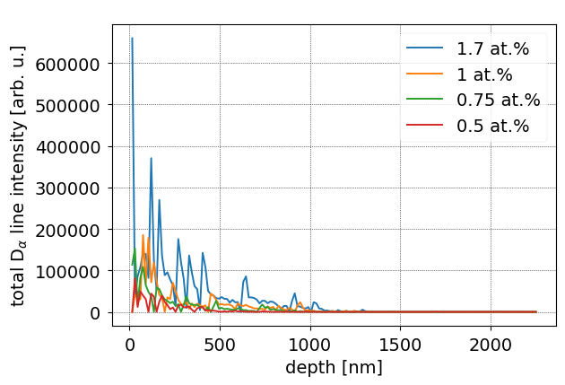
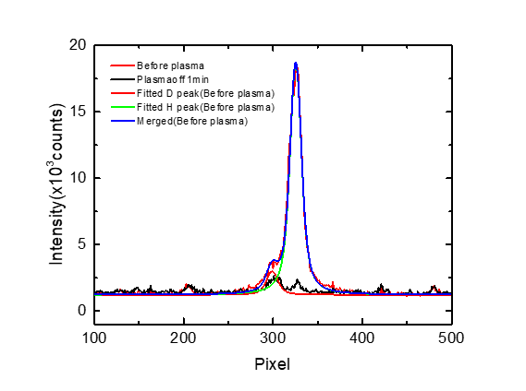
Deuterium retention measurements in pre-damaged tungsten material by LIBS.
SP ps-LIBS and NRA depth profiles
General Information
Pre-damaged tungsten material could have enhanced reservoir for hydrogen isotopes
Measurements: ax situ by single pulse ps-LIBS and double pulse ps-LIBS; in situ by ns-LIBS in PSI-2
Task and questions to be addressed
Measurement of deuterium retention ax situ in pre-damaged tungsten by using ps-LIBS
Measurement of deuterium retention in situ in pre-damaged tungsten by using ns-LIBS in PSI-2
Approach
Displacement-damaged W samples were prepared by using W³⁺-ions with an energy of 10.8 MeV up to a damage dose of 0.23 dpa. All samples were loaded by D in plasma at 370K and were partially outgassed under different conditions and D content measured by NRA
SP&DP ps-LIBS (λ=355nm, 35 ps, ≈20 mJ, spot ∅ 0.75 mm) in vacuum pressure 5 10⁻⁵ Pa at the lab
SP ns-LIBS (λ=1064 nm, 7 ns, 0.7 J, spot ∅ 0.8 mm) in PSI-2 fasility
Results
SP ps-LIBS can detect deuterium concentrations of ≈1at.% with ≈15 nm depth resolution
DP ps-LIBS has higher sensitivity but larger signal fluctuation that need further investigation
According to ns-LIBS measurements, the deuterium content in pre-damaged tungsten was slightly reduced after plasma exposure in PSI-2, probably, due to higher surface temperature during plasma
Outgassing T_{max}= 641 K
D content 1at.% by NRA
DP ps-LIBS and NRA depth profiles
by NRA
SP ns-LIBS in PSI-2
Fitted D+H before plasma
Fitted H before plasma
Fitted D before plasma
1min after plasma
Deliverable: PWIE-SP X.X2.T-T004-D004
Status: completed
Facilities: PSI2 (3 days)
Linked WP or TSVV: if applicable

Slide 5
Absolute fuel content in W samples and composition
General Information
Absolute content of hydrogen isotopes measurement in W by ps-LIBS in Ar (CF LIBS approch)
Measurement of the hydrogen isotopes composition by ps-LIBS in Ar (in support LIBS measurements on JET)
Task and questions to be addressed
Applacability of CF-LIBS method for the W spectral line in the visinity of Balmer-α lines
Develop procedure for extraction isotopes composition from measured Balmer-α lines
Approach
W samples with “natural“ H content and W coated Mo sample loaded with D
SP ps-LIBS (λ= 1064nm, 35 ps, ≈10 mJ, spot ∅ 0.3 mm) in Ar at atmospheric pressure
SP ps-LIBS H_{α} line profile fitting
Results
Plasma density from H_{α} fitting by single Lorentzian function
Number of fitting parameters for H_{α} line can be reduced by using experimental H_{α} line shift-width dependence
By using two Lorentzian functions, fitting can be improved
Only WI (656.320 nm) and WI ( 657.393 nm) lines have defined parameters for CF analysis, broder spectral range requiered
Electron density from H_{α} line FWHM
H_{α} line shift vs H_{α} line FWHM
Deliverable: PWIE-SP X.X2.T-T004-D004
Status: completed
Facilities: NA
Linked WP or TSVV: if applicable

