Slide 1
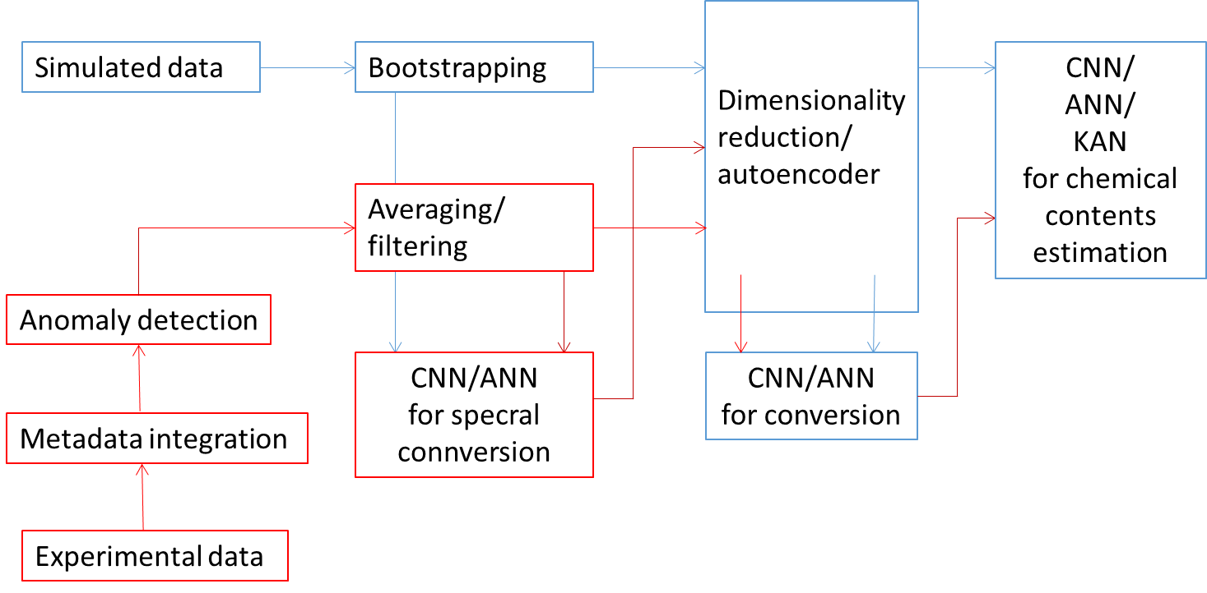
Investigation of Machine Learning algorithms for LIBS
General Information
The task is aimed on the development of machine learning models for processing LIBS data with quantitative chemical analysis as the final goal. The works has been initiated on synthetic spectra and in the present stage is focused on experimental data.
Task and questions to be addressed
Verification of possibility of conversion between experimental and simulated LIBS data.
Verification of the efficiency of chemical contents estimation ML algorithms for experimental LIBS data.
Approach
Application of pre-processing methods as dimensionality reduction and spectral filtering.
Application of ML models for anomaly detection for spectra with too low quality to be employed in training.
Application of DNN (Deep Neural Networks) and CNN (Convolutional Neural Network) for chemical contents estimation.
Results
For experimental data obtained in laboratory condtions the chemical contents estimation gives very good results which are even better after dimensionality reduction (becouse of eliminating noise).
Experimental data obtained during the Be campaign at VTT are noisy and samples are relativeey often rejected by anomaly detection algorithms; however, they significantly benefit from preprocessing.
Deliverable: PWIE-SP X.x.y-Txxx-Dxxx
Status: completed/ongoing/delayed/cancelled
Facilities: Device name (days allocated)
Linked WP or TSVV: if applicable

