Slide 1
Reporting meeting WPPWIE SP-X 2024
Pavel Veis, Sahithya Atikukke, Sanath Shetty, Shweta Soni, Pavitra Bhat, Michal Stano, Matej Veis, Dhanada VS, Ivan Urbina et al.
Comenius University in Bratislava
PWIE-SP X.X2.T-T004-D006 | Improvement of depth resolution by RLIBS. CF-LIBS study on B containing coatings. ps and/or ns CF-LIBS analysis of relevant samples. | Hennie van der Meiden | 31/12/2024 | 17 | Achieved

Slide 2
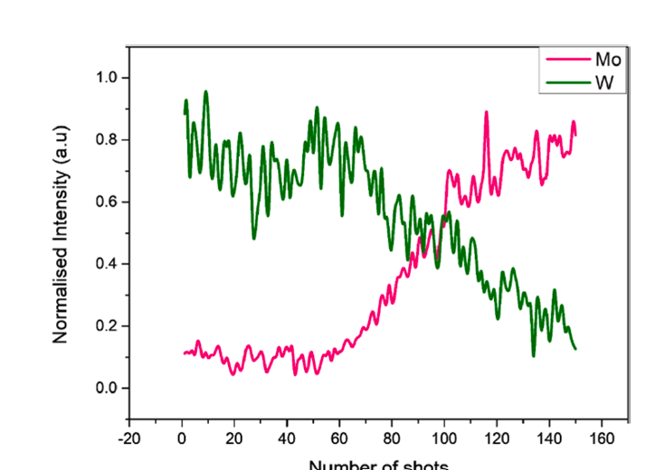
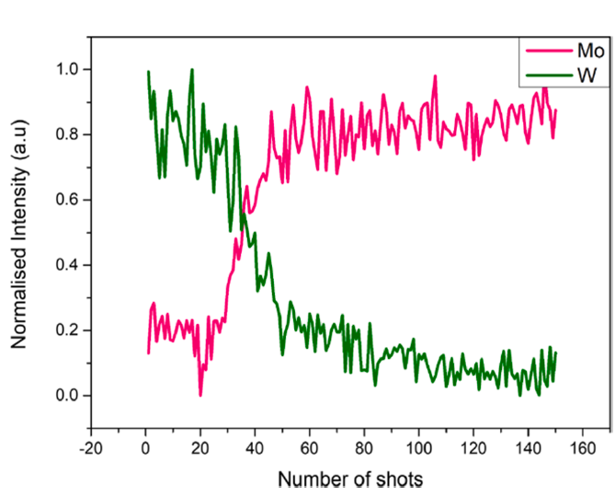
Resonant-LIBS
This study explores Resonant Laser-Induced Breakdown Spectroscopy (RLIBS) for depth profiling.
A key advantage of RLIBS over conventional LIBS is its reduced ablation rate, leading to higher-resolution in-depth profiles.
Depth profiling conducted using a tunable EKSPLA NT342C nanosecond laser system.Laser range: 210–2600 nm; energy levels at 2 mJ per pulse (UV).
Tungsten and Tantalum-coated Mo substrate used as sample. Laser tuned to 255.14 nm for resonant W I transition and 222.75 for off-resonant ablation.
• Depth profiling comparison:
- Resonant condition requires ~90 laser shots to reach substrate
- Off-resonant condition requires ~30 laser shots
• Ablation rate observed:
- Resonant: 0.09 μm/pulse
- Off-resonant: 0.248 μm/pulse
• RLIBS demonstrates greater depth resolution compared to conventional LIBS
S. Atikukke et al., NME, 2024

Slide 3
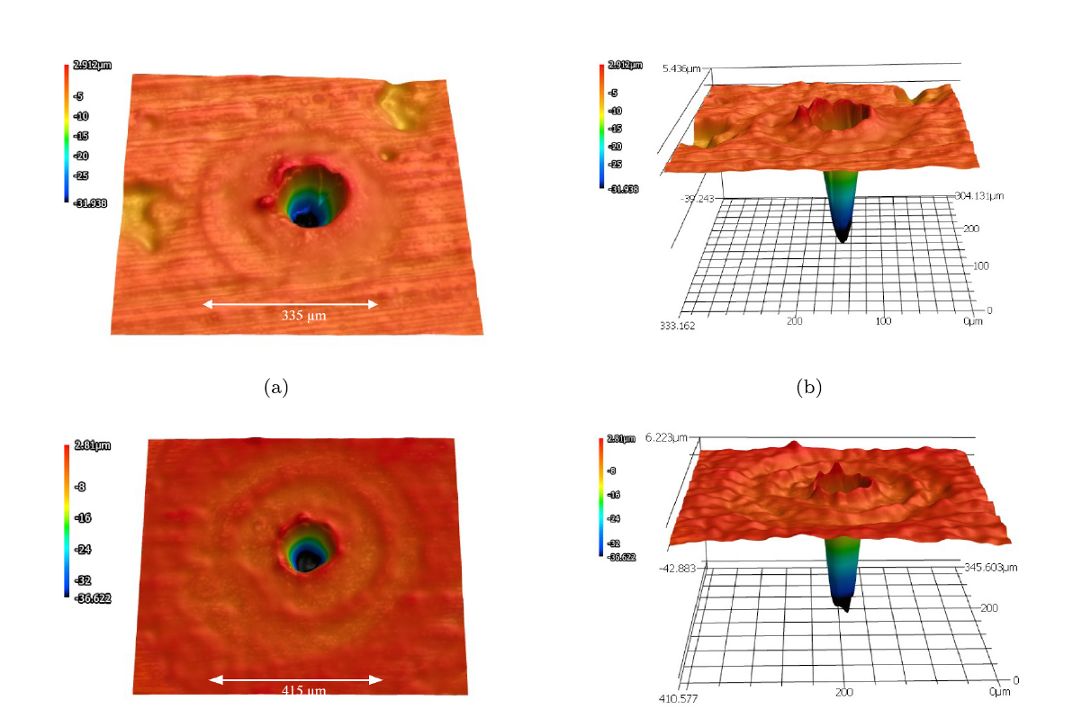
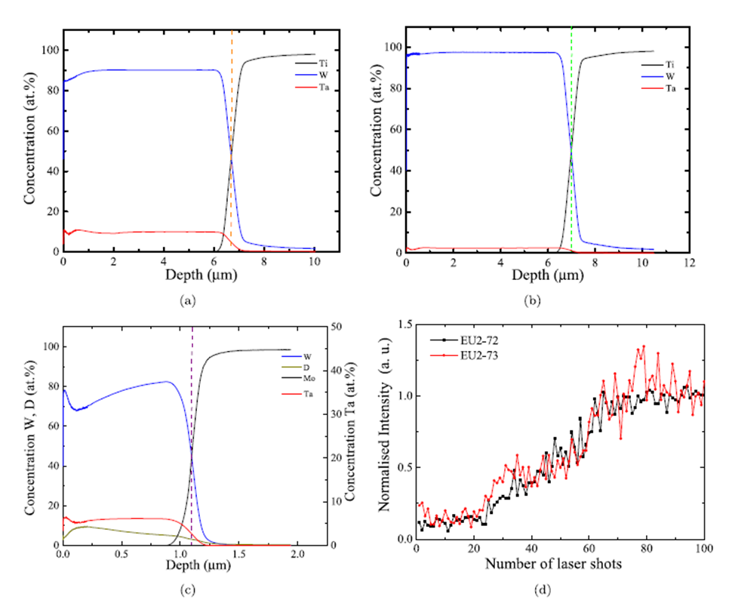
Depth profiling with ps-LIBS
• Samples:
- EU2–72, EU2–73 (WTa coatings on Mo)
- EU2–75 (WTa+D coating on Mo)
• Experimental Setup:
- Chamber pressure: 5 ± 0.2 mbar, Argon gas
- Picosecond Nd:YAG laser at 532 nm (29 ± 4 ps pulse duration)
- Two laser energies tested: 1 mJ and 3 mJ
• Depth profiling using GDOES and LIBS techniques for layer thickness
• Confocal microscopy was used to analyze crater dimensions formed by ps-LIBS
• Ablation rates:
- EU2–72: 0.133 μm/pulse (1 mJ), 0.28 μm/pulse (3 mJ)
- EU2–73: 0.131 μm/pulse (1 mJ), 0.178 μm/pulse (3 mJ)
S. Soni et al., SCAB, 2024

Slide 4
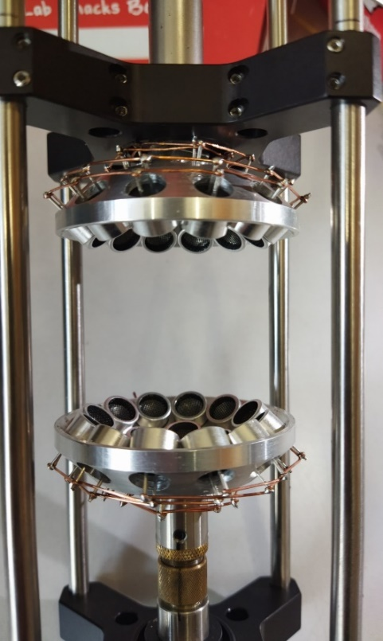
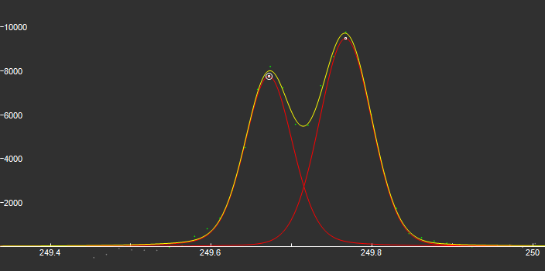
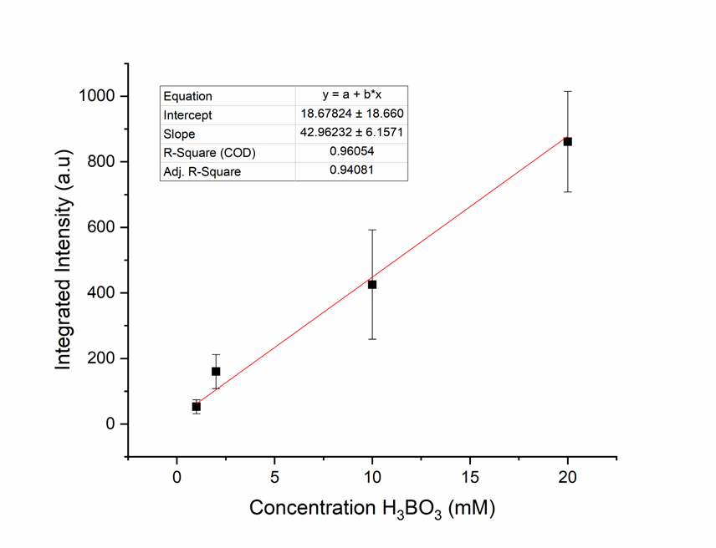
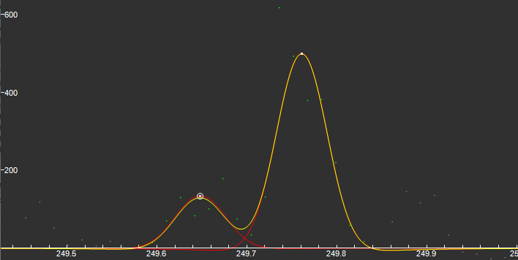
Lev- LIBS Boron Analysis for future thing Boron LIBS analysis
The acoustic levitation system was employed for making analysis in H₃BO₃. The solutions were prepare from a mother solution 0.099M. The doublet recorder by the detector are show below.
H₃BO₃(ac) 20mM
DT = 1µs
GT = 3µs
H₃BO₃(ac) 1mM
DT = 1µs
GT = 3µs
Deliverable: PWIE-SP X.X2.T-T004-D006
Status: completed / partially done / in progress / delayed / cancelled
Facilities: or Modelling:
Linked WP or TSVV:
The acoustic levitation system.
(Lev-LIBS)

