Slide 1
PWIE SPX meeting
Indrek Jõgi
University of Tartu

Slide 2
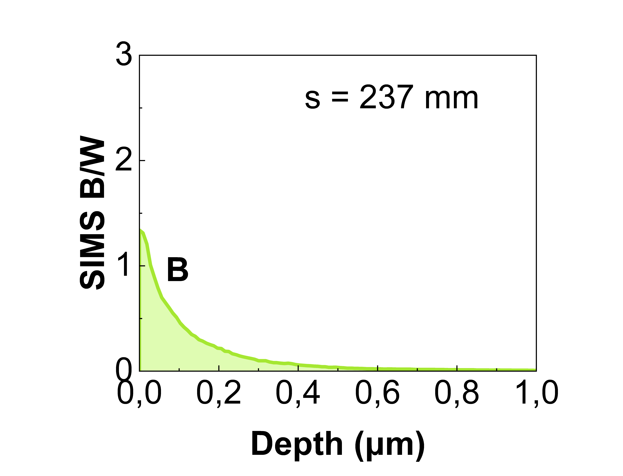
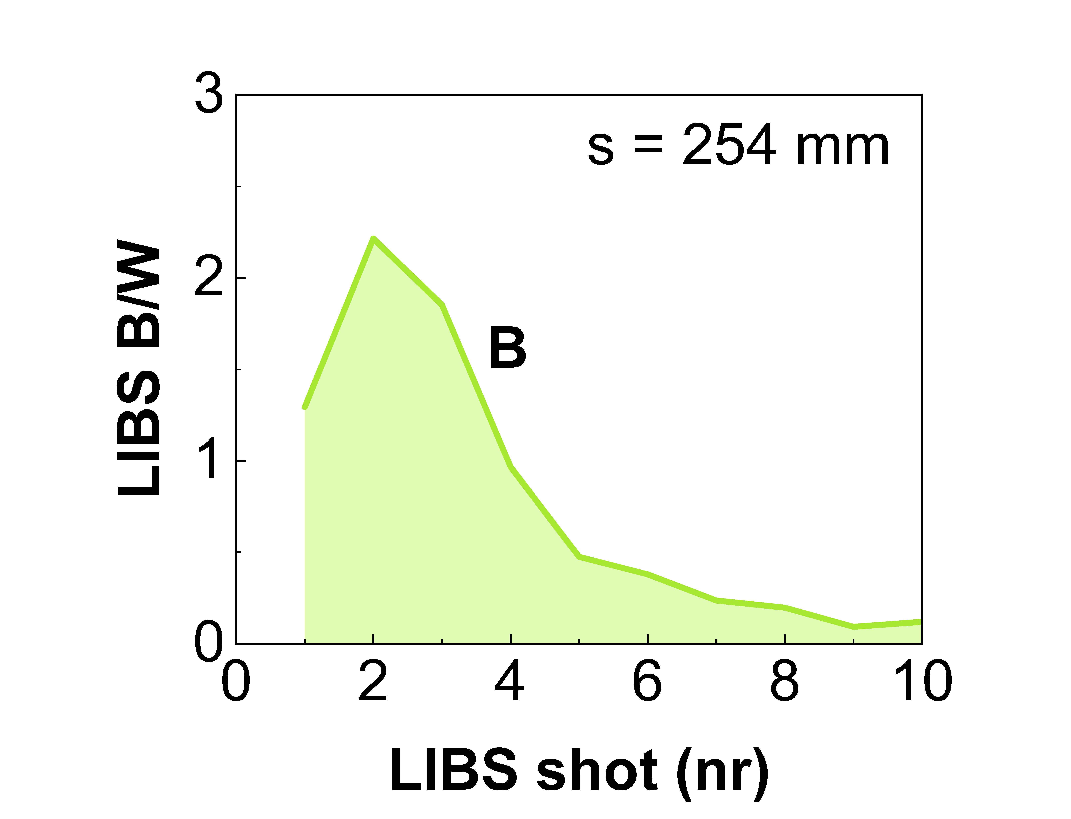
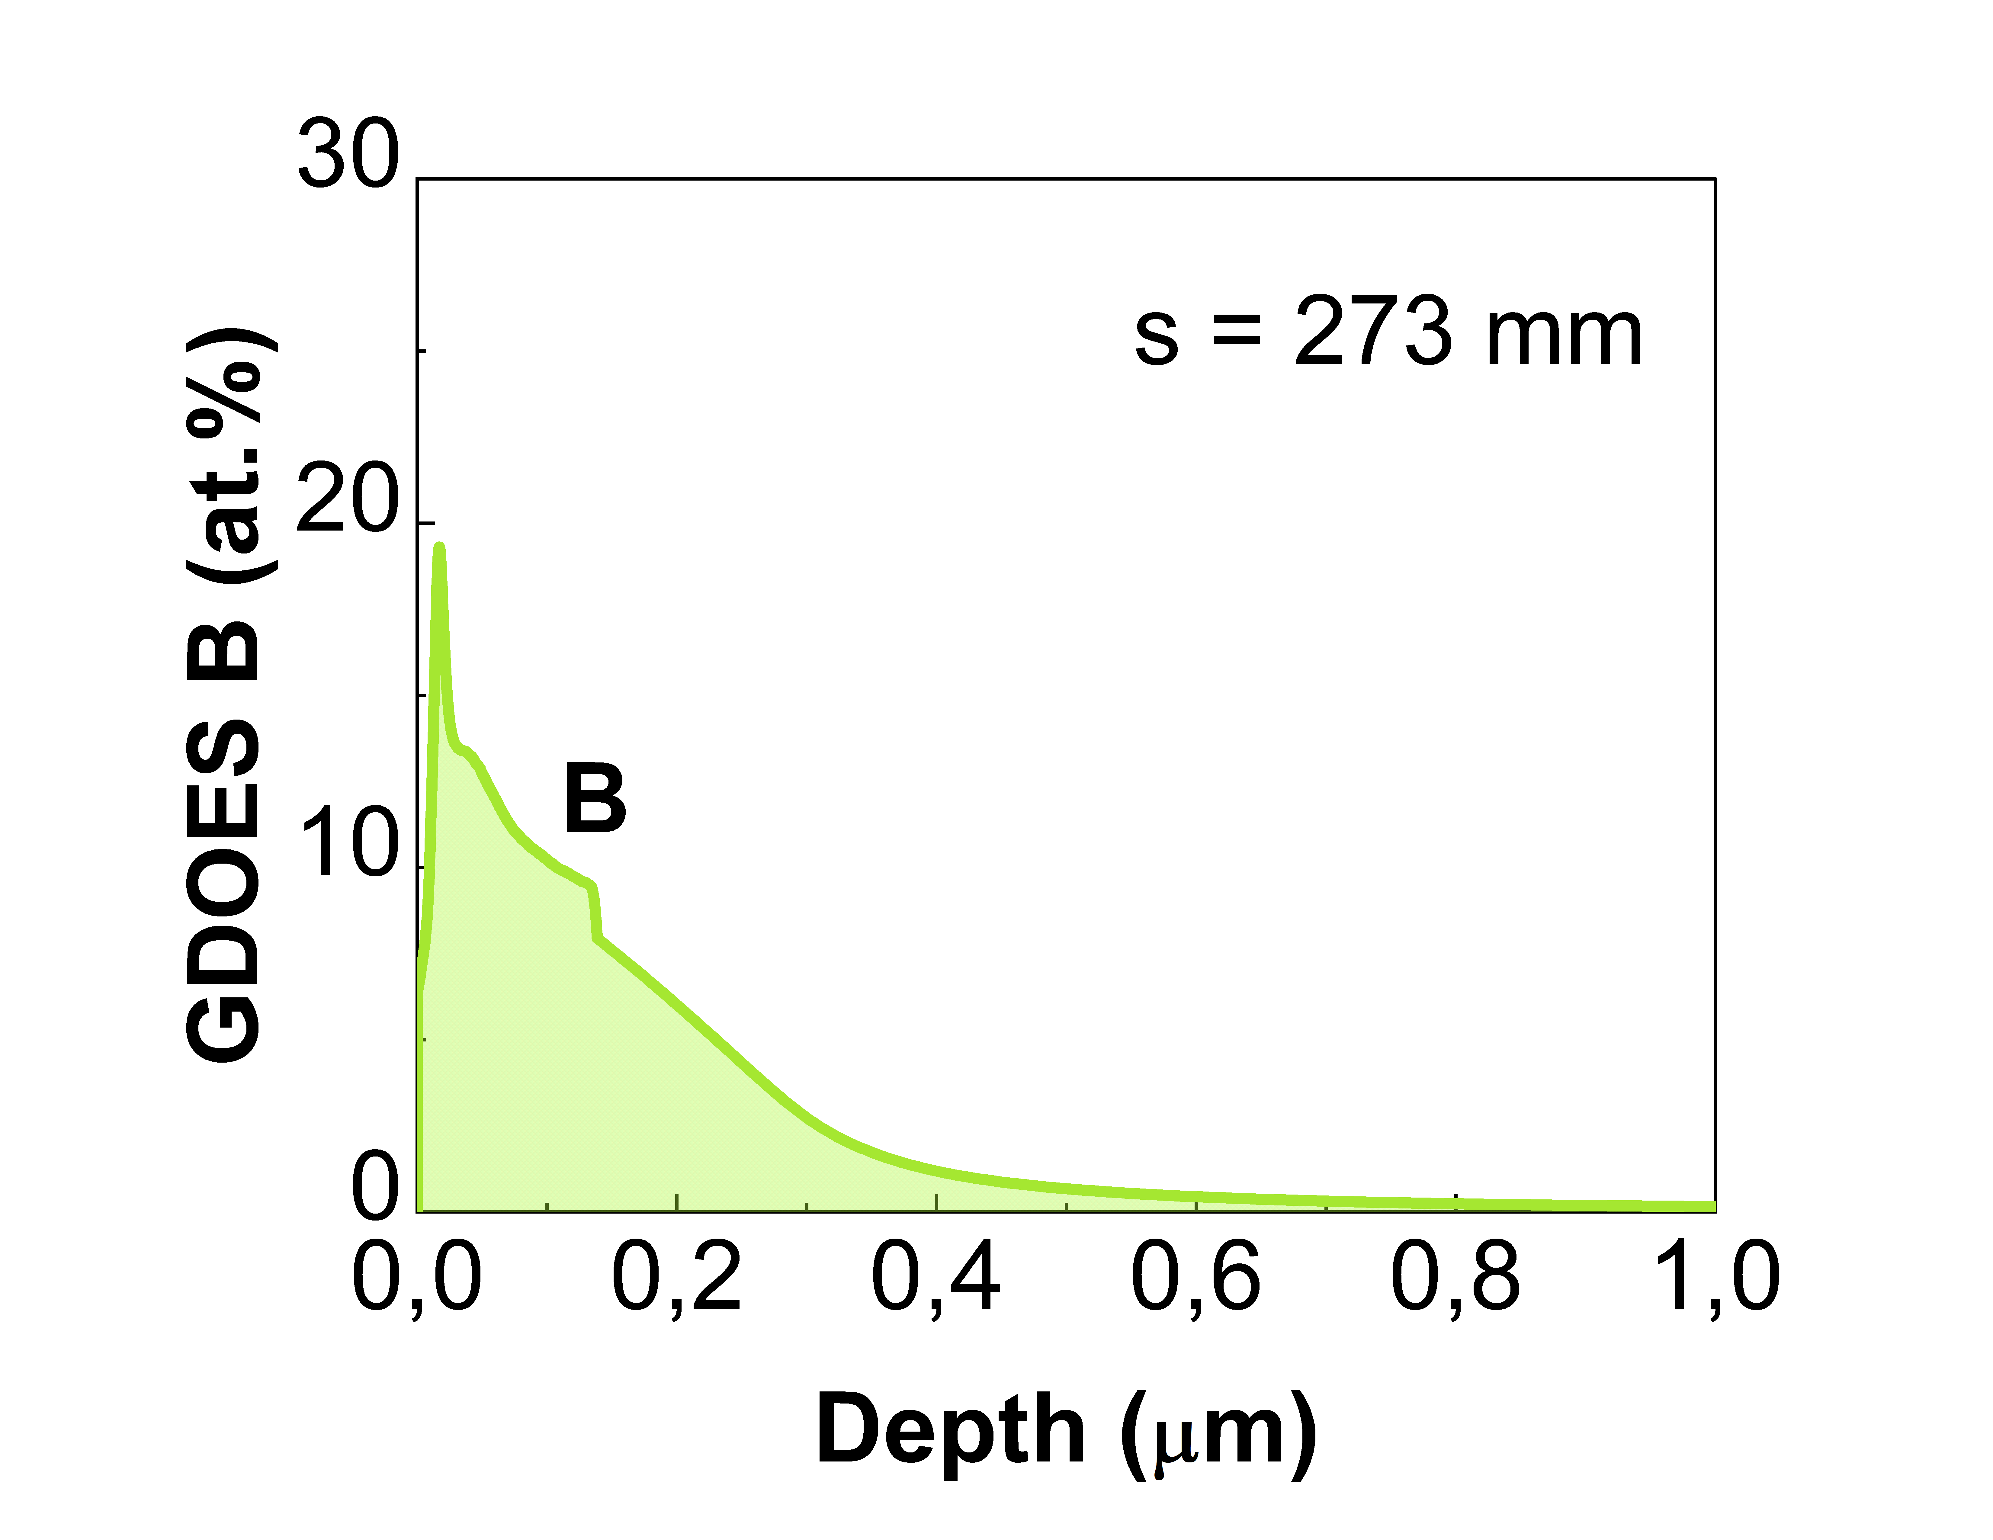
Analysis of B containing coatings and/or W coatings with LIBS
Comparison of B depth profiles and total B determined by LIBS, SIMS and GDOES on WEST 32i/20o tiles
LIBS spectrum
shot nr
B depth distribution in C4-32i erosion region
B I lines
C I line
0.26
GDOES
SIMS
LIBS
W – 0.9 to 2 μm
Mo marker – 100 nm
W – 12 μm
14
32
89
104
237
254
293
311
341
356
376
415
453
489
507
546
565
142
199
274
s (mm)
Mo – 3 μm
C
LIBS
SIMS
SIMS
GDOES
LIBS
SIMS
SIMS
LIBS
LIBS
SIMS
SIMS
LIBS
SIMS
SIMS
SIMS
LIBS
GDOES
GDOES
GDOES
GDOES

Slide 3
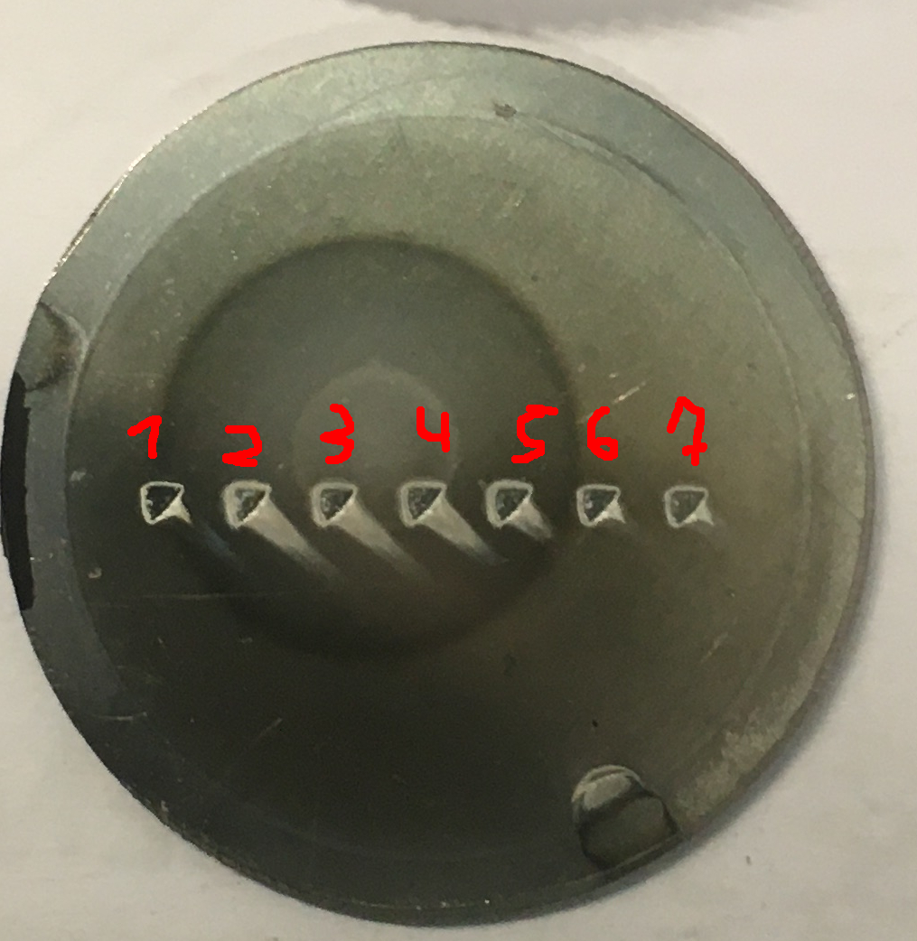
LIBS results on He loaded samples and surface modifications
Magnum-PSI He plasma exposure 2700 s
LIBS He intensity
He spatial distribution
LIBS Depth profiles
He detectable during first LIBS shot
ToF-ERDA He retention (150 nm)
Edge 16·10¹⁵ at/cm²
Center 247·10¹⁵ at/cm²
Formation of Ta/Mo rich surface layer in the Center (up to 4 shots)
1 μm c-W

Slide 4
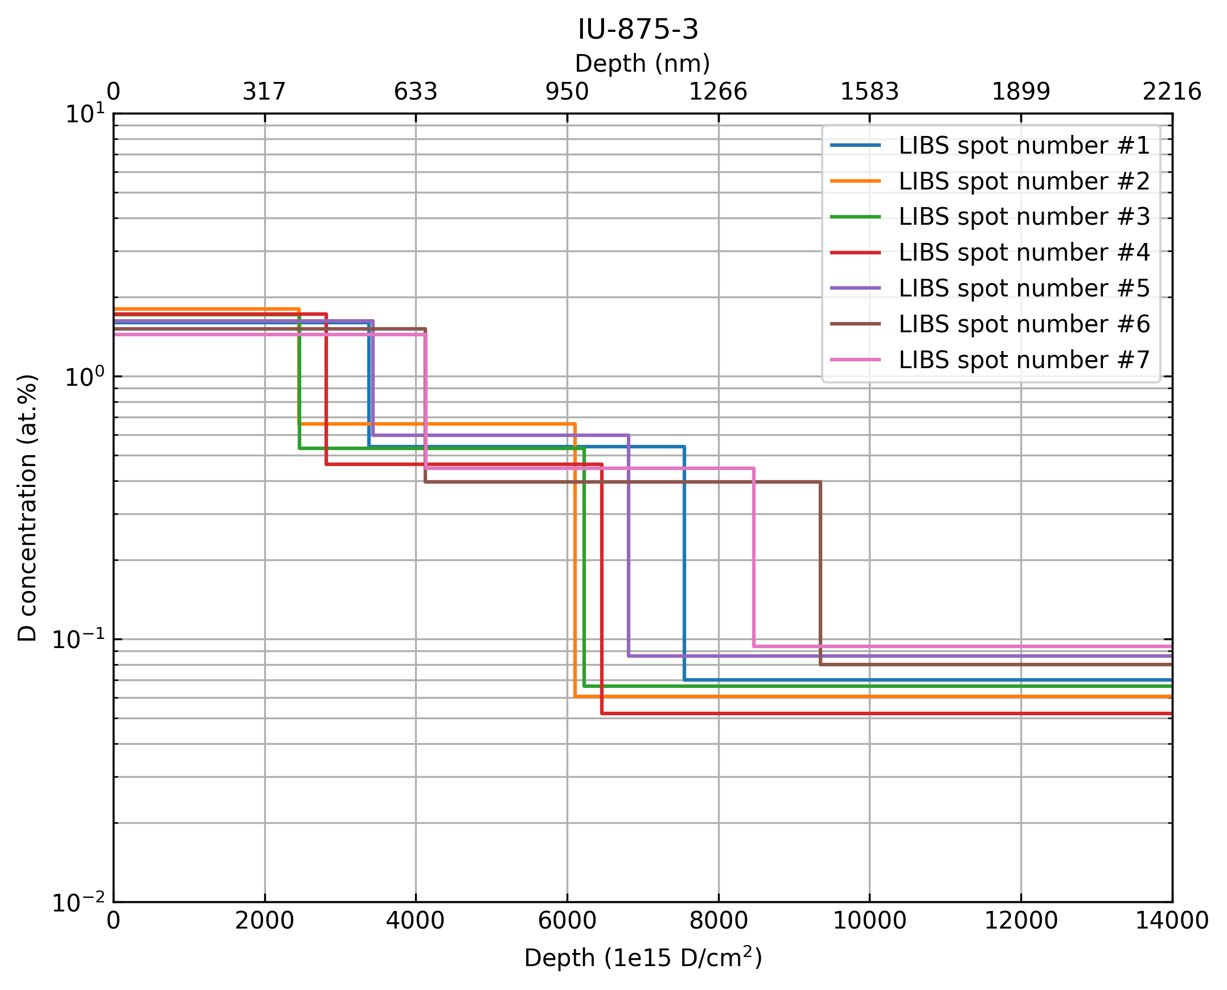
Outgassing, recycling and retention after D plasma loading
Magnum-PSI D₂-N₂ or D₂-Ne plasma exposure 2700 s, example for 5 μm c-W
Depth profiles
Spatial distribution
Depth profiles comparable
Depth (nm)
Spatial distribution for D₂-N₂ and D₂-Ne plasma exposure somewhat conflicting
0
317
633
950
1266
1583
1899
2216
10¹
NRA
10⁰
D concentration (at. %)
10⁻¹
D₂-N₂ plasma
10⁻²
0
2000
4000
6000
8000
10000
12000
14000
Depth (1e15 D/cm²)

Slide 5
LIBS on Be containing coatings with diferent type of fuel content
Experiments in VTT for the preparation of JET remote handling operation
LIBS in atm. pressure Ar, 20 m fiber for signal collection and Echelle type Aryelle spectrometer for wide spectral range
LIBS spectrum (2ONG7A-7)
Limitations for remote handling application
B and C are not detectable because strong lines near 250 nm absorb in long fiber and lines between 300-500 nm are too weak due to low LIBS plume temperature
Ghost lines present due to Echelle type spectrometer
H/D/T line intensities were near the detection limit and overlapping
Be I 332.1 nm
Cut-off by long fiber
Cut-off by mirror
Be ghost lines
W I lines
LIBS and SIMS depth profiles of 14IWG1A 11a
Be, W, Mo, Fe, Ni, Cu, Cr, Ar, H, D were present in the spectra
Samples were from different positions on limiters (2XR11, 4D15) and divertor (HFGC, 14IWG1A, 2IWG3A, b12_167, 2ONG7A, 2ONG8B).
Deposit layers distinguishable in LIBS depth profiles and confirmed by SIMS
LIBS
SIMS

