Slide 1
IJCLab and its contribution to HerHEA project In situ TEM with He ion implantation of HEA at IJCLab Stéphanie Jublot-Leclerc, Aurélie Gentils + new postdoc : Antoine Combrisson Université Paris-Saclay, CNRS/IN2P3, IJCLab, Orsay, France Meeting #2, 14/11/2024
EUROfusion, ENR-MAT.02.VTT-T001
2024-2025
https://indico.euro-fusion.org/event/3309/

Slide 2
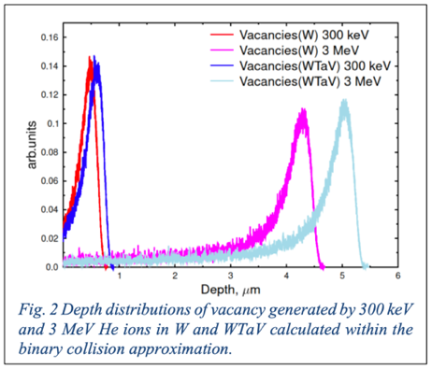
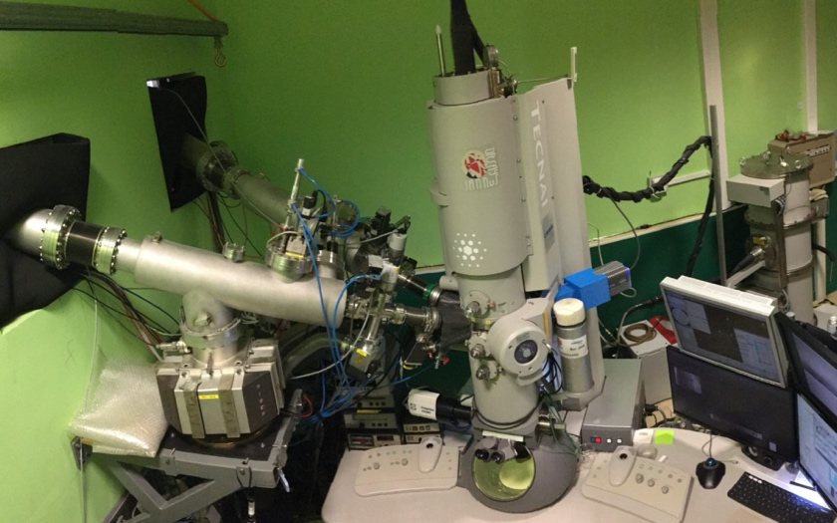
Our task : observing the bubbles nucleation and growth by in situ ion TEM
- which compositions of alloys for the
in situ exp. ?
- thin foil preparation dev. / optimization
- ions parameters (similar as for some ex situ experiments ?)
Helium, 10-20 keV
One condition: influence of a coupled few MeV irradiation ?
- implantation temperature : RT and 500°C
- Observation of He bubbles nucleation and growth vs fluence
To be chosen : binary -WMo, WTa, WV, ternary –WTaV- or WTaMoNbV ? and W ?
https://mosaic.ijclab.in2p3.fr
Orsay
ARAMIS
From MF Barthe
0.5 – 6 MeV ions
10 – 500 keV ions
IRMA
In situ TEM coupled to 190 kV IRMA ion implanter and 2 MV ARAMIS accelerator
« The evolution of created defects (and, in particular, the size and density of cavities, voids and bubbles) will be monitored in different compositions vs the fluence at room temperature and 500°C), for selected parameters chosen with the help of simulations. »
M3.1 In situ TEM experiments performed (Links to D3.1) June 2025
https://indico.euro-fusion.org/event/3309/
HerHEA project, EUROfusion, ENR-MAT.02.VTT-T001, 2024-2025

Slide 3
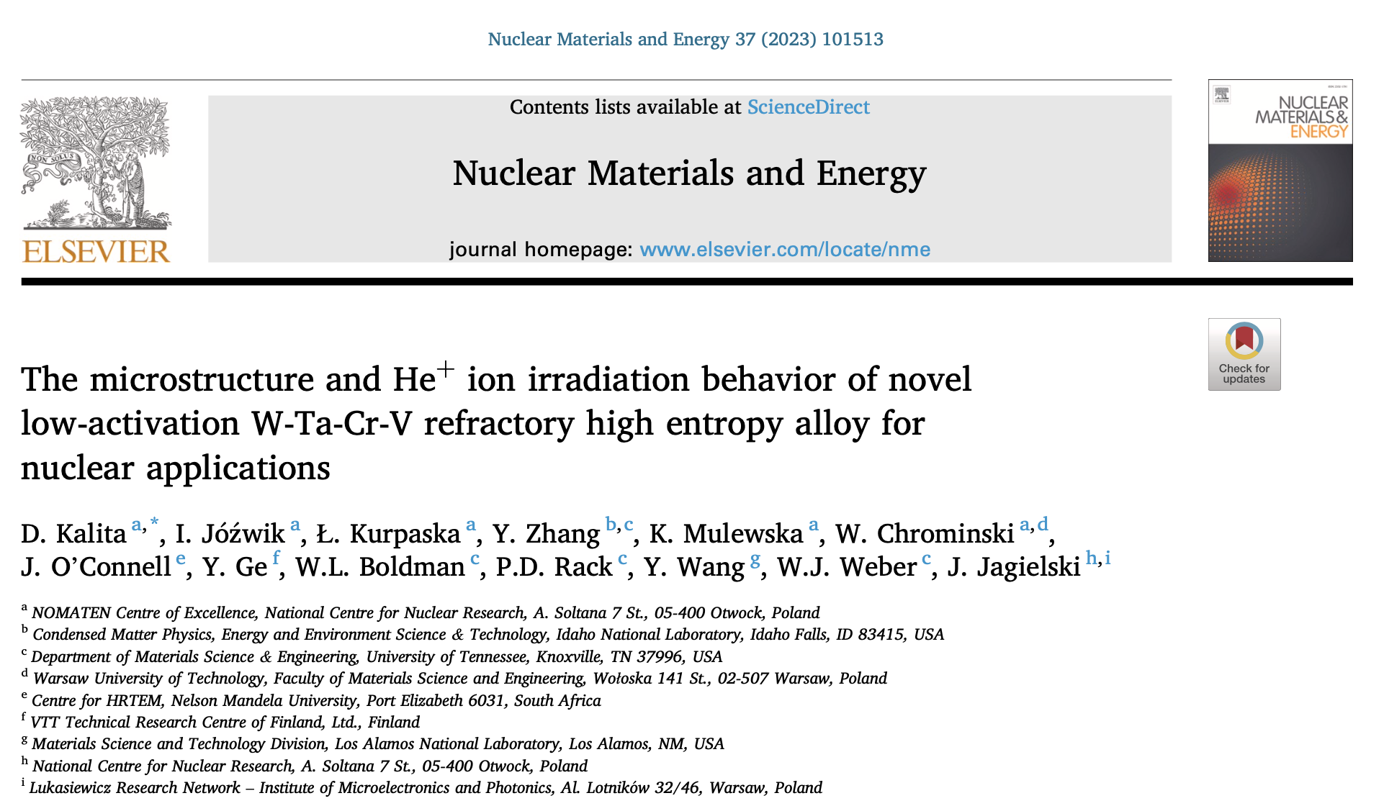
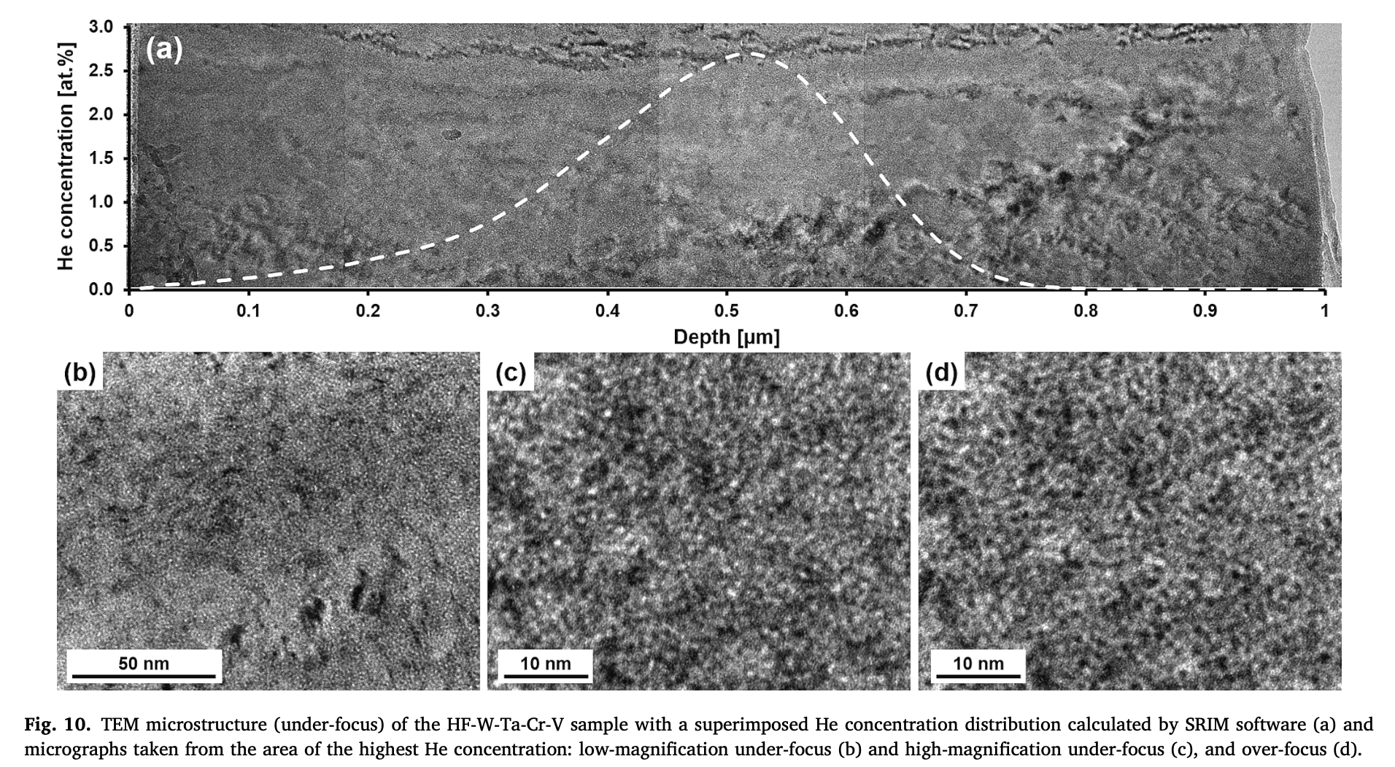
Literature – He ion implantation in W-based HEA
W-Ta-Cr-V thin film, 200 keV He⁺ at RT
https://doi.org/10.1016/j.nme.2023.101513
https://indico.euro-fusion.org/event/3309/
HerHEA project, EUROfusion, ENR-MAT.02.VTT-T001, 2024-2025

Slide 4
Future work
We found a subcontractor in France for the EDM to cut the specimens as requested for the characterization techniques.
The delay is short (less than a week), and the price is 25 € per sample (square of 7*7*0.5 mm).
As there is 4 compositions (W, W-Ta, W-Mo and W-V), and we need 12 samples of each (10 for CEMHTI, and 2 for IJCLab), the total cost is 25 x 4 x 12 = 1300 €
Select the material(s) to be studied (depending on availability)
Prepare TEM thin foils (to be optimized)
Check the initial microstructure
Select the He ion implantation conditions (based on the literature data + simulations ?)
energy, temperature, range of fluence (+ coupled to irradiation ?)
Ex situ + in situ TEM ?
to follow the nucleation and growth of bubbles
Analyse the data
Interpretation + publication
https://indico.euro-fusion.org/event/3309/
HerHEA project, EUROfusion, ENR-MAT.02.VTT-T001, 2024-2025

Slide 5
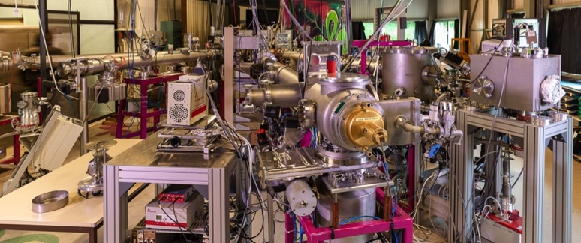
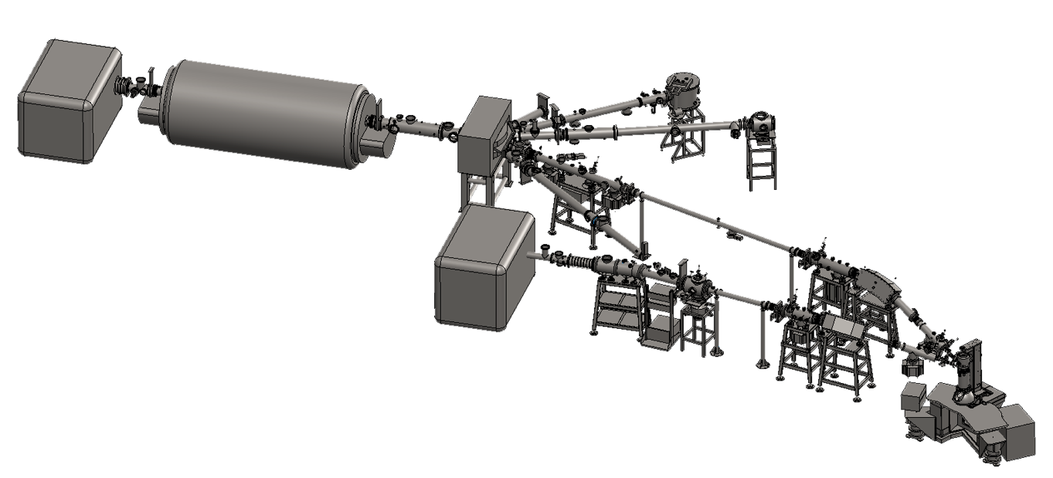
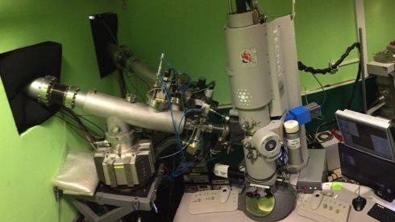
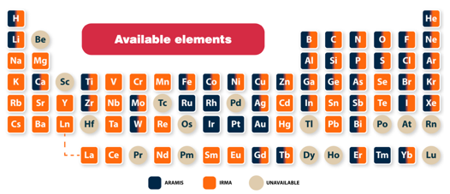
Ion modification and analysis of materials, in situ TEM
The JANNuS-Orsay experimental hall :
ARAMIS, IRMA, in situ TEM
Ion Beam Analysis
RBS, RBS/C, ERDA, PIXE, μPIXE, PIGE
ARAMIS
Ion implantation Ion irradiation
LN₂ –> 1000°C
https://mosaic.ijclab.in2p3.fr
XRD
ARAMIS since 1987
2 MV Tandem – Van de Graaff
in construction (SIXPAC project)
SNICS negative ion source:
500 keV < E < 11 MeV ; 10 nA < i < 10 μA
Penning source @ HV : i < 20 μA
200 keV < He < 3.6 MeV ; 200 keV < H < 1.8 MeV
IRMA
IRMA since 1979
190 kV ion implanter
10 - 570 keV, up to 20 mA
Bernas-Nier source
TEM
E. Cottereau et al., NIMB 45 (1990) 293
H. Bernas et al., NIMB 62 (1992) 416
Ion implantation and in situ RBS/C
LN₂ –> 600°C
Available elements
J. Chaumont et al., NIMB 198 (1981) 193
In situ dual ion beam Transmission Electron Microscope
since 1980 Updated in 1994, 2007
Home-made ion accelerators
M.-O. Ruault et al., J. Mater. Res. 20 (2005) 1758
A. Gentils et al., NIMB 447 (2019) 107

