Slide 1
The diffusion of helium in tungsten-based refractory alloys by molecular dynamics
HeRHEA meeting
Guanying Wei
14 November

Slide 2
Outline
Potential for He-refractory alloys
Binding energy(He-He, He-Vacancy)
Migration energy
Diffusion of He

Slide 3
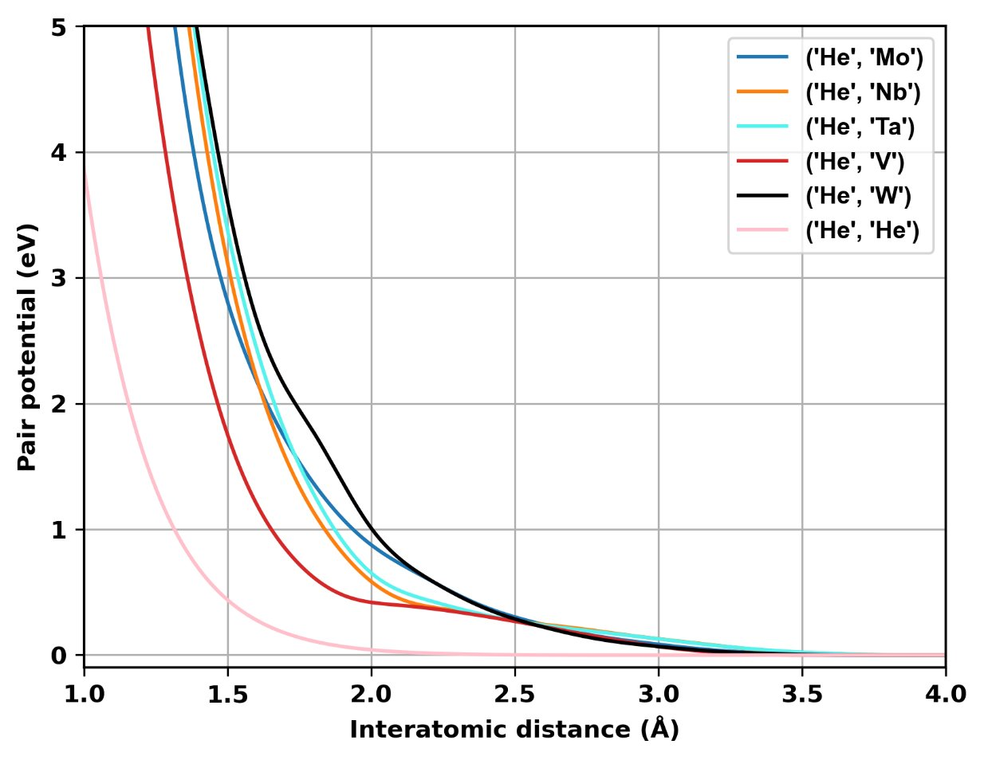
Potential He-refractory alloys

Slide 4
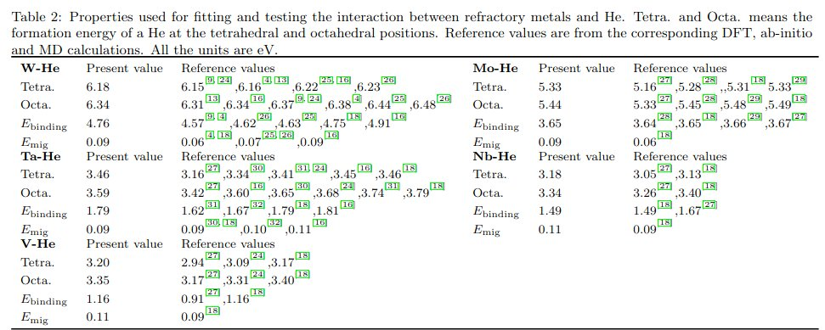
Potential He-refractory alloys
Fitted property for metal – He and comparison with DFT as well as existing data.

Slide 5
Check the stable configuration for 2 He atoms (From Toni Sutinen)
Put the first He at a Tetrahedron site, then the second He is put at another Tetrahedron which is far away from the first one 0.5 -5.0 Å with 0.5 as interval. Do the minimization and check the final distances between 2 He atoms.

Slide 6
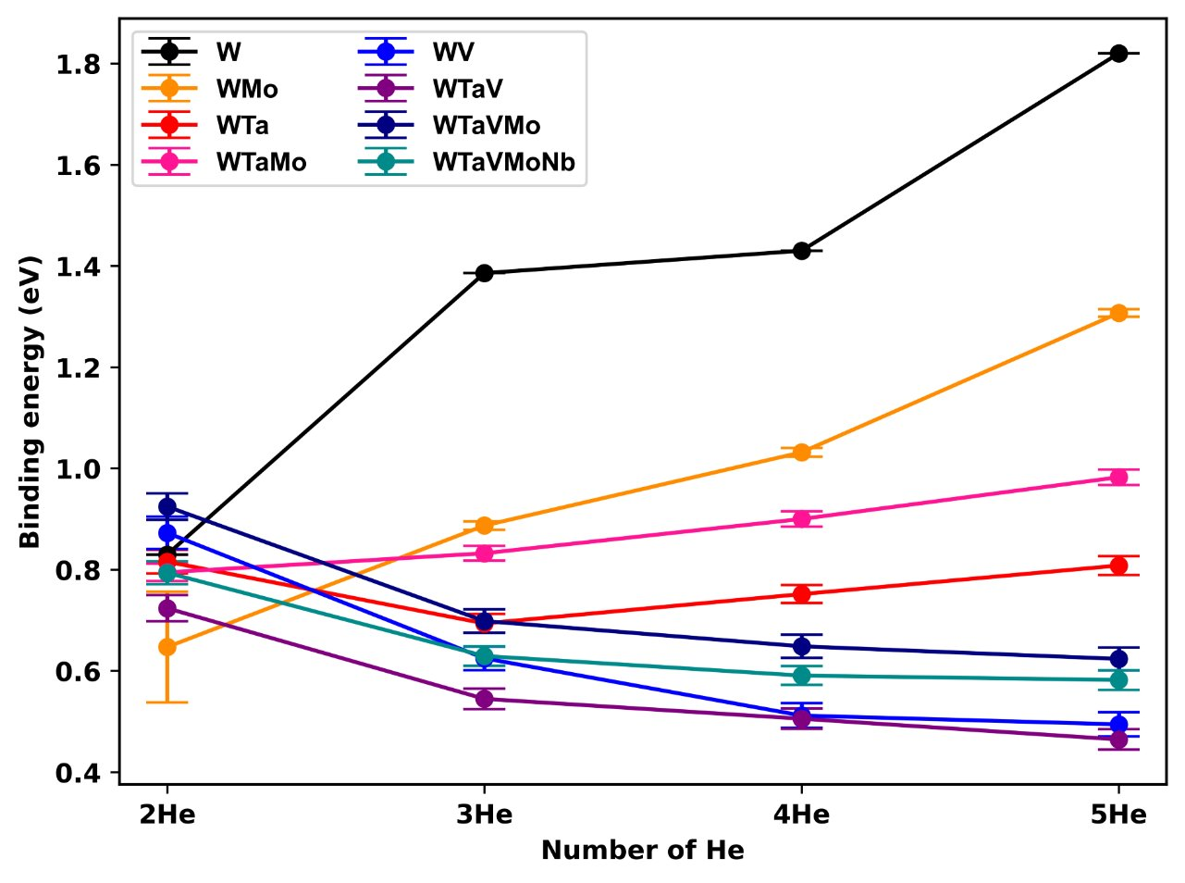
Binding energy between He clusters​
V-free materials: increase
V-containing materials:decrease
Pure metals

Slide 7
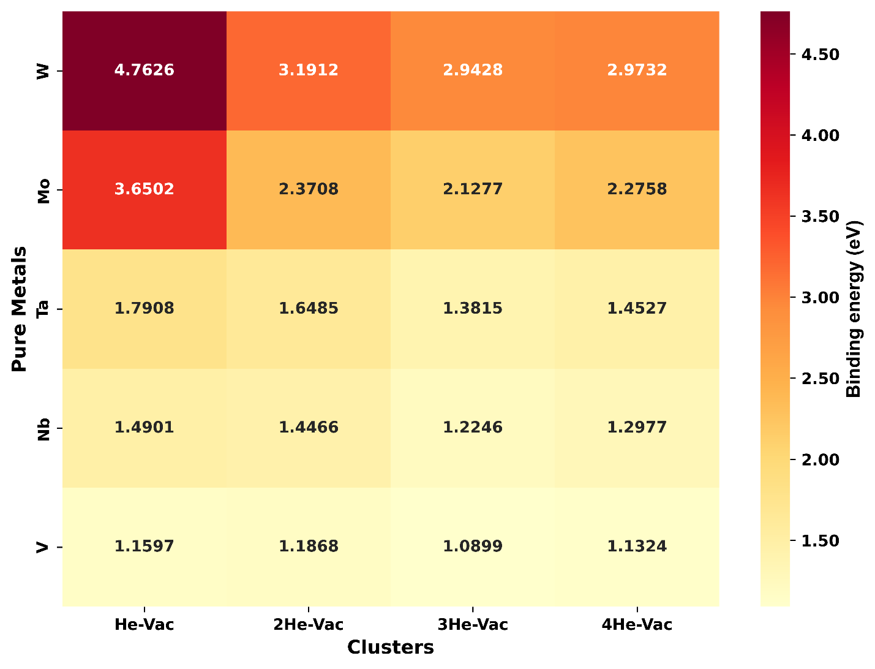
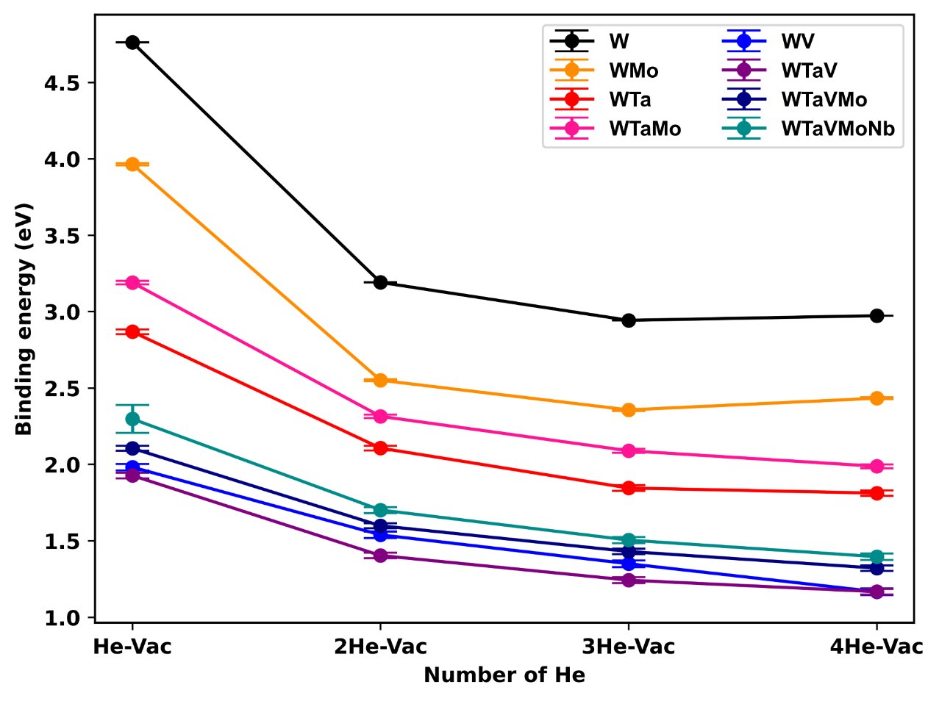
Binding energy between He and Vacancy​

Slide 8
Migration energy of a He atom​
He position​ | WTa​ | WMo​ | WTaMo ​ | WV​ | WTaV​ | WTaVMo​ | WTaVMoNb​
(0,0.5,0.25)*a ​ (0,0.5,0.75)*a | 0.2002+- 0.0041​ | 0.1319+- 0.0027​ ​ | 0.1961+- 0.008​ ​ | 0.4310+- 0.0074​ ​ | 0.3422+- 0.0053​ ​ | 0.3244+-0.0053​ ​ | 0.2887+- 0.004​ ​

Slide 9
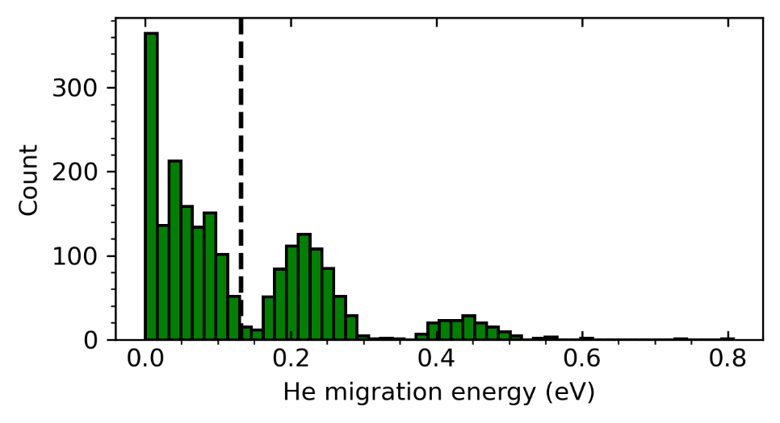
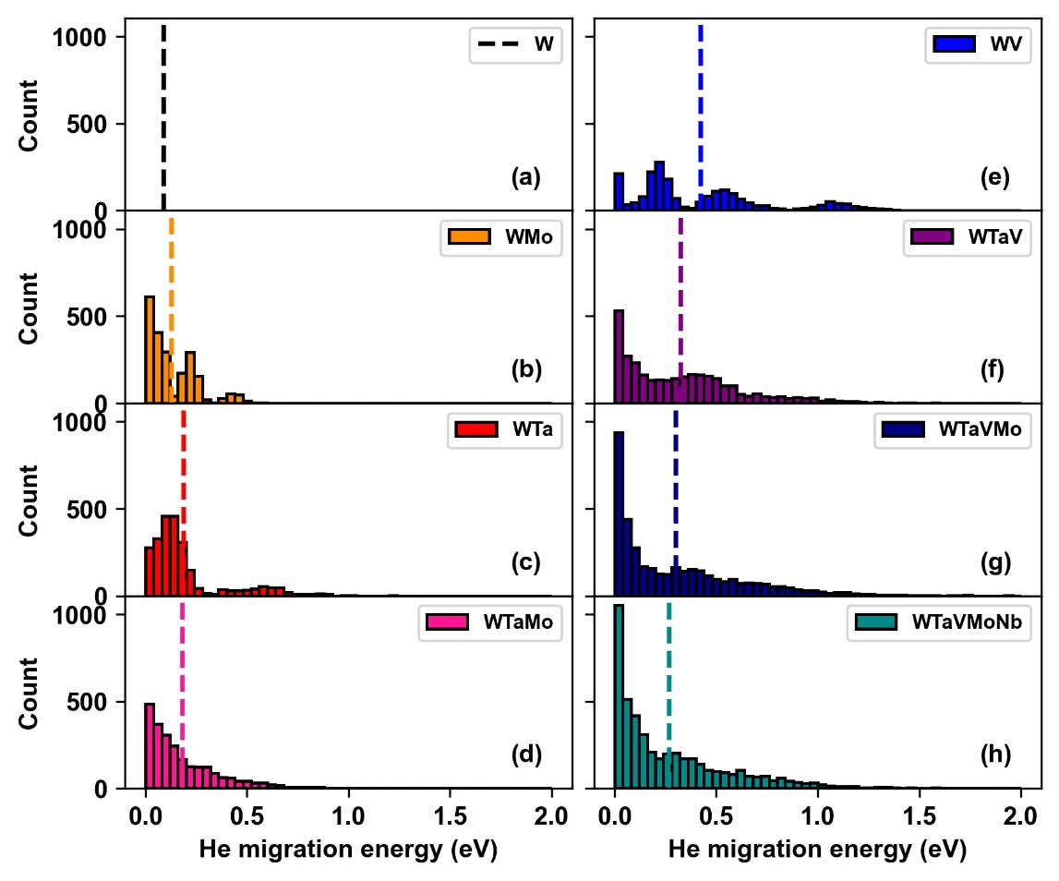
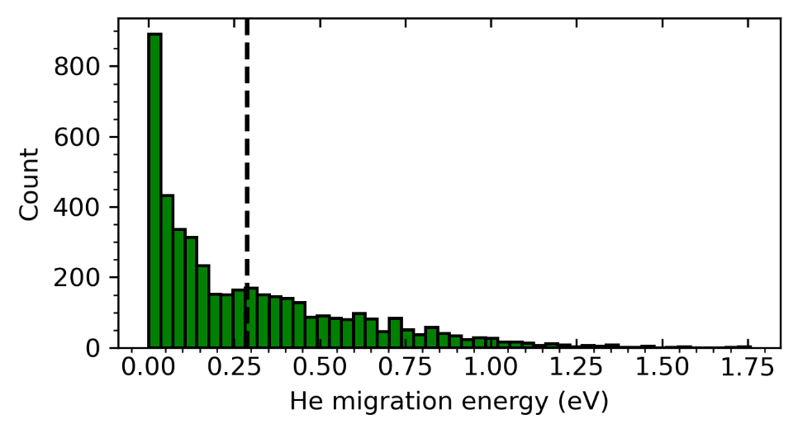
Migration energy of a He atom​
The effect of entropy on the He migration
WMo
WTaVMoNb

Slide 10
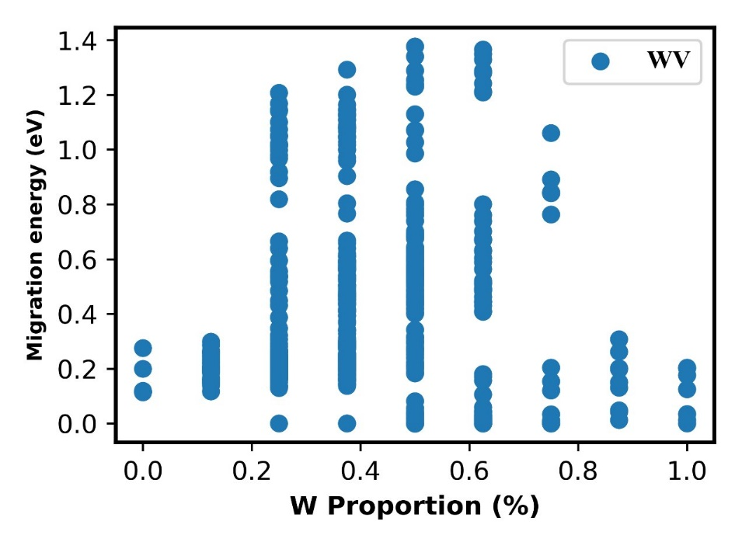
Migration energy of a He atom​
Effect of Helium Atom Coordination Environment on its Migration

Slide 11
Diffusion of He (MD simulation)
Box size: 20*20*20 = 16000 atoms + 0.1% Vacancies(16) +1% He (160 atoms)​
Potential: tabGAP potential + He-He pair potential​
Minimize first​
NPT relax 5 ns at 300 K, 900 K and 1500 K

Slide 12
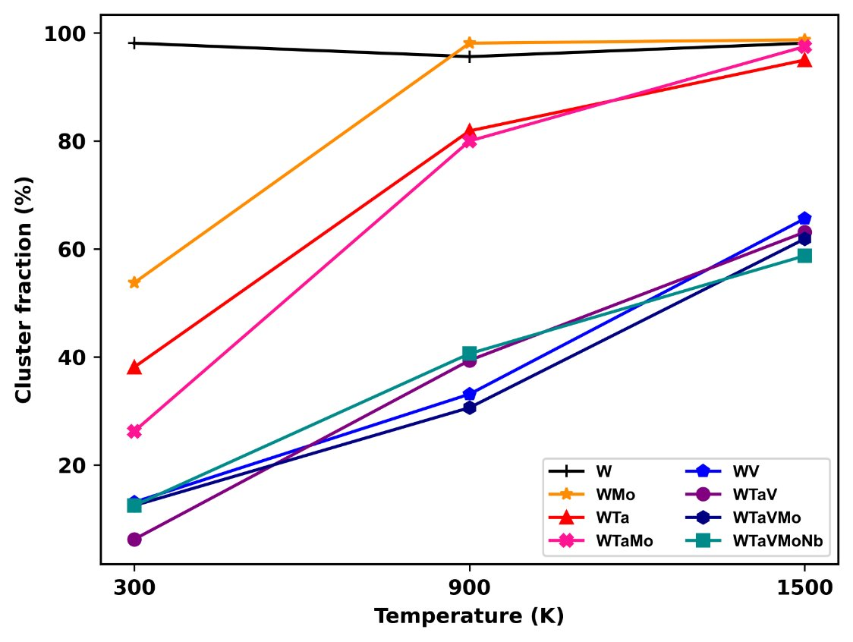
Cluster fraction
Growth with the temperature, He atom prefers to be individual in V-containing materials.

Slide 13
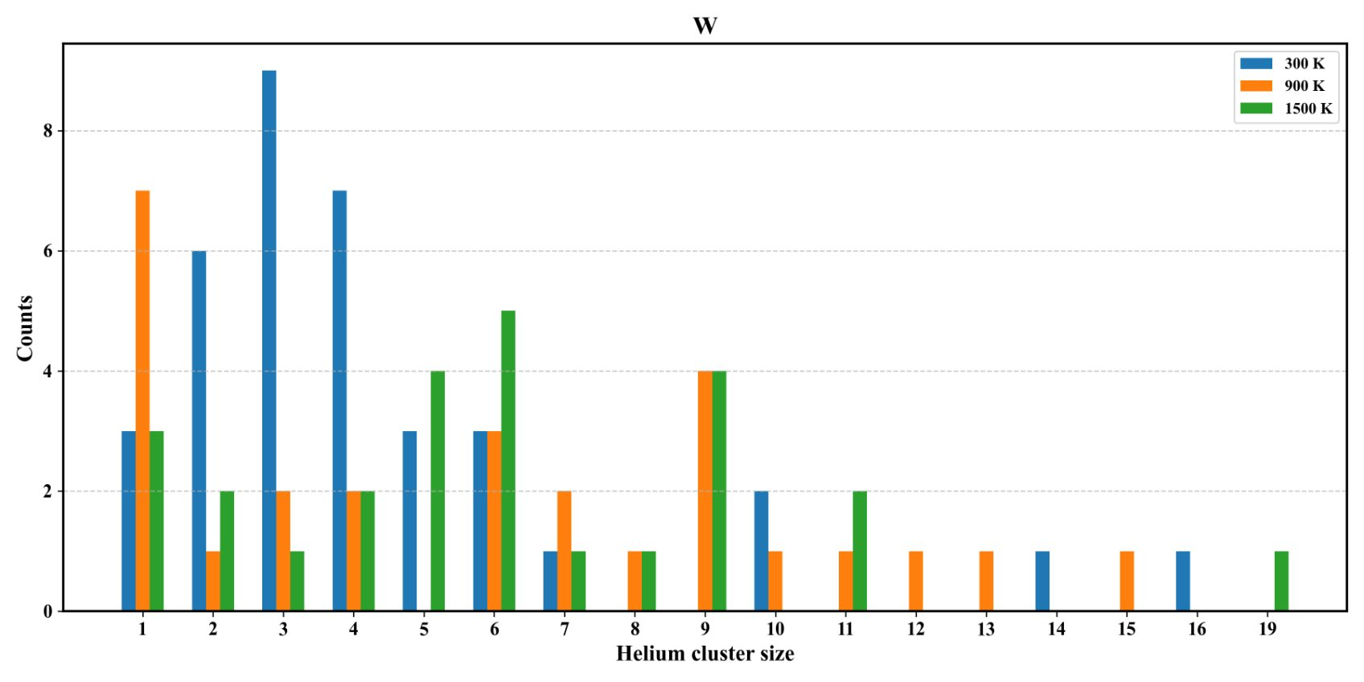
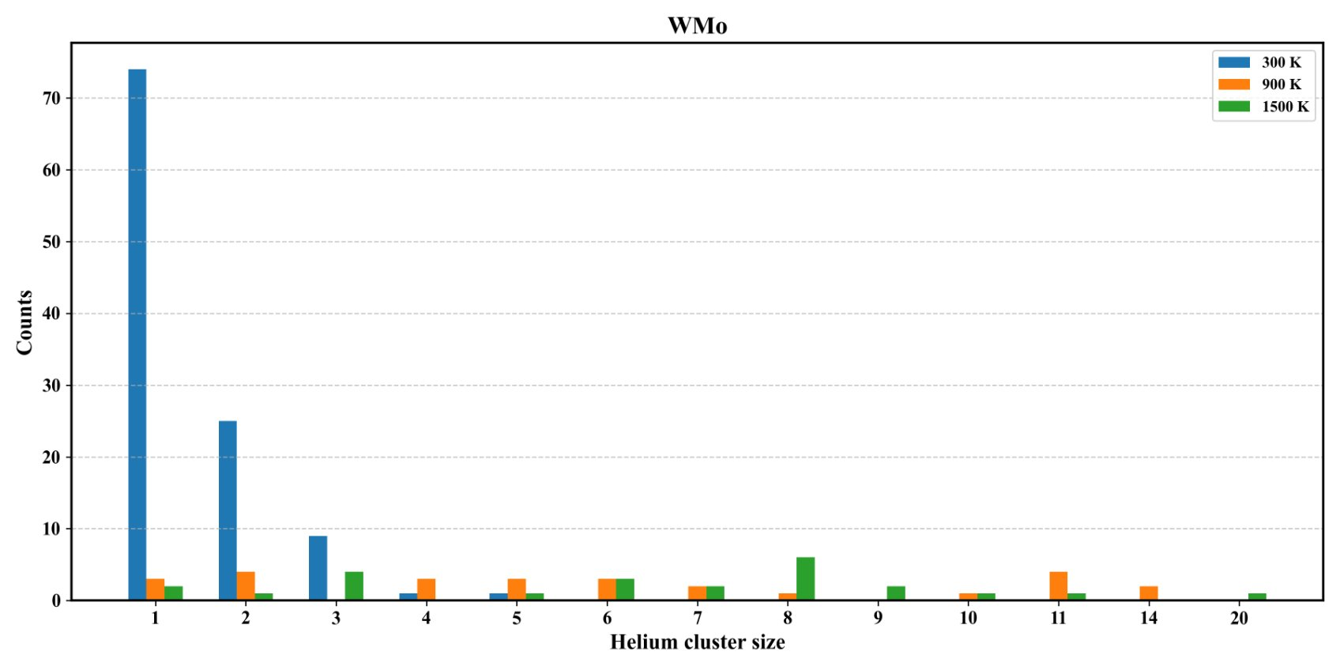
Distribution of cluster size(V-free)​

Slide 14
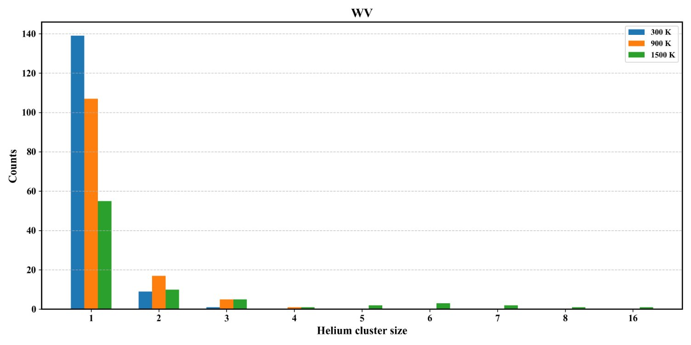
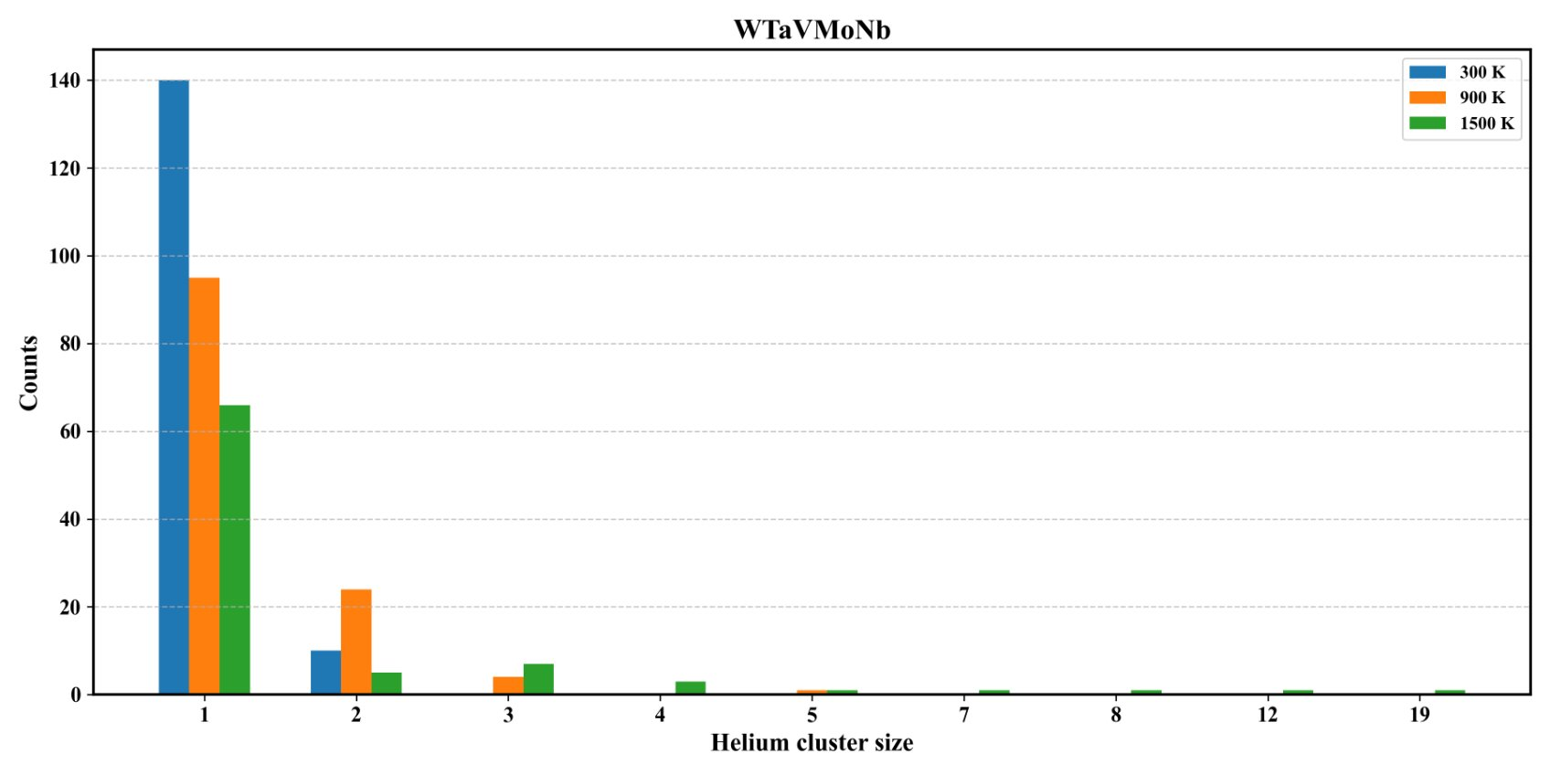
Distribution of cluster size​(V-containing)

Slide 15
Evolution of He​

Slide 16
Thank you for your attention!
Notes:
Thanks

