Slide 1
JET LID mirror holder
18/05/2020 | G. Sergienko, A. TERRA

Slide 2
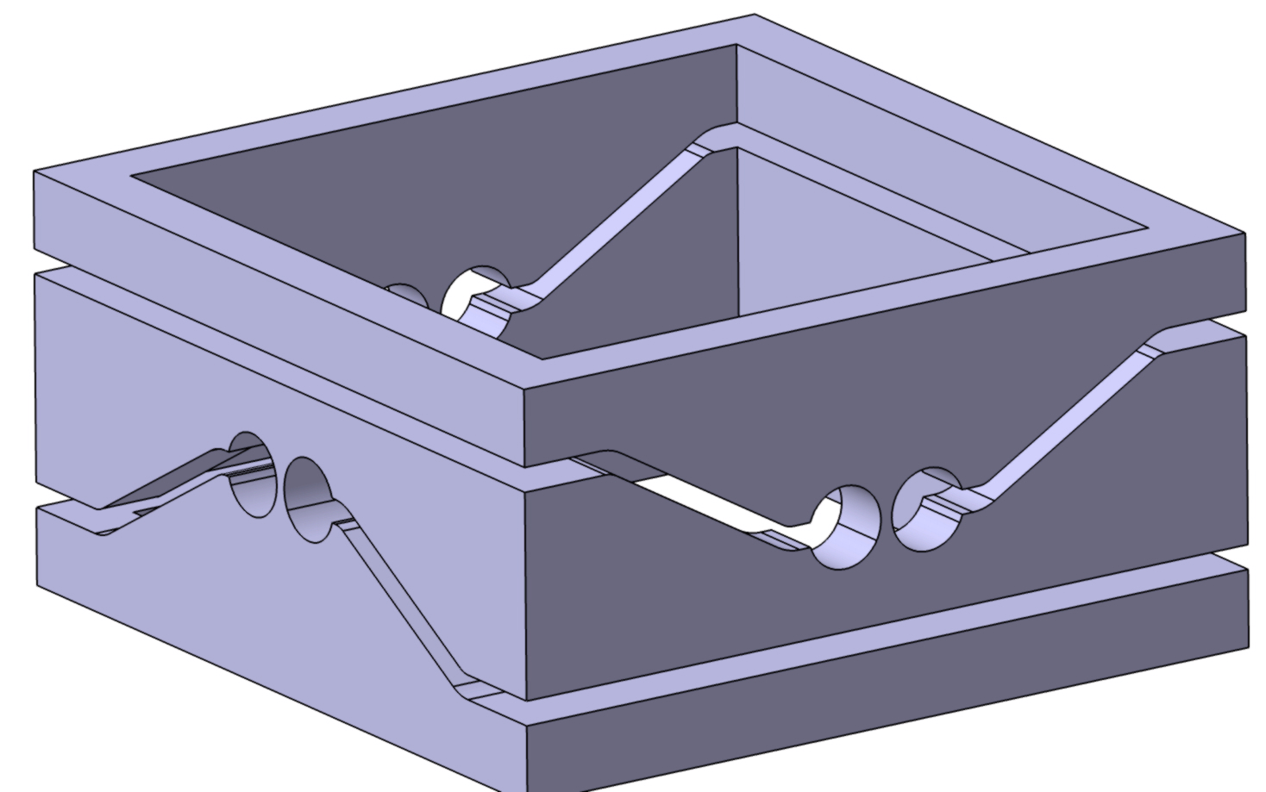
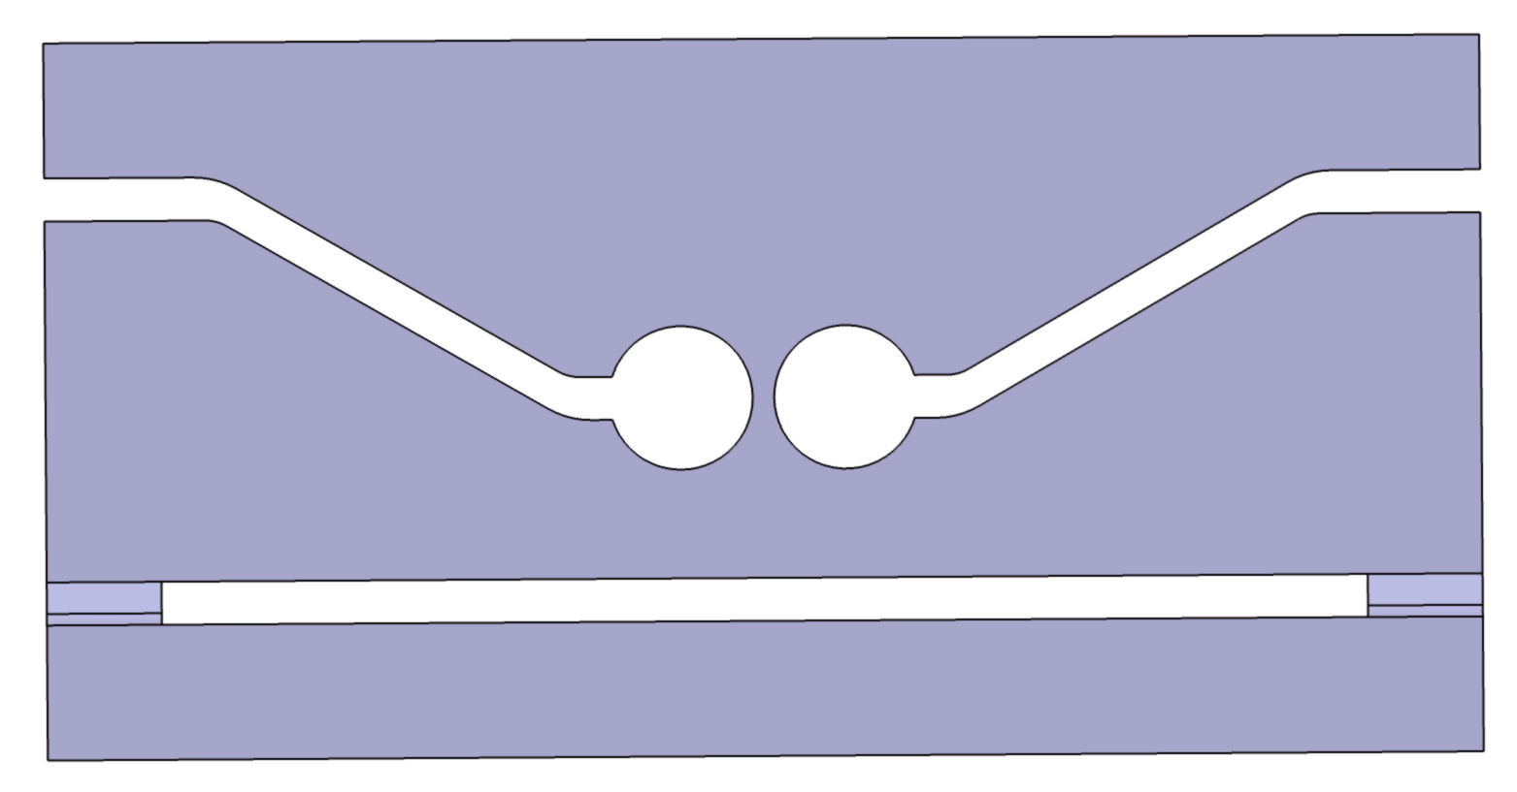
Qualitative approach
Concept
a, mirror stiffness and stability to vibration, force required for adjustment and long term so stress in material. Manufacturing accuracy
C(mm) ~ C’(mm) ~ C’’(deg)
c
c’
c’’
b, mirror stiffness and stability to vibration, force required for adjustment and long term so stress in material
r, precision of pivot axis definition
Stainless steel 316L
Yield strength ~250MPa
UTS ~400MPa
20C

Slide 3
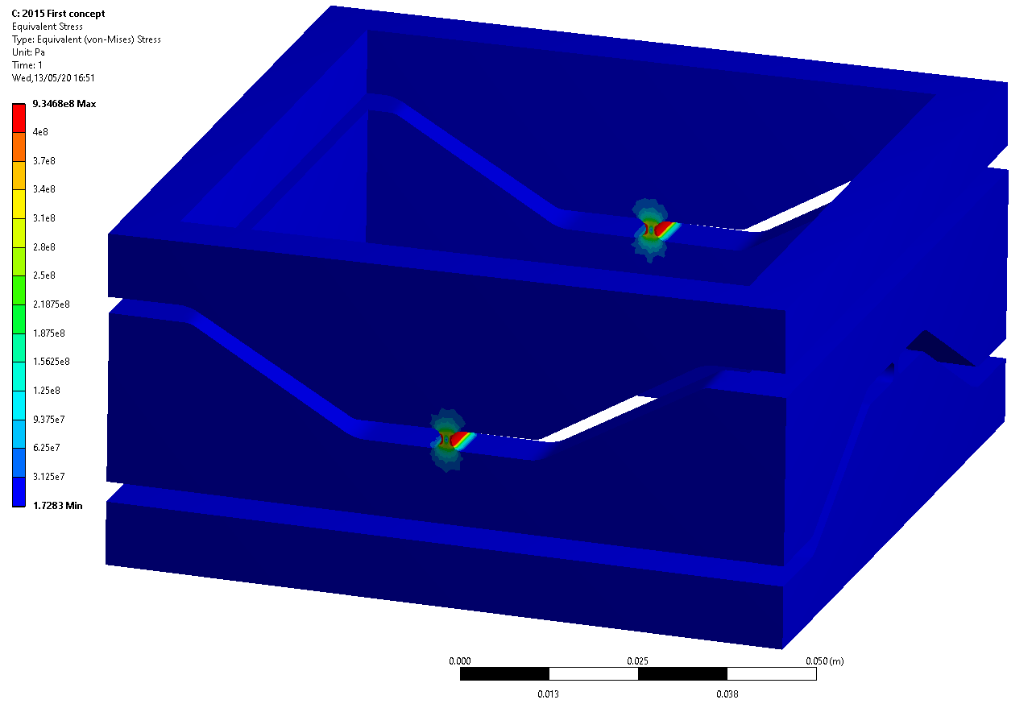
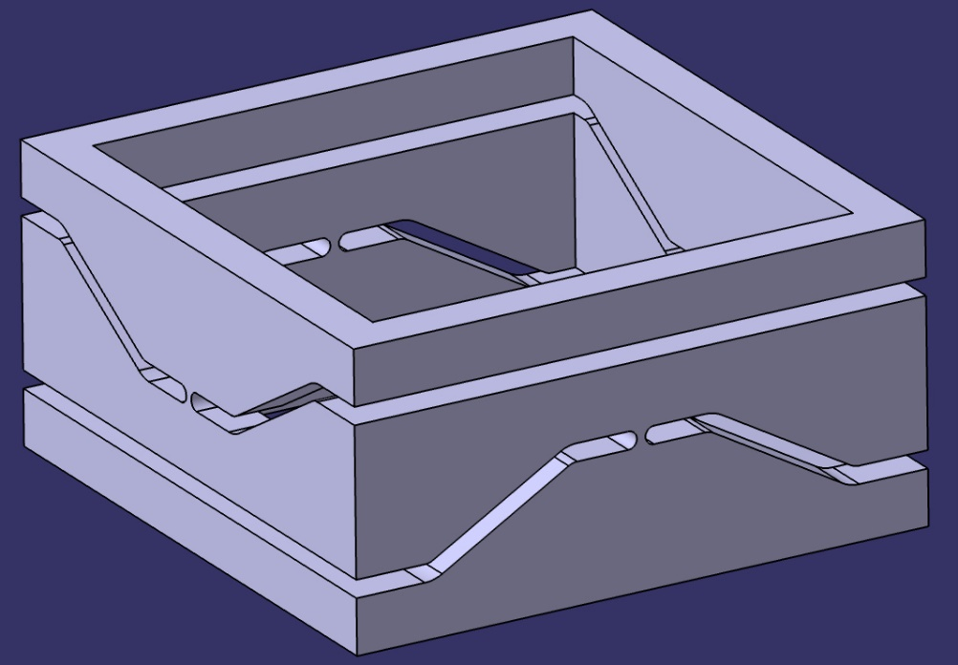
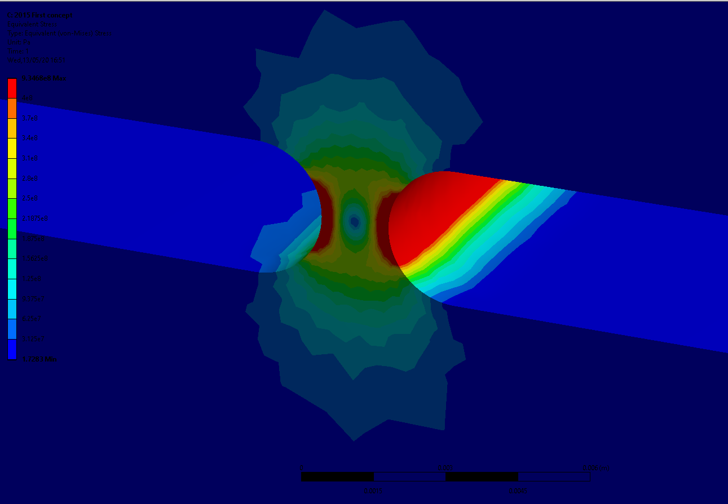
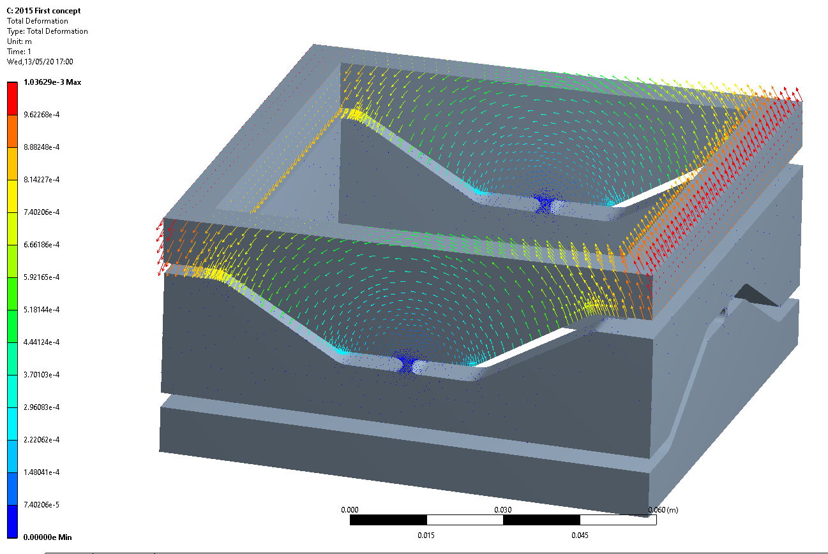
2015 Model
a=1.5mm, b=3mm, r=1.5mm
Very stiff (150N / deg or mm)
Very high stress -> failure or very low fatigue
Good accuracy

Slide 4
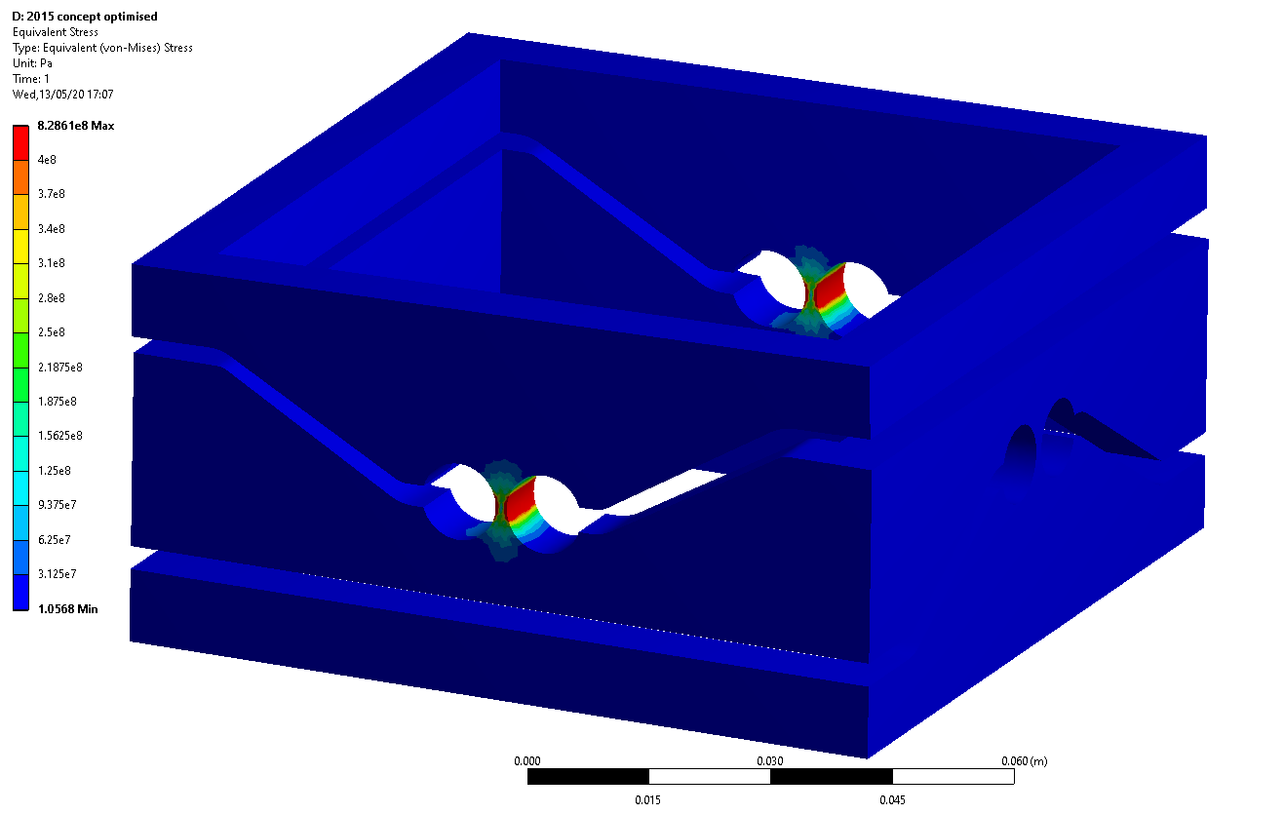
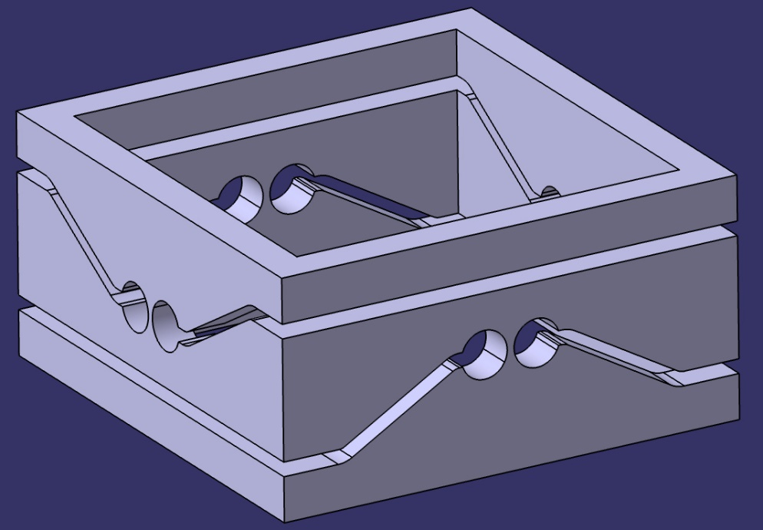
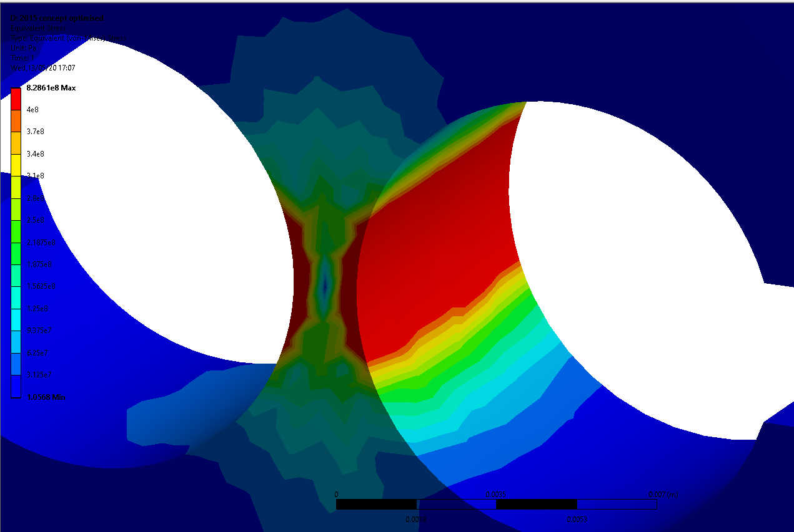
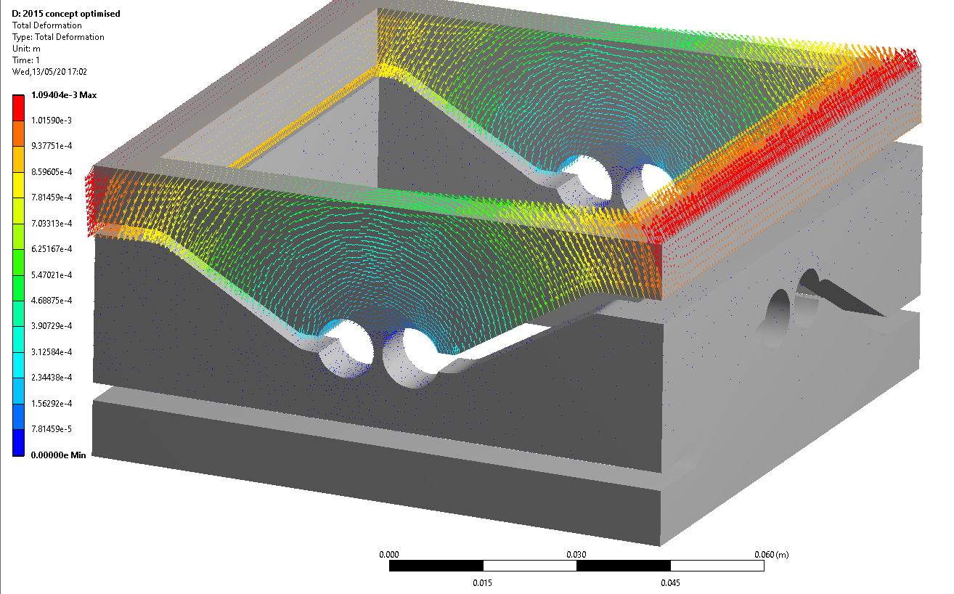
2015 Model refined
a=1.5mm, b=10mm, r=5mm
Quite stiff (100N / deg or mm)
Stress reduced but still high -> failure or very low fatigue
good accuracy

Slide 5
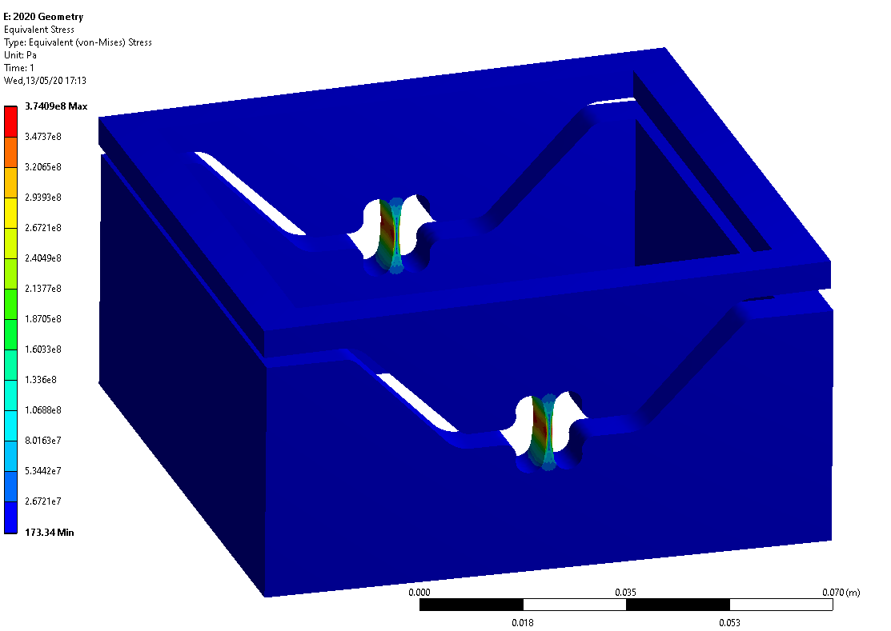
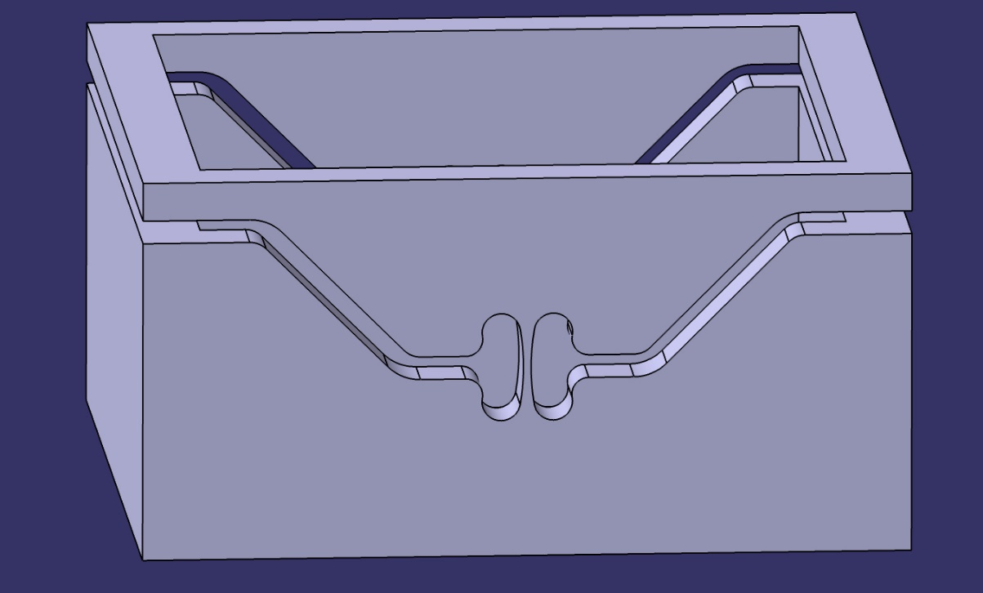
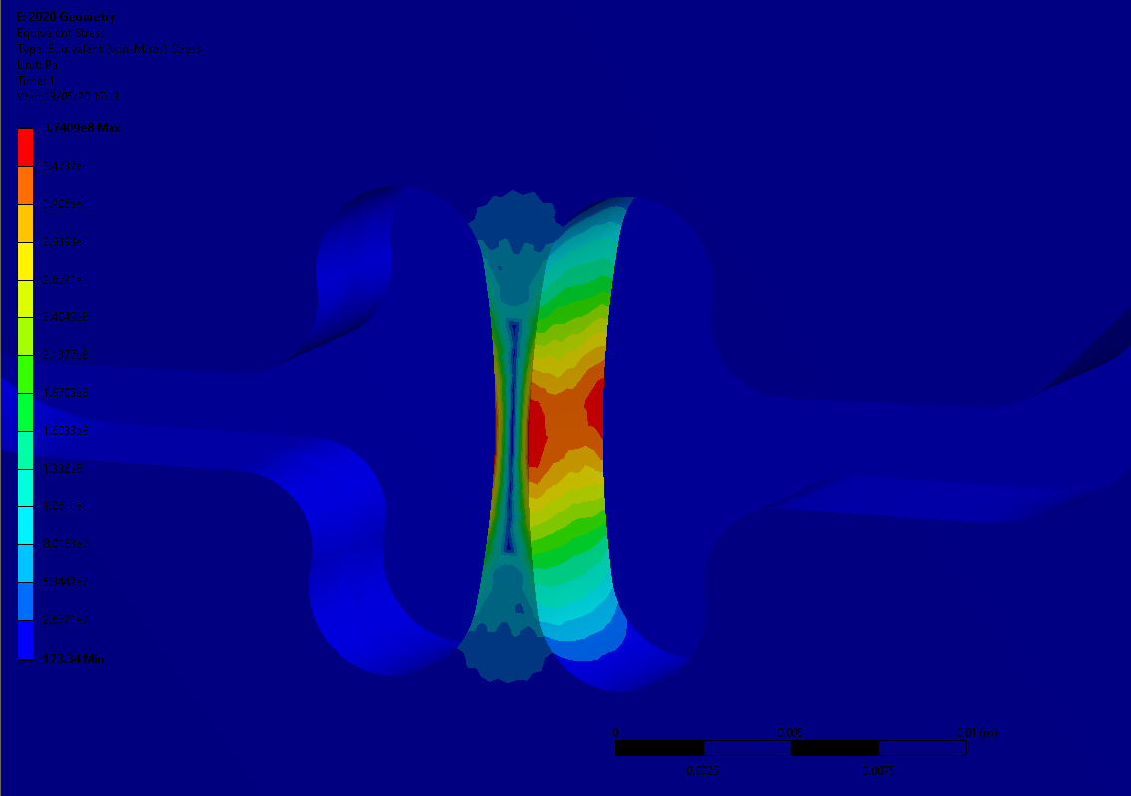
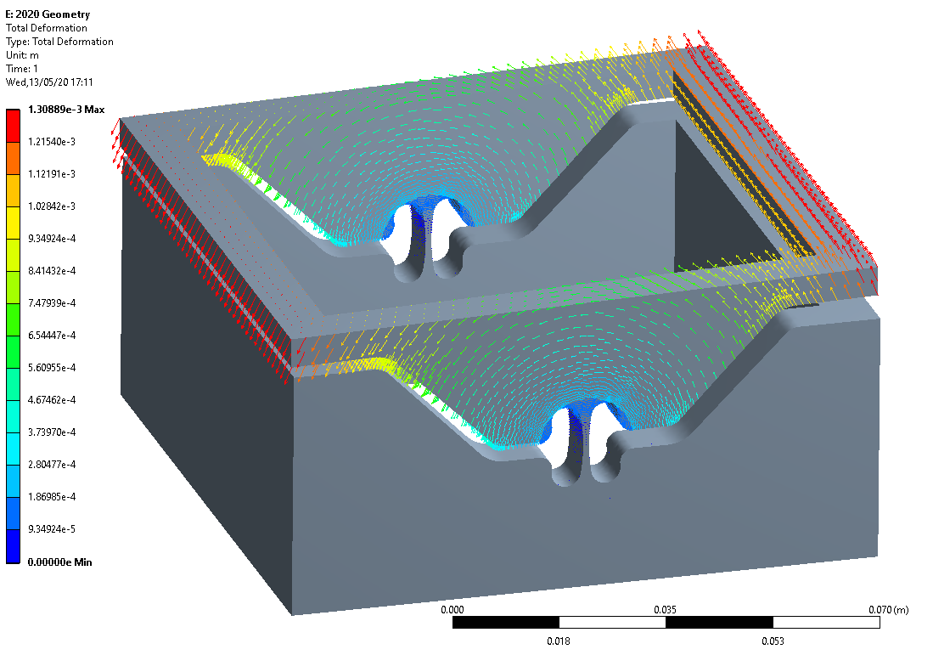
2020 Model
a=1mm, b=12mm, r=30mm
Low stiffness (20N / deg or mm)
Stress pretty low
Lower accuracy

Slide 6
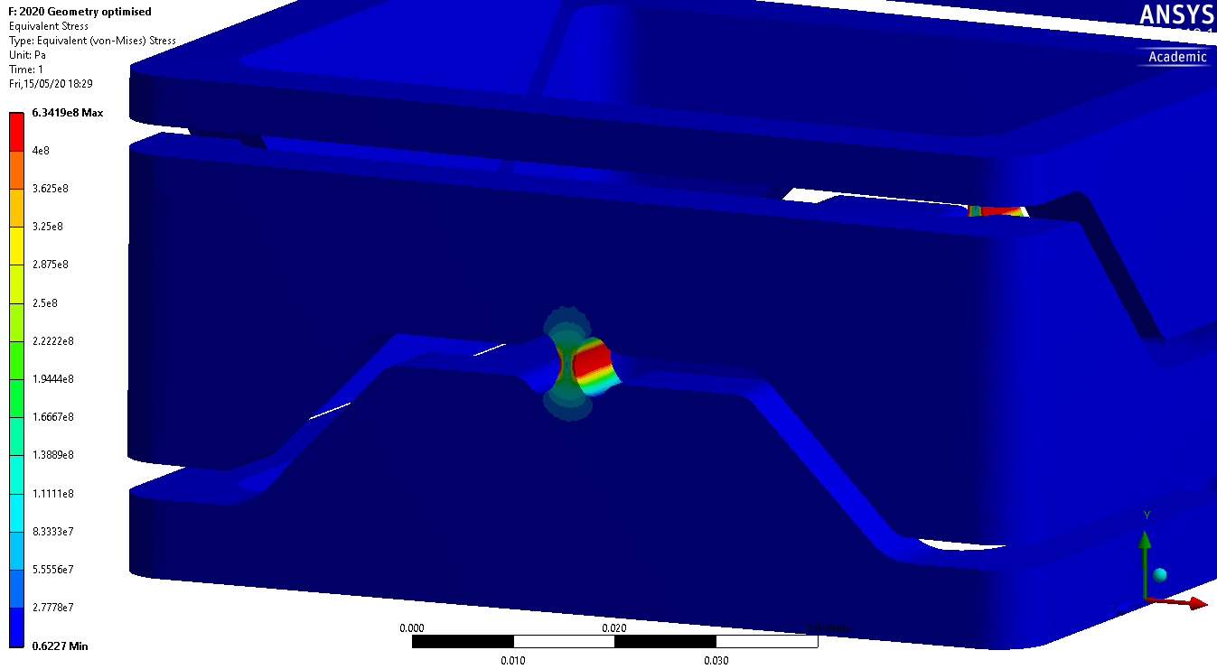
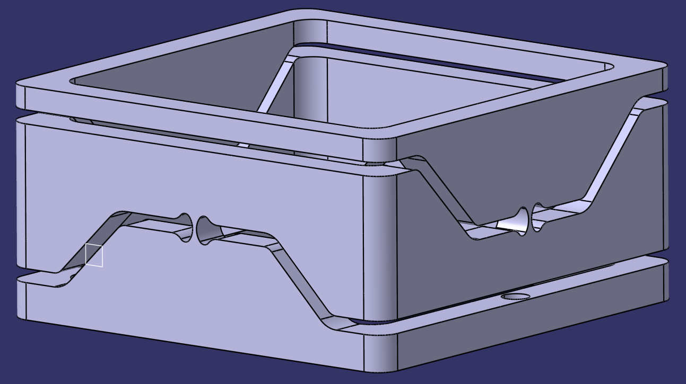
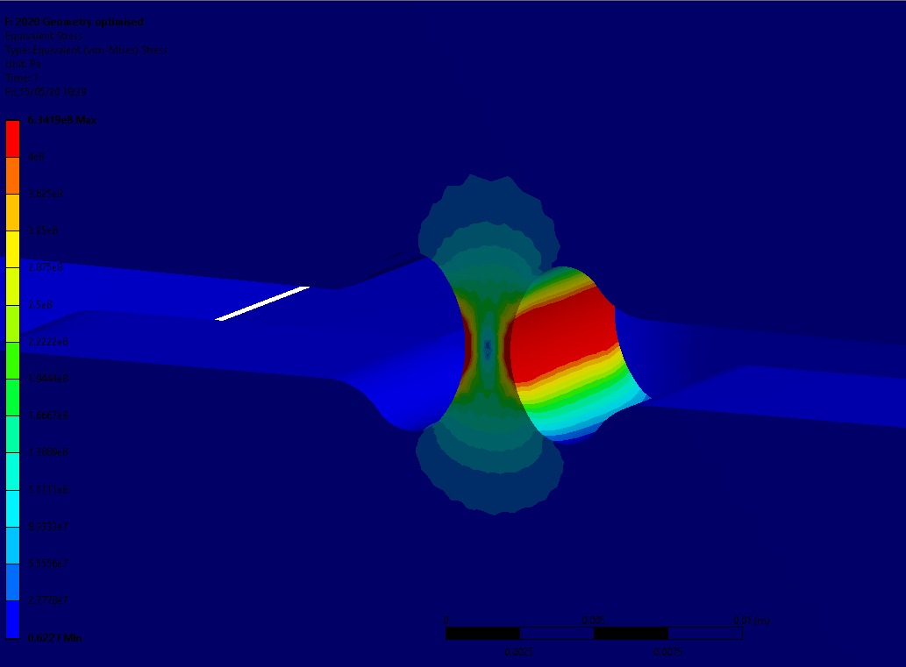
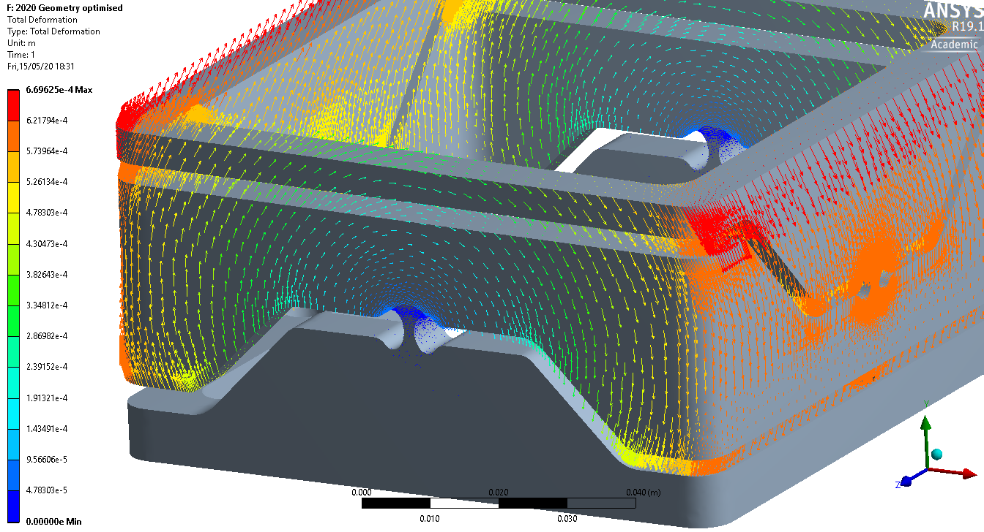
2020 Model rev2
a=1.7mm, b=5mm, r=mm
Pretty high stiffness (150N / deg or mm)
Medium to high Stress
Good accuracy
Best compromise so far, but still need optimization

Slide 7
2020 Model
Best compromise so far, but still need optimisation

