Slide 1
ZEMAX model of JET LID optics
18/05/2020 | G. Sergienko

Slide 2
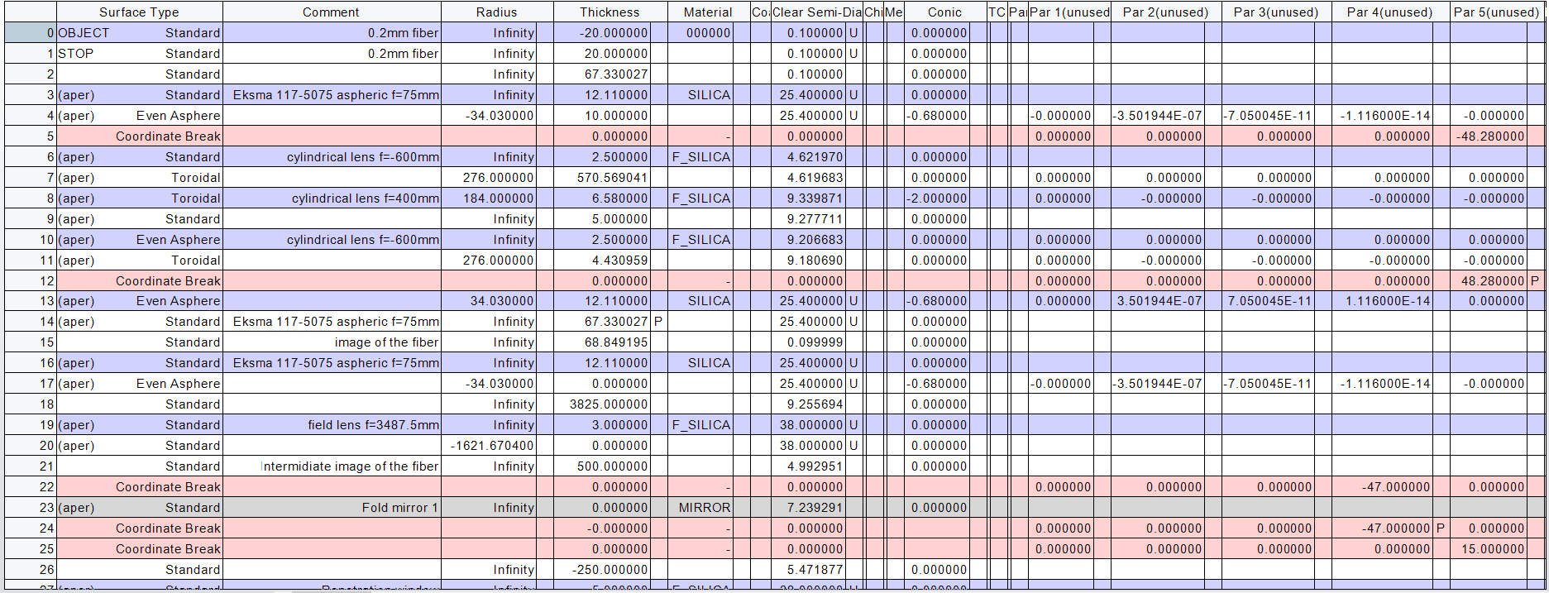
ZEMAX model of LID optics

Slide 3
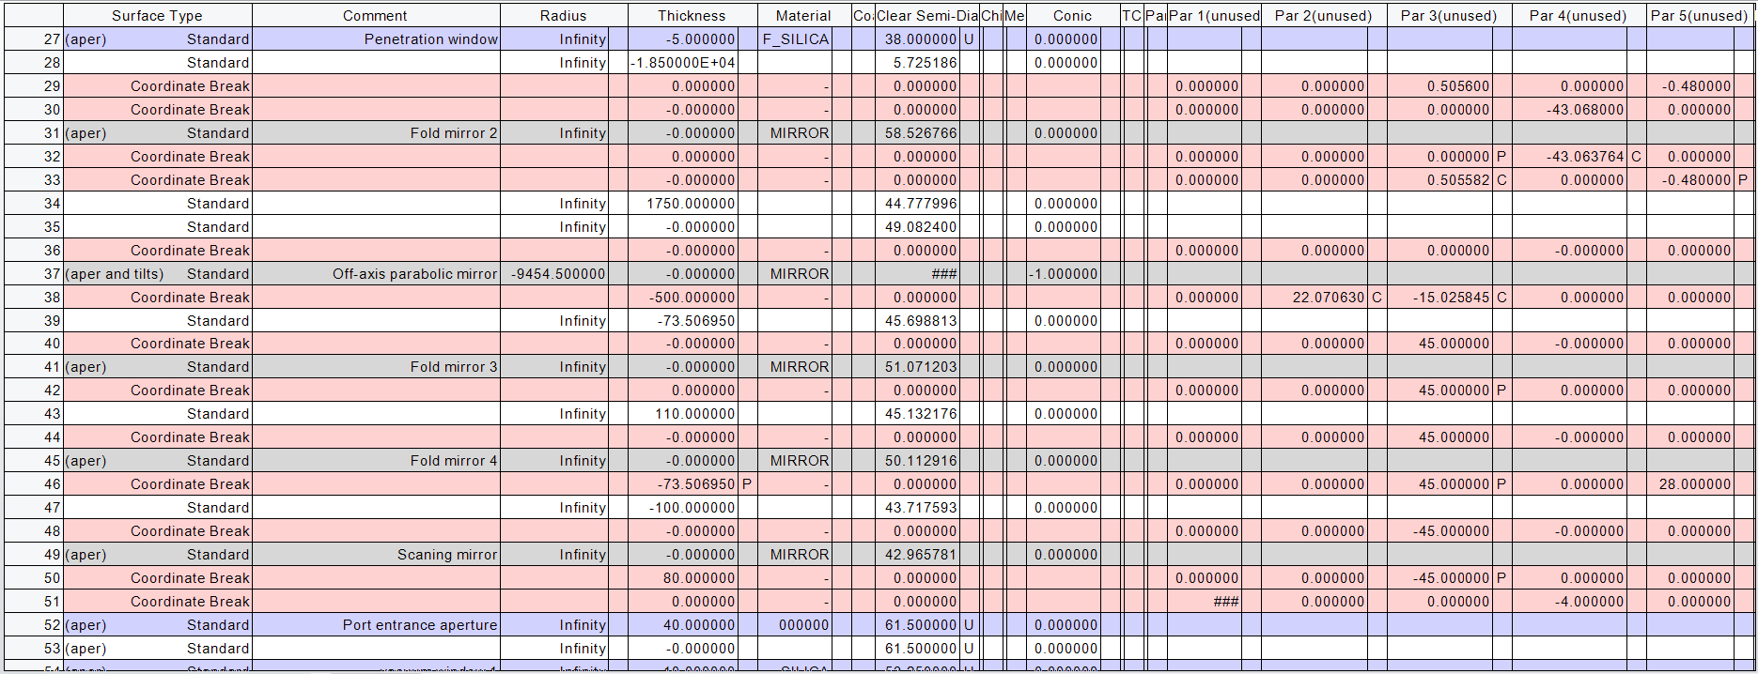
ZEMAX model of LID optics

Slide 4
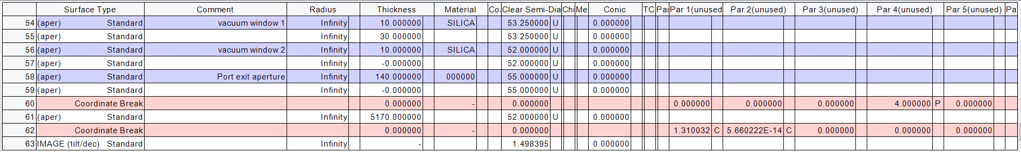
ZEMAX model of LID optics

Slide 5
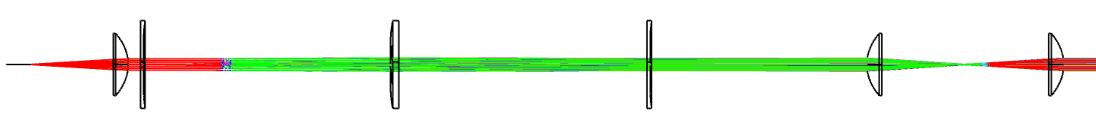
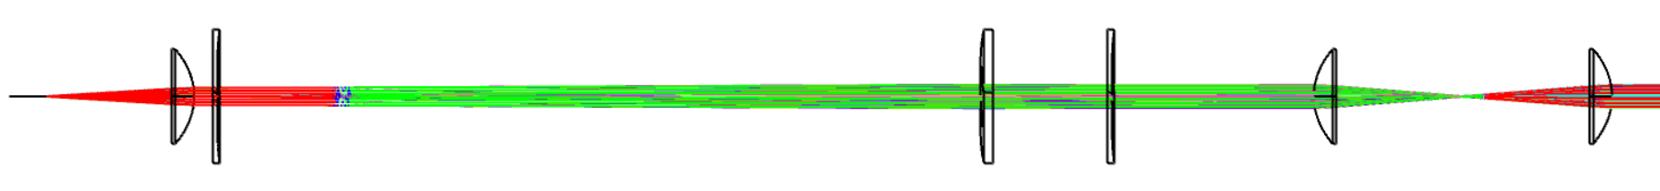
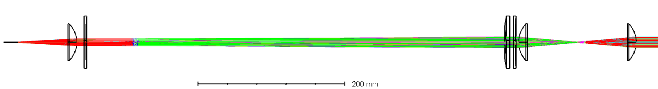
Beam shaper
1:1
0.66:1
0.53:1

Slide 6
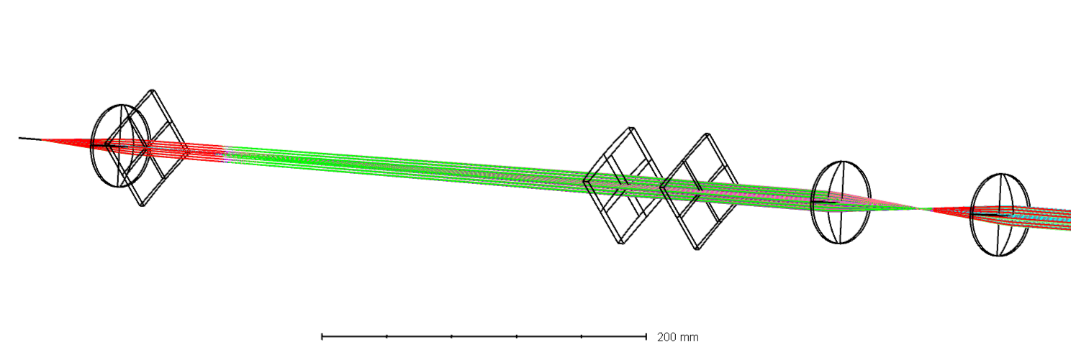
Beam shaper
f₁=-600mm
f₂=400mm
f₃=-600mm
Cylindrical lenses
Cylinder lenses are rotated along its optical axis

Slide 7
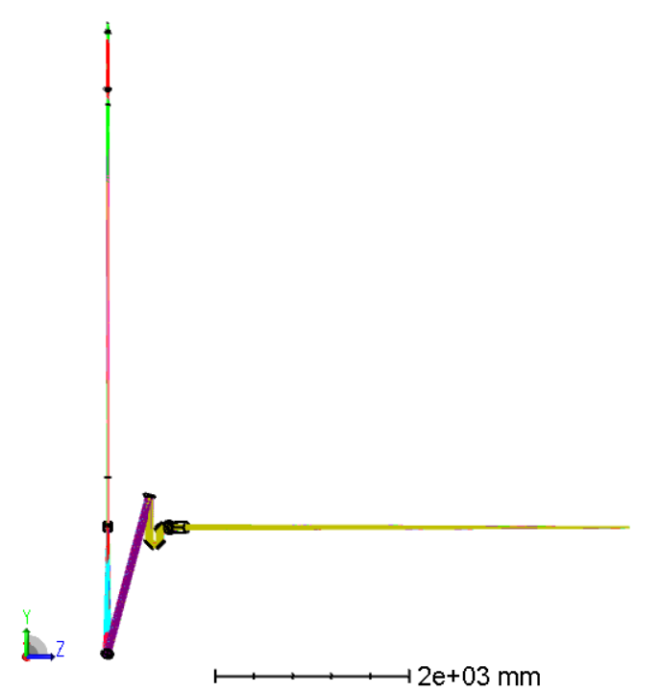
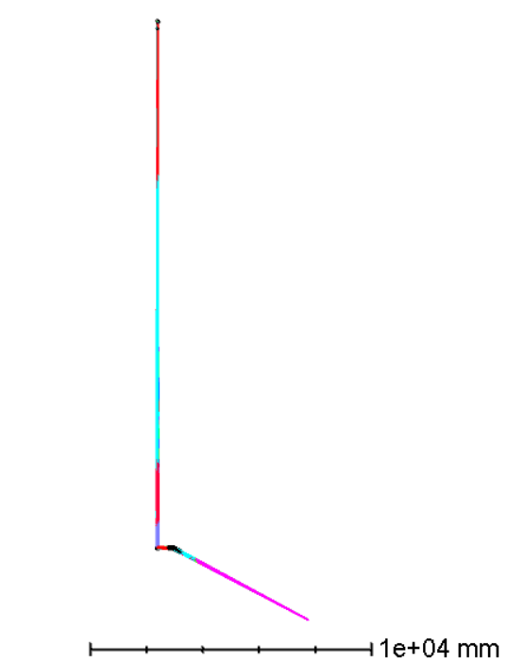
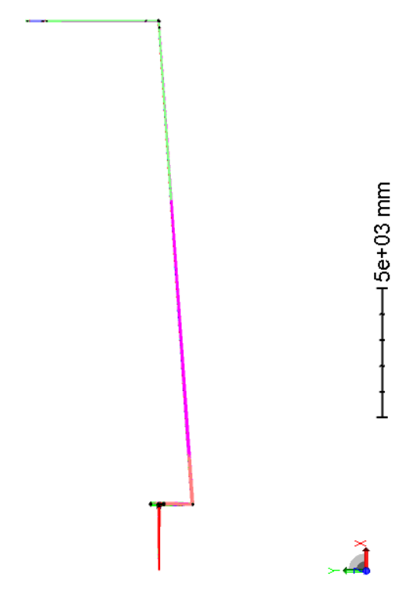
ZEMAX model of LID optics
Top view
Front view
Side view

Slide 8
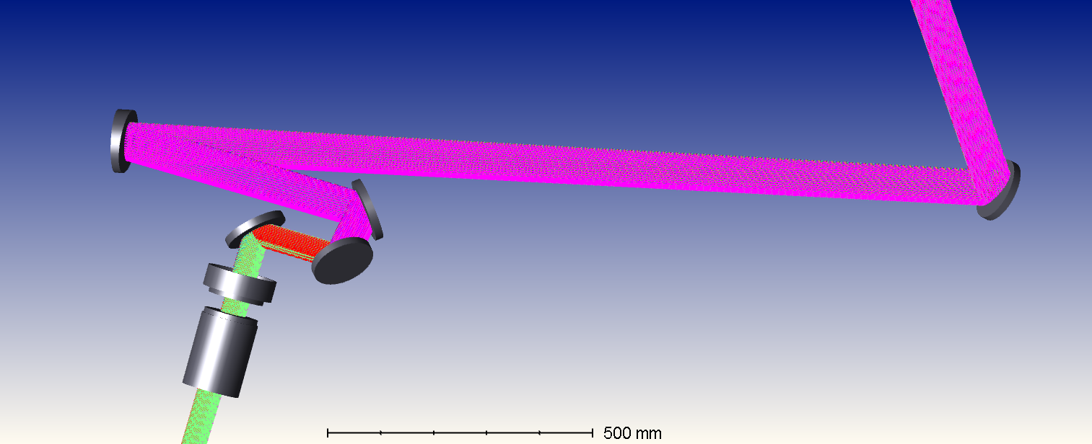
ZEMAX model of LID optics

Slide 9
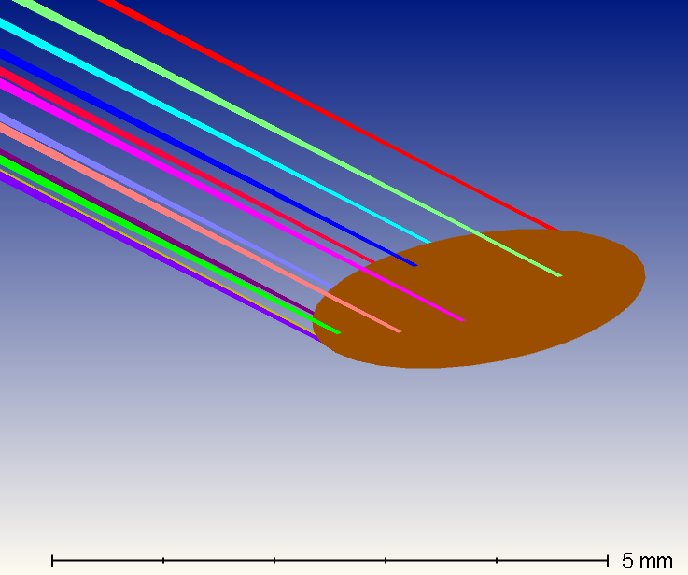
Laser spot shape on Tile 0
Beam shaper 1:1
Beam shaper 0.66:1
90°
90°
41.5°
41.5°

Slide 10
Spot diagram for tile 0

