Slide 1

FZJ Lab activities after shutdown
Activities and Aims Concerning LID Project
18.5.2020 I Miroslaw Zlobinski

Slide 2
Activities in FREDIS
LID study of JET tiles:
LID scans with constant laser parameters
=> aim: identify potential areas with constant D content
Laser parameter variations in areas of constant retention
=> desorption fraction as function of heating temperature/laser energy
=> influence of laser pulse duration on desorption at similar heating temperature
=> influence of elliptic laser spot on desorption

Slide 3
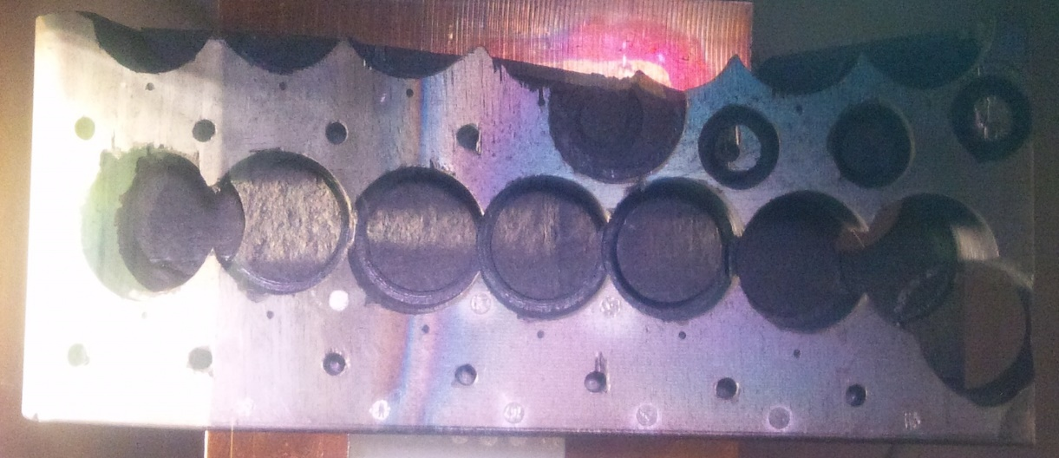
Activities in FREDIS: Example “tile 0” (HFGC 14N LH 2014-2016)
area with constant D content
variations of
laser energy
pulse duration
Ratio of desorbed D to maximum
=> desorption fraction

Slide 4
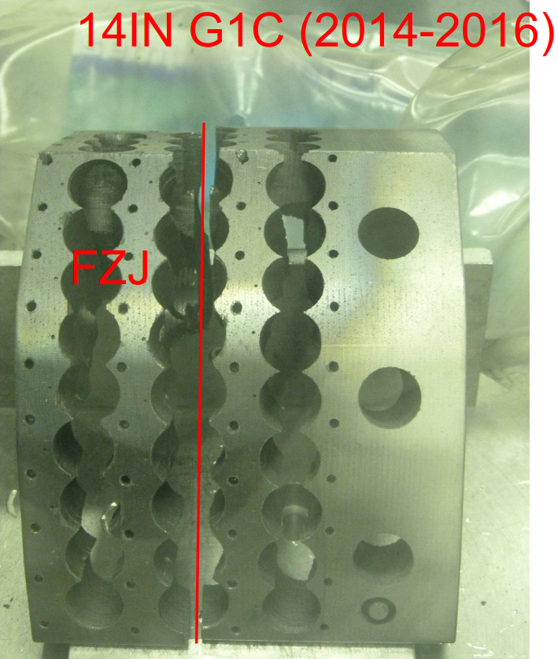
Activities in FREDIS: further JET samples already in FZJ
2XR10 (ILW3)
+ several small samples for TDS
samples with larger constant areas would be useful for more laser parameter variations

Slide 5
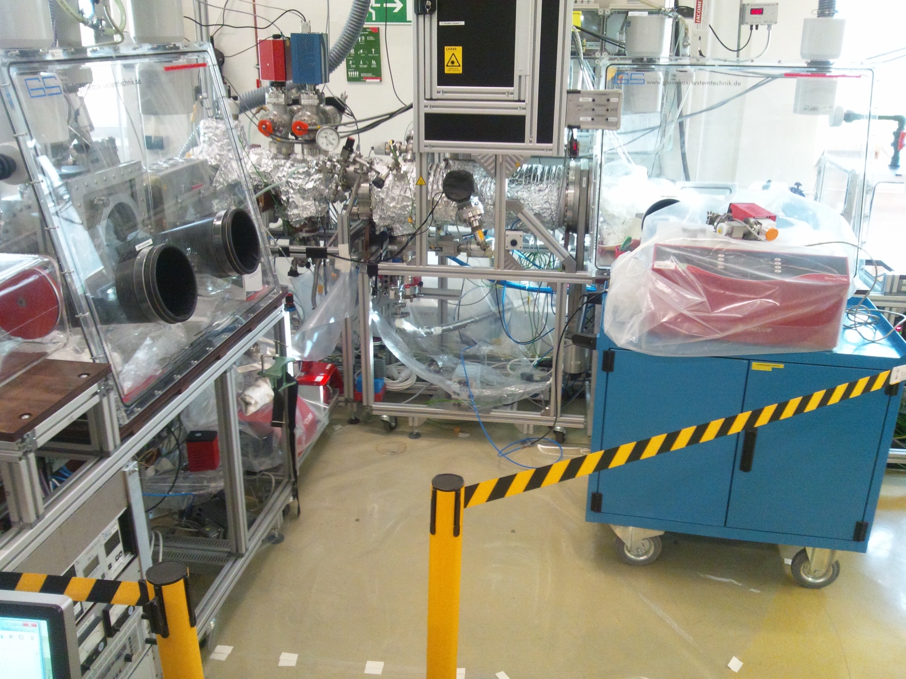
Activities in FREDIS: time plan
FREDIS was modified to be tritium compatible just before FZJ lockdown but is still in beryllium barrier and covered in foil
during lockdown last upgrades arrived (full-metal valves, metal hoses, etc.) to be installed (~ 1 week)
final cleanup of FREDIS exterior from potential Be contamination
take swipe tests
=> wait for their analysis on Be contamination (1-2 weeks)
=> resume LID work at FREDIS
depends on PPE availability
(ca. end of June)

Slide 6
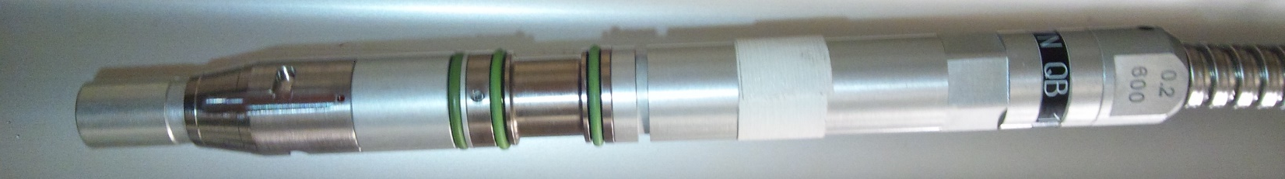
Activities with existing lasers (FLS652N)
2 of these lasers at FZJ (at FREDIS and PSI-2) using 0.6 mm fibre diameter (high performance fibre Optoskand)
fibre compatible with JET optical path must be smaller (~ 0.2 mm fibre)
measure transmission / energy loss for such fibres
aim: assess if Coherent laser with fibre is an option for JET
i.e. if energy transmission high enough
2 approaches:
existing thin optical fibres (to do: preparation incl. fixation/gluing, polishing of the fibre end, measure)
(experience with 0.4 mm fibre and FLS352: 80% transmission)
with high performance fibres (e.g. Optoskand) (to be procured)
available diameters: 0.05 mm, 0.1 mm, 0.15 mm, 0.2 mm, 0.3 mm, 0.4 mm, 0.6 mm, 0.8 mm, 1 mm

Slide 7
Activities with existing lasers (FLS652N)
2 of these lasers at FZJ (at FREDIS and PSI-2) fibre optic cables
Attempt to increase optical beam quality in free air beam (without fibre) i.e. reducing divergence
by means of telescope beam widening
aim: assess if Coherent laser without fibre is an option for JET
i.e. if BPP < 8 mm mrad can be achieved

Slide 8
End

