Slide 1
KT5 sensitivity tests for LIDS-QMS project - restart plans -

Slide 2
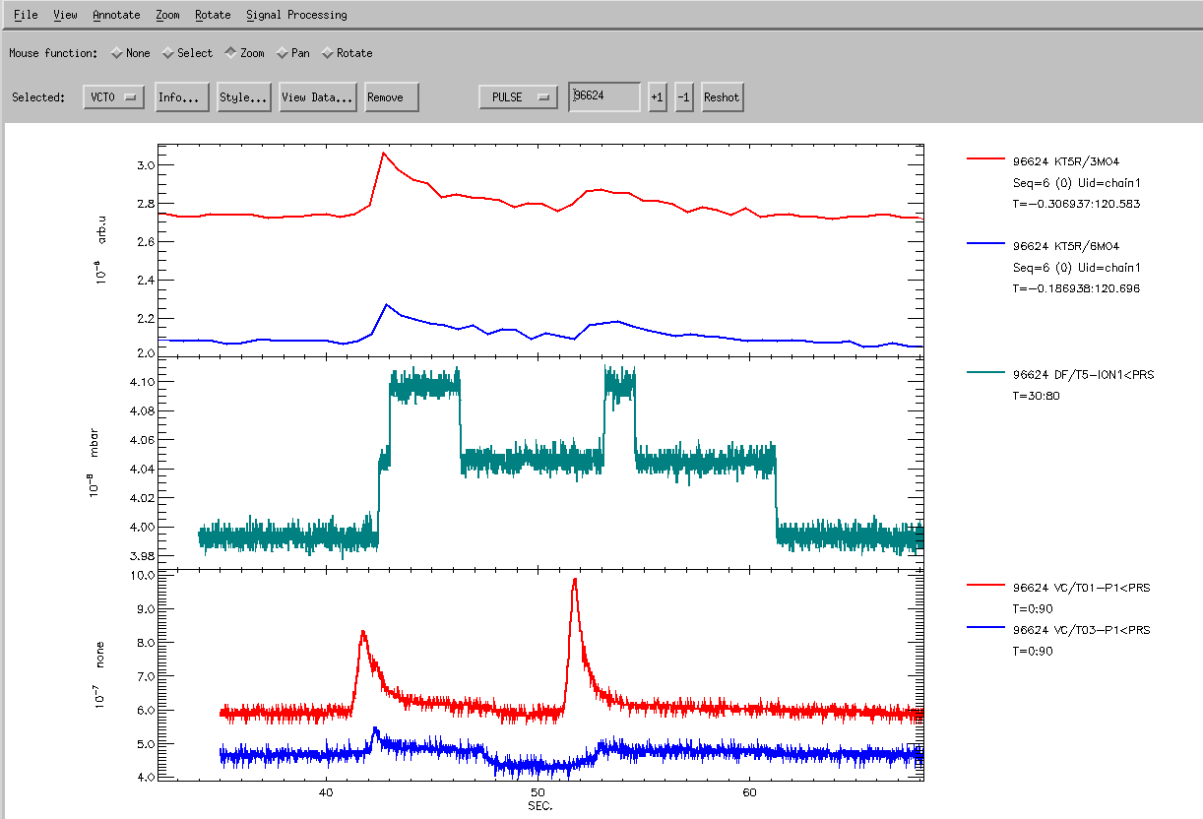
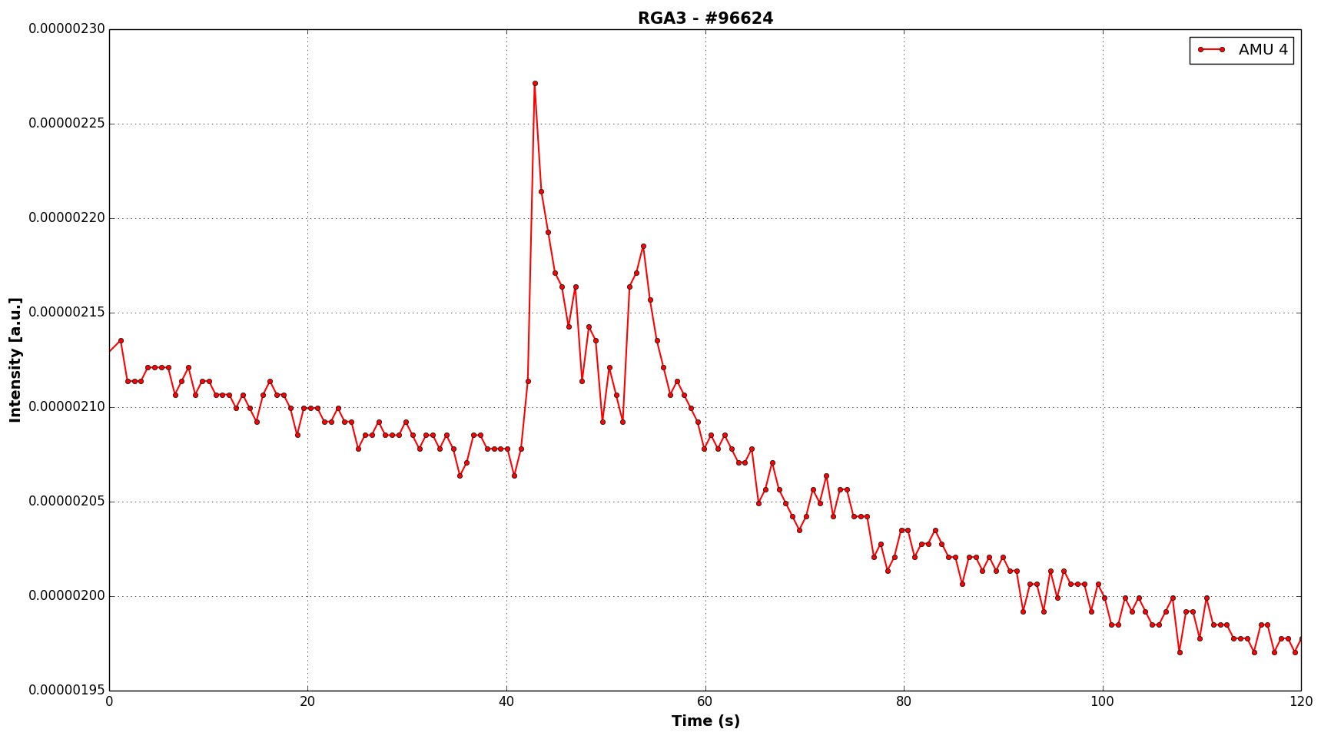
1. Dry run #96624
*LHe in the cryo panels
Background not stable

Slide 3
2. Restart plan – proposed gas puffs
Cryo cold (LHe)
No. | Gas amount (D atoms) | Cryo pump valves | Comment
1(3) | 1.00E+18 | OPEN | similar with dry run #96624 - Monday morning
2(4) | 1.00E+18 | CLOSED
3(1) | Aim 5E+17 & 1E17 | OPEN | 1st puf at 42 sec; 2nd puff at 52 sec
4(2) | Aim 5E+17 & 1E17 | CLOSED | 2nd puf at 42 sec; 2nd puff at 52 sec
Cryo warm (LN)
No. | Gas amount (D atoms) | Cryo pump valves | Comment
1 | 1.00E+18 | OPEN | similar with dry run #96624
2 | 1.00E+18 | CLOSED
3 | Aim 5E+17 & 1E17 | OPEN | 1st puf at 42 sec; 2nd puff at 52 sec
4 | Aim 5E+17 & 1E17 | CLOSED | 2nd puf at 42 sec; 2nd puff at 52 sec
KT5 – OCT8 subdivertor
No. | Manufacturer | Detector type | detection
RGA3 | Hiden | SEM | Profile 3.5-4.5; 0.1 amu
RGA6 | Hiden | SEM | Profile 3.5-4.5; 0.1 amu
RGA7 | Hiden | SEM | MID; amu 2,3,4,18,28
*RGA4 | MKS | SEM | MID; amu 2,3,4,18,28
Main chamber RGAs (*TBD)
No. | Manufacturer/Location | *Detector type | detection
RGA1 | Hiden/OCT1 | SEM/Faraday | Profile 3.5-4.5; 0.1 amu
RGA2 | Hiden/OCT1 | SEM/Faraday | MID; amu 2,3,4,18,28
RGA5 | MKS/OCT6 | SEM/Faraday | MID; amu 2,3,4,18,28
RGA10 | MKS/OCT1 | SEM/Faraday | Profile 3.5-4.5; 0.1 amu

