Slide 1
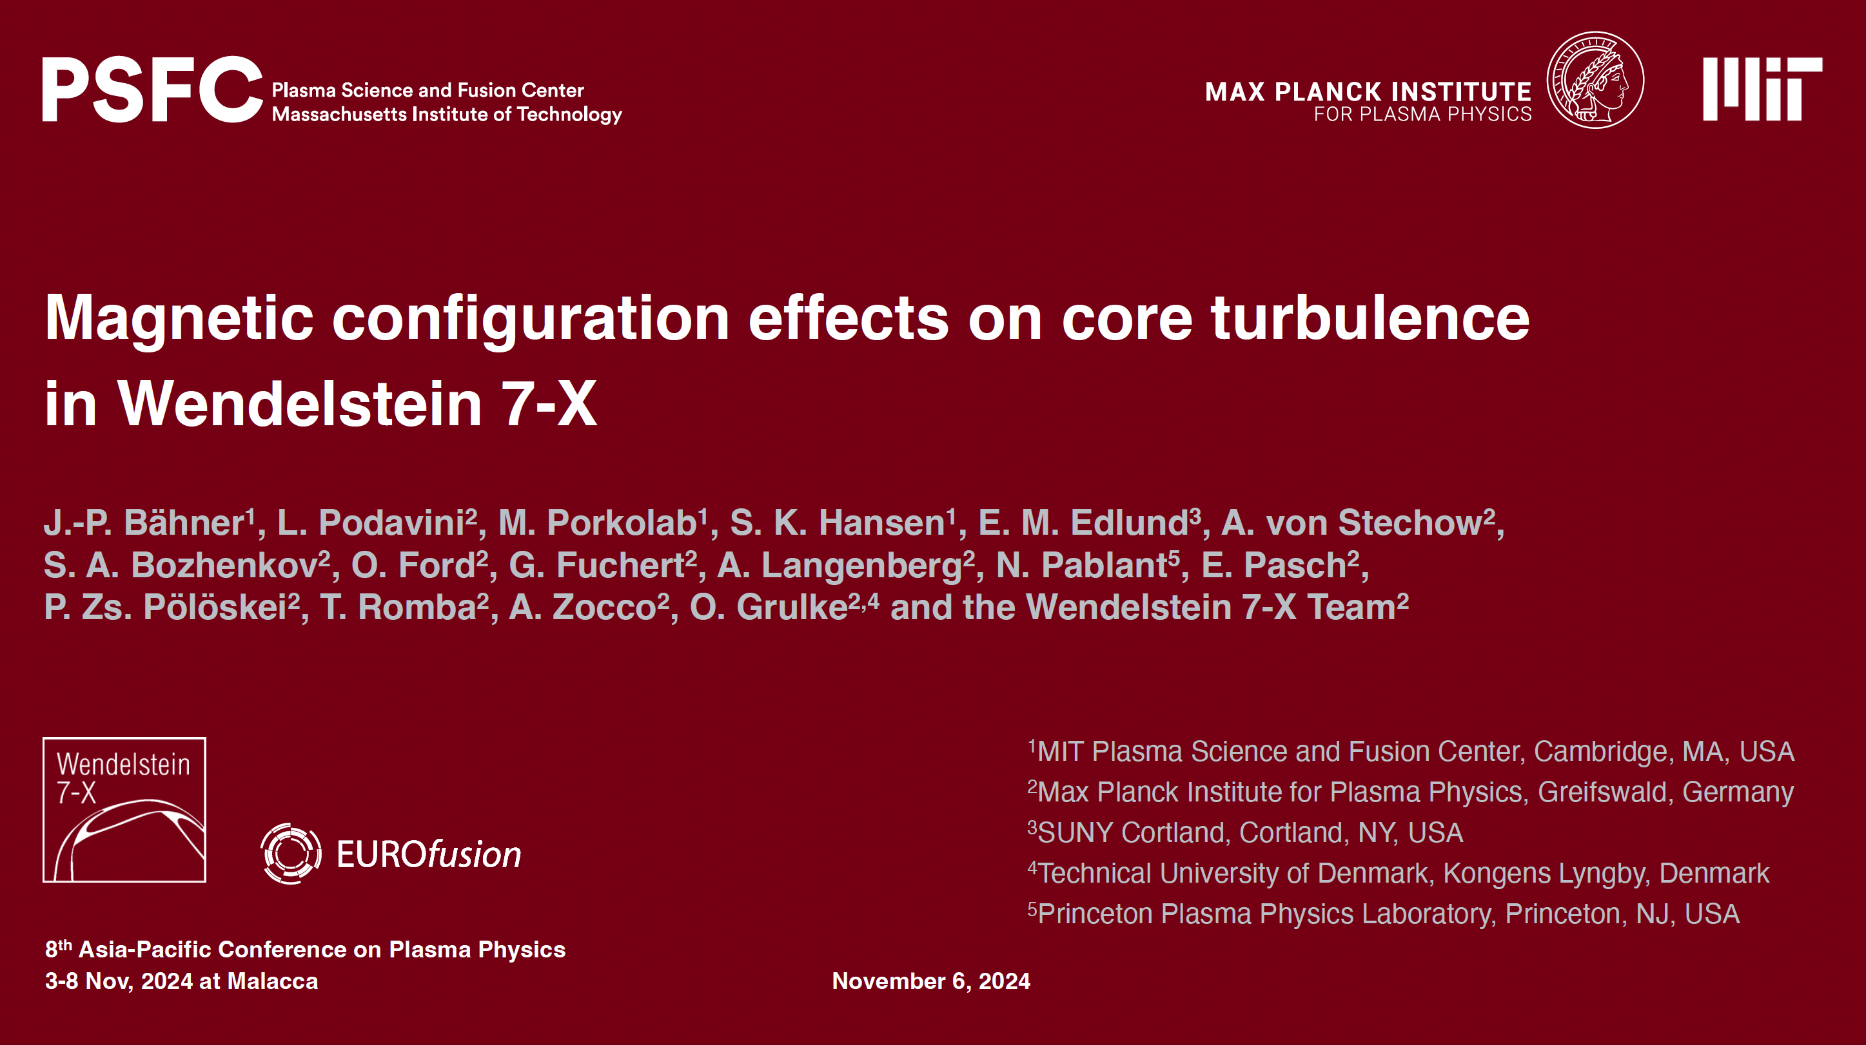
Agenda
# | Title of contribution | Speaker
1 | TSVV13 updates (Reporting) | J. M. García Regaña (CIEMAT)
2 | Gyrokinetic core turbulence simulations on the magnetic configuration effects in W7-X | L. Podavini (IPP-Greifswald)
Next meeting:
December 9 at 11:00 CET (10:00 UK)
J. M. García Regaña | TSVV-13 Meeting 21 | Zoom | 18/11/2024 | Page 1

Slide 2
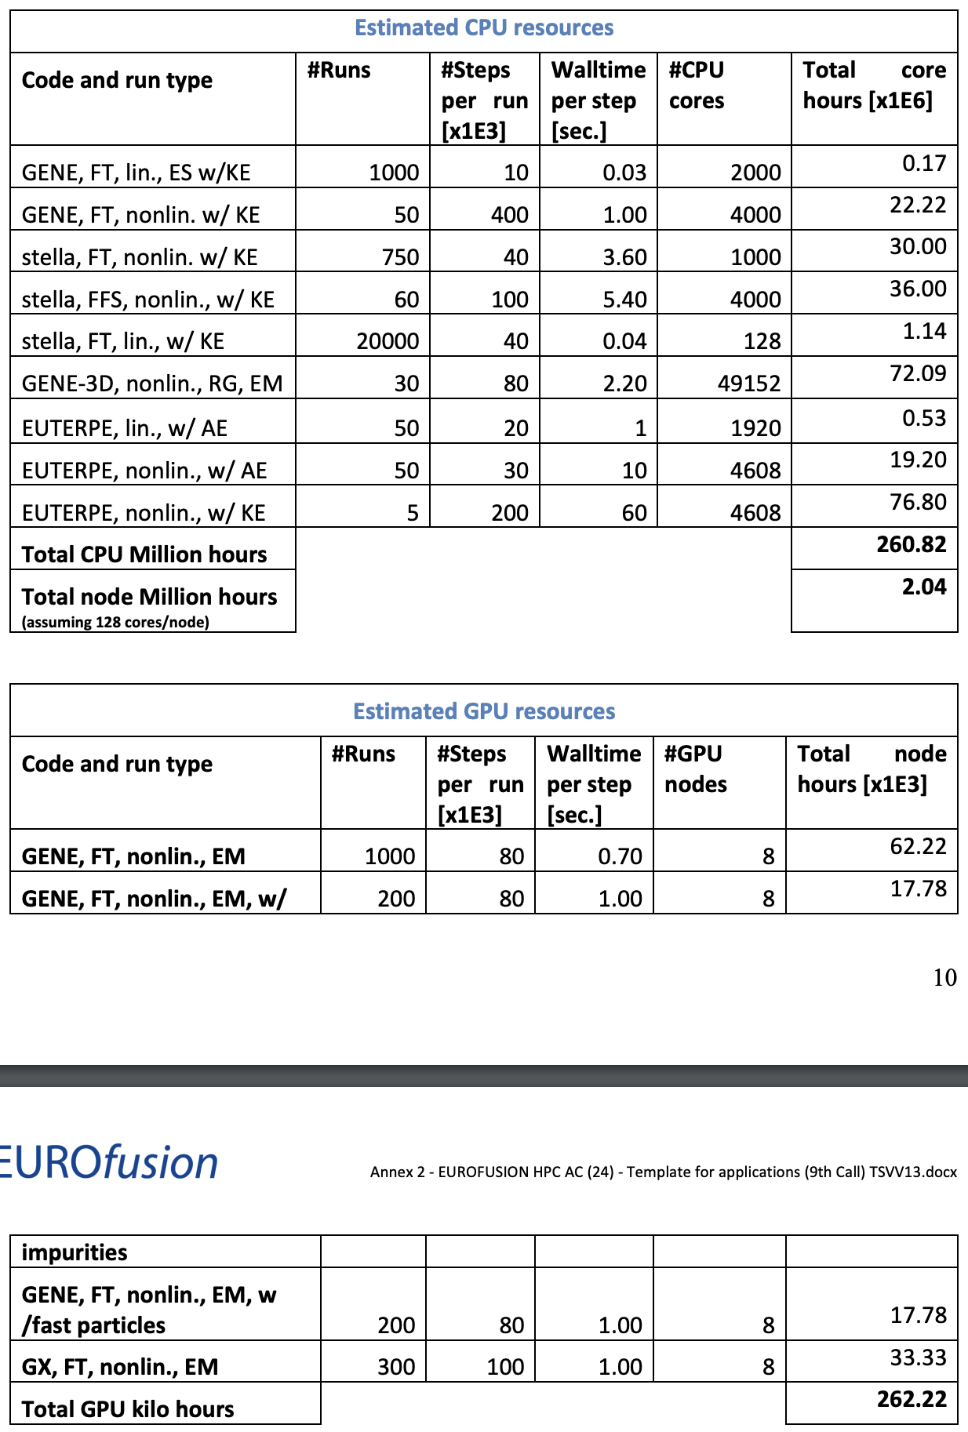
HPC requested resources
J. M. García Regaña | TSVV-13 Meeting 21 | Zoom | 18/11/2024 | Page 2

