Slide 1
Measurements of radial neutral density profiles from Balmer-α emission in Wendelstein 7-X
T. Romba, F. Reimold, O.P. Ford, T.W.C. Neelis, P. Zs. Poloskei, and the W7-X Team§
§ O. Grulke et al 2024 Nucl. Fusion 64 112002

Slide 2
Abstract
Information on the neutral density distribution in a fusion reactor is crucial in view of plasma fueling from the edge. In order to estimate the radial distribution of neutrals in the Wendelstein 7-X stellarator, H emission from electron impact excitation and recombination is measured at multiple locations and matched with calculated emission spectra. In the introduced framework, the neutral density is reduced to a flux surface quantity, limiting the inference to the confined region. The radial neutral density profiles are parameterized by a low number of spline knots which depict the free parameters within the fitting routine.
Inferred neutral density profiles are found to agree within one order of magnitude across the available viewing geometries. Toroidally oriented lines of sight are found to systematically predict lower neutral densities. This observation is attributed to the model simplifications in combination with large differences in integration volumes between the geometries. In accordance with expectations, neutral densities are found to decrease with increasing plasma density. Key restrictions of the model are identified in the reduction of the neutral density to a flux surface quantity, uncertainties in the plasma profiles and instrument function, as well as line integration effects outside the last closed flux surface.

Slide 3
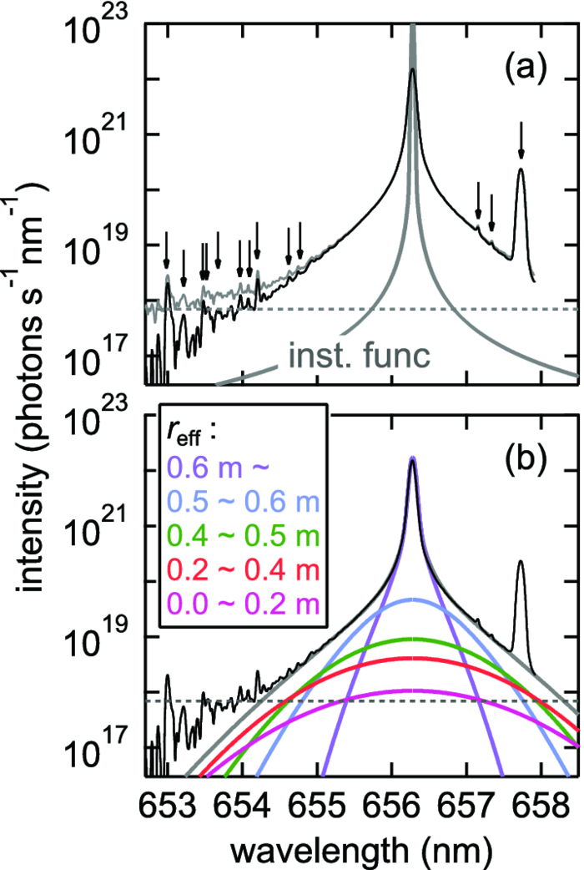
Motivation
Successful measurements of neutral density profiles at LHD from $H_{α}$ emission [5,6,7]
Use localization via $T_{i}=T_{0}$ with
$$σ=λ_{0}\sqrt{\frac{eT_{0}}{mc^{2}}}$$
Dedicated spectrometer with large spectral range
Assume a flux surface constant $n_{0}$
Low $T_{i}$
High $T_{i}$
K Fujii, Rev. Sci. Instrum. 85, 023502 (2014)

Slide 4
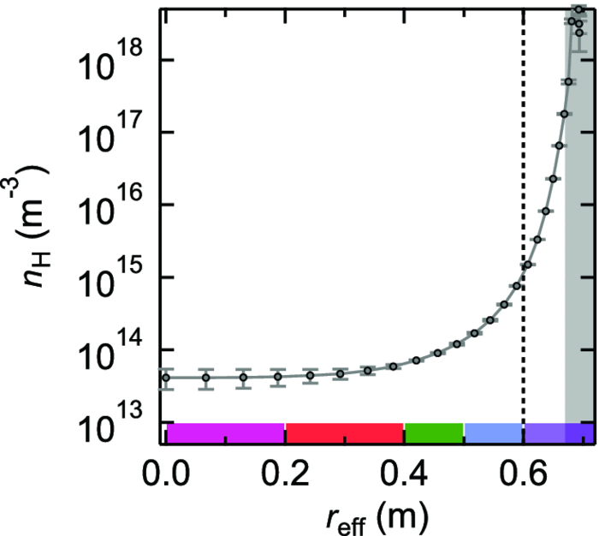
Motivation
Successful measurements of neutral density profiles at LHD from $H_{α}$ emission [5,6,7]
Use localization via $T_{i}=T_{0}$ with
$$σ=λ_{0}\sqrt{\frac{eT_{0}}{mc^{2}}}$$
Dedicated spectrometer with large spectral range
Assume a flux surface constant $n_{0}$
LCFS
K Fujii, Rev. Sci. Instrum. 85, 023502 (2014)

Slide 5
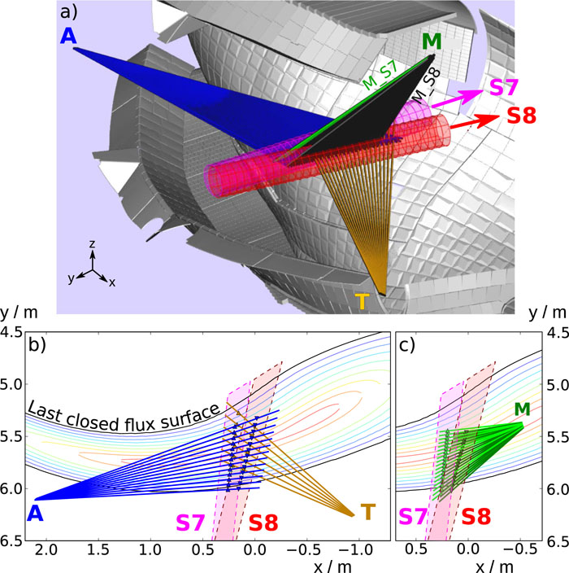
Approach
Misuse spectrometer normally used for beam emission measurements
Challenges to face:
Account for instrument function effects
Inferior dynamic range to one used at LHD
Deal with cold component of $H_{α}$ emission
Result:
Neutral density profile in the outer half of the plasma
O Ford, Rev. Sci. Instrum. 91, 023507 (2020)

Slide 6
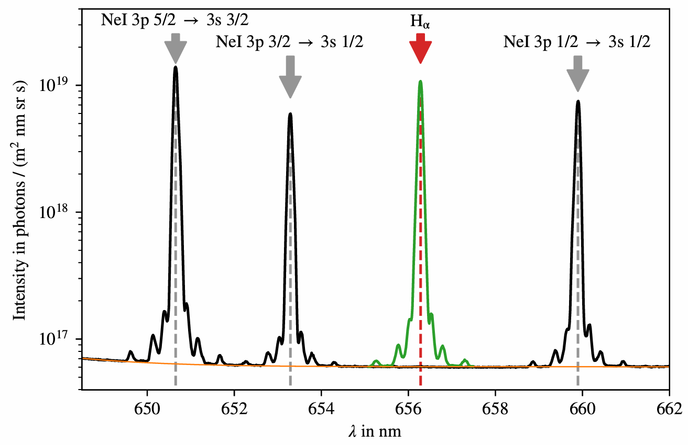
Instrument function
Instrument function convolved into measurement
No measured instrument function at the $H_{α}$ transition at $656.28nm$
Interpolate one from Neon pencil lamp measurements

Slide 7
Spectral fitting
Assuming a flux constant $n_{0}$, the plasma emission is given by:
$$I_{H_{α}}\left(λ\right)=\int_{LoS}{\sum_{FS}{n_{e}\left(l\right)⋅\left(n_{0}\left(l\right)⋅{\left\langle σv\right\rangle }_{eie}+n_{i}\left(l\right)⋅{\left\langle σv\right\rangle }_{rec}\right)}}⋅\frac{1}{\sqrt{πσ_{FS}^{2}}} exp\left[−\frac{{\left(λ−λ_{FS}\right)}^{2}}{σ_{FS}^{2}}\right]dl$$
Electron impact excitation
Recombination

Slide 8
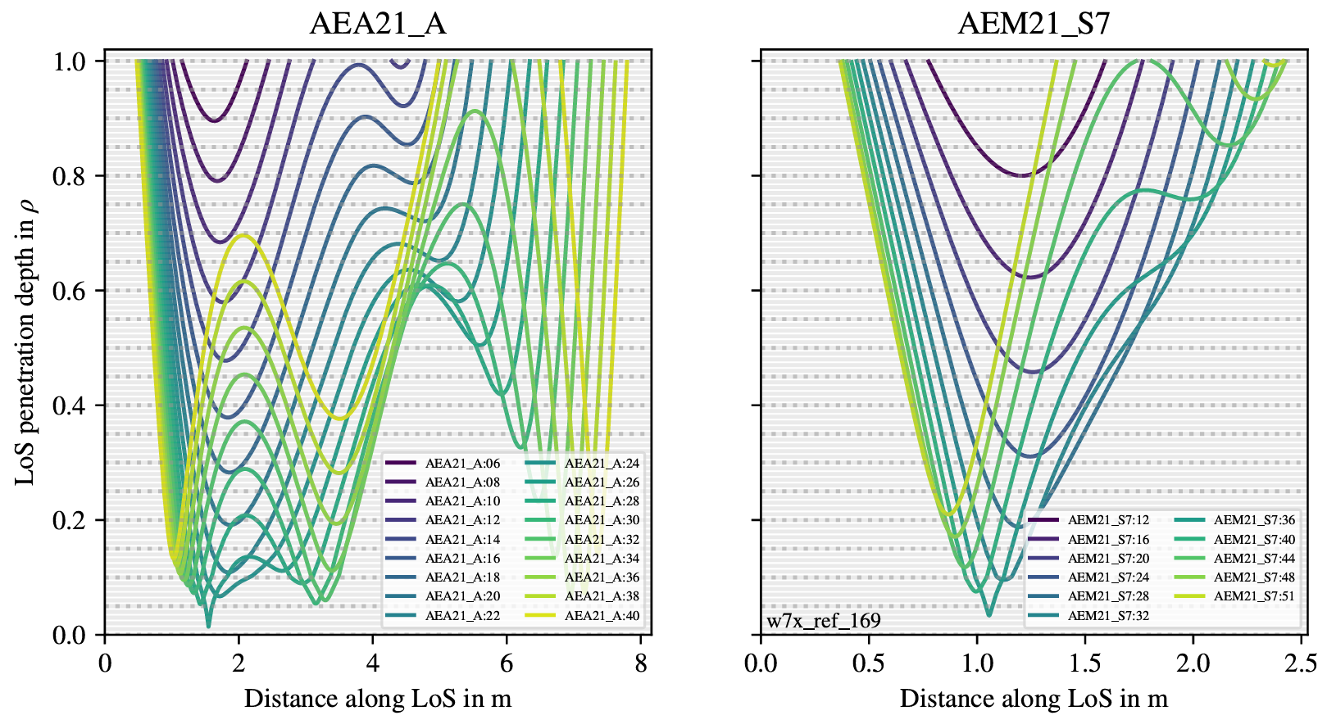
Line of sight geometry

Slide 9
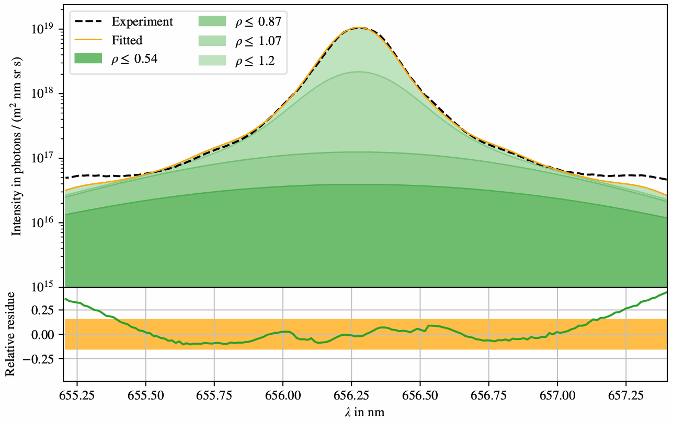
Spectral fitting
20180920.017
Assuming a flux constant $n_{0}$, the plasma emission is given by:
$I_{H_{α}}\left(λ\right)=\int_{LoS}{\sum_{FS}{n_{e}\left(l\right)⋅\left(n_{0}\left(l\right)⋅{\left\langle σv\right\rangle }_{eie}+n_{i}\left(l\right)⋅{\left\langle σv\right\rangle }_{rec}\right)}}⋅\frac{1}{\sqrt{πσ_{FS}^{2}}} exp\left[−\frac{{\left(λ−λ_{FS}\right)}^{2}}{σ_{FS}^{2}}\right]dl$
Each line of sight assessed individually
Low sensitivity of fit to high temperature components
Monotonically decreasing $n_{0}$ with five free spline nots

Slide 10
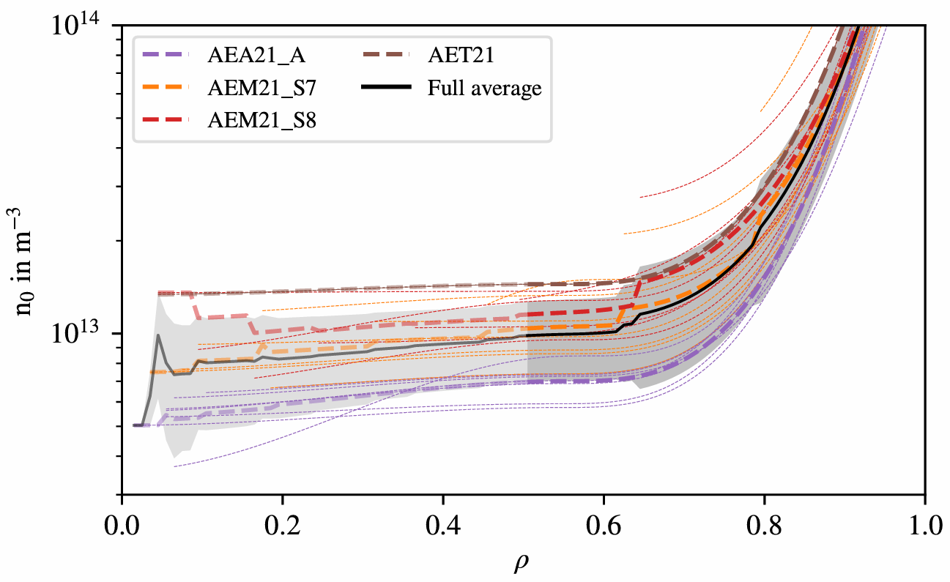
Neutral density profiles
Doubtable values inside half radius due to low sensitivity of fit to high temperature region
Systematic deviations between line of sight fans
20180920.017

Slide 11
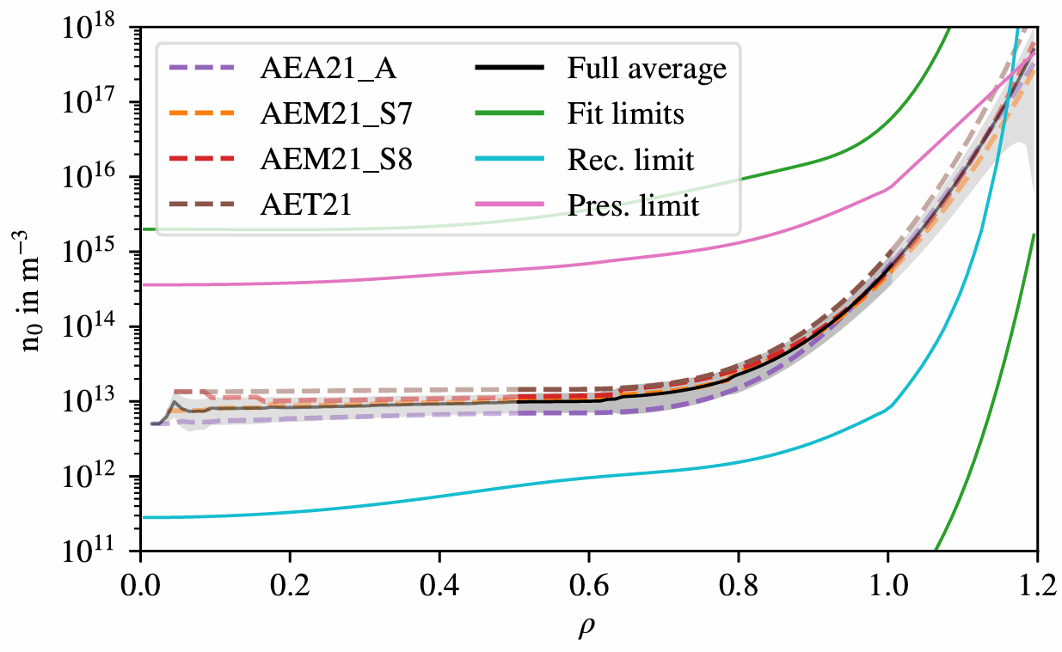
Neutral density profiles
Doubtable values inside half radius due to low sensitivity of fit to high temperature region
Systematic deviations between line of sight fans
Nonsensible values outside confined region
Determined values found to lie inside sanity check
20180920.017

Slide 12
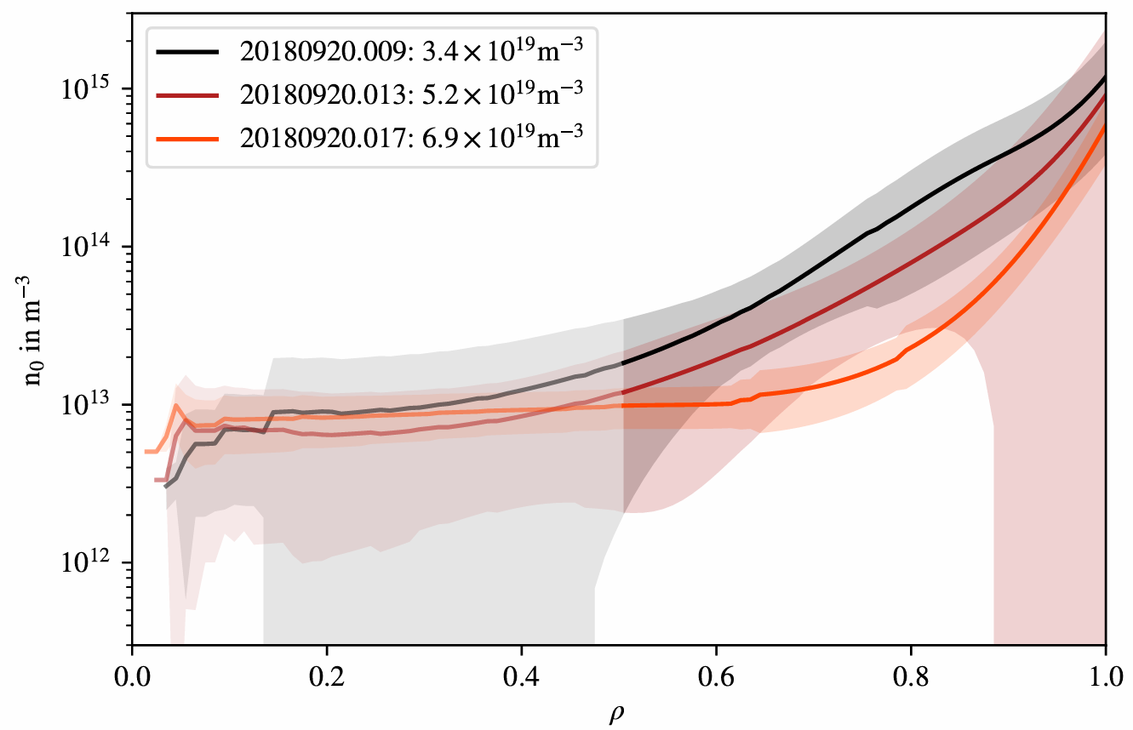
Reaction to change in plasma density
Neutral density found to decrease with increasing plasma density
Associated to high plasma collisionality
Indication of increased $τ_{p}$ with increasing density

Slide 13
Summary
Analysis of neutral density profiles from $H_{α}$ emission assessed for W7-X
Main assumption of flux surface constant neutral density
Validity restricted to outer half of the confined region
Obtained densities within sanity check range
Reaction of profile to increase in electron density

Slide 14
Summary
Analysis of neutral density profiles from $H_{α}$ emission assessed for W7-X
Main assumption of flux surface constant neutral density
Validity restricted to outer half of the confined region
Obtained densities within sanity check range
Reaction of profile to increase in electron density
→ PhD topic with O. Ford (E3)

Slide 15
Backup

Slide 16
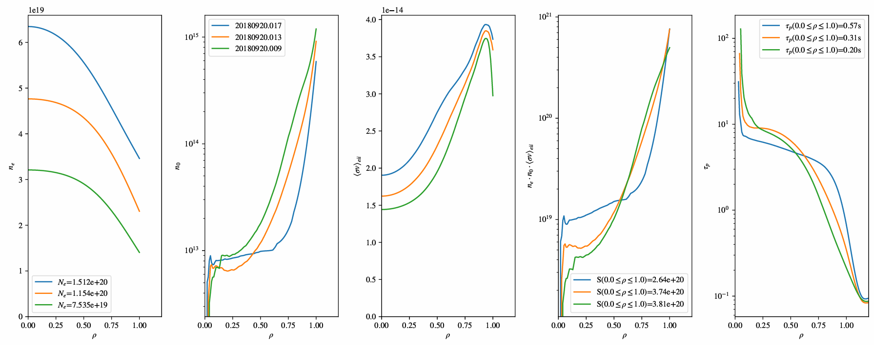
Coarse assessment of $τ_{p}$

