Slide 1
WP Wendelstein 7-X Brainstorming 2026-2027
2026-2027 Brainstorming
Marcin Jakubowski (TFL), Arturo Alonso (DTFL), Ivan Calvo (DTFL)
Juliane Haese (PSO)

Slide 2
Present structure of WP W7-X
2024-W7X-2.1: W7-X Campaigns
2024-W7X-2.2: Scientific Preparation of Campaigns
2024-W7X-2.3: Scientific Exploitation
2024-W7X-3.1: Support of Enhancement Projects
2024-W7X-3.2: Diagnostics Developments
2024-W7X-3.3: Support actions for EU Components and W7-X
2024-W7X-5.1: Coordinated Working Group
2024-W7X-5.2: ITER (linked to FSD-PrIO)
2024-W7X-5.3: DEMO & HELIAS Basis (linked to FTD)

Slide 3
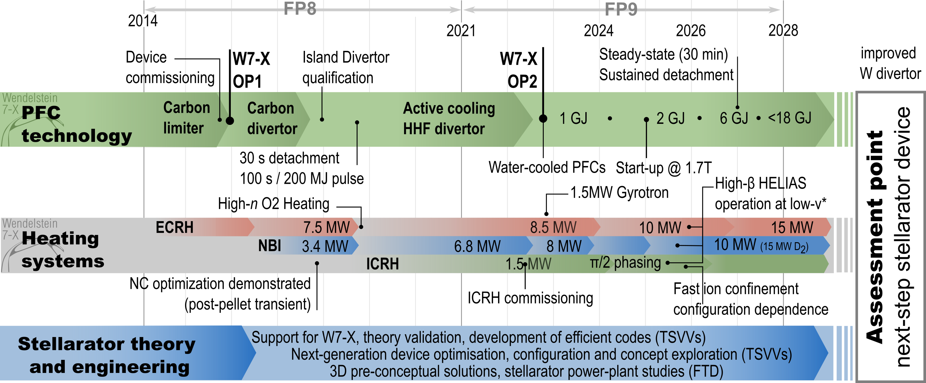
Mission of W7-X: Demonstrate HELIAS maturity towards the reactor
OP2.4 OP2.5

Slide 4
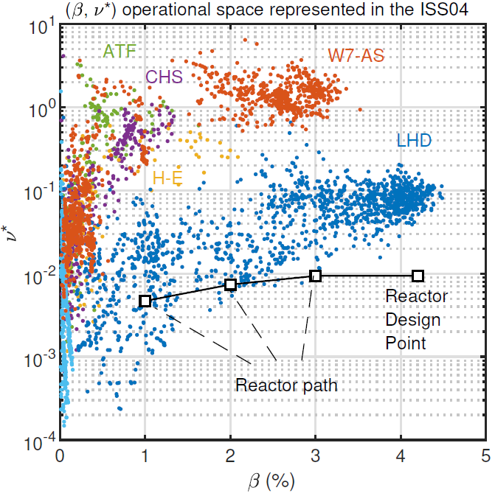
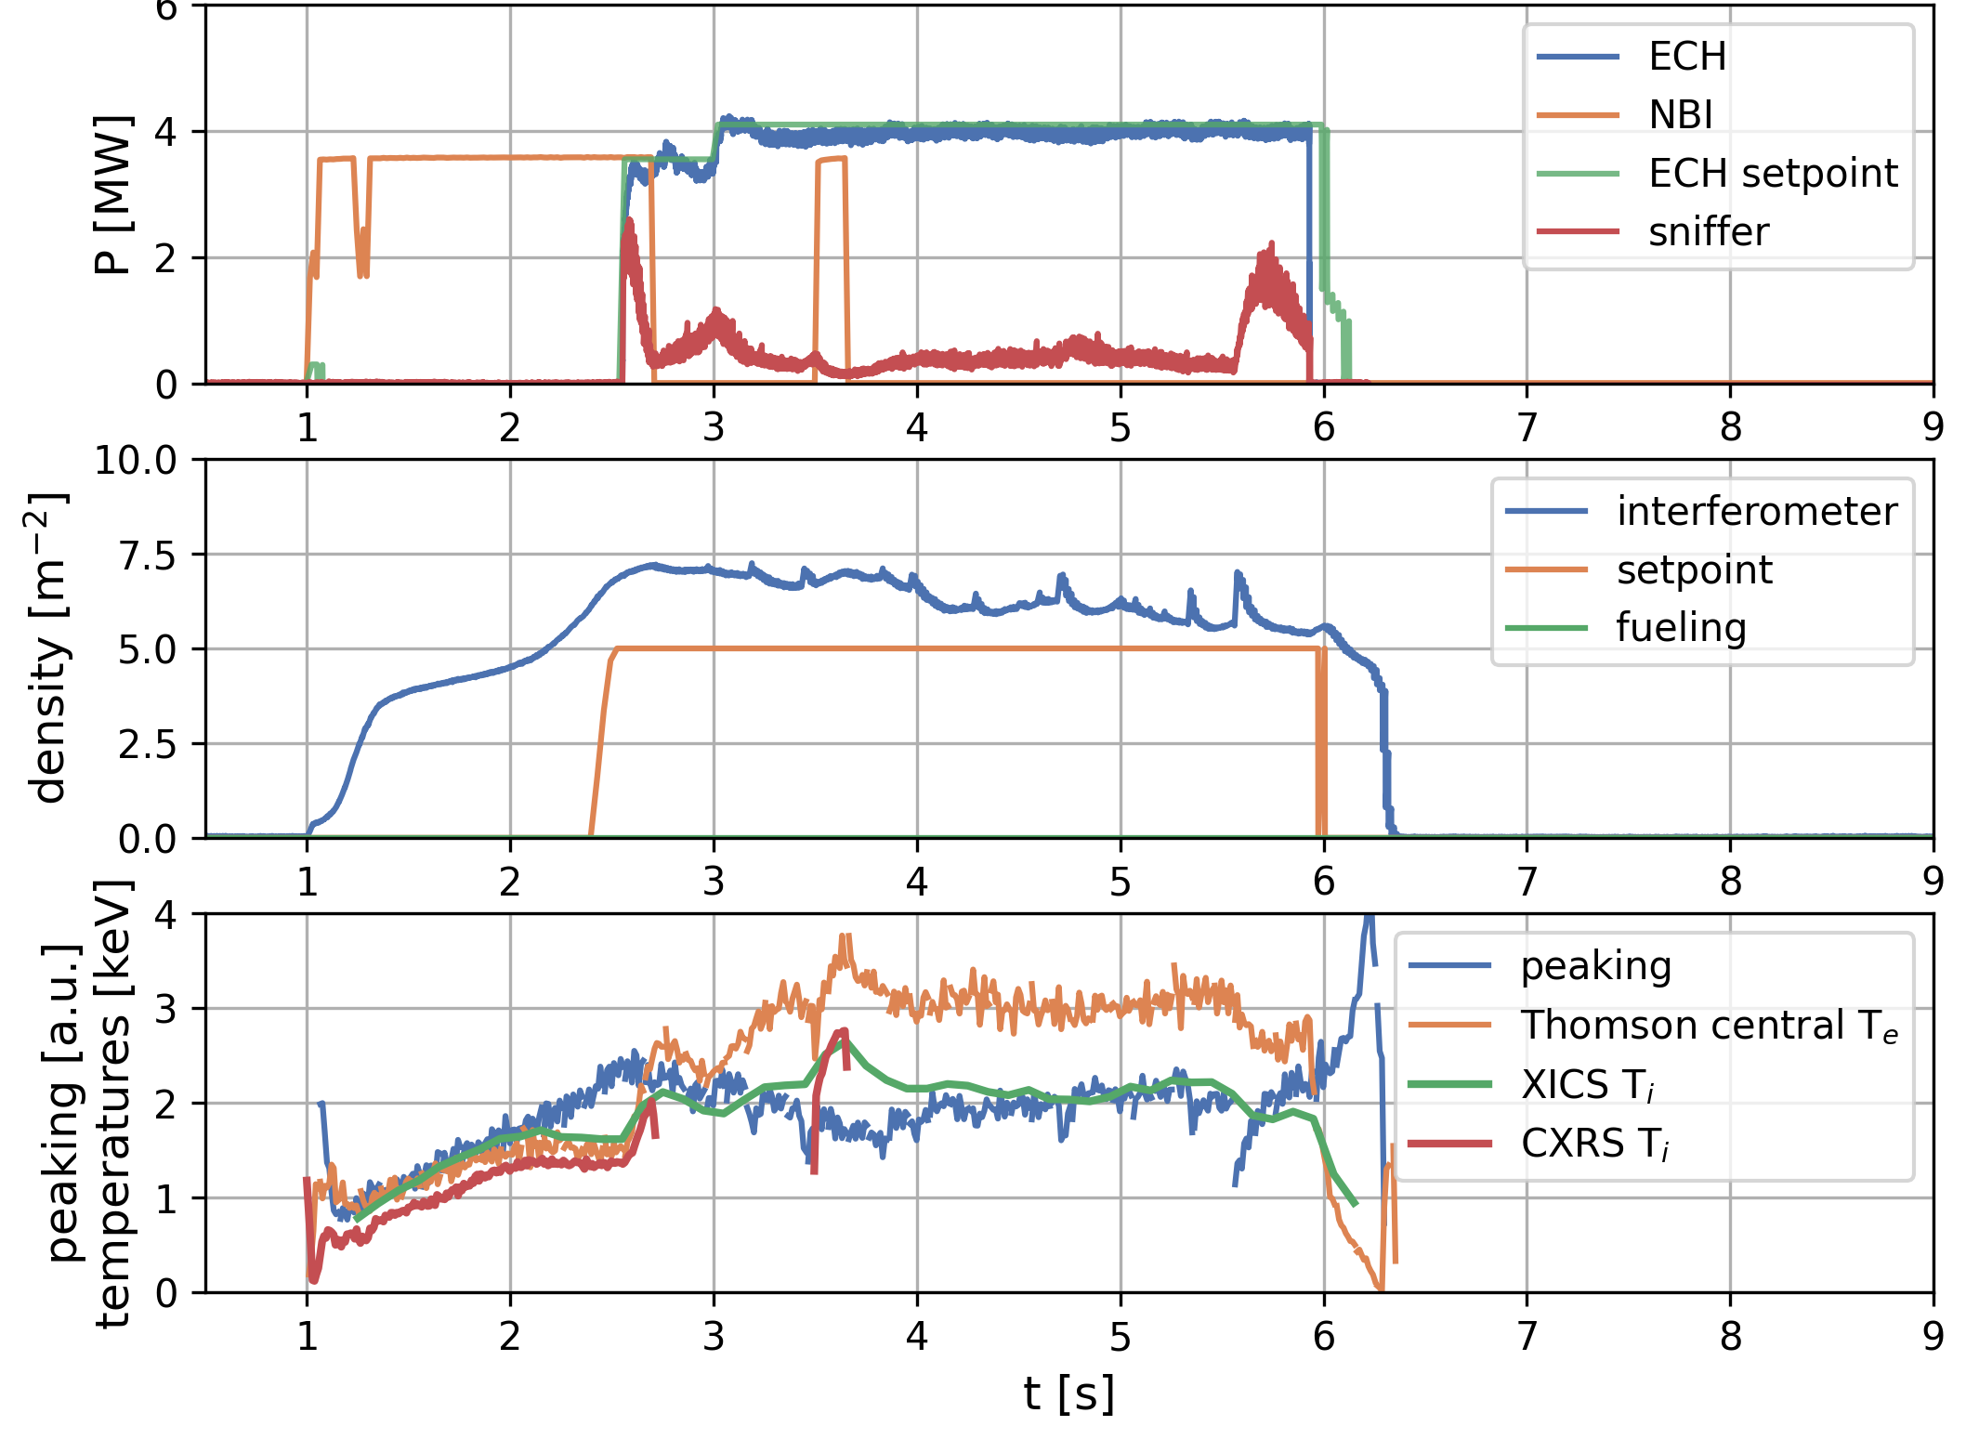
Development of low-B scenarios at W7-X
Successful development of low-B scenarios at W7-X
Low-B operation at W7-X allows an easier access to high-β, low-ν* operation, potentially close to reactor design values. Requires additional heating!!
2025
2026
2027
W7-X
<OP2.2
W7-X
OP2.3
W7-X
OP2.4
W7-X
OP2.5

Slide 5
Development of new gyrotrons
Development of 2 MW gyrotron
Short pulse tests at KIT
Enhance cavity cooling up to 25 MW/m²
Prototype production should start end of 2026

Slide 6
High level objectives - core physics
Development of fast ion scenarios (ICRH & NBI):
Heating the plasma with ICRH
Minority heating and tri-ion heating
Modelling of fast ions (incl. validation)
Improve modelling efforts for both edge & core turbulence (TE community)?
3d topology of W7-X (incl. magnetic islands)
Validate existing codes (also local simulations) at high beta
Behaviour of impurities (incl. tungsten) in high beta/good confinement plasmas

Slide 7
High level objectives - boundary physics
Enhance understanding of island divertor physics, including heat and particle exhaust, neutral compression, and edge turbulence.
Molecular spectroscopy
Integrate drifts into EMC3-Eirene simulations for better predictions (starting already in 2025)
Neutral compression / helium exhaust
Impurity behavior & control in steady-state
ERO modeling for erosion (W), migration (N₂,C),
impurity measurements
Use of novel methods for divertor surveillance (steady-state, synergy with PrIO)

Slide 8
Key physics issues
WP W7-X in FP9 is already significantly aligned with the goal of advancing the HELIAS-type reactor's maturity.
In 2026/2027 there will be two experimental campaigns (OP2.4 & 2.5) where we want to support preparation, participation and exploitation.
Increased input power and low-field operation allow access to previously inaccessible regimes for core physics & island divertor exhaust studies.
By 2025, the HELIAS Gaps Group will provide additional recommendations for the W7-X scientific program, which should inform the structure of WP W7-X.

Slide 9
HELIAS gaps
In 2025 a group of experts will define gaps between present day status of HELIAS line and future reactor needs
Heat and particle exhaust in the island divertor
MHD equilibrium and stability
Core transport and confinement
Fast particle confinement and interaction with Alfvén waves
Plasma-wall interaction
Scenario integration
The outcome should clearlify identify issues, which can be adddressed at W7-X. This will also influence structure of the tasks for WP W7-X

