Slide 1
The infrared imaging video bolometer at Wendelstein 7-X Paper rehearsal
G. Partesotti*, G. A. Wurden, F. Reimold, B. J. Peterson, F. Federici, K. Mukai, K. A. Siever, J. von Miller, D. Zhang, A. Demby, and the W7-X Team.

Slide 2
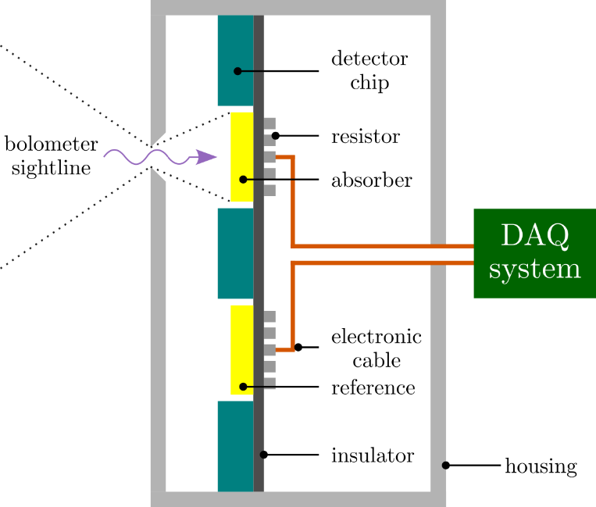
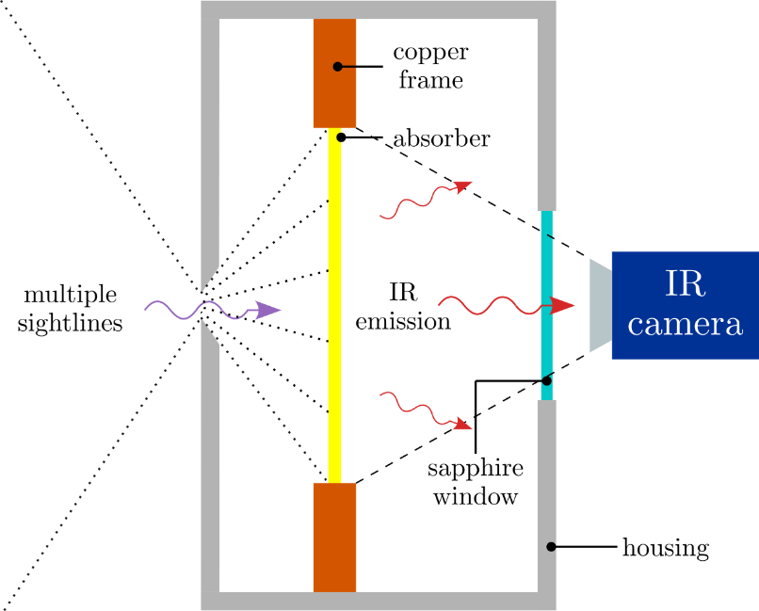
I. Introduction
Measurements of plasma radiation are essential for power exhaust and physics studies
Bolometers are a consolidated diagnostic to measure plasma radiated power
Plasma radiation $→$ measure temperature rise $→$ calculate absorbed power
Resistive bolometers: measure electrical resistance of resistor thermally connected to absorber
Imaging bolometers: image temperature distribution on foil using high-resolution IR camera
InfraRed (imaging) Video Bolometer: IRVB
resistive
imaging

Slide 3
Overview
Introduction
The IRVB design at W7-X
Measurement procedure
Interpolation to foil reference frame
Calibration of the foil thermal properties
Experimental results
Conclusions

Slide 4
Overview
Introduction
The IRVB design at W7-X
Measurement procedure
Interpolation to foil reference frame
Calibration of the foil thermal properties
Experimental results
Conclusions

Slide 5
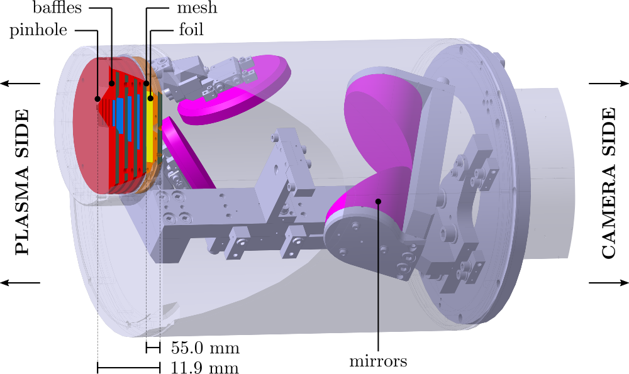
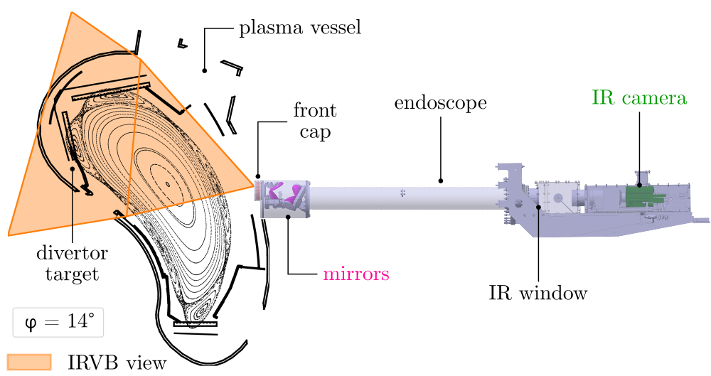
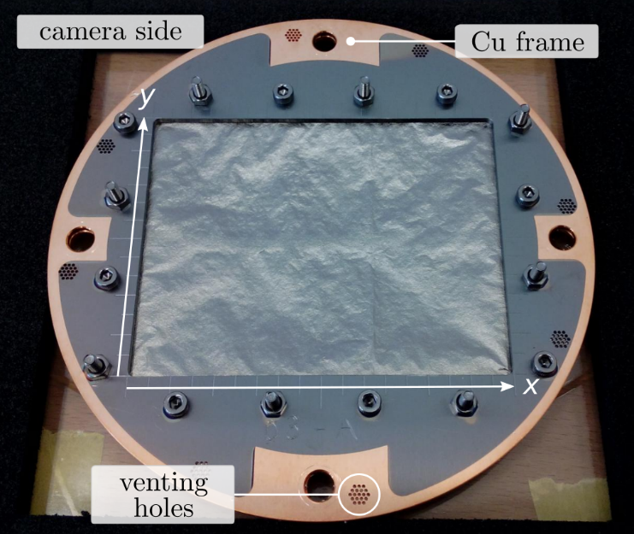
II. The IRVB design at W7-X
Large (7cm $×$ 9cm) 5$μ$m-thick gold foil
C-coated on both sides with CVD
5mm $×$ 5mm square pinhole
Foil housed inside steel endoscope
Four Al-plated mirrors used for imaging IR radiation
IR camera placed at endoscope back (TH)

Slide 6
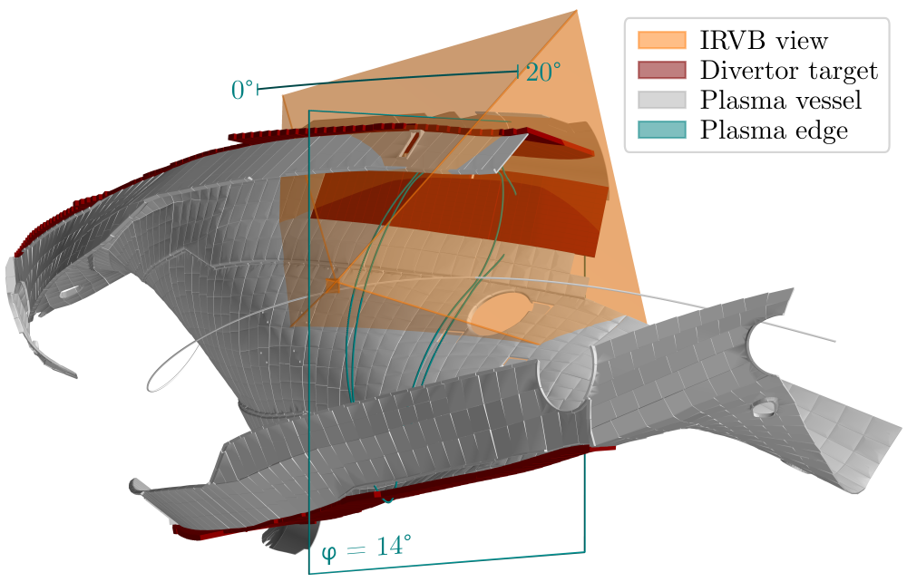
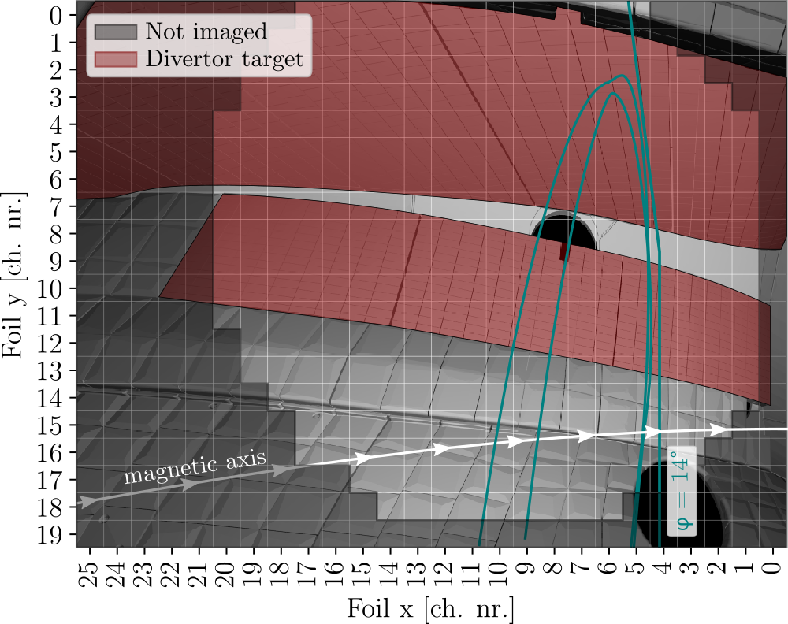
II. The IRVB design at W7-X
Measure plasma radiated power on the upper divertor unit, module 51 (AEK51 port)
Wide collection angle of 40° poloidal $×$ 68° toroidal. Coverage in the toroidal range $φ=0°−20°$.
View limited to upper portion of plasma cross-section and low-iota section of divertor target plates
Define 20$×$26 pixel grid on foil surface (total of 520 channels of 3.3mm $×$ 3.3mm size)

Slide 7
Overview
Introduction
The IRVB design at W7-X
Measurement procedure
Interpolation to foil reference frame
Calibration of the foil thermal properties
Experimental results
Conclusions

Slide 8
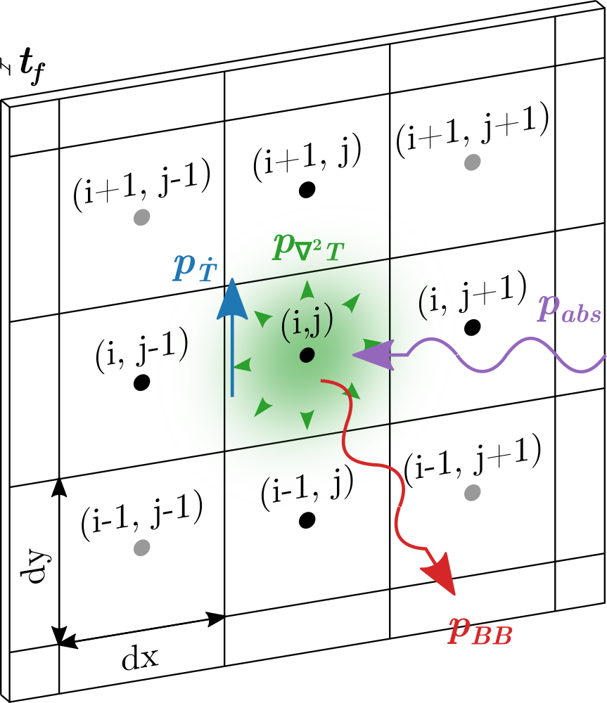
III. Measurement procedure
IRVB channels (pixels) are not independent
Heat diffusion on the foil surface and black body radiation need to be accounted for
The incident radiation power $p_{abs}$ is calculated by solving a 2D heat transfer equation [1]
$p_{abs}=p_{∇^{2}T}+p_{BB}+p_{\dot{T}}$
$p_{∇^{2}T}=−\frac{1}{S}\left[\frac{d^{2}T}{dx^{2}}+\frac{d^{2}T}{dy^{2}}\right]$
$p_{BB}=2εσ_{SB}\left(T^{4}−T_{0}^{4}\right)$
$p_{\dot{T}}=\frac{1}{κS}\frac{dT}{dt}$
Thermal properties of the foil need to be calibrated
Three calibration coefficients: $ε, κ, S$
[1] B.J. Peterson et al. RSI 2000

Slide 9
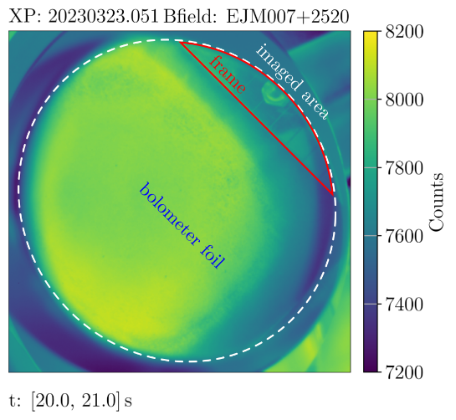
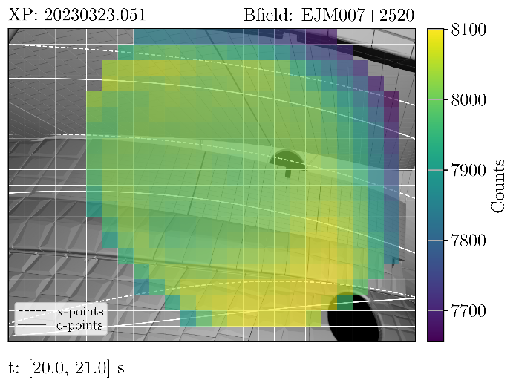
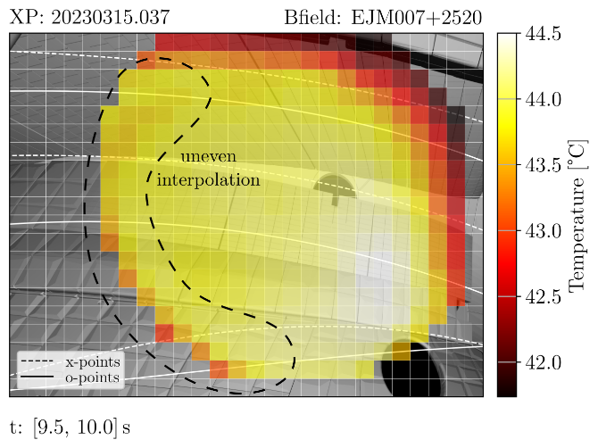
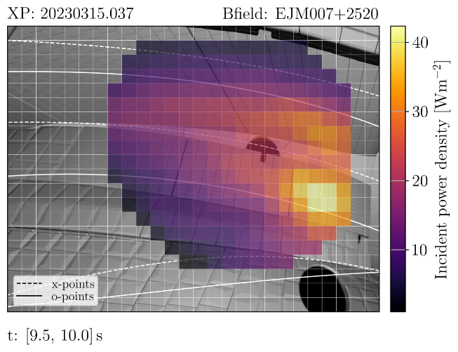
III. Measurement procedure
Main steps in the IRVB data analysis:
The measured counts data is mapped from the IR camera image to the foil pixels
The counts are converted to temperature $T$ using camera conversion coefficients
The 2D heat transfer equation is applied to calculate the absorbed power $p_{abs}$
$p_{abs}$ is the bolometer measurement (line-integrated power)
Units of power density on foil surface (Wm⁻²)
Counts on IR camera
Counts on foil view
$T$ on foil view
$p_{abs}$on foil view
1
2
3

Slide 10
Overview
Introduction
The IRVB design at W7-X
Measurement procedure
Interpolation to foil reference frame
Calibration of the foil thermal properties
Experimental results
Conclusions

Slide 11
IV. Interpolation to foil reference frame
Foil is only partially imaged due to mirror magnification being too large
Only one portion of the Cu frame is visible
Data values on the foil surface need to be assigned to the correct bolometer channel

Slide 12
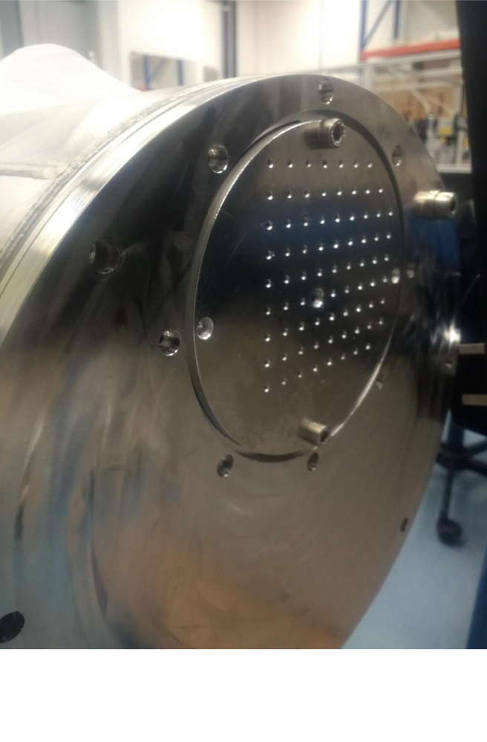
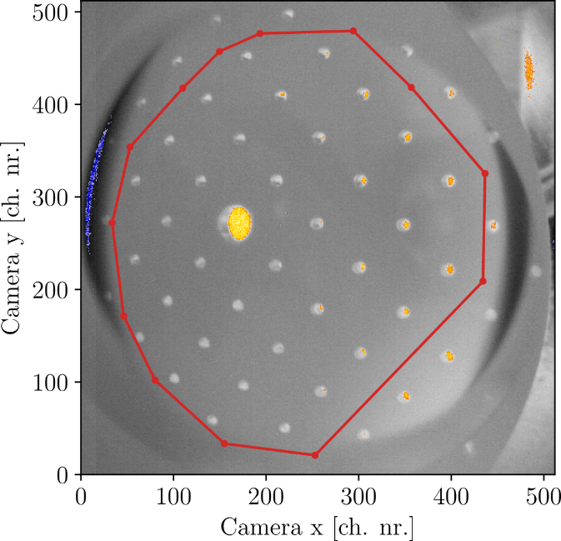
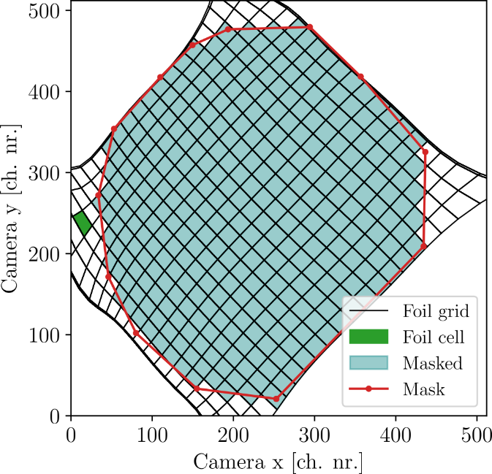
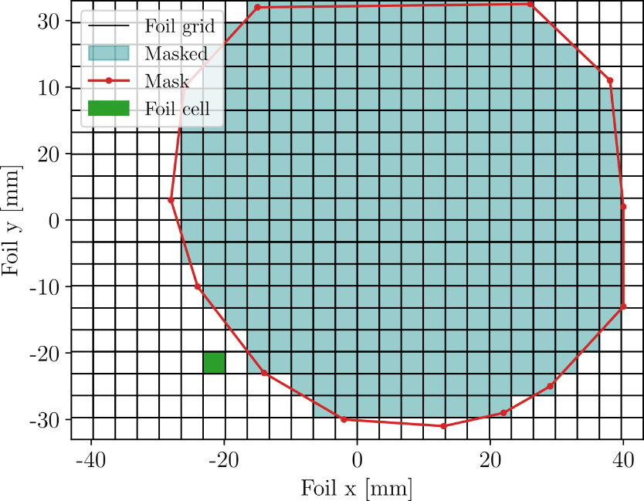
IV. Interpolation to foil reference frame
Interpolation from high-resolution camera view to bolometer pixel grid (20 $×$ 26 channels)
Effect of optics estimated using a calibration plate with regularly spaced holes
Bivariate spline interpolation used to go from camera view to foil view (and vice versa)
Interpolation accuracy gets worse near edge of the view
A mask is used to select acceptable pixels.

Slide 13
IV. Interpolation to foil reference frame
Foil is only partially imaged due to mirror magnification being too large
Only one portion of the Cu frame is visible
Data values on the foil surface need to be assigned to the correct bolometer channel

Slide 14
IV. Interpolation to foil reference frame
Conversion counts-to-temperature using camera calibration
Some features can be identified in the temperature distribution
The features seem to follow a different thermal response
Probably due to bad interpolation

Slide 15
Overview
Introduction
The IRVB design at W7-X
Measurement procedure
Interpolation to foil reference frame
Calibration of the foil thermal properties
Experimental results
Conclusions

Slide 16
V. Calibration of the foil thermal properties
2D heat transfer equation:
$p_{abs}=p_{∇^{2}T}+p_{BB}+p_{\dot{T}}$
$p_{∇^{2}T}=−\frac{1}{S}\left[\frac{d^{2}T}{dx^{2}}+\frac{d^{2}T}{dy^{2}}\right]$
$p_{BB}=2εσ_{SB}\left(T^{4}−T_{0}^{4}\right)$
$p_{\dot{T}}=\frac{1}{κS}\frac{dT}{dt}$
Three coefficients need to be calibrated:
Emissivity ($ε$): power absorption and radiative cooling
Heat diffusivity ($κ$) [m²s⁻¹]: temperature gradients
Heat sensitivity ($S$) [KW⁻¹]: magnitude of thermal response

Slide 17
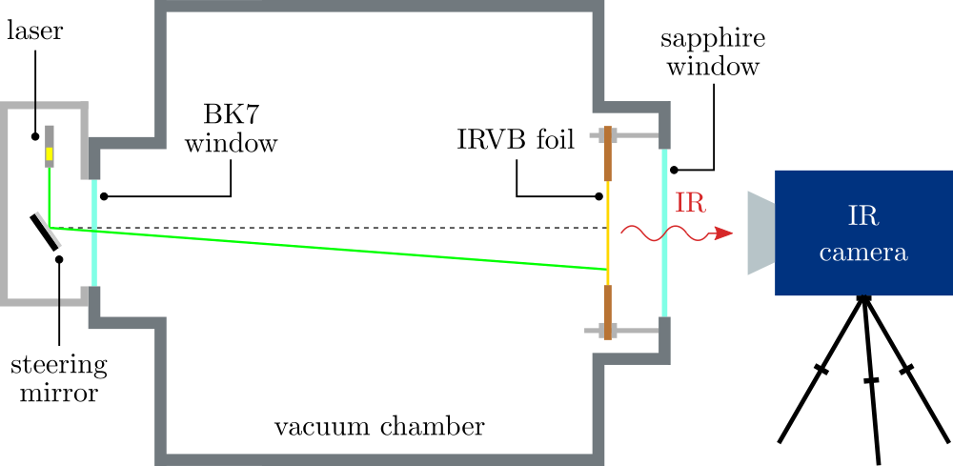
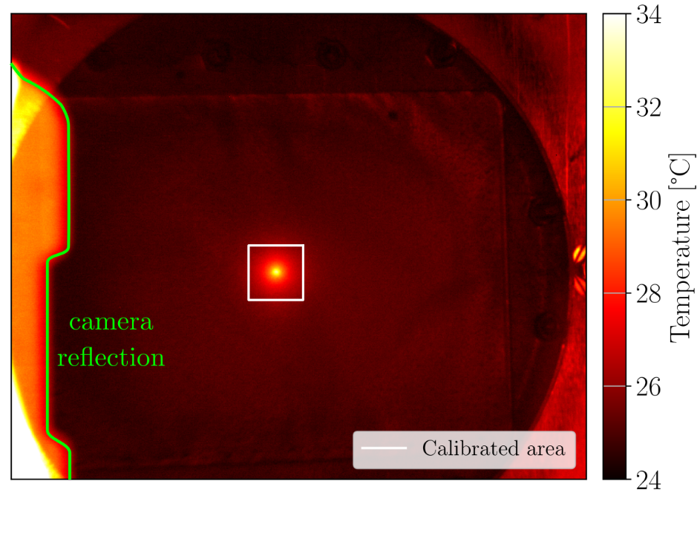
V. Calibration of the foil thermal properties
Foil calibration is carried out in the lab with laser irradiation experiments [1]
Foil thermal response is measured using a high-resolution IR camera
The combination of $\left(ε, κ, S\right)$ is found that reproduces laser power and time profile
Accuracy of calibration method is tested on synthetic data (3% error)
[1] F. Federici et al. RSI 2023

Slide 18
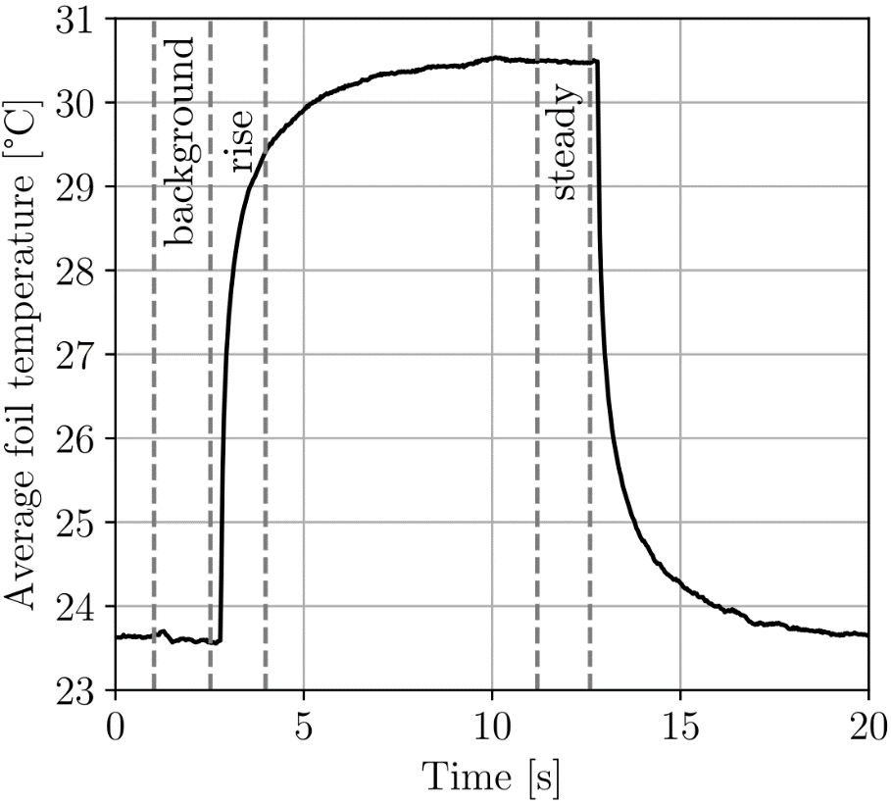
V. Calibration of the foil thermal properties
Laser is applied with square wave temporal profile
Thermal properties are extracted from foil response
Applied to ROI surrounding the laser spot
Calibration is spatially resolved on the foil surface
$κS=\frac{∑p_{\dot{T}}}{p_{abs}}$ $S=\frac{{∑p}_{∇^{2}T}}{p_{abs} − ∑p_{BB} + ∑p_{\dot{T}}}$
$ε$ = (0.754 $±$ 0.001)
$κ$ = (4.63 $±$ 0.49)10⁻⁵ m²s⁻¹, $S$ = (672 $±$ 25) KW⁻¹
Missing proper camera calibration and settings
Calibration of the 5$μ$m gold foil is still preliminary
Calibration is being repeated for multiple foils with optimized setup

Slide 19
Overview
Introduction
The IRVB design at W7-X
Measurement procedure
Interpolation to foil reference frame
Calibration of the foil thermal properties
Experimental results
Conclusions

Slide 20
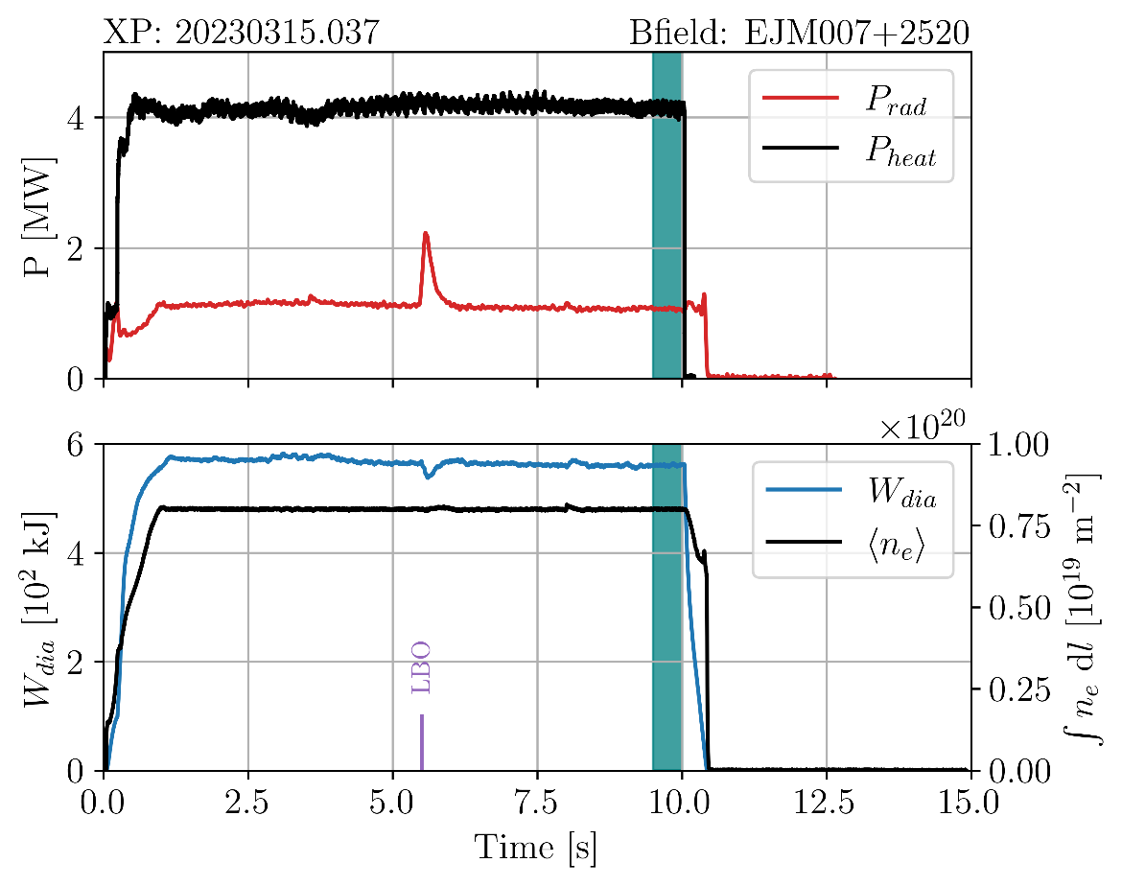
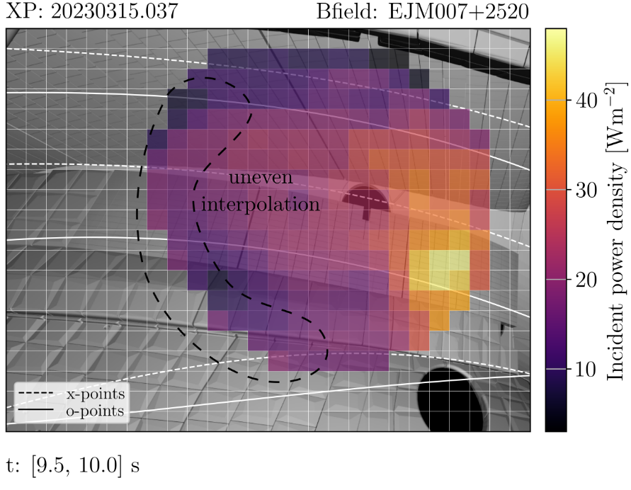
VI. Experimental results Inference of the incident radiation power
Example OP2.1 plasma discharge in standard configuration (XP:20230315.37)
Constant applied power and plasma density
Steady-state $P_{rad}$ signal (except for LBO injection @ 5.5s)
Incident power $p_{in}$ [Wm⁻²] is calculated by solving 2D heat transfer equation
Incident power $p_{in}$

Slide 21
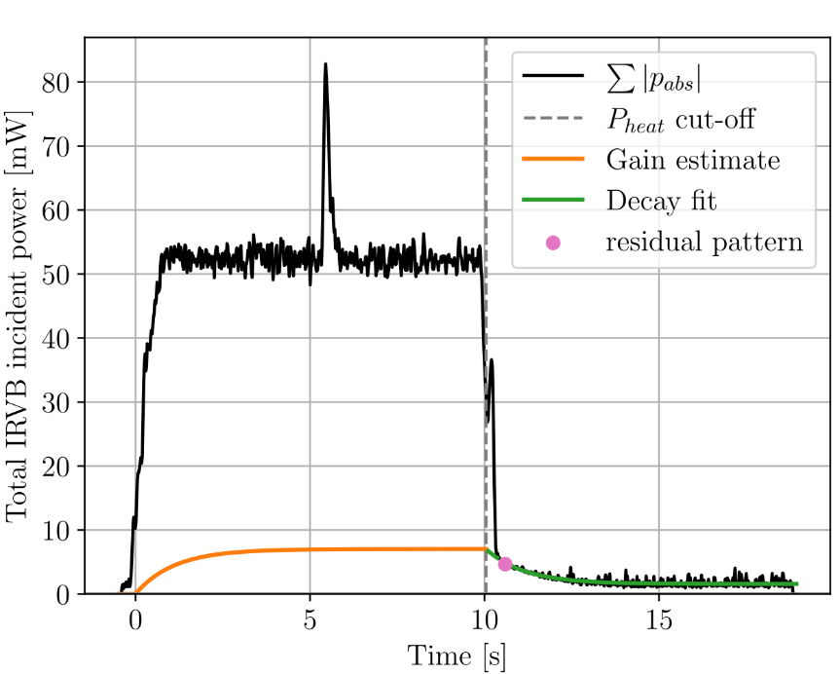
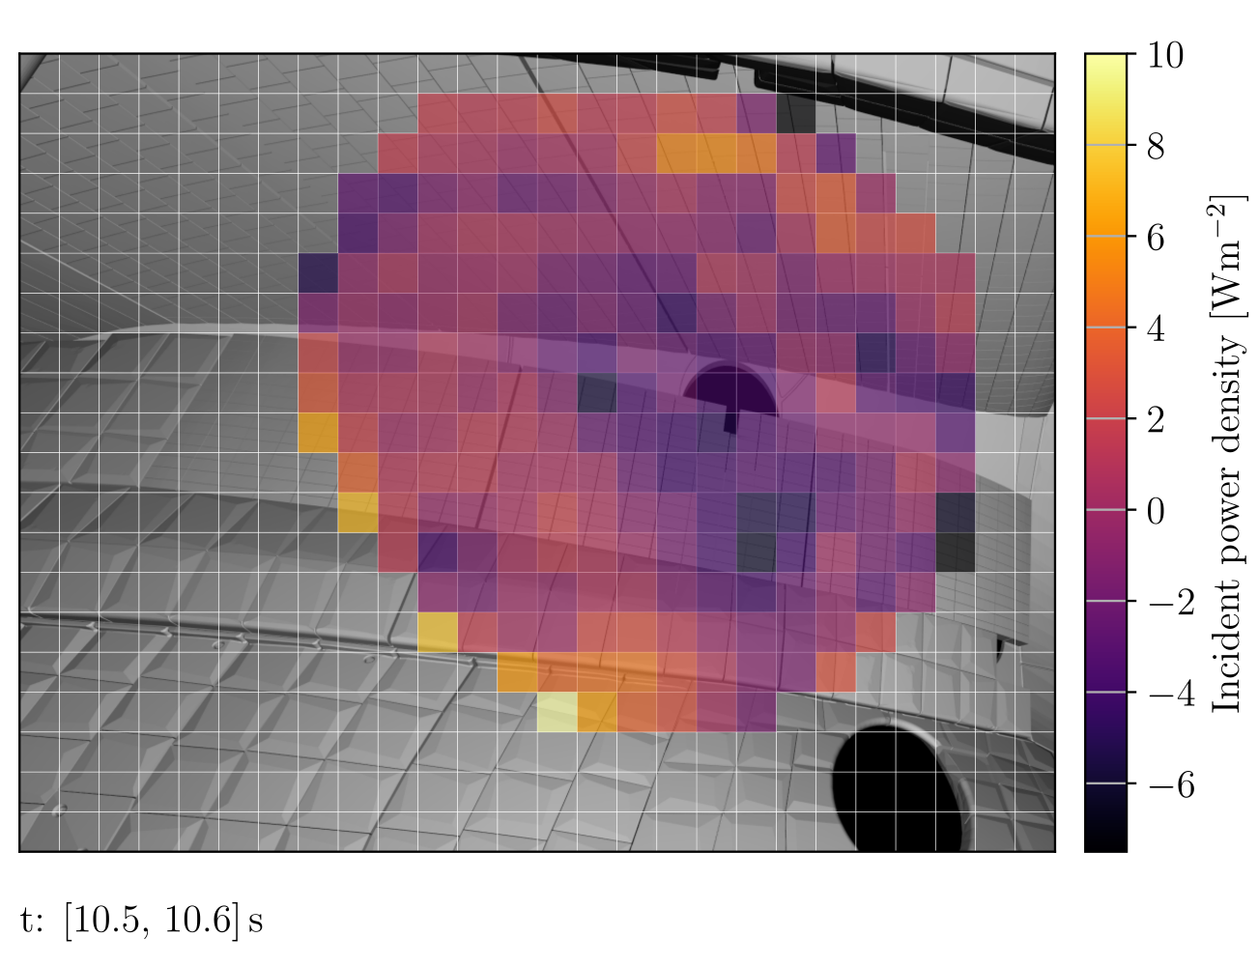
VI. Experimental results Inference of the incident radiation power
Non-uniform foil response (buildup of features in IRVB image)
Probably arising from bad imaging and non-uniformity of foil calibration coefficients
Features are estimated after heating power cut-off and subtracted
Rescaled during the discharge using exponential fit
Incident power $p_{in}$
Exponential fit
Residual power pattern $p_{res}$

Slide 22
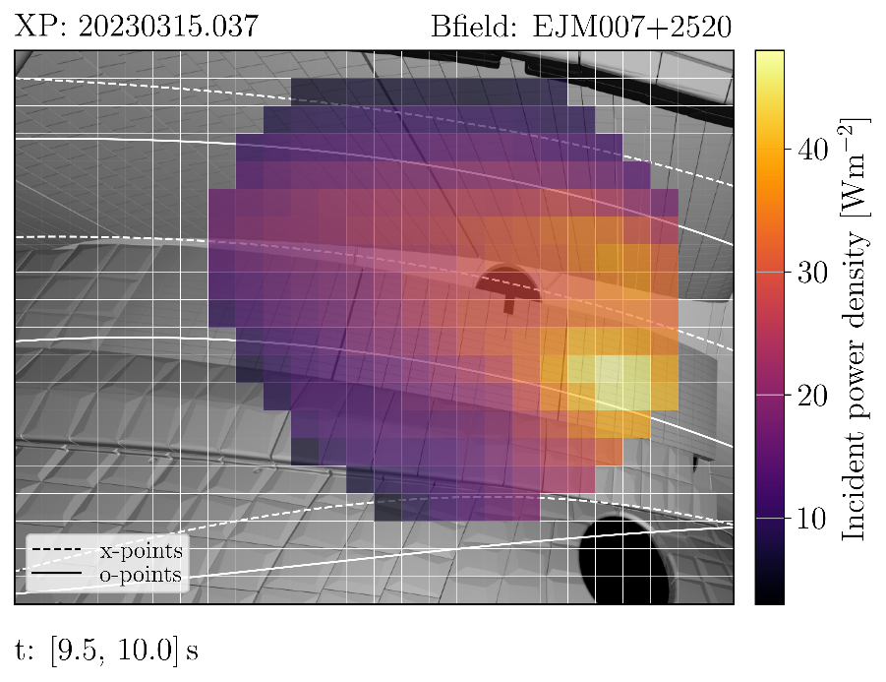
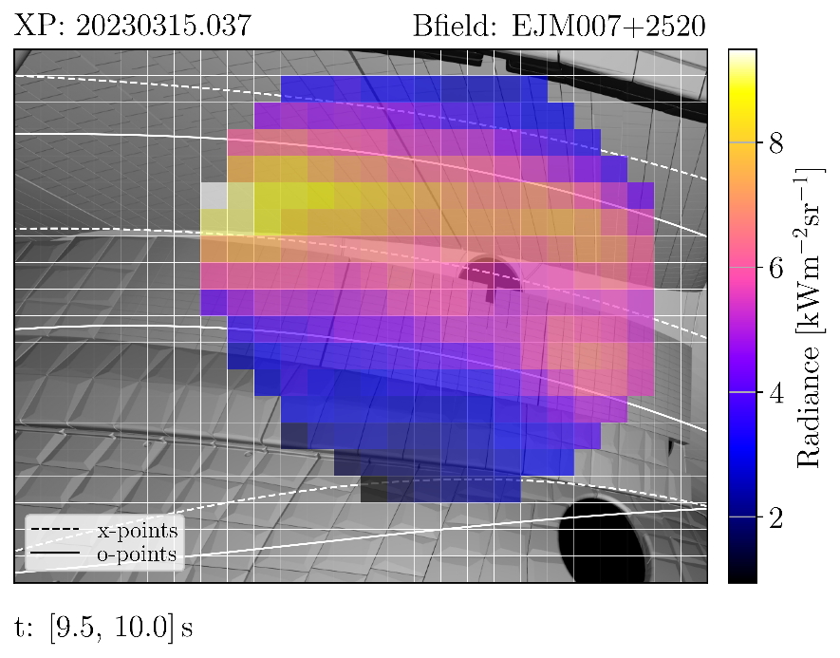
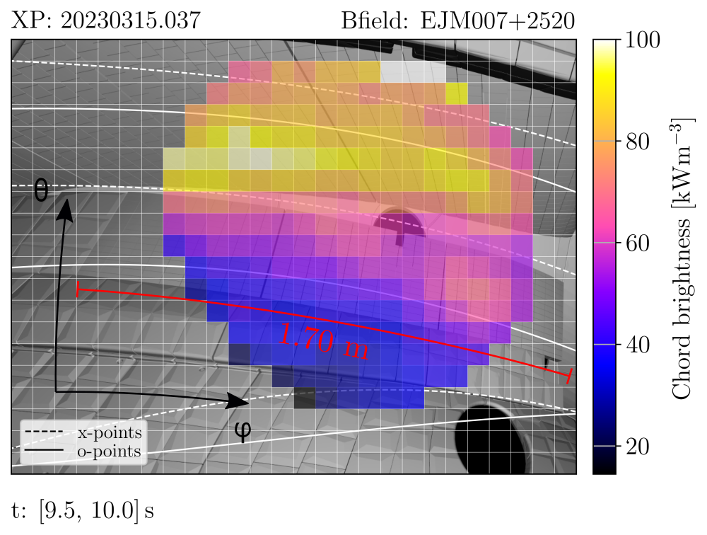
VI. Experimental results Analysis of plasma radiation
Incident power (after $p_{res}$ correction) is converted to radiance $L$ [Wm⁻²sr⁻¹]
$L=\frac{p_{in}l_{bol}^{2}}{e}$ ($l_{bol}$ [m] bolometer channel size, $e$ [m²sr] channel etendue)
Radiance is converted to chord brightness (or emissivity) $ε_{chord}$ [Wm⁻³]
$ε_{chord}=\frac{4πL}{d_{LoS}}$ ($d_{LoS}$ [m] intersection length with plasma volume)
Corrected incident power $p_{in}$
Radiance $L$
Chord brightness $ε_{chord}$

Slide 23
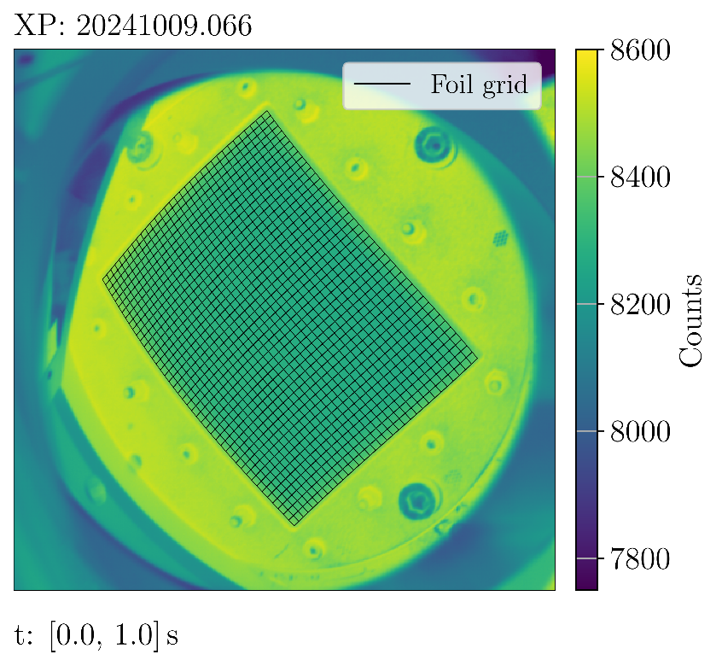
VI. Experimental results Improved design
Adjusted imaging mirrors
Image entire surface area of the foil
Higher uniformity of the foil sampling
More coverage of the foil frame
OP2.1 IR camera image
OP2.2 IR camera image

Slide 24
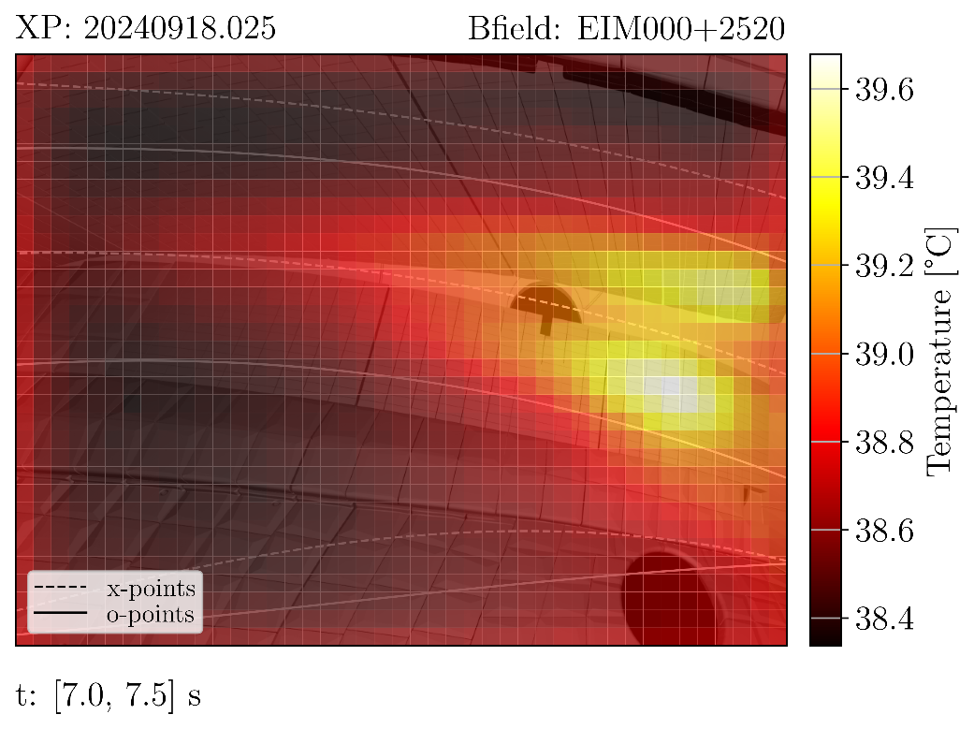
VI. Experimental results Improved design
Substituted 5.0$μ$m gold foil for 2.5$μ$m platinum foil
Thinner foil $→$ higher sensitivity $S$ (higher signal-to-noise ratio)
Platinum $→$ lower diffusivity $κ$ (smaller bolometer pixels)
2mm $×$ 2mm bolometer pixels $→$ Higher spatial resolution.
OP2.1 $T$ measurement
OP2.2 $T$ measurement

Slide 25
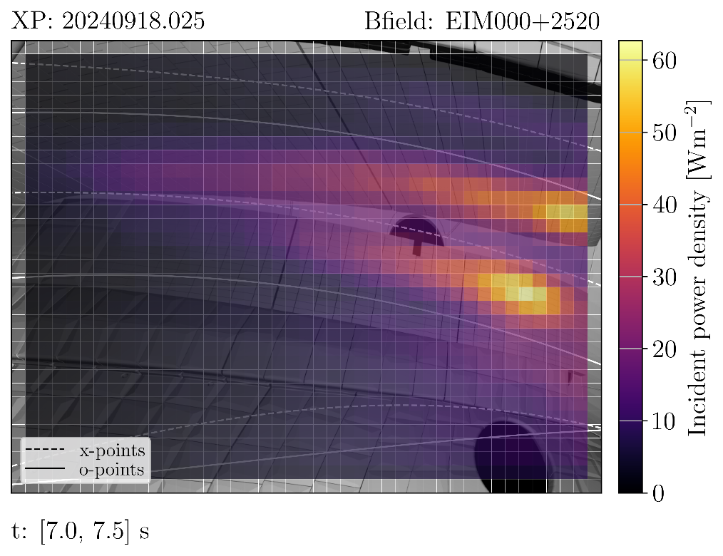
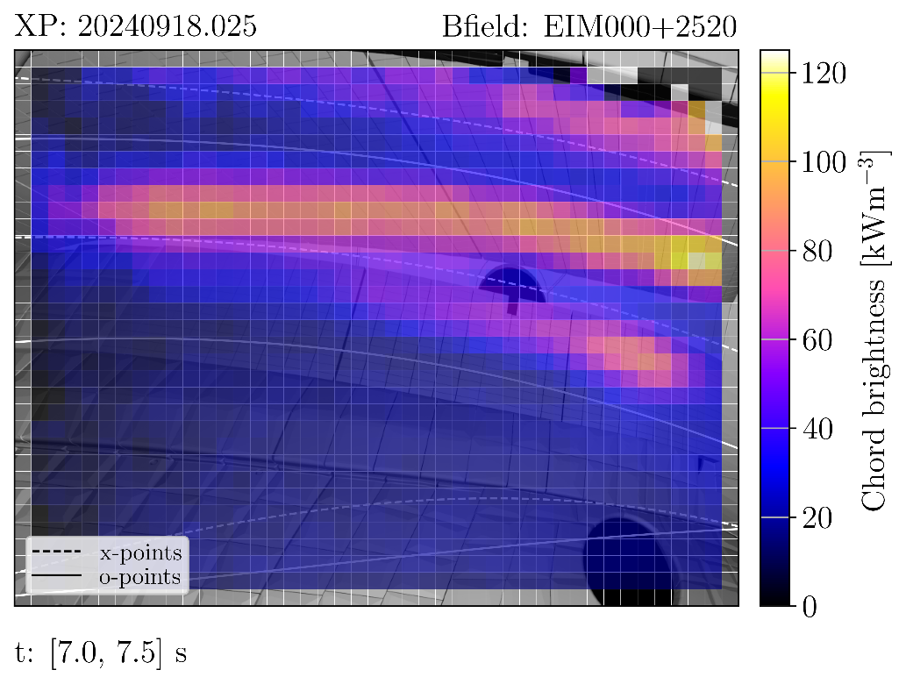
VI. Experimental results Improved design
Early OP2.2 results confirm and extend OP2.1 observations
Larger field-of-view and improved image quality
Noise (NEPD) reduced from 3.93 Wm⁻² (5.0$μ$m Au) to 1.99 Wm⁻² (2.5$μ$m Pt)
Toroidal asymmetry of plasma emissivity (factor $×$2 across 10 cm distance)
OP2.2 $p_{in}$ measurement
OP2.2 $L$ measurement

Slide 26
Overview
Introduction
The IRVB design at W7-X
Measurement procedure
Interpolation to foil reference frame
Calibration of the foil thermal properties
Experimental results
Conclusions

Slide 27
Overview
Introduction
The IRVB design at W7-X
Measurement procedure
Interpolation to foil reference frame
Calibration of the foil thermal properties
Experimental results
Conclusions

Slide 28
VII. Conclusions
IRVB diagnostic operational
Calibrated thermal properties of multiple bolometer foils (10% uniformity)
Remove non-uniformities in foil thermal response using fitting procedure
Divertor radiation pattern characterized by field-aligned stripes
Toroidal radiation asymmetry
New OP2.2 design with improved signal-to-noise ratio, field-of-view and resolution

Slide 29
Acknowledgments
This work has been carried out within the framework of the EUROfusion Consortium, funded by the European Union via the Euratom Research and Training Programme (Grant Agreement No 101052200 — EUROfusion). Views and opinions expressed are however those of the author(s) only and do not necessarily reflect those of the European Union or the European Commission. Neither the European Union nor the European Commission can be held responsible for them.
This work was supported by the U.S. Department of Energy at Los Alamos National Laboratory, operated by Triad National Security LLC, for the National Nuclear Security Administration (Contract No. 89233218CNA000001).
This research was supported by the NINS-DAAD International Personal Exchange Program, JSPS Grant \# 22KK0039, NIFS Grant \# SIU004 and for B. J. Peterson the Alfried Krupp Wissenschaftskolleg Greifswald underwritten by the Stiftung Alfried Krupp Kolleg and the Alfried Krupp von Bohlen und Halbach-Stiftung.
G. A. Wurden, F. Reimold, B. J. Peterson, F. Federici, K. Mukai, K. A. Siever, J. von Miller, D. Zhang, A. Demby, and the W7-X Team

Slide 30
Additional slides

Slide 31
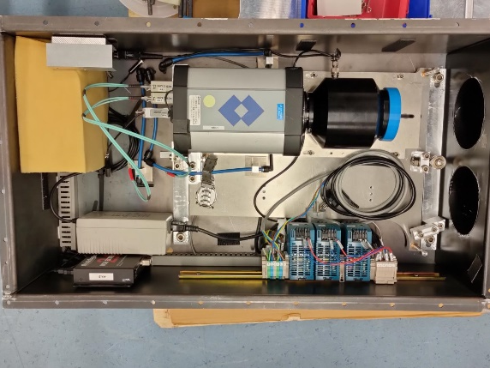
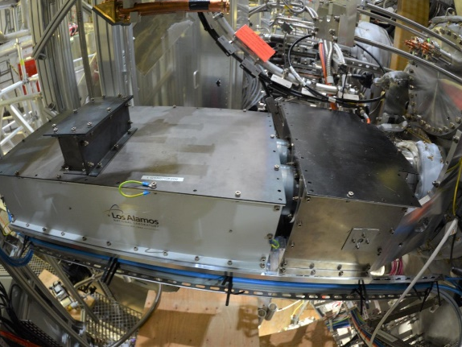
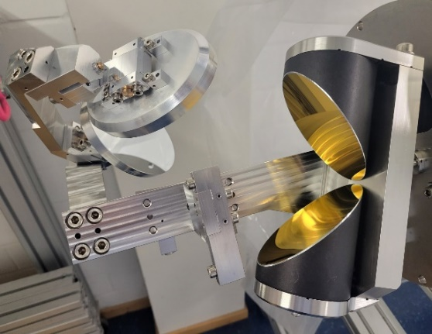
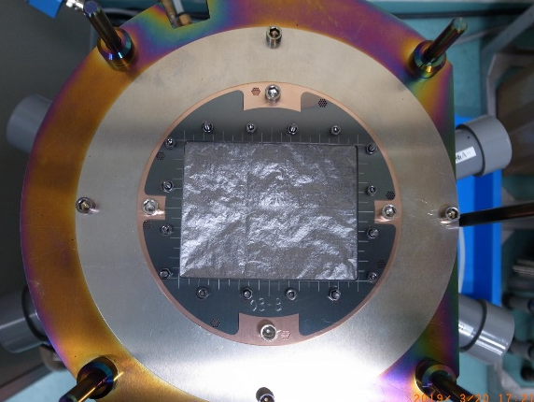
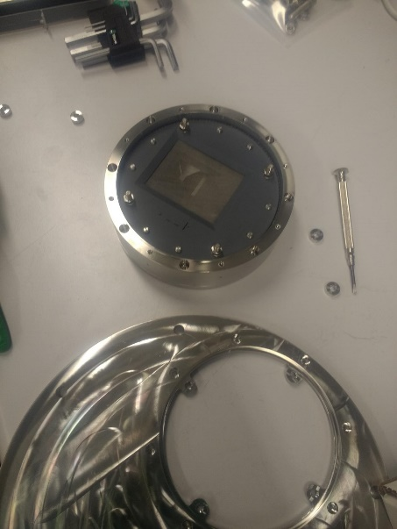
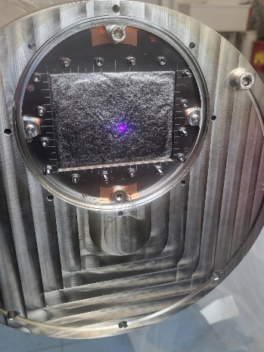
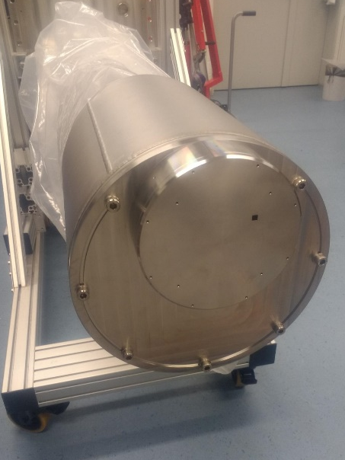
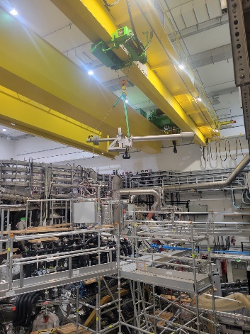
IRVB components
camera box (closed)
camera box (open)
parabolic mirrors
foil + frame
endoscope cap
foil (assembled)
endoscope front
torus hall

Slide 32
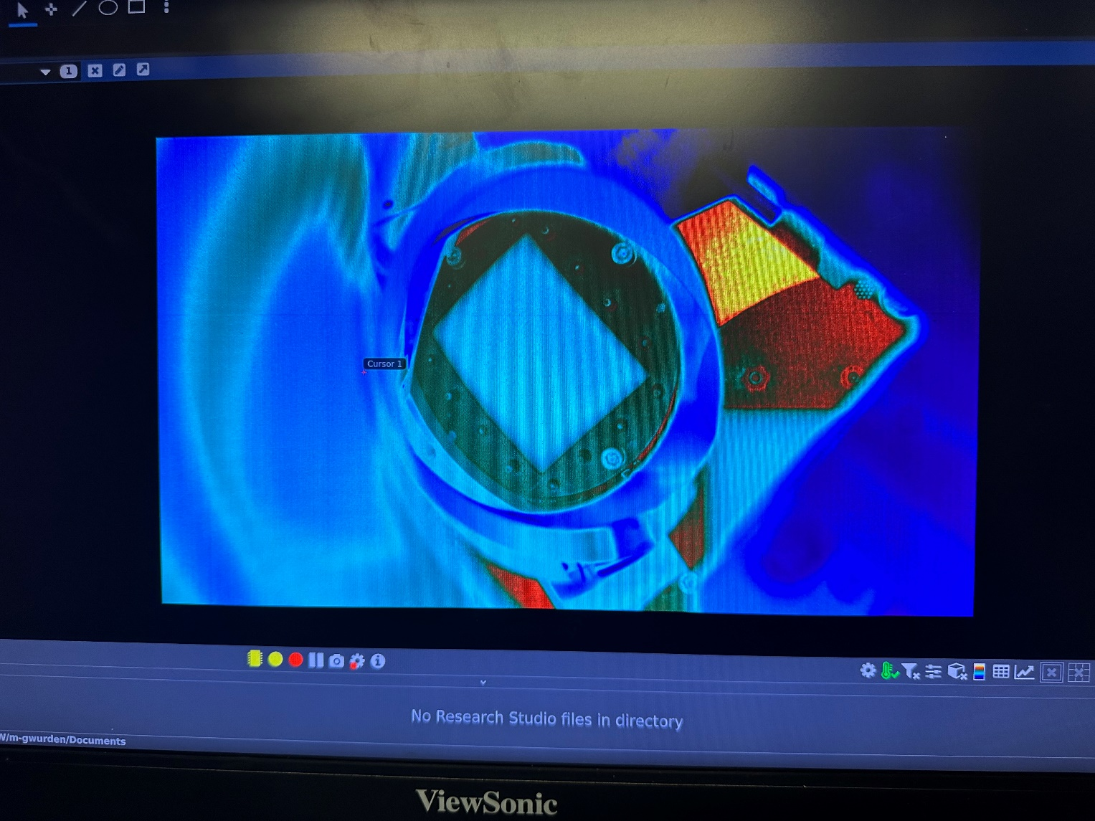
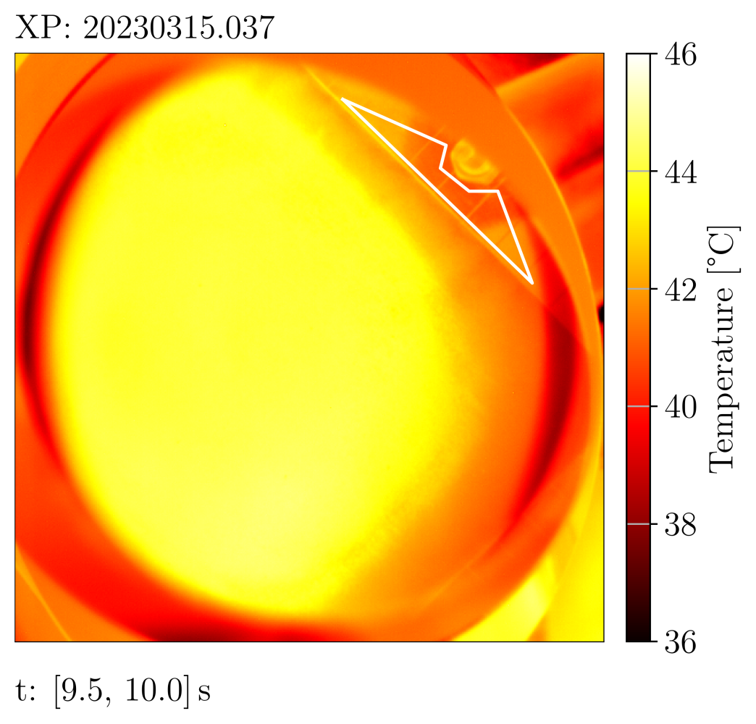
Full camera view

Slide 33
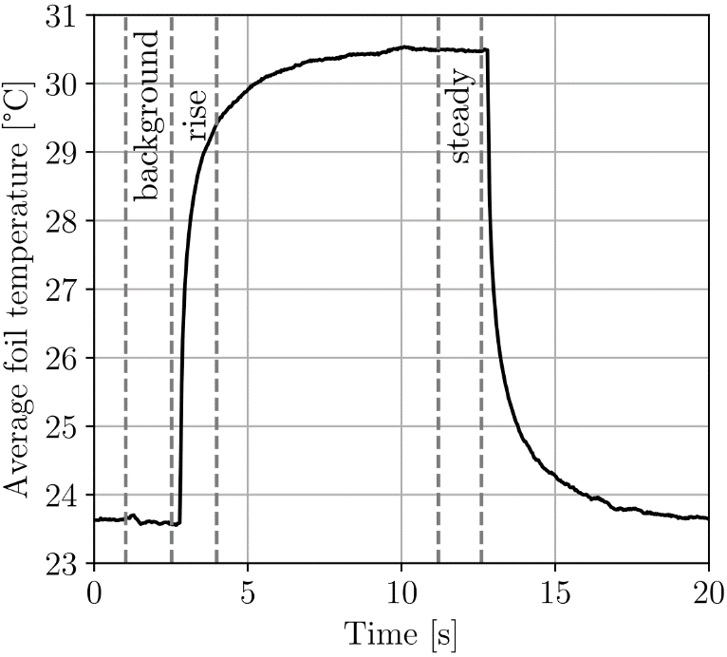
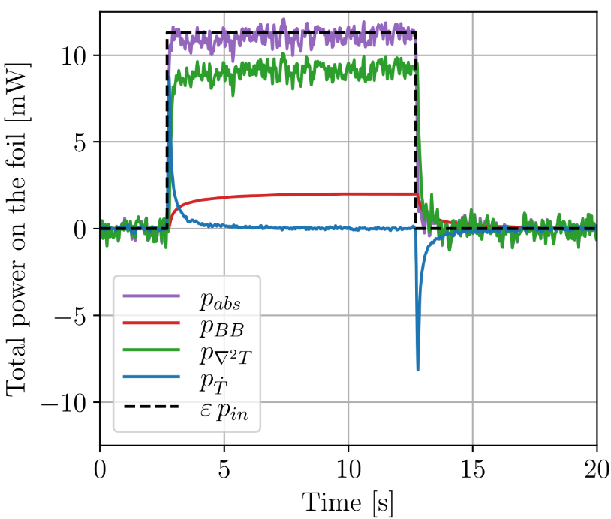
Calibration procedure
Emissivity $ε$ is calculated by comparing temperature to black-body reference
$\left(κ, S\right)$ are calibrated in two steps:
$κS=\frac{∑p_{\dot{T}}}{p_{abs}}$
$S=\frac{∑p_{∇^{2}T}}{p_{abs} −∑p_{BB}+∑p_{\dot{T}}}$

Slide 34
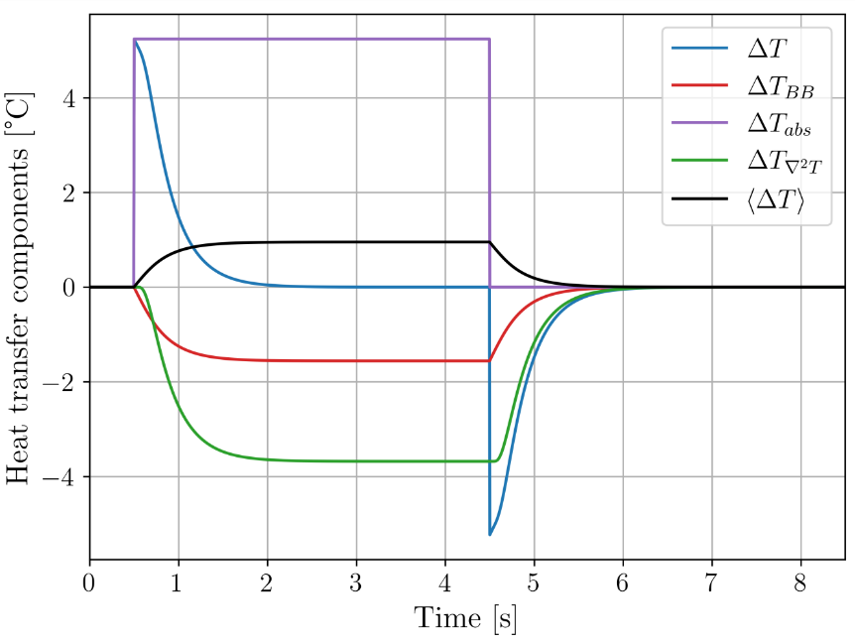
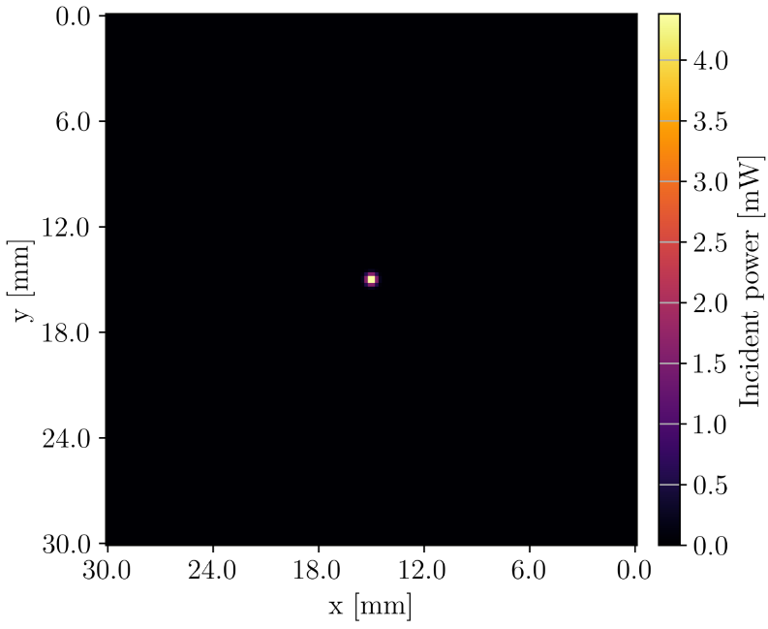
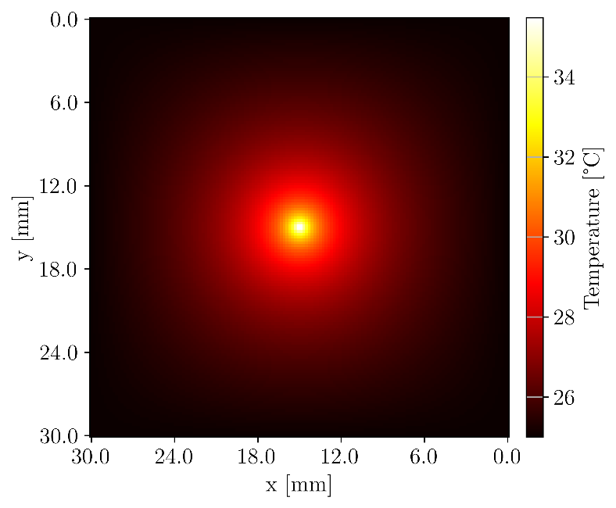
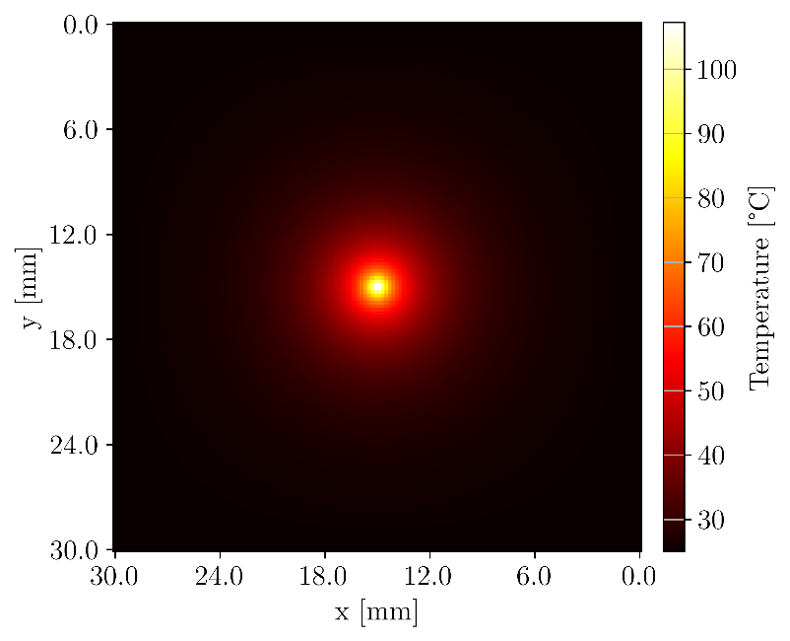
Synthetic data
Known power pattern applied to foil
Forward calculate temperature distribution $T$
Foil thermal properties are known
Add random noise fluctuations
Simulation is resolved in time and space
Applied $p_{abs}$
$T$ on 5.0$μ$m Au
$T$ on 2.5$μ$m Pt

Slide 35
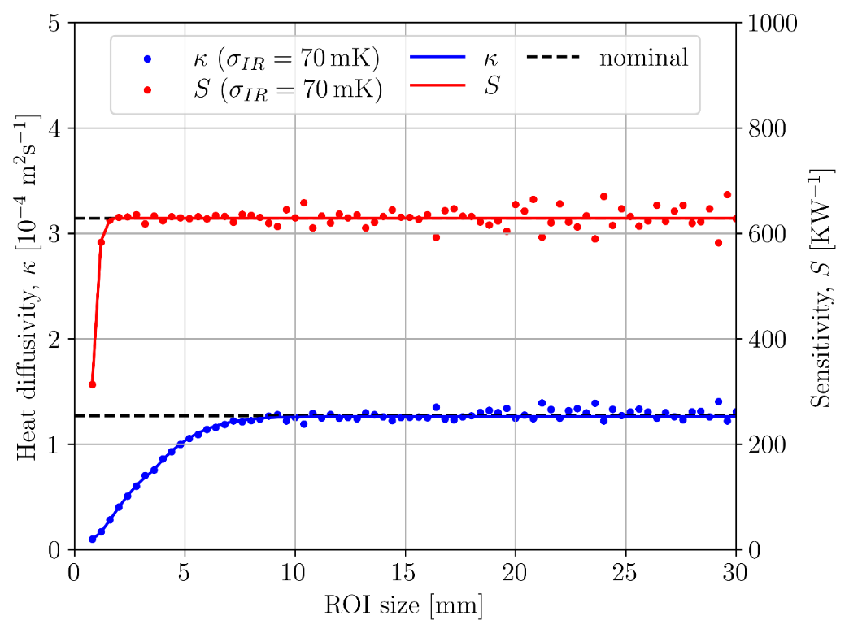
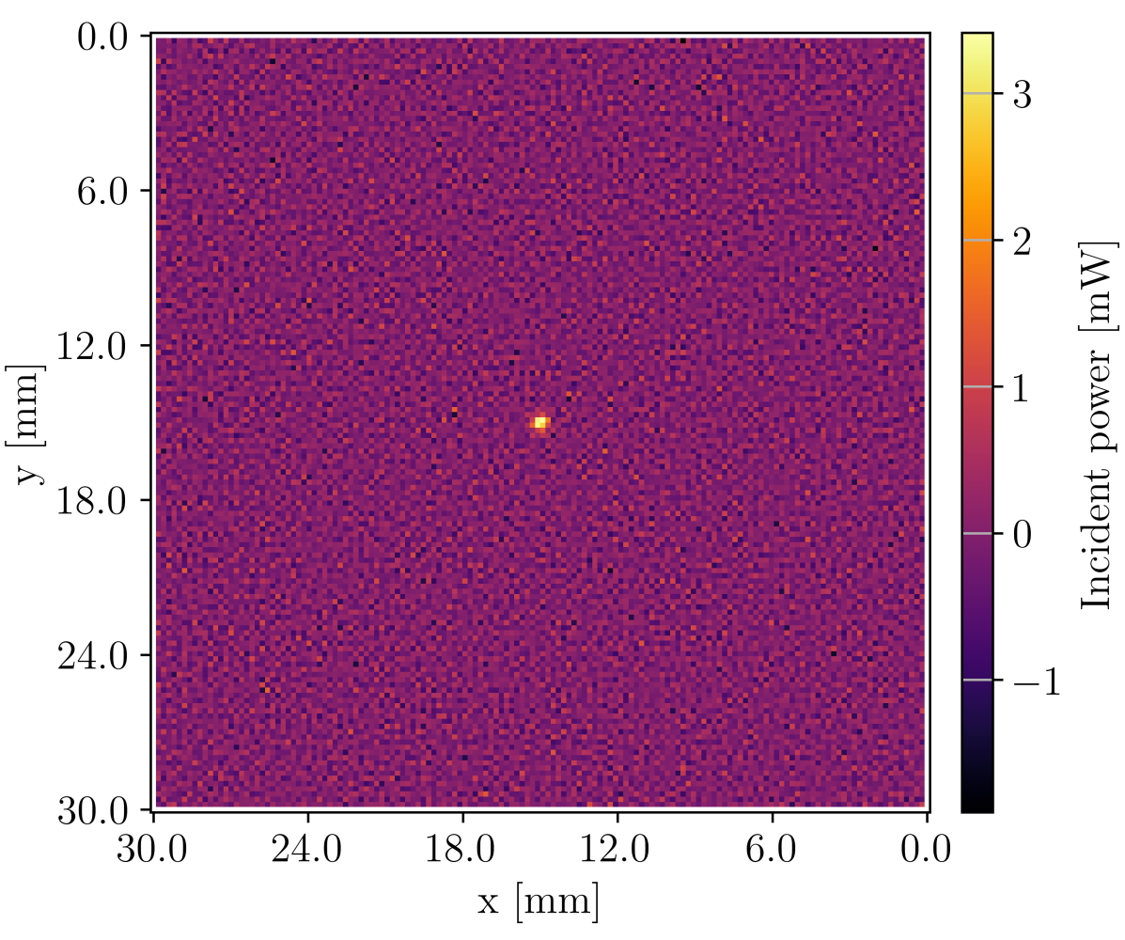
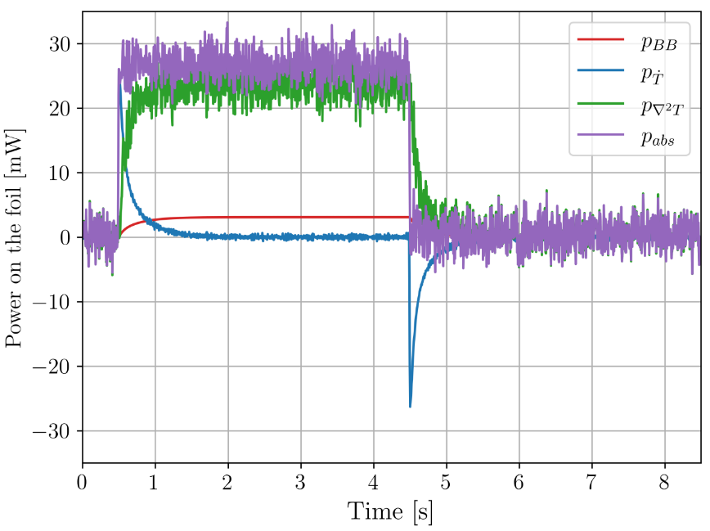
Backward solution
Use 2D heat diffusion equation to calculate power
Compare with original input power
Use synthetic data to test accuracy of calibration procedure
3% error for 5.0$μ$m Au. 1% error for 2.5$μ$m Pt.
Minimal 10mm $×$ 10mm calibration area for 5.0$μ$m Au (5mm $×$ 5mm for 2.5$μ$m Pt ).

Slide 36
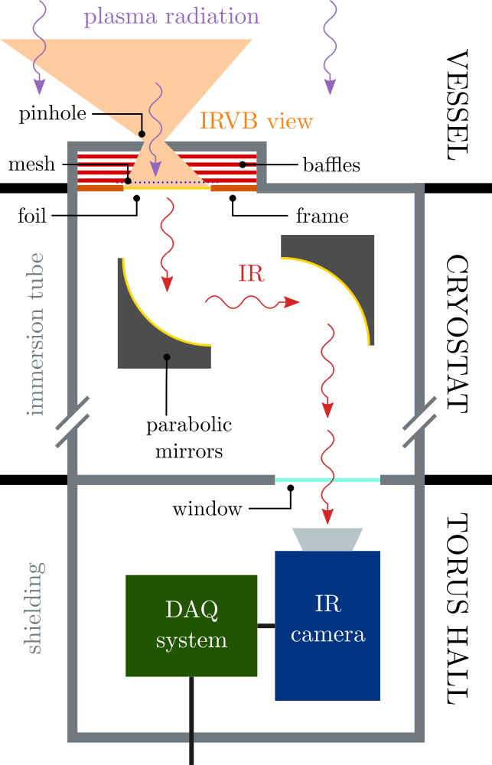
IRVB schematic

Slide 37
IRVB geometrical parameters

