Slide 1
DIFFER TSVV-5 2024
Overview of activities
P.W.C. Groen and E. Westerhof

Slide 2

Work done
Reproducing a coupled run (SOLPS-ITER with FreeFEM) of Jorge Gonzalez
Code refactoring, i.e. introduce derived type “particle” in EIRENE (concept)
Document coding rules for EIRENE
Expanding Magnum-PSI simulations to vibrationally resolved H₂

Slide 3
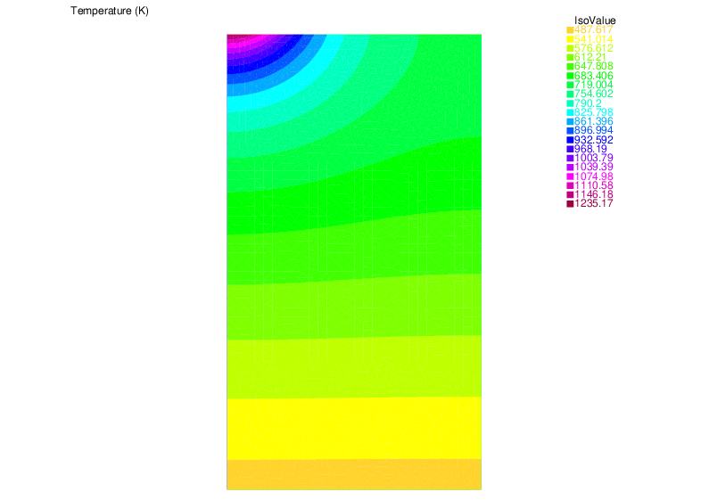
Reproducing coupled run SOLPS-ITER - FreeFEM
Simulation of plasma heat flux on (linear device) Magnum-PSI target,
calculating the target’s temperature
Coupling SOLPS-ITER, i.e. B2.5 with FreeFEM [1] code describing the target,
as done by J. Gonzalez [2] and G.F. Nallo [3]
Performed steps in short
  In SOLPS-ITER code, work in feature/eunomia_FEWall branch
  Take coupled (i.e. SOLPS-ITER w/ EIRENE) successful run of E. Westerhof’s
  Adapt/add/modify the files, links, etc. needed for running it with FreeFEM,
  and run (Marconi)
  Report it
[1] freefem.org (Finite Element Method code)
[2] J. Gonzalez et al., Plasma Phys. Control. Fusion 65 (2023) 045009
[3] G.F. Nallo et al., Journal of Fusion Energy (2023) 42:41
Target temperature output

Slide 4
Code refactoring (concept)
Inventory candidates for derived type, suggestion by Y. Marandet: in eirmod_comprt.f
Choice: at first,
  let position and velocity be derived types themselves
  let these derived types in turn be ‘attributes’ of the particle derived type
First tested only passing particle%pos%x0 in arguments (for the sake of overview),
then passing an ei_particle_type instance, using this x0
In this way, only one (particle) argument is needed instead of X0, Y0, Z0, VELX, VELY, VELZ, …
TYPE ei_position_type
REAL (DP), POINTER :: x0
REAL (DP), POINTER :: y0
REAL (DP), POINTER :: z0
END TYPE ei_position_type
TYPE ei_velocity_type
REAL (DP), POINTER :: x
REAL (DP), POINTER :: y
REAL (DP), POINTER :: z
END TYPE ei_velocity_type
TYPE ei_particle_type
TYPE (ei_position_type) :: pos
TYPE (ei_velocity_type) :: vel
END TYPE ei_particle_type

Slide 5
Document EIRENE coding rules
In order to have a clean and uniform way of coding EIRENE a set of rules has been suggested (that are strongly advised to follow once established)
After a number of iterations in the TSVV-5 VCs a version has been realized ready to share in the Juelich GitLab
The Word document has been transferred to a Markdown document for uploading in GitLab

Slide 6
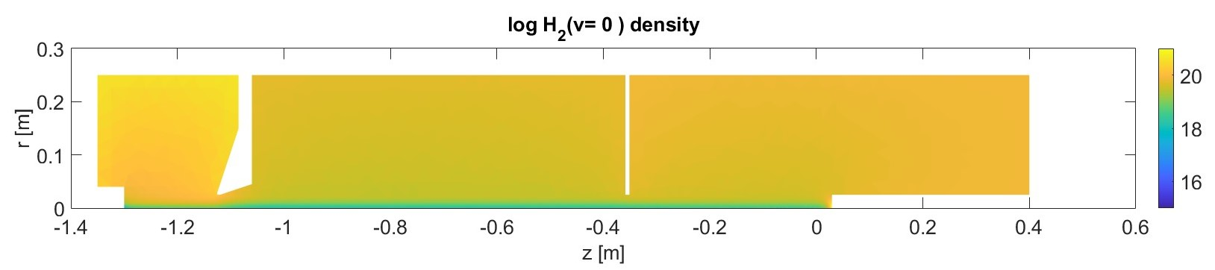
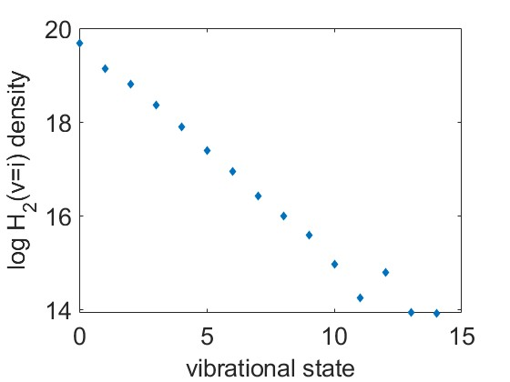
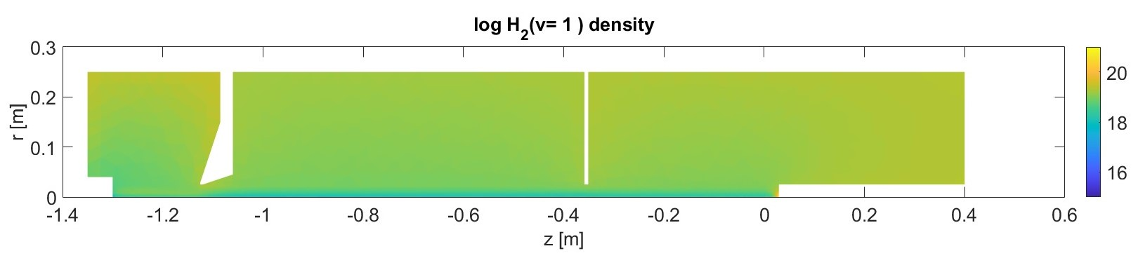
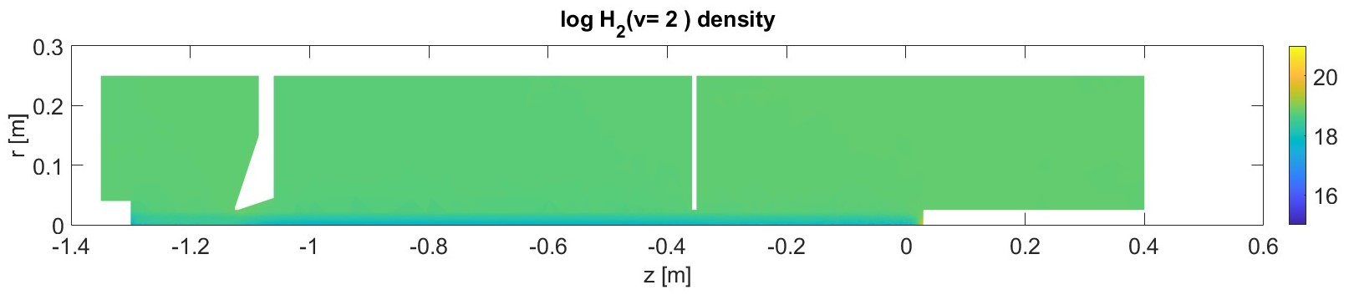
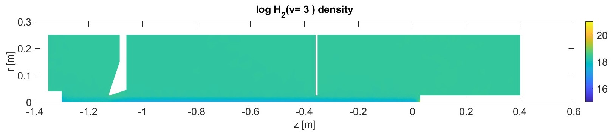
Magnum-PSI simulations with vibrationally resolved H₂
Based on high density (0.47 Pa) case from Chandra and Gonzalez et al.
vibrational distribution outside plasma beam

Slide 7
Magnum-PSI simulations outside TSVV-5
Improvements to solps-iter physical model to include rotation of the plasma beam and its coupling to the neutral particle distribution (HJ de Blank)
Radial conductivity, caused by ion-neutral CX-friction, reduces the parallel current in the plasma beam.
SOLPS-ITER adapted to take into account co-rotation of neutrals with the plasma beam.
Analysis of directed spectra of the neutral velocity distributions in EIRENE shows a radially peaked profile of hot co-rotating H-atoms (red curve) and a hollow profile of cooler non-rotating H-atoms (blue curve).
Dots: standard 1-fluid Eirene quantities over all H-atoms

Slide 8
Work planned (2025)
Coupled run SOLPS-ITER-FreeFEM for Magnum-PSI simulation
Implement the coupling with FreeFEM in the SOLPS-ITER master branch
(including descriptions, manual etc.)
Implement the neutral particle heat load on the target
Code refactoring
Implementation of the particle derived type
Investigate and possibly add extension of the particle type with internal states
Further options to be discussed

