Slide 1
Contributions from Aalto University and KU Leuven
TSVV-5 : Reporting 2024
Ray Chandra¹, Mathias Groth¹, Niels Horsten², Vesa-Pekka Rikala¹, Timo Kiviniemi¹
¹Aalto University, Espoo, Finland
²KU Leuven, Leuven, Belgium
Dec 13, 2024

Slide 2
TSVV-5 deliverables 2024: development and application of EIRENE photon model & EIRENE validation in JET and AUG plasmas
Development and validation of self-consistent plasma-gas-photon coupled model in SOLPS-ITER ⇒ PSI 2024 (Ray Chandra)
Technical implementation of EIRENE self-iteration scheme in B2.5-EIRENE coupling (required for photon-gas coupling) and the parallelization of grid for fast CRM calculation
Re-evaluation of SOLPS-ITER JET81472 D plasma solutions in varying midplane separatrix density with the plasma-gas-photon coupled model ⇒ SOLPS-ITER cases for H and T, upon availability, w/ isotopologue-dep. rates
Extension of atomic H collisional-radiative model to include molecular H2 contributions to H* populations
Merge EIRENE w/photon module into Jugit and/or version at ITER
Continue data analyses of JET-ILW H, D, T and DT L-mode plasmas for PSI 2024, using SOLPS-ITER to include changes to EIRENE ⇒ Aalto U / KU Leuven (PSI 2024 invited talk by Niels Horsten)

Slide 3
TSVV-5 deliverables 2024: development and application of EIRENE photon model & EIRENE validation in JET and AUG plasmas
Development and validation of self-consistent plasma-gas-photon coupled model in SOLPS-ITER ⇒ PSI 2024 (Ray Chandra)
Technical implementation of EIRENE self-iteration scheme in B2.5-EIRENE coupling (required for photon-gas coupling) and the parallelization of grid for fast CRM calculation
Re-evaluation of SOLPS-ITER JET81472 D plasma solutions in varying midplane separatrix density with the plasma-gas-photon coupled model ⇒ SOLPS-ITER cases for H and T, upon availability, w/ isotopologue-dep. rates
Extension of atomic H collisional-radiative model to include molecular H2 contributions to H* populations
Merge EIRENE w/photon module into Jugit and/or version at ITER
Continue data analyses of JET-ILW H, D, T and DT L-mode plasmas for PSI 2024, using SOLPS-ITER to include changes to EIRENE ⇒ Aalto U / KU Leuven (PSI 2024 invited talk by Niels Horsten)
Completed Started Not yet started

Slide 4
TSVV-5 deliverables 2024: development and application of EIRENE photon model & EIRENE validation in JET and AUG plasmas
PESDT post-processing routines for EIRENE, including CHERAB reflections (PSI 2024 Vesa-Pekka Rikala, Aalto U)
Simulations of sub-divertor gas dynamics for H, D and T to assess potential fuel segregation (Timo Kiviniemi, Aaron Vesa Aalto U)

Slide 5
TSVV-5 deliverables 2024: development and application of EIRENE photon model & EIRENE validation in JET and AUG plasmas
PESDT post-processing routines for EIRENE, including CHERAB reflections (PSI 2024 Vesa-Pekka Rikala, Aalto U)
Simulations of sub-divertor gas dynamics for H, D and T to assess potential fuel segregation (Timo Kiviniemi, Aaron Vesa Aalto U)

Slide 6
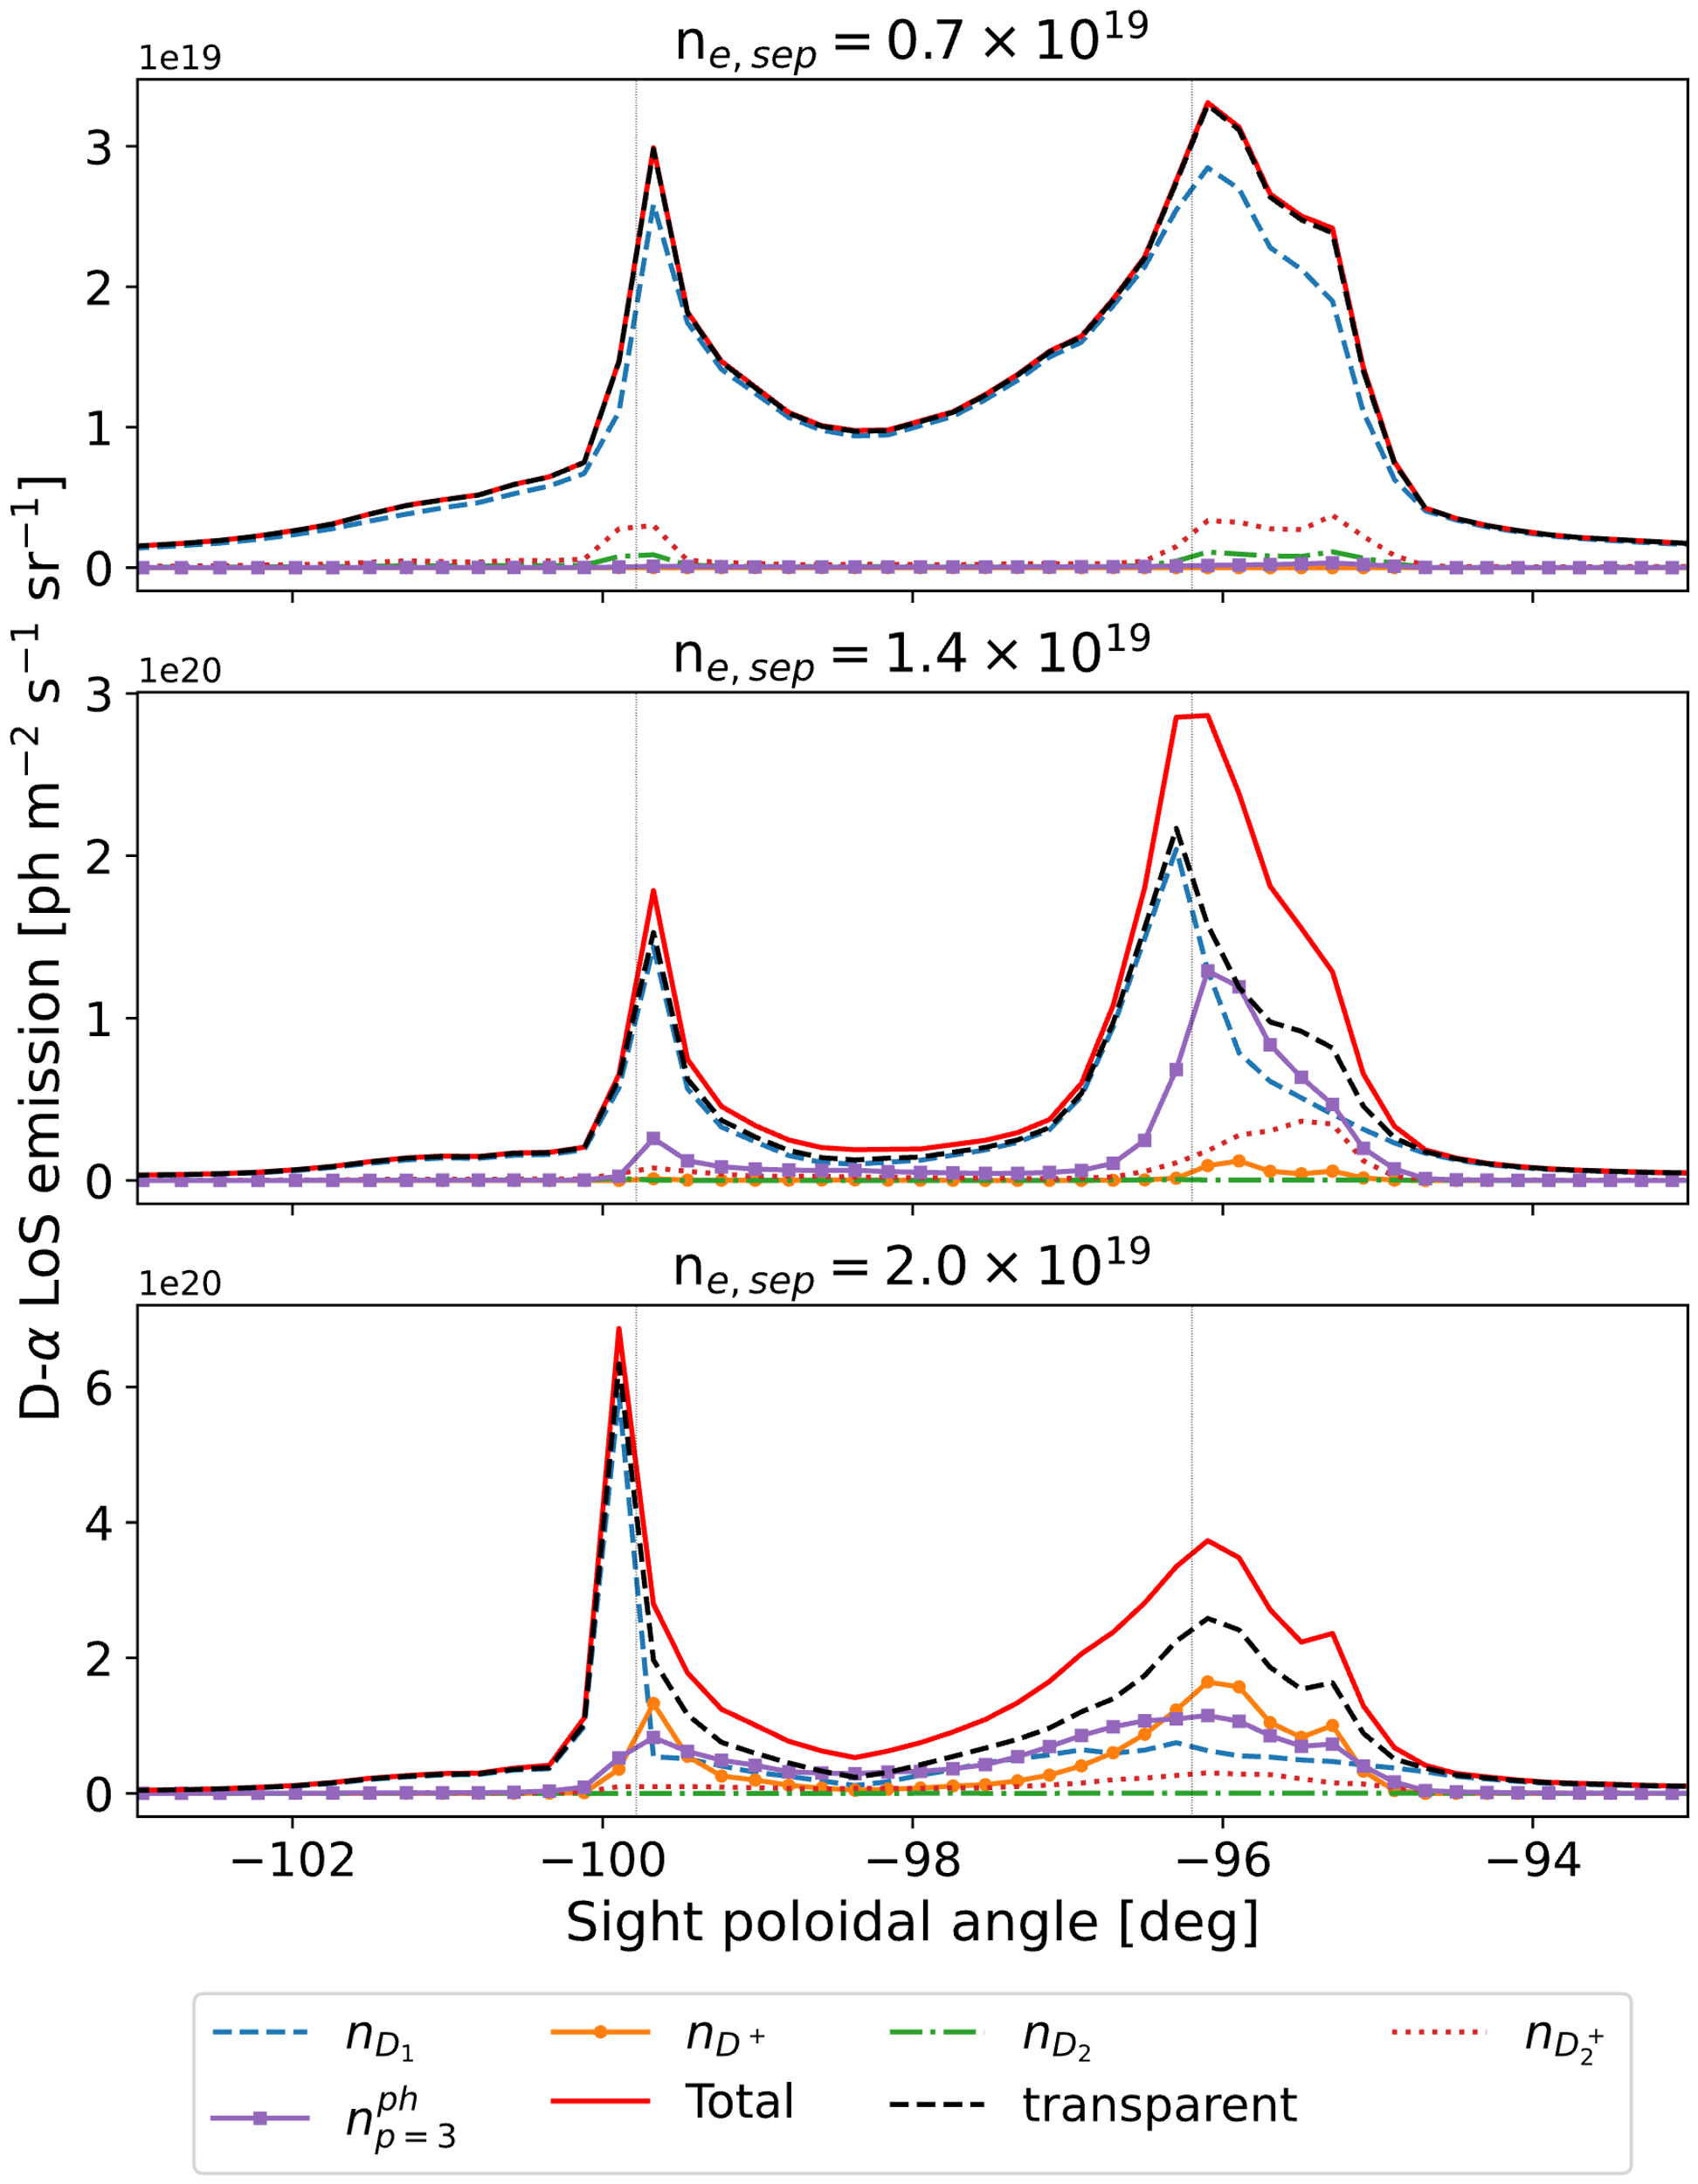
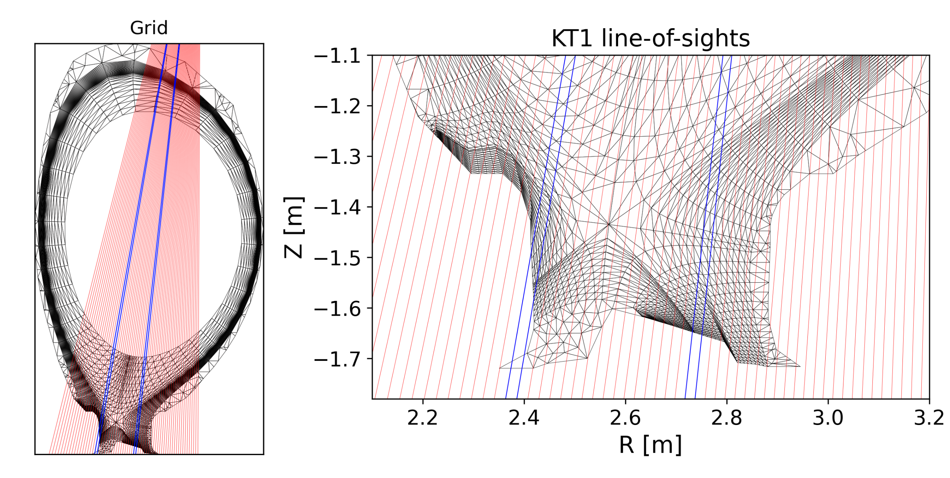
Ly-β opacity enhances D_{α} emission by 50%-100% in the LFS strike point of JET-ILW L-mode plasmas in high-recycling and detached conditions
Sight lines of the vertically viewing scanning mirror VUV-vis imaging spectroscopy system (KT1) in JET-ILW superimposed on the SOLPS-ITER grid. Blue lines are strike point locations.
0.7x10¹⁹ m⁻³
1.4x10¹⁹ m⁻³
EIRENE Ly-α and Ly-β photons tracing module applied to JET-ILW SOLPS-ITER L-mode plasma stationary solutions with increasing $n_{e,sep}$ densities
Line-integrated D-𝛼 emission using KT1 sightlines, separated by contributions from external densities and by Ly-𝛽 absorption ($n_{ph,p=3}$), negligible effects on the inner strike point
2.0x10¹⁹ m⁻³
R. Chandra et al., PSI 2024

Slide 7
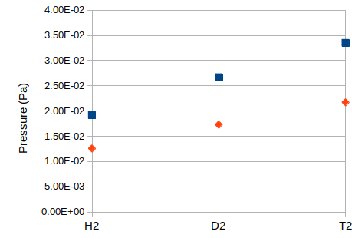
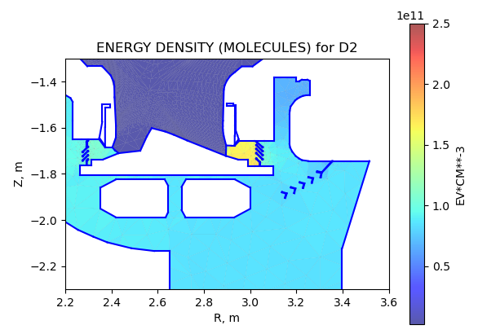
Sub-divertor pressure in JET increases with isotope mass (H₂ → D₂ → T₂), while the introduction of a secondary louvre increases pumping
Upstream prim. louvre
Standalone EIRENE simulations of gas dynamics of both JET and AUG sub-divertor (sealed-off at sub-divertor) exhibits square root of mass dependence of gas pressure (as expected for molecular flow)
Gas influx was imposed at sub-divertor entrance from SOLPS-ITER runs (Horsten et al. , PSI 2024) → N-N interaction negligible at low influx, important for higher core plasma density/sub-divertor pressures
Primary louvres create local pressure gradient between the divertor and the cryo pump, while secondary louvres increases pump flux ( ⇒ ~15% reduction in sub-divertor pressure) → qualitatively consistent with S. Wiesen et al., EPS 2019
Downstream
prim. louvre
primary
secondary
Timo Kiviniemi, Aaron Vesa

Slide 8
SOLPS-ITER underestimate of I_{LFS-plate,max}, including in simulations with power across core boundary increased to full auxiliary heating power
H D T
Niels Horsten et al., PSI 2024

Slide 9
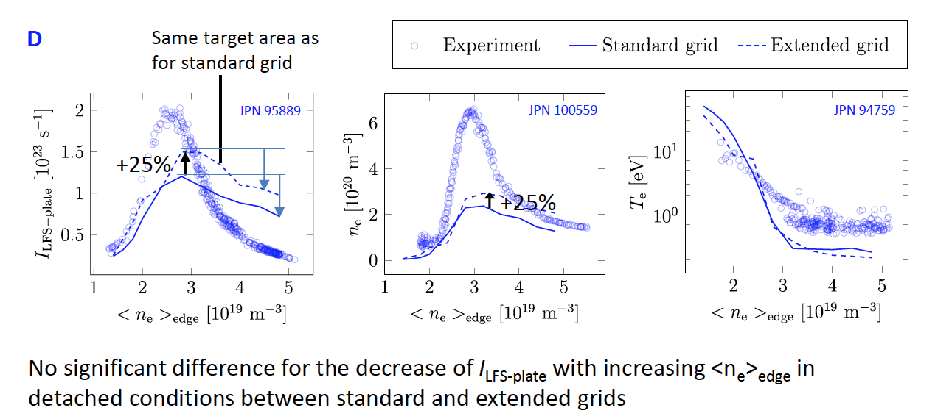
Extending the grid increases the peak I_{LFS-plate} and n_{e} by 25%, but some under-predicting the ion current remaining
Niels Horsten et al., PSI 2024

Slide 10
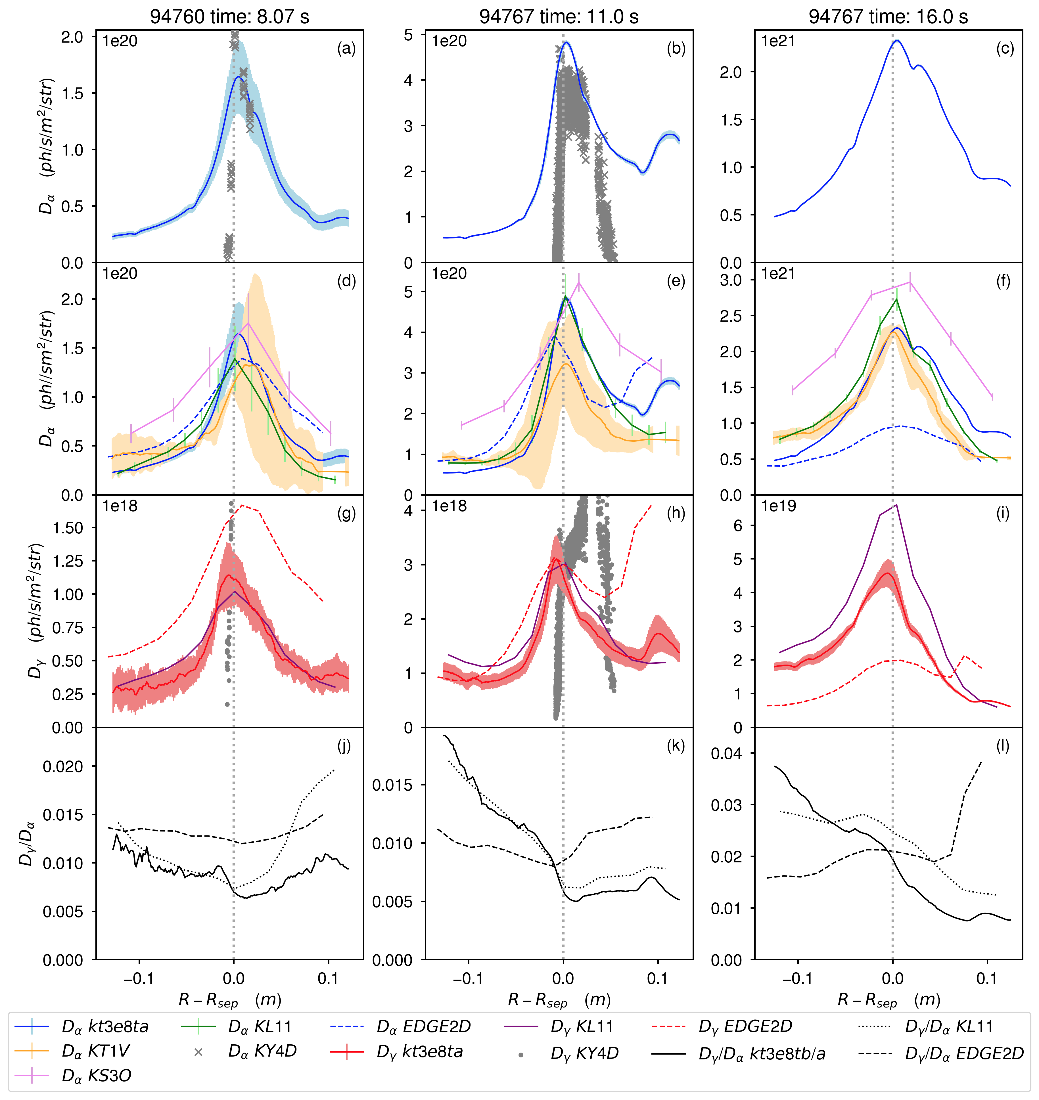
Measured and EDGE2D-EIRENE predicted D_{α} and D_{γ} are within the measurement uncertainties in low- and high-recycling conditions
Stronger broadening of predicted profiles than measured in all plasma conditions
KT1V, KL11, and KT3e8Ta/b are consistent in the measured emissivity, while KS30 is higher by 20% to 50%
EDGE2D-EIRENE predicted D_{γ}/D_{α} ratio increases with increasing degree of detachment
In detached conditions the EDGE2D-EIRENE predictions are lower by a factor of 3
Vesa-Pekka Rikala et al., PSI 2024

Slide 11
Work plan for 2025: Photon module + improved neutral-neutral models with velocity dependent relaxation rates in EIRENE
Investigate isotope effect of JET sub-divertor in transitional area (K_{n} < 10) → validate prediction against measured pressure at (KT5P) Baratron location
Assess impact of primary and secondary louvres → introduce simplified (orifice-type) conductance in JET sub-divertor for SOLPS-ITER (c.f., Scarabosio and Zito for AUG sub-divertor) → adjust simplified conductance to reproduce pressure measured in gas calibration pulses for different isotopes
Assess pressure range for molecular vs. vicious flow, need for improved BGK model(s), e.g., velocity dependent relaxation rates
Continue technical implementation of EIRENE self-iteration scheme in SOLPS-ITER for photon-gas-plasma coupling and application for the re-evaluation of EDGE2D-EIRENE and SOLPS-ITER for JET L-mode density scan (cases from N. Horsten et al., PSI 2024) → EIRENE internal CRM for H2 and parallelization of grid for fast CRM calculation

