Slide 1
Meeting to identify Digital Twin Pilot projects: Breeding Blanket
Identification of Digital Twins projects
S. D’Amico on behalf of the BB design Team and the DEMO Central Team
16 December 2024

Slide 2
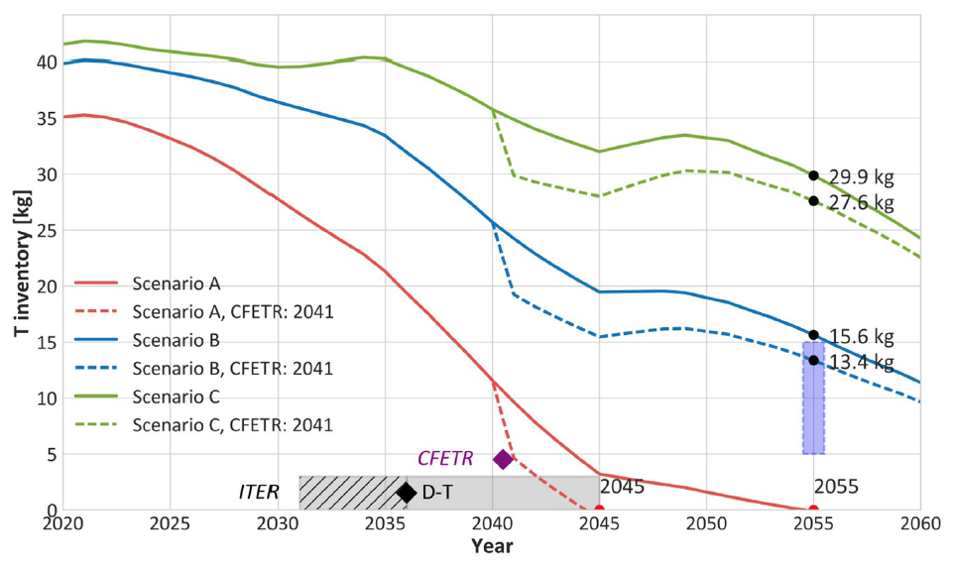


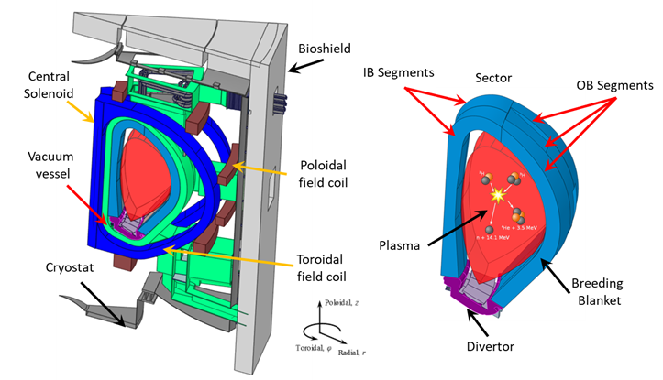
Breeding Blanket R&D Programme: Background
Breeding blanket technology is crucial for the development of fusion power
  Heat removal for electrical production: (~300-500 MWe) predictably and safely, with minimal environmental impact
    use Reduced Activation Ferritic-Martensitic ‘RAFM’ steel → EUROFER
    minimization of tritium permeation, dust and corrosion products generation
  Breed tritium: “a 2 GW_{th} fusion power DEMO will consume around 111 kg T/FPY, and this clearly underscore the indispensable requirement to achieve T-self-sufficiency”
  Radiation Shielding of the Vacuum Vessel and Coils
    Absorb plasma radiation on the first wall
    Dose in epoxy / 10 fpys - Limit: 50 MGy
    N-heating - Limit: ~444 W/m³ (TF cond.)
M. Kovari et al, (2018) Tritium resources available for fusion reactors, Nuclear Fusion, 58, 026010, DOI: 10.1088/1741-4326/aa9d25
  The main BB Loads and boundary conditions are:
    Inertial (dead weight and earthquake)
    Thermal (nuclear heating and heat fluxes)
    Pressure and Electromagnetic loads
    Material damage

Slide 3
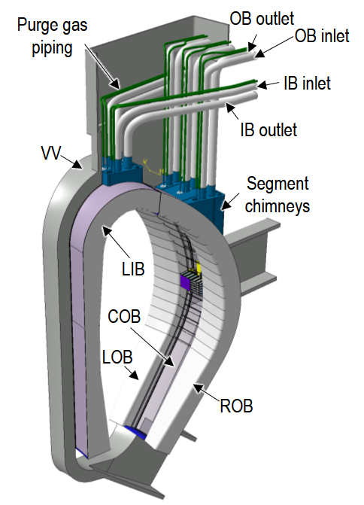
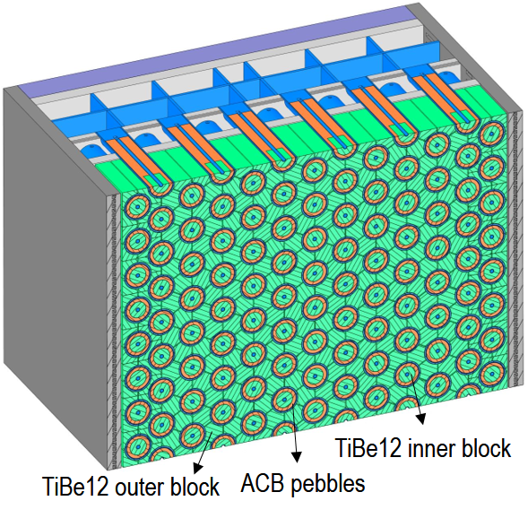
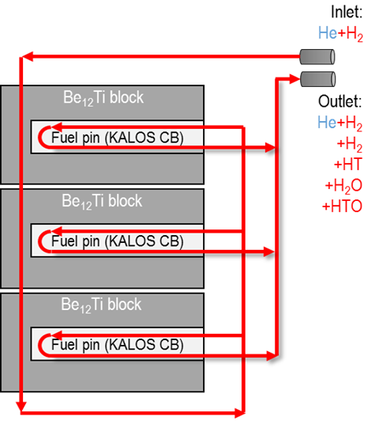
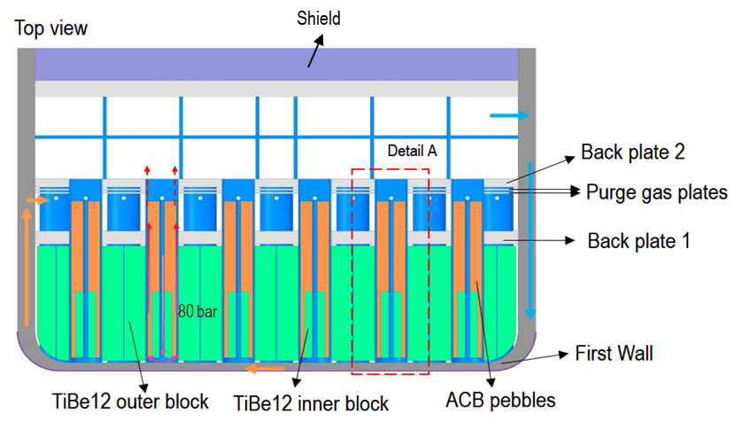
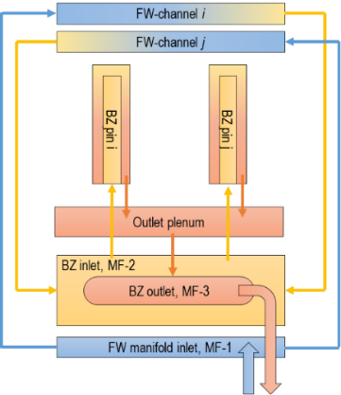
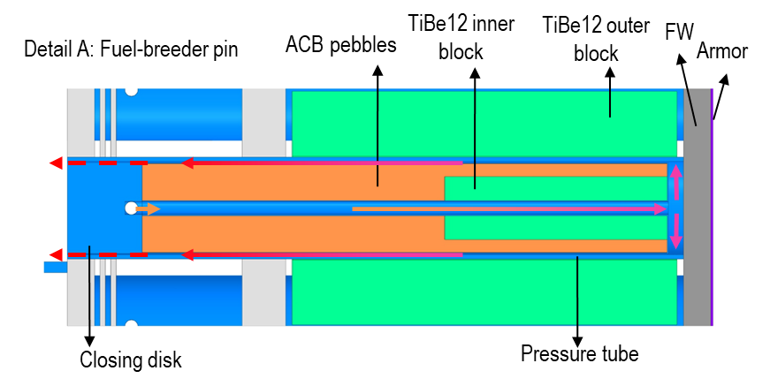
Current BB design variants: the HCPB concept
G. Zhou et al, (2023) The European DEMO Helium Cooled Pebble Bed Breeding Blanket: Design Status at the Conclusion of the Pre-Concept Design Phase, Energies, 16, 5377 , DOI: 10.3390/en16145377
Helium Cooled Pebble Bed Concept (HCPB)
Structural Material: EUROFER (RAFM steel), ~3000 t
Breeder: ACB-KALOS (Li₄SiO₄ + 35 mol% Li₂TiO₃ ) in form of a pebble bed, ⁶Li at 60%, ~165 t
Neutron multiplier: Beryllide (TiBe₁₂) hexagonal rods, 612 t
Coolant: helium 300-520°C @ 8 MPa, ~ 4.2 t
Plasma protection: 2 mm W layer (wo Limiters)
T extraction with purge Helium: 0.1% H₂ (%H₂O) @ ~8 MPa, ~ 137 m³

Slide 4
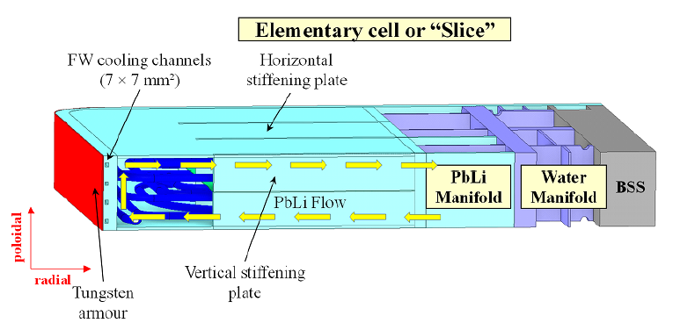
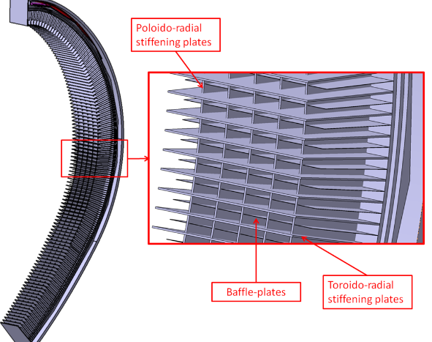
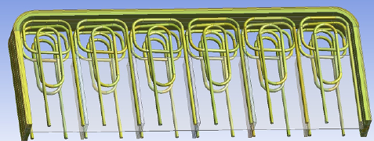
Current BB design variants: the WCLL concept
Water Cooled Lead Lithium Concept (WCLL)
Structural Material: EUROFER (RAFM steel), ~3500 t
Breeder/neutron multiplier: PbLi (⁶Li at 90%) liquid (~330 °C @ 0.25-1.55 MPa), ~10,000 t,
Coolant: Water (295-328°C @ 15.5 MPa), ~520 t
Plasma protection: 2 mm W layer (wo Limiters)
T extraction from recirculating PbLi
P. Arena et al, (2023) Design and Integration of the EU-DEMO Water-Cooled Lead Lithium Breeding Blanket, Energies, 16, 2069 , DOI: 10.3390/en16042069

Slide 5
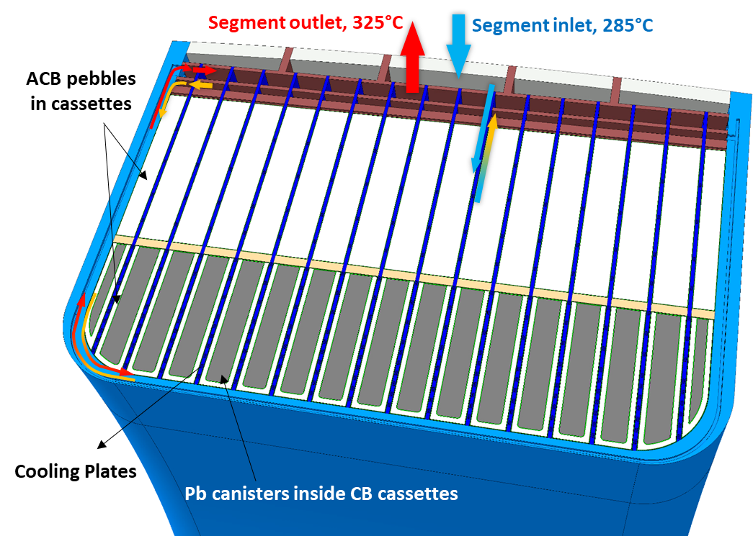
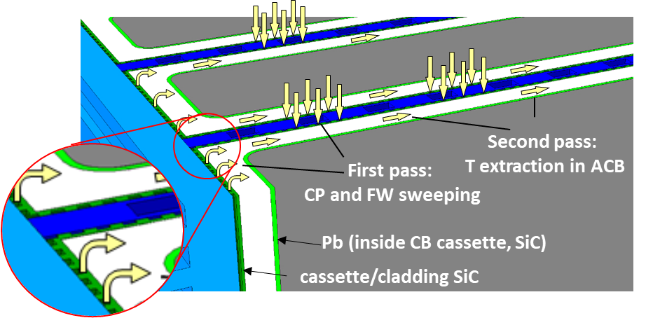
Exploring variants: the WLCB concept
    Water-cooled Lead Ceramic-Breeder Concept (WLCB)
    Structural Material: EUROFER (RAFM steel)
    Coolant: Water at PWR conditions (285-325 °C @155 bar)
      cooling scheme: BZ and FW in series
      radial cooling plates (acting as stiffeners)
    Breeder: ACB (Li₄SiO₄ + 35 mol% Li₂TiO₃ ) in form of a pebble bed, ⁶Li at 60% and Li₈XO₆, X=Pb, Zr…) in cassettes
    Purge gas: He + %H2 @2bar
    Neutron multiplier: molten Pb in cassettes
    Neutron spectra shifter: metal hydride such as ZrH_{x} (?) or YH_{x} (?) in cassettes
    Cassettes (cladding): SiC (?) ~2 mm thick

Slide 6
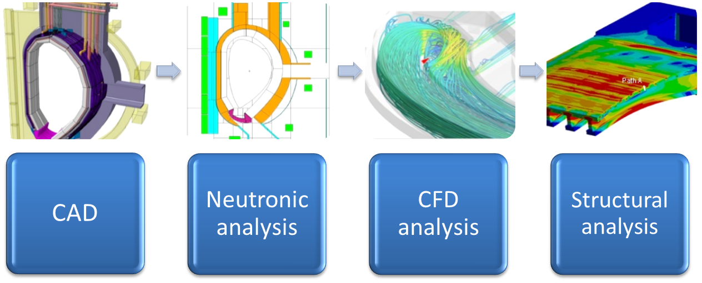
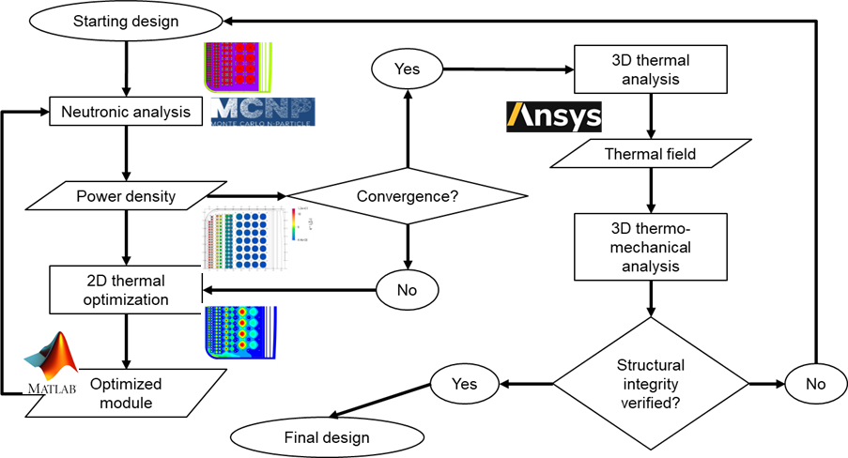
Important points and possible problems around the topic:
BB modelling (for minimum design)

Slide 7
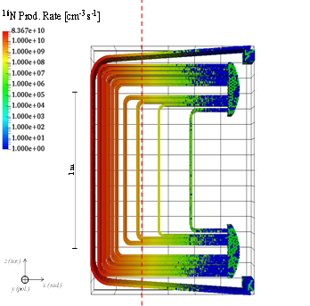
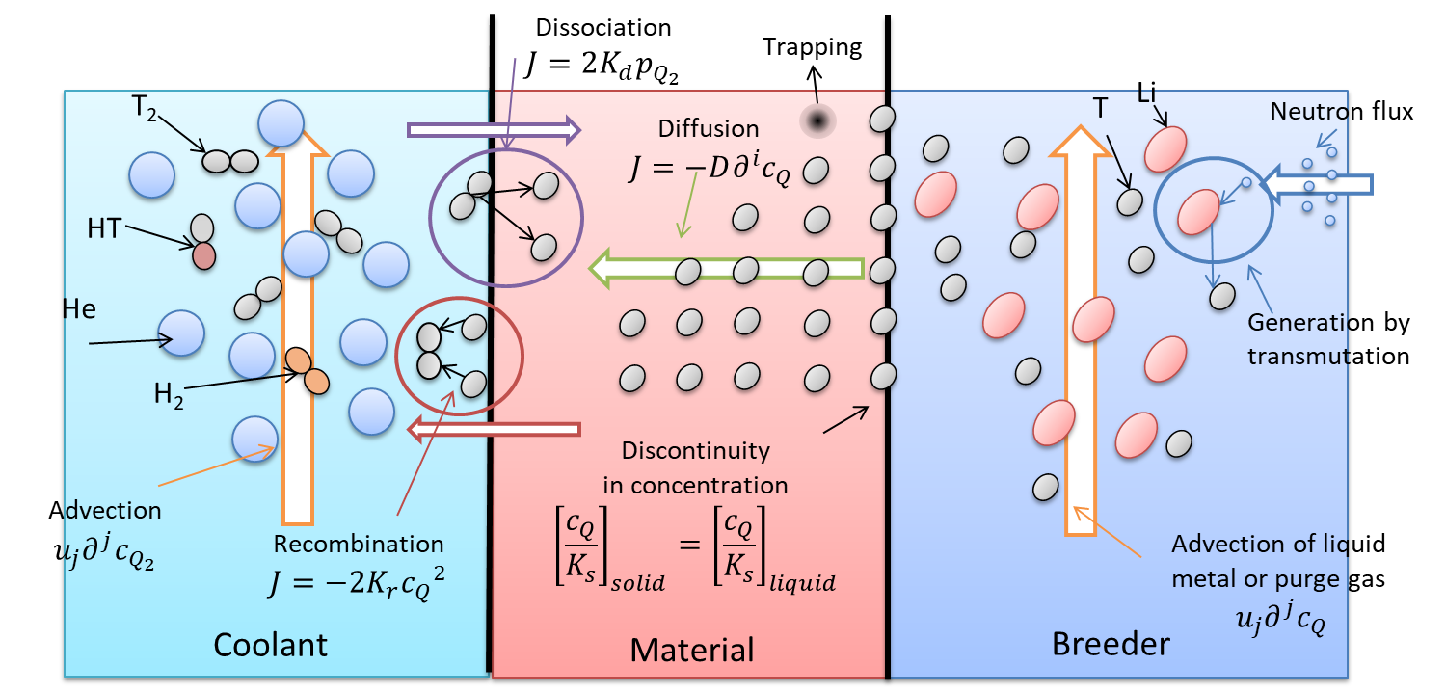
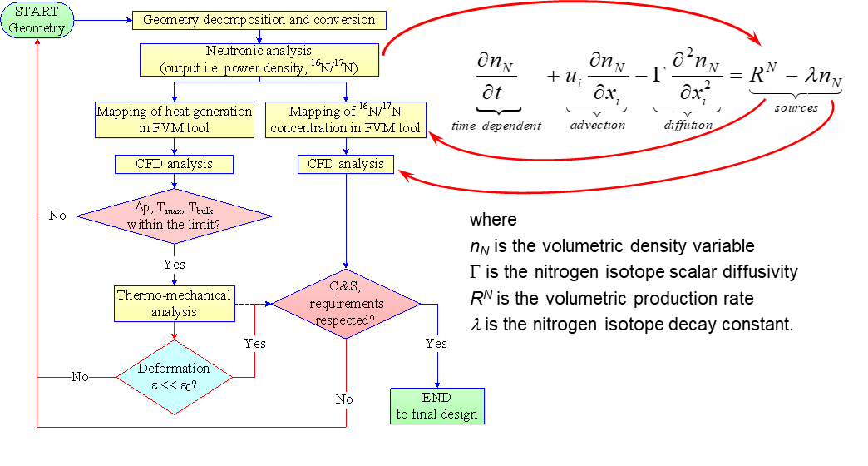
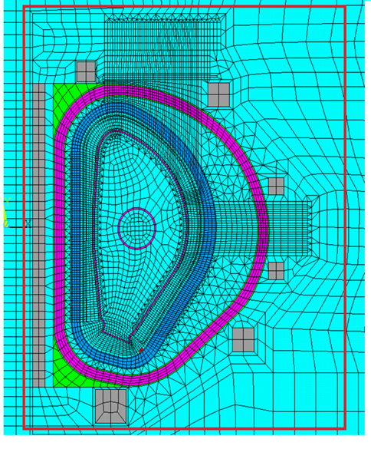
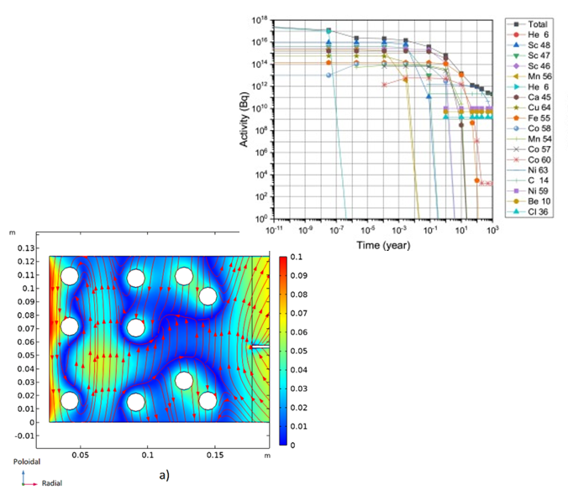
Important points and possible problems around the topic:
BB modelling (for extended design)
Water activation analysis
Tritium transport analysis
Electromagnetic analysis
Etc. (e.g. MHD, activation, …).

Slide 8
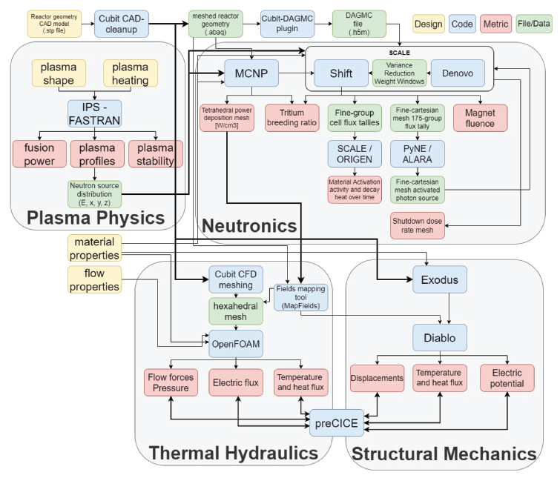
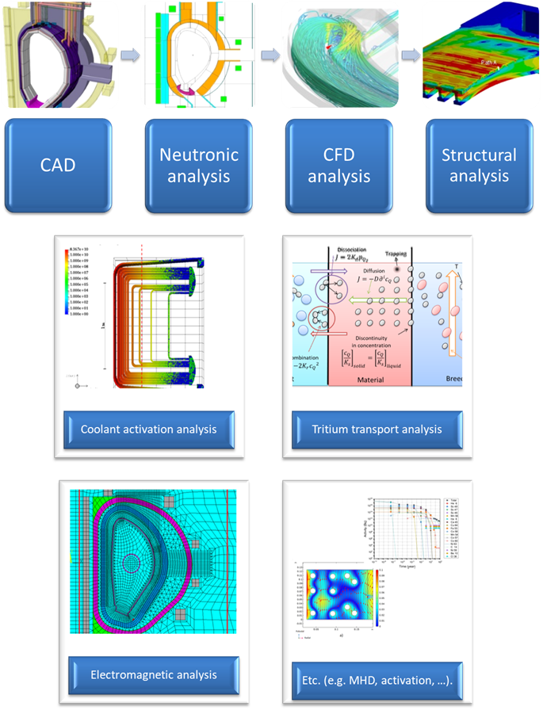
Toward a Breeding Blanket Digital Twin?
Near term objective: identification of a common simulation framework plus workplan for its development
No integrated or component tests in a relevant environment available
Digital Database
Uncertainties Evaluation
V. Badalassi et al, (2023) FERMI: Fusion Energy Reactor Models Integrator, Fusion Science and Technology, 79, 345-379 , DOI: 10.1080/15361055.2022.2151818

Slide 9

… for your kind attention!

Slide 10
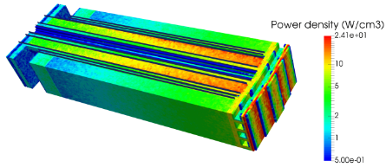
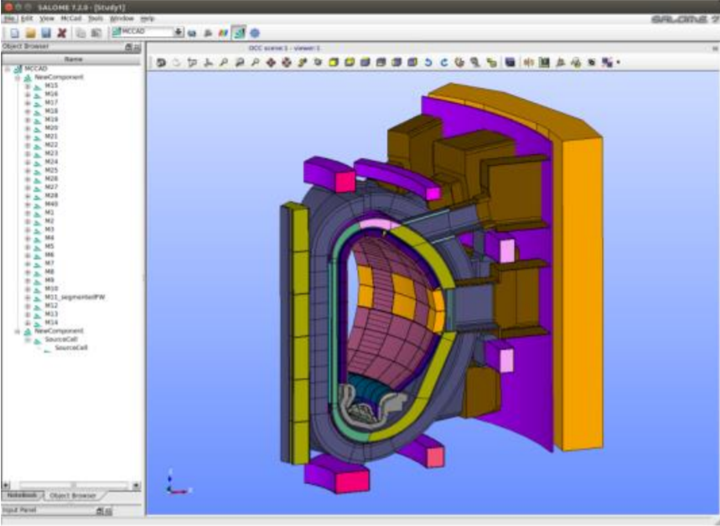
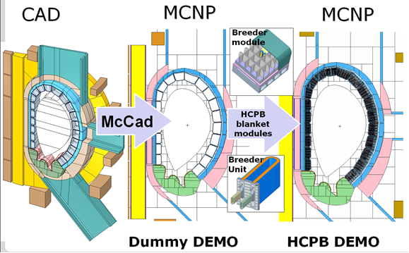
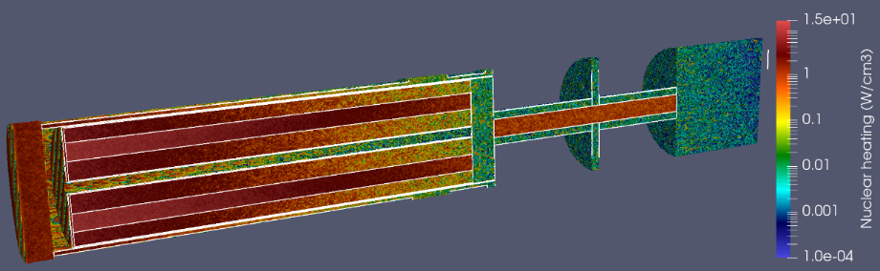

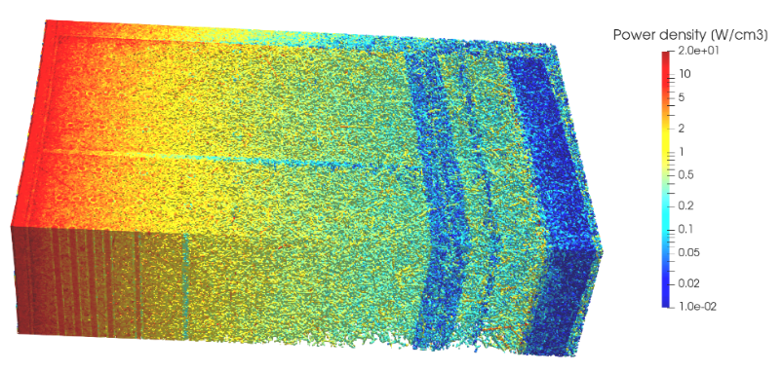
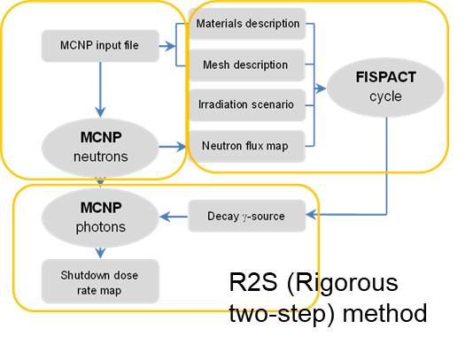
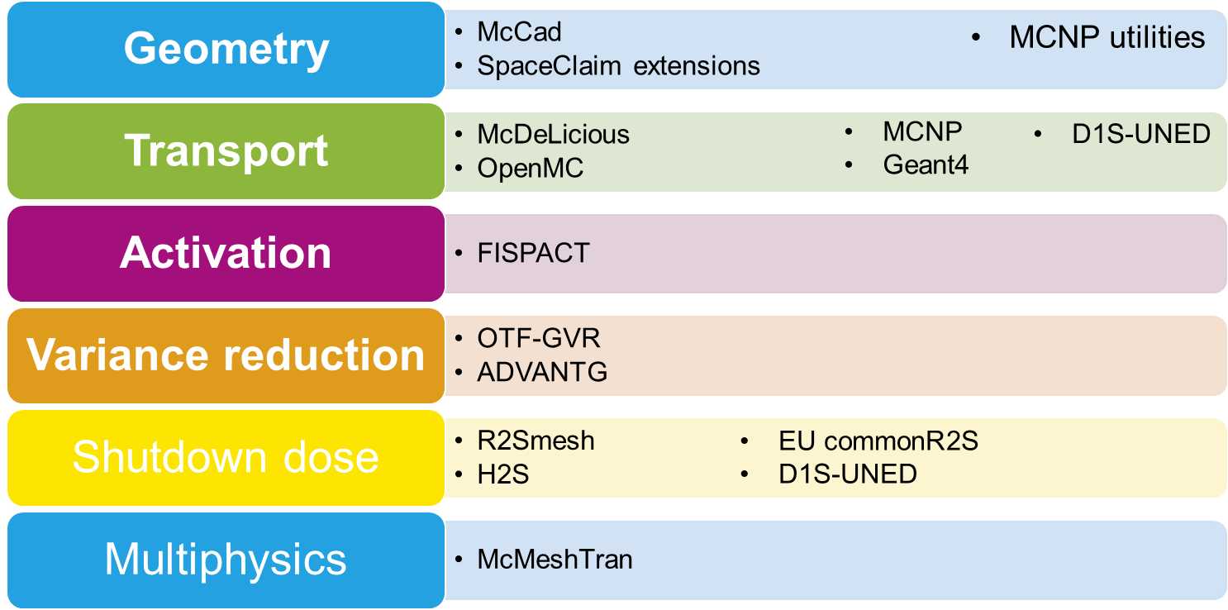
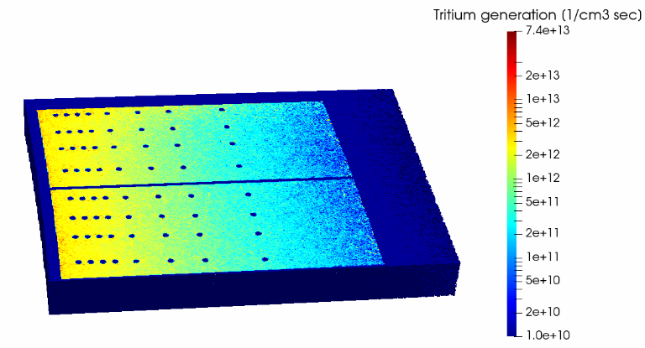

Neutronic analysis
Neutronics workflows for system design and plant radiological protection analyses
HCPB Blanket MCNP model
Courtesy of D. Leichtle
Nuclear responses (heat, flux, etc.)

Slide 11
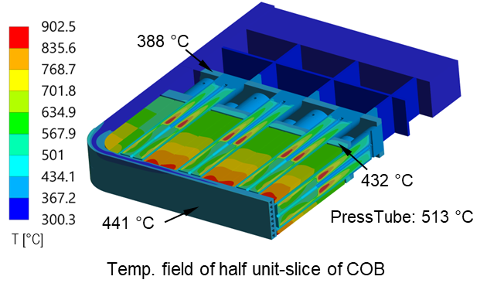
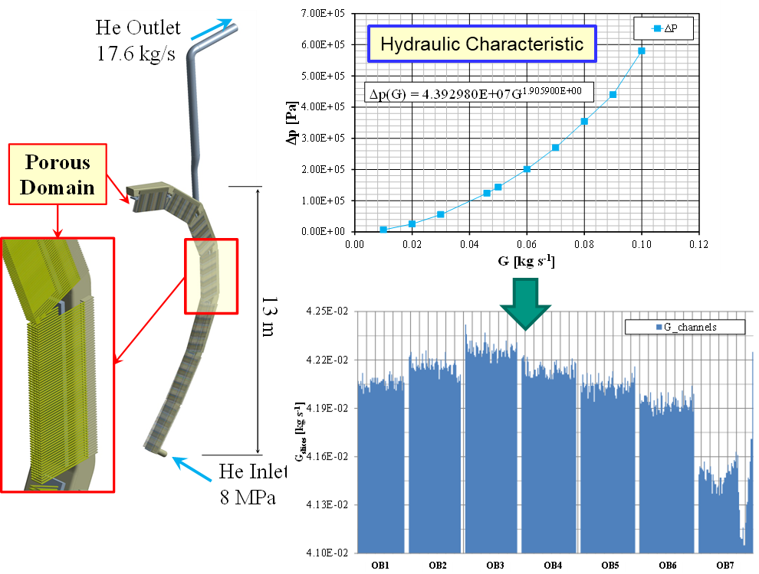
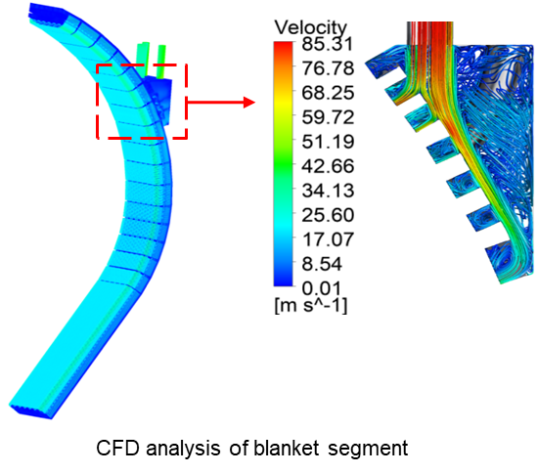
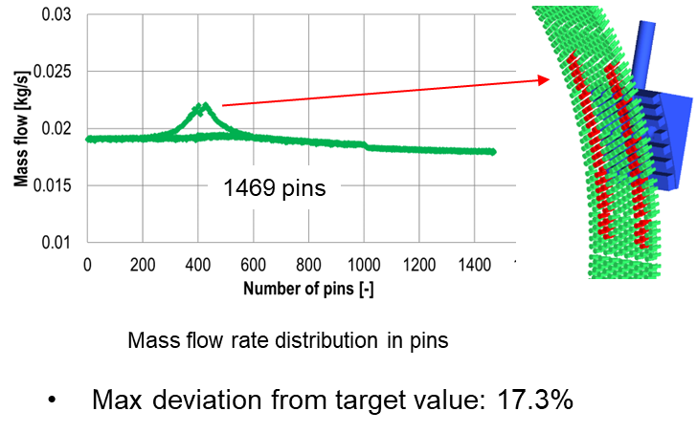
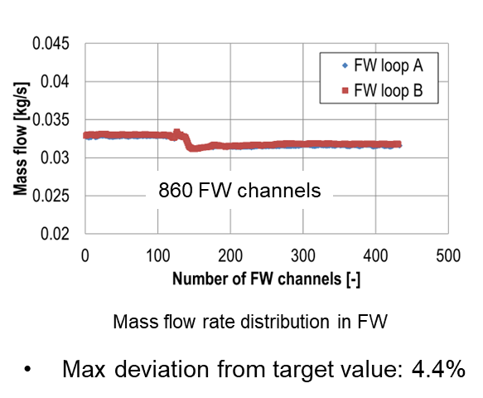
Thermal-hydraulic analysis
Local model
Implementation of material properties, correlations (e.g. contact resistance, etc.)
Power density on the whole volume;
Non-uniform heat flux on the FW (max 0.1-0.5 MW/m²);
Temperature and mass flow rate of the working fluid;
Adiabatic conditions on the sides and back of the BB;
Symmetry conditions in the poloidal direction.
Segment model
Use of porous domains.
Courtesy of G. Zhou

Slide 12
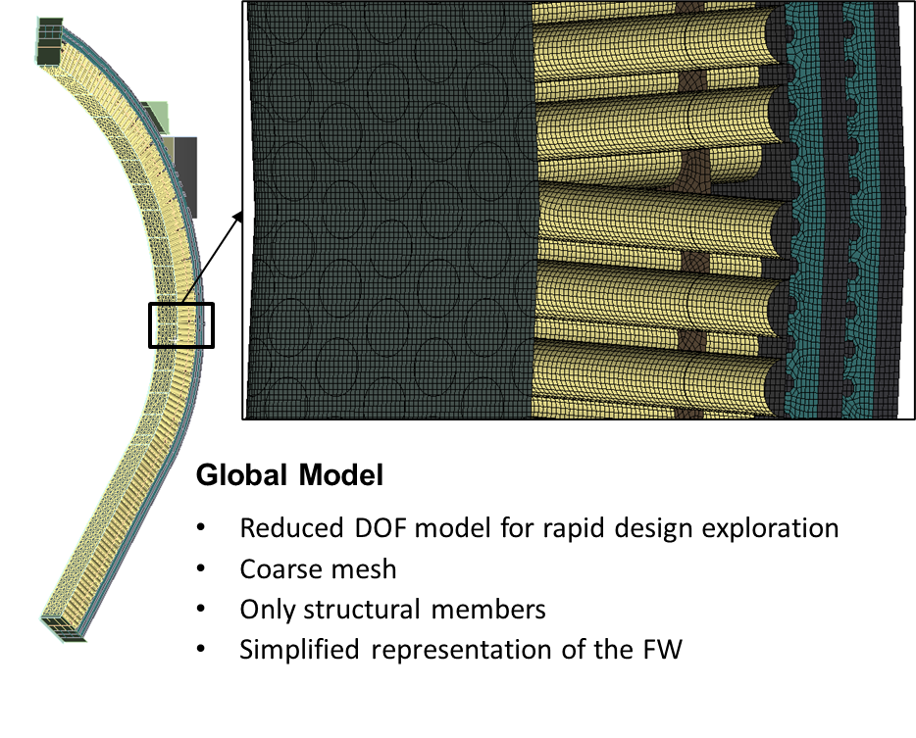
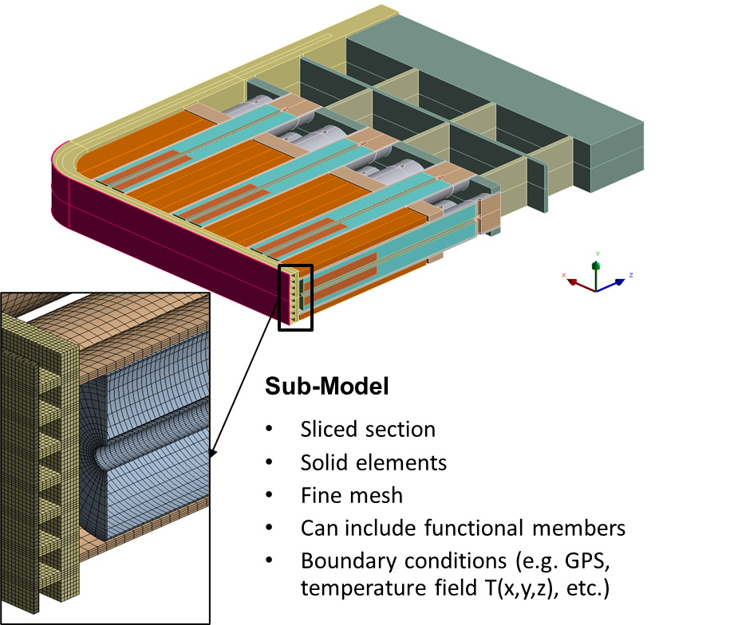
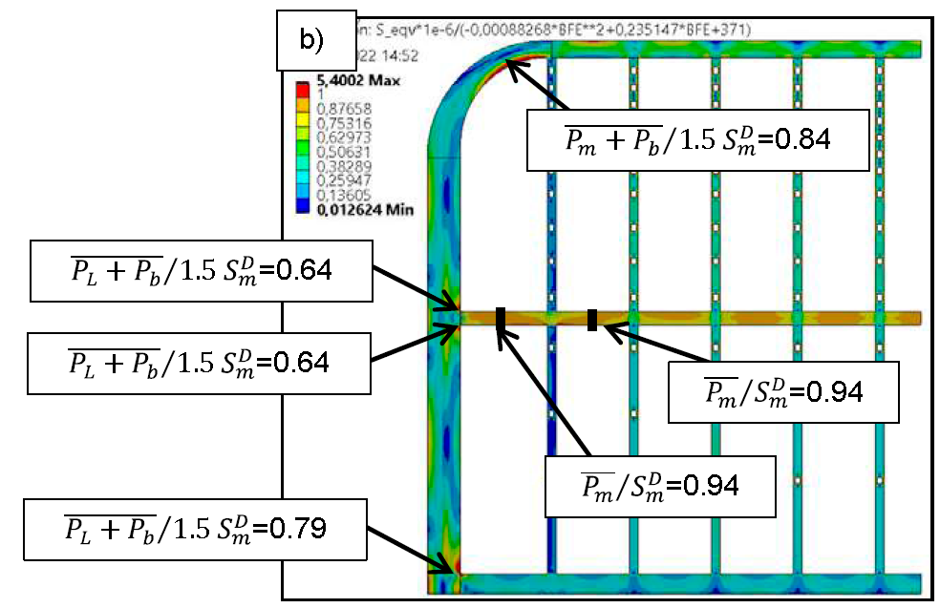
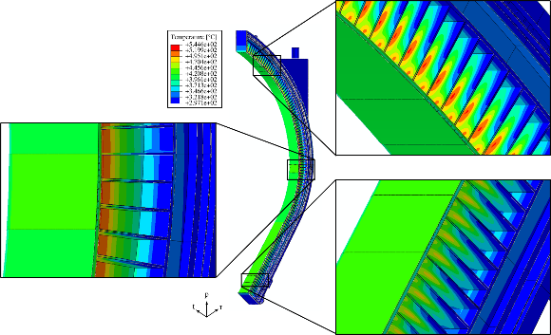

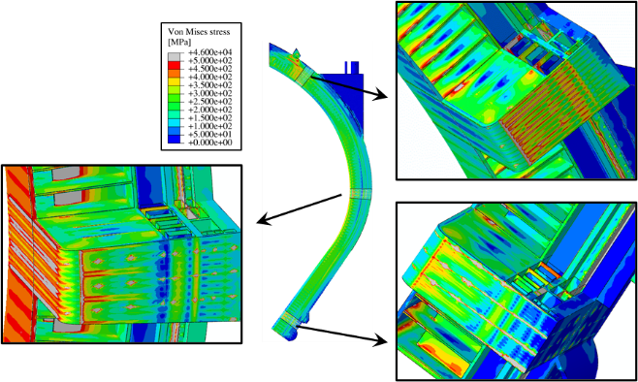


Structural analysis
Courtesy of A. Retheesh
Courtesy of I. Catanzaro
Shift channels 2mm inwards

