Slide 1
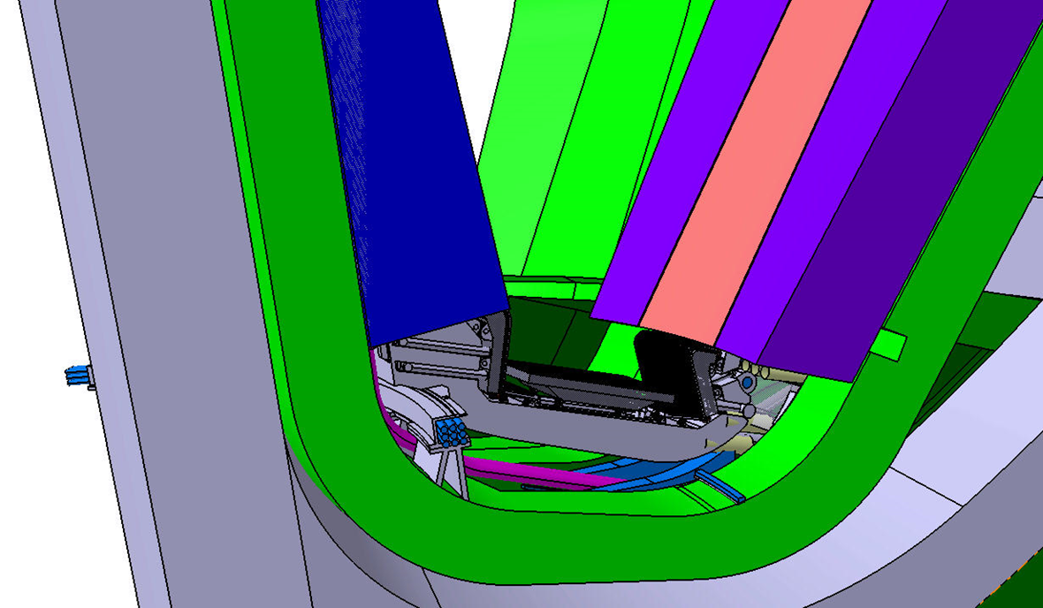
EU DEMO Divertor: high-level requirements
‘2020’ DEMO baseline (P_{fus}: 2 GW, P_{sep}: 154 MW, $f_{rad}^{div}$: ~0.8, NWL: 1 MW/m²)
Power to exhaust (to be revised)
nuclear: 139 MW, particle: 122 MW, radiation: 78 MW
Peak power density: 10-20 MW/m² at the SP, ~8W/cm³ in the PFCs
Required shielding for the VV: ≤ 1 dpa/6 fpy
Specified lifetime: ≥ 1.5 fpy
Reduced activation (ILW: ALARA), no HLW
R.A.M.I. + recyclability
48 cassette modules, 16 lower ports
1

Slide 2
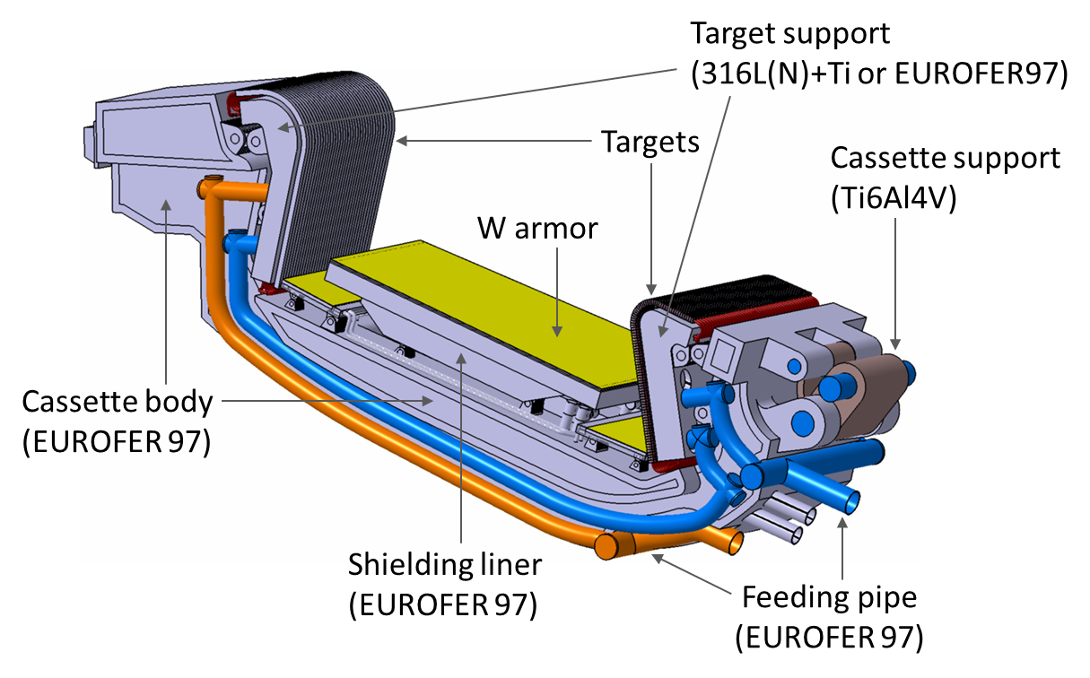
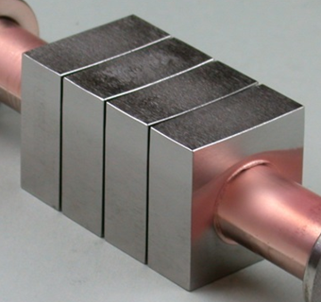
Divertor : Important points and possible problems
Optimal PFCs contour configuration (thermal loads/power exhaust, gas conductance/pumping)
Design concept complying with high level stakeholder requirements (R.A.M.I., waste, safety)
Operational uncertainty related to transient events (foreseen/accidental)
Currently, design not fully verifiable due to low technology maturity (TRL/MTRL ≤ ~4)
W
CuCrZr
ITER-like tungsten monoblock target
Block width: 23-26 mm
Armor thickness: 6-8 mm
Block thickness: 12 mm

Slide 3
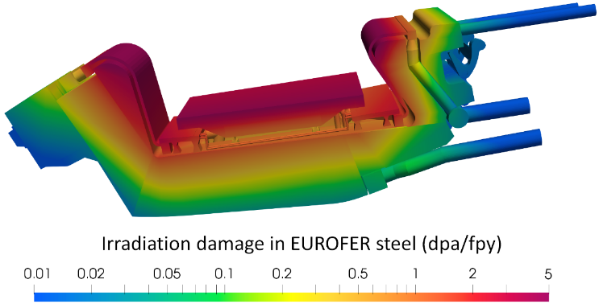
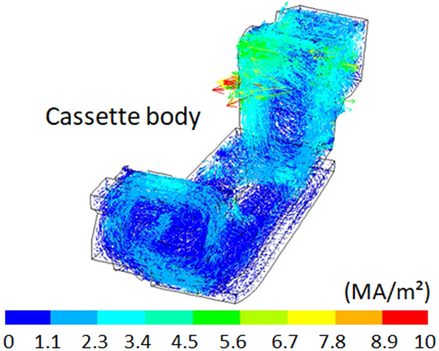
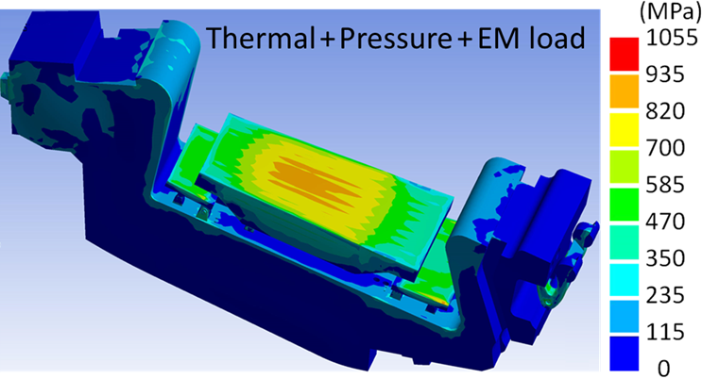
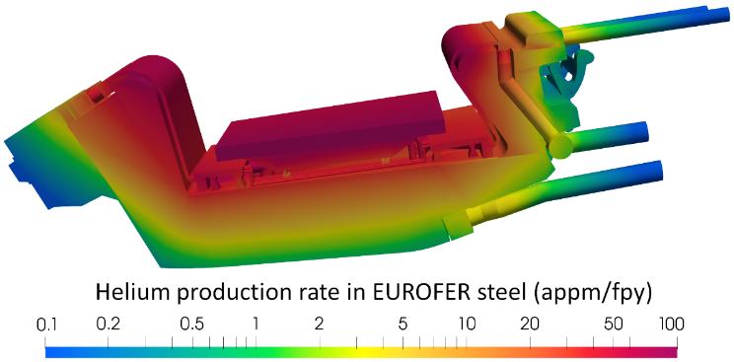
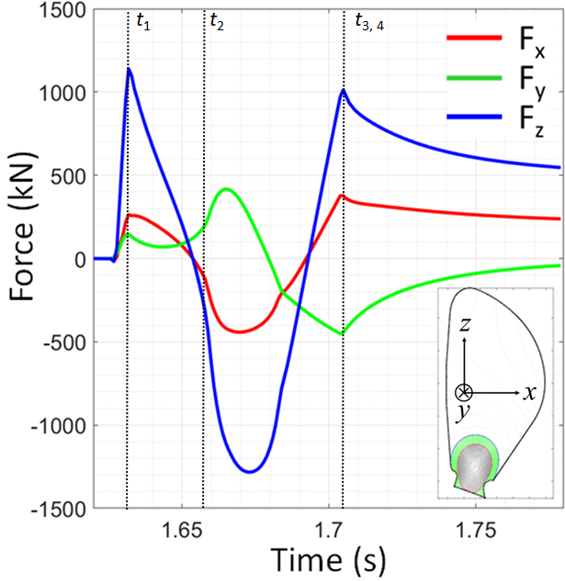
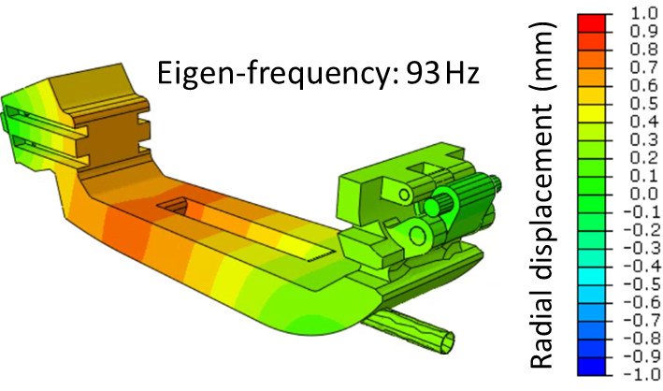
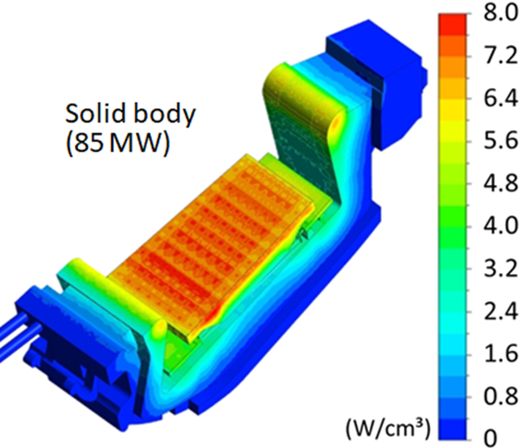
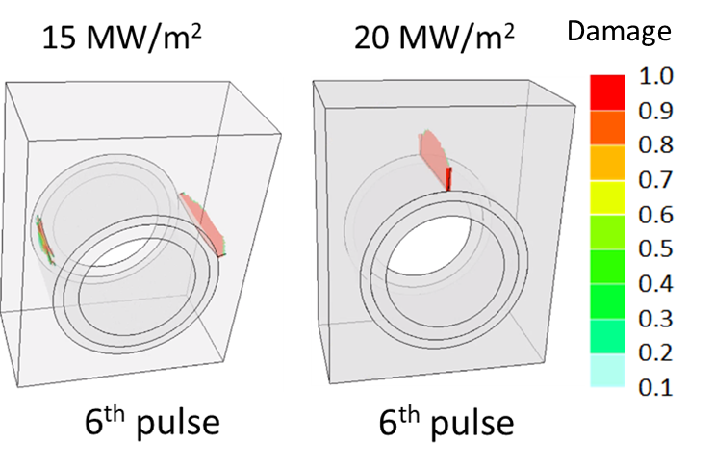
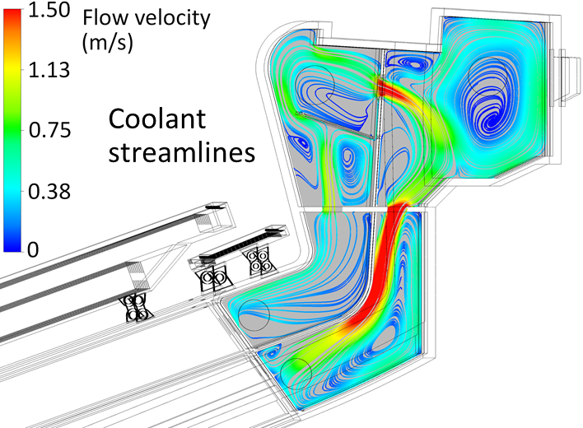
Divertor: Multiphysics simulation
Neutronics
Electrodynamics
Structural mechanics
Structural dynamics
Magneto-
mechanics
Thermo-hydraulics
Fracture/failure mechanics

Slide 4
Divertor : Initial ideas on how to set up digital twins
Option 1: Physics-based preliminary iterative optimization of PFCs contour configuration
approach: (sequential) coupling of CAD layout, SOLPS & DIVGAS (ITERVAC?), ERO
motivation: integrated simulation framework based on a common design platform
issues: big difference in computational time-scale/method, multiple parameter ranges
deliverable in 2025: concept feasibility study & a case study as proof-of-methodology
Option 2: Integration of radiolysis/ACP (& CFD?) simulation modules for divertor/limiter/PHTS
approach: creating computational interfaces to define boundary conditions at junctions
motivation: assessment of thermohydraulic/nuclear behavior of coolant at the plant scale
issues: computational feasibility not ensured
deliverable in 2025: concept feasibility study & a case study as proof-of-methodology
Option 3: Coupled structural dynamics of DIV/BB/VV by EM loads upon VDE-D (back-up)

