Slide 1
Important points and possible problems around the topic: Tokamak control functions
Design for Control
Supervisory
Coordination
Pre-programmed events
Stochastic events
Magnetic configuration
Burn & profiles
“kinetic”
Exhaust & divertor state
Break-down
Burn through, current ramp,
flat top,
Magnetic configurations changes
LH /HL transition
Operational limits
MHD
Density
Radiation
Actuator failure
Sensor failure
Ip
Magnetic configuration
Position, shape
Vertical stability
β, n_{e}, J, T_{e} control
DT ratio control
P_{fus} control
Low Z_{eff} accumulation, incl. He accumulation
High Z_{eff} shielding
Dissipate 90-95% of P_{SOL} via controlled injection of impurities and fuel

Slide 2
Initial ideas on how to set up digital twins for the topic: Synthesis-based engineering
synthesize
generate and implement
C
C_{R}
formalize
C_{R}
C
extract
define
H_{R}
Hardware-in-the-loop
extract
P_{R}
P_{D}
P
P_{H}
P
design
model
enrich
realize
Synthesized supervisory controllers
based on plant and requirement models
nonblocking, controllable maximally permissive
Possible behavior satisfies imposed requirements
Not restricting more than necessary
Can deal with VERY large discrete state-spaces
Extensive validation required.
Simulation
System test

Slide 3
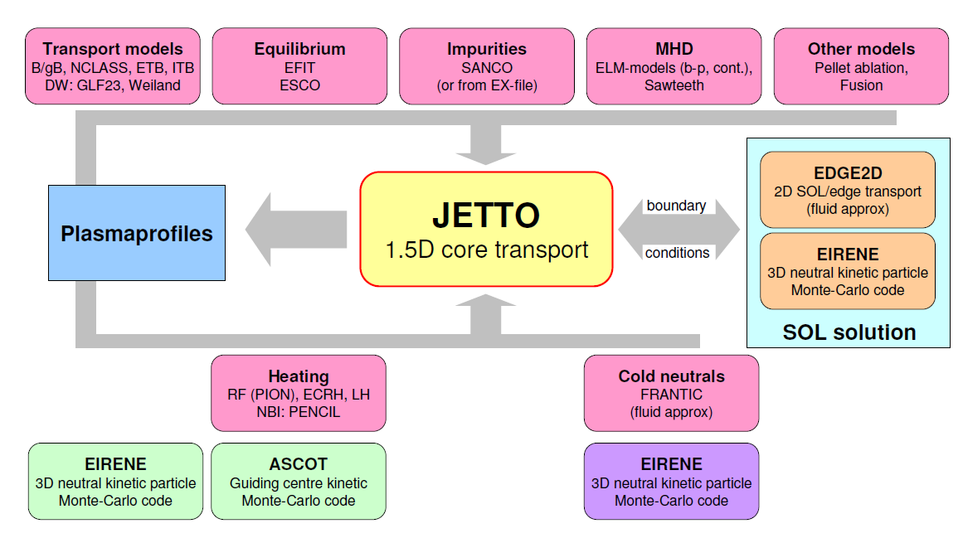
The vision: Interfacing of advanced controllers with full device code (e.g. JINTRAC using “muscle 3”).
Magnetic config Controller
Exhaust Controller
H-mode
Controller
Supervisory Controller
Density
Controller
Ti, Te, j
Controller
Burn
Controller
MHD
Controllers

Slide 4
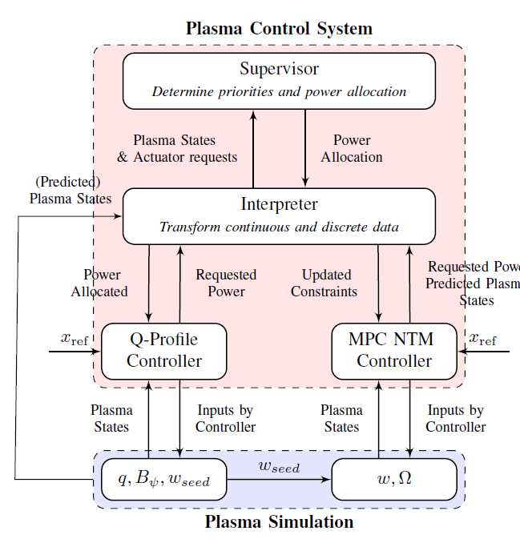
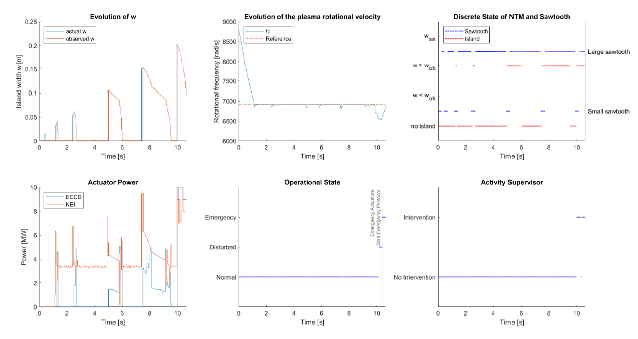
What could be delivered at the end of a 1 year pilot project? First result synthesized supervisor for reduced model
Non-blocking, maximally permissive.
10¹² discrete states for reduced model.
Projects for Lithography ~10⁵⁰, Ministry infrastructure and public waterways ~10²⁴⁰.
SC synthesized in < 10s on a std. laptop. Evaluated ~1ms
Very promising!!

Slide 5
Complexity in Nuclear Fusion Plasmas Implications for fusion plasma control
The physics is –mostly- known well enough to proceed.
Systems of domain controllers, sensors, actuators, plasma → Model Based Systems and Control
Model predictive controllers exist for magnetics, kinetics, exhaust and stochastic events.
Well beyond standard reference trackers or disturbance rejectors.
Fusion research should now focus on system integration and optimization
System perspective → Model Based System Engineering
Automated fail-safe synthesis of supervisory possible
Validation (model-model), validation (experiment → supervisor), validation (supervisor → experiment)

