Slide 1
Application of Quantum Computing to Plasma Fusion
ENR-MOD SB (Monitoring of 2024 activities)
Christos Tsironis
National Technical University of Athens

Slide 2
QC project team
National Technical
University of Athens
Fikioris Georgios
Glytsis Elias
Hizanidis Kyriakos
Kominis Yannis
Koukoutsis Efstratios
Papadopoulos Aristeidis
Papagiannis Panagiotis
Theodonis Ioannis
Tsironis Christos
Amaro Oscar
Fonseca Ricardo
Gamiz Lucas Inigo
Omar Yasser
Silva Luis
Vranic Marija
EUROfusion Beneficiaries
National Center for Scientific Research “Demokritos”
GREECE
Instituto Superior Técnico
PORTUGAL

Slide 3
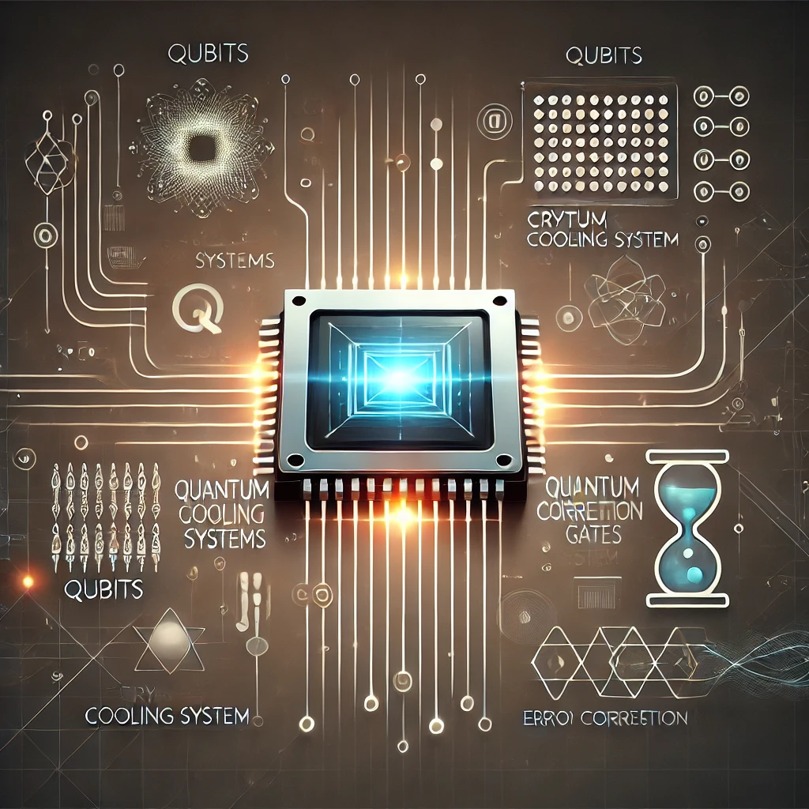
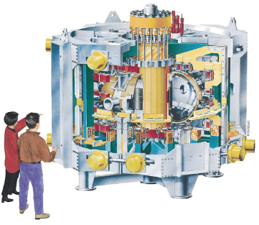
ENR project overview
Objective: Highlight the transformative impact of QC both in computational & theoretical level in plasma fusion.
Quantum computers offer capabilities beyond classical machines → entanglement, quantum parallelism, …
Plasma is dominated by complex/collective processes requiring formidable computational demands (example: EM propagation phenomena that require full-wave description → scattering, mode purity, field polarization, …).
Opportunity for the distinct fields of magnetic & inertial fusion to find synergy in research!
Project implementation based on multidisciplinary team structure & collaboration.
Work breakdown in different parts and goals.
Phase 1 (NTUA): QC formulation & simulation of Maxwell’s equations for electromagnetic waves in cold & thermal inhomogeneous magnetized plasma.
Phase 2 (IST): QC formulation & simulation of 0D 3-wave mixing with variational error correction & quantum representation of the 1D problem.

Slide 4
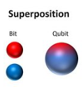
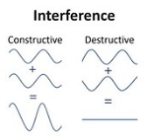
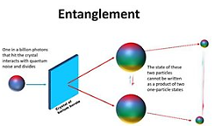
Introduction to Quantum Computing
Quantum computing relies on many fundamental principles of quantum mechanics.
Superposition: State in which a quantum entity can represent not just one possibility, but a combination of multiple possibilities.
Decoherence: Process in which quantum entities can decay, collapse or change, converting into single states (measurable by classical physics).
Entanglement: Process in which multiple quantum entities become correlated more strongly than regular probability allows.
Interference: Phenomenon in which entangled quantum states can interact & produce more or less-likely probabilities.
Decoherence
Qubit
Correlated
qubits
qubit: The fundamental carrier of information in quantum computing!
Qubits can behave like binary bits (store either 0 or 1), but also be weighted combinations of 0 & 1 at the same time!
Each qubit can output only a single bit of information at the end of the computation.
Qubits in superposition can scale exponentially: 2 qubits can compute with 4 pieces of information, 3 with 9, ….
Qubits in superposition can create multidimensional computational spaces where complex problems can be represented in new ways (inherent parallelism: allowing for process of many inputs simultaneously).

Slide 5
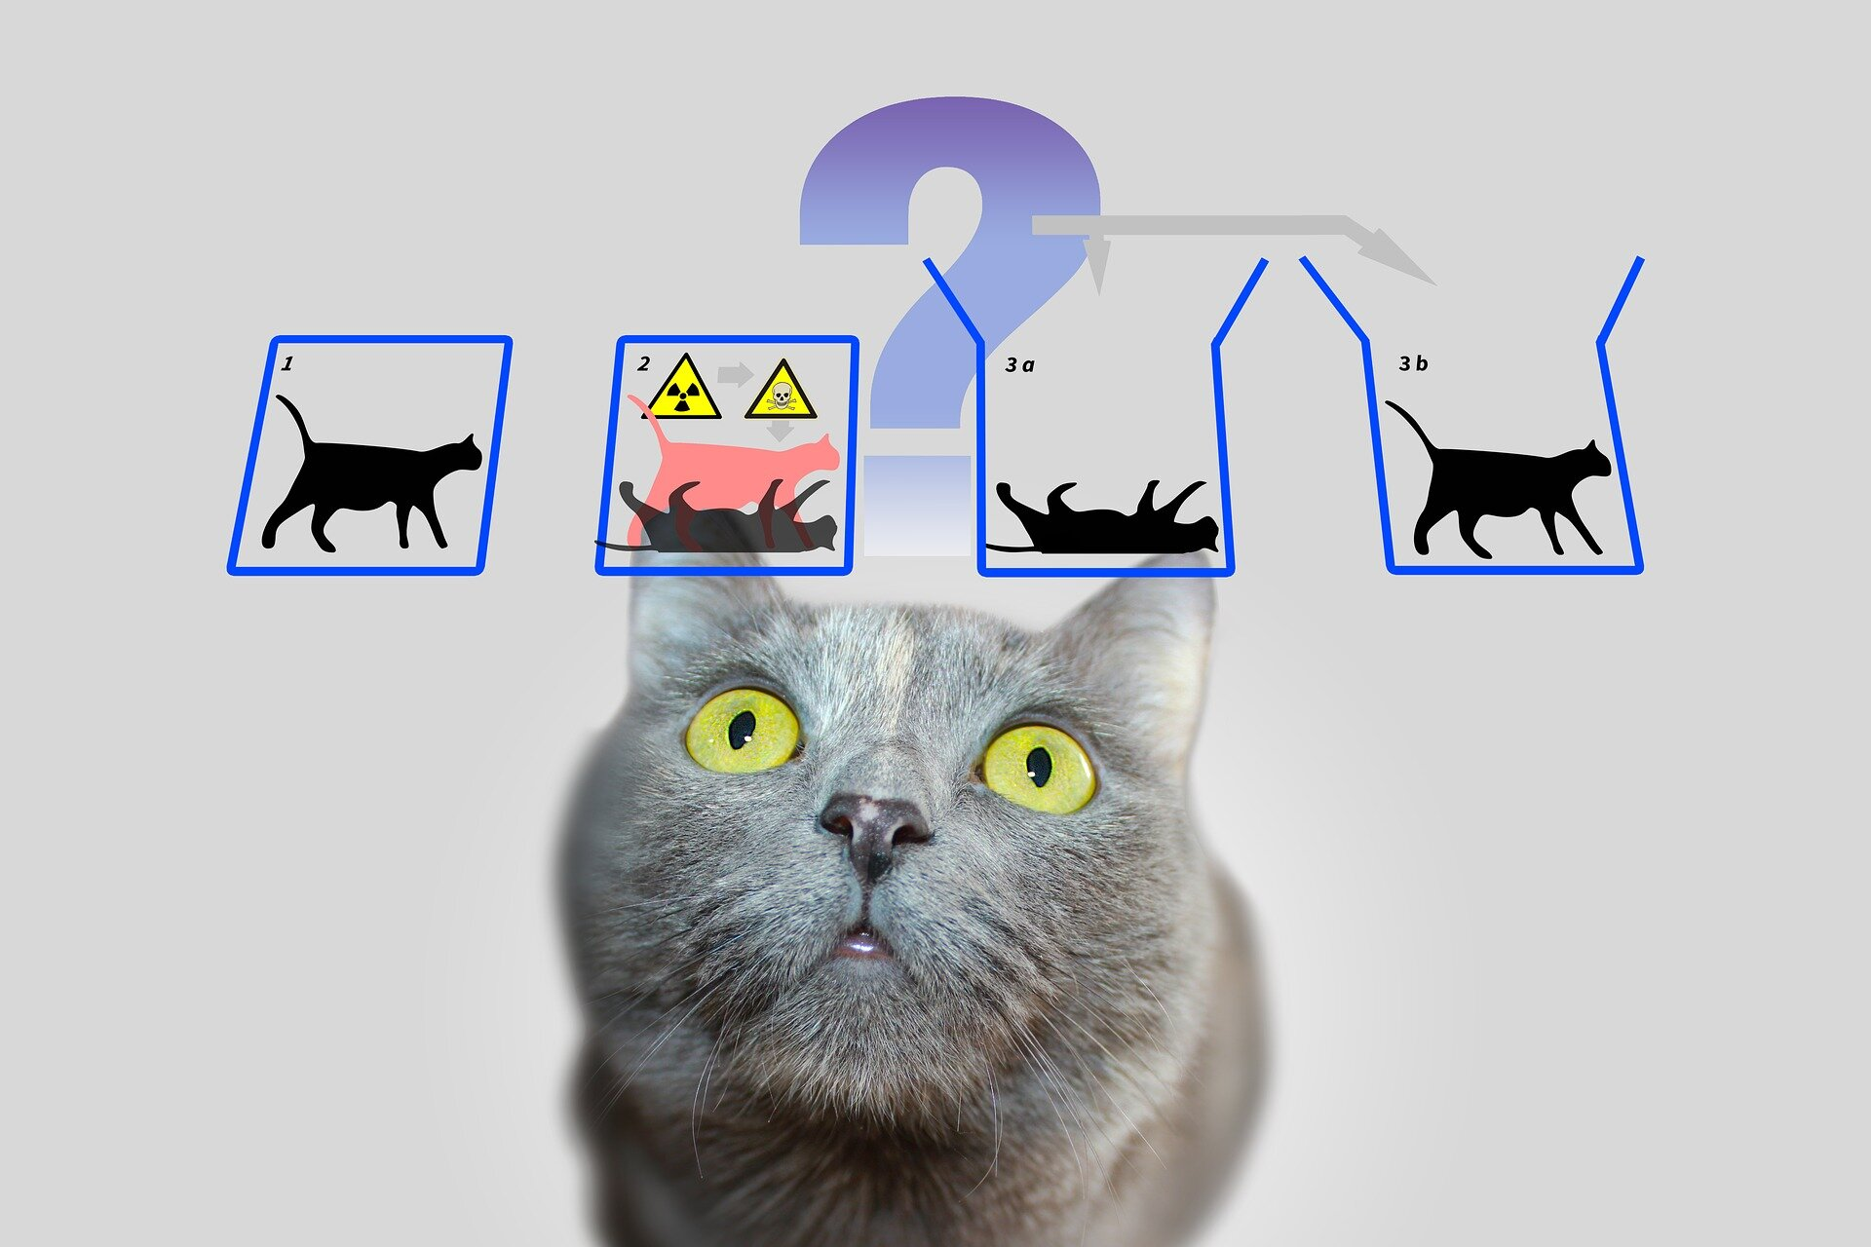
The Schrödinger equation
Quantum computers operate under the physics of closed quantum systems.
Schrödinger equation: with unitary evolution operator .
Unitary (probability-preserving) dynamics dictated by Schrödinger equation:
Probability preservation (for closed systems):
INITIAL
STATE
The above nomenclature describes only the “pure” states of a quantum system!
In general, a system may be in one of a number of pure states $\left.|ψ_{ι}\right\rangle$ with probability $p_{i}$.
Description in terms of the density matrix formalism:
Tr(ρ²) ≤ 1
(=1 @ pure state)
COMMUTATOR
OPERATOR
Positive-definite operator with Tr(ρ) = 1

Slide 6
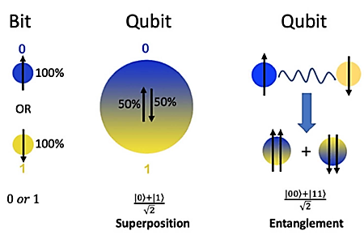
Quantum states
Quantum computers obey the laws of quantum dynamics → Computations should be represented in the analogous math & physics formalism!
Representation of qubit as coherent quantum state:
n qubit composite pure state (in binary number computational basis):
Entaglement:
(COMPUTATIONAL) BASIS VECTORS
①
②
③

Slide 7
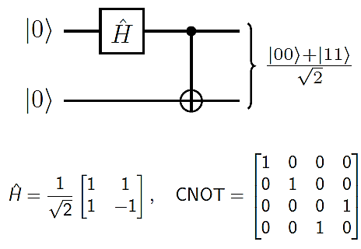
Quantum gates & circuits
Unitary (probability-preserving) evolution allows the use of logical operations.
Simplification in the representation by replacing the (in principle) multiple gates with quantum circuits.
Quantum circuit: Collection of wires ( → qubits) & boxes ( → qubit gates).
Input state provided from left-side, outcome state produced at right side.
Control by 1-bit → solid black dot vs control by 0-bit → hollow white dot.
Advantage if the decomposition to qubit gates is simple ( → shallow circuit).

Slide 8
Quantum simulation of systems described by linear PDEs
Quantum simulation is the process of approximating the unitary dynamics generated by the Hamiltonian operator in Schrödinger equation.
Establish Schrödinger representation of classical linear PDEs to permit quantum simulation of evolution operator $\hat{U}$.
Unitary evolution is present only when $\hat{D}$ is Hermitian tensor (characteristic of conservative systems).
Non-unitary evolution (when $\hat{D}$ has an anti-Hermitian part) connected to dissipation.
Treatment by employment
of other similar techniques
(quantum channels, LCU, …)
GOAL
Implement n-qubit unitary operator $\hat{U}=exp\left(−it\hat{D}\right)$
for total simulation time into O[poly(n)]
elementary quantum gates within accuracy ε.

Slide 9
Quantum approach for Maxwell’s equations
Under the 6-vector formalism for the EM field, Maxwell’s equations can be compactly written in the form of a Schrödinger-like PDE.
Constitutive relations for the fields:
Boundary conditions for the field in configuration space:
Formulation for anisotropic media ( → magnetized plasmas).

Slide 10
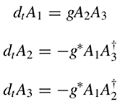
Quantum approach to wave-wave interaction problem
3-wave mixing problem can be described in terms of Hamiltonian formulation.
Hamiltonian system has 2 constants of motion: ( ).
In the basis , any state of the D-dimensional subspace V is represented by .
COUPLING
COEFFICIENT
(Nonlinear) problem mapped to (linear) Schrödinger-like equation!
QUANTUM DESCRIPTION BASED ON THE (DERIVED) UNITARY EVOLUTION MATRIX

Slide 11
Quantum Computing algorithms
Quantum algorithms work by storing and manipulating information in a way not accessible to classical computers, which can provide speedups for certain problems.
A QC computation works by preparing a superposition of computational states.
A quantum circuit uses operations to generate entanglement, leading to interference between the different states.
Many possible outcomes are canceled out through interference, while others are amplified.
The amplified outcomes are the solutions of the computation to the problem.
Qubit encoding: Representation of classical states as quantum superpositions.
First step: Finite spatial discretization of the continuous (classical) state in configuration space.
Second step: Definition of amplitude & spatial registers of qubits.
Third step: Discretization of configuration space on 3D lattice →
Final result: Classical state translates into n=n_{q}+n_{p}–qubits quantum state →
→

Slide 12
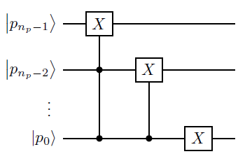
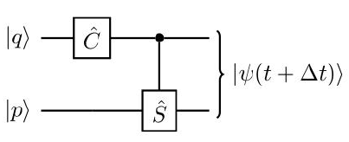
Qubit Lattice Algorithm (QLA)
QLA is actually a multi-dimensional discrete random walk.
.
Implementation of quantum circuit

Slide 13
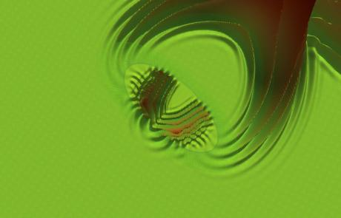
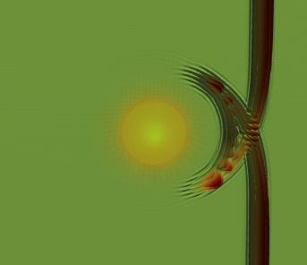
Phase 1 – Deliverable 1
Simulation of propagation & scattering of wave-packets & pulses in cold magnetized plasma with continuous & steep gradient inhomogeneity profiles. Implementation of QLA to quantum circuits & test on IBM Qskit. Comparison of results.
Theoretical setup outlines formal framework & quantum decomposition of the unitary evolution (→ required for constructing a QC algorithm).
QLA simulations of Gaussian wave packet scattering in scalar inhomogeneous dielectrics (corresponding to non-magnetized plasmas) can help testing the capabilities of the (spatio-temporal) initial value simulators.
Follow-up journal publication in preparation: Introduction of explicit algorithm by encoding QLA as quantum walk Hamiltonian simulation process.
Quantum walks have been prioritized over other approaches due to natural alignment with QLA & simpler/explicit encoding.
Includes comparison of the scalings of the quantum algorithm vs classical FDTD (→ testing on IBM Qskit & comparisons linked to Deliverable 2).
1 journal publication (selected as Editor’s pick) & 1 conference presentation.

Slide 14
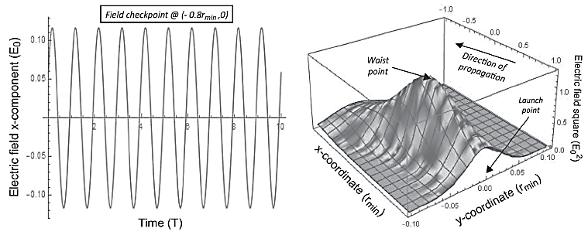
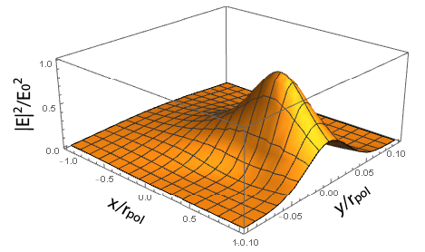
Phase 1 – Deliverable 2
Comparison of QLA & QHS simulation results with FDTD for the same set of equations & parameters. Investigation of limitations & advantages of each method.
QC testing & benchmark delayed (manpower unavailability).
Challenges in defining appropriate initial conditions for QLA (traditional response theory not formulated as IVP).
Theoretical evidence: Resource-efficiency in the asymptotic limit for the quantum walk algorithm over (3D) FDTD method.
Simulations of EM scattering in 3D lattice with N nodes: QLA requires poly(log(N)) logical gates vs FDTD O(N) operations.
Supported by QLA results in reduced non-dispersive cases, capable of capturing full-wave phenomena associated with the geometry & gradient steepness of scatterers.
Performed FDTD simulations of EM wave propagation in cold plasma (preparation for the benchmark with QC method).

Slide 15
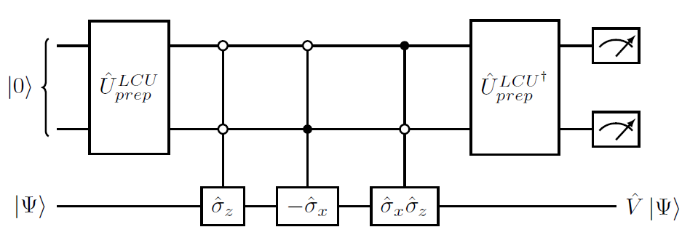
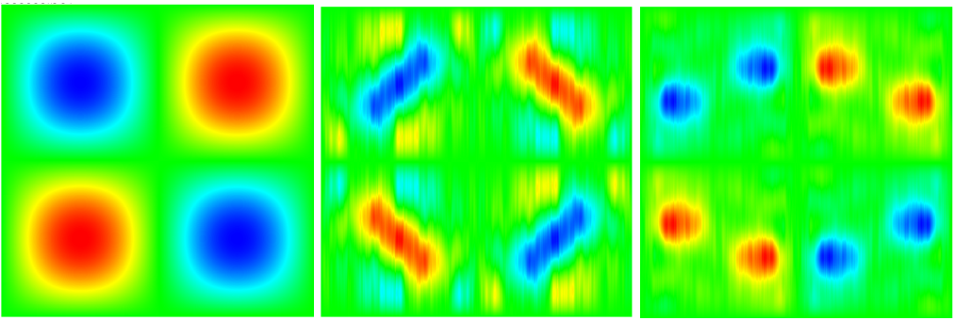
Phase 1 – Work on 2025 deliverables
Formulation of non-Hermitian plasma permittivity tensors for modeling the dissipative and transient regime.
Algorithmic approach to efficiently handle collisional dissipation effects in dispersive media.
Quantum simulation & implementation of non-unitary processes ( → dissipative EM phenomena).
Prepare framework for modelling EM waves in kinetic plasma ( → non-Hermitian permittivity tensor).
2 journal publications (selected as Editor’s Pick).
Transitioning to quantum algorithms for nonlinear physical problems and plasmas.
COLLABORATION WITH IST TEAM
QLA-based approach for tackling problems in classical fluid dynamics with nonlinearities present.
1 journal publication & 2 conference presentations.

Slide 16
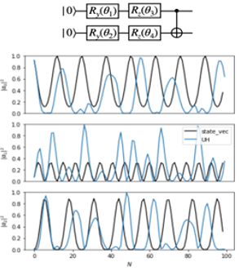
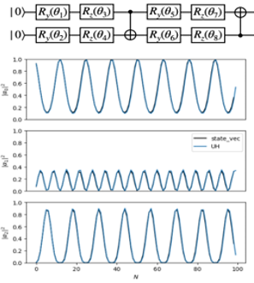
Phase 2 – Deliverable 1
Quantum simulation of 3-wave mixing scenario with different parameters & circuit depths to evaluate the decoherence errors.
Study of 0D setup: Implemented mapping of the occupation probability of each wave to a 2-qubit system.
Standard quantum Hamiltonian simulation can accumulate errors after several time-steps.
Variational approach (VQE) has the advantage of shorter circuit depth & wavefunction reconstruction → Offline post-processing
VQE noiseless simulation of the 0D 3-wave mixing problem for 2 variational ansatzes with different expressibility
Deeper circuits appear more robust than shallower circuits → Optimal observable retrieval might depend on robustness of variational ansatz to noise.
Simulations in real quantum hardware must consider inherent noise → Apply error mitigation techniques (Pauli twirling).
2 conference presentations.

Slide 17
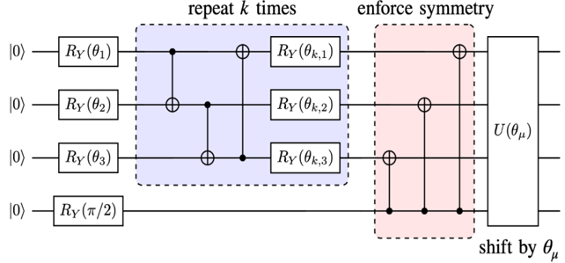
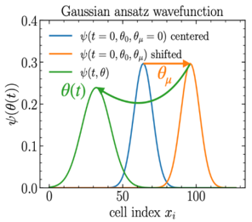
Phase 2 – Deliverable 2
Simulation of same physical setup & implementation on IBM Qskit and IBM quantum computer.
Testing result: Particular ansatz that allows for shallow circuits & stable loading of Gaussian-like wavefunctions with few parameters.
Improved chances of use in quantum hardware!
Quantum circuit implementation: Qubits have Y rotation gate with parameterized variable (except for the last qubit indexed n).
Application of CNOT operations assuming general n-1 wavefunction.
Depth minimization by enforcing mirror-symmetry around half of the computational basis.
Advection operations shift the wavefunction by θ_{µ}.
Improve state-of-the-art: Optimize VQ circuits for more realistic scenarios, with parameters that can be mapped to physical problems.
Study expansions on analytical solutions → predictive power over required computational resources for large-scale QC simulations.

Slide 18
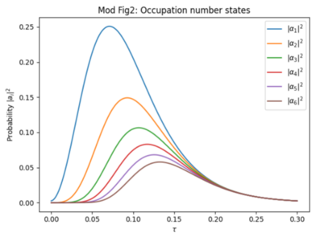
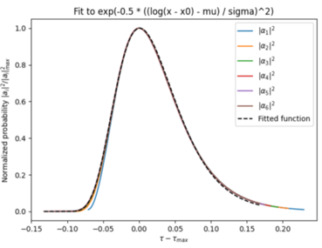
Phase 2 – Deliverable 3
Elaborating different variational algorithm candidates & quantifying the error reduction. Choosing the best method.
Gaussian-like ansatz of Deliverable 2 shows possibility of creating shallow & robust expression that can efficiently reproduce symmetrical functions.
Results published in 1 arXiv preprint.
Caveat of method: Gaussian-like ansatz requires expressions based on a symmetric function.
Fails to reproduce asymmetry effects like skewness.
Performed tests on robustness of the ansatz by varying the quantum circuit size & depth.
In general, the quantum circuit has to have the same number of controlled rotations blocks as its number of qubits.
1 journal publication & 1 conference presentation.

Slide 19
Overview of scientific deliverables
Scientific deliverable (2024 scientific deliverables as specified in the Task Agreement) | Achieved: Fully/Partly/Not | Evidence for achievement, brief reason for partial or non-achievement
Simulation of propagation & scattering of wave-packets/pulses in cold magnetized plasma with continuous & steep gradient inhomogeneity profiles. Implementation of QLA to quantum circuits & test on IBM Qskit. Comparison of results. | Fully | Scientific results included in 1 journal publication (also 1 article in preparation) & 1 conference presentation.
Quantum simulation of 3-wave mixing scenario with different parameters & circuit depths to evaluate the decoherence errors. | Fully | Scientific results included in 2 conference presentations.
Simulation of the same physical set up & implementation on IBM Qskit and IBM quantum computer. | Partly | Delayed due to manpower shift (balanced by progress on nonlinear QC included in 2 conference presentations).
Elaborating different variational algorithm candidates & quantifying the error reduction. Choosing the best method. | Fully | Scientific results included in 1 journal publication & 1 conference presentation.
Comparison of the QLA & QHS simulation results with FDTD for the same set of equations & parameters. Investigation of limitations & advantages of each method. | Partly | Delayed due to manpower shift (balanced by progress on QC formulation for kinetic plasmas included in 2 journal publications).

Slide 20
Dissemination of the project
Publications in peer-reviewed journals (2024)
First author | Title of manuscript | Journal
E. Koukoutsis | Quantum simulation of dissipation for Maxwell equations in dispersive media | Future Generation Computer Systems
O. Amaro | Variational quantum simulation of the Fokker-Planck equation applied to quantum radiation reaction | Journal of Plasma Physics
E. Koukoutsis | Quantum implementation of non-unitary operations with biorthogonal representations | Quantum Information & Computation
M. Soe | Quantum lattice representation of nonlinear classical physics | Radiation Effects and Defects in Solids
Planning for journal publications in 2025
Invited talk by K. HIZANIDIS,
ICEAA-IEEE-APWC, Portugal 2024
• Space-time algebra formulation of cold magnetized plasma (arXiv preprint)
IBM Qskit implementation of cold-plasma propagation & benchmarking with classical methods.
Theoretical framework & circuit implementation for EM wave dissipation in kinetic plasmas.
Theoretical framework & mapping strategy to QC for the extension of 3-wave mixing system to 1D.
Implementation of 1D three-wave mixing evolution on a quantum circuit & QC simulations.

Slide 21
Dissemination of the project
Poster presentations in conferences (2024)
Presenter | Title of presentation | Conference
E. Koukoutsis | Quantum simulations for EM wave scattering in cold inhomogeneous magnetized plasma | 50th EPS Conference on Plasma Physics (Spain, 8-12/7/2024)
O. Amaro | Quantum hybrid simulation of strong-field QED | 37th European Conference on Laser Interaction with Matter (Portugal, 16-20/9/2024)
E. Koukoutsis | Non-linear quantum computing for plasma physics | 66th APS Division of Plasma Physics Meeting (United States, 7-11/10/2024)
E. Koukoutsis | Non-linear QC for simulation of non-linear physical problems | European Quantum Technologies Conference 2024 (Portugal, 18-20 /11/2024)
O. Amaro | Variational simulation of non-perturbative QED
L. I. Gamiz | Simulating electron-positron pair production using quantum Monte-Carlo
Planning for conference presentations in 2025
51st EPS Conference on Plasma Physics (Lithuania)
European Fusion Physics Conference 2025 (France)
67th APS Division of Plasma Physics Meeting (USA)
E. Koukoutsis (NTUA) & L. I. I. Gamiz (IST) are
preparing the organization of an EPS satellite
meeting on QC for Plasma Physics (12/7/2025)!

Slide 22
Work plan for 2025
Proposal for annual work plan
Title | Description
QLA implementation on quantum hardware & comparison with classical methods | Quantum circuit implementation of QLA algorithm for cold plasma propagation test on IBM Qskit. Comparison of QLA simulation results with FDTD for the same set of equations and parameters. Investigation of limitations & advantages of each method.
QHS & implementation on quantum hardware | Implementation of 3-wave mixing scenario with different parameters & circuit depths on IBM Qskit and IBM quantum computer (if available).
Mapping strategy to QC for 1D extension | Elaborating a strategy to represent a 1D phase-space effectively on Qubits, such that the system can be evolved with a quantum algorithm
Theoretical work for QC to be applicable in a thermal plasma | Representation of Maxwell equations in temporal domain with thermal plasma permittivity tensor as Schrödinger equation.
Implementing 1D 3-wave mixing evolution on a quantum circuit | Development of quantum algorithm. If the hardware is available, the algorithm should be tested directly; otherwise, the results should be obtained on a quantum simulator (including estimated decoherence errors.
Investigation of a quantum implementation | Quantum circuit implementation of electromagnetic wave damping in inhomogeneous thermal (kinetic) plasma.
⧾
⧾
⧿

Slide 23
Change requests for 2025 (wrt initial programming)
Manpower modifications
Inclusion of new team members: Substitution of NTUA group member Prof. E. Glytsis (retirement) by D. Vallis (PhD student, good math background) in Q4 of 2025.
Modifications to commitment: Small PM exchanges between 3 members of NTUA team.
Deliverable modifications
Inclusion of all parts of the 2024 deliverables that have been delayed.
Update of project scope regarding QC implementations & benchmarks for kinetic plasma problems that involve EM wave dissipation (→ set as target beyond this ENR project).
Missions (inside & outside the EU)
Mission program within EUROfusion labs/institutes: No modification wrt initial plan.
Problem/request: A prospect has appeared for fruitful international collaboration with MIT group (↔ but have not re-applied our 2024 IC request, due in November 2024…).

