Slide 1


+
2024 Monitoring Meeting EUROfusion ENR Project (ENR-TEC.02.KIT)
Novel Dual-Harmonic Gyrotrons for DEMO Featuring Fast Switching Between Distant Frequencies: Concept, Elaboration and Experimental Demonstration of Key Elements
Stefan Illy on behalf of the ENR Project Team

Slide 2
Outline
Introduction / Main Objective and Approach
T1: Novel Concepts for Advanced Fast Switching Between Harmonics
  Ultra-fast switching using the acceleration voltage
  Fast switching using a small variation of B-field controlling the electron beam radius
  Dual-harmonic waveguide launchers and quasi-optical system
T2: Enhancements on Mode Selectivity
T3: Multi-Frequency Dual-Harmonic Operation at DEMO-Relevant Frequencies
T4: Preparation of 2nd Harmonic Experiments
Conclusion and Outlook

Slide 3
Introduction

Slide 4
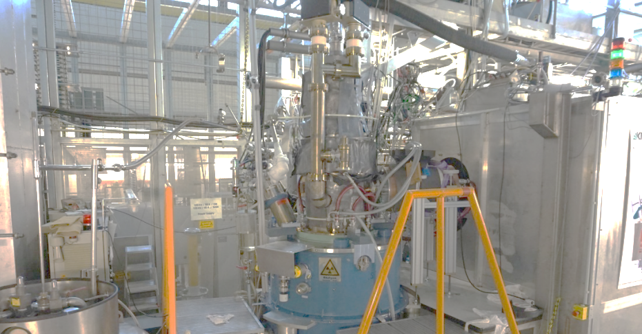
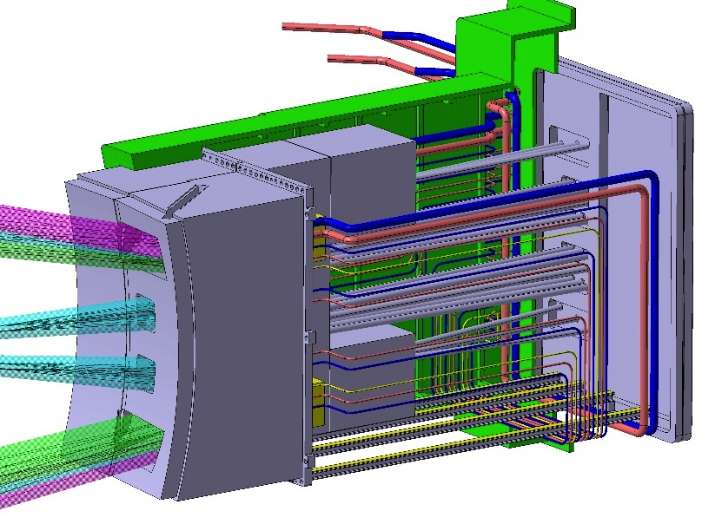
Key Components of the DEMO EC System
Gyrotron
EC equatorial launcher
4
Quasi-optical transmission line
Plasma

Slide 5
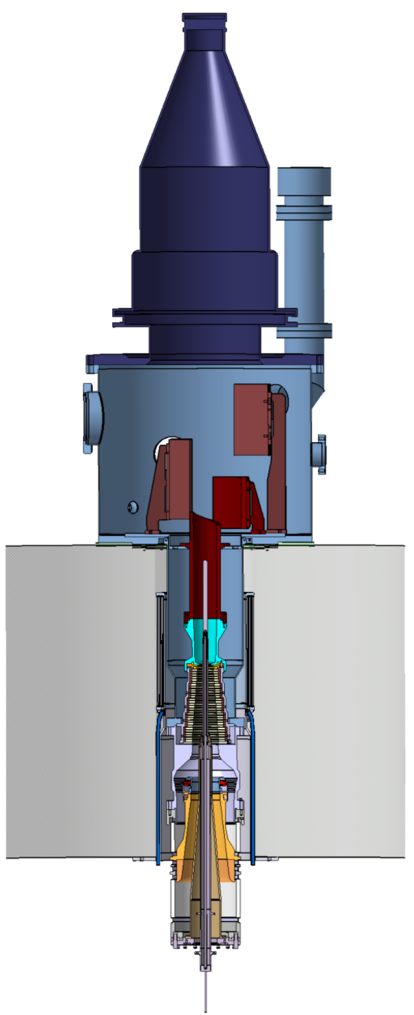
Key Components of the DEMO EC System
Gyrotron
Collector
Gaussian beam output at CVD diamond window
Height ~3 m, weight ~1 ton
EC equatorial launcher
Super Conducting Magnet (s = 1)
~6 T @140 GHz
~7 T @170 GHz
~8 T @200 GHz
~10 T @240 GHz
f [GHz] ~ s·28/γ·B [T]
Coaxial cavity
5
Cathode/Emitter (MIG)
Quasi-optical transmission line
Plasma
The required magnetic field becomes an issue for operation at > 200 GHz
→ Gyrotrons operating at 2nd Harmonic (s=2) might be the solution!

Slide 6
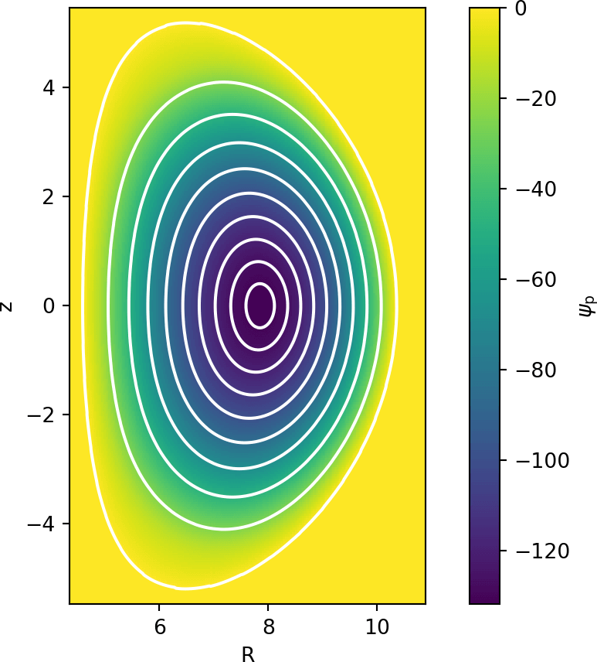
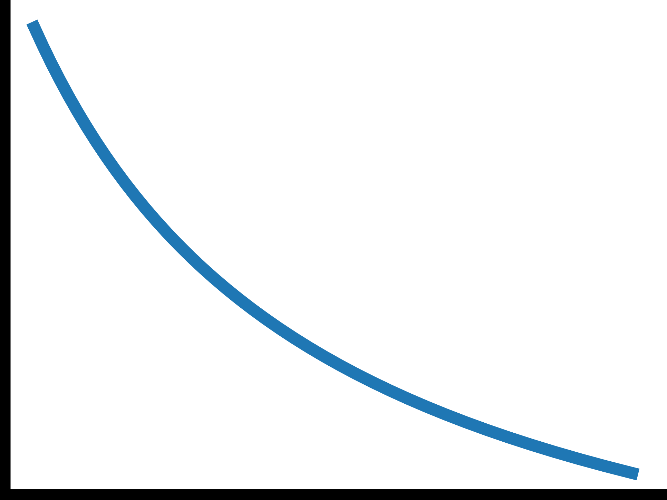

Problem: DEMO Radiative Instabilities
Radiation caused by Tungsten flakes at the outer plasma can lead to disruption.
Magnetic field in the plasma depends on the radius (ω_{c} = e B_{z} / (γ m) ∝ B ∝ 1/R ).
Center heating (< 30 MW required) at s = 2 and edge heating (> 70 MW required) at s = 1.
Same gyrotron, launcher, window and transmission line for center & edge heating.
Has to be fast switchable within ≲ 1 second.
_{Poloidal Magnetic Flux Density}$Ψp_{}$
Toroidal Magnetic
Field B_{torr}
Radius R

Slide 7
ENR Second Harmonic Gyrotron
Target: MW-class gyrotrons operating at 1st harmonic (s = 1) and at 2nd harmonic (s = 2) of the electron cyclotron frequency
Plasma center heating and mitigation of radiative instabilities (RI) with the same gyrotron
Fast (sub-second) switching between distant frequencies
Two enabling technologies will be addressed:
  The coaxial-type cavity technology that is specifically adapted to the operation at
  2nd harmonics in combination with advanced inner and outer corrugations.
  The Multi-stage Depressed Collector (MDC) technology based on E×B drift concept
Potential of saving ≳ 100 MW of installed spare power for EU-DEMO
(Baseline 2019)

Slide 8
T1: Novel Concepts for Advanced Fast Switching Between Harmonics

Slide 9
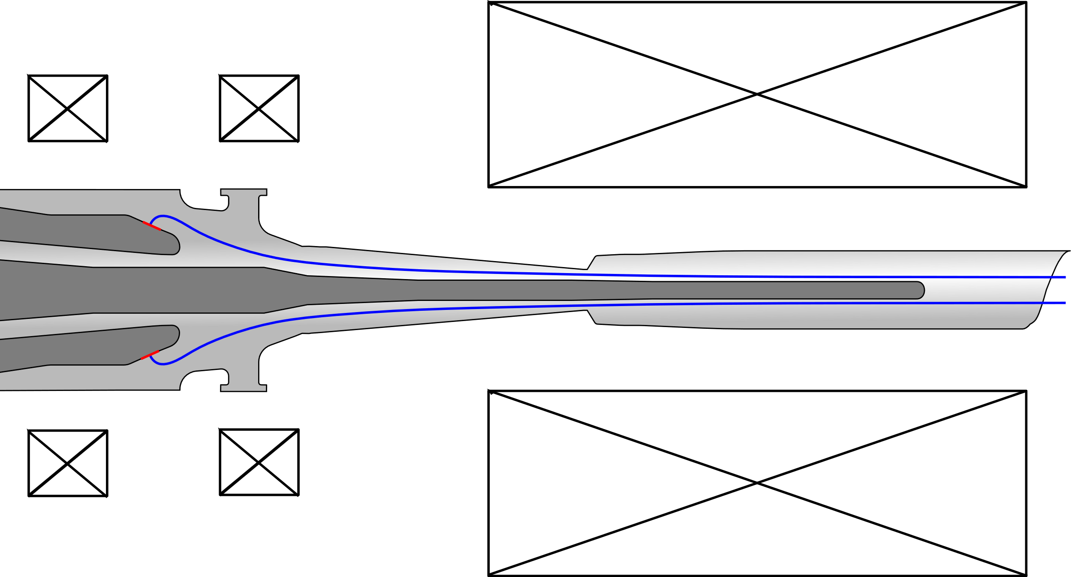
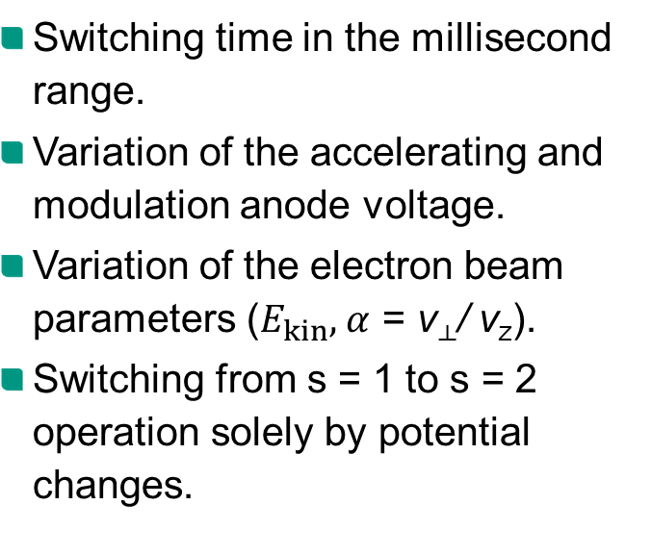
T1.1 Ultra-Fast Switching Using the Acceleration Voltage (Using the Triode Concept)
Switching time in the millisecond range.
Variation of the accelerating and modulation anode voltage.
Variation of the electron beam parameters ($E_{kin}$, $α$ = v⟂/ v_{z}).
Switching from s = 1 to s = 2 operation solely by potential changes.
Modulation
Potential
Accelerating
Potential
Cathode
e⁻ Beam

Slide 10
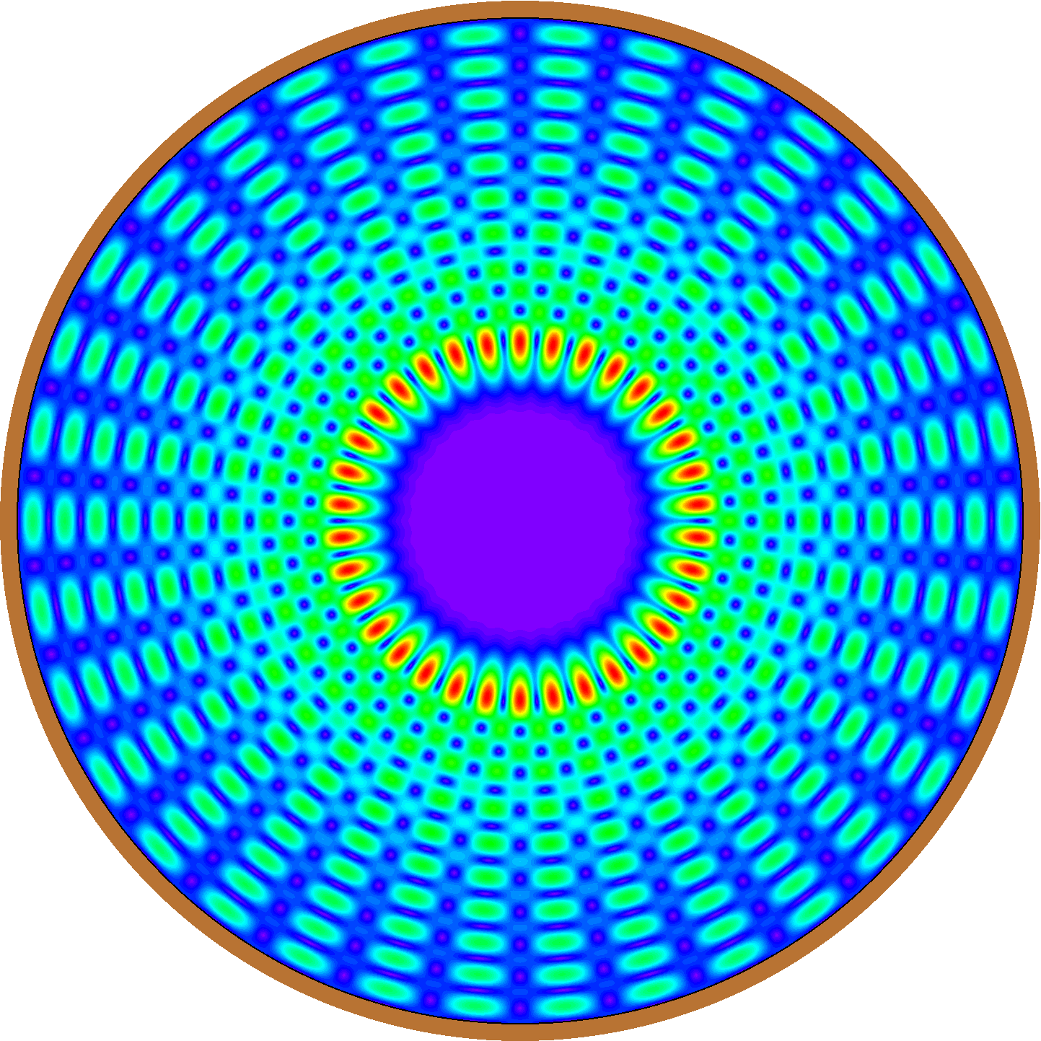
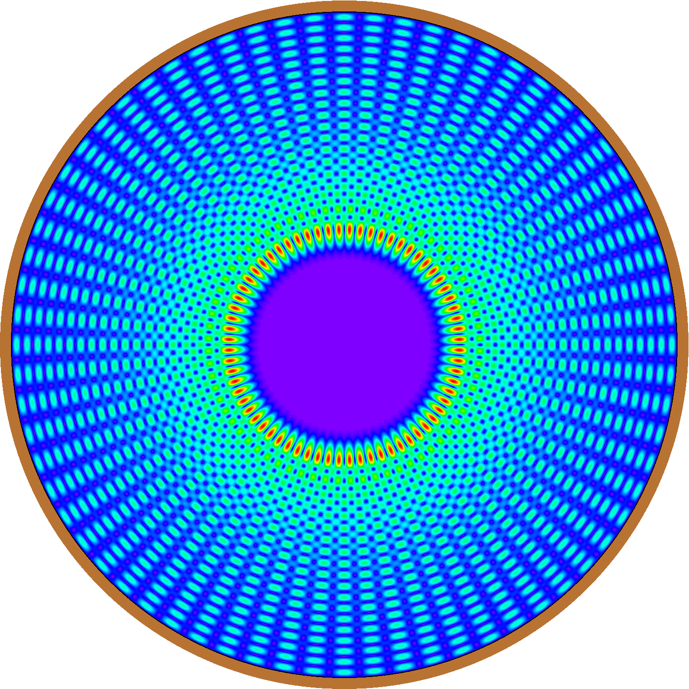
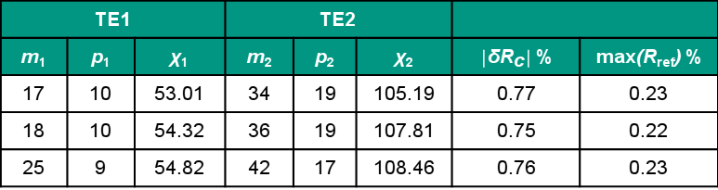
T1.1 Ultra-Fast Switching Using the Acceleration Voltage (1)
Dual-harmonic gyrotron for ECRH and RI control is based on two operating modes:
TE2 (2nd harmonic, frequency f₂) and TE1 (1st harmonic, frequency f₁ ≅ f₂/2).
Operational constraints: similar caustic radii (R_{c2} ≅ R_{c1}) and minimal reflection for both TE2 and TE1 at the diamond window.
Mode pairs selection:
  Maximum 1% difference in caustic radii (|δR_{c}| < 1%).
  Maximum 1% window reflection coefficient for both cases (max(R_{ref}) < 1%).
  Eigenvalue 80 < χ₂ < 110 for TE2 (to allow for MW-class operation)
TE1 |  |  | TE2
m₁ | p₁ | χ₁ | m₂ | p₂ | χ₂ | $\left|\text{δ}{\text{R}}_{\text{c}}\right|$ % | max(R_{ref}) %
17 | 10 | 53.01 | 34 | 19 | 105.19 | 0.77 | 0.23
18 | 10 | 54.32 | 36 | 19 | 107.81 | 0.75 | 0.22
25 | 9 | 54.82 | 42 | 17 | 108.46 | 0.76 | 0.23
TE_{17,10}
TE_{34.19}
Table 1: Top mode-pairs for dual-harmonic operation based on the combined metric |δR_{c}| + max(R_{ref})

Slide 11
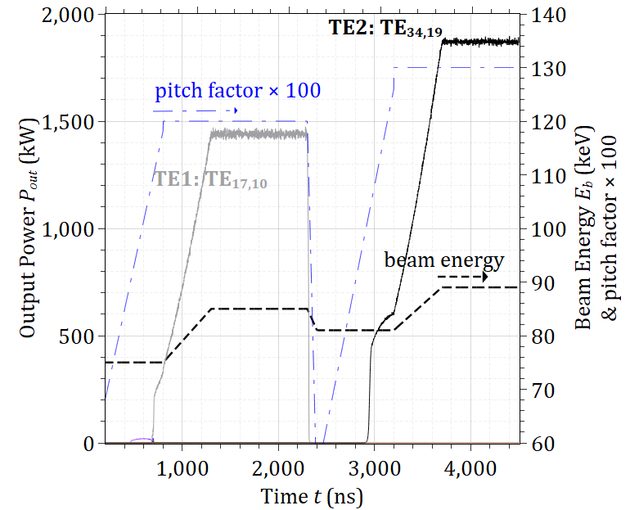
T1.1 Ultra-Fast Switching Using the Acceleration Voltage (2)
  Dual-harmonic operation and rapid switching scenario:
    Use the coaxial cavity designed to operate at the 2nd cyclotron harmonic to deliver 1.55 MW at 170 GHz using the TE_{34,19} mode (see T 4).
      Investigate this cavity without modifications for dual-harmonic operation. (from Table I)
        TE2: TE_{34,19};170 GHz
        TE1: TE_{17,10}; 85 GHZ
      The excitation of the first harmonic mode is examined using the triode gun concept.
    Rapid variations in the kinetic energy and/or the pitch factor α (via rapid variations of the voltage) will be required for the rapid switching between the two harmonics.
Muti-mode simulations (18 competing modes) demonstrating ultra-fast switching with a triode.

Slide 12
T1.2 Fast Switching Using Different Guiding Center Radii
Switching time in the second range.
Varying the magnetic field at the emitter changes the electron beam radius in the cavity.
Hysteresis effect, depending on sweep direction could lead to a suppression of the second harmonic operating mode.
Adjustment of Gun
Magnetic Field
Main Magnetic Field
constant
Adjustment of Electron Beam Radius

Slide 13
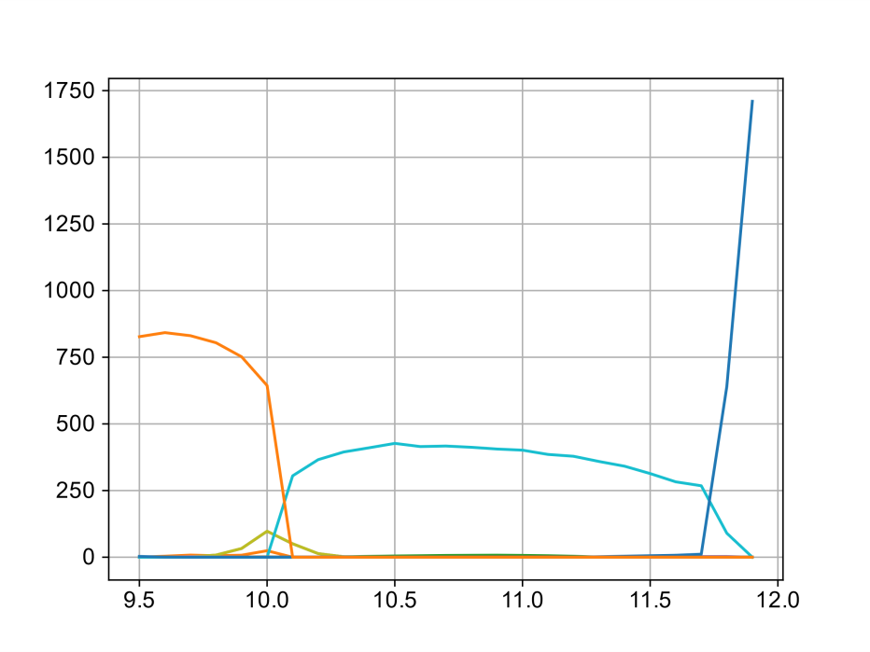


T1.2 Fast Switching Using Different Guiding Center Radii
Investigated mode pair:
Mode pair non-optimal in terms of launcher design & window reflections.
s = 1 | s = 2
TE_{20,10} | TE_{34,19}
r_{gc} = 11.7 mm | r_{gc} = 9.7 mm
B_{e} = 88 mT | B_{e} = 106 mT
f = 86.6 GHz | f = 170.0 GHz
P = 1.7 MW | P = 1.0 MW
η = 33 % | η = 17 %
TE_{20,10}
Output Power $P$ in kW
TE_{34,19}
TE_{19,10}
Guiding Center Radius $r_{gc}$ in mm

Slide 14
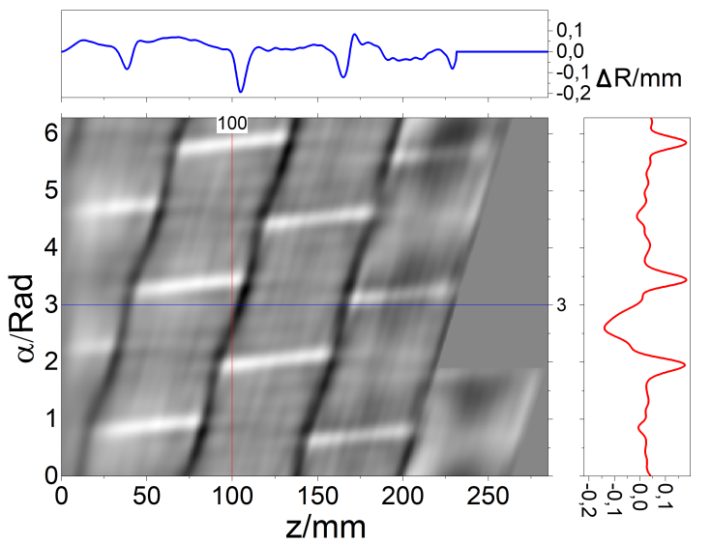
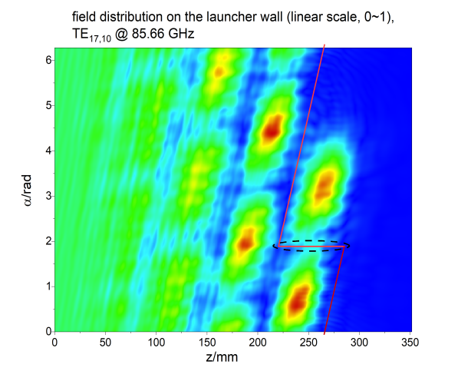
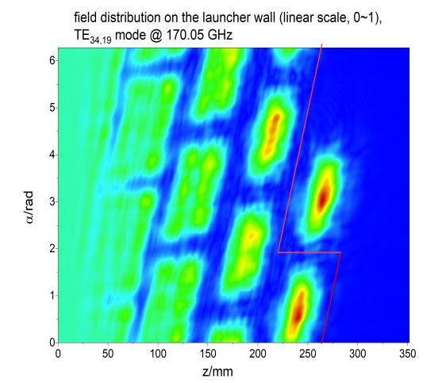
T1.3 Studies on Dual-Harmonic Launchers and
Quasi-Optical System (1)
A mirror-line launcher for the TE17,10 mode @ 85.66 GHz and the TE34,19 mode @ 170.05 GHz
GMC: Gaussian Mode Content
GMC=
97.05%
GMC=
97.3%
The wall profile of the mirror-line launcher.
Field distributions on launcher wall, operating in the TE_{17,10} mode @ 85.66 GHz (left) and in the TE_{34,19} mode @ 170.05 GHz (right).
Disadvantages: 1. The RF beam @ 85 GHz could not be focused very well (due to the wavelength @ 85 GHz, which is two times larger compared to the 170 GHz case) → relatively large power density at the launcher cuts.
2. Relatively strong reflection on the straight cut @ 85 GHz, "ripple" appears on the field on launcher wall.

Slide 15
T1.3 Studies on Dual-Harmonic Launchers and
Quasi-Optical System (2)
Outlook: A new mode series
For the TE34,19 and TE17,10 modes, the ratio of the caustic radius to the launcher radius is about 0.323 → mirror-line launcher well suited.
A hybrid-type launcher instead of the mirror-line launcher, provides higher GMCs and lower fields on the launcher cuts.
The rules for the new mode series using a hybrid-type launcher:
1) ratio of the caustic radius to launcher radius would be about 0.5;
2) the deviation of the caustic radius would be as small as possible.

Slide 16
T2: Enhancements on Mode Selectivity

Slide 17
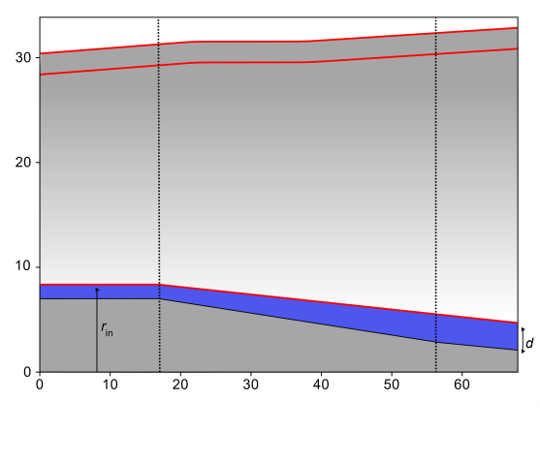
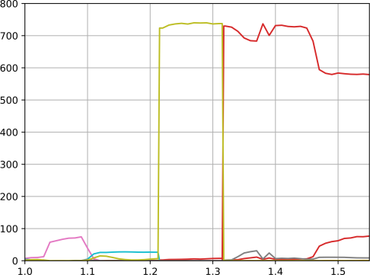
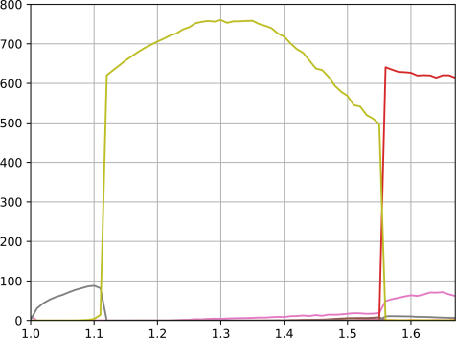




T2.1 Tapered Inner Corrugations
Target: Better suppression of the fundamental competing modes
  Increase drop of the eigenvalue along the cavity axis.
  Decrease of the diffractive Q factor.
  Increase of the starting current.
Operating mode barely affected by the insert.
Relaxed tolerance requirements.
Constant Corrugation Depth
TE_{36,20}
TE_{19,11}
RF Output Power $P_{out}$ in kW
Radius r in mm
Constant
Depth
Tapered
Depth
Constant
Depth
TE_{17,11}
TE_{18,11}
Pitch Factor $α$ in a.u.
Axial coordinate z in mm
Variable Corrugation Depth
TE_{36,20}
TE_{19,11}
Mode | Hollow Cavity | Constant Corrugation Depth | Tapered Corrugation Depth
TE_{36,20} | Q = 2985 | Q = 2951 | Q = 2950
TE_{17,12} | Q = 900 | Q = 410 | Q = 242
RF Output Power $P_{out}$ in kW
TE_{16,12}
Critical fundamental
Pitch Factor $α$ in a.u.

Slide 18

T2.2 Profiling on Outer Corrugations (1)
For the enhancement of the mode selectivity, in order to reach eigenvalues above χ=125, a new scheme of axially profiled corrugations was proposed.
The outer corrugations are localized on the axis to selectively suppress only the competing modes and not the operating one.
The transition from corrugated to non-corrugated regions is performed by appropriate profiling the areas.
As an illustrative example, the excitation of TE_{40,23} (χ=126) at 204 GHz and at second harmonic have been used.
  Main 1st harmonic competing modes are TE_{19,12} and TE_{19,13}.
  TE_{40,23} cannot be excited with corrugations only on the insert (without profiling TE_{19,12} suppresses TE_{40,23}).

Slide 19
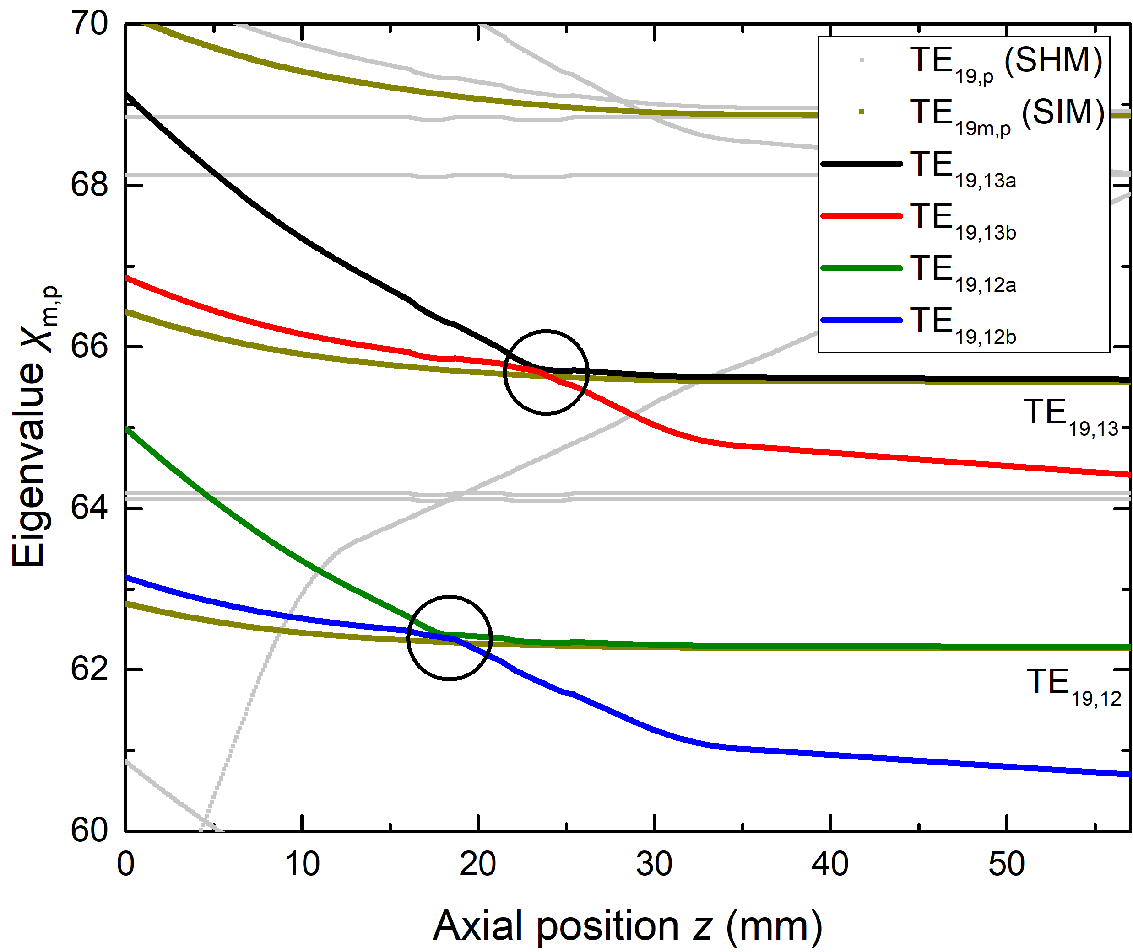
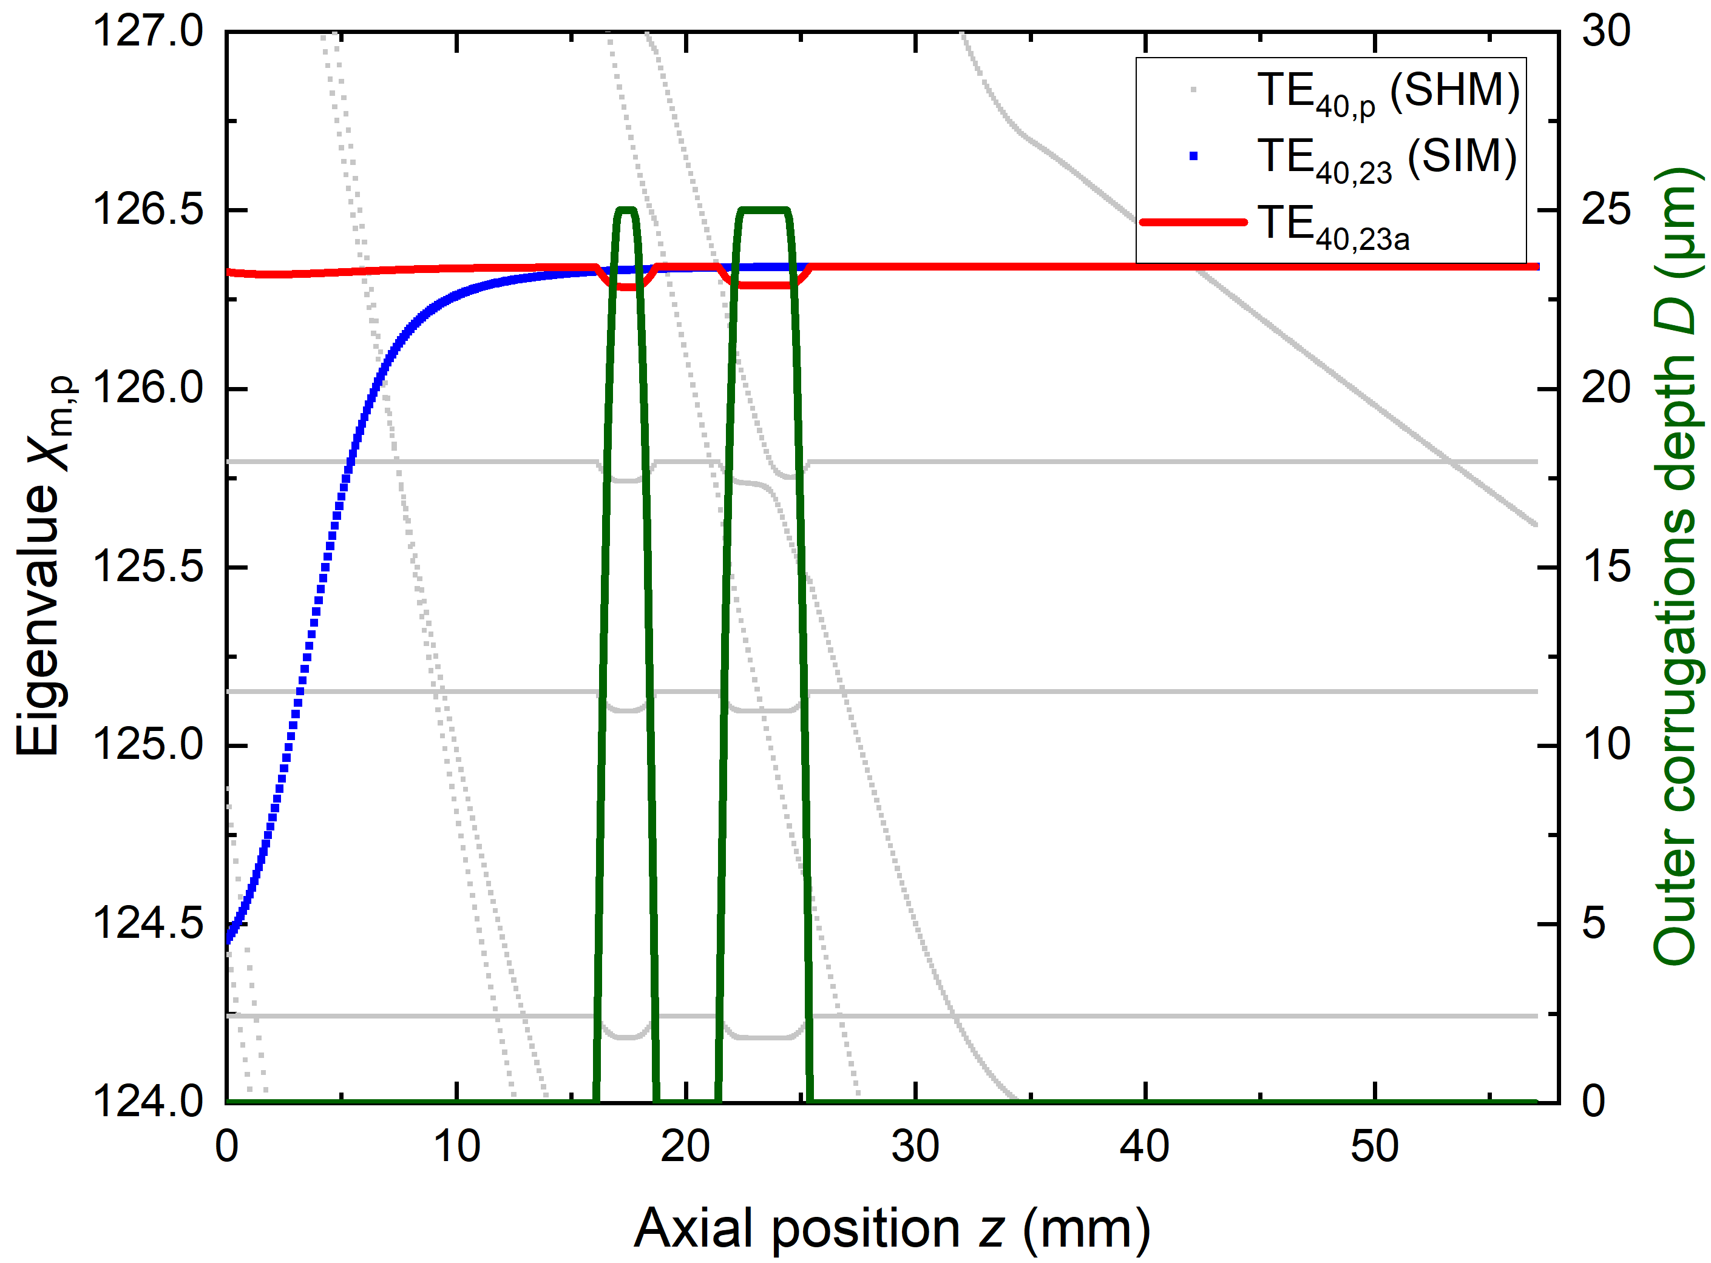
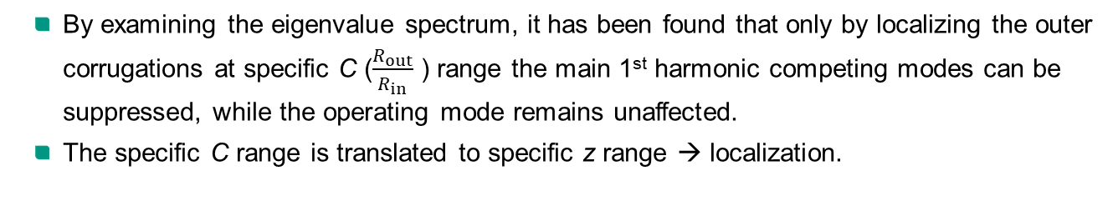
T2.2 Profiling on Outer Corrugations (2)
By examining the eigenvalue spectrum, it has been found that only by localizing the outer corrugations at specific C ($\frac{R_{out}}{R_{in}}$ ) range the main 1st harmonic competing modes can be suppressed, while the operating mode remains unaffected.
The specific C range is translated to specific z range → localization.

Slide 20
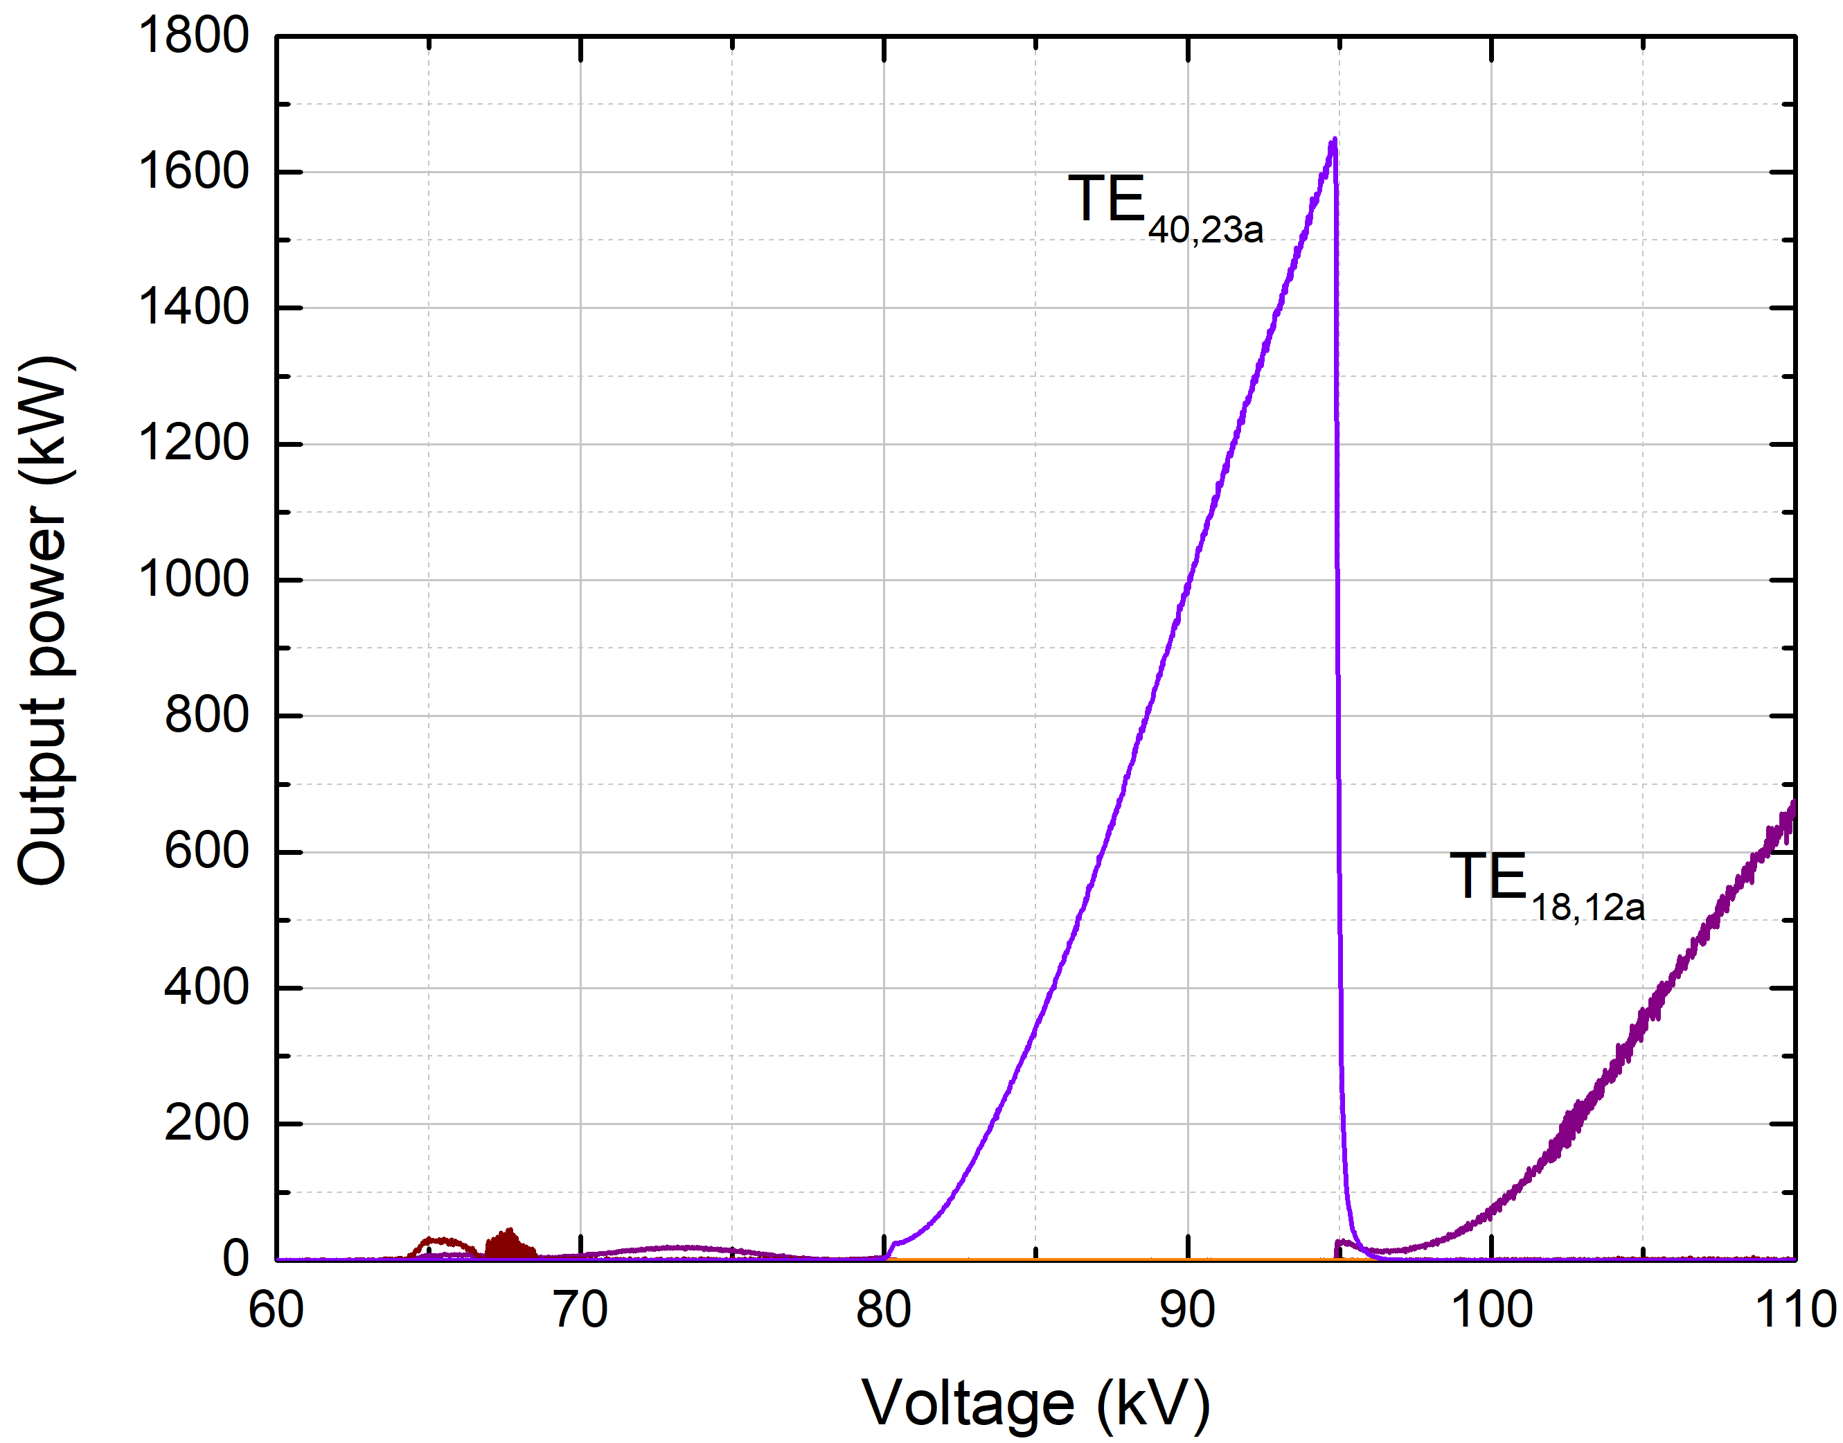
T2.2 Profiling on Outer Corrugations (3)
Interaction results showed that TE_{40,23} at 204 GHz can be excited with diode startup at MW-power level.
Performance:
  P_{out}=1.65 MW,
  η=22%,
  Ohmic loading below technological limits
  (ρ_{out}=2.09 kW/cm², ρ_{in}=0.24 kW/cm²).

Slide 21
T3: Multi-Frequency Dual-Harmonic Operation at DEMO-Relevant Frequencies

Slide 22
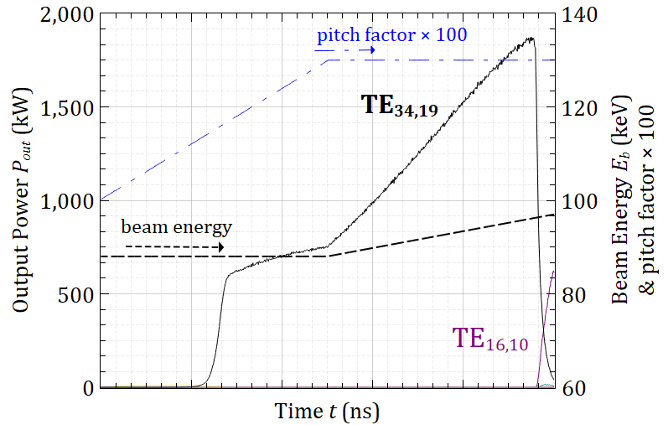
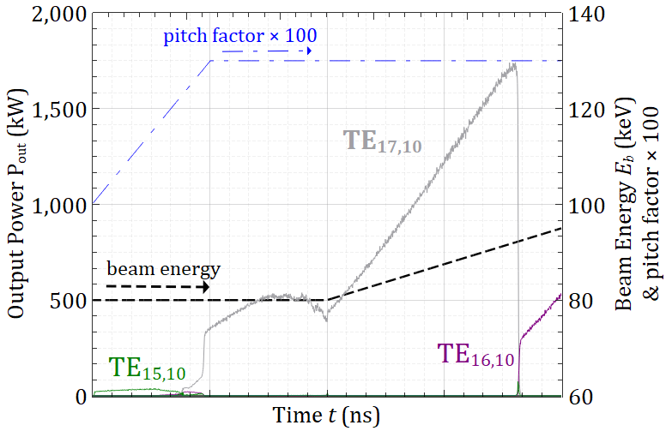
T3.1 Multi-Frequency Dual-Harmonic Operation at DEMO-Relevant Frequencies
Working case for relevant frequencies: 170 / 85 GHz (Frequencies for DEMO not yet determined)
A promising rapid-switching scenario exists (p. 11); however, the dual-harmonic operation lacks power balance between the harmonics.
The 1.55 MW – 170 GHz cavity was redesigned:
  Achieved: comparable output power for both harmonics in multimode simulations.
  Caveat: challenging insert loading for TE_{17,10} (ρ_{in} = 1.68 kW/cm² at 1.55 MW)
  CW operation will probably not be feasible.
Next steps: Search for a more suitable mode pair.

Slide 23
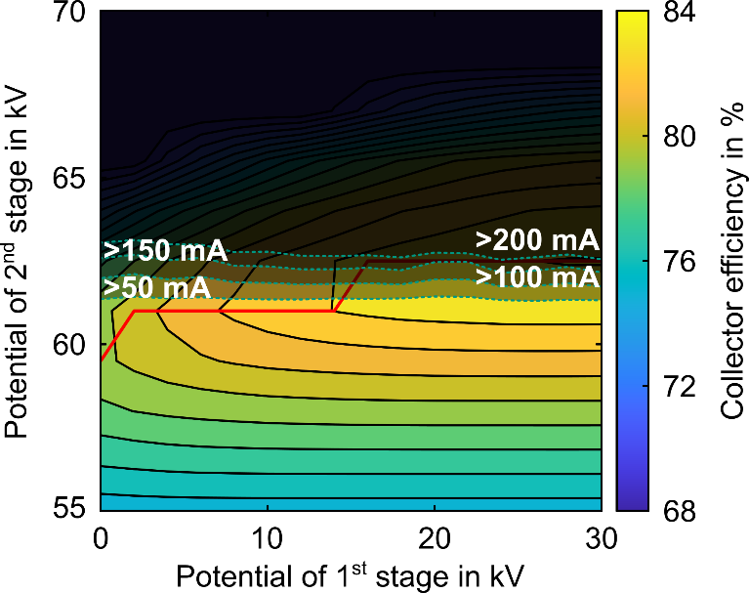
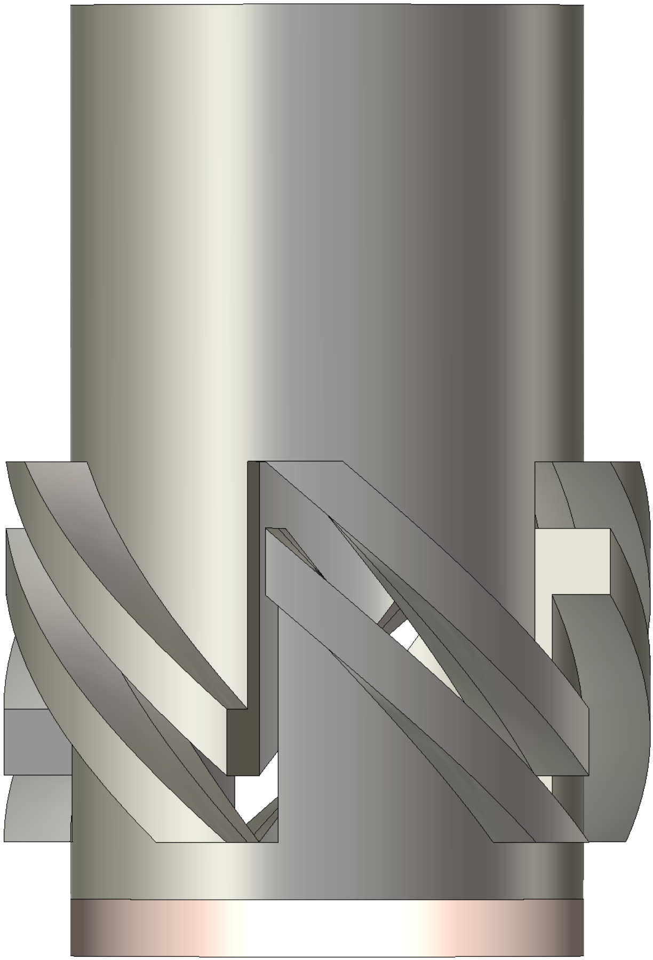
T3.2 Design of a Multistage Depressed Collector (MDC)
Interaction efficiency of 2nd harmonic operation is limited
→ apply MDC based on E × B concept.
Operation at low magnetic field allows shortening of E × B section
(620 mm → 200 mm) using a 5-fold helical structure (instead of 3-fold).
Achievable collector efficiency:
83 % (applying 20 kV / 61 kV).
Resulting gyrotron efficiency:
54 % (assuming 20 % interaction and
90 % optical efficiency).
200 mm
Optimized short-pulse MDC for low magnetic field application (left) and simulated performance with efficiency and reflected current (right).

Slide 24
T4: Preparation of 2nd Harmonic Experiments

Slide 25
T4.1 A New Design for Experimental Demonstration of High-Power Second-Harmonic Operation
To prepare for the upcoming experiment, a cavity operating at beam parameters compatible with the available KIT test stand was designed from scratch.
Focus was given to robust and stable excitation of the 2nd-harmonic TE_{34,19} mode at 170 GHz in diode startup.
Achieved performance:
  Output power at cavity exit P_{out}=1.55 MW.
  Interaction efficiency η = 23 %.
  Outer ohmic loading ρ_{out} = 2.08 kW/cm².
  Inner ohmic loading ρ_{in} = 0.36 kW/cm².
Sensitivity analysis was performed against many parameters. Excellent stability with respect to:
  Velocity beam spread.
  Magnetic field value and displacement.
  Coaxial insert and beam radii.
Simulation results showing stable excitation of the 2nd-harmonic operating mode TE_{34,19} in diode startup. 100 1st- and 2nd-harmonic competitor modes are included in the simulation. Assumed spreads: 6% rms in pitch factor, 2.0 Larmor radii uniform guiding center spread.

Slide 26
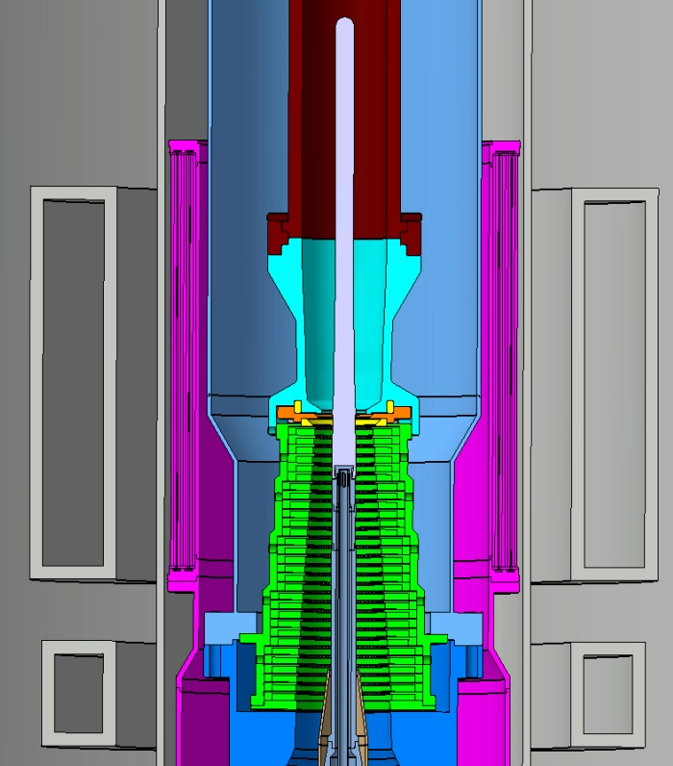
T4.2 Preparation for the Experiment
Design of a modular short pulse insert with a replaceable tip.
Preparation of the technical drawings.
Investigation of the available diode gun in different two magnet systems.
Investigation of operation with triode gun have also been performed (depends on availability).
Experiments planned in Q3/2025.

Slide 27
Conclusion and Outlook

Slide 28
Conclusion
Simulations show dual harmonic operation should be possible in coaxial cavity gyrotrons.
New mode selection scheme for dual harmonic operation was developed.
Introducing profiled inner/outer corrugations can enhance mode selectivity.
Launcher antenna for dual-harmonic operation possible.
Efficiency ≳ 50 % can be reached using an MDC.
Preparations for 2nd harmonic experiments are ongoing.

Slide 29
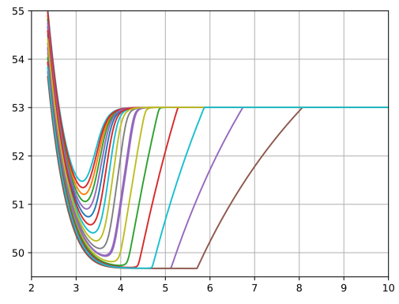




T2.1 Tapered Inner Corrugations
Target: Better suppression of the fundamental competing modes
  Increase drop of the eigenvalue along the cavity axis
  Decrease of the diffractive Q factor
  Increase of the starting current
Operating mode barely affected by the insert
Relaxed tolerance requirements
Constant Corrugation Depth
d = 0.4 $λ_{c,o}$
TE_{36,20}
TE_{19,11}
d = 0.0$λ_{c,o}$
Eigenvalue $χ_{m,p}$ in a.u.
RF Output Power $P_{out}$ in kW
TE_{17,11}
TE_{18,11}
Outer to Inner Wall Ratio $\frac{r_{out}}{r_{in}}$ in a.u.
Pitch Factor $α$ in a.u.
Variable Corrugation Depth
TE_{36,20}
TE_{19,11}
Mode | Hollow Cavity | Constant Corrugation Depth | Tapered Corrugation Depth
TE_{36,20} | Q = 2985 | Q = 2951 | Q = 2950
TE_{17,12} | Q = 900 | Q = 410 | Q = 242
Radius r in mm
Constant
Depth
Tapered
Depth
Constant
Depth
RF Output Power $P_{out}$ in kW
TE_{16,12}
Axial coordinate z in mm
Pitch Factor $α$ in a.u.

