Slide 1
How to configure and run the ETS-6
Thomas Jonsson

Slide 2
Installing dressed ETS-6
The main ETS-6 documentation is on the ITER Physics webpages https://users.euro-fusion.org/iterphysicswiki/index.php/ETS-6_Documentation
Note that the instructions for installing a private version of the ETS-6 are here: https://users.euro-fusion.org/iterphysicswiki/index.php/Setup_for_ETS-6
A dressed Kepler – a Kepler-installation with physics actors included.
Installing a dressed kepler:
Load a kepler module, at present: kepler/2.5p5-3.1.1_dressed_3.28.1
Create an installation with: kepler_install NAME
Load installation: kepler_load NAME
NOTE: you have to run kepler_load in every new window!
Check available installations: “kepler_avail”
Fetch the ETS-6 workflow svn checkout https://gforge6.eufus.eu/svn/keplerworkflows/trunk/imas/ETS ETSwf

Slide 3
Running the ETS-6
The workflow ETS6.xml is in the ETSwf directory (created on prev. page)
The ETS6.xml is executed using kepler. To start ETS6.xml in kepler:
One option is to start kepler with the command > kepler and then load the workflow – click File, then Open….
Or you execute the command > kepler `pwd`/ETS6.wf
A third option is to use the autoGui > autoGui and then load the workflow – click “Load Workflow” …
We’ll now go though how to set up a run in the autoGui…

Slide 4
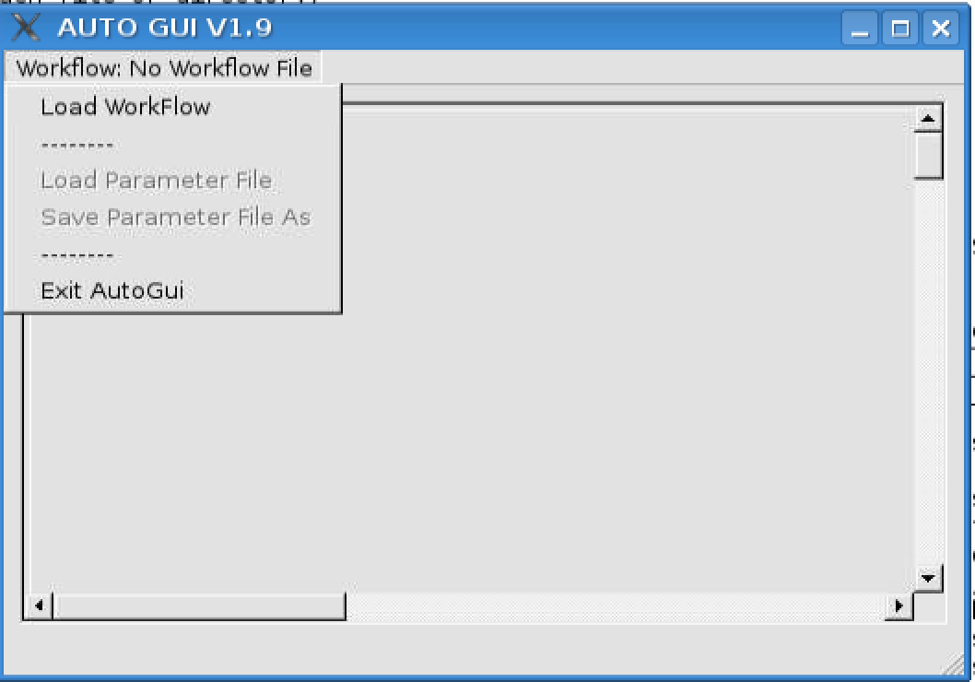
Load the workflow
In the autoGui you load a workflow by selecting “Load Workflow”
Then find the path to the ETS6.xml workflow.
NOTE: The autoGui design is documented here.

Slide 5
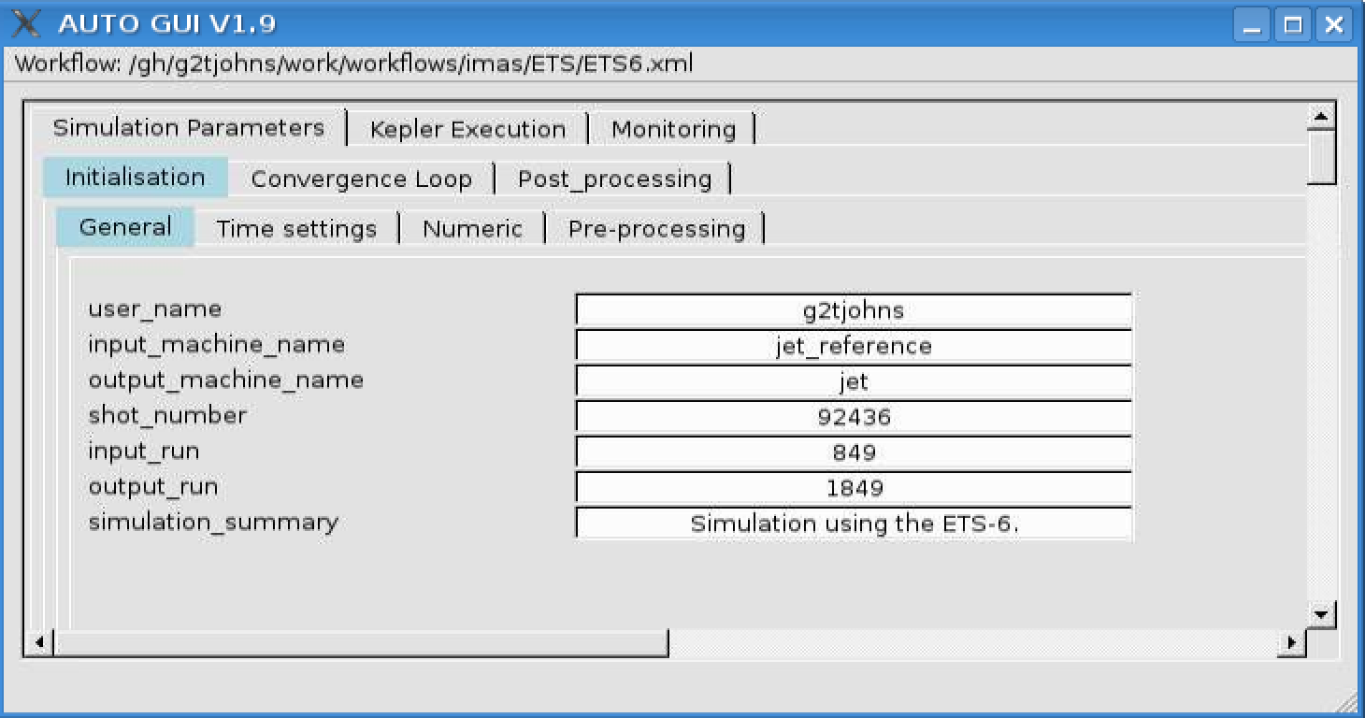
autoGui panels: Initialisation/General

Slide 6
autoGui panels: Initialisation/Time settings

Slide 7
autoGui panels: Initialisation/Numerics

Slide 8
autoGui panels: Initialisation/Pre processing

Slide 9
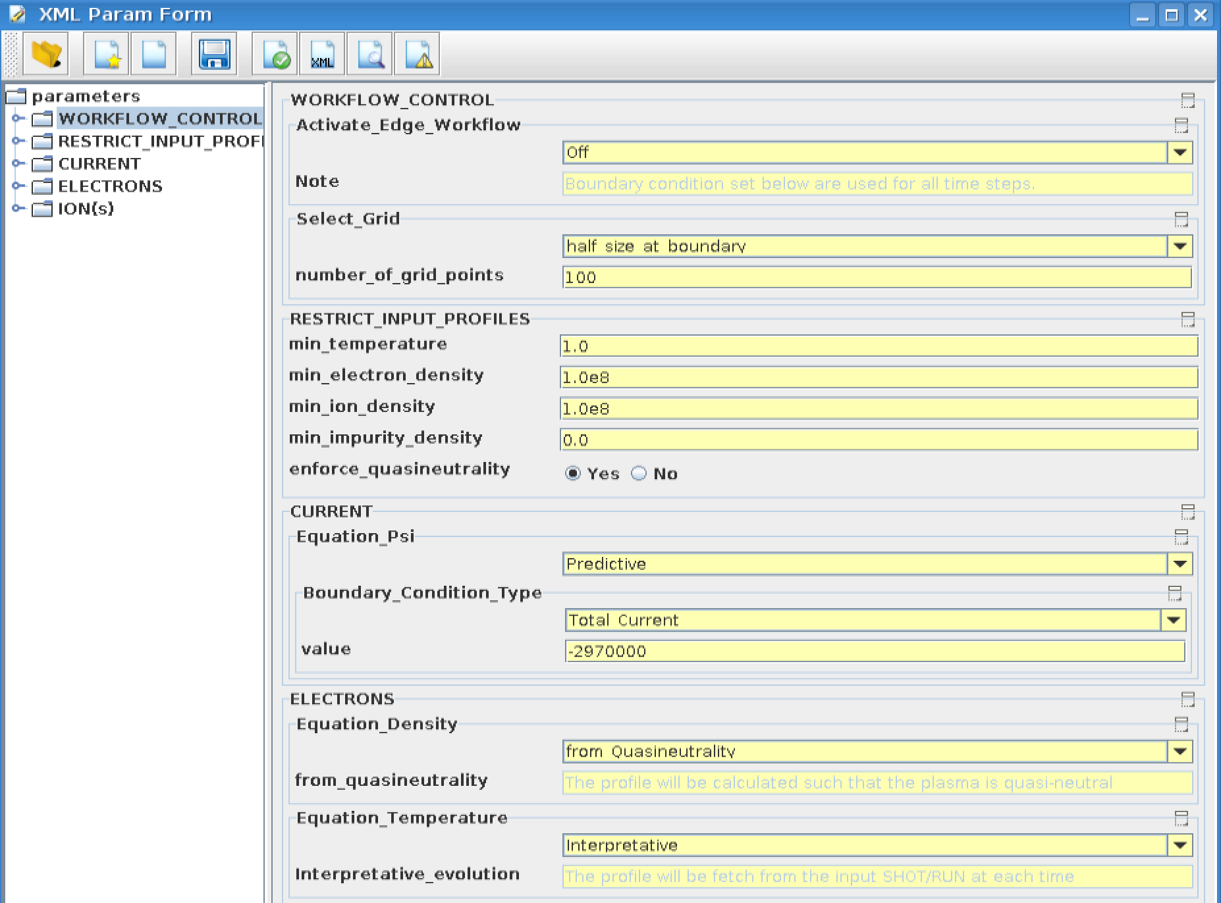
Code parameters for ETS-init, page 1

Slide 10
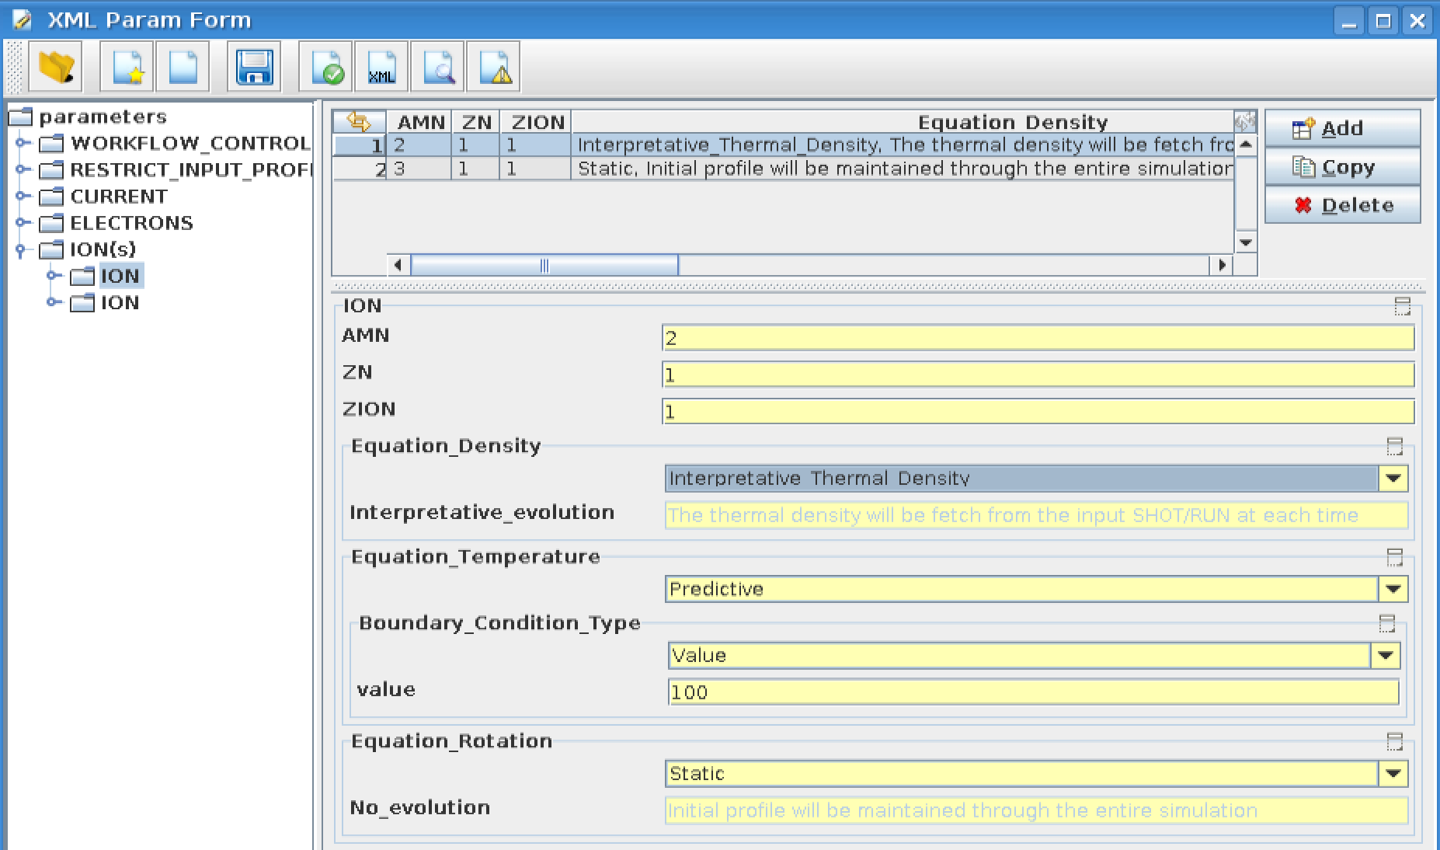
Code parameters for ETS-init, page 2

Slide 11
Code parameters for ETS-init, page 3

Slide 12
Code Parameters for eqinput

Slide 13
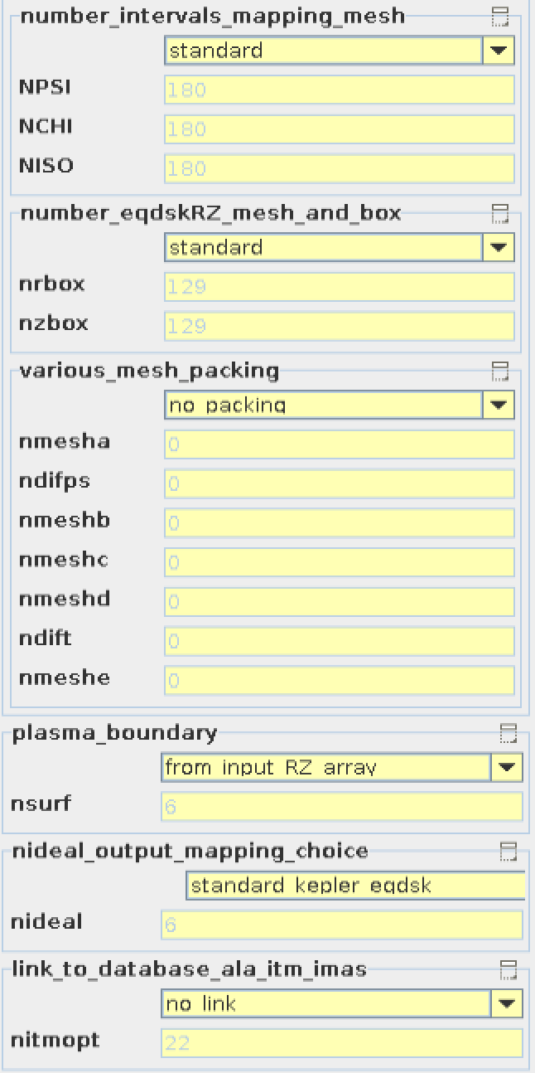
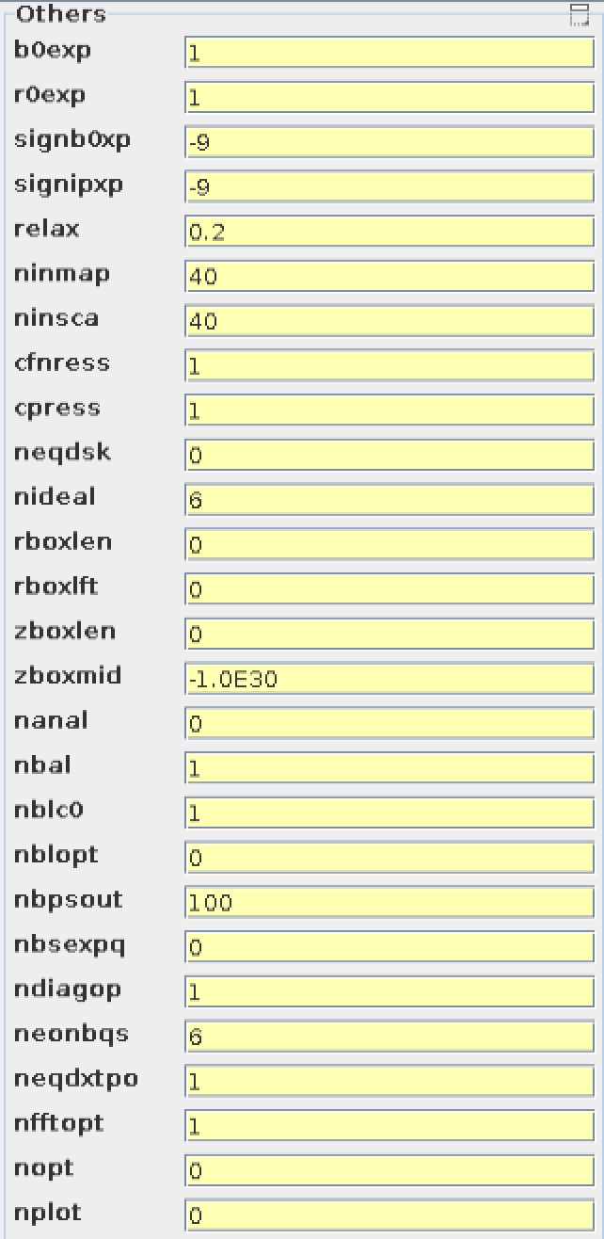
Code parameter for CHEASE, page 1

Slide 14
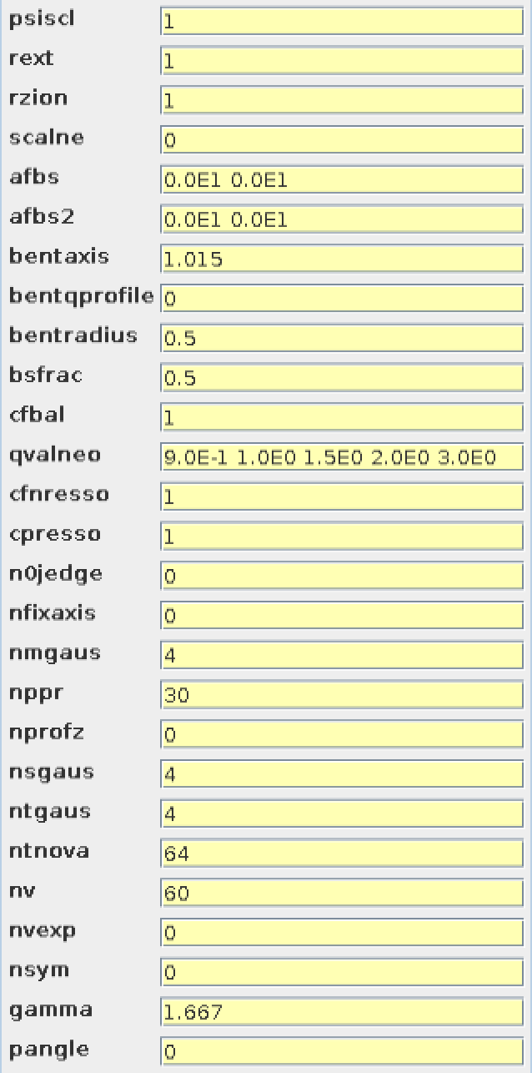
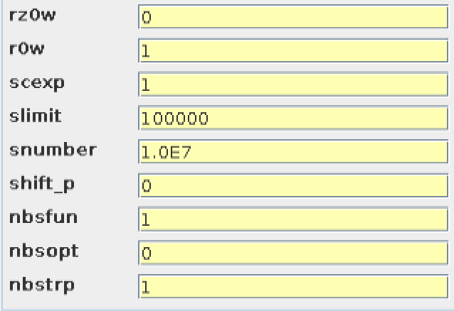
Code parameter for CHEASE, page 2

Slide 15
Convergence Loop / General

Slide 16
Convergence Loop / Transport

Slide 17
Convergence Loop / Equilibrium

Slide 18
Convergence Loop / Sources / General

Slide 19
Convergence Loop / Sources / ECRH

Slide 20
Convergence Loop / Sources / ICRH

Slide 21
Convergence Loop / Sources / NBI and nuclear

Slide 22
Convergence Loop / Sources / HCD sources and profiles

Slide 23
Convergence Loop / Sources / Runaway

Slide 24
Convergence Loop / Edge

Slide 25
Kepler Execution

Slide 26
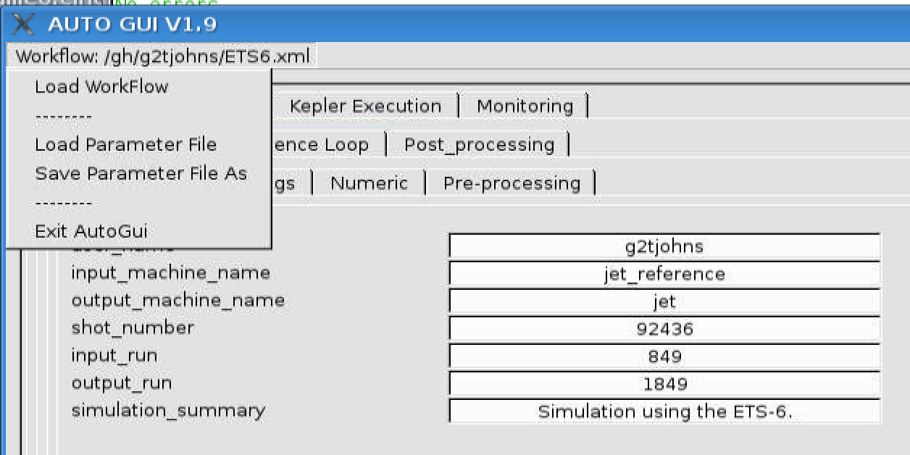
Loading and saving parameter files!
All parameters prepared in the autoGui can be saved to a “param” file
“param-files” can be loaded in either the autoGui, the Kepler canvas, or used to run Kepler from the command prompt

Slide 27
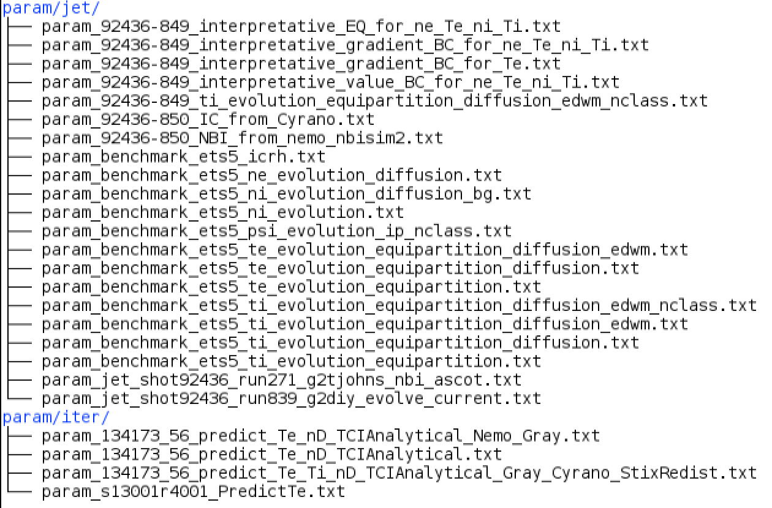
Saved param files for ETS-6
Folder ETSwf/ created on page 1

Slide 28
Regression testing
Run script > run_test.sh
Verify the result > cd kplots > ./cmp_test.py

