Slide 1
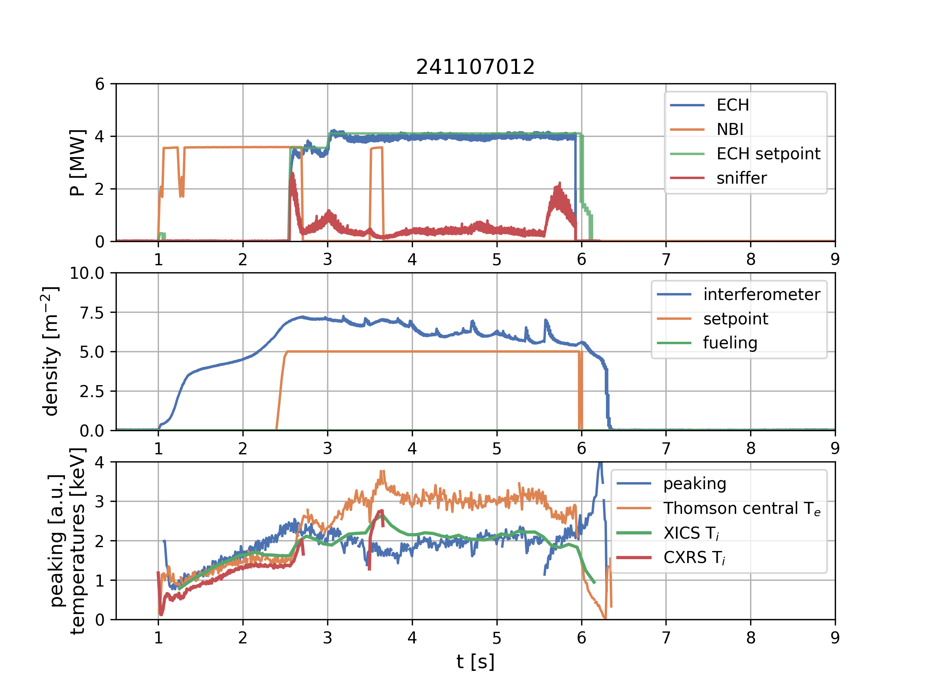
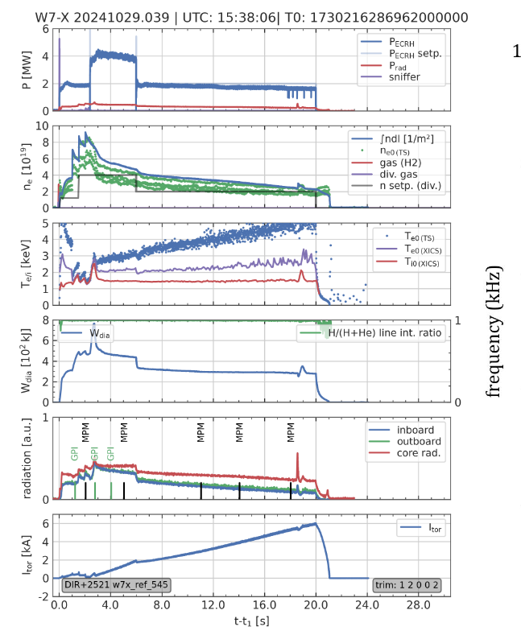
Campaign OP2.2 finished on Dec 12
Pulse length up to 308 s (although < 1 GJ).
Low-field operation with sustained higher ion temperatures for > 3 s
Exploration of island divertor scenarios in different configurations
First operation of new steady state pellet injector.
Campaign reporting initiated – deadline Jan 31, 2025

Slide 2
Dissemination of codes
Code name | No. interested people
EMC3-EIRENE / EMC3-Lite | 6
ASCOT5 | 5
GVEC | 4
GENE-3D | 4
EUTERPE | 4
BOUT++/BSTING | 2
GRILLIX | 2
MONKES | 1
GENE-X | 1
KNOSOS | 1
GENE | 1

Slide 3
Level-3 reporting initiated
Modelling of fast ions and heating scenarios |  | Main reporter: | Christoph Slaby
2024-W7X-2.2.3-CIEMAT-BCS: Scenario preparation for the 2024/25 campaign | Scenario preparation for the 2024 and 2025 campaign (BSC) | Modelling of heating scenarios | Report on ICRF modelling
2024-W7X-2.2.3-CRPP: Scenario Preparation for the 2024/ 25 campaign | Scenario Preparation for the 2024 campaign (CRPP) | Modelling of scenarios for fast particle production | Report on development of ICRH scenarios
2024-W7X-2.2.3-KIPT-KINR: Scenario Preparation for the 2024/25 campaign | Scenario Preparation for the 2024 campaign (KINR) | Modelling of Drift-sound and Alfven-modes | Report on drift-sound and Alfven-mode calculations
2024-W7X-2.3.3-VTT: Scientific exploitation of the 2022 and 2023 campaign | Scientific exploitation of the 2024 and 2025 campaign (VTT) | Analysis of 2022/ 2023 experiments | Report on wall power loads from ICRH-generated ions
Deadline for reports – January 31st 2025
Grand Deliverable reports postponed to Feb 28, 2025 due to ongoing campaign and level-3 reporting.

