Slide 1
2025 Annual Work Plan => ITER support Work Package WP05-PWIE Plasma Wall Interaction and Exhaust
WP Project Leader
Sebastijan Brezinsek

Slide 2
2025 Objectives: Focus ITER support (I)
Impact of the tungsten first wall on tungsten source strength: simulation of first wall W erosion, deposition, and screening in limited, start-up, and diverted plasmas in ITER
=> first wall erosion, profiles to the wall, CXN and seed species (EAST neutral particle data as benchmark)
=> partially with IO plasma background / Thrust 2 activities TSVV-5,6,7 / SP D activities
=> PWIE code benchmark experiments in TE experiments
=> Atomic and molecular data of W (revised W line selection for ITER)
Understanding layer formation in WEST high fluence experiment: mimic WEST divertor conditions in MAGNUM-PSI, layer stability in laboratory experiments, HHF experiments and incorporate in migration simulations
=> Characterisation of layers under WEST-like flux , impact energies and material temperature conditions in lab experiments
=> Full analysis of post-mortem samples (… dust conversion factor)
=> Simulation of experiments with ERO2.0
W first wall PFCs damage predictions: Impact of VDEs and REs on ITER PFCs (transfer from Be PFCs)
=> Post-mortem analysis at JET: Be First wall and W divertor (ramp down RE at end of JET lifetime)
=> Simulations of REs and transfer from JET to ITER (partially in TSVV-7)
=> Operation beyond PFC specification and damage evolution of W PFCs
Temporary W first wall components testing: HHF and steady-state plasma exposure
Facilities available and discussion with IO about coatings (discussions on existing techniques / WP DIV)

Slide 3
2025 Objectives: Focus ITER support (II)
Characterisation of boron layers and impact on wall conditions: B layer properties, oxygen gettering, homogeneity, benchmark experiments for ERO2.0 modelling (incl. boronization experiments) *
Advanced simulation of physical and chemical erosion of boron: MD simulation data, benchmark experiments in linear plasma devices, and their simulations
Initial simulation of Boron migration and lifetime assessment: B first wall, mixed surface, thin B layer
ITER first mirror performance in the presence of boron: boronization / boronization + plasma / deposition*
Impact of boron on tritium retention in ITER: Start of T retention matrix (scaling law), T removal techniques (ICWC, ECWC, GDC), in-situ and ex-situ T quantification techniques (laser-techniques, NRA, TDS)
Active removal of fuel-containing boron layers: erosion, dust formation, and dust properties (i.e. TOMAS)
Wall conditioning optimisation: ECWC, ICWC, GDC and combinations to be tested in TOMAS
Laser-based technique development for thin B layers and partially eroded layers (in-situ/ex-situ)
Transfer of in-operando laser-based technique from JET and linear plasmas to ITER
Experiments coordinated with WPTE and WPW7X : linked by pre/post-mortem analysis and modelling

Slide 4
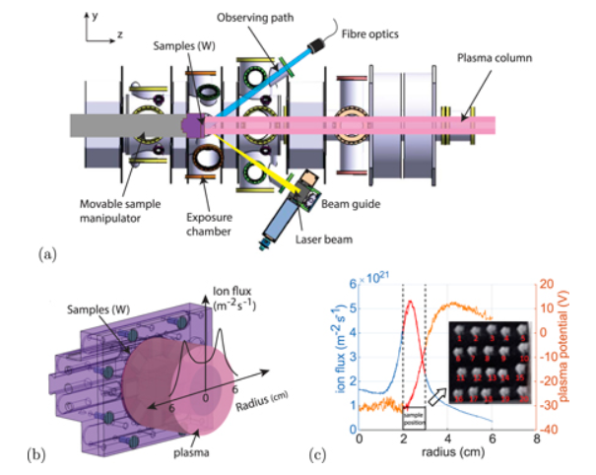
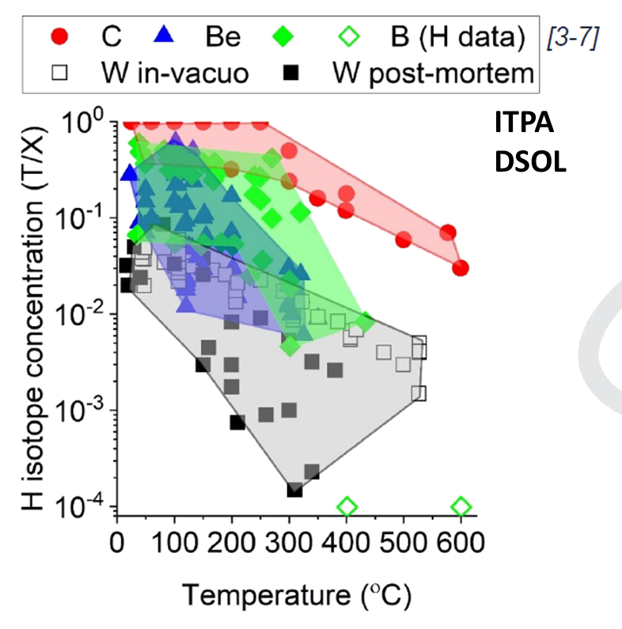
2025 Description of Work: Focus ITER support (I)
Understanding layer formation in
WEST high fluence experiment
Characterisation of boron layers
and impact on wall conditions
Impact of boron on
tritium retention in ITER
Impact of thermal stresses
on W layer stability during
W migration
In operando studies of boron layers
and fuel retention in PSI-2 via LIBS
and post-mortem analysis
Laboratory, tokamak and linear plasma studies to assess fuel content in co-deposited and implanted D in boron layers
Meeting EUROfusion - the European Commission
February 2025
Mimic W flux, divertor plasma,
and PFC temperature conditions
in MAGNUM-PSI
Mimic ITER B erosion, SOL-plasma,
and PFC temperature conditions
in D plasmas in PSI-2
Mimic ITER conditions during deposition of B (scaling law)
=> Be, W and C matrix exist!

Slide 5
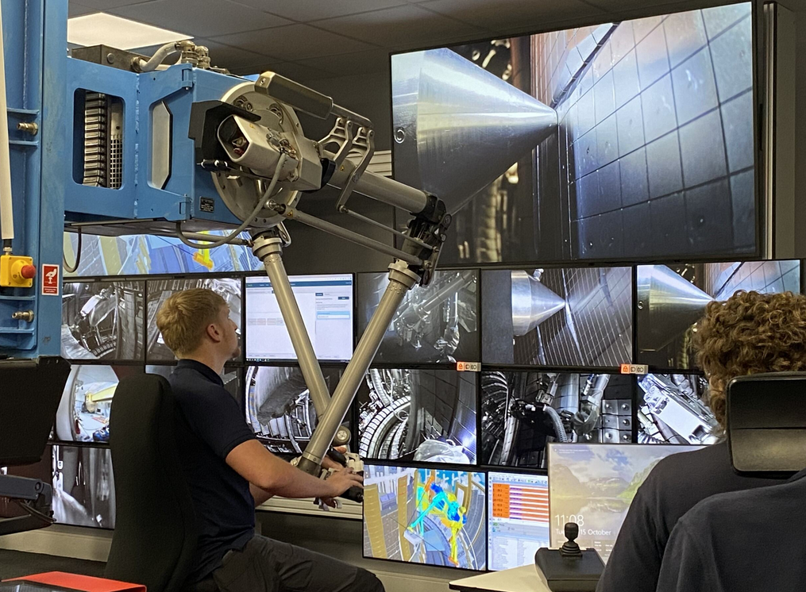
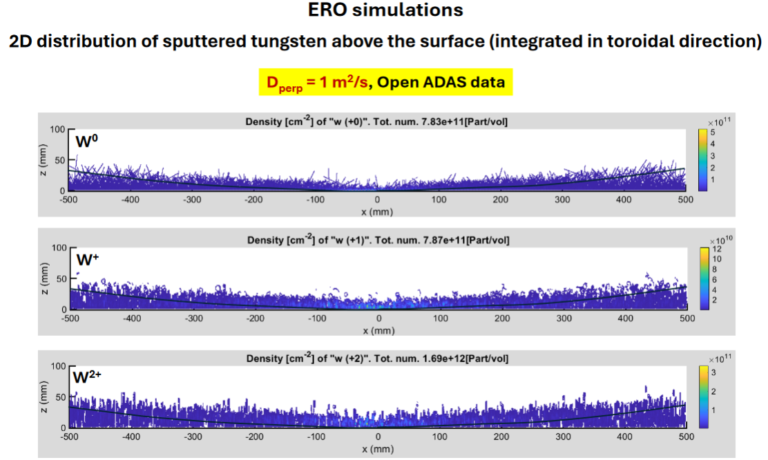
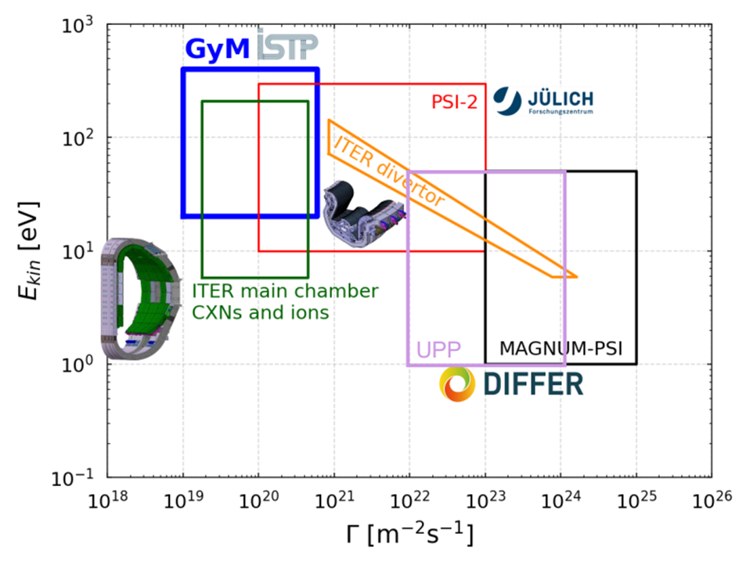
2025 Description of Work: Focus ITER support (II)
Analysis of JET-LIBS data (RH arm) and start of post-DT tile analysis
Simulation of W sources and re-deposition in ITER
W erosion, prompt re-deposition,
and first wall fluxes W sources
Interpretation of LIBS data and provision
of spatial and depth-resolved layer composition and fuel retention in JET post DT.
ITER-start up conditions coupled with ERO
ITER input
Predictive simulation of W erosion, influx and migration in ITER. Experiments to address
e.g. code assumptions on erosion at wall
Meeting EUROfusion - the European Commission
February 2025
LID-QMS and LIBS applied in-vessel.
Comparison of in-vessel and post-mortem analysis for selected PFCs foreseen
Scan of conditions and role of impurities
In W prompt redeposition at first wall
and divertor
Operational space of linear machines
regarding impact energy and D ion flux
covering ITER conditions

Slide 6
Substantial part of activities and linear, HHF and analysis machine time for ITER activities
HR and MR accountancy is complicated as part is also DEMO-relevant at the same time
TSVV-5 (EIRENE/NGM), -6 (SOLEDGE3X-/EMC3-EIRENE) and -7 (ERO/MIGRAINE)
are all supporting ITER simulations (partial change of scope in 2024)
Note: main PWIE laboratories have also ITER-contracts/partnerships
for some specific studies: CEA, FZJ, DIFFER, ERM-KMS, IPP?
=> No overlap, but complementary and extended work (ITPA as coordination)

