Slide 1
Overview of the prioritized ITER related tasks in WPSA
EUROfusion PSD Meeting
Carlo Sozzi

Slide 2
Specific contributions still valid from 2016 baseline
(mostly from 2nd ETCM January 2023)
Determination of Error fields from Assembly → guidance to ITER assembly
λ_{q} for Inner Wall limited plasmas → confirmation of ITER FW design
Low V_{loop} plasma start-up (ohmic and ECH assisted) but high Z effects ?
EC wall conditioning and fuel removal (but C besides B?)
Disruption loads and mitigation (CQ) and REs
Test of specific systems : ECRH stray radiation and Steady-state magnetic sensors
Validation on N-NBI shine-through loads (DT-1 commissioning in H & then change to D ?)
IMAS : Use/validation of ITER simulators, synthetic diagnostics and analysis workflows
ELM control with 3-D fields (size scaling)
Fast particle studies (N-NBI)

Slide 3
Specific contributions still valid from 2016 baseline
(mostly from 2nd ETCM January 2023)
Tasks on EFCCs modeling and control tools
Enhancements of edge diagnostics
Development of modeling for breakdown
Performed in IC, to be continued
MGI, runaway diagnostics
Tasks for sensor developments and inst.
Fast camera for monitoring (alarm)
Task on technical support for IMAS installation and use
FILD, Gamma & Neutron spectrometers
General remark: hw related tasks (enhancements) involve co-funding by F4E. EUROfusion (WPSA) initiative in proposing and supporting enhancements brings in multiplying factor N in actual funding, 1<N<10

Slide 4
Specific topics for new baseline
High Priority Issues
Fuel retention and removal from boronized layers
Use of alternative to GDC for boronization (ICWC and solid boron injection)
W impact on limiter phase of ITER scenarios
W impact on Q = 10 burning phase:
W wall source with small ELMs and extrinsic impurities
W wall source location and SOL screening
W pedestal transport (screening)
W transport in core plasma and control (e.g. by electron heating)
Operational space of small ELM + radiative divertor H-modes wrt. to Q = 10 needs
JT-60SA with carbon wall can contribute to some of them but extensive contributions to new baseline requires W wall + divertor installed in JT-60SA

Slide 5
JT-60SA transition to W first wall and divertor
Overall objective for JT-60SA: operations in W before ITER starts operations
In WPSA-2025: Establish a plan for the EU contribution to the transition to W divertor and wall. This includes several lines of work and collection of information of activities performed in other EuroFusion WPs
Boundary conditions, pro and cons for testing of W-PFCs in JT-60SA might be considered
Definition of the scientific priorities for the C phase and for the W phase and W-related preparation experiments in the C phase of JT-60SA (ET)
Definition of plasma scenarios and corresponding magnetic configuration (ET), supported by WPTE and Theory and Simulation developments
Modeling of heat load (WPTE)
Core and impurity transport (WPTE)
Modeling of heat load and bevel shaping on divertor PFCs – Short term study on PFCs (WPDIV) (supported with WPSA funding)
Modeling for divertor PFCs shape optimization (WPPWIE)
Development and test/qualification of divertor PFCs (WPDIV)
Test of materials with linear plasma devices (WPPWIE)
Upgrade of diagnostics for W monitoring, wall and divertor protection (WPSA)
Upgrade of the heating systems (WPSA)
Upgrade of the protection system (WPSA)
Review of the wall cleaning systems and procedures (WPSA)
Review of the gas injection system (WPSA)

Slide 6
Additional information: Main hw systems under development
Name | Acronym | Present status (January 2025) | 2025 Objective | Comment
Edge Thomson Scattering | ETS | Under installation | Complete installation for plasma commissioning
Divertor VUV | DivVUV | Under assembly | Delivery to Naka and start installation for plasma commissioning
Divertor Cryopumps | DivCryo | Under installation | Complete installation for operational commissioning
Massive Gas Injection | MGI | Under installation | Complete installation for operational commissioning | Minor repair required
Pellet Launching System | PLS | Centrifuge under procurement; Tender for source being launched | Test of the centrifuge | Previous contract for source cancelled
Tangential Phase Contrast Imaging | TPCI | Manufacturing Starting | Complete Manufacturing | Joint project EU (EPFL-SPC)-JA(NIFS)
Fast Ion Loss Detector | FILD | Manufacturing Starting | Complete Manufacturing
Doppler Reflectometry | DR | Design | Complete Design
Gamma Ray Spectrometry | GRS | Conceptual Design | Complete Conceptual Design
Compact Neutron Spectrometry | CNS | Feasibility Study | Complete Feasibility Study

Slide 7
Resources (2025)
research item | PMs | %
tot overall about | 215 | 100
diagnostics work | 41 | 19.06977
synthetic diagnostics and breakdown modelling | 9 | 4.186047
plasma control (ITER algorythm) | 6 | 2.790698
divertor modelling (shaping) | 12 | 5.581395
total | 68 | 31.62791
This in an underestimation: other activities (not in Alberto’s list) may have interest: eg, TS at high temperature, operations in a large SC tokamak etc.

Slide 8
TSVVs
Objectives in Thrust 3 TSVVs fully aligned with ITER physics issues (IRP)
Disruption Management (Thermal, EM load mitigation, RE avoidance & mitigation
ELM control
Evolution of energetic particle populations and their influence on MHD stability
Management of the burning plasma scenario
TSVV 8: non-linear modeling of MHD transients (JOREK)
ELMs
Disruptions
MHD-Kinetics hybrid modeling (energetic particles, turbulence)
ELMs (RMP, Pellet, SOL and divertor…)
Disruptions (SPI, VDE, Force mitigation)
TSVV 9: modeling of runaway electrons
Kinetic modeling of RE in JOREK
SPI mitigation in ITER: RE generation
Termination of RE beams and related NTM dynamics
TSVV 10: multi-scale modeling of burning plasma
Effects of high energy particles on plasma dynamics, taking into consideration mutual coupling of turbulence, Alfvén instabilities, MHD.

Slide 9
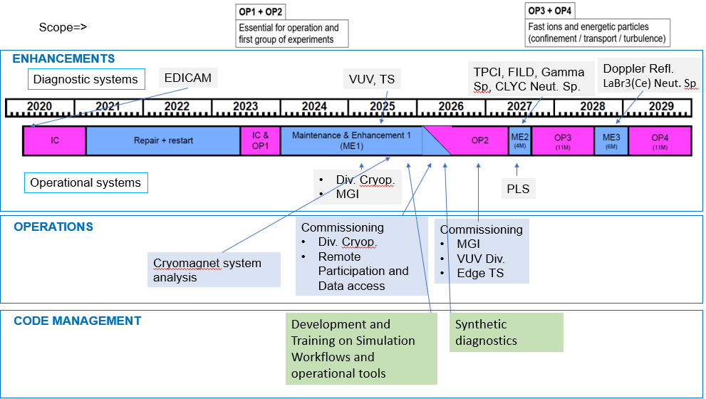
Background: JT-60SA status and mid-term plan
Main objectives of 2024-25 ME1 shutdown
completion of the insulation reinforcements (mainly poloidal coils and CS modules)
installation of extensive set of new key components and subsystems in preparation of the next operational campaign OP2 (P-N NBI, ECRF launchers, in-vessel coils, stabilizing plate, C-IC divertor, diagnostics, analysis cluster…)
AC W-wall
Timeline BASC approved
W-plan approval in Oct 25
Commissioning with H plasmas for D plasma operation
Break down and plasma formation studies
Commissioning NB injectors into plasma, including monitoring of shine-through vs energy (esp. N-NBI)
Step-by-step increase of plasma current up to 5.5 MA
Test of plasma control schemes: current, position, density, heating
ITER risk mitigation
Studies of L-H transition (H and D and possibly addition of He)
Disruption/ Runaway Generation and mitigation studies (including MGI)
Scenario development
Initial integrated scenarios development towards ITER standard H-mode
OP2 Baseline​, OP2 Hybrid​, OP2 ITB​
BA-STP technical objective: demonstration of Poloidal Field Coils operation at the rated design value (20kA) during OP2 after the insulation reinforcement performed in 2022-2024.
OP2 objectives

Slide 10
WPSA Objectives 2026/2027
EUROPE Strategic Priorities
scenarios compatible with W-PFCs.
Management of disruptions and runaways
Fast ion physics
real-time control strategies
2026: OP2 restart, systems commissioning and first operation (edge TS, div. VUV, MGI)
Support systems operation
Support data production
Finalize procurements for ME2
Finalize preparation of installation and commissioning of ME2 systems
Support design and procurements for ME3 -2028 (DR, Neutron monitor and Neutron Spectrometer 2)
Support data validation and analysis including IMAS
Develop upgrades and new enhancements in preparation of W operation (diagnostics, heating, control, protection etc)
2027: ME2 installation of FILD, TPCI, Gamma spectrometer, PLS1, (neutron spectrometer 1)
Support installation and integration of ME2 systems
Develop enhancements for ME3 (DR, edge diagnostics?)
Develop upgrades in preparation of W operation (diagnostics, heating, control, protection etc)
Gain experience in operation of high current, high plasma volume SC device

Slide 11
Overview of the prioritized ITER related tasks: specs
prepare a 5-10 min presentation with not more than 5 slides addressing the following items:
Which are the 3-5 main Research questions you are addressing for ITER?
What is the relation of these research questions with the present ITER Research Plan?
What are the human and facility resources allocated for these 3-5 individual questions? – please provide the numbers total for each main research questions, fraction of your WPs total budget and integral value for these main objectives
Which 3-5 objectives are the TSVVs in the thrust you are coordinating addressing for ITER?
Please upload the slides on indico…

