Slide 1
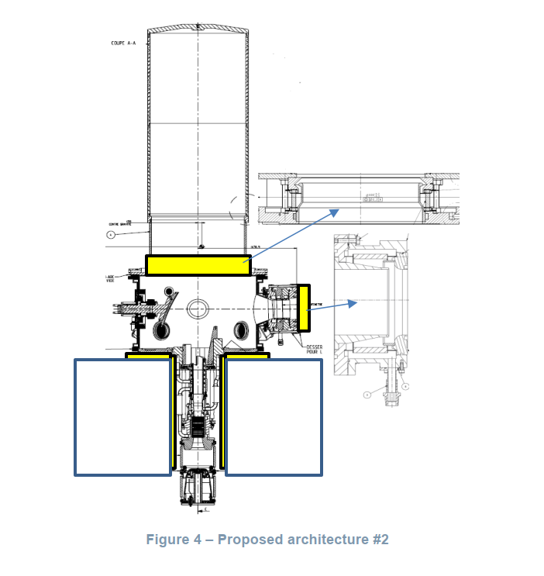
Gyrotron developments (IPP, KIT, Polito, NCSRD)
Development and Testing of High-Power Gyrotrons Advancing gyrotron technology, particularly the 2 MW gyrotron (2025–2027), which shares key design similarities with ITER, including operating modes, hollow cathode configuration, and magnet design.
- The gyrotron developed for W7-X should fit in the existing ITER-gyrotron magnet design if possible. - Tests show that no critical operation limits have been found so far in the existing multi mode cavities of the W7-X and ITER gyrotrons.
- The electron optics should be up-scaled to 140 GHz from the ITER-gyrotron design.
WP W7-X resources in 2025:
ENEA-Polito: 19 PM
NCSRD: 20 PM
KIT: 50 PM
Notes:
The dual-laser calibration technique in Thomson scattering diagnostics improves measurement accuracy by using two laser pulses of different wavelengths to calibrate the system. A new data analysis method simplifies error estimation, making calibration more precise. In ITER's core LIDAR system, a ruby laser offers the best calibration accuracy (~1%) when paired with the main Nd:YAG laser. In the RFX-mod system, a combination of Nd:YAG and Nd:YLF lasers enables accurate calibration despite their small wavelength difference.

Slide 2
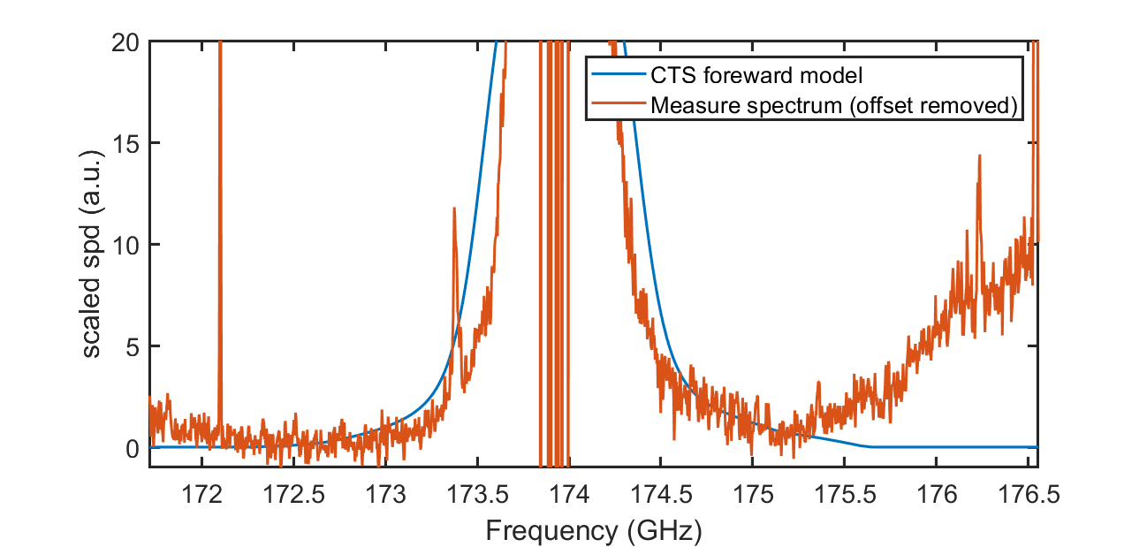
Collective Thomson Scattering (MPG, DTU)
Collective Thomson scattering (CTS) installed at Wendelstein 7-X to measure a projected velocity distribution function of mainly confined fast ions. At ITER, where it has to provide with the measurements of the fast ion velocity distribution function across the plasma cross-section.
Advancements in Plasma Diagnostics: The 174 GHz CTS system at W7X operates within 172-176 GHz, reducing electron cyclotron emission noise and improving measurements of fast ions and bulk plasma parameters.
Improved Signal Processing: A newly developed radiometer enhances the signal-to-noise ratio
First Measurements and Model Comparison: In 2023-2024, the system was commissioned, providing the first CTS spectrum from W7X discharges with NBI fast-ions
WP W7-X Resources: 12 PM + campaign participation (DTU)

Slide 3
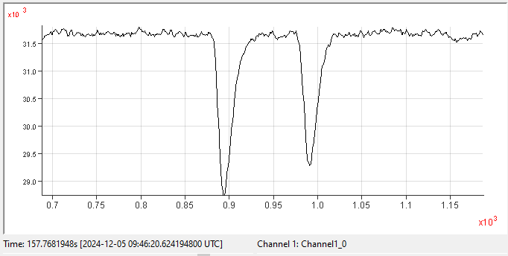
Dual-laser wavelength Thomson scattering (MPG, ENEA-RFX)
This method has two advantages compared to single laser wavelength TS:
-higher electron temperatures can be measured without any change in spectral filter set-up
-allows in situ spectral calibration
1064 nm
1319 nm
14
spectral
coverage
polychro-
mator
+ 255 nm
___ 1 keV
___ 2 keV
___ 10 keV
___ 20 keV
___ 40 keV
single shot pulse shape of scattering signals
#20241205.prog.23, T_{e}= 6 keV, n_{e}=4·10¹⁹ m³
12
effective
spectral coverage
10
8
Spectral power (W/(sr m))
6
4
2
W7-X, Source. E. Pasch
0
200
400
600
800
1000
1200
1400
1600
1800
2000
Wavelength (nm)
WP W7-X Resources 2025: 3 PM + OP2.3 campaign participation

Slide 4
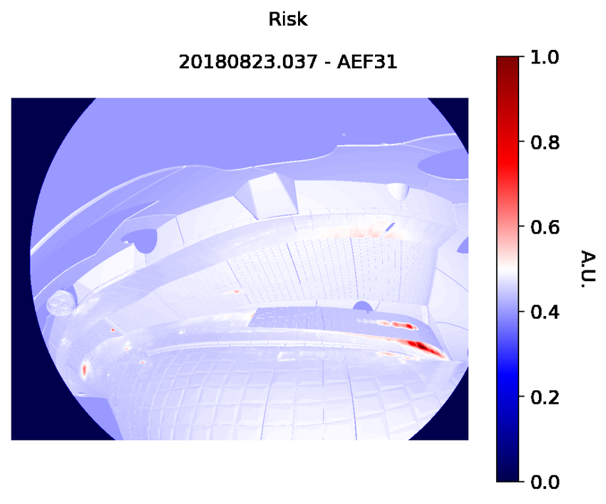
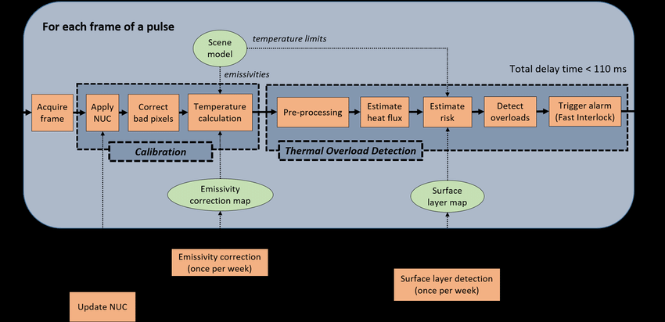
Steady-state capable IR PFC protection system MPG (W7-X), CEA (WEST), ENEA-UNICA (W7X), IPPLM (W7-X, WEST)
Joint program on developing IR protection systems for PFCs
Implementation of system to detect thermal events in real-time and interrupt operation if a critical event occurs (MPG, CEA).
Development of the automatic (also with machine learning) to detect events, model reflections on PFCs in real time (MPG, CEA, ENEA, IPPLM).
Automatic failure detection of the PFCs from analysis of infrared images (IPPLM, CEA)
Resources: 2 EEG grants (CEA, IPPLM) WP W7-X Resources (2025):
ENEA-UNICA 5 PM
CEA 8 PM

Slide 5
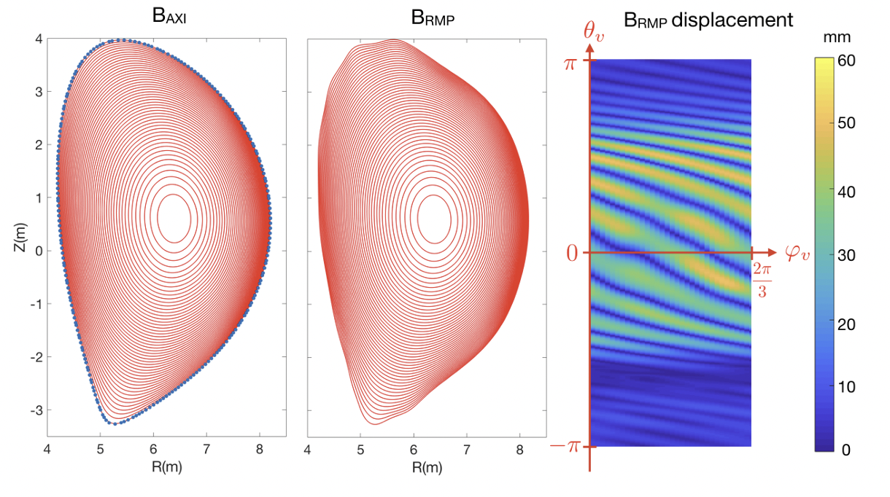
Modelling for ITER
ITER will operate with 3D perturbation fields
WP W7-X: Drift Implementation in EMC3-Eirene (2025-2027) Enhancing modeling of resonant magnetic perturbation (RMP) scenarios for the ITER divertor by incorporating drift effects in the EMC3-Eirene code. Resources in 2025 (6 PM)
TSVVs:
The application of stellarator gyrokinetic codes to 3D-perturbed tokamak configurations is one of the key deliverables of the TSVV13 task.
ITER 3D configurations (rippled and RMP-perturbed) used in [Reynolds-Barredo NF 2020] have been adopted by the TSVV13 team to address this deliverable.
Preliminary electrostatic turbulence analyses began in 2024 but were interrupted due to the unavailability of MARCONI. Work is expected to resume with the commissioning of PITAGORA in 2025.
[Reynolds-Barredo NF´2020]

