Slide 1
2025 Annual Work Plan
Work Package WP06-PrIO Preparation of ITER Operation
WP Project Leader : Xavier Litaudon
Project Support Officer : Gloria Falchetto
PMU Coordinator Officer : João FIGUEIREDO
Assigned to: Fusion Technology
Meeting 07 Feb 2025 ITER priorities in PSD work packages
Lead beneficiary

Slide 2
PrIO Long-Term Objectives [PrIO PMP & WP 2020-2025]
As ITER is crucial for the fulfilment of the European fusion Roadmap, EUROfusion needs to be ready to play a leading role in ITER operation to contribute to its success, and ultimately, to benefit from ITER in view of DEMO
The European Roadmap states “To ensure its (ITER) success, a team is needed with deep understanding of the critical plasma issues and equipped with comprehensive validated modelling tools to design and optimise the plasma and its control”.
With a growing participation of the EUROfusion members in the preparation of the ITER scientific programme, it is necessary to increase the integration and coordination of the relevant EUROfusion activities to provide coordinated EUROfusion inputs to ITER Organisation (IO) and to position the EU laboratories to obtain maximum benefits from ITER operation.
This WP should lay the foundation of a coordinated, strong EUROfusion participation in a single EU team approach (with F4E) for the coming ITER scientific exploitation, benefiting from the strength of the EUROfusion command and competences in technology, experiments/operation and simulation.

Slide 3
PrIO Implementation and 2025 resources
WPPrIO is implementing some elements of the high-level recommendations and priorities stated in the white paper on “The preparation of EUROfusion role in ITER operation and scientific exploitation” endorsed at the EUROfusion GA in Dec. 2020¹
5 Sub-Projects – PPY resources in 2025 (574 PM for SP-2 to SP-5)
  SP-1. Project management 13.4 PM
  SP-2. Preparation of ITER first experimental campaigns 182 PM (including AI projects)
  SP-3. Plant systems and plasma operation 48 PM ( Including new ECRH activity)
  SP-4. ITER Neutral Beam Test Facility and R&D 226 PM
  SP-5. Neutronics, Nuclear waste and Safety 117 PM
1 EUROFUSION GA (20) 32 - 4.7 - ITER White Paper Report WG1 Issue 1 10-Dec-2020 (Decision).docx and EUROFUSION GA (20) 32 - 4.7 - ITER White Paper Report WG2 Issue 3 7-Dec-2020 (Decision).docx

Slide 4
High level overview in terms of the involvement for a relevant EU implication in ITER and the impact level on the EU DEMO Design [EUROfusion GA 2020]
Sub-systems | Required involvement for EU implication in ITER operation | Impact level on EU DEMO design
TF & PF Magnets and Cryo-plant | *** commissioning (* full op.) | ++ (for DEMO design)
Divertor & PFCs | *** | ++
Tritium Plant | *** | +++
Breeding Blanket System | *** | +++
H&CD: Neutral Beam | *** (NBTF) | +++
Diagnostics (Synthetic Diagnostic–PrIO) | *** | +++
Control and Analysis/operational/simulation tools | *** | ++ (+++ some control aspects)
Neutronics, Waste and Radiological Protection | ** | +++
H&CD: Electron Cyclotron | ** | ++
H&CD: Ion Cyclotron | ** (operation in present facilities) | +
Vacuum Vessel | * | +
Remote Handling Equipment | * | +
Vacuum Pumping & fueling | * | +
Building, Electrical Power Supply & Distribution System | * | +++ (for DEMO design)
PrIO contributions
(+++): Unique, (++) High, (+) Significant (***) Strong: organized team with defined commitments, (**) Organized team, (*) Expertise for follow-up

Slide 5
PrIO objectives in support to ITER
Contribute to the preparation at the EUROfusion Consortium level of the initial ITER experimental campaigns
  develop synthetic diagnostics [for the EC procured ITER diagnostics for the first phase of ITER operation ] and data analysis tools within IMAS
  design ITER operational scenarios through modelling with tools validated on EUROfusion experimental facilities
Support knowledge capture and transfer on operational topics from EUROfusion facilities in view of ITER operations.
  EUROfusion Operations Network on relevant operational competencies and coordination of operational studies (NBI, ECRH)
Contribute to the activities of the ITER-NBTF and the scientific exploitation of smaller ITER-like ion sources located at IPP-Garching
  provide results necessary to optimise the ITER NB system and to define the technical requirements of the procurement arrangements
Improve and transfer knowledge on neutronics, nuclear technology and safety issues
  develop and validate nuclear codes, neutronics tools and experimental techniques
  Contribute to risk mitigation of ITER operations and maintenance activities by analysis and lessons learned of JET DT operation

Slide 6
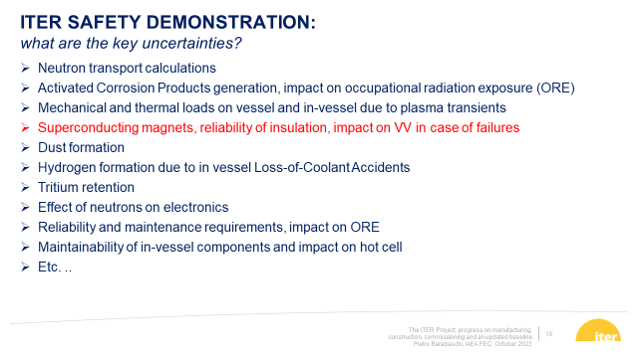
PrIO activities well aligned with IO key safety uncertainties
PrIO contributions
[P. Barabaschi FEC 2023]

Slide 7
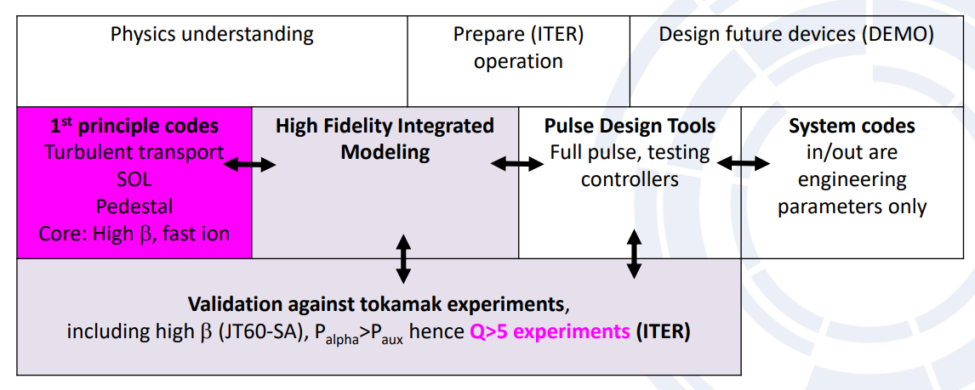
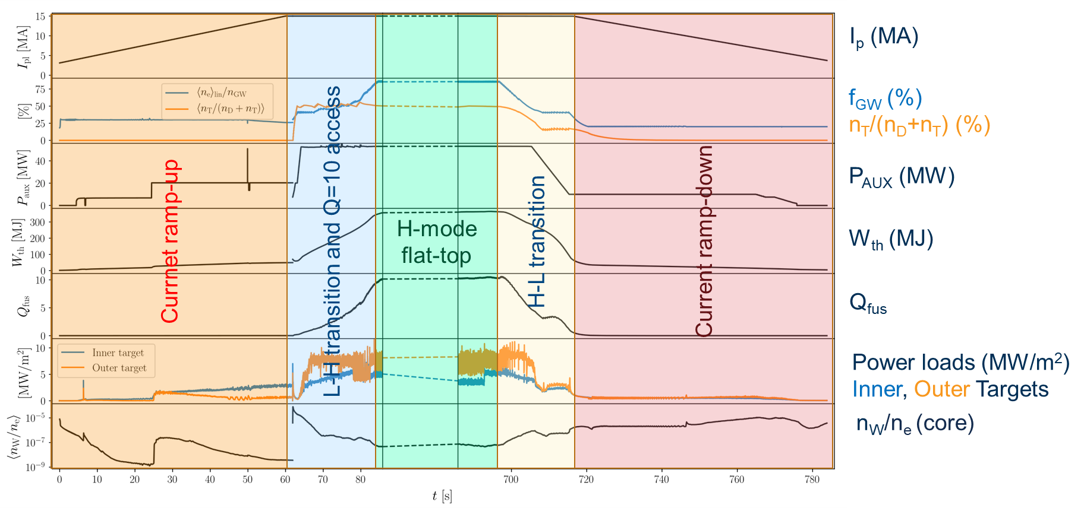
Thrust 5: Whole-Device Modeling – ITER related objectives
TSVV 2 Physics Properties of Strongly Shaped Configurations
TSVV 14 Multi-Fidelity Systems Code for DEMO
TSVV 11 Validated Frameworks for the Reliable Prediction of Plasma Performance and Operational Limits in Tokamaks
[C. Bourdelle EPS 2024 & PPCF]
  Validation of the High Fidelity Plasma Simulator (HFPS)
  using experimental data in IMAS from AUG, JET, TCV, WEST, on the EUROfusion Gateway
  Large scale validation on all EU W devices
  GENE-Tango simulations of ITER baseline scenario
integrated modelling of the whole plasma across all phases of a discharge
[E. E Militello Asp ITER Integrated modelling ITPA-IOS]

Slide 8
Back-up slides

Slide 9
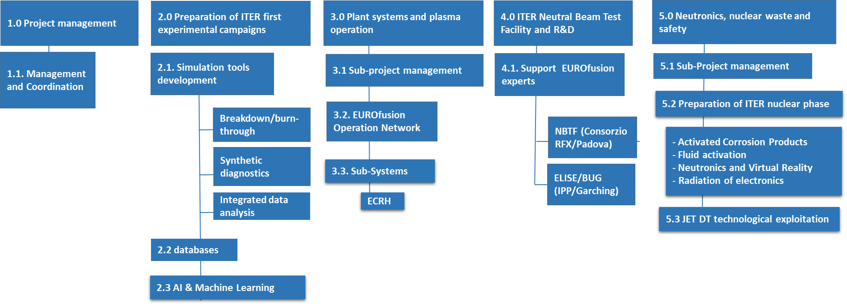
2025 high-level Objective and Structure
In the context of ITER's re-baselining efforts to achieve Q=10 as quickly as possible, PrIO is delivering validated and reliable operational tools—including methods, codes, and procedures—while also facilitating knowledge transfer in areas such as ECRH, NBI, and neutronics, to support risk mitigation ahead of ITER's operational phase.
Expanded
Expanded
New
New
New
[PrIO Overview published : 2024 Nucl. Fusion 64 112006]

Slide 10
2025 Description of work : new activities
PrIO-2: Synthetic diagnostics (in support to ITER EU procured diagnostics)
  Bolometer diagnostics for ITER and tomographic reconstruction software
  Analysis Tools & Calibration Techniques for the ITER magnetic measurements
  Radial Neutron Camera and Gamma Ray Spectrometer
PrIO-2: Integrated multi-diagnostics data analysis tool (IDAV) in view of ITER
PrIO-2: Multi-machine Infra-Red image database (experimental & simulation data)
PrIO-2: Artificial Intelligence (AI) and Machine Learning (ML) projects related to operation and/or use of multi-machine databases
PrIO-3: ECRH commissioning procedures transferable to ITER-plant
PrIO-5: Neutronic - Assess the impact of ITER re-baselining and Comprehensive JET DT technological exploitation analysis
    Special issue in Plasma Physics & Controlled Fusion on JET D-T neutronics

Slide 11
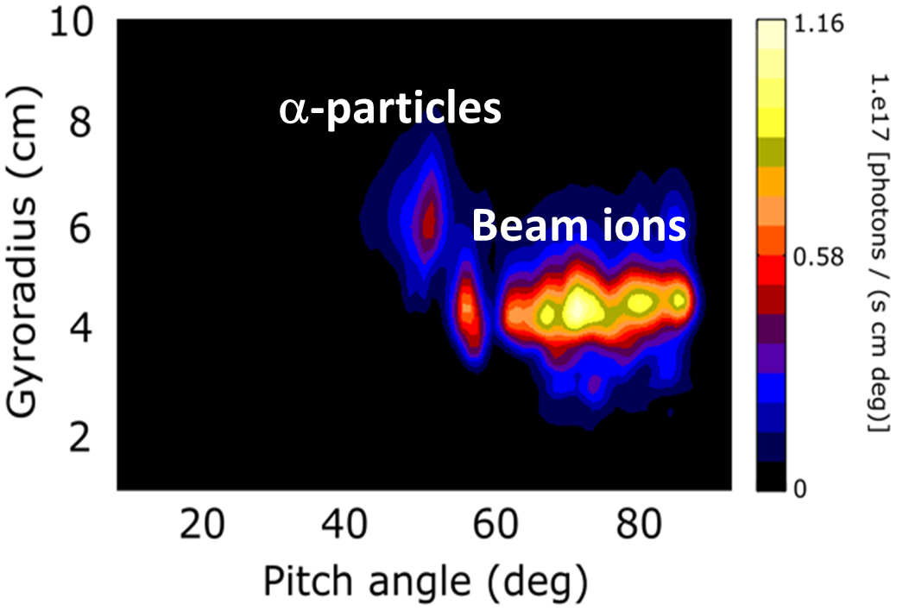
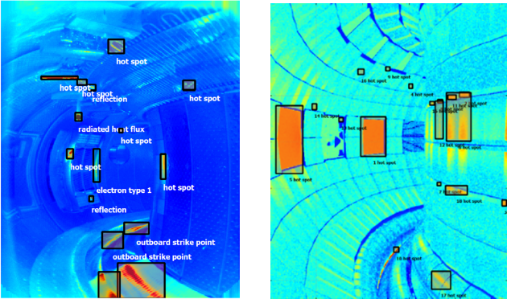
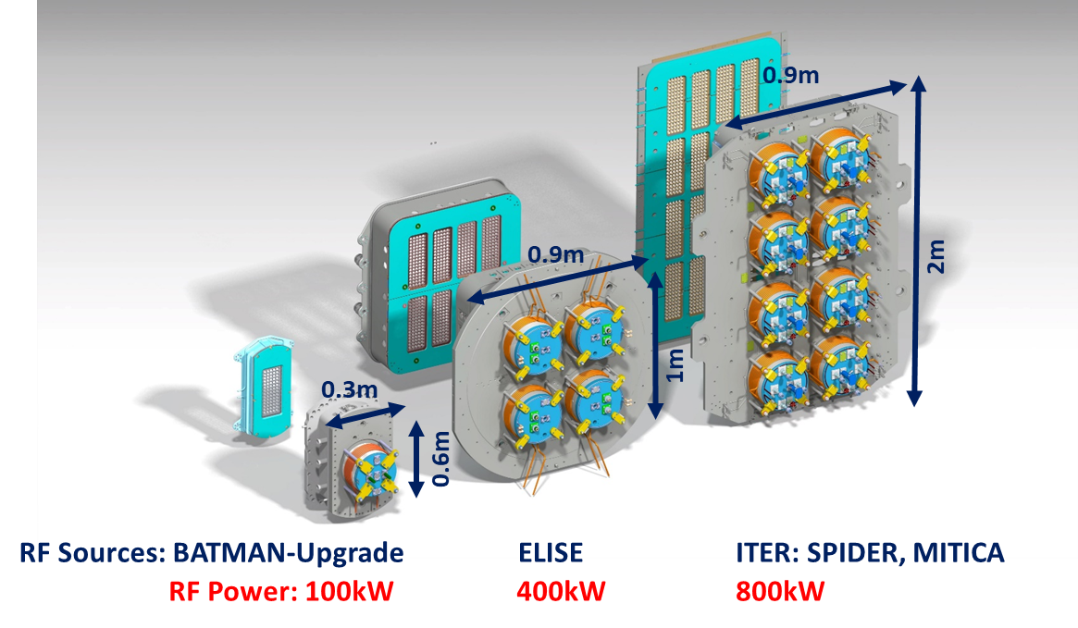
2025 Description of Work – Selected key highlights [1/2]
PrIO-2 Simulation tools development
  ITER predictive plasma initiation simulations with the new W Wall (within the IMAS framework)
  ITER Fast Ion Loss Diagnostics (FILD): consequences of the new magnetic configuration with the full W wall
  Simulation of ITER IR synthetic images in presence of plasma emission in IR and integration in IMAS
PrIO-3 Sub-systems, Heating & Current Drive, ECRH
  Validated commissioning procedure of the CW ECRH system transferable to ITER
PrIO-4 ITER Neutral Beam test Facility and R&D for ITER NB
  Participate in ELISE, BATMAN Upgrade and NBTF: operation, analysis of beam and plasma diagnostics, design, simulation, interpretation and extrapolation to support ITER NBI (agreement to be extended beyond 2025)
Meeting EUROfusion - the European Commission
February 2025

Slide 12
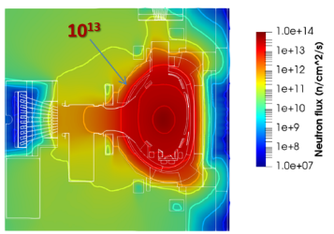
2025 Description of Work, PrIO-5 Neutronics - Selected key highlights [2/2]
Simulation of the radiation field in ITER
  - modelling for ITER with the full-W wall, bridging the gaps between plasma physics and neutronics
Neutronics and Safety plan in support to ITER
  Feasibility studies of neutronics experiments during ITER D-D, D-T-1 in support of DT-2 licensing : transfer of know-how from JET to ITER on neutron streaming, shutdown dose rate, water activation …
Activated Corrosion Products (ACP) tools development and experiment for ITER
  experiments on copper and main isotopes of stainless steel at Frascati 14MeV Neutron Generator (FNG), OSCAR-Fusion validation
Water activation experiments and material (gamma) shielding at KATANA TRIGA Mark II
Radiation qualification of safety electronics in support to ITER
  Procurement, installation and characterization of a novel neutron test bed at FNG for testing diagnostics, electronics and critical ITER components.
JET DT technological exploitation
  Implement activities during the JET decommissioning phase (pending agreement between UKAEA and EUROfusion) in support of the preparation of ITER decommissioning
Meeting EUROfusion - the European Commission
February 2025

Slide 14
2025 Description of work : new activities
PrIO-2: Synthetic diagnostics (in support to ITER EU procured diagnostics)
  Bolometer diagnostics for ITER and tomographic reconstruction software
  Analysis Tools & Calibration Techniques for the ITER magnetic measurements
  Radial Neutron Camera and Gamma Ray Spectrometer
PrIO-2: multi-machine Infra-Red image database (experimental & simulation data)
PrIO-2: Integrated multi-diagnostics data analysis tool (IDAV) in view of ITER
PrIO-2: Artificial Intelligence (AI) and Machine Learning (ML) projects related to operation and/or use of multi-machine databases
  Tokamak operation Conversational AI Interface Using Multimodal Large Language Models
  AI-assisted Plasma State Monitoring for Control and Disruption-free Operations
  Identification and confinement scaling of hybrid scenarios across multiple devices
  Applying AI/ML for NBI ionization and slowing-down simulations using ASCOT/BBNBI
  Machine learning accelerated pedestal MHD stability simulations
  Machine learning accelerated SOL simulations: SOLPS-NN
PrIO-3: ECRH commissioning procedures transferable to ITER-plant
PrIO-5: Special issue in Plasma Physics & Controlled Fusion on JET D-T neutronics

