Slide 1

PWIE SP A: Presentation of 2025 Tasks & Plans
Meeting PWIE 2025 Prague
Jan W.Coenen & SPA Contributors
Forschungszentrum Jülich Gmbh, Institut for Fusion Energy and Nuclear Waste Management IFN-1 52425 Jülich, Germany,

Slide 2
SPA– 2025 - Overview
SP A.1 Synergistic Load Studies of Plasma-Facing Materials for ITER & DEMO
Focus on damage evolution of ITER-like MBs
(including WEST MBs)
Recrystallisation evolution in W (incl. modelling)
Focus on ITER-like MBs testing under multiple seeding, species, ELMs, and He
Plasma qualification of new materials for DEMO and other toroidal facilities (e.g. W7-X)
Disruption-like loading for DEMO (incl. OLMAT)
Melting of MBs => MEMETO modelling)
KIPT as possible during cicumstances
SP A.2 High Particle Fluence Exposures of Plasma-Facing Components for ITER
SP A.3 Advanced Materials under thermo-mechanical and plasma loads
SP A.4 High Temperature performance of Armour Materials: Recrystallization and Melting
SP A.5 Compass-U

Slide 3
WP PWIE SPA 1
Update for 2025

Slide 4
Synergistic Load Studies of Plasma-Facing Materials for ITER & DEMO
Deliverable Owner | Beneficiary | PM | Deliverable (Team)
M. Wirtz | FZJ | 4 | D001 (M. Gago, D. Dorow-Gerspach*)
T. Morgan | DIFFER | 4 | D002, (T. Morgan)
P. Tabares | CIEMAT | 6 | D003 (D. Alegre)
H. Greuner | MPG | 3 | D004 (H. Greuner, H. Maier, J.Riesch)
I. Garkusha | KIPT | 15 | D005 (I. Garkusha)
Total |  | 32
Establish a test matrix for Materials utilized in WEST and ITER with respect to updated load specifications. in the available devices (DIFFER, FZJ, MPG)
Study the impact of synergistic loads on ITER and DEMO relevant baseline Materials (tungsten, W-FGMs on Steel) and new materials developments with Laser (Laser at PSI-2) and e-beam (JUDITH) as well as steady-state plasma exposure (He, H). A special focus will be the qualification of these materials under high cycle numbers and seed-impurities exposure. (FZJ)
Post-mortem analysis will characterize the induced surface modifications and damages as well as investigate changes of the materials properties due to e.g. recrystallization behavior and/or surface morphology changes. (FZJ, MPG, DIFFER, KIPT)
Determine underlying mechanisms of evolution of crack propagation in materials for ITER and current day devices. (FZJ, DIFFER, KIPT, MPG, CIEMAT)
Qualify W materials for use in W7-X. (MPG, FZJ)
Synergy effects from sequential stationary (PSI-2 / MAGNUM-PSI, OLMAT) and transient (QSPA) plasma loads. (DIFFER, MPG, FZJ, KIPT, CIEMAT)
Studies of fatigue cracks formation in deformed/re-crystalized W, fatigue damage of W_{f}/W wires, latticing W etc. (FZJ)
Combination of pulsed and steady state loading (e.g. behavior of QSPA pre-damaged targets in PSI-2, JUIDTH compared with reference samples). (FZJ, KIPT)
Study the Behavior of pre-cracked samples under edge loading conditions - links to HHF facilities such as JUDITH and WEST. (DIFFER, FZJ)
Device | Beneficiary | Days | Related Deliverable
PSI-2 | FZJ | 10 | D001
JUDITH | FZJ | 15 | D001
Accelerator | FZJ | 3 | D001 jointly with SPA 3/SPA 4
GLADIS | MPG | 5 | D004
MAGNUM-PSI | DIFFER | 5 | D002
UPP | DIFFER | 5 | D002
OLMAT | CIEMAT | 10 | D003
Deliverable ID | Deliverable Title
D001 | Damage threshold for different W materials at varying loading conditions in matrix form / Understanding the damage mechanisms and changes in material properties and changes in the retention behavior (FZJ)
D002 | “Evaluation of redeposited tungsten microstructure and evolution under transient loading” (DIFFER) – with focus on Properties under synergistic Loading
D003 | Exploitation of OLMAT as HHF facility – Testing of baseline and advanced materials – Laser & OLMAT exposures (CIEMAT)
D004 | Qualification of W-Heavy Alloys for use in W7-X in conjunction with test on new tungsten mock-ups (WPMAT) and PFUs for WEST (WPTE) (MPG)
D005 | Analysis of material properties after sequential HHF transient and steady-state plasma loading (KIPT).

Slide 5
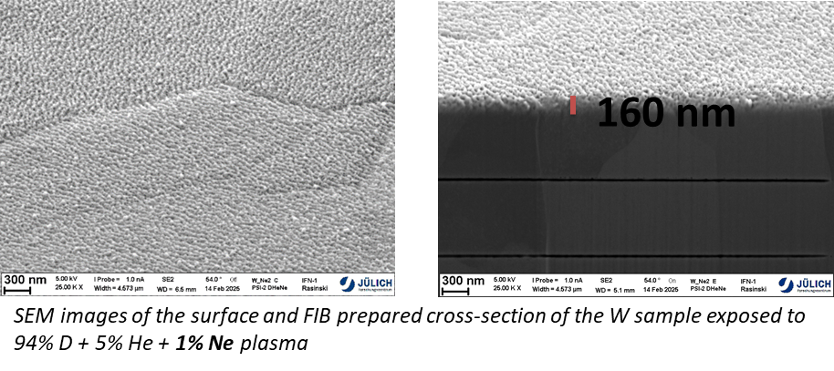
Plans for 2025
Based on the first exposure to 94% D + 5% He + 1% Ne (left), further experiments with plasma exposure to mixed D+He+Ne plasma with various fractions of Ne (0; 1 and 5 % of Ne) to explore its influence on the structure and morphology of W.
The goal of the experiment is to help assess the influence of seeding gases foreseen for ITER with relevant ELM like laser loading in the PSI-2 on the morphology changes of exposed W.
For each exposure samples exposed only to mixed plasma as well as plasma and laser will be investigated. Multi sample holder in PSI-2 allows simultaneous exposure up to 8 samples.
Samples will be characterized by means of electron microscopy techniques – SEM, FIB and TEM
PSI-2 94% D + 5% He + 1% Ne
Base Temperature ~ 900 °C
Ion Flux ~ 2.5 × 10²¹ m⁻²s⁻¹
Fluence ~ 1 × 10²⁵ m⁻²
Energy ~ 175 eV
Early stage of the fuzz formation on the sample exposed to plasma only, as well as 160-350 nm erosion
Nanobubble formation at the depth of 100 nm for the laser exposed sample.

Slide 6
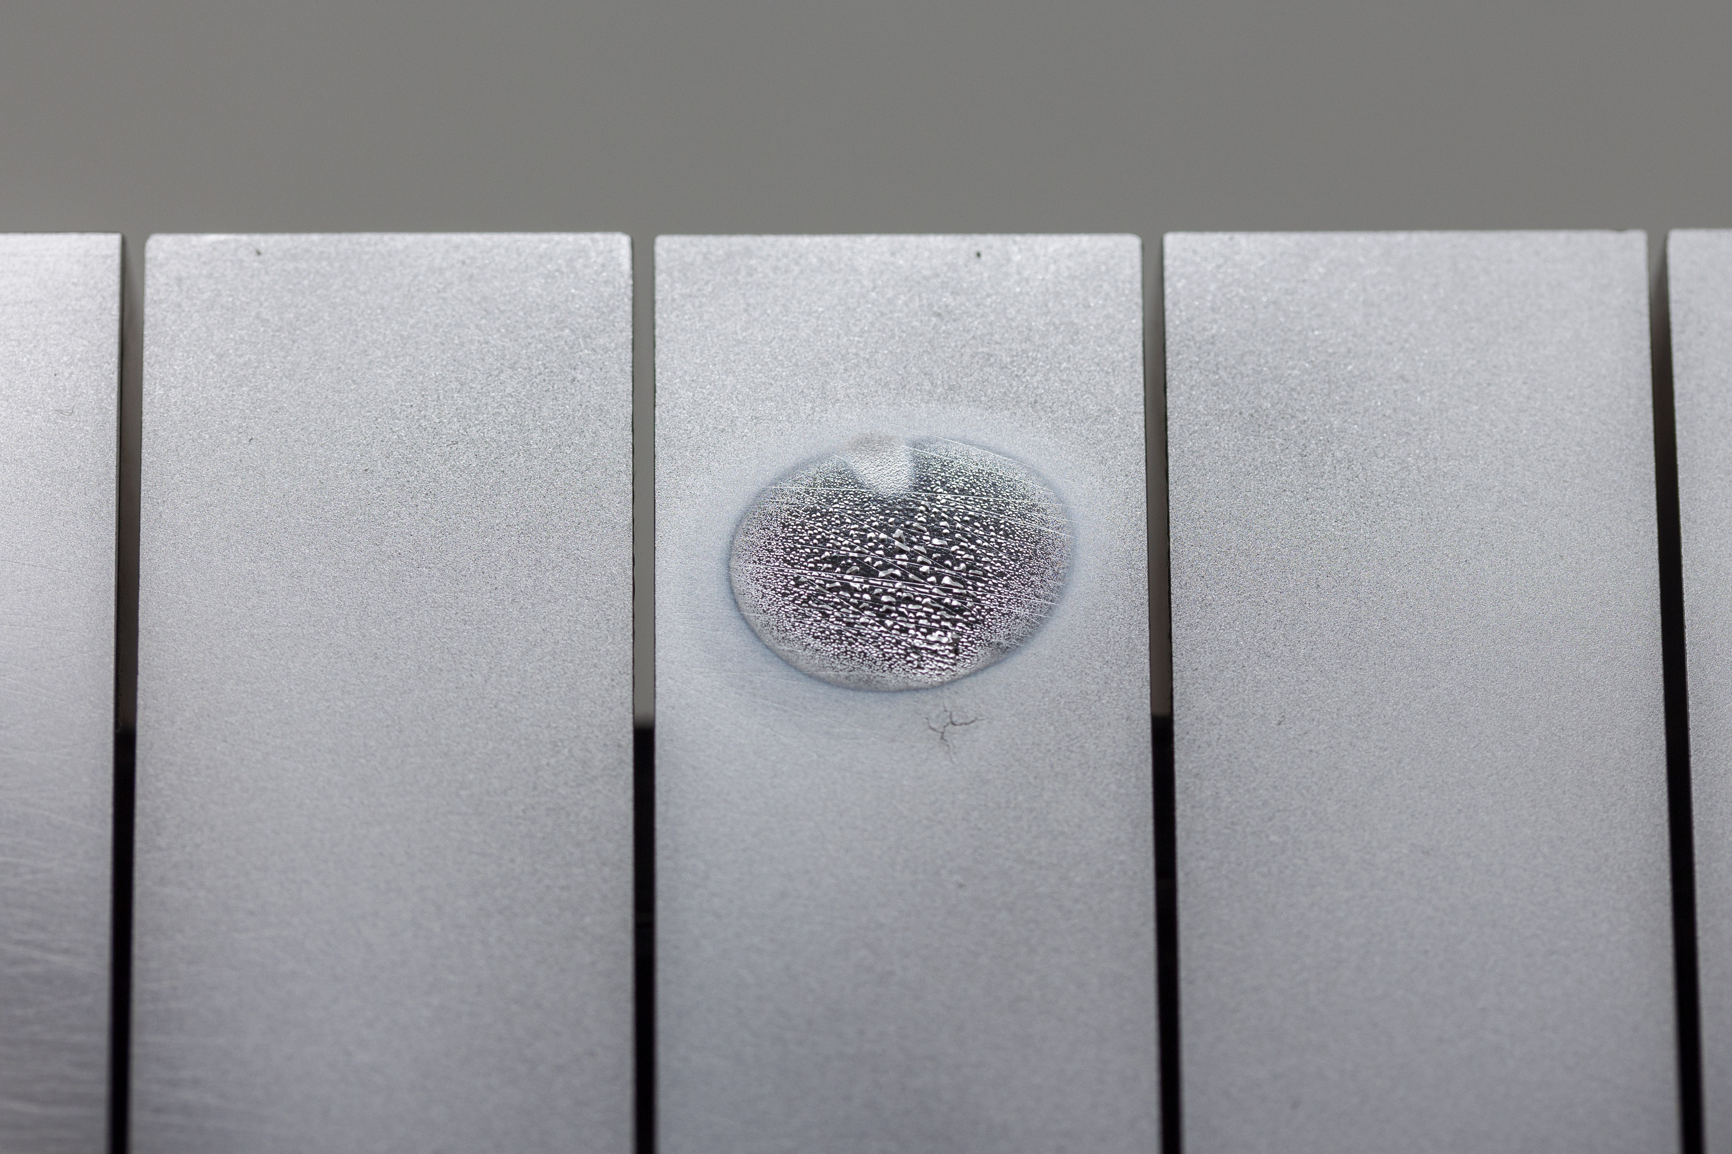
Background and motivation
Switch of ITER wall from Be to W gives additional W source which may lead to thick deposition layers
Thick W layers observed in WEST with ‘UFO’ flaking events
Previous Magnum-PSI results show strong re-deposition of sputtered W leading to thick partially de-laminated layer
Motivation to investigate this further in a controlled manner
500 µm
Do deposited layers behave like bulk W?
How well do they adhere to the surface (dust)?
How much tritium could they retain (co-deposition effect)?
300 µm

Slide 7
Goals for new experiments
Two main goals for experiment week:
How stable are previously created layers?
  Use pre-created layers and expose to ELM-like loading (LASAG laser)
What is W:D ratio in co-deposited layers, and how does switching to D plasma change W layer?
  Use similar approach as previous but with Ar-seeded D plasma

Slide 8
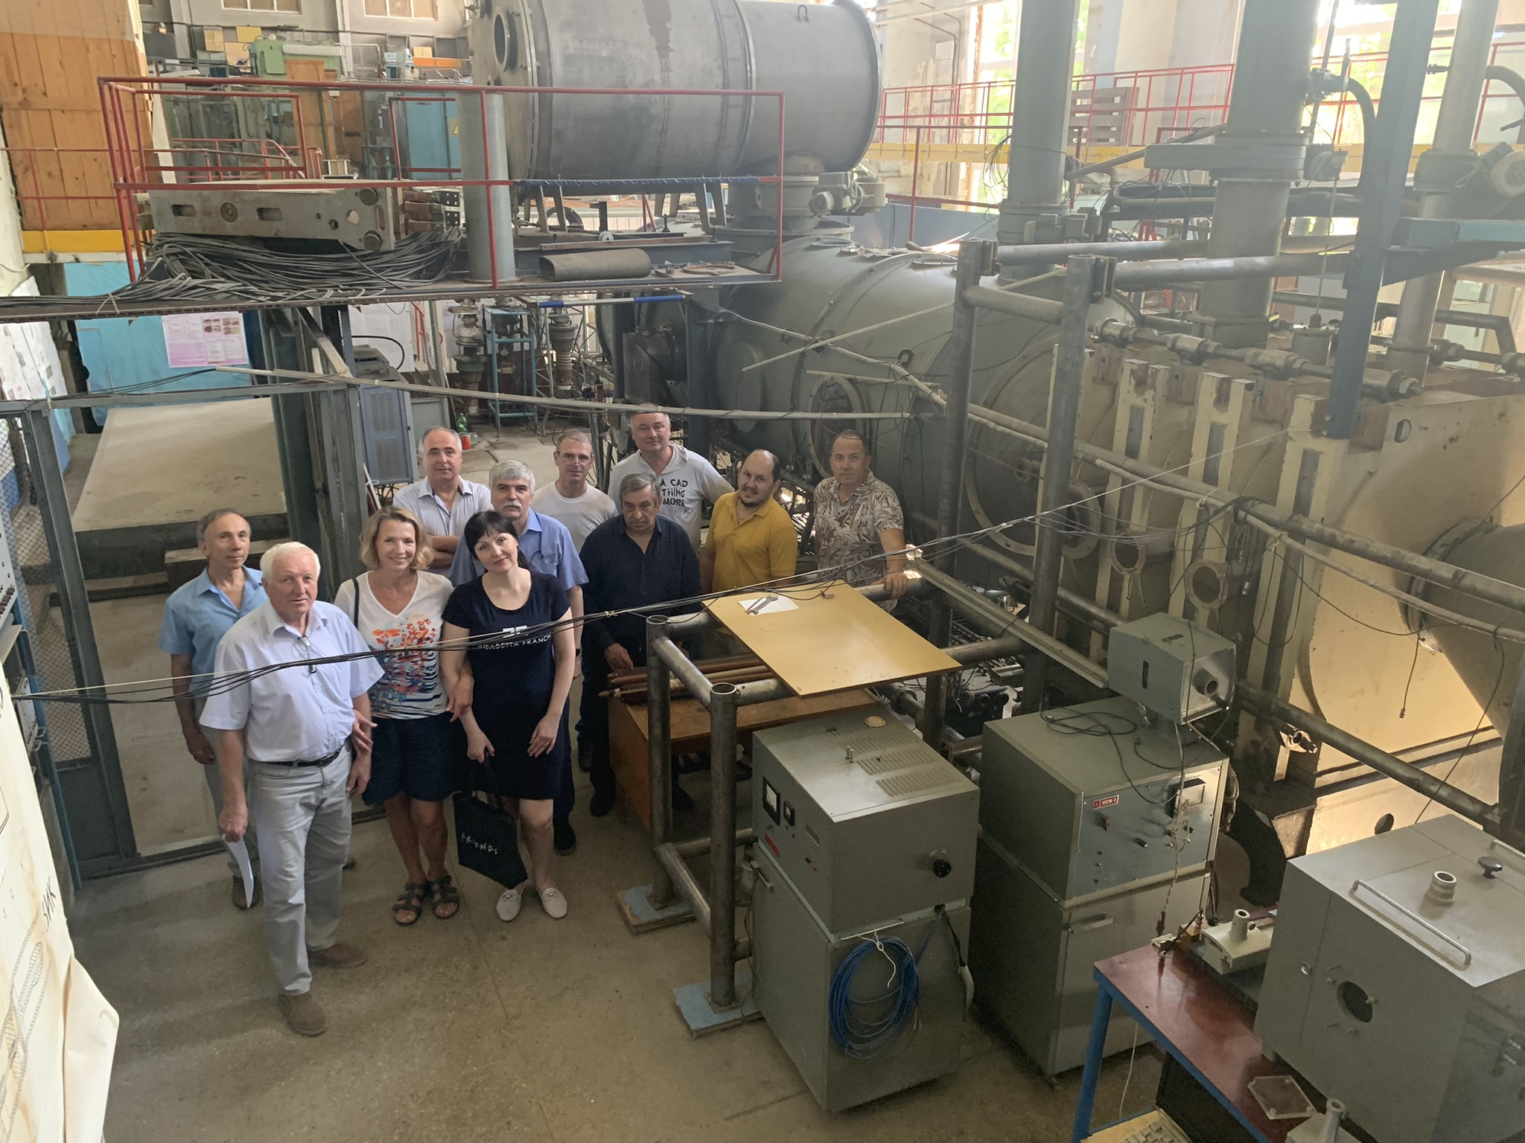
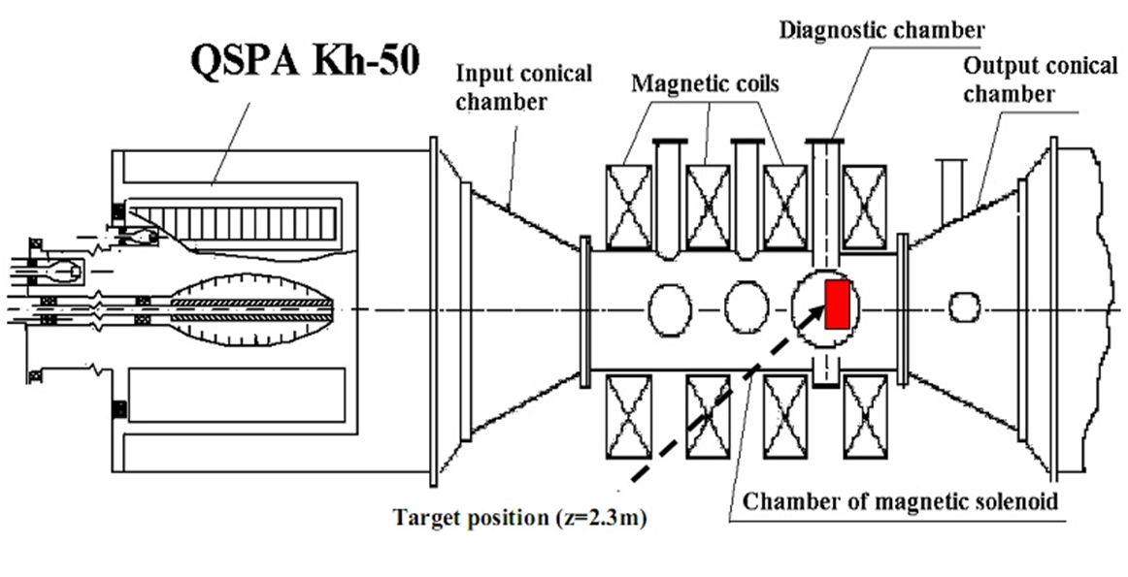
Facility: QSPA Kh-50
Energy density [MJ/m²] | (0.5-30)
Pulse duration [ms] | 0.25
Magnetic field [T] | 0.54
Plasma pressure [MPa] | (0.3-1.8)
Particle flux [ions×(m⁻²s⁻¹)] | up to 10²⁷
Diameter of the plasma stream [cm] | 18 cm
About three month of successful plasma operation were achieved during the summer of 2024
S.S. Herashchenko et al. 2023 Fus. Eng. & Des. 190 113527
Capable of reproducing both disruptions and ELM loads in terms of energy and particle fluxes!

Slide 9
PWIE-SP A.A1.T-T004-D005: Summary and Future Plans
Analysis of material properties after sequential HHF transient
and steady-state plasma loading (KIPT)
Summary 2024
Samples were initially exposed in Upgraded Pilot-PSI (UPP) and Magnum-PSI in collaboration with Tom Morgan
Additional QSPA exposure (T=RT, 10 pulses, 0.9 MJ/m²) was performed
Surface melting, cracking (large and intergranular cracks), pores.
Post-mortem analyses are in progress
Abstract on the performed work was accepted for the 20th PFMC (19- 23 May 2025 Ljubljana, Slovenia)
Works to be performed in 2025
    The influence of sequential steady-state plasma and transient loading on cracking/melting thresholds will be studied at preheated tungsten surfaces.
    The main damage mechanisms of exposed surfaces will be evaluated.

Slide 10
SP A.1 Synergistic Load Studies of Plasma-Facing Materials for ITER & DEMO: CIEMAT
D003: Exploitation of OLMAT as HHF facility – Testing of baseline and advanced materials – Laser & OLMAT exposures
OLMAT BEAM: fatigue studies in large holder
2025 plans
  Installation: try to enhance thermal contact at holder to be at room T: screw at center Now ~200 ºC.
  Repeat at larger power to find cracking threshold: 2000 Pulses at a 1-40 MW/m² power distribution.
    ITER-like W: try to purchase or from collaborators
    New PM-Wf/W (if available from JFZ)
    New WCrY alloys with/without spinodal structure. Being cut and polished.
    Additive Manufactured AM-W to check for lower properties: initial materials very bad.
    W/WC from JSI: in production (Thanks to Petra Janus!)
    Study WCrY/CuCrZr joints by HIP-DB (if fabricated on time)
  Expose some of the previous samples to laser pulses to reach DEMO pulses (~5000) and more.
    Look for synergies caused by H fragilization (KeV in OLMAT)
Deliverable: PWIE-SP A.1.T-T003-D003
Status: finished
Facilities: OLMAT 5 days
Linked WP or TSVV: none

Slide 11
WP PWIE SPA 2
Update for 2025

Slide 12
High Particle Fluence Exposures of Plasma-Facing Components for ITER
Deliverable Owner | Beneficiary | PM | Deliverable (Team)
T. Morgan | DIFFER | 5 | D001 (T. Morgan)
M. Balden | MPG | 2 | D002 (S. Elgeti)
Total |  | 7
Recrystallization behavior of DEMO tungsten grades under high flux/fluence plasma loading with impurity seeded deuterium plasmas (DIFFER)
Pre- and post-analysis of materials and components (MPG)
Further analysis linked to facilities and staffing in SP B
Device | Beneficiary | Days | Related Deliverable
MAGNUM-PSI | DIFFER | 8 | D001
UPP | DIFFER | 5 | D001
Deliverable ID | Deliverable Title
D001 | Fatigue cracking and creep evolution of W samples and W-monoblocks exposed to strike point sweeping (DIFFER)
D002 | Pre- and post-characterization of samples (MPG)

Slide 13

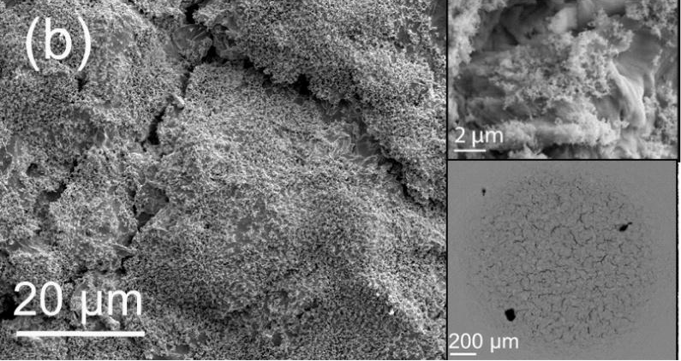
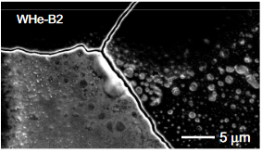
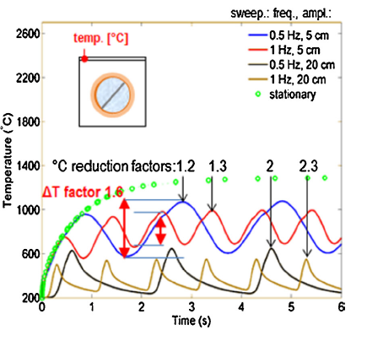
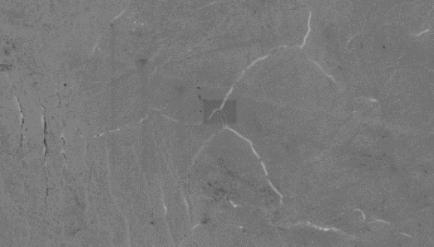
Exploring PMI effects on strikepoint sweeping-induced W fatigue cracking
The thermal cycling caused by strikepoint sweeping will impose cycles of plastic deformation on the W monoblock armour, which will eventually lead to low-cycle fatigue cracking. Fatigue cracking may be accelerated by many plasma-material interactions, potentially reducing monoblock fatigue life.
Understanding the mechanics of these possibly synergistic effects will be vital for divertor lifetime analysis.
Rx mediated crack initiation in W
Y. Li et. al. 2021)
He-induced W fuzz & cracking of W
(G. Temmerman et. al. 2015)
He blistering + ELM-like thermal loading of W
D. Nishijima et. al. 2011)
predicted DEMO monoblock surface temperature during strikepoint sweeping (F. Maviglia et. al. 2021)
Cracking & blistering of redeposited W (Begrambekov et. al. 2019)
H plasma + ELM-like thermal loading of W
(M. Wirtz et. al. 2015)

Slide 14
Conclusions & plans for 2025
Conclusions:
A robust method for using Magnum-PSI to explore the combined effects of PMI and strikepoint sweeping on the fatigue cracking behaviour of W has been developed. This was used to explore the effects of 1 Hz, 100 mm strikepoint sweeping on W with and without prior H implantation. The effects of ELM-cracking followed by strikepoint sweeping were also explored.
This found that, without prior H implantation, macroscopic cracking occurs in < 150 cycles (<15 reattachment events). H plasma implantation was found to increase this to 450-600 cycles, possibly due to increased dislocation entanglement. ELM cracking followed by strikepoint sweeping resulted in macroscopic cracking after <100 cycles. Evidence of W liberation from cracked surfaces, and localized melting and droplet formation were observed.
Plans for 2025:
Develop an in-situ crack detection diagnostic, to enable number of cycles to failure (N) to be determined.
Explore the effects of other PMI, including He nano-fuzz, recrystalised W
Explore other strikepoint sweeping regimes under consideration for DEMO (e.g. 5 Hz sweeping over 400 mm). These regimes may instead result in elastic deformation (high cycle fatigue regime) which could be less affected by PMI effects, increasing fatigue lifetime.

Slide 15
WP PWIE SPA 3
Update for 2025

Slide 16
Advanced Materials under thermo-mechanical and plasma loads
Deliverable Owner | Beneficiary | PM | Deliverable (Team)
J.W. Coenen | FZJ | 5 | D001 (M. Wirtz, J.W. Coenen, A. Litnovsky)
T. Morgan | DIFFER | 3 | D005
I. Garkusha | KIPT | 15 | D004
D. Terentyev | LPP-ERM/KMS | 4 | D003
J. Riesch | MPG | 2 | D002, D006 ( S. Elgeti)
Total |  | 29
Plasma qualification of new materials (WPMAT) and components (WPDIV) for DEMO: Thermal shock and plasma synergistic loading of advanced material including exposures in Magnum-PSI (KIPT, DIFFER, FZJ)
Exposure of advanced materials e.g. W_{f}/W (WPPRD), SMART alloys (WPMAT), additively manufactured components (WPDIV) and others to heat loads and/or plasma loads for assessment of their PWI properties and exploration of limits of their application (FZJ, MPG)
Study of basic thermo-mechanical properties for advanced materials for divertor applications including reference material properties for comparison with neutron-irradiated sample in future (LPP-ERM/KMS, MPG)
  Establish experimental techniques
  Mechanical testing of W-yarns up to very high temperatures, subsequent microstructural characterization (link to neutron irradiation of W yearns & subsequent mechanical testing) (SCK-CEN as part of RU LPP-ERM/KMS)
  Establish experimental basis by e.g. self or proton damage (MPG, FZJ)
  Effect of fusion environment on the mechanical properties of W wire (MPG/ SCKCEN)
Exposure in plasma devices to study the interplay of recovery, recrystallization, plasma and ELM-like loading on surface cracking and fatigue lifetime (FZJ, KIPT, DIFFER)
Post-mortem analysis to characterize the induced surface and microstructure modifications as well as changes of the materials properties due to e.g. recrystallization behavior and/or surface morphology changes (FZJ, MPG)
Device | Beneficiary | Days | Related Deliverable
PSI-2 | FZJ | 8 | D001
JUDITH | FZJ | 10 | D001
GLADIS | MPG | 5 | D002, D003, D006
Accelerator | MPG | 12 | D002, D003, D006
QSPA | KIPT | 10 | D004
MAGNUM-PSI | DIFFER | 5 | D005
UPP | DIFFER | 5 | D005
Deliverable ID | Deliverable Title
D001 | Analysis of Material behavior under Plasma and heat loading regarding mechanical properties e.g. cracking, embrittlement, and microstructure. Link to SP A4 (FZJ)
D002 | Performance of advanced materials under high heat loads and their microstructural characterization (MPG)
D003 | Results from tests of small-scale samples of W and other advanced materials and components (LPP-ERM/KMS)
D004 | Investigation of advanced materials and coatings under ELM-like/disruption transient loading and subsequent analysis.(KIPT)
D005 | “Effect of ELM loading on microstructure evolution of W coated RAFM steels” (DIFFER)
D006 | Effect of energetic ion irradiation on the strength of W wire (MPG)

Slide 17

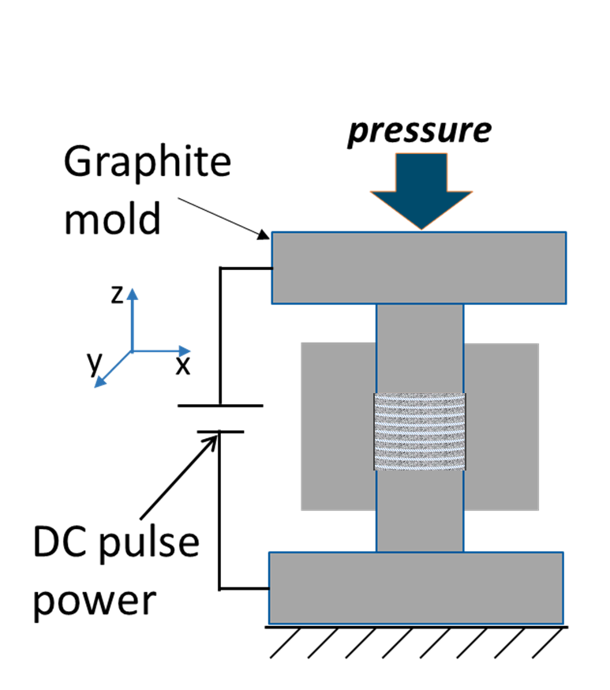
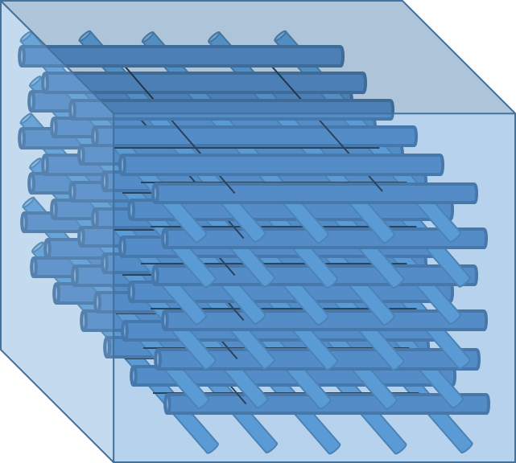
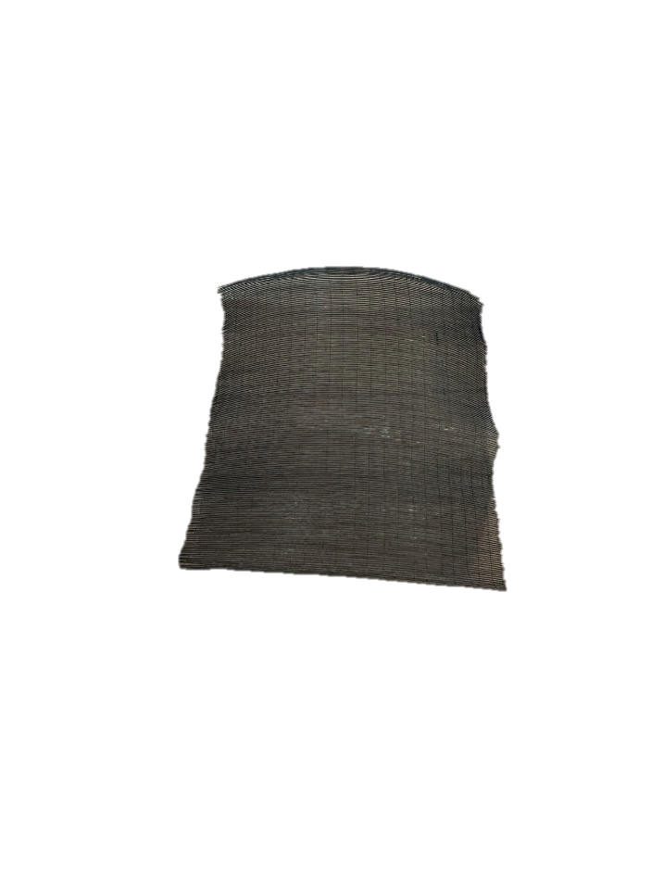
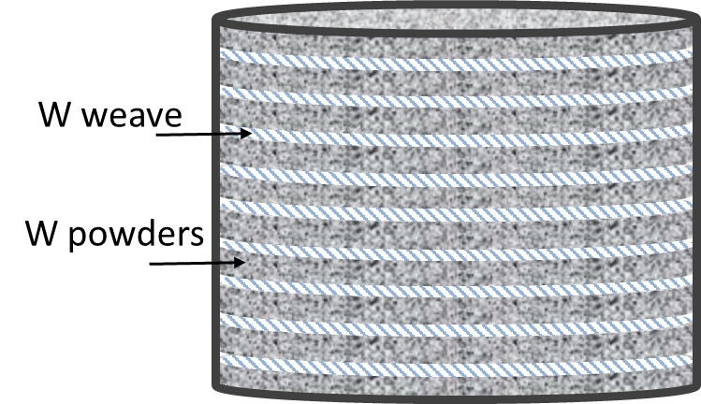
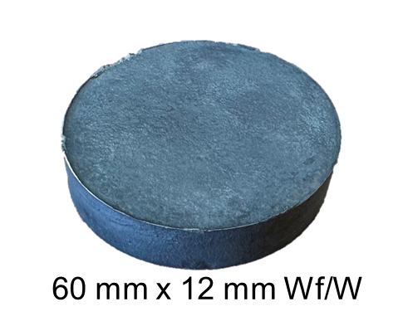
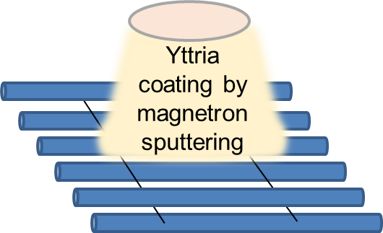
Long fiber W_{f}/W
Tungsten Weaves laser cutting and coating
Alternate placement of W weaves and W powders in the graphite tool of SPS
Spark Plasma Sintering (SPS)
Wf/W with long aligned fibers
Production
~50 mm
x50
~60 mm
1800°C, 50MPa, 10 min, vacuum, 50°C/min
2x

Slide 18
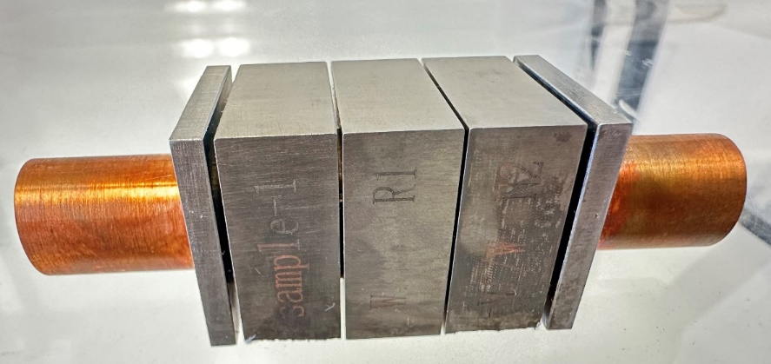
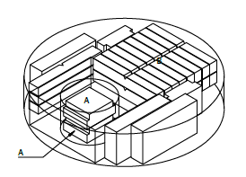
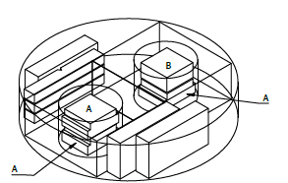
Iter-W
FZJ coating
~1.5 µm initial coating thickness
Industrial PVD coating
~5 µm initial coating thickness
Broke during joining with Cu cooling structure

Slide 19
Facility: QSPA Kh-50
Energy density [MJ/m²] | (0.5-30)
Pulse duration [ms] | 0.25
Magnetic field [T] | 0.54
Plasma pressure [MPa] | (0.3-1.8)
Particle flux [ions×(m⁻²s⁻¹)] | up to 10²⁷
Diameter of the plasma stream [cm] | 18 cm
About three month of successful plasma operation were achieved during the summer of 2024
S.S. Herashchenko et al. 2023 Fus. Eng. & Des. 190 113527
Capable of reproducing both disruptions and ELM loads in terms of energy and particle fluxes!

Slide 20
PWIE-SP A.A3.T-T004-D004: Summary and Future Plans
Investigation of advanced materials and coatings under ELM-like/disruption transient loading and subsequent analysis (KIPT)
Summary 2024
Analysis of surface modification of fusion-relevant materials, caused by repetitive transient plasma pulses leading to W melting, has been performed for QSPA exposed samples.
Next steps: FIB cuts and metallographic cross-sections are in progress in collaboration with M. Wirtz, M. Rasinski (FZJ)
Works to be performed in 2025
The investigations will involve advanced materials (various types of tungsten and etc.) subjected to high-flux transient plasma loads.
High-flux testing of different coatings (including boron) deposited on materials such as austenitic and RAFM steels, copper, tungsten, etc. followed by analysis will be performed too.

Slide 21
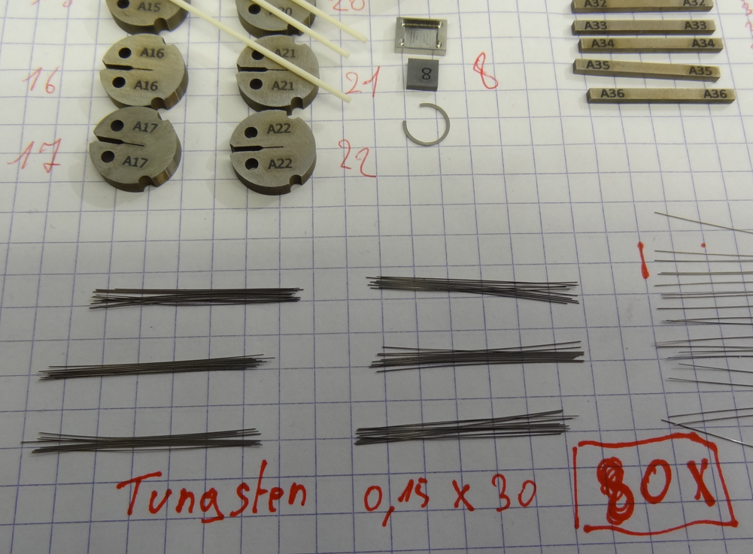
SP A.3 Advanced Materials under thermo-mechanical and plasma loads: LPP-ERM-KMS
Title: Results from tests of small-scale samples of W and other advanced materials and components (LPP-ERM/KMS)
Scope:
Perform neutron irradiation of 145 µm W wires at 0.2 and 1 dpa, at 400 and 1000 ⁰C.
Perform mechanical tests on 145 µm W wires after irradiation to check if DBTT has raised above RT
Perform neutron irradiation of KLST samples fabricated latest Wf-W plate prepared by FZJ
Results / Issues
Irradiation of the wires has been performed according to the required conditions
Bend tests in Hot Cell environment are prepared and are to be executed in Q1 2025
Once bed tests are completed, fracture surface will be investigated by SEM
Then, the samples will be sent to KIT for TEM examination
Irradiation of 8 KLST samples made of Wf-W at 600C for 0.6-1 dpa has started.
Deliverable: PWIE-SP A.3.T-T003-D003 / PWIE-SP A.3.T-T003-D007
Status: partially done
Facilities: BR2 irradiation (no cost will be charged to the project) or Modelling: N/A
Linked WP or TSVV: WP-MAT-IRRAD

Slide 22
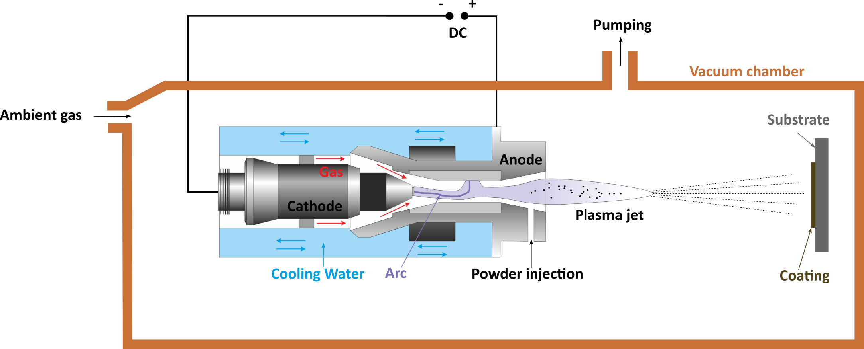
Low Pressure Plasma Spraying (LPPS) of tungsten (W) on different substrates
Coating campaign
The coating campaign has been finalized.
High-quality coatings were produced on tungsten substrate and Eurofer97:
  ≥ 500 µm thickness
  Porosity ≤ 3%
  Low residual stresses
Coatings on carbon fiber composite (CFC) delaminate; Mo interlayer not successful
Tungsten
Eurofer
Carbon fiber composite

Slide 23
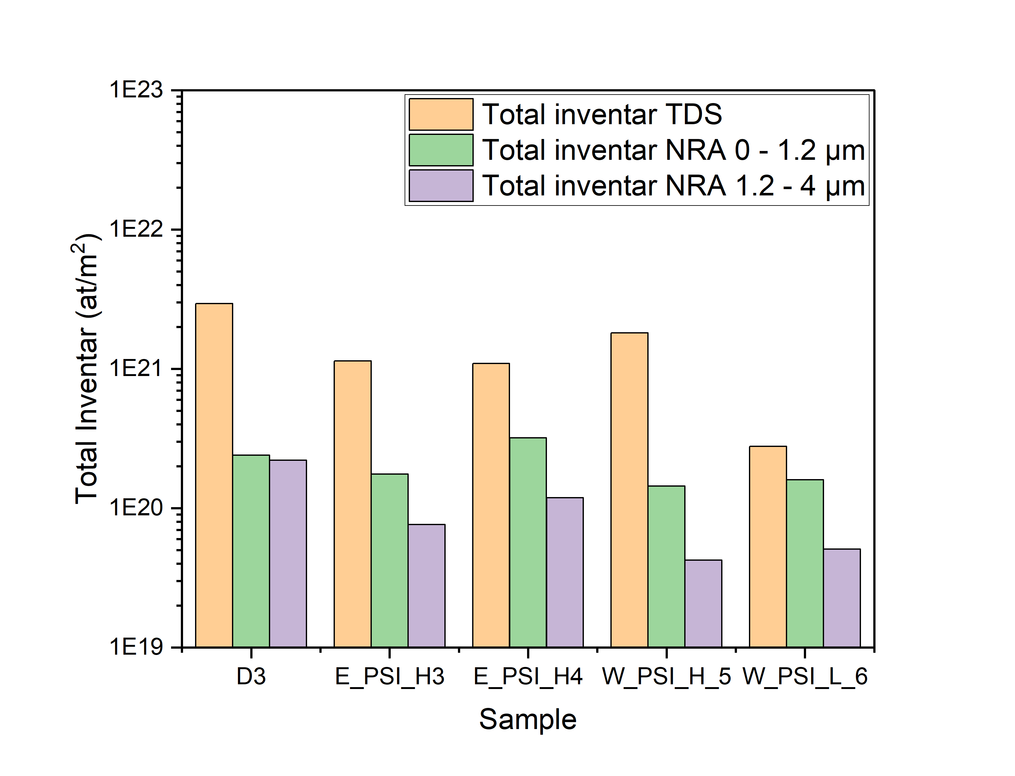
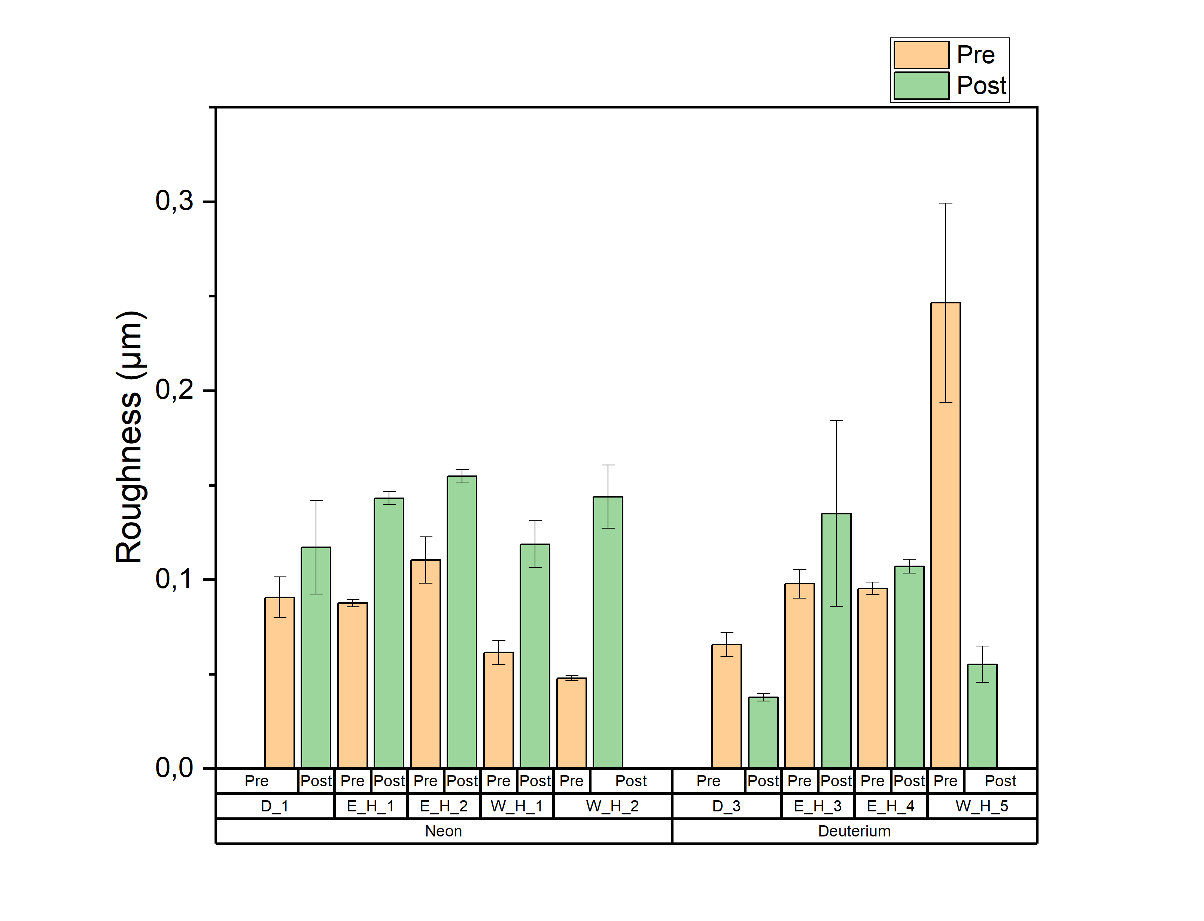
Outlook
Plasma exposure experiments
High heat flux experiments
High heat load experiments of up to 20 MW /m² (Monoblock design)
Cyclic heat and high temperatures at the interface of coating and substrate
W
Substrate
Further plasma exposure experiments:
Higher fluences
Test for divertor region
Comparing for different LPPS production parameters:
Impact of the LPPS parameter on the plasma performance
Impact of the substrate material
In-situ application
Pilot design of an implementation in a fusion device
Consideration of conditions such as radioactivity and pollution
Defect detection system

Slide 24
WP PWIE SPA 4
Update for 2025

Slide 25
High Temperature performance of Armour Materials: Recrystallization and Melting
Deliverable Owner | Beneficiary | PM | Deliverable (Team)
M. Richou | CEA | 9 | D001
W. Pantleon | DTU | 9 | D002
S. Ratynskaia | VR | 12 | D003 (S.Ratynskaia, P.Tolias,K. Paschalidis, T. Rizzi, A. Kulachenko)
I. Garkusha | KIPT | 30 | D004
M. Rasinski | FZJ | 4 | D005 ( M. Rasinski, A. Kreter, M. Vogel)
Prof. Hidding | HHU | 6 | D006
Total |  | 70
Characterization of microstructural changes caused by plasma exposure. Tungsten-based material exposed to different plasma conditions will be investigated in terms of mechanical and microstructural depth profiles. Heterogeneities will be traced in hardness and orientation maps and the locally dominating restauration mechanism identified. (DTU)
Tungsten material exposures in the QSPA under giant ELMs or disruptions with pronounced surface melting (KIPT). Characterization of dust in QSPA experiments: size analysis, influence of B field on trajectories. Stick effects at the surface.
Plasma heat loads which causes surface recrystallization and changes in Microstructure and melt threshold (QSPA/PSI-2/GLADIS) (KIPT, CEA, VR)
Assessment of effect of H and He on W recrystallization with links to WP TE (FZJ, DTU, CEA)
Joint activities with WP TE on damaged components (e.g. melting) (VR)
Experiments on Recrystallization in PSI-2 linked with SP A1 (FZJ, DTU)
Further application of MEMENTO modelling to melt flows across castellated PFCs (link with WPTE experiments ).
Further development of the MEMENTO + Geant4 code chain for RE-induced bulk melting assessments.
Further development of thermomechanical modelling of RE-induced PFC brittle failure (Geant4 + COMSOL).
Initial development of full thermomechanical modelling of RE-induced explosions of brittle PFCs including fragmentation (Geant4 + LS-DYNA)"
Device | Beneficiary | Days | Related Deliverable
PSI-2 | FZJ | 3 | D005
QSPA | KIPT | 10 | D004
Accelerator | VR | 5
Deliverable ID | Deliverable Title
D001 | Assessment of plasma impact on material properties linked to ITER relevant PFUs (CEA)
D002 | Annealing of chosen tungsten-based materials and quantification of recrystallization kinetics (DTU)
D003 | Development of MEMENTO and MEMENTO + GEANT 4 including RE - Damage (VR)
D004 | Influence of plasma pre irradiation with heat loads near surface recrystallization on surface damaging with heat loads above the melting threshold (KIPT)
D005 | Analysis of PSI-2 exposed materials, focusing on funding the relevant regime for fuzz formation in AUG He campaign (FZJ)
D006 | Simulation of Runaway Impact by Electron Beam at 10-100MeV

Slide 26

IGW A.L.M.T./2 second plate – hardness evolution
New IGW plate from via
Hardness evolution during annealing
Time to half hardness loss
Core faster
than edge
(as for previous
A.L.M.T. plates)
Tempe-rature | IGW2 core | IGW2 edge
1150 °C | ≈ 40 h | ≈ 60 h
1200 °C | ≈ 12 h | ≈ 24 h
IGW core | IGW edge
78 h | 195 h
19 h | 36 h
Recrystallization
faster than previous
IGW plate from A.L.M.T.

Slide 27

Conclusions 2024 / Outlook 2025
Powder metallurgical W_{f}/W from
Annealing at 1450 °C: fiber recrystallization after 1 d
Grain growth in bulk matrix, fibers dissolved after 2 w
Porous matrix coarsens and looses coherence
Annealing at 1350 °C: fiber recrystallization after 1 w
Continuation 2025: alternative fiber matrix combinations
continuous fibers, porous matrix
short fibers, compact matrix
IGW2 different annealing temperatures
specimen received; characterization ongoing

Slide 28
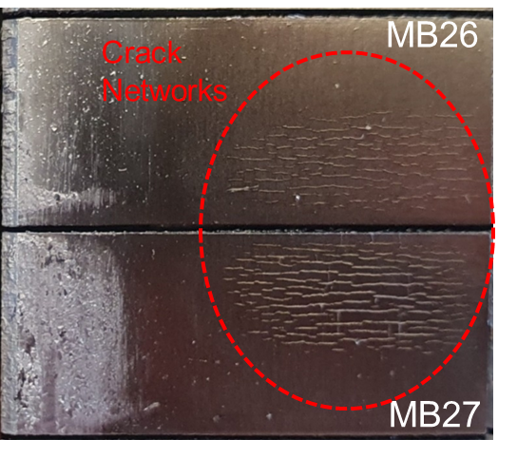
2 topics investigated in 2025 (9pm)
28
  Topic A (30%): Assessment of plasma impact on material properties linked to ITER relevant PFUs (CEA) (follow-up)
    Study the influence of He on the evolution of tungsten properties (comparative study with WEST samples)
    Perform He implantation study to characterize defects generated and assess the evolution of mechanical props based on multi-scale approach
  Topic B (50%): Top surface cracking investigation (up coming slides)
    Perform an overview highlighting the crack networks distribution at the WEST divertor (Phase II) → follow up (cf leading edge study in 2024)
    Investigate the rational: Are these cracks resulting from manufacturing stress release? Is a common link between leading edge and top surface (impact of the manufacturing route?)
    Perform post-mortem analysis (microscopy, XRD) on the top surface and the leading edge
    Consider residual stresses the modelling (if needed)
Shadowed areas due to bevel

Slide 29
Facility: QSPA Kh-50
Energy density [MJ/m²] | (0.5-30)
Pulse duration [ms] | 0.25
Magnetic field [T] | 0.54
Plasma pressure [MPa] | (0.3-1.8)
Particle flux [ions×(m⁻²s⁻¹)] | up to 10²⁷
Diameter of the plasma stream [cm] | 18 cm
About three month of successful plasma operation were achieved during the summer of 2024
S.S. Herashchenko et al. 2023 Fus. Eng. & Des. 190 113527
Capable of reproducing both disruptions and ELM loads in terms of energy and particle fluxes!

Slide 30
PWIE-SP A.A4.T-T004-D004: Summary and Future Plans
Influence of plasma pre-irradiation with heat loads above the melting threshold on surface damaging with heat loads near surface recrystallization (KIPT) (the title some modified in compare with 2024)
Summary for 2024:
SEM studies of exposed solid and lattice tungsten samples showed crack formation contributing to surface profile development.
FIB cuts and metallographic cross-sections are in progress in collaboration with FZJ
Works to be performed in 2025
Investigation of surface damage/modification caused by melt motion on surfaces of the reference materials will be performed.
Evaluation of tungsten surface damage at heat loads near the recrystallization threshold will be carried out for samples that have exhibited melt motion effects on their surfaces after the pre-damaging stage.

Slide 31
WP PWIE SPA 5
Update for 2025

Slide 32
Compass-U
Deliverable Owner | Beneficiary | PM | Deliverable (Team)
Renaud Dejarnac | IPP.CR | 16 | D001 (J.Mtejicek, A.Rednyk,R.Dejarnac,P.Vondracek,J.Caloud,K.Patocka,M.Durovec,M.Bousek,J.Klecka,D.Kirhetov)
Daniel Alegre | CIEMAT | 2 | D002 (D. Alegre, S. Shick, D. Tafalla, P. Fernández-Mayo, T., Hernández, A. De Castro and E. Oyarzabal)
Pavel Veis | CU | 4 | D003
Thomas Morgan | DIFFER | 2 | D004
Laura Laguardia | ENEA | 2 | D005 (Iafrati, Pedroni, Ghezzi, De Angeli)
Marius Wirtz | FZJ | 1 | D006
Elzbieta Fortuna-Zalesna | IPPLM | 6+6 | D007
James Paterson | UKAEA | 4 | D008, D009
Total |  | 39
Task under SP A5 include the preparatory work on assessing and analysing the material candidates for COMPASS-U this includes particularly heat flux performance as well as material evolution on microstructure, and surface condition. The work is based on a comprehensive pre-characterization of the 9 candidate W materials (IPPCR) with a potential down-selection to main suppliers, Plansee, ALMT, AT&M. Exposures will be performed in JUDITH, PSI-2(FZJ), OLMAT (CIEMAT) and Magnum (DIFFER). As an example, disruption simulation on the surface and at edges of COMPASS-U W armor will be performed at OLMAT. The damage threshold in terms of power density and number of pulses will be determined, especially critical at edges. The damage at maximum power densities, ~7 GW/m², will also be studied to determine the damage of mild or partially mitigated disruptions in DEMO (expected at a minimum of 30 GW/m²).
Pre- and post-Characterization including various techniques as highlighted in the deliverables will be performed (FZJ, CIEMAT, DIFFER, ENEA, IPPLM). A new addition here is particular the detection of nano-cracking in the surface layer of the first wall as it can be crucial for reducing D/T fuel retention in the wall. CW IR laser heating and IR camera scanning of heated area allows the rapid detection of nano-cracking in the top layer of the first wall (CU). Comparative analysis for the various materials will be performed also including comparing multiple analysis techniques
Deliverable ID: | Deliverable Title:
D001 | Comprehensive pre-characterization of the 9 candidate W materials
D002 | Fast transient simulation on COMPASS-U W armor by a CW laser at OLMAT
D003 | Nanocracking detection studies on sxposed materials from PSI-2, Magnum, OLMAT, JUDITH
D004 | ELM-like loading effects on different W grades
D005 | Post Mortem Analysis , and TDS
D006 | Studies on Materials supplied for COMPASS U in on HHF
D007 | Comparative Microscopy studies on samples exposed in PSI-2, MAGNUM, JUDITH & OLMAT
D008 | Establish a round robin test with other HHF Test Facilities to Benchmark HIVE (UKAEA without EUROfusion funding)
D009 | Tungsten High Temperature testing.
Device | Beneficiary | Days | Related Deliverable
OLMAT | CIEMAT | 4 | D002
MAGNUM-PSI | DIFFER | 2 | D004
PSI-2 | FZJ | 2 | D006
JUDITH-2 | FZJ | 8 | D006
Microscopy – 10+10 k€ - IPPLM
Hive + Lab – 75k€ - UKAEA

Slide 33
IPPLM - Update
Magnum-PSI Samples: Will not be available before the holidays. Two sets will be received—one post-Magnum exposure and another post-HIVE exposure.
• OLMAT Samples: Likely to be examined before the second campaign planned for summer. This will be a non-destructive study.
• JUDITH Samples: Large OVT-like samples are ready for post-mortem analysis.
• PSI-2 Samples: Currently with Jiri—I hope to receive them soon for comparative studies.
• Research Techniques: SEM/EDX, profilometry, XRD, FIB, TEM, and additional methods as needed.

Slide 34

Heat flux exposure at PSI-2
Thermal shock-type tests done at FZJ in 2024
Profilometry on all 9 materials done at FZJ
SEM done on ALMT, AT&M, Plansee at FZJ
SEM done on remaining 6 materials at IPP
2
3

Slide 35
Recrystallization studies
Gradient annealing experiment arranged at ChauCoLase (EMSE)
Preparation ongoing
Isothermal annealing in HT chamber with XRD (IPP)
Experiments ongoing
Example of results:
Bango Alloy

Slide 36
2025 Activity
After exposure to steady-state and transient heat loads (PSI-2 and/or Magnum PSI) of the selected tungsten first-wall plasma-facing components of COMPASS-U, post-exposure characterization will be performed to detect fuel retention and surface microstructure modifications.
The following techniques will be used:
Thermal Desorption Spectroscopy (TDS)
Scanning Electron Microscopy (SEM)
Atomic Force Microscopy (AFM)

Slide 37
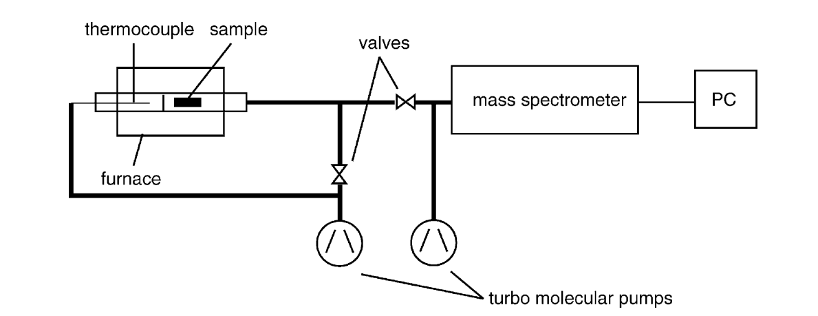
Thermal Desorption Spectroscopy (TDS).
The TDS diagnostic system is capable of assessing resistance to fuel retention.
Our TDS is a custom-built high-vacuum system in which:
Direct currents are driven through the substrates, reaching surface temperatures of approximately 2000 K.
A Pfeiffer mass spectrometer is connected to the turbomolecular pump of the chamber.
The sample temperature and the gas leak rate from the samples are recorded simultaneously.
Temperature measurement is performed through the vacuum vessel viewports using a pyrometer and a Type C thermocouple in direct contact with the sample.
Pyrometr thermocouple

Slide 38
Microstructure and mechanical characterization
To assess the morphological modifications occurring in the W surface layers due to plasma exposure, a series of post-exposure characterization tests will be conducted using:
Scanning Electron Microscopy (SEM)
Atomic Force Microscopy (AFM)

Slide 39
SP A.5 COMPASS-U: CIEMAT
SPA.5 D002 Fast transient simulation on COMPASS-U W armor by a CW laser at OLMAT
Laser: get top hat profile
2025 Plans
  Installation: test laser operation for hours (sample and window cooling)
  Experiments:
    Already started mitigated disruptions at edges (150-1000 MW/m²): previous ITER-like W and PM-Wf/W to learn to operate all new equipment
    In 1-2 weeks continue with provided COMPASS-U samples.
    Confocal microscope and SEM characterization at CIEMAT
    Send samples to Elzbieta Fortuna for non-destructive characterization. Return to us in summer
    Perform mitigated disruptions simulation by laser at center of other W samples (ILW, WCrZrY, PM-Wf/W)
    Continue with returned COMPASS-U samples.
    Characterize at CIEMAT and send again to Elzbieta
Deliverable: PWIE-SP A.5.T-T002-D002
Status: ongoing
Facilities: OLMAT 5 days
Linked WP or TSVV: none

Slide 40


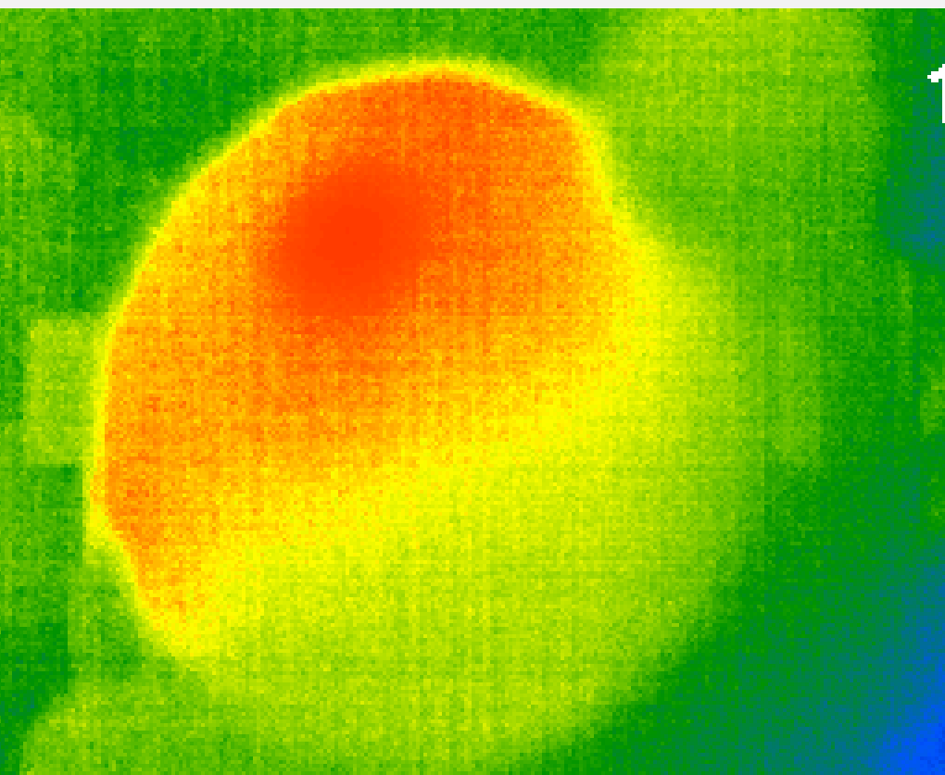
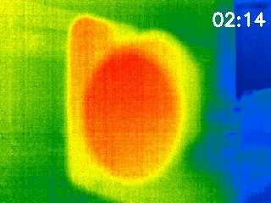
IR Camera for surface analysis – cracking detection
Comenius Univ. in Bratislava
Deliverable: PWIE-SP A. S. T-T001-D003
Work done in 2024
IR camera
Study analyses the surface for cracks and indentation using IR camera.
Seek thermal S314SPX IR camera was acquired to analyse the surface.
Python program was developed to record images and videos.
A CW IR laser operating at 1470 nm was used to heat the surface.
Initial tests after laser heating were done on conductive (W metallic) and insulating (plastic) materials – Fig.1. & Fig.2.
Localized hotspots were observed at the indented positions in the image captured by the IR camera.
Working currently on W/metallic samples.
Fig. 1: IR heating on plastic.
Sample
Fig. 2: IR heating on W sample.
Notes:
Seek thermal S314SPX IR camera spec: Sensor Resolution: 320 x 240
Field of View: 56 degrees HFOV, 4.0mm
Frame Rate: Up to 27Hz

Slide 41
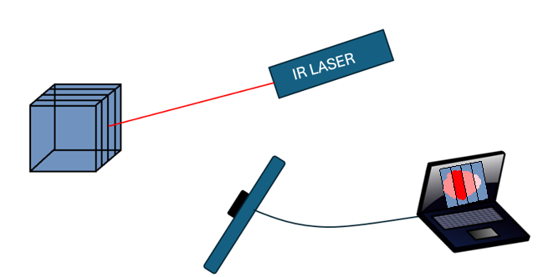
IR Camera for surface analysis – cracking detection
Comenius Univ. in Bratislava
Ongoing work:
Expanding the laser beam using a beam expander to uniformly heat the surface.
The cool down phase will be recorded and any heat retention or abrupt variation in temperature on the sample surface will be analyzed.
Experiments with various surfaces with deep artificial cracking:
sandwich of W layers with an unpolished surface,
sandwich of polished W layers,
and eventually, sandwich of W layers with liquid contact inter layers,
test on real samples with deep cracking.
IR detection of deep artificial cracking by temperature jump.
Fig 3: IR heating on various sandwich structure composites for creation of artificial deep cracking.
Task for 2025
Research on artificial deep cacking of different materials including W and testing on real sample (depending on the disposition).
Deliverables:
  Detection of sub-microcracking on Tungsten surface.
Notes:
Seek thermal S314SPX IR camera spec: Sensor Resolution: 320 x 240
Field of View: 56 degrees HFOV, 4.0mm
Frame Rate: Up to 27Hz

Slide 42
WP PWIE SPA Outlook
A few comments

Slide 43
General Remarks
Continuation of SPA activities
Full Establishment of SPA 5
  Inclusion of Tasks at UKAEA

Slide 44
