Slide 1

WP PWIE - High heat flux testing of materials and components - 2025
Mauricio Gago, Daniel Dorow-Gerspach, Marius Wirtz, Marcin Rasinski

Slide 2
Task Specification
This task contributes to the qualification of current baseline materials and beyond by different heat load treatment techniques and quantifying the difference in damage behavior by the different loading techniques as well as the additional impact of fuel species and other fusion relevant conditions. In addition, it helps with the long-term activities in the FSD and FTD to predict the power load capabilities and damage thresholds for materials envisioned for current and future fusion devices.
This includes the qualification of materials for W7-X (in collaboration with WPDIV and WPW7X) and preparation of exposures in WEST and ASDEX Upgrade (via WPTE). The basis for the tests are materials defined by WPMAT and WPDIV. ITER as baseline for the use in current devices as well as DEMO.
Samples from pre-damaged experiments in WEST /DEMO limiter samples (WPDIV)/Composite and Alloy Samples (WPPRD)
Tasks to be performed:
Establish a test matrix for materials utilized in WEST and ITER with respect to updated load specifications in the available devices
Study the impact of synergistic loads on ITER and DEMO relevant baseline Materials and new materials developments with laser and e-beam (JUDITH) as well as steady-state plasma exposure (He, H). A special focus will be the qualification of these materials under high cycle numbers and seed-impurities exposure. (FZJ)
Post-mortem analysis will characterize the induced surface modifications and damages as well as investigate changes of the materials properties due to e.g. recrystallization behavior and/or surface morphology changes.
Determine underlying mechanisms of evolution of crack propagation in materials for ITER and current day devices
Qualify W materials for use in W7-X
Synergy effects from sequential stationary (PSI-2 / MAGNUM-PSI, OLMAT) and transient (QSPA) plasma loads
Studies of fatigue cracks formation in deformed/re-crystalized W, fatigue damage of Wf/W wires, latticing W etc.
Combination of pulsed and steady state loading (e.g. behavior of QSPA pre-damaged targets in PSI-2, JUIDTH compared with reference samples)
Study the Behavior of pre-cracked samples under edge loading conditions - links to HHF facilities such as JUDITH and WEST.

Slide 3
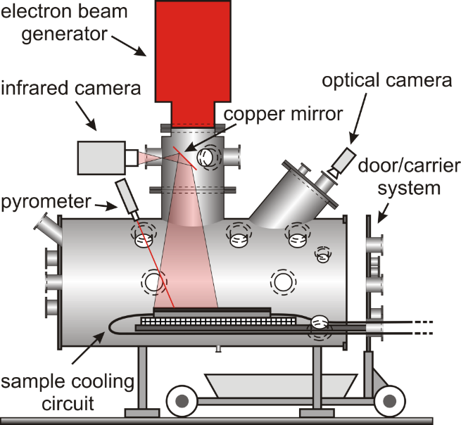

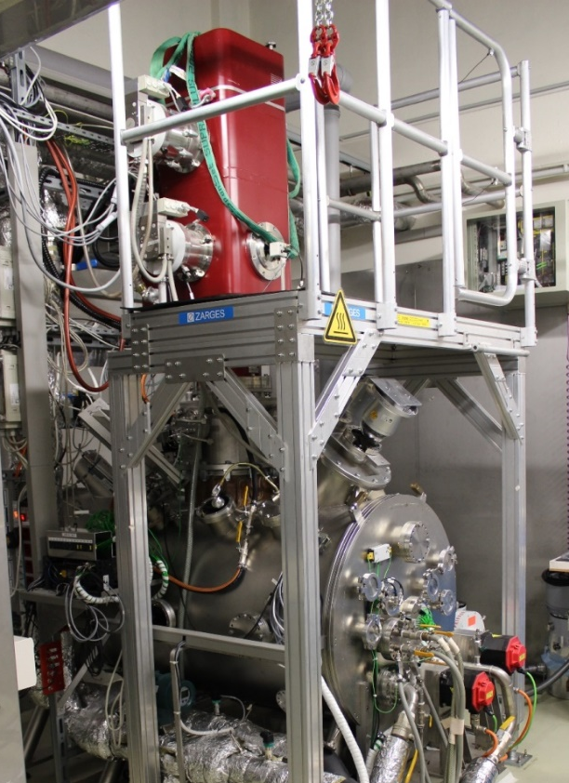
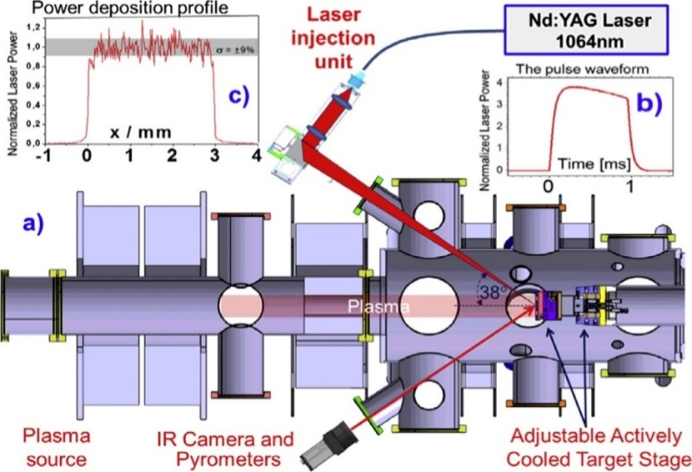
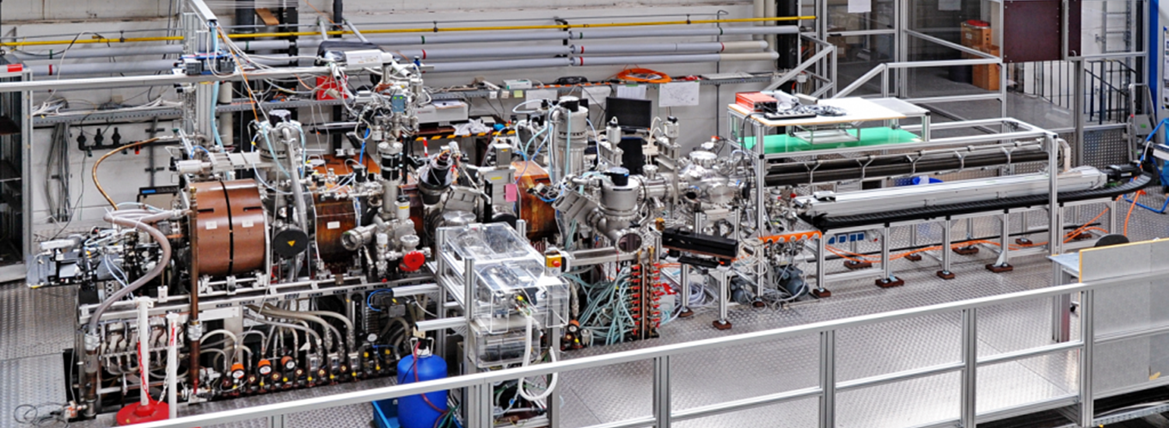
Experimental devices
JUDITH 2
PSI-2
Stationary loads
D, He, Ar, N plasma
Plasma column Ø 60 mm
Ion flux ≤ 10²³ m⁻²s⁻¹
Incident E_{i} (bias) 10 – 300 eV
Base temp. ≤ 1000 °C
ELM-like heat pulse
Nd:YAG laser λ 1064 nm
laser energy ≤ 72 J
Machine parameters
Total power: 200 kW
Acc. voltage: 40 – 60 kV
Irrad. area: 40 × 40 cm²
Power density: ≤ 2 GWm⁻²
Pulse length: 5 µs – cont.
Beam FWHM: 3 – 12 mm
(typ. 8 – 10 mm)
Cooling circuit
Temperature: 20 – 120 °C Max. pressure: 4 MPa
Max. flow: 200 l/min
Cooling power: ≤ 150 kW
Monitoring of water quality

Slide 4
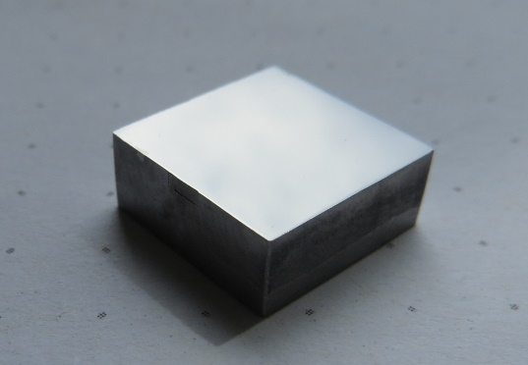
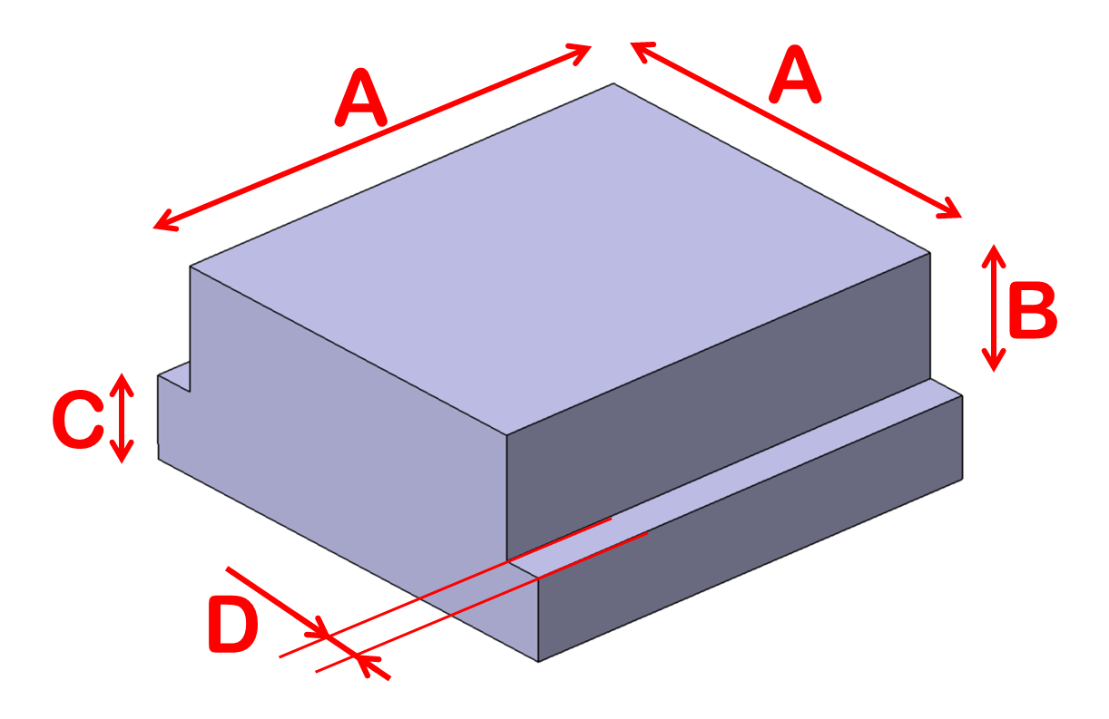
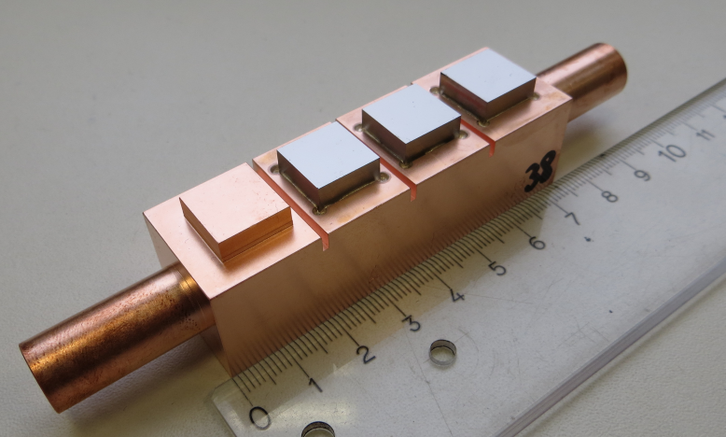
Sample geometries
JUDITH 2
PSI-2
Thermal shock (typical geometry): 12 × 12 × 5 mm³
A: 10 mm; B: 2 mm; C: 3 mm; D: 1 mm
Cooling connectors: pipes of 18 or 15 mm diameter or holes of 12 mm diameter

Slide 5
Analysis of PSI-2 exposed materials, focusing on finding the relevant regime for fuzz formation in AUG He campaign
Achieved in 2023-2024
Comparison between linear devices (PSI-2) and tokamak (AUG) environment for fuzz formation
Check previous exposures in PSI-2 with simultaneous plasma and laser loading
Check best conditions to reproduce AUG He fuzz
From existing exposures
New PSI-2 exposures
PSI-2 He exposure - Fuzz formation
Base Temperature ~ 900 °C
Ion Flux ~ 6 - 8 × 10²¹ m⁻²s⁻¹
Fluence ~ 1 × 10²⁵ m⁻²
Energy ~ 160 eV
Laser
200 MW/m² and 400 MW/m² 0.5 ms, 25 Hz
Temperature 1100 – 1700 °C
(600 °C increase during the laser shot)
Laser
100 MW/m² 0.5 ms, 25 Hz and 200 Hz
40 MW/m² 0.5 ms, 200 Hz

Slide 6
Results 2024
100 MW/m² 25 Hz - in the laser spot
x
PSI-2 He exposure - Fuzz formation
Base Temperature ~ 900 °C
Ion Flux ~ 6 - 8 × 10²¹ m⁻²s⁻¹
Fluence ~ 1 × 10²⁵ m⁻²
Energy ~ 160 eV
SEM images of the surface and FIB prepared cross-section of the W sample exposed to He plasma with 100 MW/m² 25 Hz laser loading
100 MW/m² 200 Hz - in the laser spot

Slide 7
Results 2024
100 MW/m² 25 Hz - outside laser spot
x
PSI-2 He exposure - Fuzz formation
Base Temperature ~ 900 °C
Ion Flux ~ 6 - 8 × 10²¹ m⁻²s⁻¹
Fluence ~ 1 × 10²⁵ m⁻²
Energy ~ 160 eV
SEM images of the surface and FIB prepared cross-section of the W sample exposed to He plasma with 100 MW/m² 25 Hz laser loading
100 MW/m² 200 Hz - outside laser spot
SEM images of the surface and FIB prepared cross-section of the W sample exposed to He plasma with 100 MW/m² 200 Hz laser loading

Slide 8
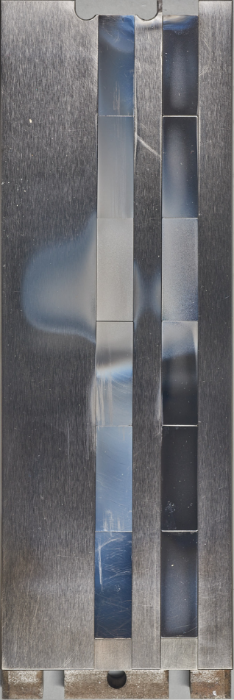
Results AUG - He
PSI-2
100 MW/m² 200 Hz
inside the laser spot
100 MW/m² 200 Hz
outside the laser spot
1
2
3
4
6
5
H-mode
Ф_{i} ~ 2-4 x 10²⁴ He/m²
2
4
6
Different exposure temperature (due to laser loading in the laser spot and outside laser) leads to formation of different fuzz structures in PSI-2.
Revealed structures fits with good agreements with surface morphology of W exposed in AUG He campaign. Locations above H-mode strike line exhibited different surface temperature.
L-mode
1
3
5

Slide 9
Conclusions
Fuzz formation during AUG He campaign very non-uniform and strongly dependent on surface temperature
Relatively good agreement between PSI-2 and AUG He W fuzz morphology for samples exposed to high frequency laser loading in PSI-2
Linear device can be a good proxy for mimicking the fuzz formation in tokamaks. Fuzz structures and bubble formation present after AUG He might be reproducible by simultaneous laser and plasma loading
Visible recrystallization of W in the laser spot position. Small grains still present beneath the fuzz – He effect on retarded recrystallization
Expose to mixed plasma 94% D + 5% He + 1% Ne plus laser loading to be finished in 2025

Slide 10
Results 2025
100 MW/m² 200 Hz - in the laser spot
PSI-2 94% D + 5% He + 1% Ne
Base Temperature ~ 900 °C
Ion Flux ~ 2.5 × 10²¹ m⁻²s⁻¹
Fluence ~ 1 × 10²⁵ m⁻²
Energy ~ 175 eV
SEM images of the surface and FIB prepared cross-section of the W sample exposed to 94% D + 5% He + 1% Ne plasma with 100 MW/m² 200 Hz laser loading
Strong surface roughening inside the laser spot.
Nanobubble formation with the bubble size below 5 nm visible on the surface.

Slide 11
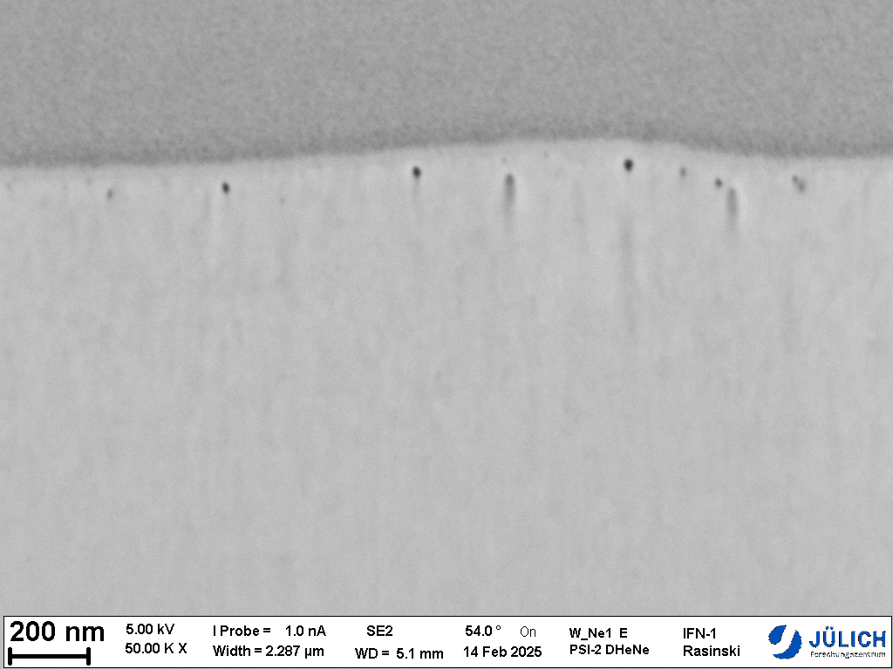
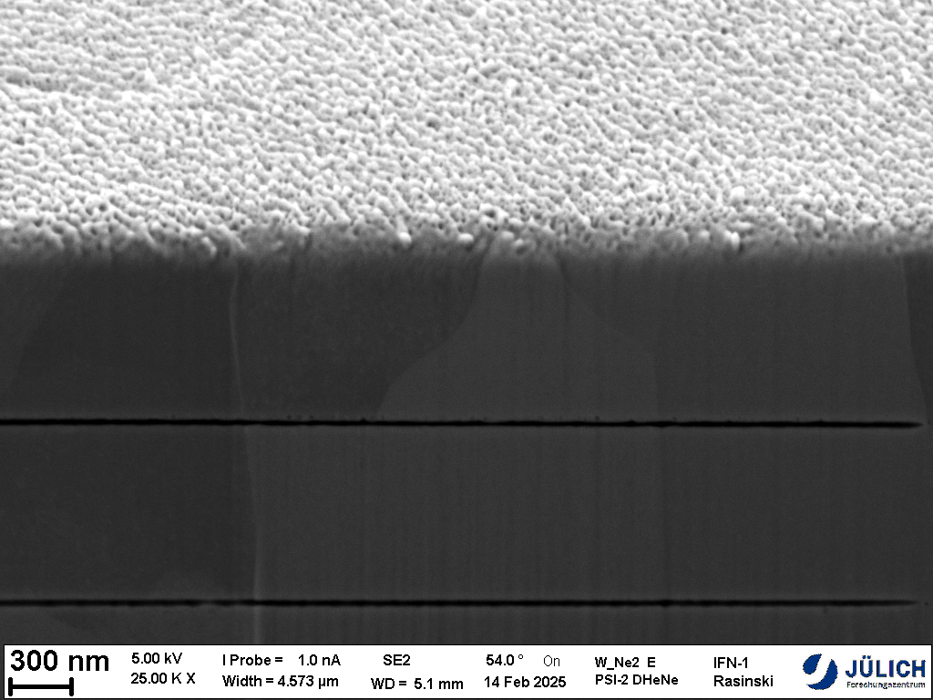
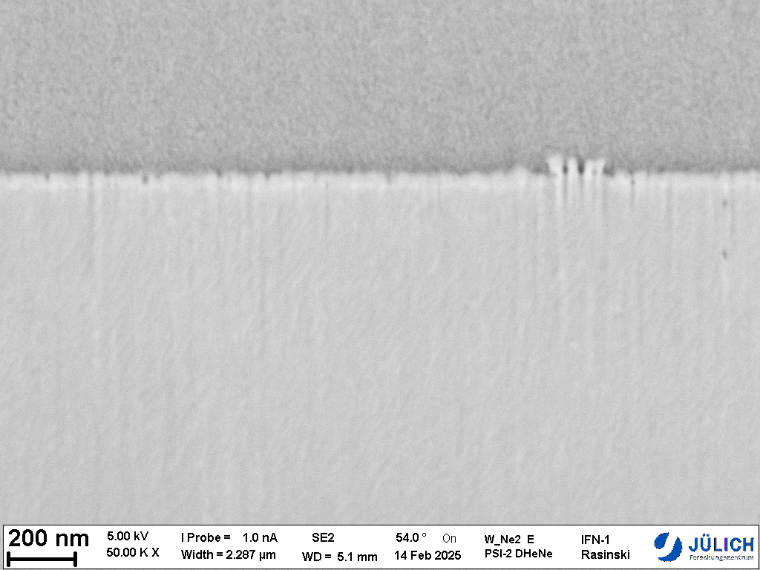
Results 2025
100 MW/m² 200 Hz - outside laser spot
350 nm
PSI-2 94% D + 5% He + 1% Ne
Base Temperature ~ 900 °C
Ion Flux ~ 2.5 × 10²¹ m⁻²s⁻¹
Fluence ~ 1 × 10²⁵ m⁻²
Energy ~ 175 eV
SEM images of the surface and FIB prepared cross-section of the W sample exposed to 94% D + 5% He + 1% Ne plasma with 100 MW/m² 200 Hz laser loading
- no laser
Early stage of the fuzz formation on the sample exposed to plasma only (thickness of about 50 nm).
Measured erosion on the plasma only sample around 160 nm and 350 nm for the laser loaded sample (outside laser spot).
Nanobubble formation at the depth of 100 nm for the laser exposed sample.
160 nm
50 nm
SEM images of the surface and FIB prepared cross-section of the W sample exposed to 94% D + 5% He + 1% Ne plasma

Slide 12
Plans for 2025
Based on the first exposure to 94% D + 5% He + 1% Ne plasma plus laser loading, further experiments with plasma exposure to mixed D+He+Ne plasma with various fractions of Ne (0; 1 and 5 % of Ne) to explore its influence on the structure and morphology of W.
The goal of the experiment is to help assess the influence of seeding gases foreseen for ITER with relevant ELM like laser loading in the PSI-2 on the morphology changes of exposed W.
For each exposure samples exposed only to mixed plasma as well as plasma and laser will be investigated. Multi sample holder in PSI-2 allows simultaneous exposure up to 8 samples.
Samples will be characterized by means of electron microscopy techniques – SEM, FIB and TEM

Slide 13
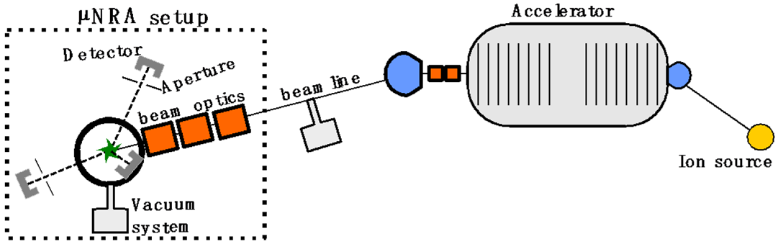
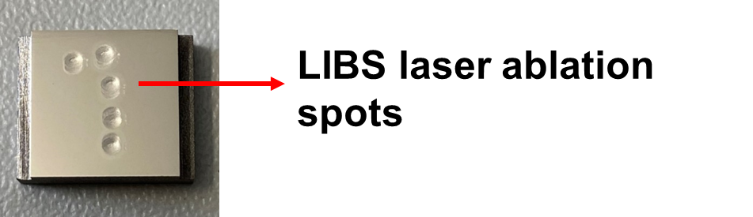
Deuterium retention in PIM-W alloys
Six different tungsten alloys were produced and tested, as well as ITER-grade tungsten (PLANSEE)
Exposed to deuterium plasma with a flux of 3.0 · 10²¹ m⁻² s⁻¹ for 85 minutes at a temperature of 280 °C in the PSI-2. Total D fluence of 15.3 · 10²⁵ m⁻²
The deuterium retention of the material was measured in-situ via laser-induced breakdown spectroscopy (LIBS), using a laser energy of 0.7 J, with a pulse duration of 7 ns
LIBS measurements were performed after 50 min of plasma exposure, 1 hour after having turned off the plasma, and 20 hours after plasma exposure
Nuclear reaction analysis (NRA) measurements were performed using ³He ions with 2.96 MeV, 6 months after exposure

Slide 14
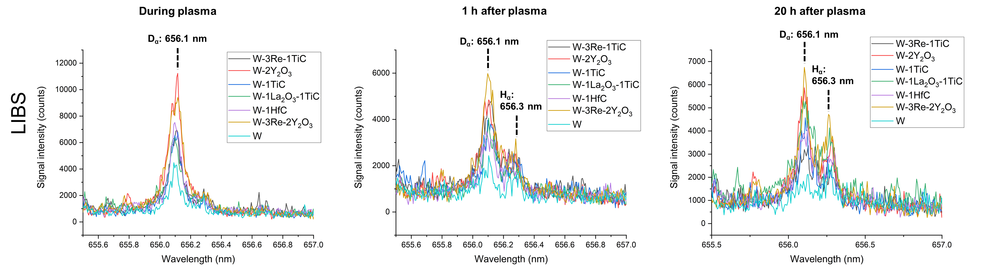
Deuterium retention in PIM-W alloys (LIBS)
In-situ LIBS analysis showed ITER-grade tungsten to have the lowest overall dynamic D retention, both during and after plasma exposure
Alloys containing yttria seem to have the highest deuterium dynamic retention, all other alloys showed a relatively similar retention behavior, particularly during plasma
Deuterium retention decreases significantly after turning plasma off, but deuterium release is relatively slow from 1 h after plasma was shut off to 20 h after plasma

Slide 15
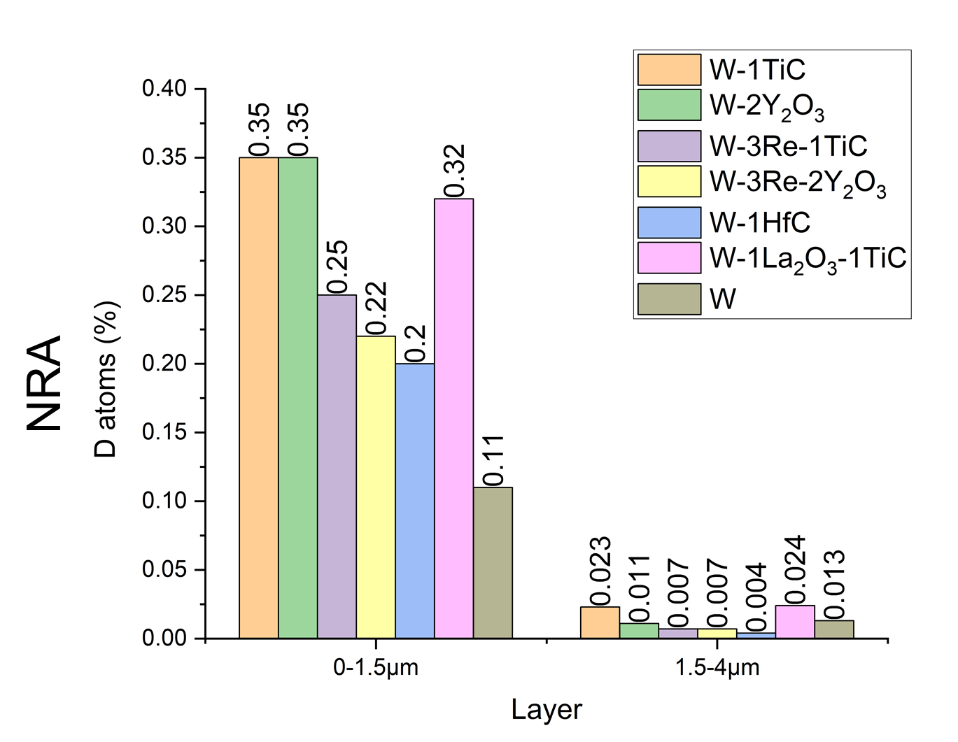
Deuterium retention in PIM-W alloys (NRA)
NRA measurements showed, for all samples, most of the deuterium retention is in the top layer, with a significant drop in retention after the first 1.5 µm
ITER-grade tungsten had a lower D retention than other materials in the top layer, but the highest retention in the deepst layer, except for alloys containing TiC
TiC containing alloys and W-2Y₂O₃ appear to have the highest overall D retention

Slide 16
Conclusions and Outlook for 2025
PIM tungsten alloys showed, in general, a higher deuterium retention than ITER-grade tungsten
Most of the retention happened in the near-surface area (first 1.5 µm) and retention dropped significantly afterwards in all materials tested
Next steps: TDS testing of bulk D retention and mechanical testing of samples after plasma and thermal shock (ELM-like) damage
TDS tests have been performed – results are being analyzed
Further tests are planned for 2025

Slide 17
Thermal shock testing
Low and high pulse number thermal shock test at PSI-2 (no plasma)
Low pulse number thermal shock tests at T_{base} = RT, 400 and 1000 °C with the laser at PSI-2
High pulse number thermal shock tests at T_{base} = 700 °C, 10⁴/10⁵ pulses of Δt = 0.5 ms, Labs = 0.4 GW/m² (F_{HF} = 9 MW/m²s^{1/2})
Spot | L (GW/m²) | Δt (ms) | F_{HF} (MW/m²s ^{½}) | number
1 | 0.19 | 1 | 6 | 100
2 | 0.38 | 1 | 12 | 100
3 | 0.38 | 1 | 12 | 1000
4 | 1.6 | 2 | 72 | 1
2
3

Slide 18

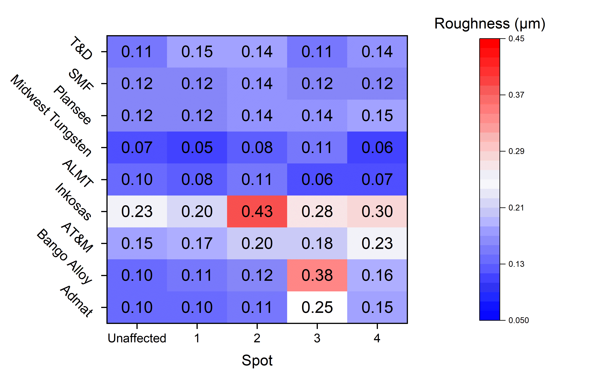
Low pulse number testing of W samples from 9 different manufacturers
400 and 1000 °C base temperature
Further post-mortem characterization at IPP-Prague µm
400 °C

Slide 19
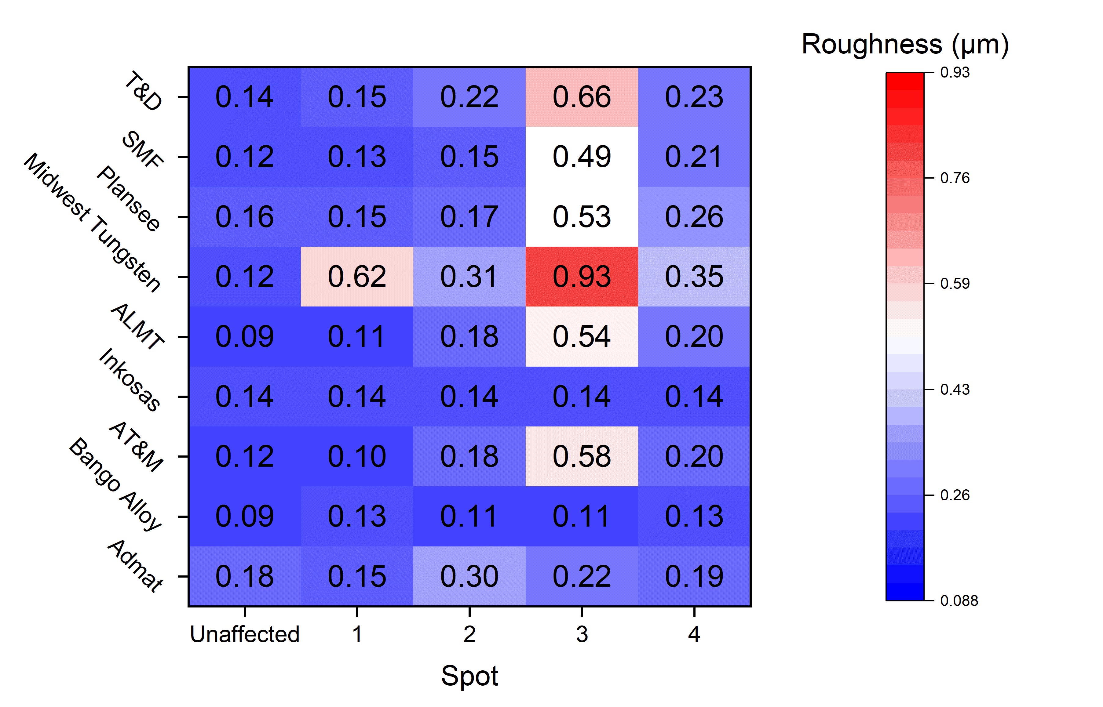
Low pulse number testing of W samples from 9 different manufacturers
400 and 1000 °C base temperature
Further post-mortem characterization at IPP-Prague µm
1000 °C

Slide 20
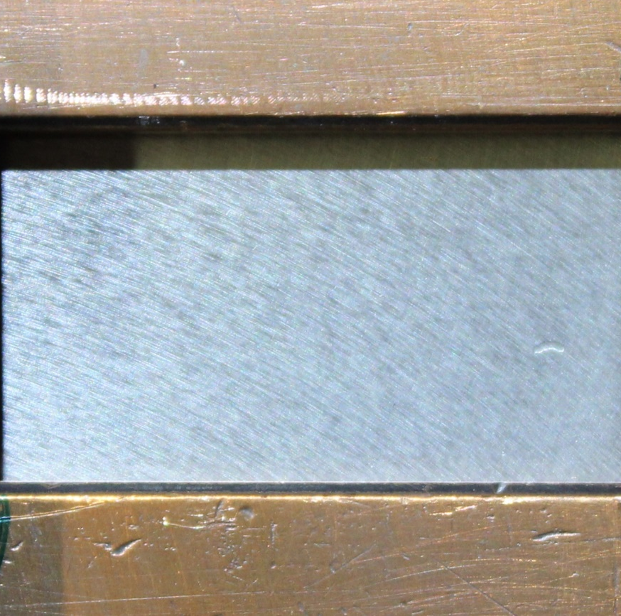
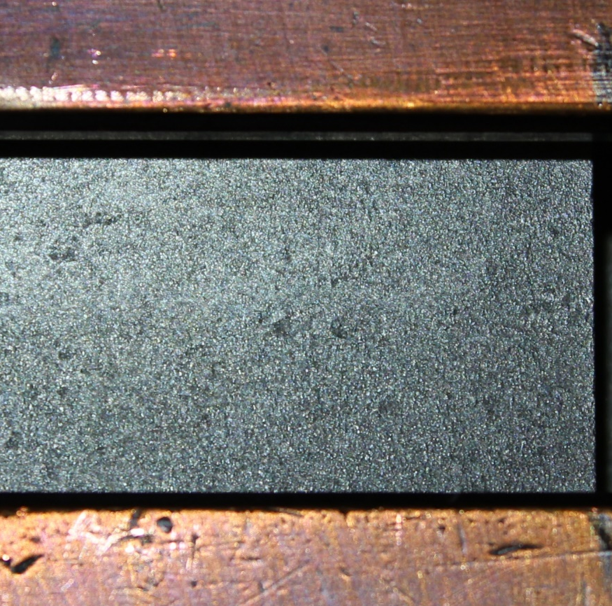
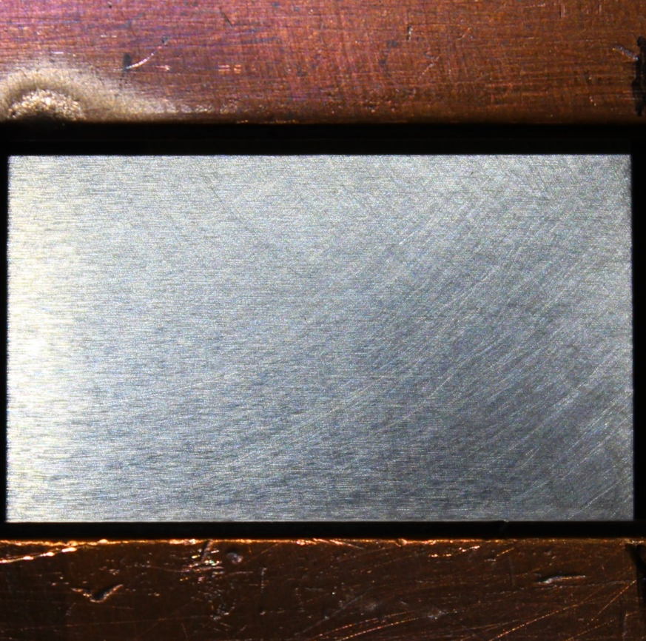

HHF tests on COMPASS-U tungsten OVT tiles
Samples – before HHF tests
Three W-tiles of very different quality and surface finish, with the one from Plansee being about 2 mm thinner than the others, complicating the mounting and heat removal
ALMT
Plansee
AT&M

Slide 21
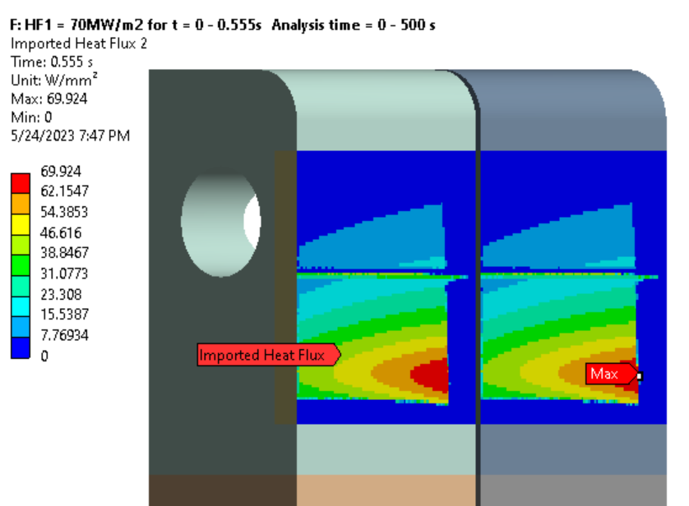
HHF test procedure
Target power load for HHF 1 (Eich profile)
Three different conditions were chosen
  All a part of ~ 20×30 mm of the total area
  HHF 1: 70 MW/m² (max.), Eich profile distribution
  0.5 s duration  reaching 2000°C
  HHF 2: 35 MW/m² (max.), Eich profile distribution
  3.0 s duration  reaching 1500°C
  HHF 3: 20 MW/m² , homogeneous rectangular
  3.0 s duration  reaching 2000°C
All with 10 pulses and time in between to cool down

Slide 22
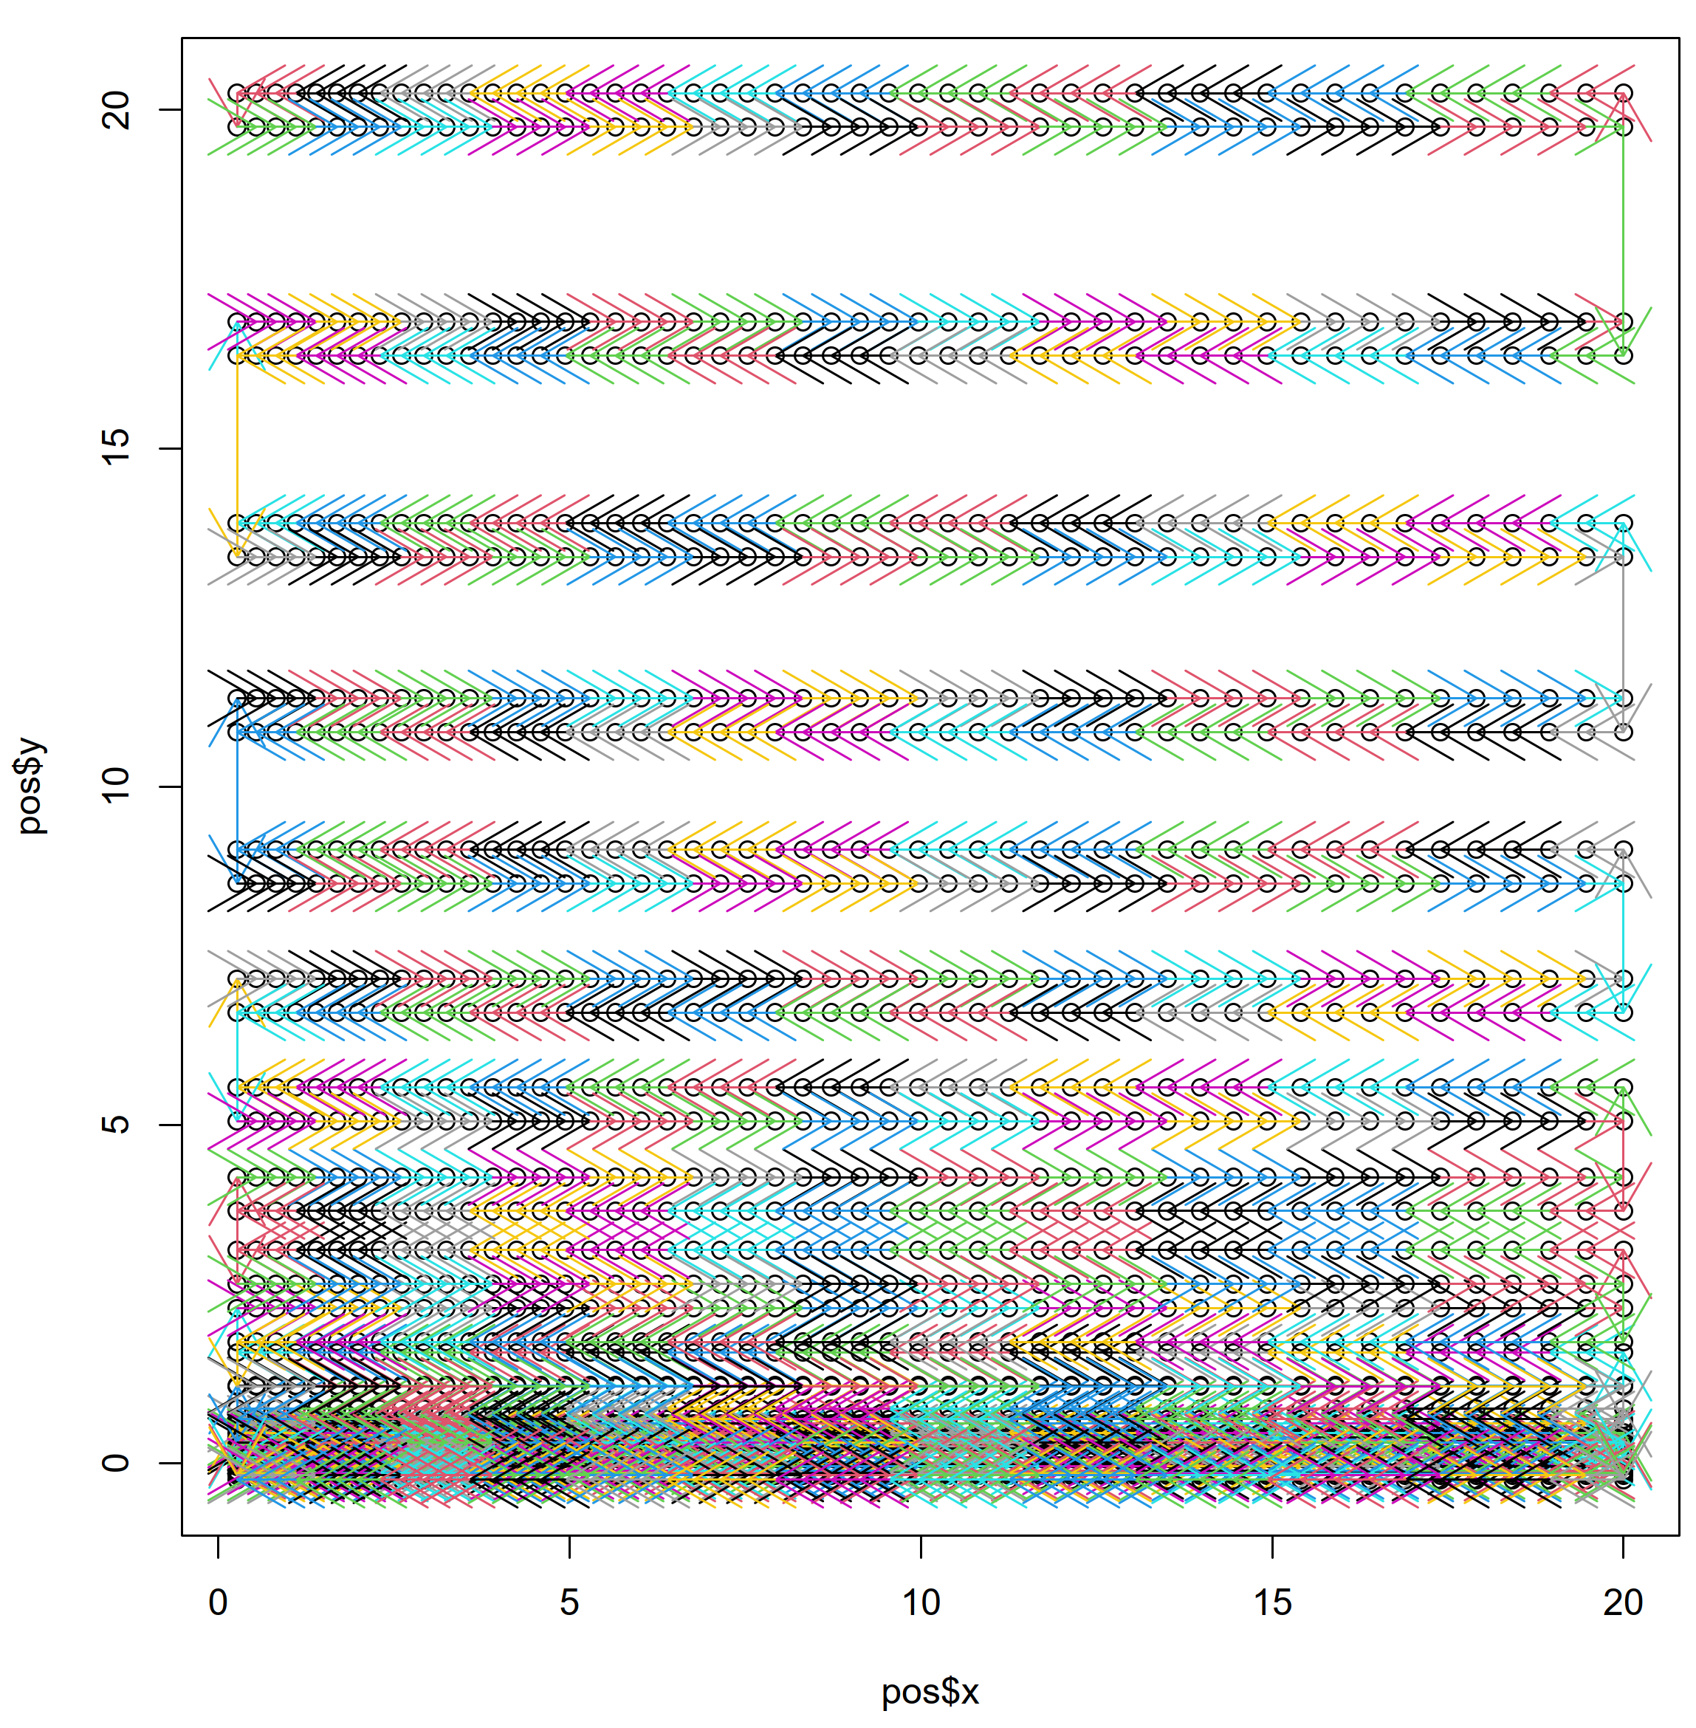
Realization of Eich’s profile
JUDITH 2
  Individual pattern can be realized
  Customizable pattern generator developed
Figure: “Eichprofil” v1, 2000 Pt, 20x20 mm
  Linear point distance increase in x
  Quadratic point distance increase in y
  There and back 1x with slight shift between
  FWHM 5.5 mm, 23 kW
  10 ms thus 0.7 MJ/m²  70 MW/m²
Beam dumps surrounding to generate sharp drop of the heat load

Slide 23
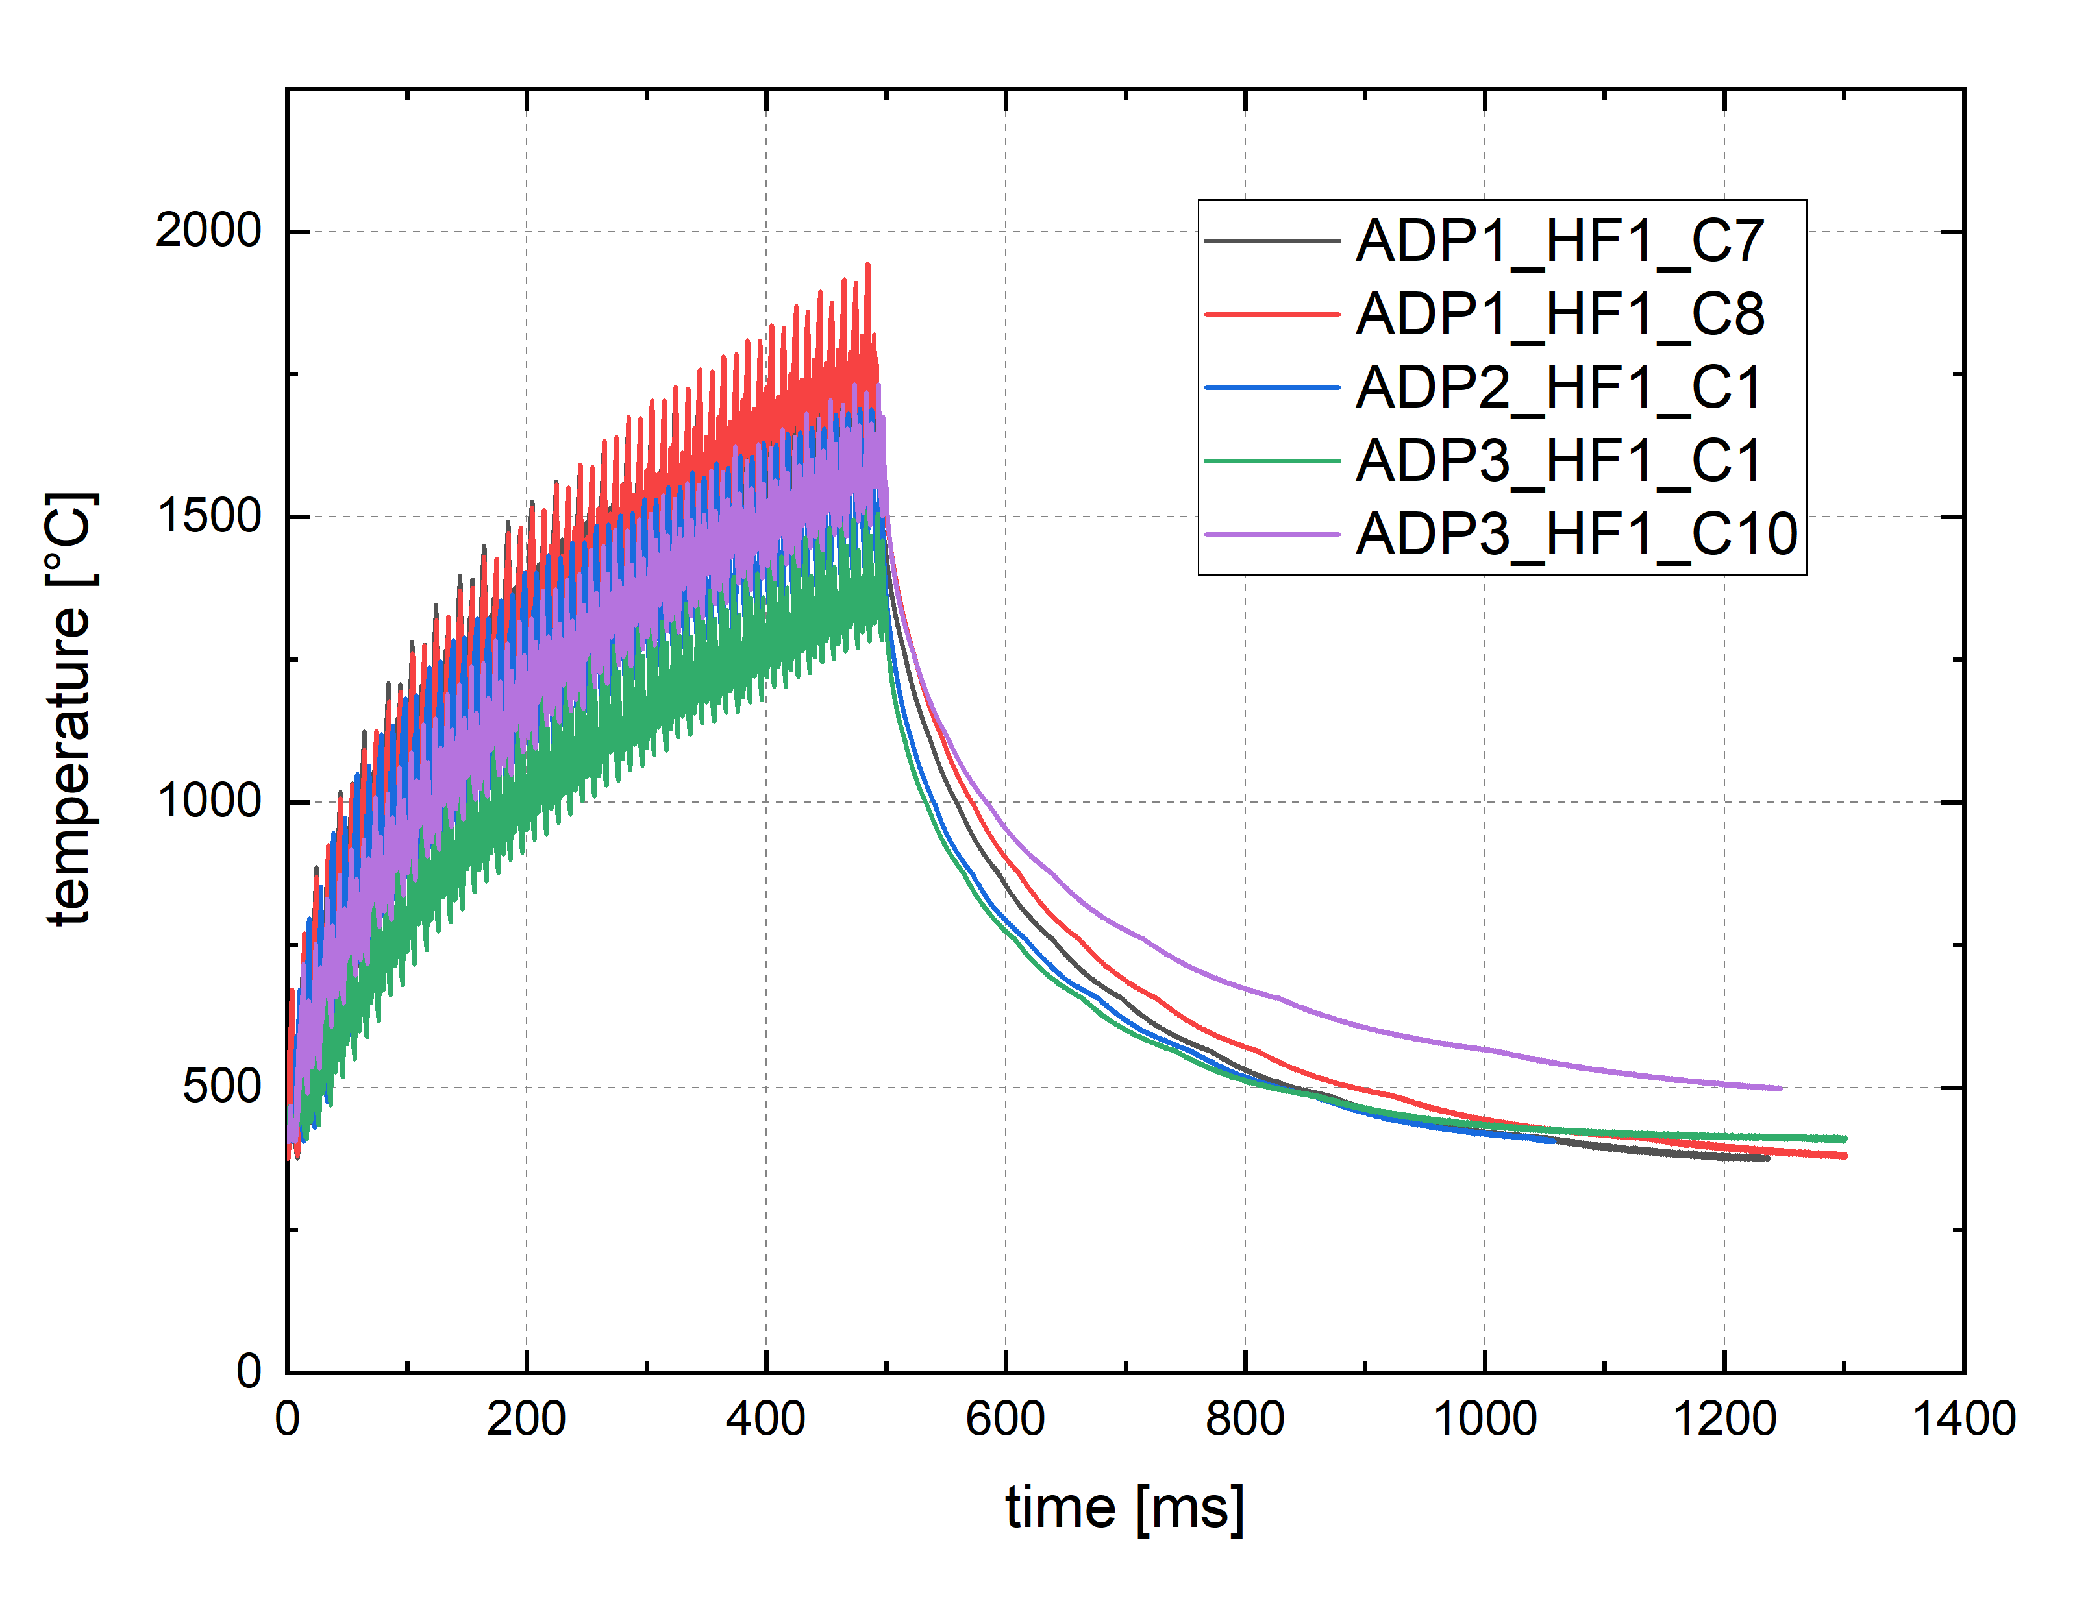
Temperature measurement – pyrometer
Fast pyrometer
  Single color  emissivity also an issue
  ε = 0.2 was used (lower limit)
  Spot location not possible to position perfectly
  Spot size bit larger than max. temp.
  Scattering artefact from e-beam scanning
Exposure time of 0.5 s can be seen
  All issues above correspond to underestimation of the measured temperature
Selection of pulses

Slide 24
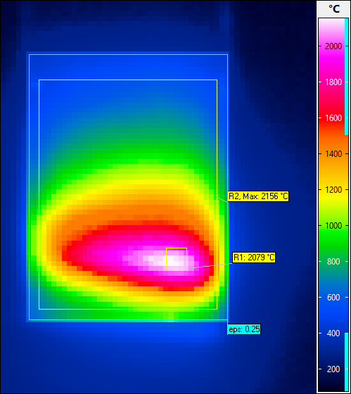
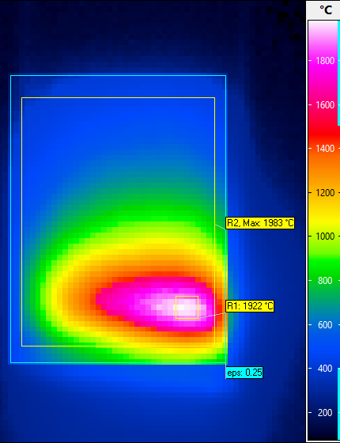
IR measurements
3rd pulse, switch off
5th pulse, switch off
Quantitatively very difficult
  ε is unknown and different for the three W
  ε is temperature dependent and vast range within one thermogram (exceeding single IR range)
  Very short, thus large changes between frames
  No steady state, thus scan of e-beam can’t be averaged using several frames
  Surface changes, thus the emissivity changes
ALMT – HHF 1
  ε = 0.25 for high temp., also used for MB chains
  100 Hz measurement frequency
  1st frame after switch off  no e-beam scanning
  Presumably 2000°C – 2200°C max. temp.
  Shape and distribution roughly what was planned

Slide 25
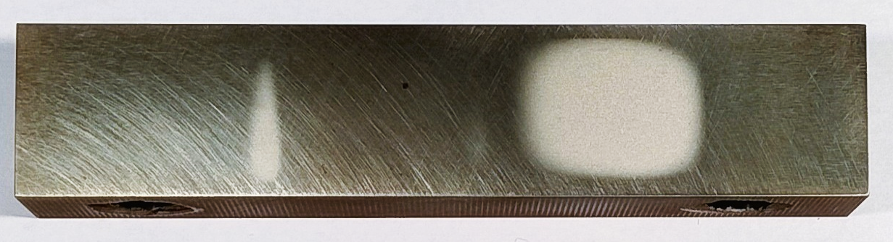
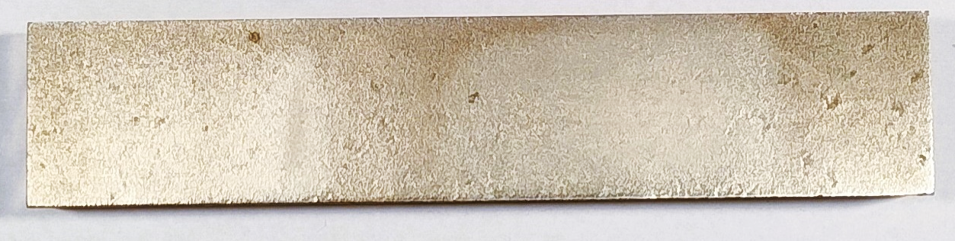
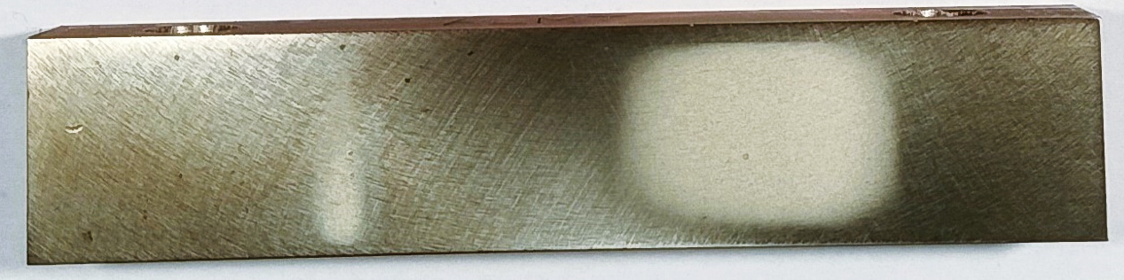
Optical inspection after HHF tests
HHF 1
HHF 2
HHF 3
All three W tiles sustained the HHF tests
No macroscopic damage
Similar roughening of homogeneous and max. of Eichs profile (HHF 1 & 3)
  Same peak temperature as intended
HHF 2 barely visible
  Clearly only at ADP 1 mainly a result of the smoother surface
ALMT
Plansee
AT&M

Slide 26
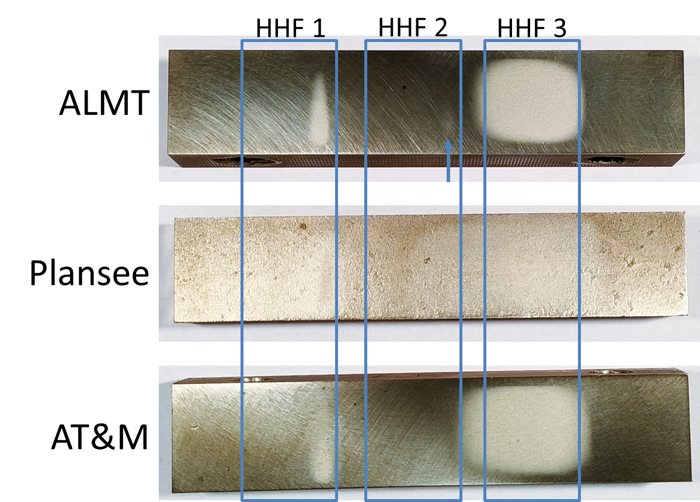
HHF tests on COMPASS-U tungsten OVT tiles - Conclusions
Three W-tiles of very different quality and surface finish from different producers were inspected in JUDITH 2 for HHF tests
Eich’s profile was used to simulate heat flux in COMPASS-U
Qunatitative comparison of the results is difficult due to different emissivity in all samples. Emissivity is dependent on surface and temperature, and both change during the experiment
All three W tiles sustained the HHF tests with no macroscopic damages

Slide 27
General conclusion
Fuzz formation during AUG He campaign was successfully replicated in PSI-2 under similar conditions, further tests planned with He, D and Ne plasma mixtures planned for 2025
Deuterium retention in PIM-W alloys and standard W was performed and compared with LIBS, NRA and TDS. Further tests and analysis of data planned.
Low pulse number testing of W samples from 9 different manufacturers was performed in PSI-2 und thermal shock testing.
HHF tests on COMPASS-U tungsten tiles, all W tiles sustained the HHF tests with no macroscopic damages

Slide 28










WPMAT / WPPRD-MAT Members
Ecole Royale Militaire
Laboratory for Plasma Physics
Institute of Plasma Physics
Academy of Sciences of the
Czech Republic
Technical University
of Denmark
Technical Research Centre
of Finland
AUSTRIA
BELGIUM
Ruđer Bošković Institute
University of Tartu
FINLAND
CROATIA
CZECH REPUBLIC
DENMARK
ESTONIA
The French Alternative
Energies and Atomic Energy
Commission
National Centre for Scientific
Research “Demokritos”
Italian National Agency for
New Technologies, Energy
and Sustainable Economic
Development
Centre for Energy Research
FRANCE
GERMANY
GERMANY
GERMANY
GREECE
HUNGARY
ITALY
Institute of Plasma Physics
And Laser Microfusion
Institute for Atom Physics
Jožef Stefan Institute
LATVIA
POLAND
PORTUGAL
ROMANIA
SLOVENIA
Centre for Energy, Environment
And Technology Research
Swedish Research Council
Kharkov Institute of Physics
and Technology
SPAIN
SWEDEN
SWITZERLAND
UKRAINE
UNITED KINGDOM

