Slide 1


Update on W_{f}/W composites within SPA 3 – FZJ
PWIE Meeting March 2025
Jan W.Coenen^{1,2} & Yiran Mao¹ for the Wf/W Team
1: Forschungszentrum Jülich GmbH, Institut für Energie- und Klimaforschung 52425 Jülich, Germany,; 2: Department of Engineering Physics, University of Wisconsin Madison, WI 53706 Madison, USA

Slide 2
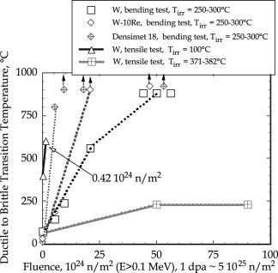
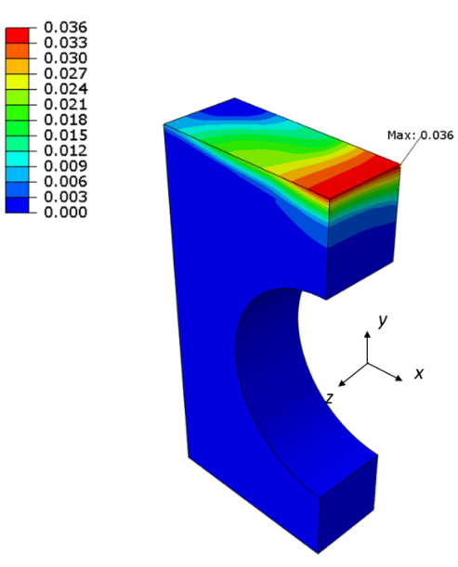
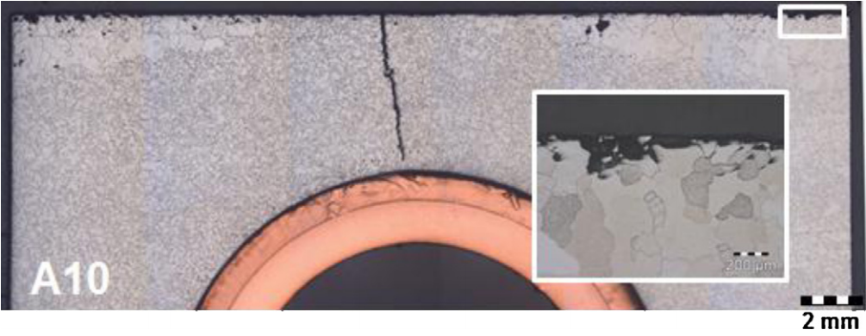
Crack formation for tungsten armor
Intrinsic brittleness of tungsten material
Thermal heat load at the divertor: thermal stress and thermal fatigue
Neutron embrittlement
G. Pintsuk et al. / Fusion Engineering and Design 88 (2013) 1858– 1861 1861
A damage resilient material is required
Accumulated equivalent plastic strain field in the tungsten armor block after the 5th HHF load cycle at 20 MW/m².
-M.Li 2015.

Slide 3
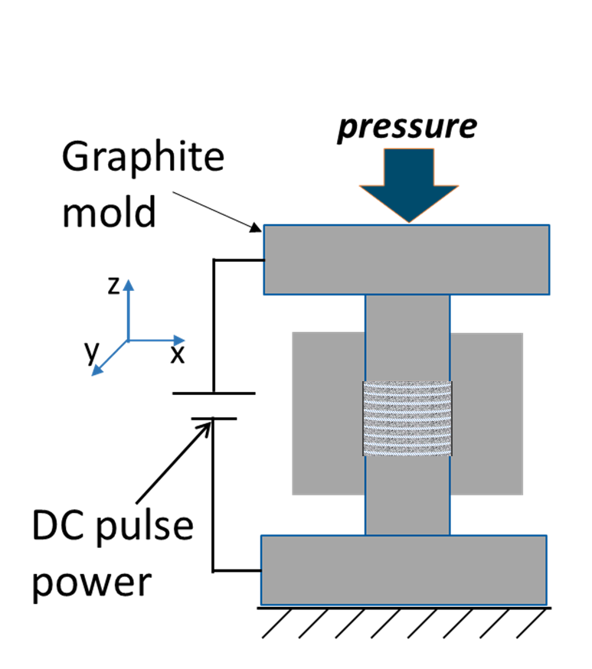
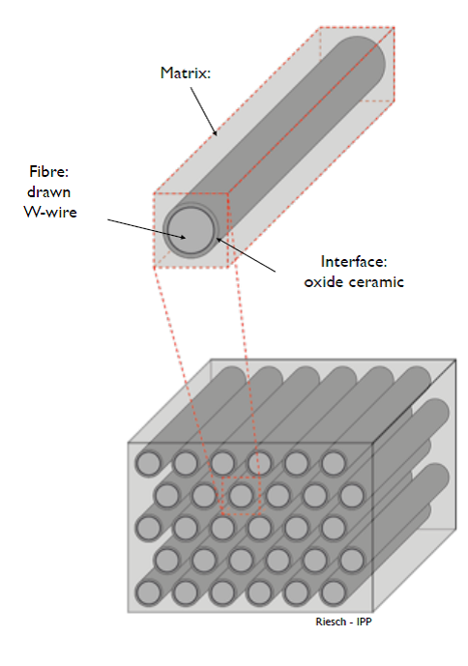
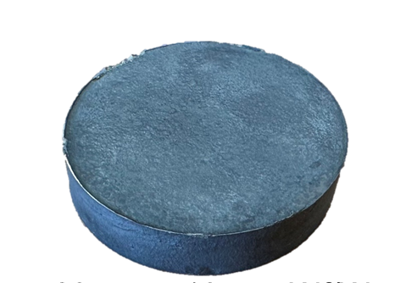
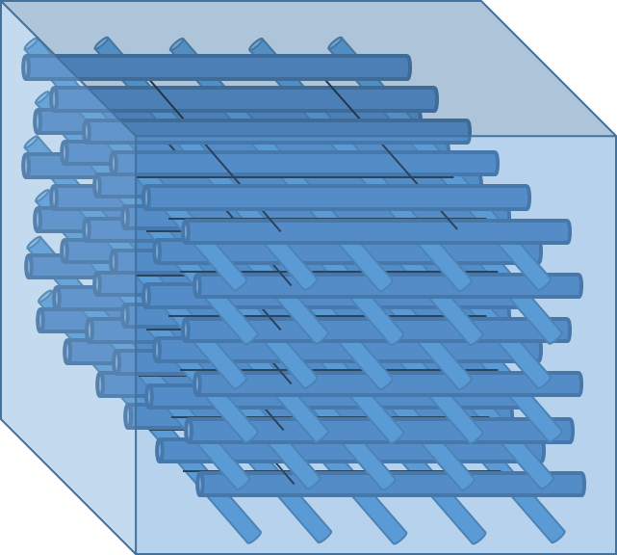
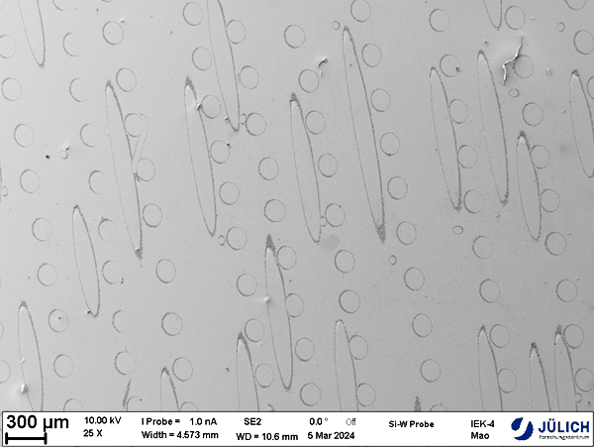
Long fiber tungsten fiber reinforced tungsten
Tungsten fiber-reinforced tungsten (W_{f}/W)
J. Riesch, Y. Han, J. Almanstotter, J.W. Coenen, T. Hoschen, B. Jasper, P. Zhao, C. Linsmeier, R. Neu, Development of tungsten fibre-reinforced tungsten composites towards their use in DEMO-potassium doped tungsten wire

Slide 4
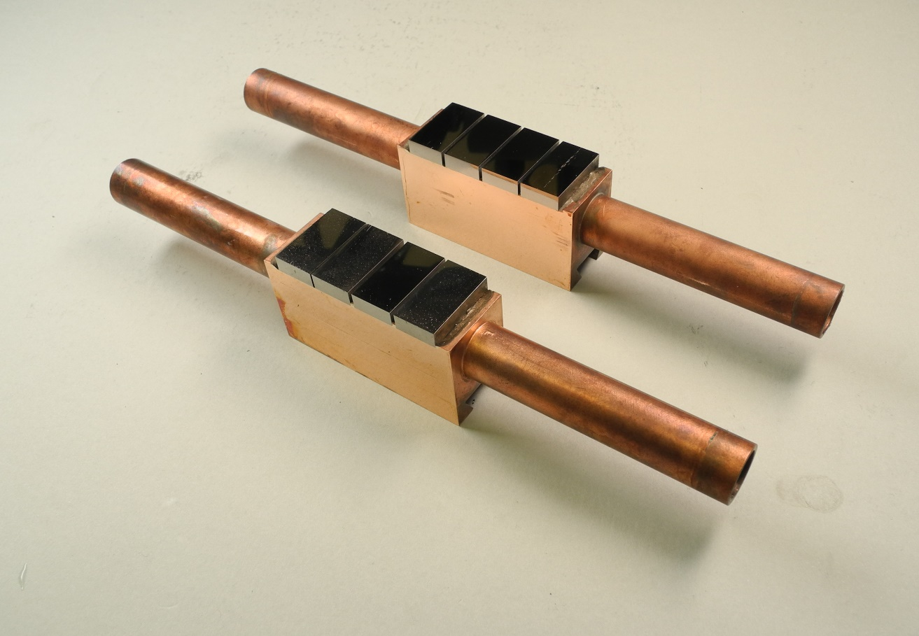
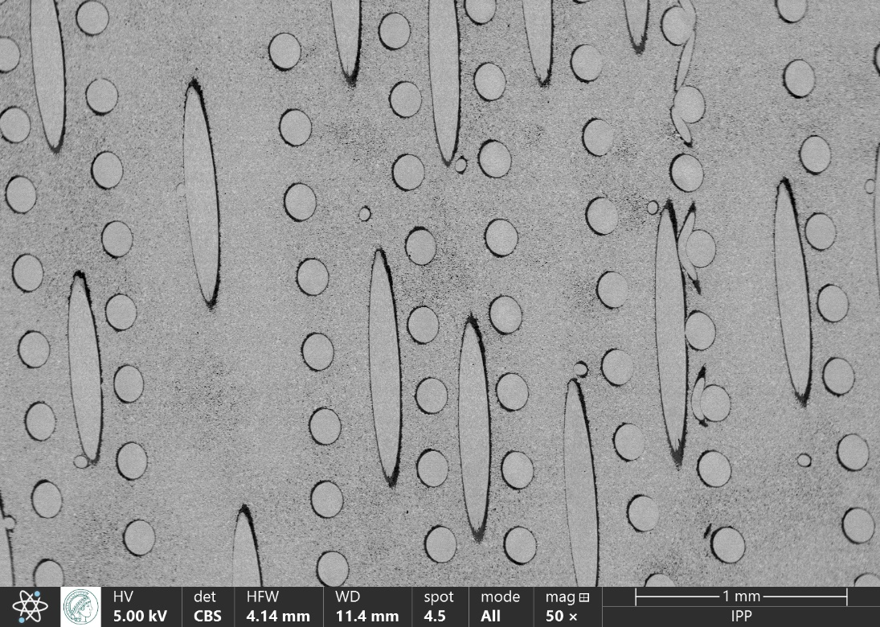
Flat tile mock-ups made of long fibre PM W_{f}/W
Flat tile mock-ups similar to DEMO standard design*
  Long fibre-reinforced PM-W_{f}/W
    fibre orientation 0/90°
    Yttria interface, thickness: L1 ≈ 5 µm, L2 ≈ 1.5 µm
  Brazing to CuCrZr cooling structure
  *) Area plasma facing surface 12 mm x 23 mm
L2
L1
top view L1
side view L2

Slide 5
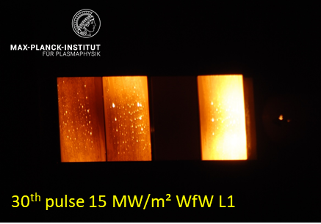
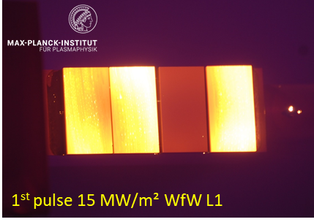
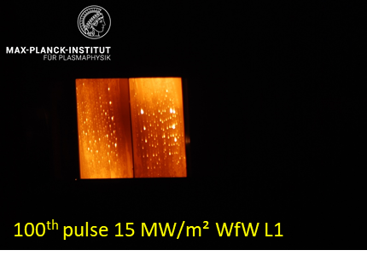
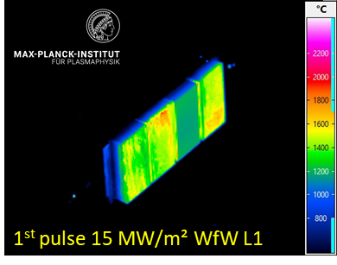
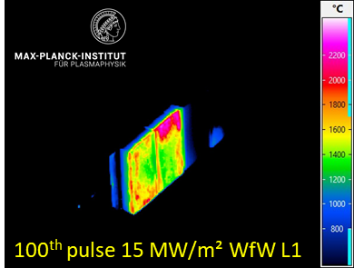
Production of Mockup based on longfibre W_{f}/W and High Heat Flux Tests
CCD images during cyclic loading.
scrapper
IR images during cyclic loading.
shielding of damaged tile
Strong surface temperature increase at the edges of tile 3 and 4 during 15 MW/m² cyclic loading
Optical microscopic analysis indicates that defects developed as well in the bonding zone between the tiles and the cooling structure, as in the W_{f}/W materials itself

Slide 6
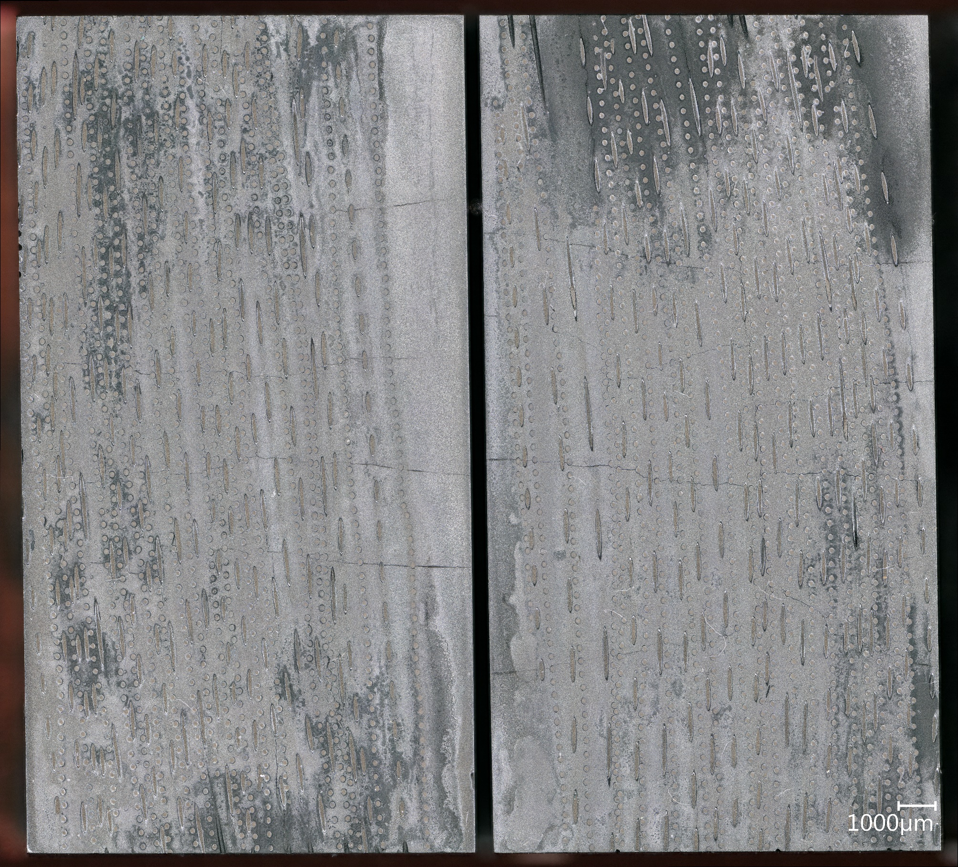
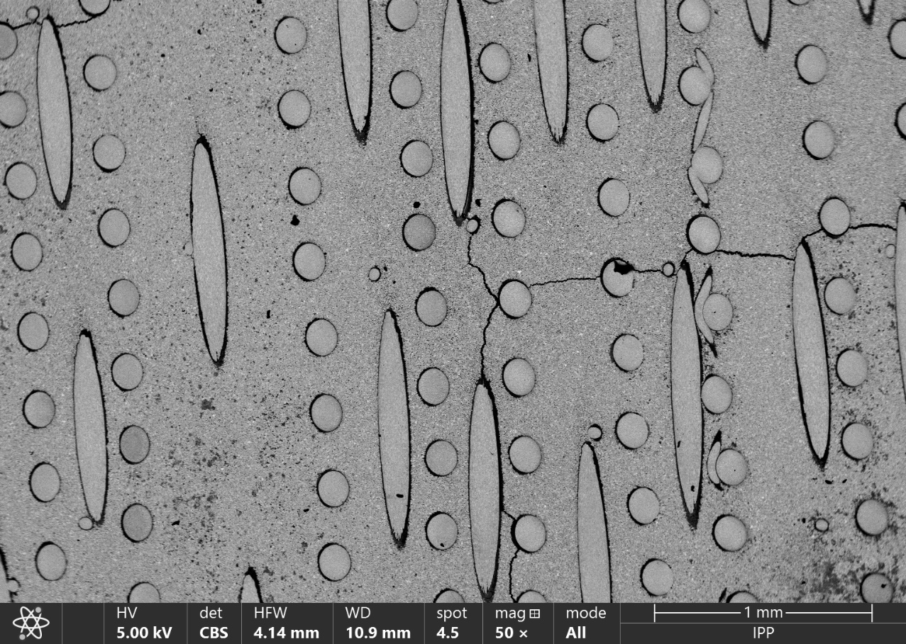
Microstructure after HHF
after GLADIS L1
WfW L1 tile 4, bottom side, after GLADIS loading
WfW L1 tile 3, top side, after GLADIS loading
Joining with the heatsink could be the bottle neck of the component, but cracking and decomposition of the yttria is also observed

Slide 7
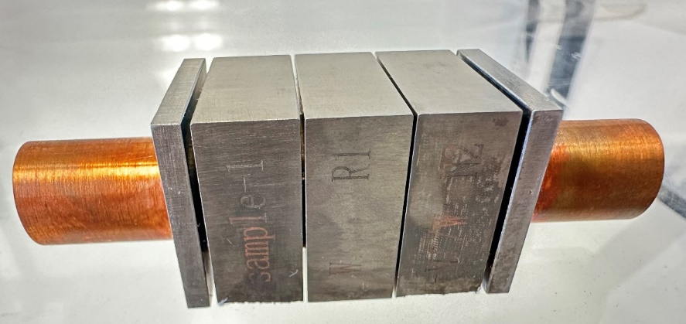
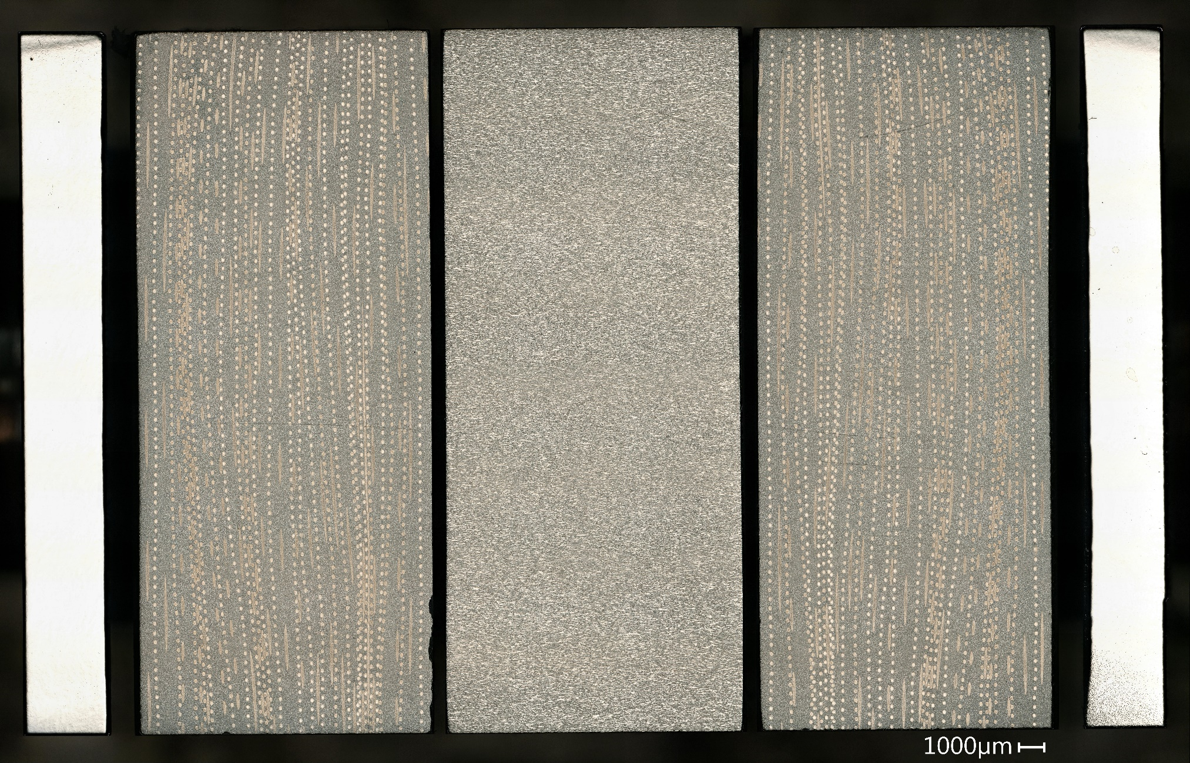
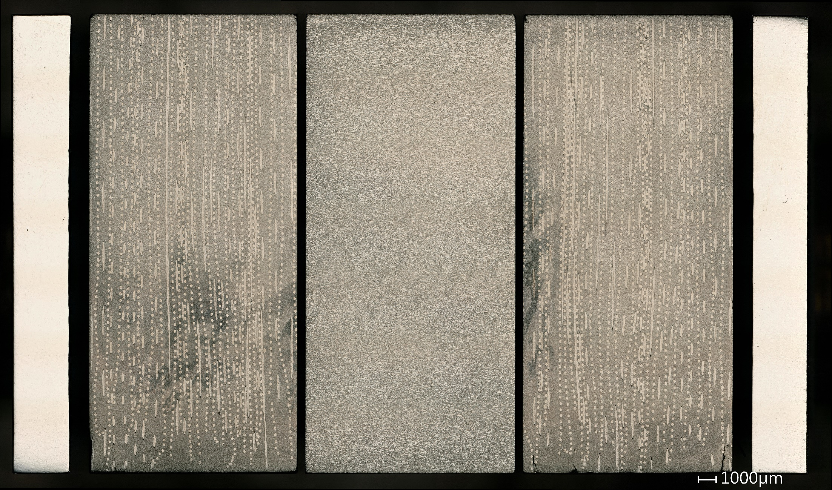
Wf/W mock-up - monoblock chain
top view
side view

Slide 8
High heat flux tests on monoblock mock-up
Hydrogen neutral beam HHF in IPP Garching
Screening to 12/15/20 MW/m² followed by 100 cycles at 10/15/20 MW/m²
  Beam time 10s
  cold water cooling
Step | screening | cyclic loading
 |  | Load | Pulses
1 | up to 12 MW/m² | 10 MW/m² | 100
2 | up to 15 MW/m² | 15 MW/m² | 100
3 | up to 20 MW/m² | 20 MW/m² | 100

Slide 9
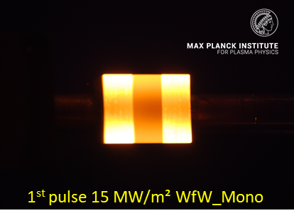
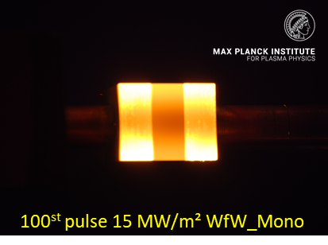
HHF on monoblock mock-up
The surface temperature distribution is nearly stable during 10 MW/m² and 15 MW/m² cyclic loading.
W_{f}/W blocks show higher surface temperature than pure W
Material is capable of surviving up to 100 cycles up to 20 MW/m²

Slide 10
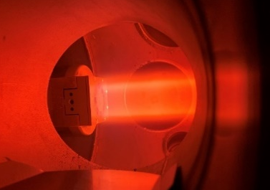
Plasma erosion
Neon plasma, 98-117 eV, flux: 1x ×10²¹ Ne⁺ m⁻²s-¹, total fluence of 3 ×10²⁴ Ne⁺ m⁻², ~90⁰C in PSI-2
Before erosion
After erosion

Slide 11
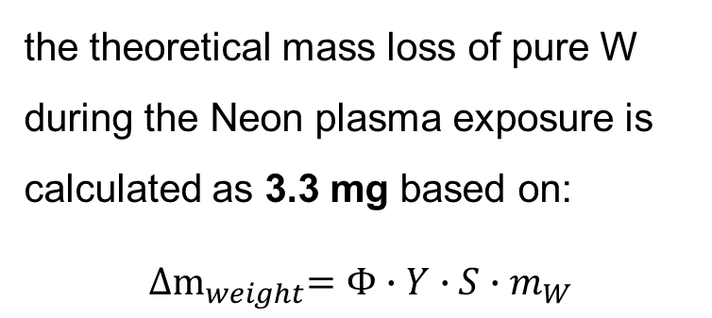
Plasma erosion
Both samples match within the experimental uncertainty compared to the theoretical value.
The results show that the mass loss and erosion depth are comparable for both types of samples. Although L-W_{f}/W composites contain yttria at the fiber-matrix interface, which has a higher sputtering yield compared to tungsten, the volume fraction of yttria is so small that, it had minimal influence on the overall erosion properties.
 | Mass loss | Depth loss
Reference W | ~2.85mg | ~2.4 µm
L-Wf/W | ~3.06mg | ~2.2 µm
the theoretical mass loss of pure W during the Neon plasma exposure is calculated as 3.3 mg based on:
${∆m}_{weight}=Φ∙Y∙S∙m_{W}$

Slide 12
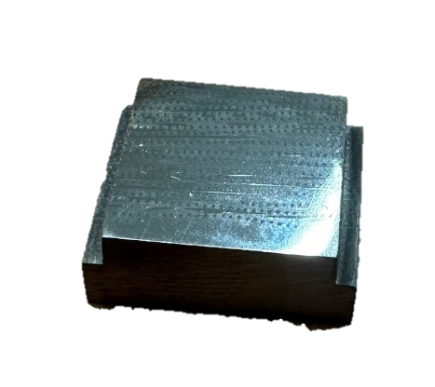
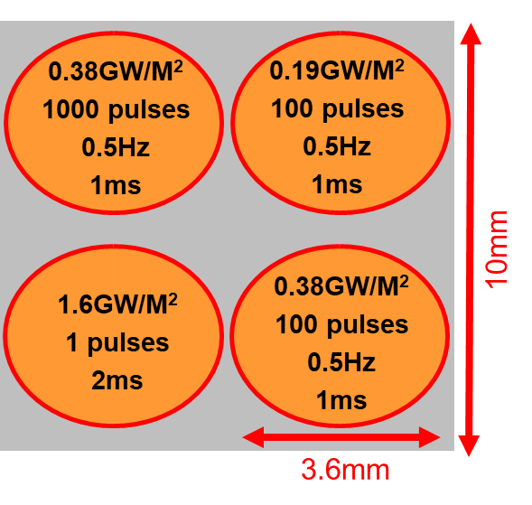
Laser shock
In PSI-2 1.6GW/m² 2ms
Lower crack density and length for W_{f}/W
Crack bridged by the fibers

Slide 13
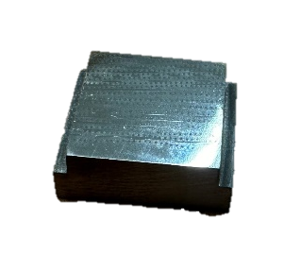
Hydrogen retention
1000µm
D plasma exposure was applied. Bias ~95V, Flux:~2.45x10²¹ m⁻²s⁻¹; the total fluence ~5x10²⁵D⁺ m⁻². During the exposure, the temperature was ~275 °C.
NRA experiments on different regions
Two points are tested, one on the region without fibers, and the other at the region with fiber/interfaces
Later, together with TDS results, these results will be helpful to understand whether we have different retention behavior for W_{f}/W compared to pure W
Matrix region
Region with fibers

Slide 14
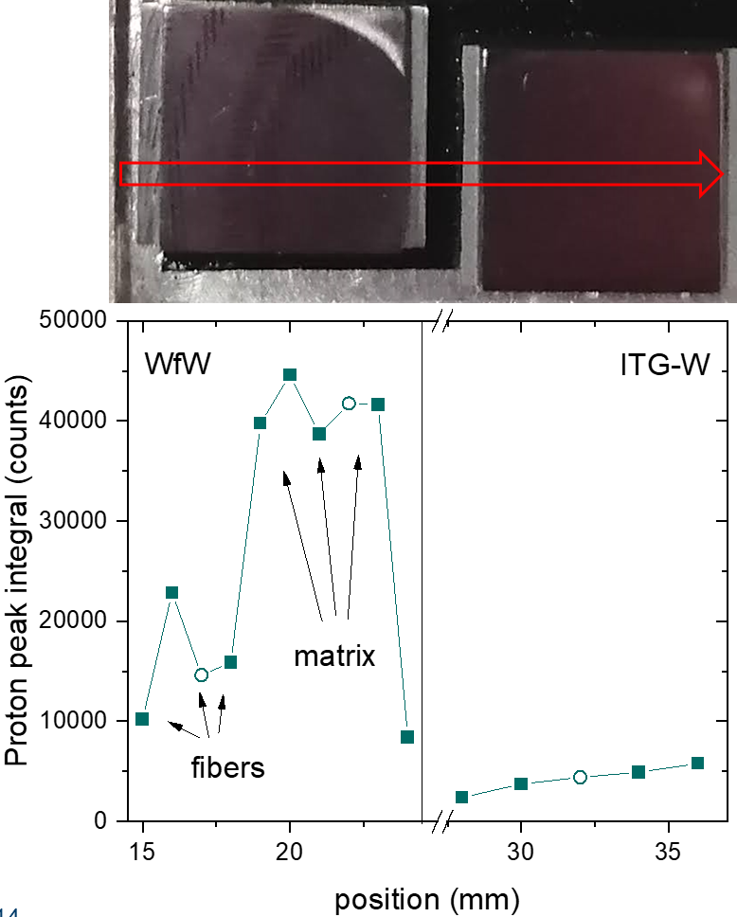
Hydrogen retention
Lateral scan with 2.4 MeV with 1 mm step width (information depth < 3.3 µm)
Depth profiling with six different ³He energies between 690 keV and 4.5 MeV to probe the deuterium within the first 7.5 micrometer
D concentration larger in the matrix than in the fibers
Both fibers region and matrix region show higher D retention than for ITG-W maybe due to lower density and higher defect density
TDS will be done for D retention of the whole sample

Slide 15
Thermal properties of L-Wf/W
Sample type | Relative density
W_{f}/W short fiber | ~91%
Porous matrix W_{f}/W | ~78%
Long fiber W_{f}/W | ~91%
Mainly due to different sintering density, different W_{f}/W show different thermal conductivity
For long fiber W_{f}/W, different thermal conductivity has been measured in different fiber arrangement

Slide 16
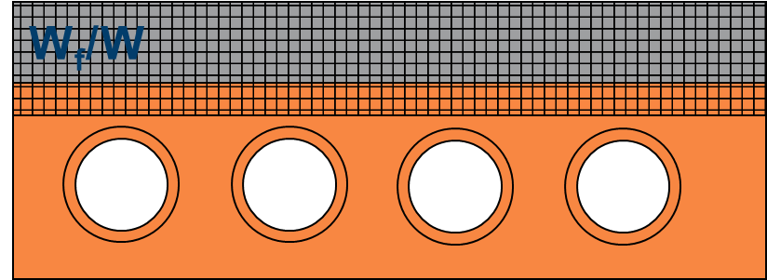
Summary
The newly developed powder-metallurgical L-W_{f}/W has been characterized, including mechanical behavior, thermal physical behavior, erosion, retention, high heat flux tests.
the W_{f}/W composites could improve significantly the damage resilience compared to pure W without losing much of other properties.
HHF tests show that for the original status of Wf/W components, 15MW/m² for flat tiles and 20MW/m² for monoblocks could be handled
Outlook
Neutron irradiation
Fiber reinforced joining
Improving the sintering density

