Slide 1


Progress in RE-induced PFC damage
modelling
S. Ratynskaia, P. Tolias, T. Rizzi, K. Paschalidis, A. Kulachenko
KTH, Stockholm

Slide 2
Outline
General:
PFC interaction→ explosive damage
Brittle vs metallic PFC response to RE-impacts
Progress for brittle PFCs:
Brittle failure predictions – benchmarking with controlled DIII-D experiment
Brittle failure predictions – modelling of WEST BN tiles damage
Fragmentation and debris model developments
Progress for W PFC
Geant4 + MEMENTO work-flow
Geant4: high fidelity energy maps, flexibility to accommodate advanced input (from DREAM, KORC, JOREK etc) and complex geometries
First controlled W damage experiments – upcoming
Conclusions and outlook

Slide 3
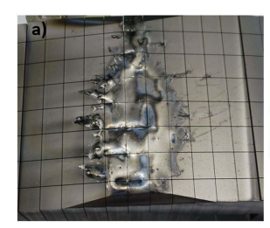
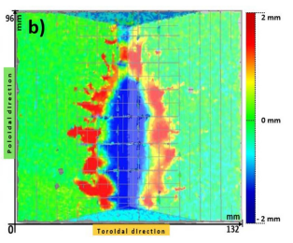
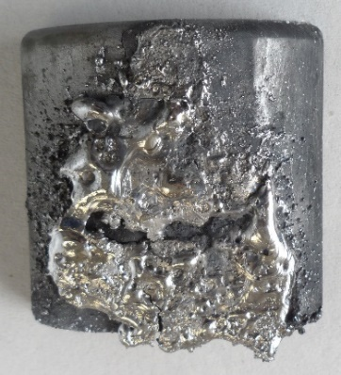
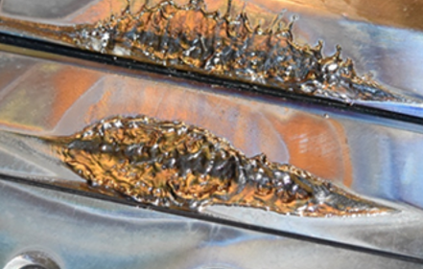
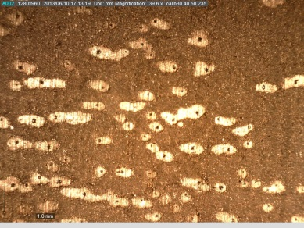
RE-induced damage: explosive behaviour with release of debris
NB: non-exhaustive list, just a few examples
M. De Angeli et al, NF 63, 014001 (2023)
Be
JET
Fast solid dust , v ~ 1 km/s
I. Jepu et al 2024 NF 64, 106047
E. Hollmann et al, PPCF
67 035020 (2025)
TZM
BN
W
FTU
WEST
WEST
Secondary damage: dust impacts on toroidal limiter
C
DIII-D
Y. Corre, ITPA divSOL, Prague Oct 21-24 , 2024
Impacts on the inner and outer bumpers
non monotonic profile → max temperature beneath the surface → internal stress buildup due to uneven thermal expansion & internal boiling → thermal shock, explosion and material detachment

Slide 4
Brittle, no liquid phase (C, BN) vs ductile with liquid phase (W, Mo)
Thermo-mechanical response has been modelled focusing on the onset of brittle failure. Large strains, crack propagation and debris formation are omitted.
ATJ graphite and BN are mildly anisotropic and characterized by approximately linear stress-strain curves up to their fracture
One-way coupled linear thermo-elasticity theory for isotropic homogeneous materials
R. B. Hetnarski and M. R. Eslami,
Thermal stresses – Advanced theory and applications, Springer, New York, 2019.
The model can be extended (finite strain, two way coupled displacement and heat equations) to model fragmentation and debris
All modelling has been so far limited to the thermal response.
The thermomechanical response in the solid phase and the hydrodynamic response in the liquid phase not considered yet.
To realistically model RE-induced W damage, we need to go beyond heat transfer and beyond one-way coupled thermoelasticity
  visco-plasticity
  shockwave propagation
  compressive flows
  internal phase transitions
  large strains / deformations
  material fragmentation
strength model incl. high strain rates, high temps. and strain hardening
multi-phase
equation of state
extended FEM, phase field method, SPH, ALE, PD etc

Slide 5
Modelling of thermomechanical response of brittle materials with no liquid phase: C and BN

Slide 6
DIII-D graphite experiment

Slide 7
Modelling of brittle material with no liquid phase: C and BN
Modelling the brittle failure of graphite induced by the controlled impact of REs in DIII-D,
S. Ratynskaia et al, NF Letter 65 024002 (2025)
Controlled DIII-D experiment
Blown-off volume
KORC (RE striking positions & momenta) → MC particle transport code Geant4 (volumetric energy deposition) → FEM multiphysics software COMSOL (thermoelastic response)
Constraints: measured conducted energy, damage topology, explosion time & blown-off material volume
Local failure criterion: maximum normal stress theory, the principal stresses are compared with the temperature dependent ultimate tensile or compressive strengths, depending on their sign.
The model is capable to distinguish between different RE impact scenarios and to identify RE parameters which provide the best match to the observations.

Slide 8
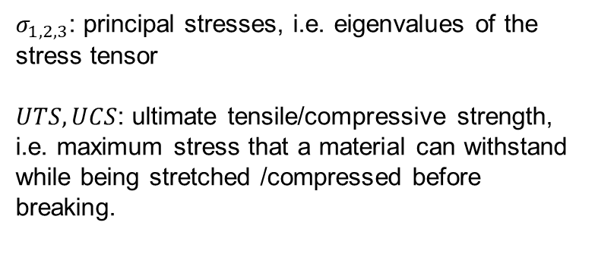
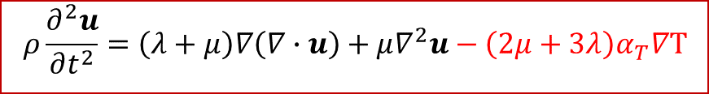
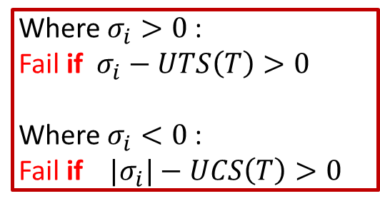



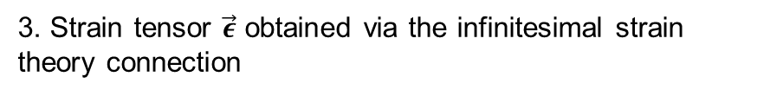
Linear thermo-elasticity theory
The COMSOL multiphysics set-ups are based on one-way coupled linear thermoelasticity theory for isotropic homogeneous materials
1. Heat conduction equation with volumetric external heat Q
Also known as normal stress, Coulomb or Rankine criterion:
$$ρc_{p}\frac{∂T}{∂t}−∇∙(k∇T)=Q$$
Where $σ_{i}>0$:
Fail if $σ_{i}−UTS\left(T\right)>0$
Where $σ_{i}<0$:
Fail if ${|σ}_{i}|−UCS\left(T\right)>0$
2. Navier equation for displacement u coupled to heat transfer through thermal expansion
$$ρ\frac{∂^{2}u}{∂t^{2}}=\left(λ+μ\right)∇\left(∇∙u\right)+μ∇^{2}u−\left(2μ+3λ\right)α_{T}∇T$$
3. Strain tensor $\vec{ε}$ obtained via the infinitesimal strain theory connection
$σ_{1,2,3}$: principal stresses, i.e. eigenvalues of the stress tensor
$UTS, UCS$: ultimate tensile/compressive strength, i.e. maximum stress that a material can withstand while being stretched /compressed before breaking.
$$\vec{ε}=\frac{1}{2}(∇u+∇u^{T})$$
4. Stress tensor $\vec{σ}$ obtained via Hooke’s law with thermal expansion
$$\vec{σ}=2μ\vec{ε}+λTr\left(\vec{ε}\right)\vec{I}−\left(2μ+3λ\right)α_{T}(T−T_{0})\vec{I}$$
R. B. Hetnarski and M. R. Eslami, Thermal stresses – Advanced theory and applications (2019)
Y. C. Fung and Pin Tong, Classical and computational solid mechanics (2001).

Slide 9
BN tiles in WEST

Slide 10
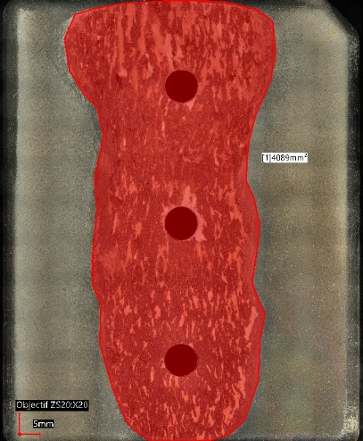
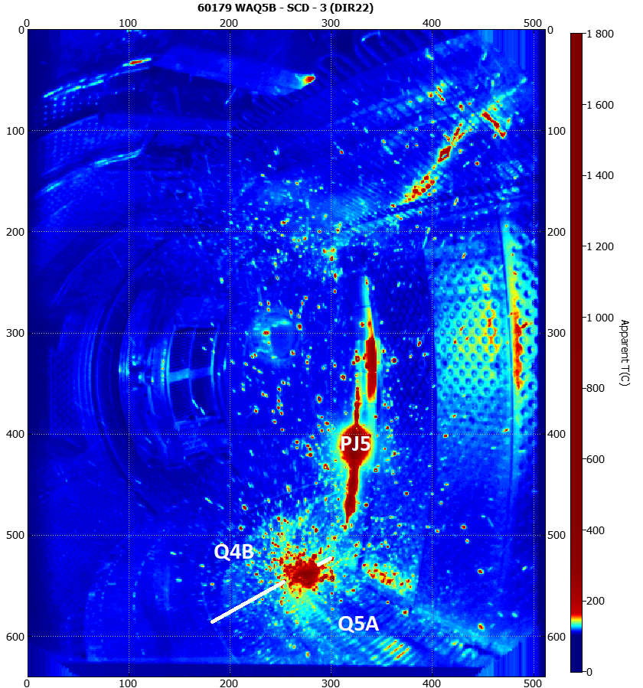
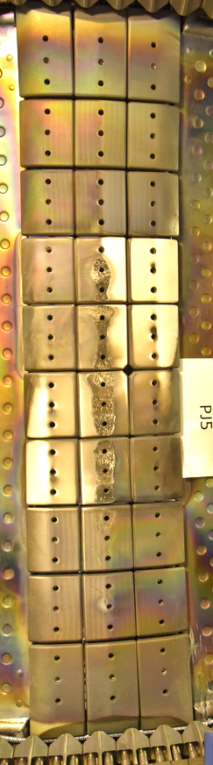
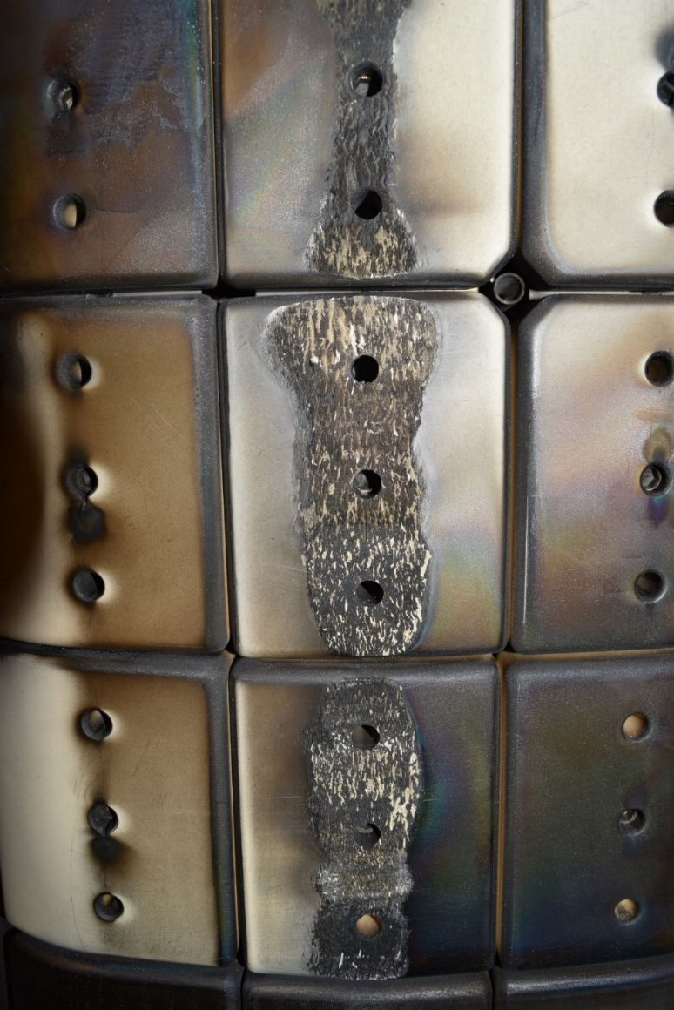
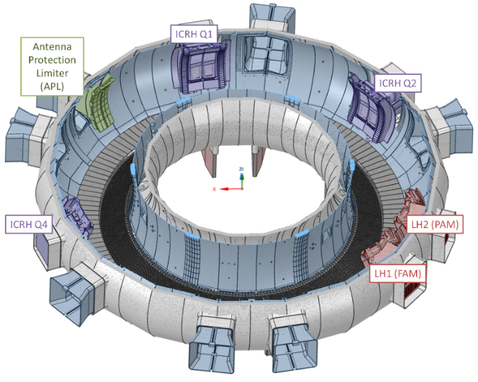
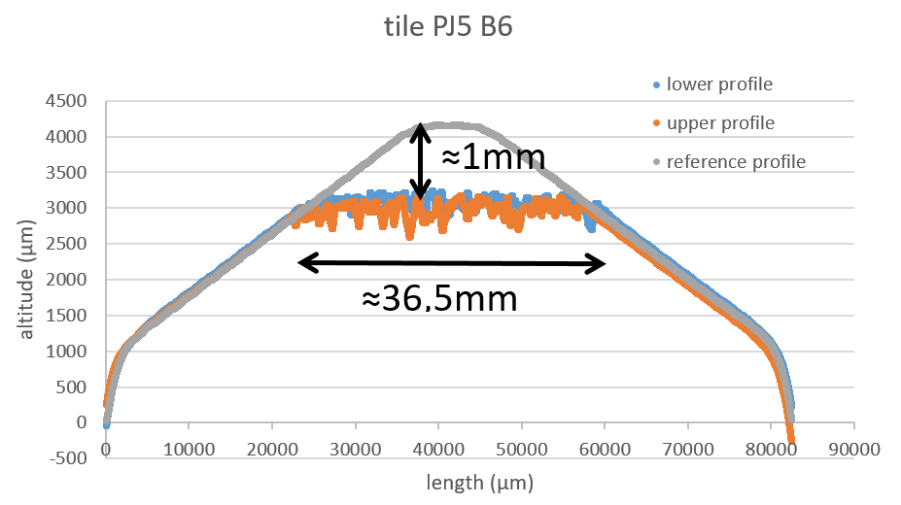
Experimental evidence and modelling constraints
Runaway Electron damage induced during the 2023-2024 experimental campaigns on the boron-nitride tiles mounted on the inner bumper PJ5
The excavated volume is interpreted as result of cumulative damage taking place in $\sim few$discharges
RE
PJ5
Optical images profilometry

Slide 11
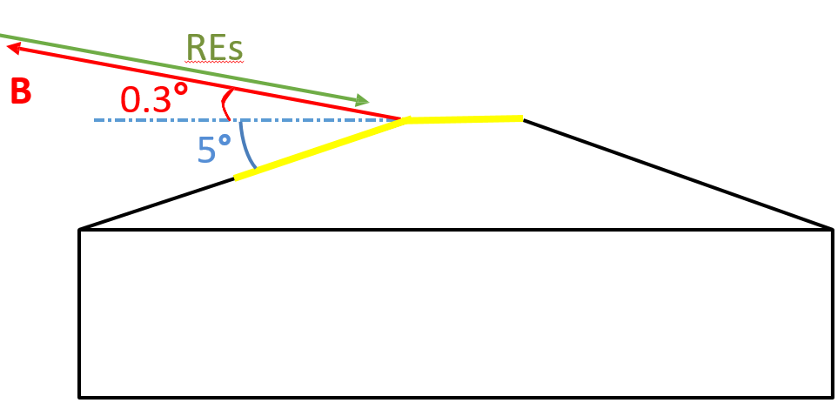
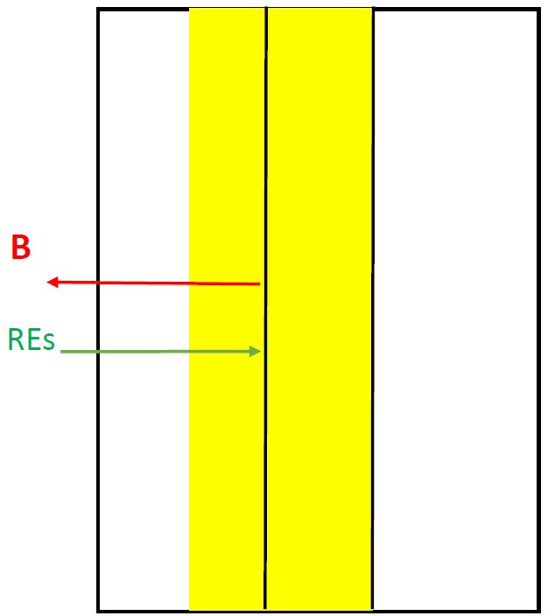

Experimental evidence and modelling constraints
BN tile geometry
B field inclination
Loading variations:
RE energy
Pitch angle
Wetted surface
Loaded energy
Loading time
$$|B| = 4T$$

Slide 12
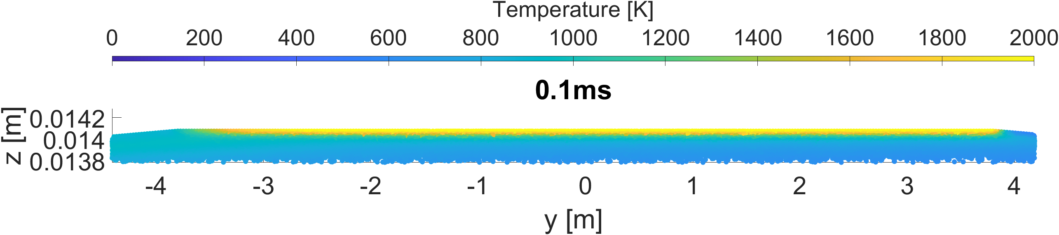
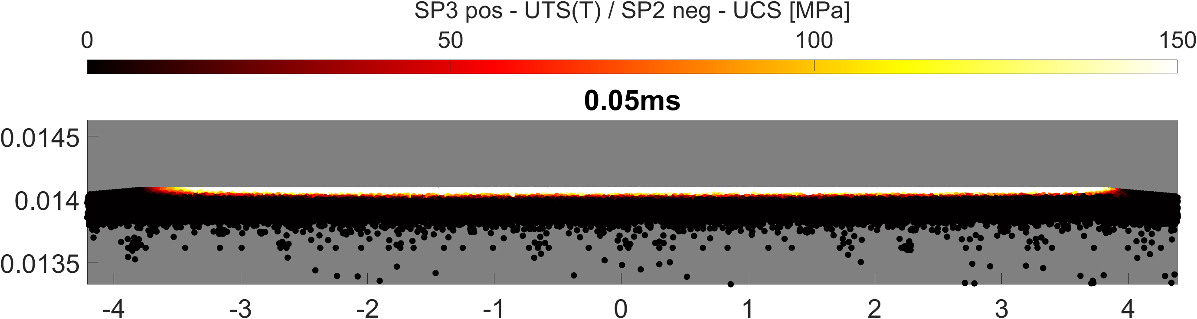
20 MeV – 20 kJ loaded – 1 ms – 0 deg pitch
T_max @ failure 1880K
Failure: 60 µm at 0.1 ms

Slide 13
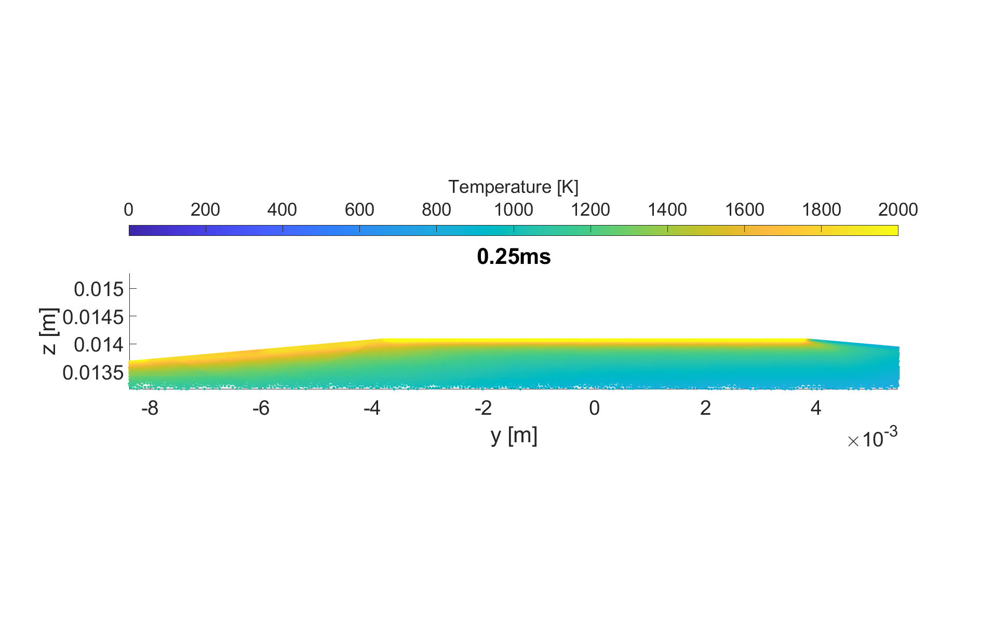
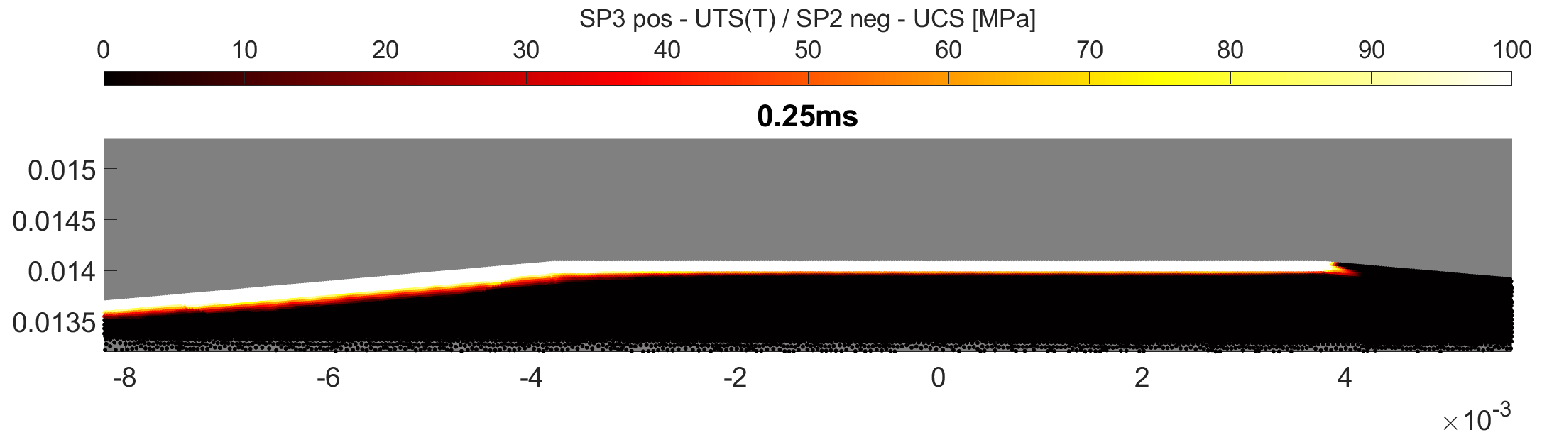
2 MeV – 20 kJ loaded – 1 ms – 0 deg pitch
Loading only top surface:
Asymmetric deposition
Instantaneous failure
T_max @ failure 2081K
Failure top: 50 µm at 0.15 ms
Failure side: at t=0.25 ms

Slide 14
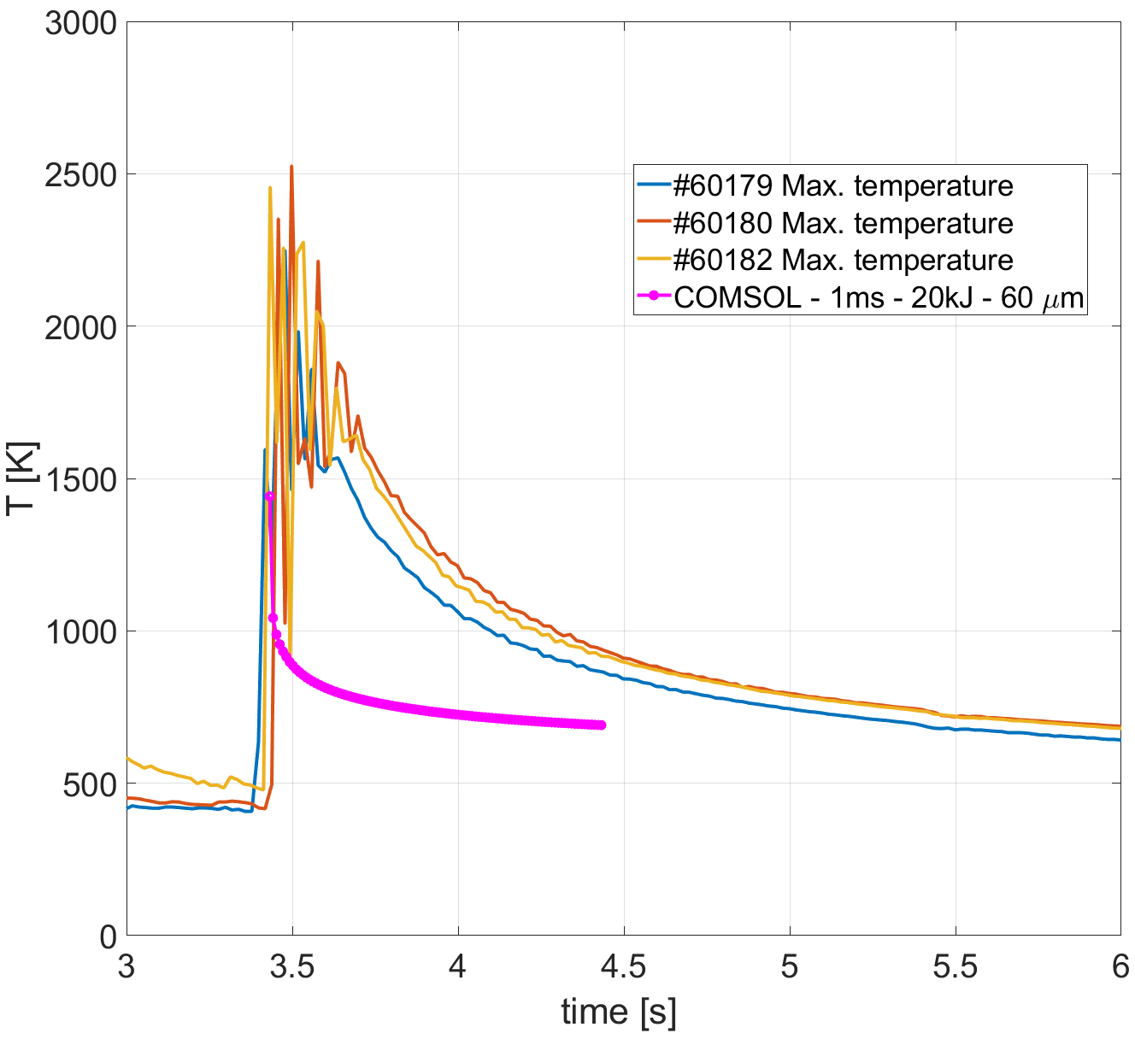
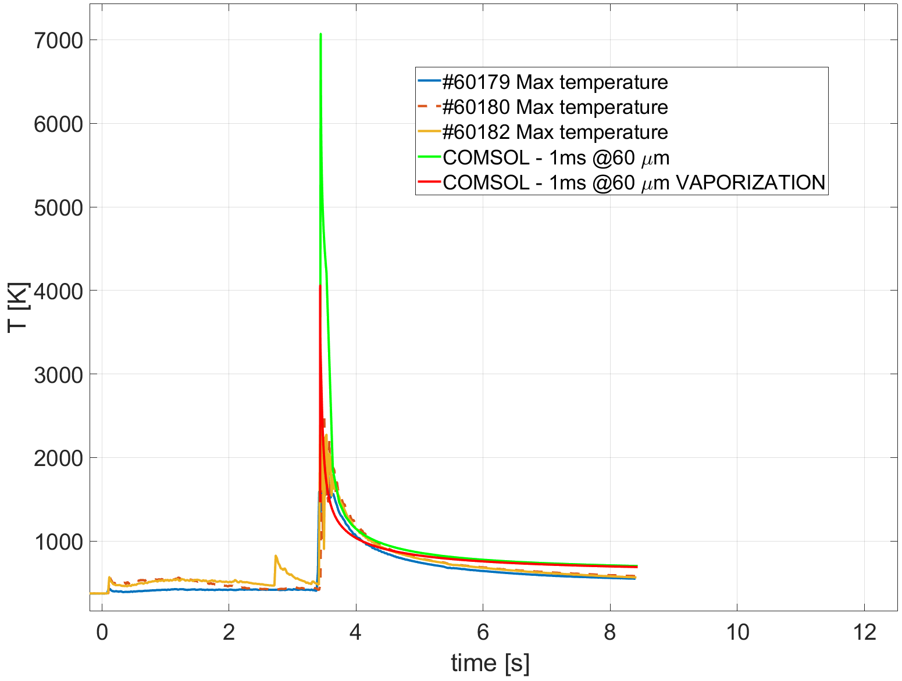
Surface temperature response vs. IR camera
20 MeV – 1 ms – 20 kJ – 0 deg pitch
Failed region is removed after failure at 0.1 ms
Loading cotinues with ’cut’ energy map and 0.1 ms temperature map as initial condition
20 MeV – 1 ms – 20 kJ – 0 deg pitch
Loading stops after failure at 0.1 ms

Slide 15
Beyond the onset of failure – modelling of fragmentation

Slide 16
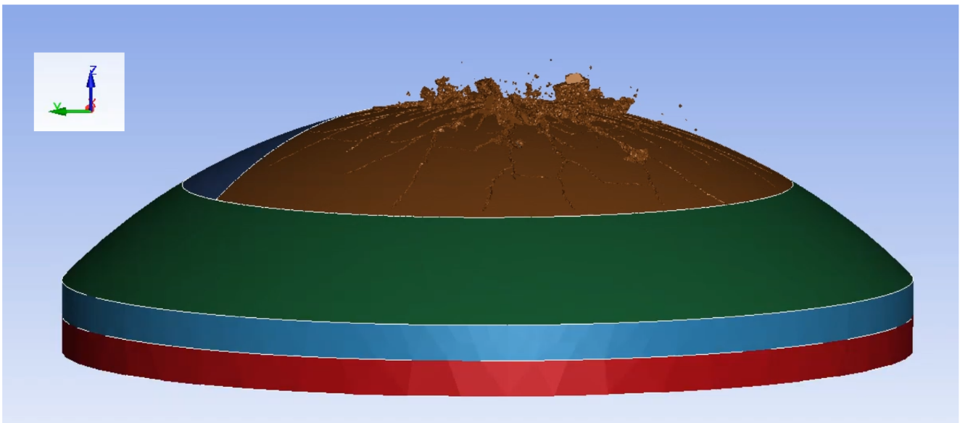
Modelling of brittle material fragmentation
FEM approach to simulate material fragmentation with the LS-DYNA software.
Two-way coupled thermo-elasticity via thermal expansion.
Element deletion method employed here to simulate fracture.
User-defined temperature dependent Rankine failure criterium
Next steps
Mesh optimization (hexaedral adaptive mesh) for accurate material losses estimates
For debris speed & sizes: the Smoothed Particle Hydrodynamics (SPH) approach.
Geant4 + LS-DYNA work-flow calculations of DIII-D graphite sample destruction under RE-loading

Slide 17
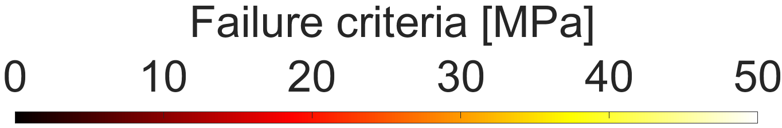
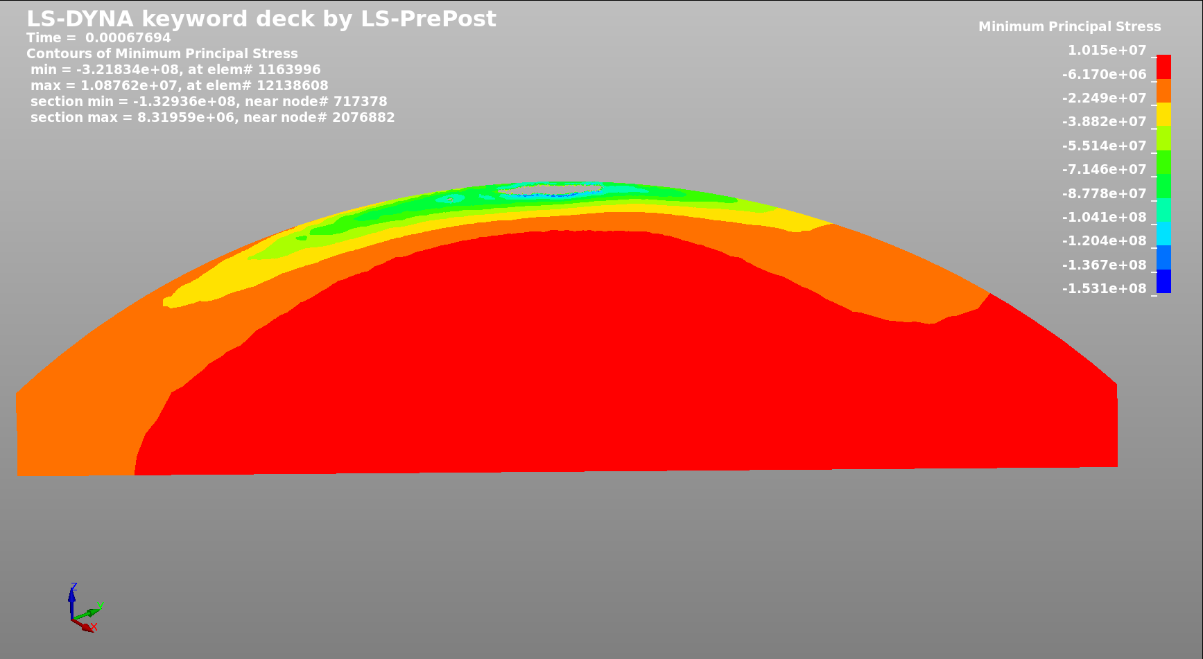
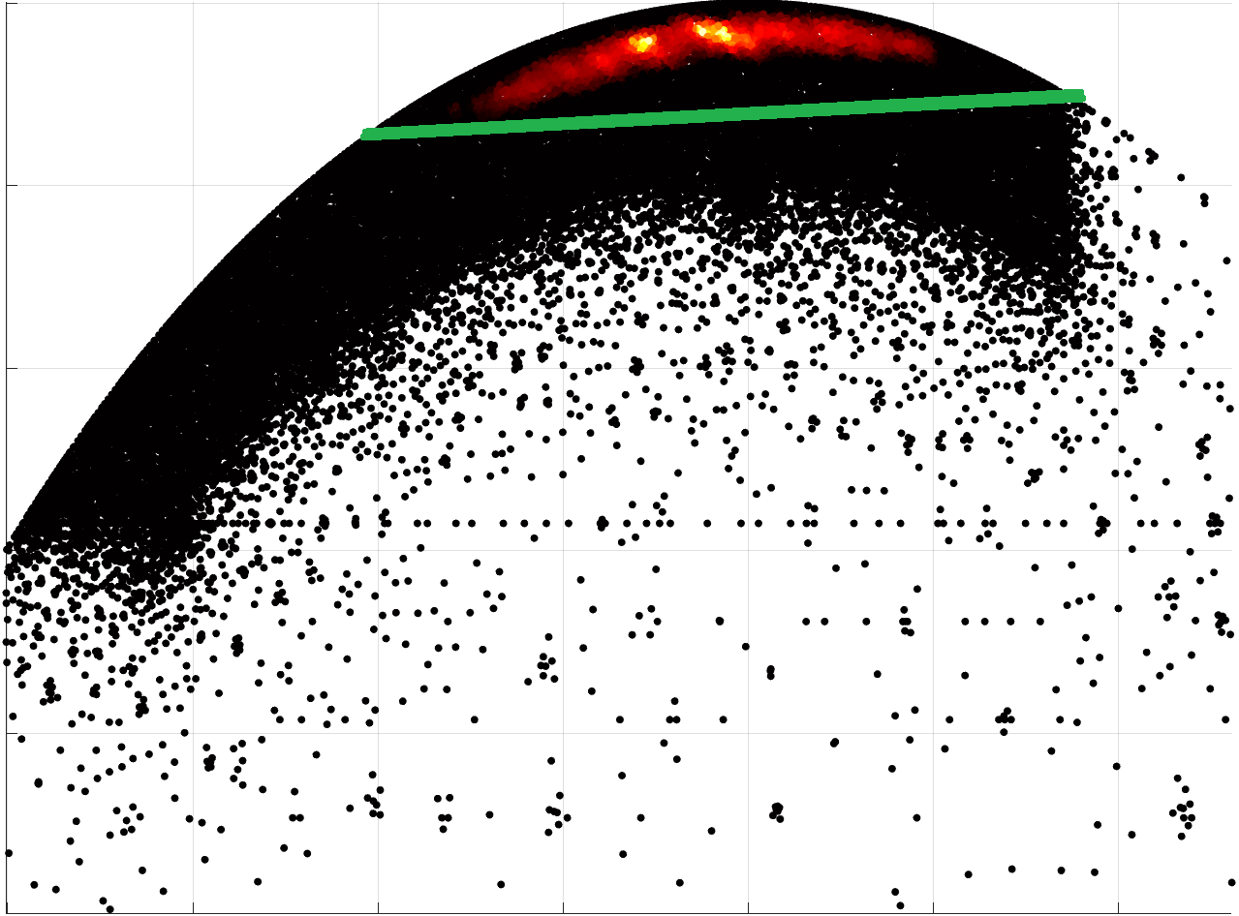
LS DYNA vs COMSOL
FEM simulation in COMSOL (NF Letter) and LS DYNA show agreement (up to failure) on:
Temperature distribution
Stress distribution
Failed region
Deleted elements
satisfying failure criteria

Slide 18
Modelling of thermal response of W PFCs to REs
Geant4 – MEMENTO work flow

Slide 19
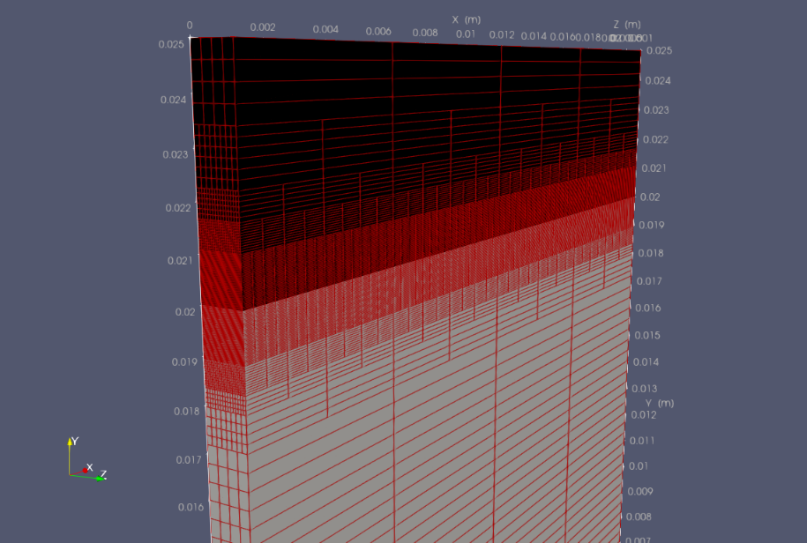
Computational efficiency of MEMENTO
RE-loading exhibits
ultra sharp and often non-monotonic profiles near the surface
followed up by more relaxed in depth-profile
Correspondingly, the thermal response exhibits
very high surface temperatures → intense vaporisation and mass loss
motion of the free surface
liquid-solid phase transition
Both surface damage & coolant / bolt integrity are of concern implying that
short temporal and spatial scales must be well resolved
long time scales must also be simulated
Free surface
MEMENTO ^{[1]} is based on the AMReX^{[2,3]} framework enabling:
  Adaptive meshing
  Sub-cycling in time, for finer time integration on finer levels
  Parallelization (OpenMP, for now)
  Non-uniform time stepping to get response on long time-scales, e.g. maximum temperature at an active cooling interface
MEMENTO heat transfer solver is tailor made for such problems
[1] K. Paschalidis et al FED 206, 114603 (2024)
[2] https://amrex-codes.github.io/amrex/
[3] W. Zhang, et al., Journal of Open Source Software 4 (37) (2019)

Slide 20
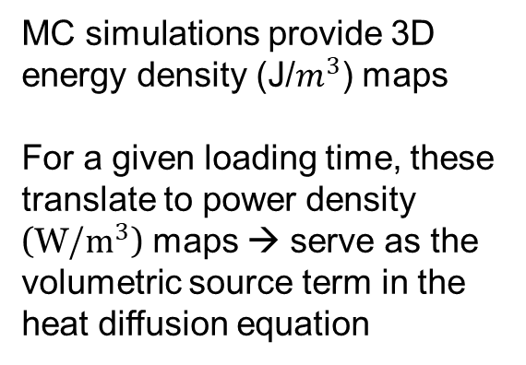
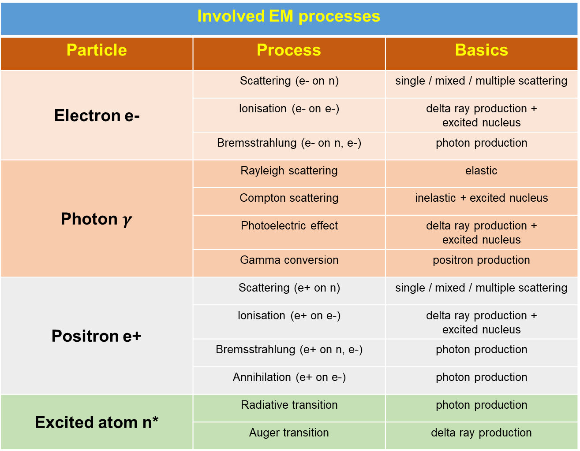
EM interactions of relevance to fusion scenarios
Involved EM processes
Particle | Process | Basics
Electron e- | Scattering (e- on n) | single / mixed / multiple scattering
 | Ionisation (e- on e-) | delta ray production + excited nucleus
 | Bremsstrahlung (e- on n, e-) | photon production
Photon $γ$ | Rayleigh scattering | elastic
 | Compton scattering | inelastic + excited nucleus
 | Photoelectric effect | delta ray production + excited nucleus
 | Gamma conversion | positron production
Positron e+ | Scattering (e+ on n) | single / mixed / multiple scattering
 | Ionisation (e+ on e-) | delta ray production + excited nucleus
 | Bremsstrahlung (e+ on n, e-) | photon production
 | Annihilation (e+ on e-) | photon production
Excited atom n* | Radiative transition | photon production
 | Auger transition | delta ray production
plus nuclear interactions, since photonuclear reactions produce neutrons (>7 MeV for W)
MC simulations provide 3D
energy density (J/$m^{3}$) maps
For a given loading time, these translate to power density (W/$m^{3}$) maps → serve as the volumetric source term in the heat diffusion equation

Slide 21
Monte Carlo simulations with Geant4
GEANT4 benchmarking activities for energy deposition in W
‘GEANT4 modelling of runaway electron transport into bulk tungsten’, T. Rizzi, P. Tolias, S. Ratynskaia, PSI 2024
Model benchmarking
Electron backscattering – comparison to experiments from bulk materials, including W
Calorimetry – comparison to experiments in bulk materials, also high Z
Electron transmission – comparison to experiments in thin foils, Gold (Z=79)
Inclusion of nuclear processes
Photo-neutron generation, elastic/inelastic neutron transport including transmutation - to check activation paths in controlled experiments (diagnostics) and ITER relevant activation of the material before the nuclear phase
Single vs multiple scattering
Realistic scenarios (RE energy and angular distributions, B field, non-uniform loading, large wetted areas) are not computationally feasible with single scattering & sufficient statistics
Multiple scattering is very fast to run but not accurate for lower energies
Need for a mixed scheme with appropriate cut-off angle (angle separating small from large angle scattering)

Slide 22
Magnetic field effects
Primary effect: re-deposition of backscattered electrons due to B-field outside the PFC
Secondary effect: changes in energy deposition profiles/gradients due to B field inside the PFC, often non-negligible difference in spite of the collision-dominated electron transport
Impact angle distribution for a given pitch angle due to gyrophase randomization
Non-uniform loading even for uniform RE impacts (with realistic PFC geometries)
T. Kunugi, Fusion Engineering & Design 23 329 (1993)

Slide 23
Geant4: high fidelity energy maps with advanced input and complex geometries

Slide 24
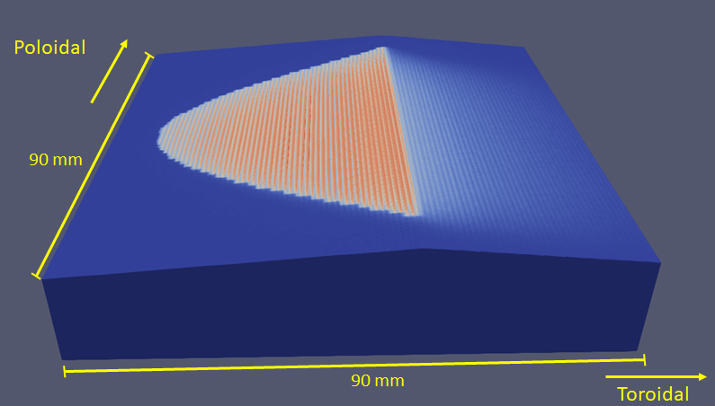
ITER runs with postulated RE distribution
NB: The FW design is not finalized
FW assumed to be made of tiles
Thickness – here scanned
Dimensions – here a representative 16 mm x 16 mm
R.A. Pitts et al, Plasma-wall interaction impact of the ITER re-baseline,
NME 42 101854 (2025)

Slide 25
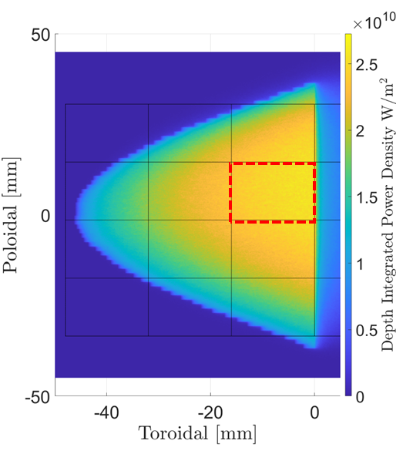
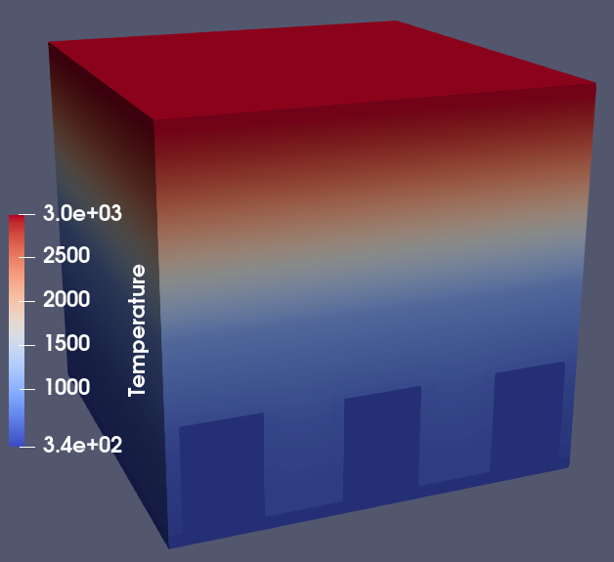
Energy deposition: two-stage approach
Single-point source wetting of the most loaded tile
(high statistics)
A 3D temperature response of a single tile on the MEMENTO simulation domain.
Note colors correspond to the temperature bar and do not indicate material layers.
The hyper-vapotron position and shape can be appreciated.
Depth-integrated power density for the “50 kJ over 1 ms” loading scenario. The apex corresponds to the 0 mm position toroidally. Thin black lines indicate the tiles, the most loaded tile is marked by the dashed red line.
Scaling: for “50 kJ” it is 6.7 kJ on the most loaded tile

Slide 26
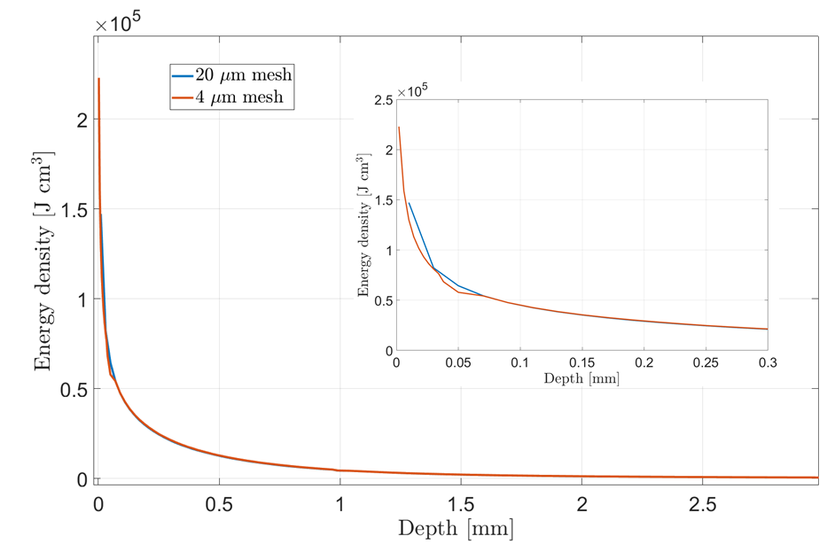
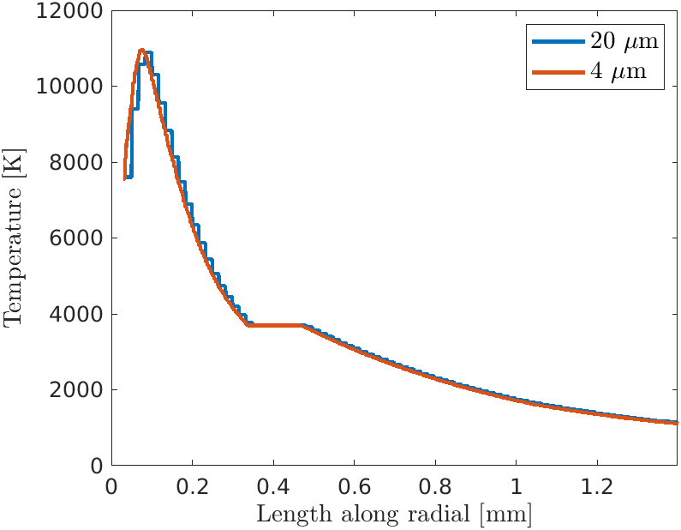
Results: surface (short time scale) & coolant (long time scale) damage
Example of the most loaded tile under ‘50 kJ over 1 ms’. Results for resolution of 4 μm and 20 μm.

Slide 27
2. DREAM input

Slide 28
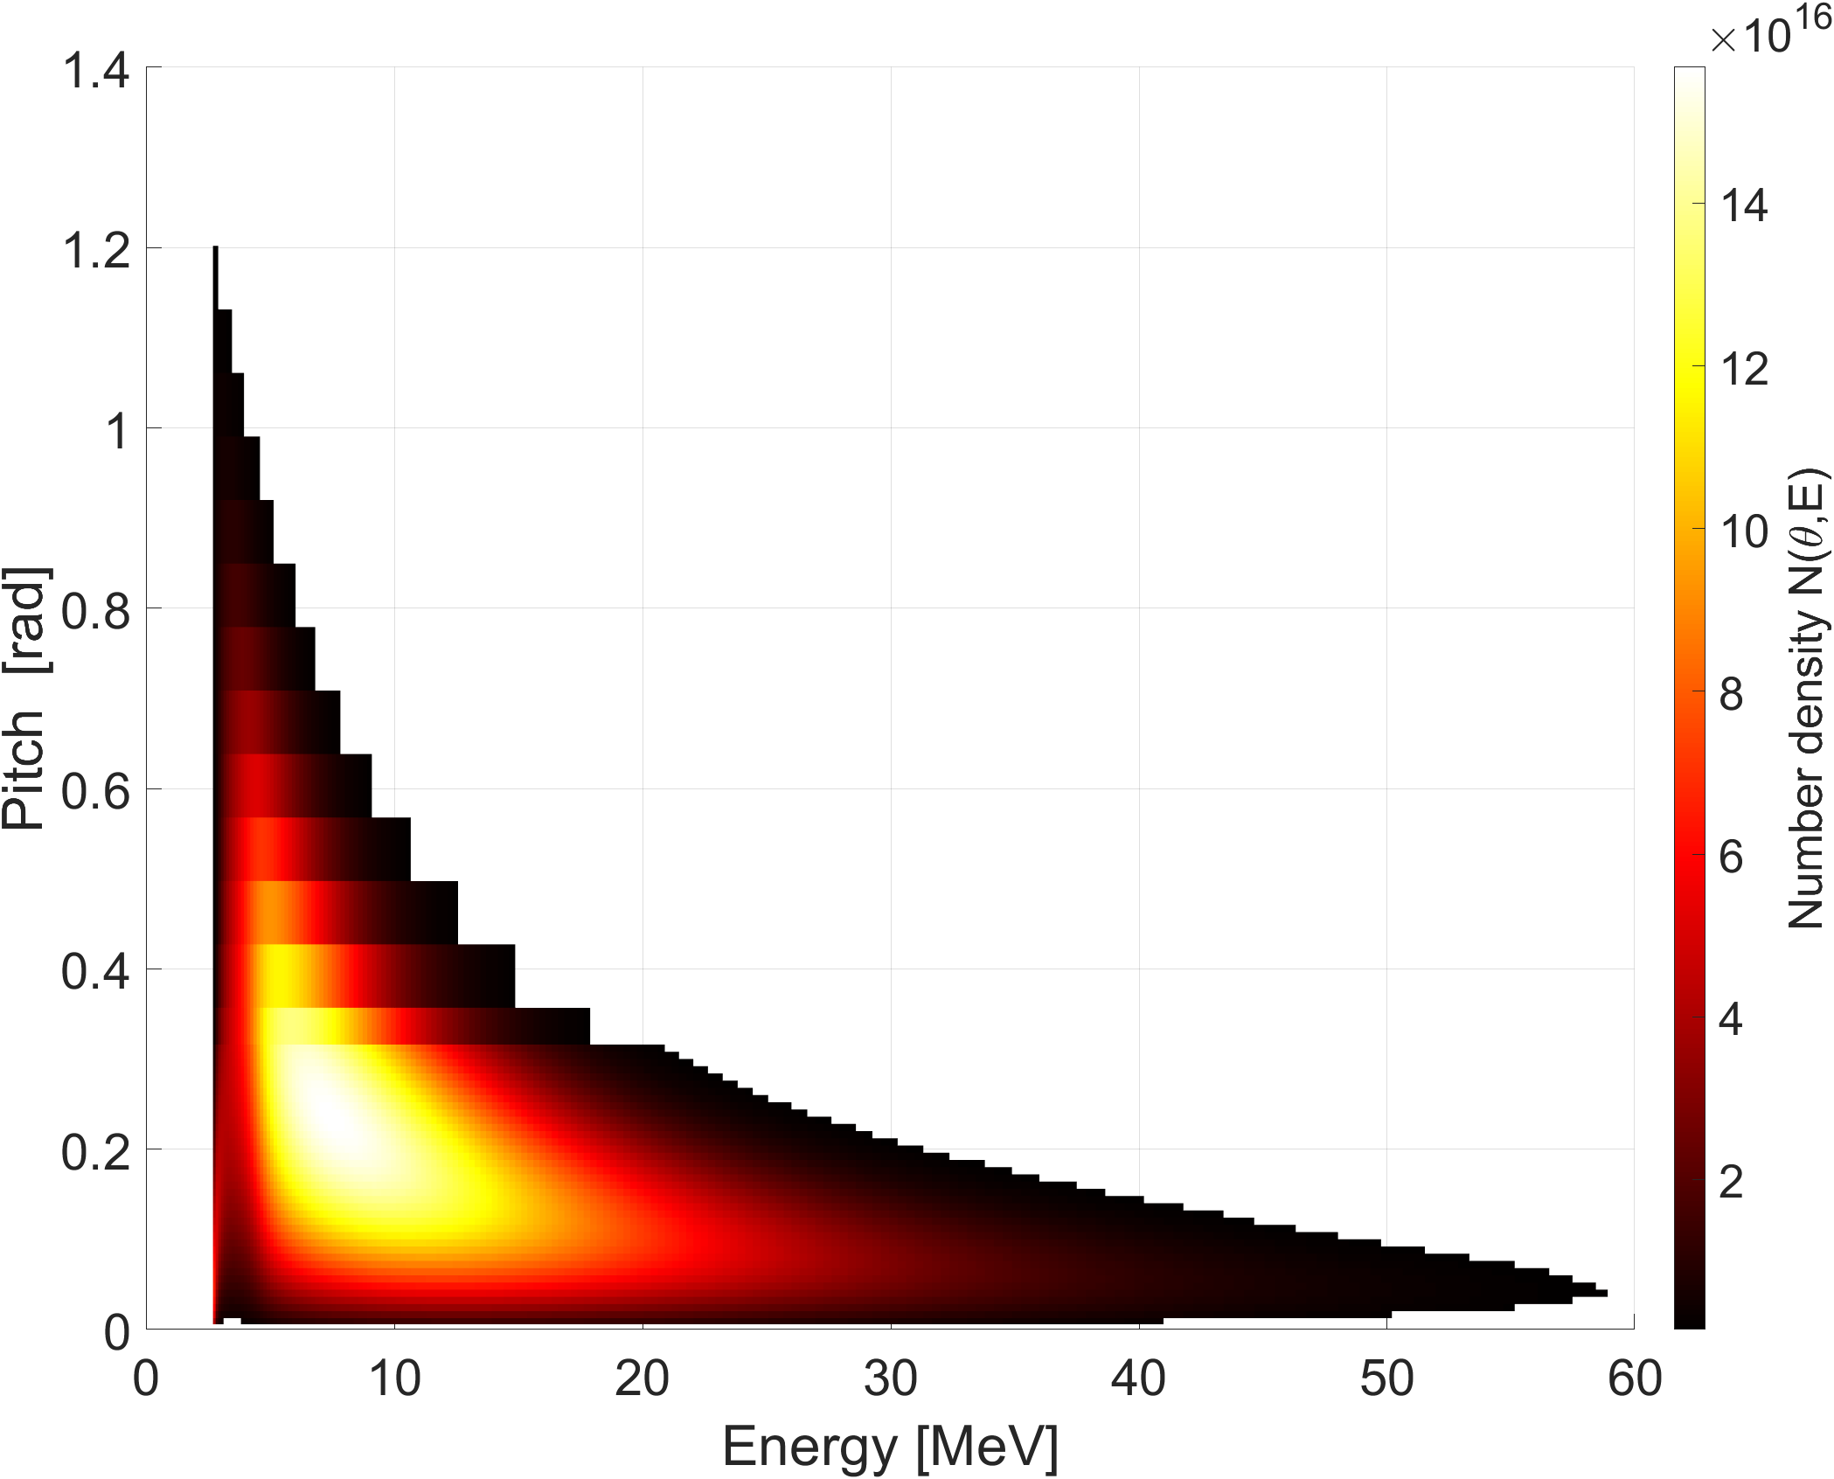
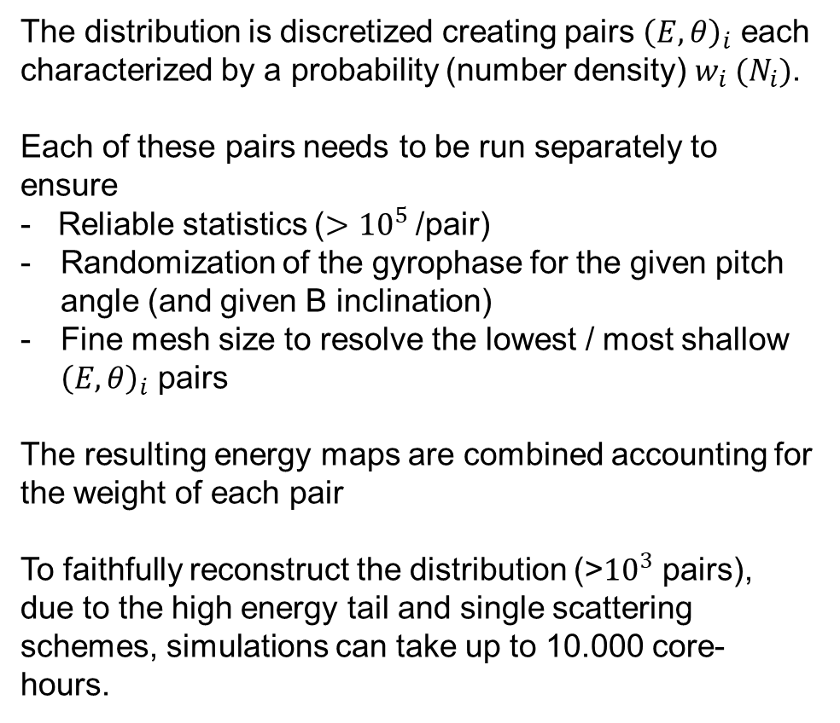
Geant4 reconstruction of DREAM distributions
DREAM provides RE distribution function in (energy,pitch) phase space
The distribution is discretized creating pairs ${\left(E,θ\right)}_{i}$ each characterized by a probability (number density) $w_{i} (N_{i})$.
Each of these pairs needs to be run separately to ensure
- Reliable statistics ($>{10}^{5}$/pair)
Randomization of the gyrophase for the given pitch angle (and given B inclination)
Fine mesh size to resolve the lowest / most shallow ${\left(E,θ\right)}_{i}$ pairs
The resulting energy maps are combined accounting for the weight of each pair
To faithfully reconstruct the distribution (>${10}^{3}$ pairs), due to the high energy tail and single scattering schemes, simulations can take up to 10.000 core-hours.

Slide 29
NB: Here the focus on
the most loaded panel
3. JOREK input (W runs)
 | Pitch | Energy | MHD case
D1 | 0.99 | Monoenerg. 26 MeV | Unmitigated
D2 | 0.99 | Monoenerg. 26 MeV | Mitigated
D3 | 0.99-1 | Avalanching-distribution (mean 2 MeV) | Unmitigated
D4 | exp(-10*pitch) | Avalanching-distribution (mean 2 MeV) | Unmitigated
V. Bandaru et al
Nucl. Fusion 64 076053 (2024)
H. Bergström et al
Plasma Phys. Control. Fusion 66 095001 (2024)

Slide 30
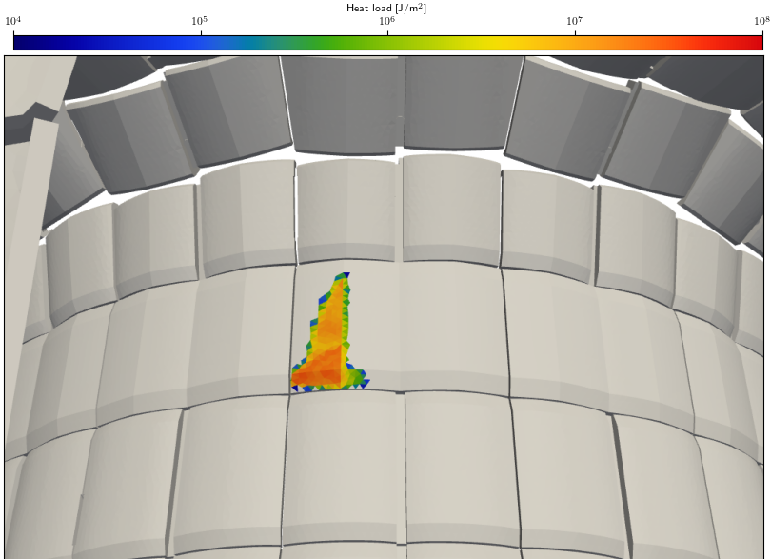
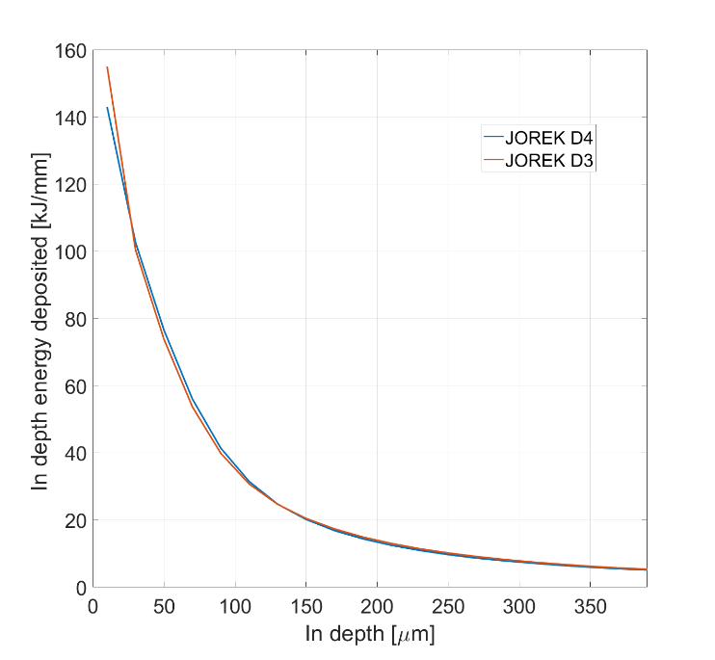
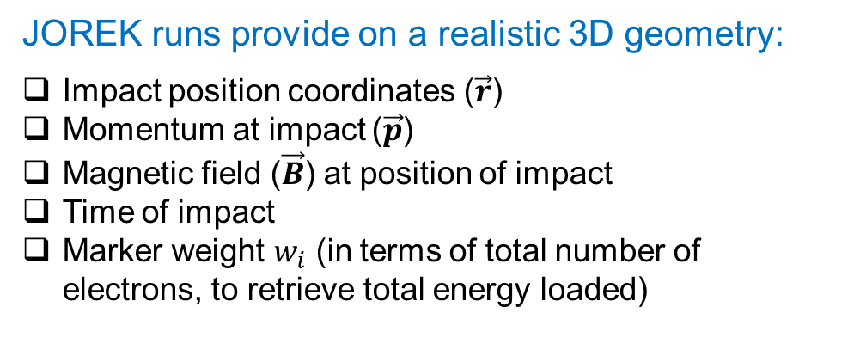
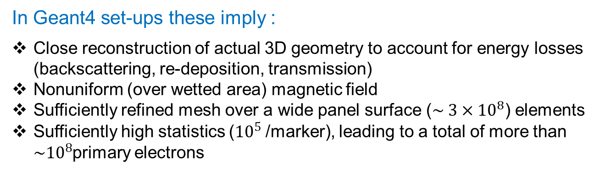
Geant4 reconstruction of RE-loading with JOREK inputs
JOREK runs provide on a realistic 3D geometry:
Impact position coordinates ($\vec{r}$)
Momentum at impact ($\vec{p}$)
Magnetic field ($\vec{B}$) at position of impact
Time of impact
Marker weight $w_{i}$ (in terms of total number of electrons, to retrieve total energy loaded)
~1 m
In Geant4 set-ups these imply :
Close reconstruction of actual 3D geometry to account for energy losses (backscattering, re-deposition, transmission)
Nonuniform (over wetted area) magnetic field
Sufficiently refined mesh over a wide panel surface ($\sim 3×{10}^{8}$) elements
Sufficiently high statistics (${10}^{5}$/marker), leading to a total of more than ${\sim 10}^{8}$primary electrons

Slide 31
Summary I
Geant4 set-ups developed to accommodate specifics of RE-impacts in fusion scenarios
Selection of accurate physics list benchmarked against experimental data on high Z materials
High resolution required for grazing angles through adaptive meshing
Reliable statistics (aiming to MC errors below 1% )
Complex PFC and B field geometries
Two stage approach to accommodate large wetted areas & the need for high statistics
Flexibility for wide RE input repertoire (empirical distributions, JOREK, DREAM, KORC)
Geant4-MEMENTO work-flow for W PFCs
Geant4 geometry and mesh is adjusted to MEMENTO’s domain and adaptive mesh
Often iterative runs to find resolution limit given the smoothing effect of thermal diffusion
INPUT
OUTPUT
RE impacts through DREAM, JOREK, KORC or any other formulations
PFC and B field geometry
PFC structure (layers, pipes etc)
Geant4
MEMENTO
(heat solver)
In-depth T profiles
Vaporization losses
Melt depths
Coolant interface T
OUTPUT
Backscattered products
PFC activation

Slide 32

Summary II
LS-DYNA modelling of brittle PFCs
Already beyond linear thermo-elastic responce of NF Letter 2025
Element deletion simulations are being mesh-optimized to
enable quantitative comparison
Outlook
Brittle PFCs
SPH and other methods for debris
speeds and sizes
W PFCs
Multi-phase equation of state (EoS) is critical.
Advanced strength model (including viscoplastic effects) is critical, e.g. Johnson-Cook model featuring material coefficients based on experiments.
We consider exploiting the results of the PWIE–funded activity of Milano CNR laboratory work on high velocity impacts [Tolias et al, FED 195, 113938 (2023); De Angeli, NME 41, 101735 (2024)] to fine tune the EoS and strength models for W.
WPTE first controlled W experiments on AUG and WEST are on the way!

