Slide 1
SP-F Update and Plans & Discussion
WP PWIE Meeting 2025
Andrei Goriaev
LPP-ERM/KMS

Slide 2
Outline
SP F / Wall conditioning & Boronization
SP F1:
Coordination of activities related to wall conditioning and boronisation with strong links to activities of machines in TE/W7-X
Recapitulation of existing knowledge
Benchmark in TE/W7-X experiments: manipulator / full device
SP F2:
(In-situ) laboratory experiments with B layers (PSI-2, MAGNUM, GYM) focus on B erosion, deposition, retention within capabilities
Generic wall conditioning studies
SP F3:
Activities at TOMAS with test of ITER conditions and needs: ECWC, ICWC, GDC
Cleaning activities of B-layers from lab or tokamaks in TOMAS
Application of in-situ LID-QMS or LIBS in those systems

Slide 3
SP F1: Coordination of wall conditioning and boronisation activities
As for 2024
Deliverable Owner | Beneficiary | PM | Deliverable (Team)
A. Gallo | CEA | 3 | D001
T. Dittmar | FZJ | 3 | D002
V. Rode | MPG | 3 | D003
Total |  | 9
Tasks to be performed:
Review of boronization procedures, experimental settings, and efficiency of boronization in toroidal devices.
Define new experiments in collaboration with TE and W7X and assessment of improved diagnostic access.
As for 2025
W7-X -> ?
CEA -> only WP TE contribution
Other devices -> ?

Slide 4
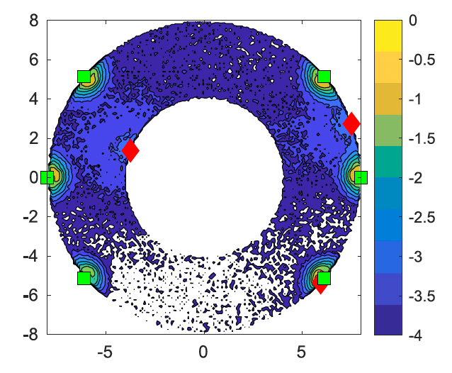
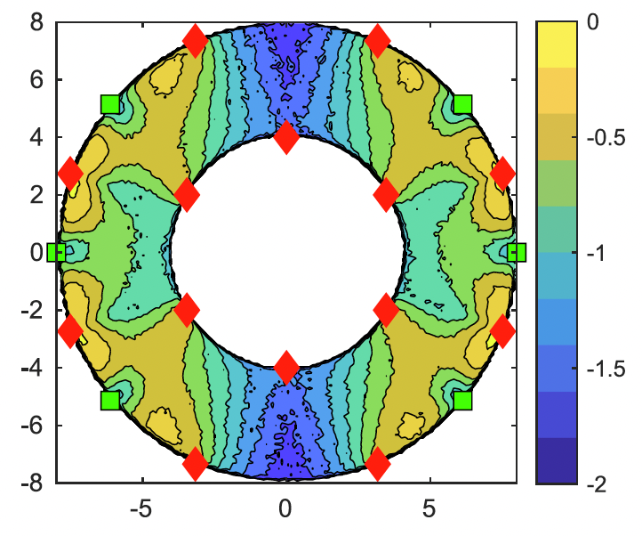
SP F1: Recapitulation of existing knowledge
Knowledge structuring
equipment for boronization
Pumps, diborane injectors, sensors, decomposers, GD anodes, ...
parameters of boronization procedures
GD pressure and current, injection, duration, gas composition, ...
diagnostics (in-situ & post-mortem)
Quartz Micro Balance (QMB), Residual Gas Analyzer (RGA), ...
boronization frequencies and need for boronization
time of boron layer deterioration, special needs (plasma start-up, ...)
experimental data and results of boronization
Effect on the consequent plasma performance
dedicated PWIE studies (-> SP F2: Benchmark in TE/W7-X experiments: manipulator / full device)
post-mortem PFC analysis, sample exposures, etc.
ITER modeling of spatial distribution of diborane reactions with respect to GD anode position (green) and injection points (red) in H₂ GD. T. Wauters et al., NME 42, 2025).

Slide 5
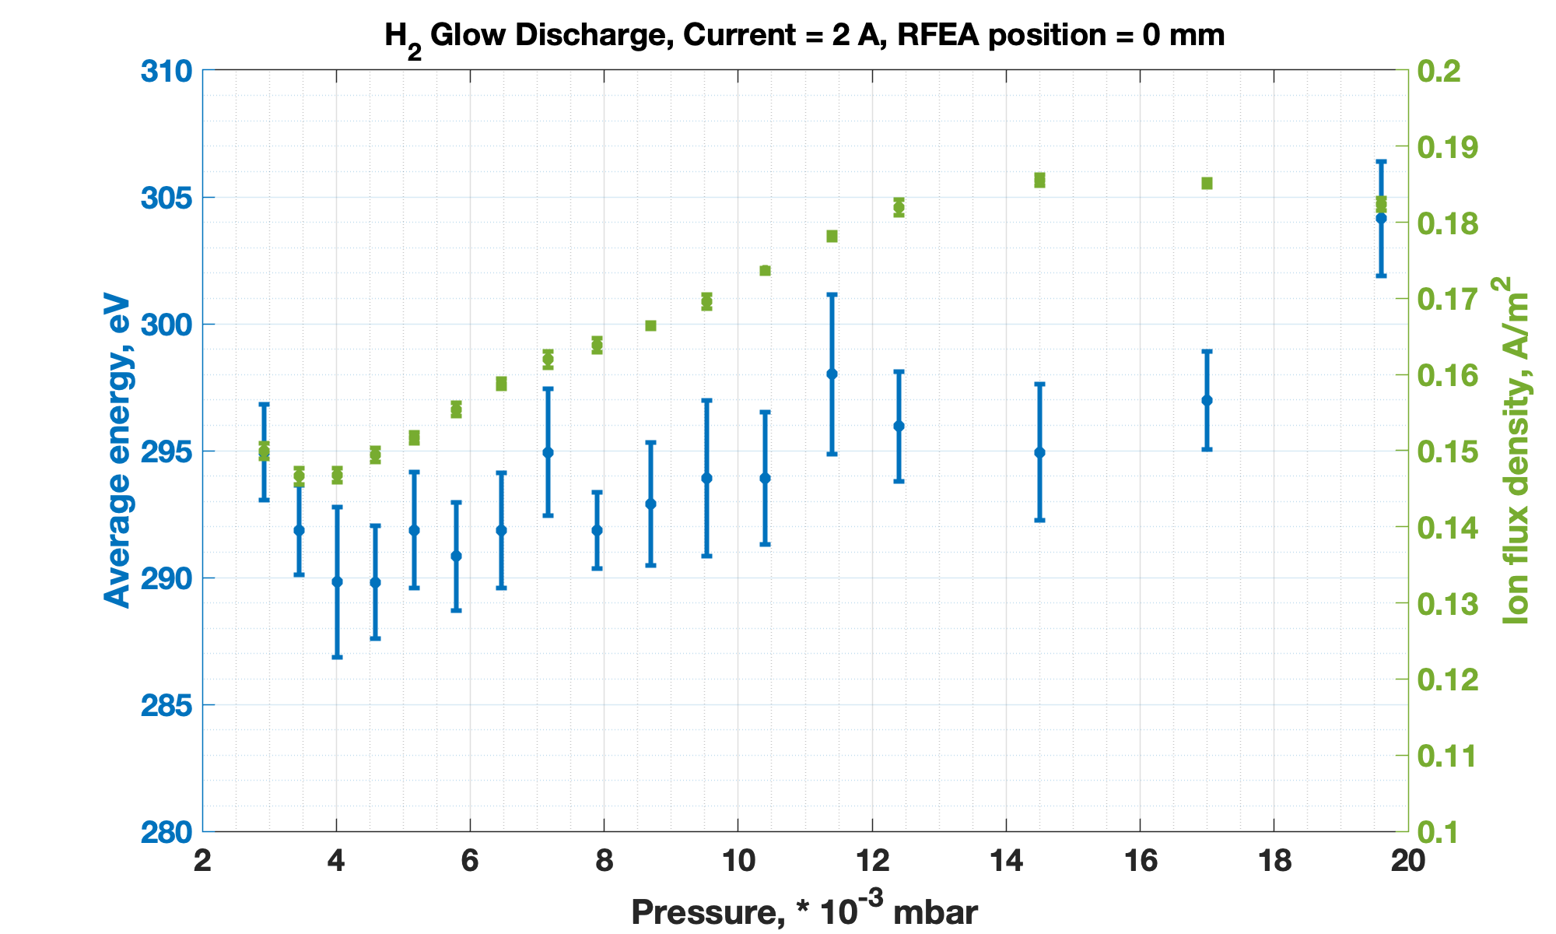
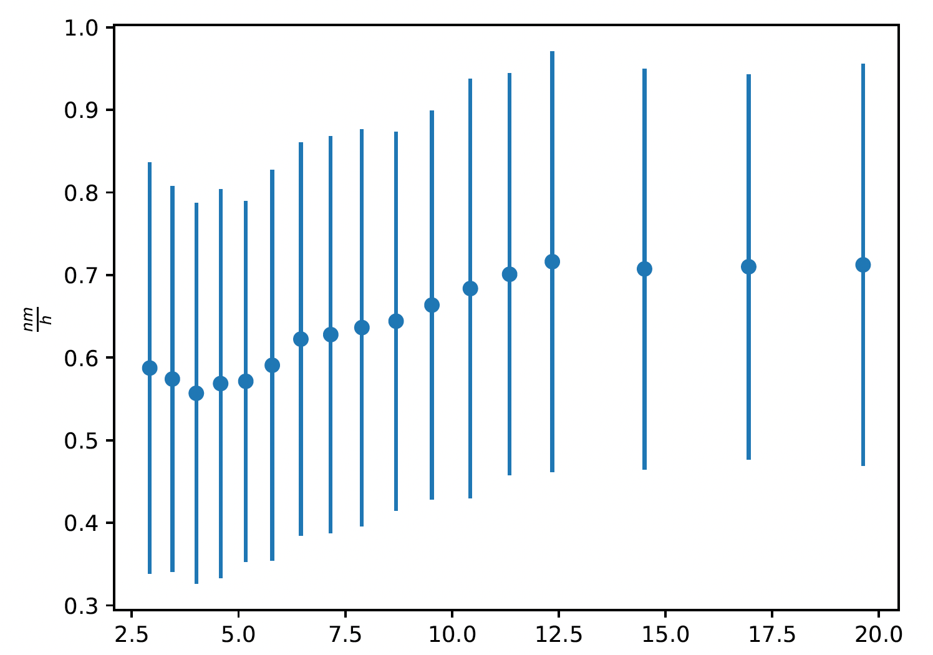
SP F2: (In-situ) laboratory experiments with B layers
A lot of overlapping activities with SP B -> strong coordination required!
Main focus on
Reference boron coated sample production and analysis for wall conditioning needs
Studies of fuel removal and retention in reference samples by laboratory wall conditioning – relevant plasmas
Studies of erosion and redeposition of mixed boron layers from reference samples by laboratory wall conditioning – relevant plasmas
Pressure, *10⁻³ mbar
Characterization of H₂-GDC and corresponding erosion rates estimation in TOMAS

Slide 6
SP F2: (In-situ) laboratory experiments with B layers
What we need to define is
Laboratory investigations on hydrogen/deuterium retention behavior in boron films
CEA, MPG, VR, CIEMAT, ...
Boron layer production set-ups/tools
Magnetron sputtering, plasma-enhanced chemical vapor deposition, Pulsed Laser Deposition
Available diagnostics
XPS, TDS, NRA, ...
Responsible people
Human resources involved

Slide 7
SP F2: (In-situ) laboratory experiments with B layers
Example of sample preparation and characterization in FZJ
Manufacturing, polishing, annealing
Boron coating by physical vapor deposition (PVD) using RF magnetron sputter device
Deuterium insertion close to substrate during deposition process
Sample pre-characterization and post-mortem analysis
Boron layer characterization (crystal phase, microstructure, thickness and elemental composition)
-> XRD, FIB/SEM, EDX
Deuterium content -> NRA, TDS
IAP experiments. Boron plasma coatings and boronization studies
Speakers: Dr Corneliu Porosnicu (IAP), Sorin Vizireanu (IAP)
In-situ ion beam analysis of deuterium retention in W-B layers: effects of composition and incorporation pathway
Speaker: Eduardo Pitthan Filho (VR)

Slide 8
SP F2: Generic wall conditioning studies
We need to define what generic wall conditioning is!
Standard wall conditioning methods
Initial wall conditioning (after venting)
Baking
Glow Discharge Cleaning
Regular wall conditioning (during plasma operation phase)
Glow Discharge Cleaning
Electron Cyclotron Wall Conditioning
Ion Cyclotron Wall Conditioning
Wall coating (Boronization)
Real-time wall conditioning
Boron dropper
Operation with elevated wall temperature

Slide 9
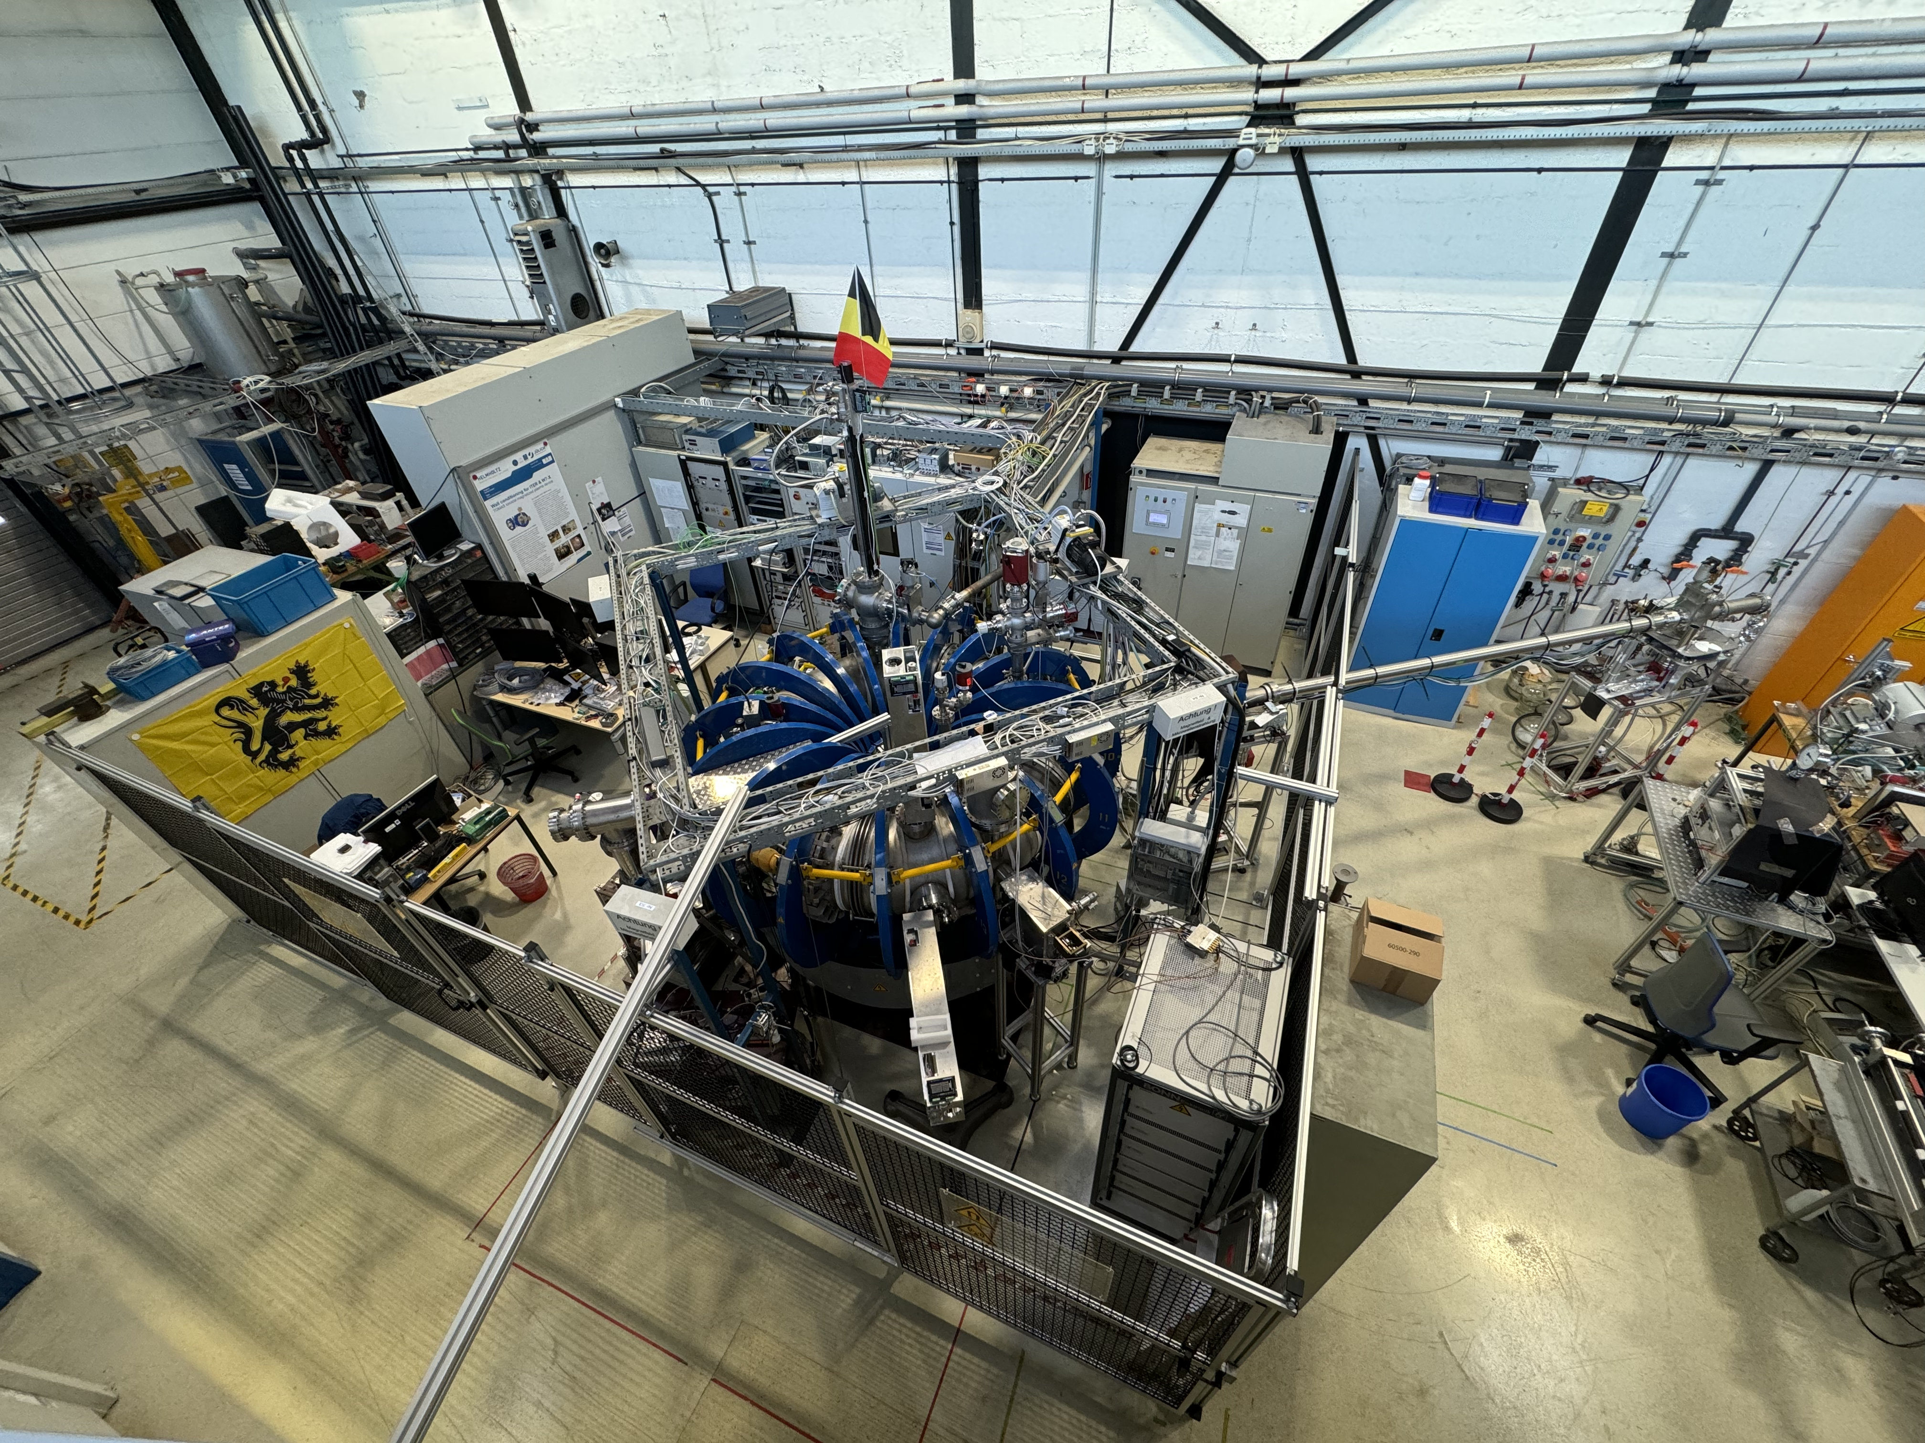
SP F3: TOMAS
Deliverable Owner | Beneficiary | PM | Deliverable (Team)
S. Möller | FZJ | 6 | D001
Y. Kovtun | KIPT | 6 | D002
A. Goriaev | LPP-ERM-KMS | 16 | D003
P. Petersson | VR | 4 | D004
Total |  | 32
Tasks to be performed:
Optimize and characterize wall conditions cleaning schemes in TOMAS and beyond
Laser-based analysis system
Assess efficiency of cleaning of boron-containing samples

Slide 10
SP F3: Activities at TOMAS with test of ITER conditions and needs
Current plasma-based wall conditioning studies
Glow Discharge Cleaning (GDC)
Characterization of plasma parameters, input for GD modelling, input for sample exposure experiments
Electron Cyclotron Wall Conditioning (ECWC)
Studies of wave absorption and propagation for model (e.g. TOMATOR-1D) validation
Ion Cyclotron Wall Conditioning (ICWC)
Characterization of plasma parameters, charge-exchange neutrals generation
Mixed ECWC+ICWC, GDC + EC
Behavior of plasma parameters, optimization of existing schemes
Diagnostics for wall conditioning studies
Residual Field Energy Analyzer (RFEA)
Time-of-Flight Neutral Particle Analyzer (ToF NPA)
LID QMS development
A highlight talk of TOMAS results and plans
Speaker: Luis Daniel Lopez Rodriguez (LPP-ERM-KMS)

Slide 11
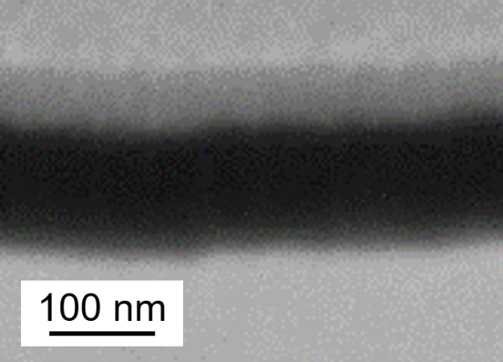
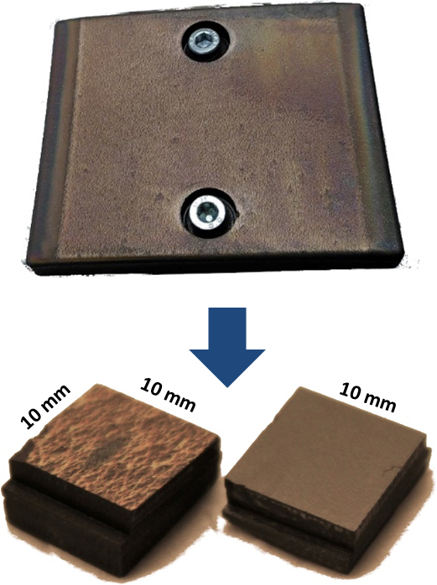
SP F3: Cleaning activities of B-layers from lab or tokamaks in TOMAS
ITER-relevant activities
Erosion and deuterium removal from D-dopped boron layers on tungsten substrates by GDC and ICWC at elevated wall temperatures
Contribution to W7-X boronization studies
Studies of boron layer erosion from graphite and tungsten substrates by GDC and ICWC
Near-surface composition of TEXTOR samples
Impurity and fuel removal from mixed C-B layers on Graphite substrates
SEM (FIB)
Pt
B
W
Boron-coated W samples for ITER-relevant studies
TEXTOR co-deposits

