Slide 1

SP F - IAP experiments. Boron plasma coatings and boronization studies.
Plama coatings – plasma parameters vs. film properties
C. Porosnicu, P. Dinca, B. Butoi, O. G. Pompilian, C. Staicu, B. Solomonea, C. P. Lungu
Approaches for surface coating with Boron by PECVD at low and high deposition rates using diborane as precursor
S. Vizireanu, G. Dinescu, D. Stoica, T. Acsente, V. Satulu, G. Dinescu, F. Dumitrache, Marius Dumitru, G. Morjan

Slide 2
Plama coatings – plasma parameters vs. film properties
C. Porosnicu, P. Dinca, B. Butoi, O. G. Pompilian, C. Staicu, B. Solomonea, C. P. Lungu
IAP-Romania

Slide 3
Outline
Boron coatings capabilities
Coating setups: TVA, HiPIMS, RF MS
Results form the B layers production task in 2025 under SBP4
Plasma characterisation - ion energy measurements
Prospects for studying B layers under SPF. Proposal of an experimental plan

Slide 4
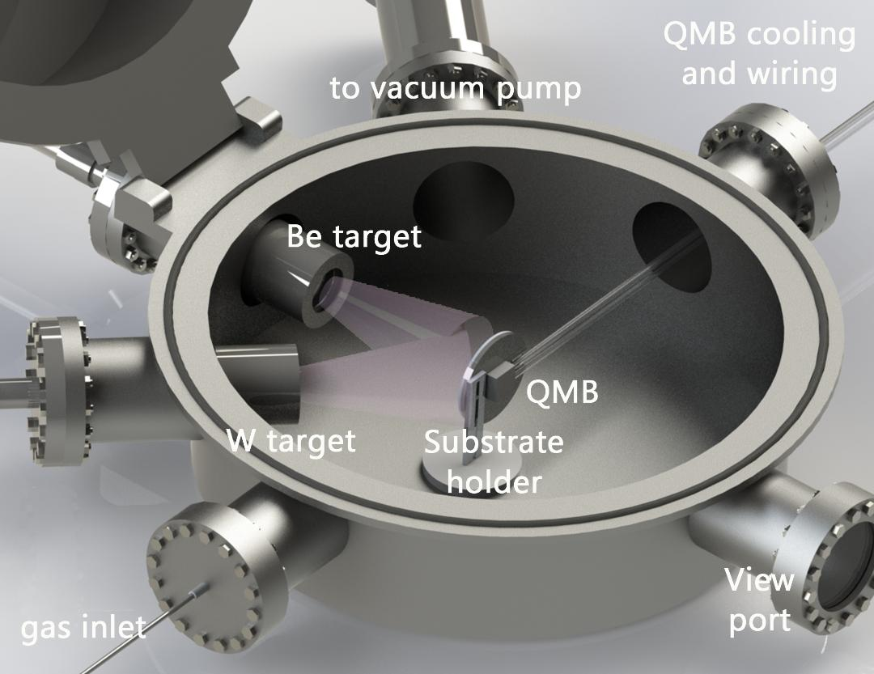
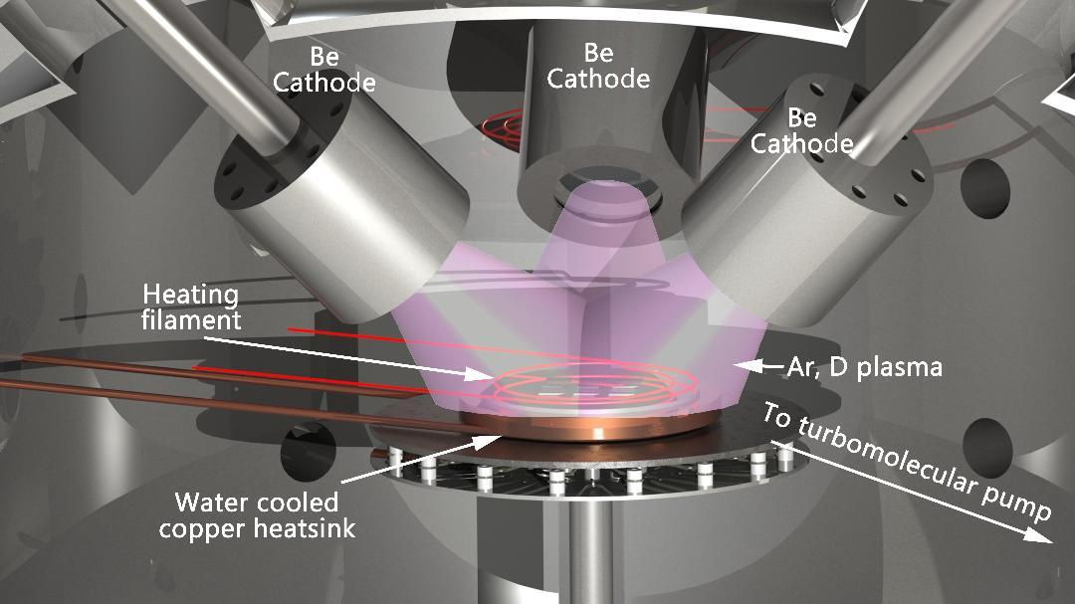
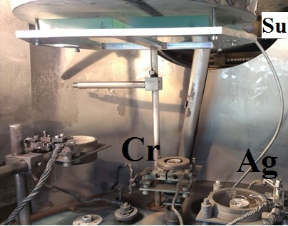
From Be/D to B/D coating process – setups available
All the setups and experience used for Be was redirected to B
Schematic description of the coating system used for B-D (Ne, N, He) layer deposition
Deposition system used for obtaining B (-W)-D/H/etc. layers
TVA Deposition system used for obtaining B (/W). layers
2024 was dedicated in setup and coating recipe development and plasma charactherisation methods

Slide 5
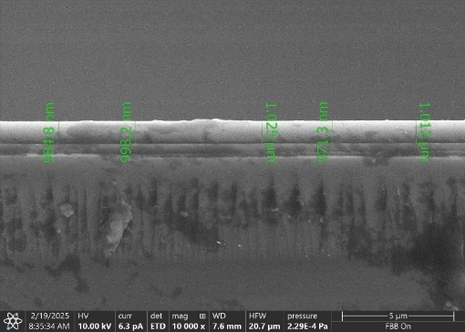
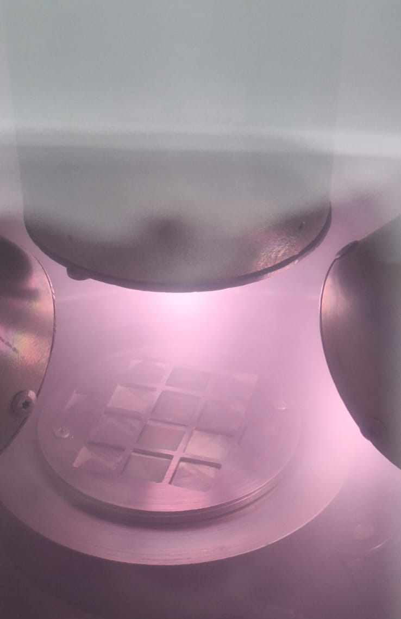
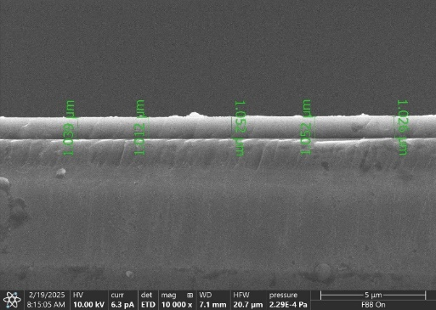
Results form the B layers production taskin 2025 under SBP4
Pre-deposition. Calibration
Measurements
Coating parameters
4x Si substrates
2 RF sources opperated at 100W each
Working pressure: 1x10⁻²mbar
Ar flow= 20sccm
D₂ flow= 20 sccm
SEM cross-section
TDS
In situ photo of the deposition
TDS results (D concentration and quantity)
Cross-section-SEM results

Slide 6
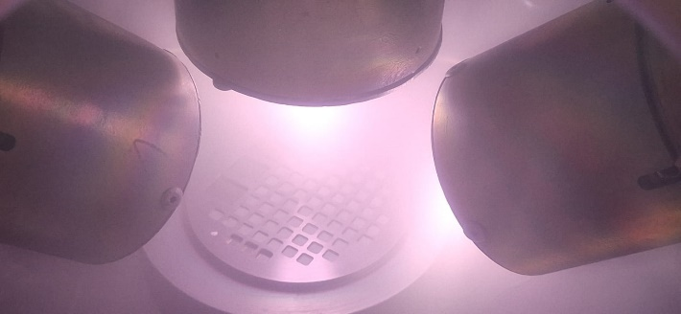
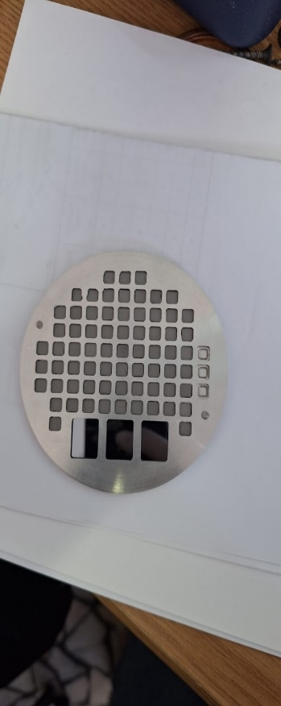
Results form the B layers production taskin 2025 under SBP4
Boron+D2(10%) 5μm
Thermal Treatment- 50ºC- 500ºC_Ramp 5ºC/min
TDS measurement during Thermal Treatment
Preparation of 5x5 mm² W samples coated with B+D₂(10%)
Subject to thermal treatment post-coating
Deuterium quantity as a function of the thermal treatment
60 tungsten substrates 5x5 mm
2 RF sources opperated at 100W each
Working pressure: 1x10⁻²mbar
Ar flow= 20sccm
D₂ flow= 20 sccm
Temperature (ºC) | D released (at/cm²⁾ | D released during the TT (%)
50 | 7.45E+14 | 0.01
100 | 8.25E+15 | 0.08
150 | 2.21E+16 | 0.22
200 | 2.98E+16 | 0.29
250 | 2.82E+17 | 2.76
300 | 1.06E+18 | 10.39
350 | 2.22E+18 | 21.76
400 | 3.24E+18 | 31.76
450 | 4.95E+18 | 48.53
500 | 6.45E+18 | 63.24
1050 | 1.02E+19 | 100.00
TDS result on B+D2_1050ºC
Sample holder
In situ photo of the deposition

Slide 7
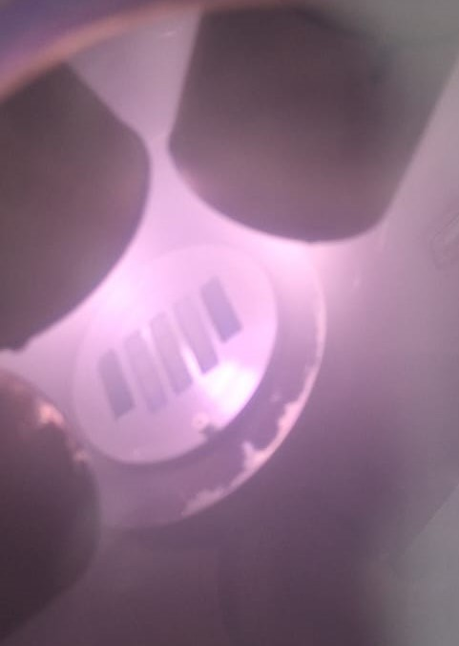
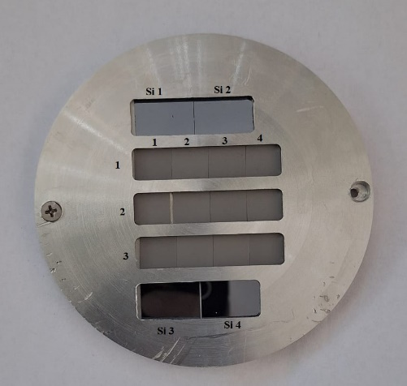
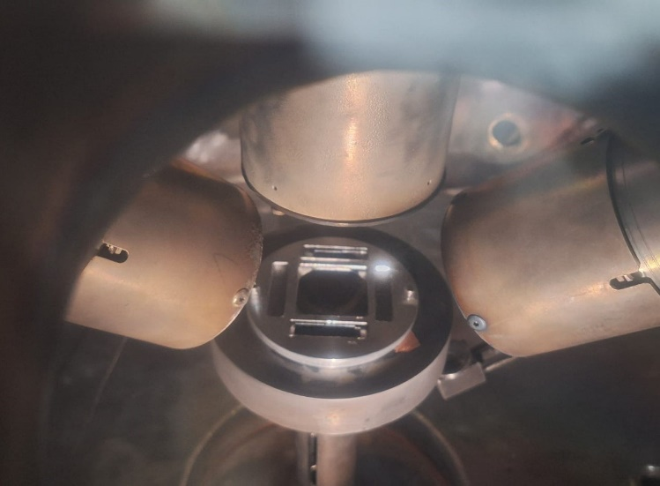
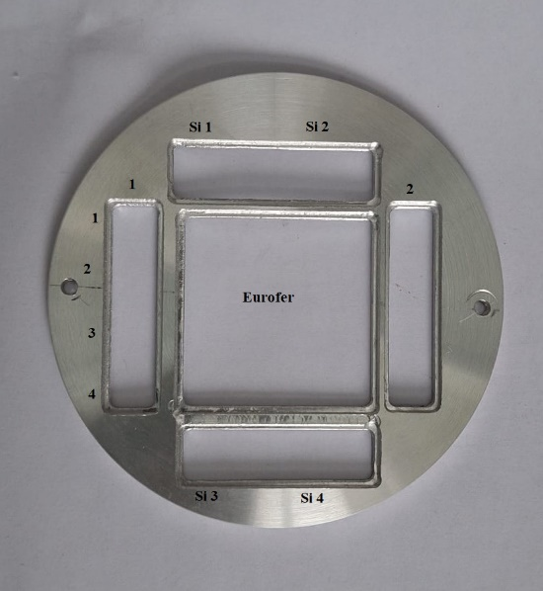
Results form the B layers production taskin 2025 under SBP4
Boron deposition (100nm)
Boron deposition (5μm) with and witout D
12 tungsten substrates 10x10 mm
2 RF sources opperated at 100W each
Working pressure: 1x10⁻²mbar
Ar flow= 20sccm
D₂ flow= 20 sccm
8 tungsten substrates
Eurofer φ 40 mm
2 RF sources opperated at 100W each
Working pressure: 1x10⁻²mbar
Ar flow= 20sccm
D₂ flow= 20 sccm
In situ photo of the deposition
Sample holder
In situ photo of the deposition
Sample holder
All samples were stable after the deposition (kept in vacuum).
Analisys (TDS, XRD,SEM, etc.) will be performed in April at IAP.
Samples to be sent this week (24-28 March) to the laboratories - sealed bags in vacuum, according to the matrix.

Slide 8
XPS on tungsten-boride formation
Request for tungsten boride layers from Penn State University (A. Marin) under a PSU - WEST collaboration.
Samples coated by TVA – task performed.
TVA parameters variation- W/B coatings with and without boride formation
Elemental relative concentrations (at. %)
Si2-6_340 nm | B1s | C1s | O1s | W4f | B/W
0.0 min sputtering | 15.1 | 45.3 | 32.9 | 6.7 | 2.3
0.5 min sputtering | 45.9 | - | 38.8 | 15.3 | 3.0
1.0 min sputtering | 58.3 | - | 15.8 | 25.9 | 2.3
5.0 min sputtering | 63.0 | - | 13.5 | 23.5 | 2.7
10.0 min sputtering | 63.3 | - | 13.1 | 23.6 | 2.7
C. Porosnicu, S. Vizireanu | PWIE meeting | Prague | 24-27 March 2025 | Page 8

Slide 9
Plasma characterisation - Ion energy measurements
RF plasma, P= 100W
BIAS voltage influence – several pressures

Slide 10
Plasma characterisation - Ion energy measurements
RF plasma, P= 1e-02 mbar
BIAS voltage influence – several RF Powers

Slide 11
Plasma characterisation - Ion energy measurements
RF plasma, Ion energy overview
BIAS, pressure and D/Ar ratio

Slide 12
Plasma characterisation - Ion energy measurements
RF plasma, Ion energy overview
RF power, pressure and D/Ar ratio

Slide 13
Plasma characterisation - Ion energy measurements
HiPIMS MP
B+Ar+D, Ar/D: 1/1
Frequency
Voltage
Pulse duration

Slide 14
Plasma characterisation - Ion energy measurements
B+Ar+D, Ar/D: 1/1,
Bipolar HiPIMS,
Positive pulse duration varried
Positive pulse voltage varried

Slide 15
Prospects for studying B layers under SPF
Proposal of an experimental plan - Example and ideas:
  Different aproach than under SPB: Focus on plasma parameters instead of coating properties.
  For each set of parameters, very well defined plasma characterization
  Ionisation degree (Langmuir probe), Ion energy (IEDF), species identification (MS, OES), etc.
  Sistematic study
  Fixed plasma parameters – well characterized plasma => what will we obtain??
  stability, morphology, composition, adhesion, hardness, fuel retention
  Work plan has to be established by SP Leaders under SPB, SPC, SP D, SPX and SPF since the need of a “database of artificial B layers for physics studies: stability, fuel content, and release”
Parameters to be varied:
RF-MS parameters (Input power) |  | Pressure (1e-03 – 1e-01 mbar)
HiPIMS MP and BP plasma parameters (Pulse duration and frequency, voltage for negative and positive pulse) |  | Acceleration voltage (0 to-200V for MS;-700V for TVA),
TVA parameters (voltage and current) |  | D/Ar ratio (1/20 – 1/1)

Slide 16
Approaches for surface coating with Boron by PECVD at low and high deposition rates using diborane as precursor
S. Vizireanu, D. Stoica, T. Acsente, V. Satulu, G. Dinescu, F. Dumitrache, Marius Dumitru, G. Morjan
IAP-Romania

Slide 17
Outline
Experimental capabilities at INFLPR for plasma and laser CVD in diborane;
    PECVD configurations used for boron deposition;
    Laser pyrolysis configuration used for preparation of B based nanoparticles;
Experimental parameters and sample labelling;
Results on Glow discharge (GD-) samples: Surface morphology;
Results on Plasma jet (J-) samples: Surface morphology;
Time stability of boron samples on Si substrates;
Boron samples deposited on W substrates;
Boron samples deposited for various temperatures;
Boron samples composition- XPS investigation;
Conclusions and future plans.

Slide 18
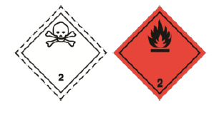
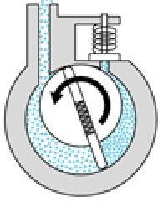
Experimental capability at INFLPR
for a boronization in diborane
Advantages: PECVD boron samples can be similar to those used in tokamak walls after boronization
Drawback: difficulties in diborane manipulation
Caution!!!
High toxicity: needs special health and safety equipment.
- TLV (Threshold Limit Values) =0.1 ppm;
immediately dangerous at 40 ppm.
Details for handling diborane B2H6
Flammable gas: auto ignition in air at temperature ~ 40°C.
Special procedures must be followed to prevent hazard.
We used a mixture of B₂H₆/H₂ at ratio 1/10 in vacuum;
Non-used B₂H₆ is burning before exhausting;
Dedicated mass-flow controllers;
Diborane detection sensors.
More safety measure must be implemented
Ar/B₂H₆ in
Discharge chamber
Residual gases exhausts
One essential component of the deposition system is the container in which we burn the flammable gas. At INFLPR this container was used before for burning silane SiH₄ and lately for B₂H₆ for boron doping by laser pyrolysis [1].
Air inlet
Vacuum pumps exhausts
Container for
diborane burning
[1]. Balas M.; Dumitrache F. et al, Nanomaterials 2018, 8, 495 https://doi.org/10.3390/nano8070495

Slide 19

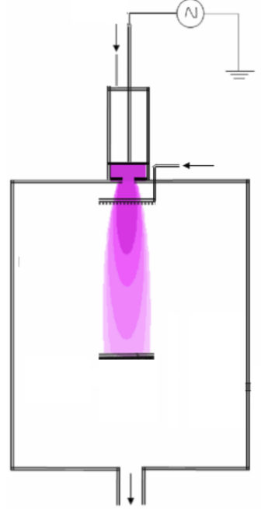
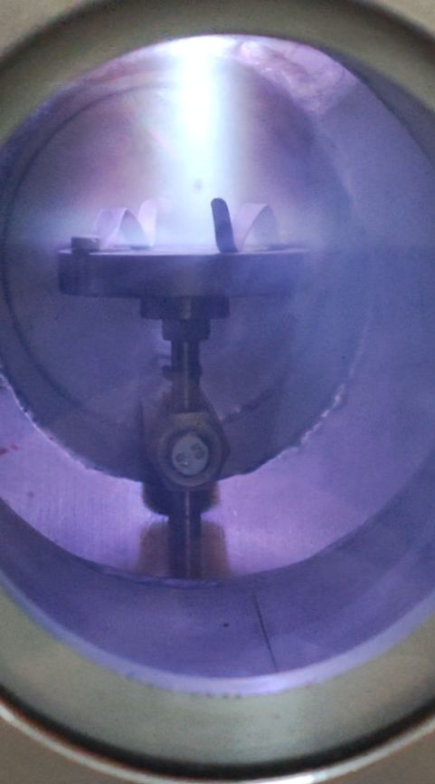
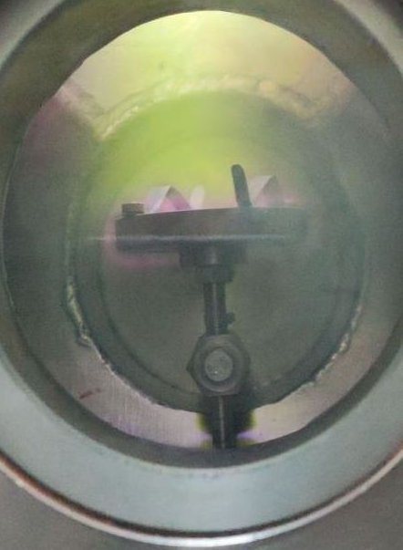
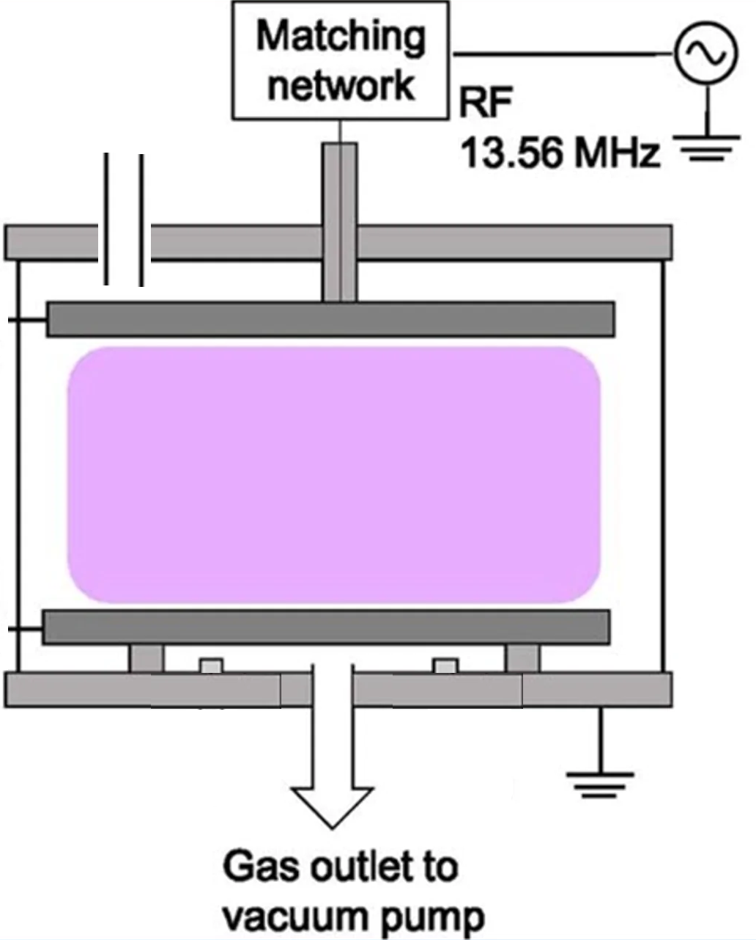
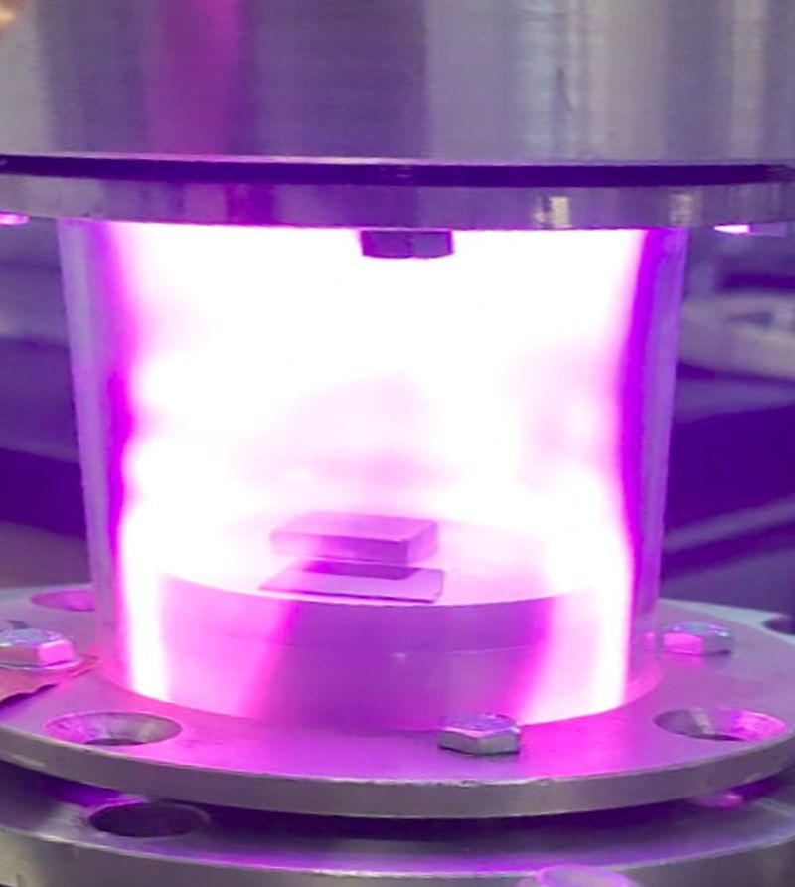
Two PECVD configurations used for boron deposition
Glow discharge (GD) configuration
RF plasma jet (J) configuration
Set-up glass tube+ 2 parallel plate electrodes (50 mm and distance in between electrode 60 mm
Set-up steel vessel +Jet plasma source used before for PECVD of nanostructure carbon
Carrier gas: Ar and Precursor: H2/B2H6
Variable Working parameters:
RF power, Nozzle substrate distance, flow rates , Pressure, Deposition time, Temperature, Substrate: Si, W
Carrier gas: Ar and Precursor: H2/B2H6
Variable parameters: RF power, Flow rates, pressure, deposition time, Substrate: Si, W
Images of the plasma jet in Ar / B₂H₆
Ar
Ar/B2H6
injection
B₂H₆
substrate
substrate
Gas ratio: Ar/Diborane
1000/5 (sccm)
300/5 (sccm)
[1]
grounded holder and chamber
[1]. S. Vizireanu et al, Plasma Sources Science & Technology 19, 034016, 2010.

Slide 20
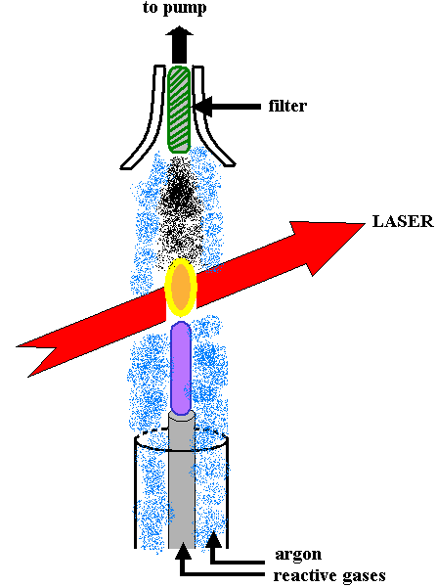
Laser pyrolysis used for Boron based nanoparticles
Specific synthesis of Boron rich NPs: B-C (O) NPs
Reactive mixture: B₂H₆ / C₂H₂/ C₂H₄: 8/1/3 (sccm), T_{flame}=780 ºC
Laser produced flame
[1]
Experimental method: laser pyrolysis
B₂H₆ was used as B precursors
Advantages:
✓pure and reproducible nano-products
✓extremely fine and monodisperse powders (d < 30 nm);
✓continuous synthesis with high rate~1-10 g/h;
✓ B doped materials, B carbide and nitride: (Fe,Ti, Si) borides.
[1]. Balas M.; Dumitrache F. et al, Nanomaterials 2018, 8, 495 https://doi.org/10.3390/nano8070495
XRD diffractogram of B_{4+x}C-O NPs NPs /Laser pyrolysis
C. Porosnicu, S. Vizireanu | PWIE meeting | Prague | 24-27 March 2025 | Page 20

Slide 21
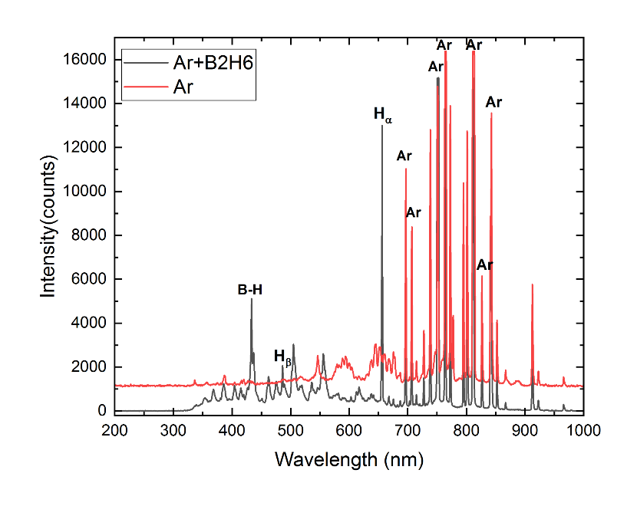
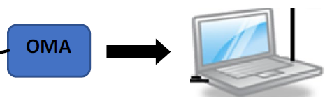
Preliminary Ar/B₂H₆ plasma jet investigation
Plasma jet Ar/ B₂H₆ at 1000/5
Plasma +Optical fiber+ Optical multichannel analyzer+ acquisition
OES investigations show the presence the Argon lines, and BH bands, H_{α} and H_{β} lines in plasma jet after introduction of 5 sccm of diborane.
Further investigations: Detailed studies follow after
I will mount a quartz window.
-OES study of He or D₂/diborane plasma in various condition.
-OES study of boron films in interaction with plasma.
-Mass spectrometry study of boron films in interaction with plasma. Study of species during sputtering of boron layers in D₂/H₂ plasma
OES in plasma jet of Ar/diborane mixture

Slide 22
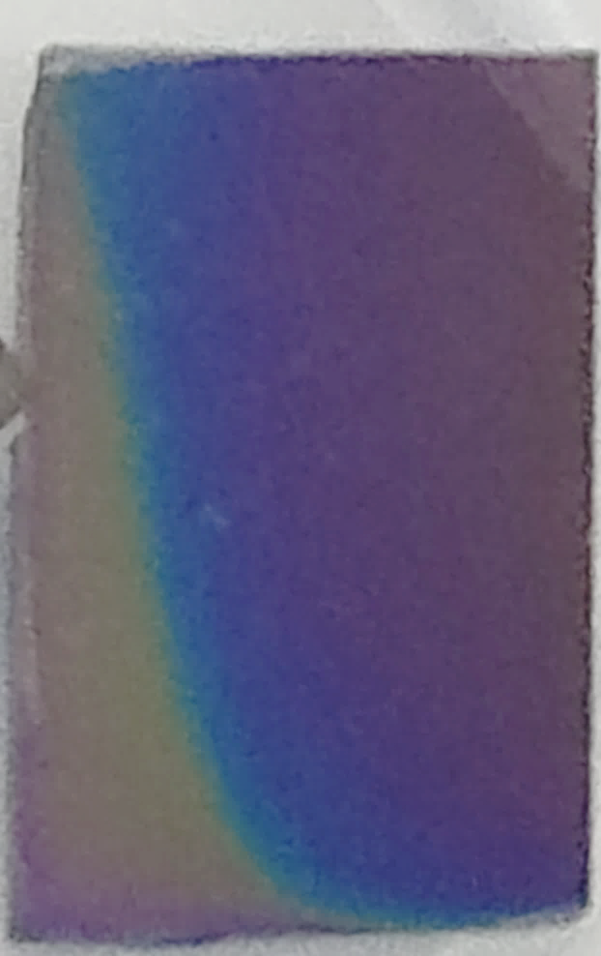
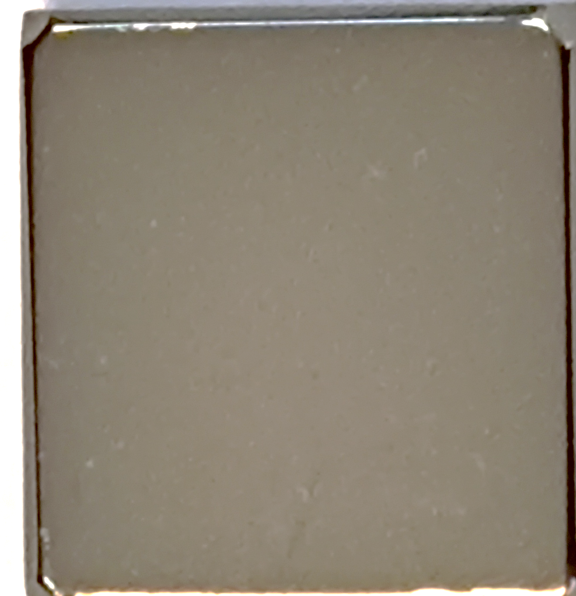
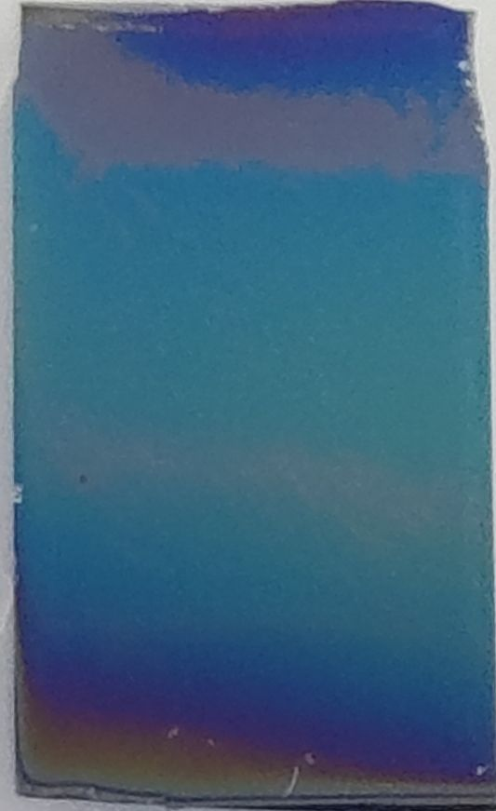
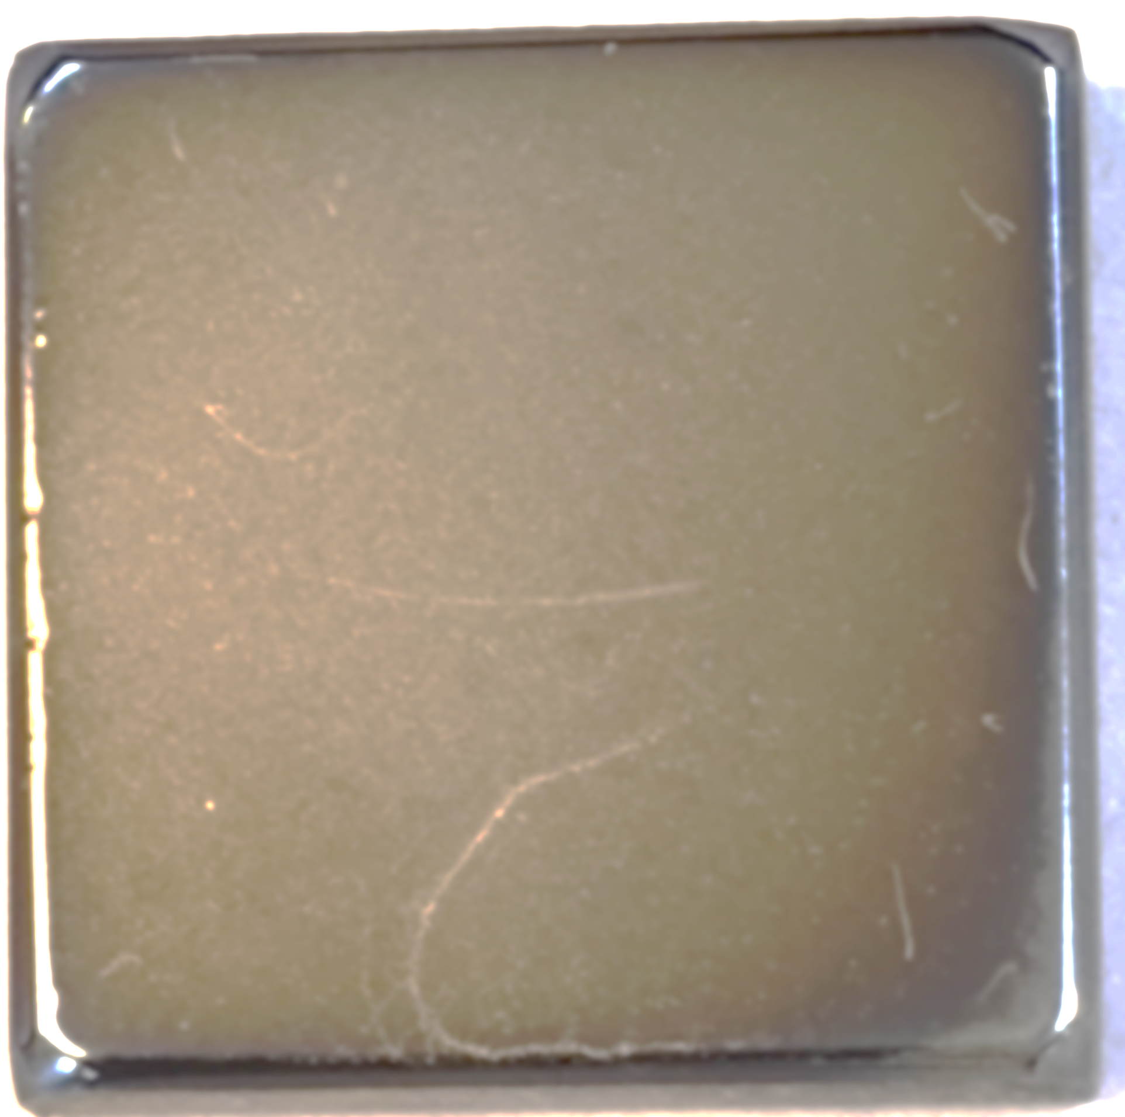
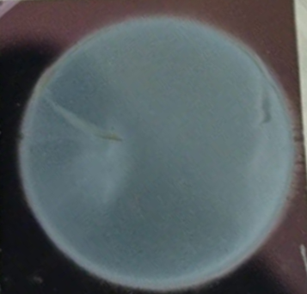
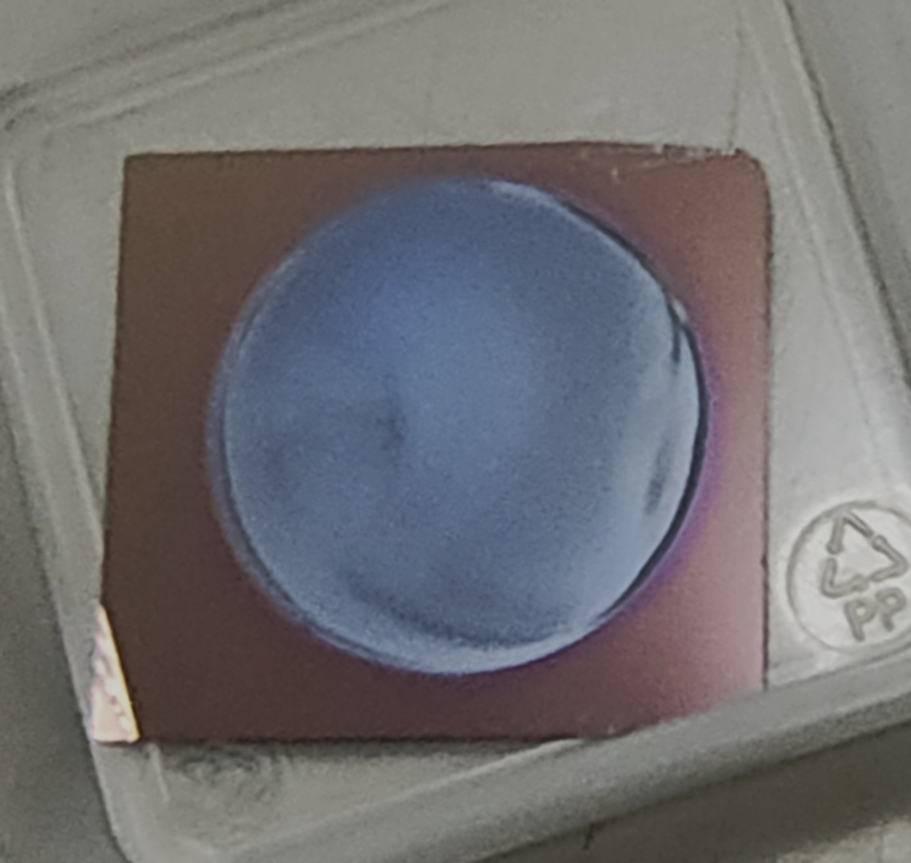
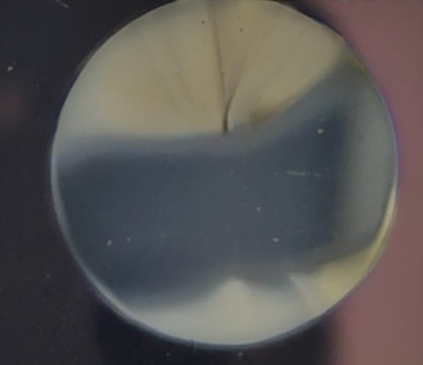
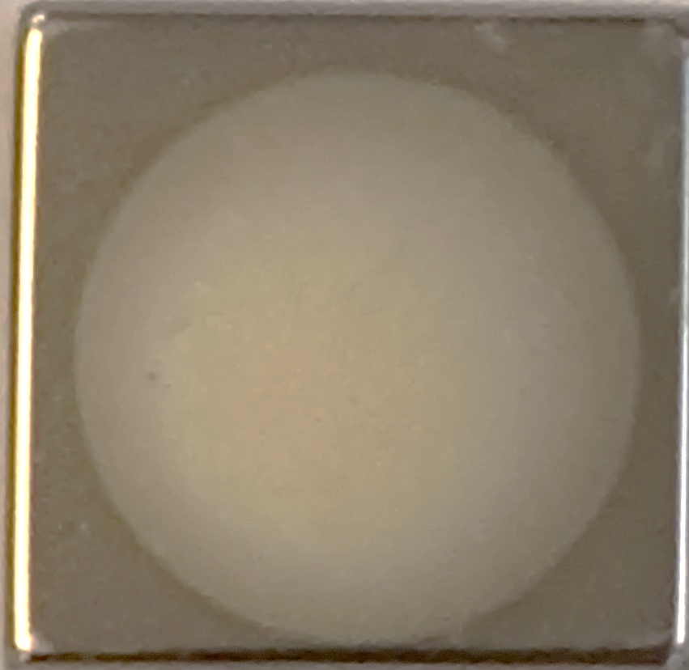
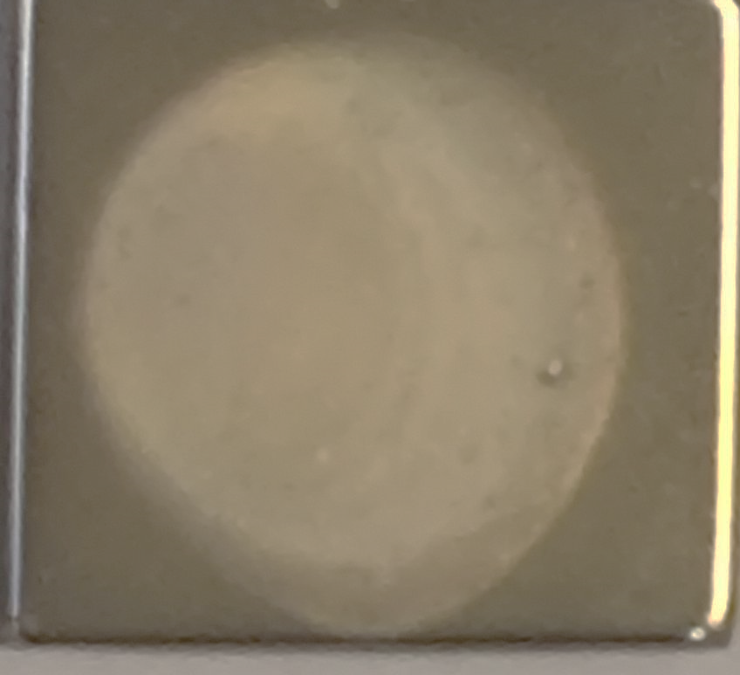
Experimental parameters and samples labels
Labelling of samples:
H-samples at High Ar flow (1000 sccm)+5sccm B₂H₆
L-samples at Low Ar flow (300 sccm) +5sccm B₂H₆
Samples label | Ar [sccm] | B2H6 [sccm] | Deposition press. [mbar] | Time [min.] | Temper. Degree C
1. Set I- Samples deposits by Glow Discharge (GD-samples)
GD-H | 1000 | 5 | 0.7 | 10
GD-L | 300 | 5 | 0.4 | 10
2 Set II Samples deposits by plasma Jet (J-samples)
J-H | 1000 | 5 | 0.7 | 10
J-L | 300 | 5 | 0.4 | 10
J-H-RT | 1000 | 5 | 0.73 | 10 | 47 ^{O}C
J-H-400C | 1000 | 5 | 0.72 | 10 | 400 ^{O}C
J-H-600C | 1000 | 5 | 0.71 | 10 | 600 ^{O}C
J-H-700C | 1000 | 5 | 0.71 | 10 | 700 ^{O}C
a)
a)
Pictures of samples a) GD-H and
b) GD-L on Si and W substrates
a)
b)
c)
a)
Pictures of samples a) J-H; b) J-L and c) to an intermediate Ar flow (500 sccm)
There are fixed parameters like RF power 100W, precursors kept always at the same flow values diborane: H2/B2H6 = 5 sccm

Slide 23
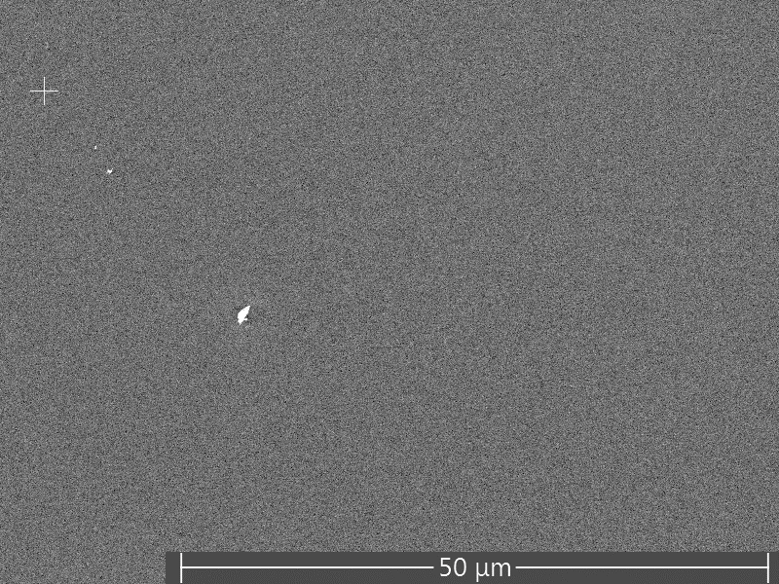
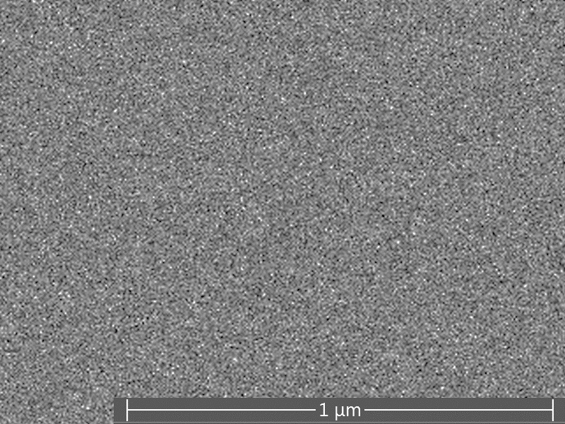
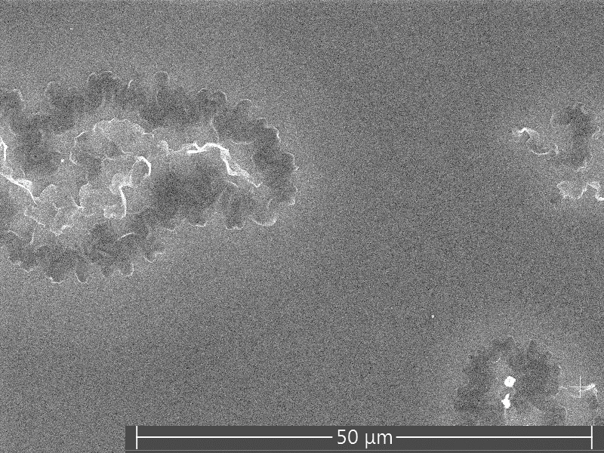
Glow discharge GD-samples: Surface morphology
SEM investigation results: top view and cross sections
Time:10 minutes, thickness ~84 nm
Smooth films
Deposit. rate: 8.4 nm/min
GD-H on Si in Ar/B2H6 ratio 1000/5 sccm top and cross section
Smooth films
Deposit. rate: 4 nm/min
GD-L, on Si from Ar/B2H6 ratio 300/5 sccm- Thickness: 40 nm

Slide 24
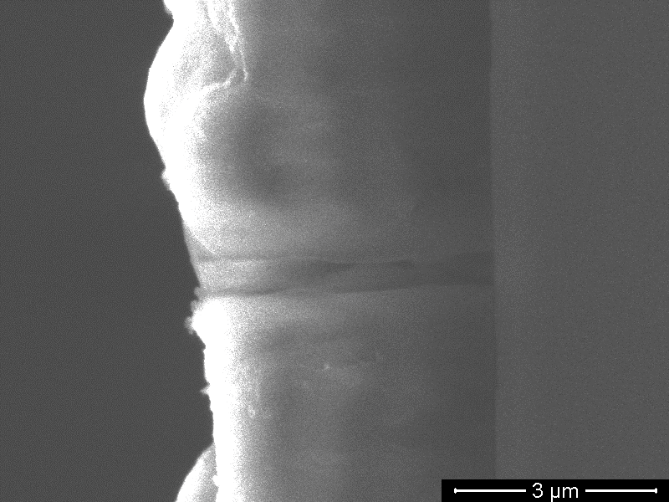
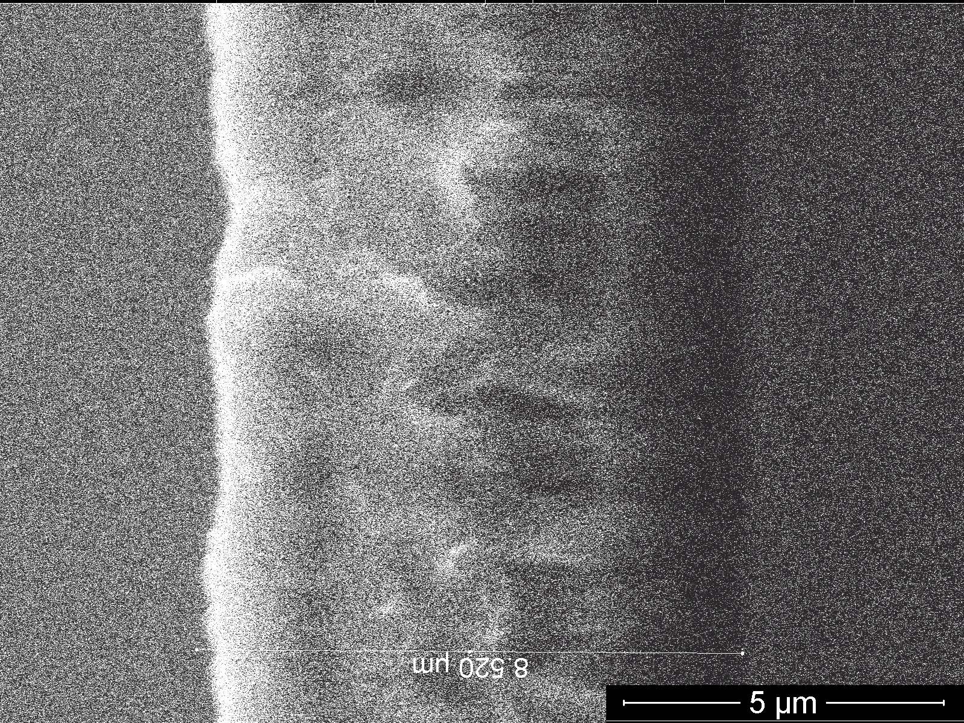
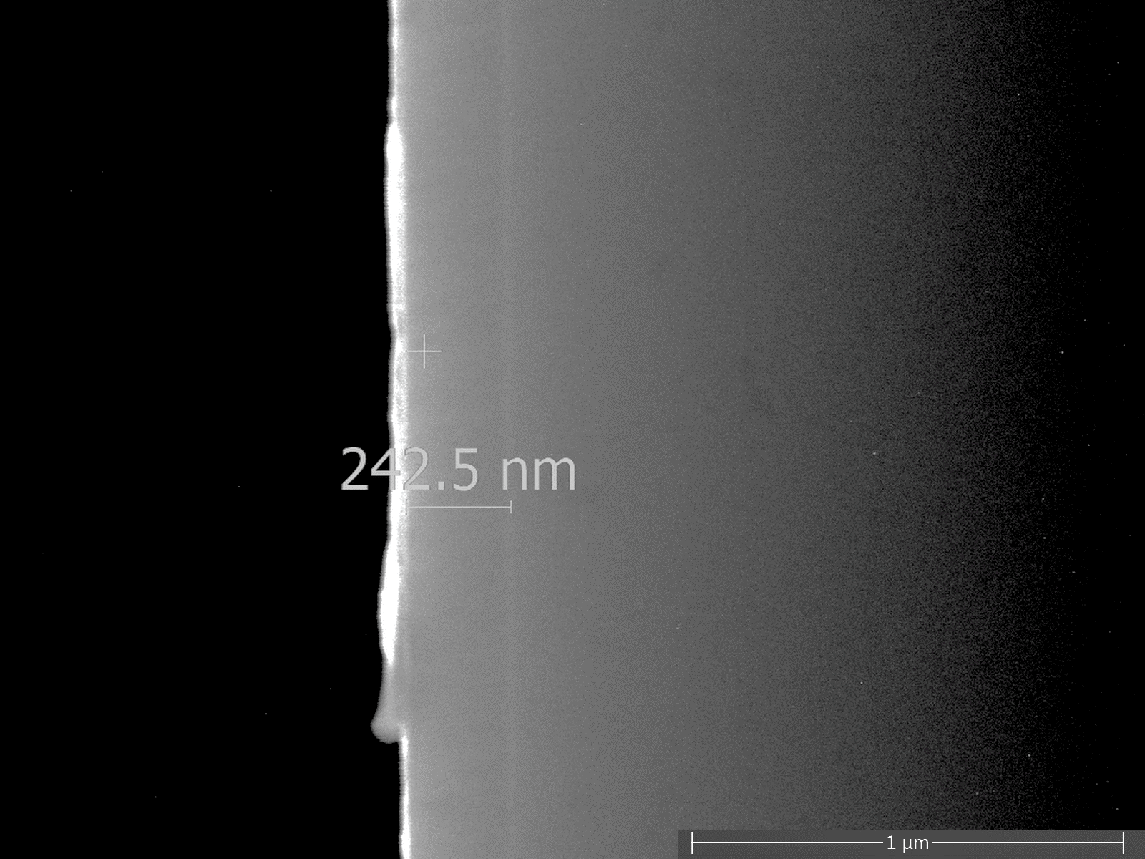
Plasma jet (J) samples: Surface morphology
Time:10 minutes, thick 4.1 μm
Time: 30 minutes, thick 8.5 μm
SEM images of J-H 1000/5 sccm top and cross section. J-H samples are rough.
thick 0.24 μm
Deposition rate of J-H samples
at about 400 nm/min
SEM images of J-L samples 300/5 sccm
J-L samples are smooth and small deposition rate ~24 nm/min

Slide 25
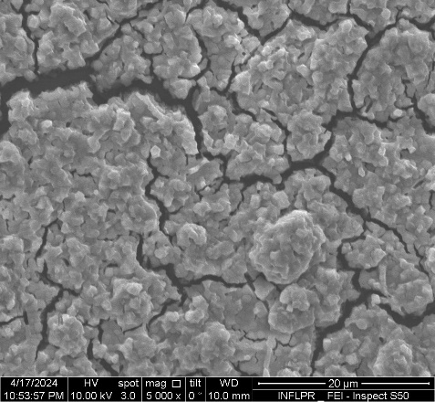
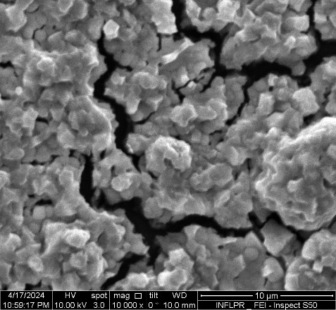
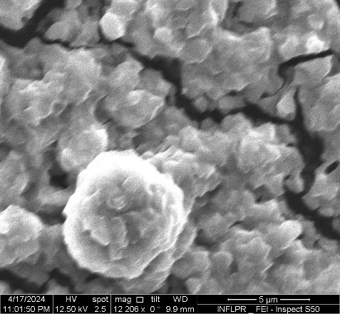
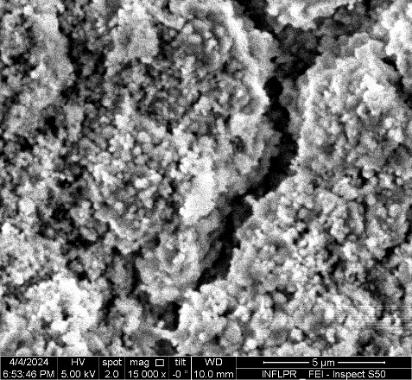
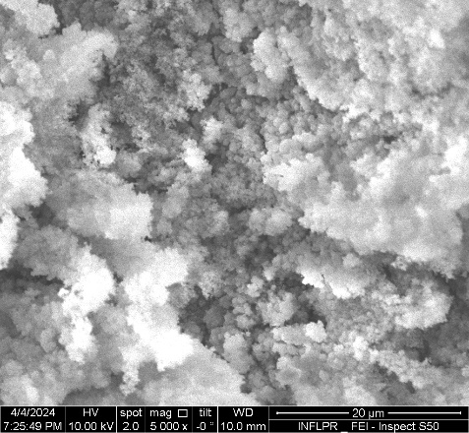
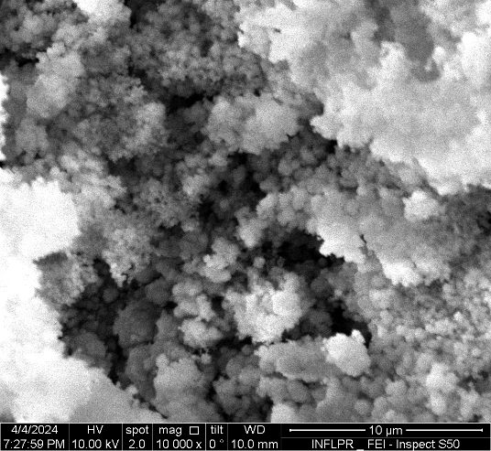
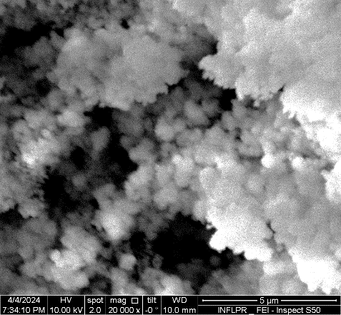
J-H samples. Details on morphology
case of J-H: for high Ar flows, the sample are very rough and irregular
Thick layer present many cracks and sponge-like morphology
At the film edges, a whitish color is observed, the film are oxidized and nanoparticles appear

Slide 26
Time stability: J-H sample on substrates Si
Adhesion behaviour in time (after 6 months)
of thick film deposited at (Ar/B₂H₆ 1000/10 sccm)
Initial SEM
SEM images of J-H sample
after 6 month.
Boron films are delaminated Exfoliation of thick layer can be observed after 6 months

Slide 27
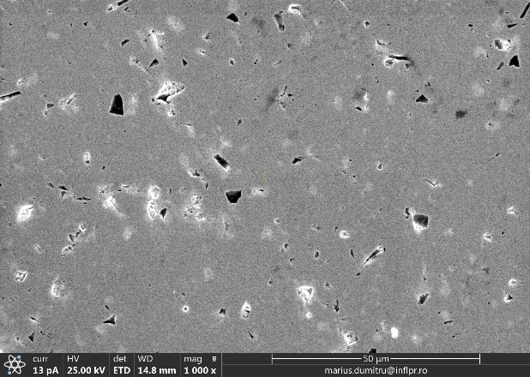
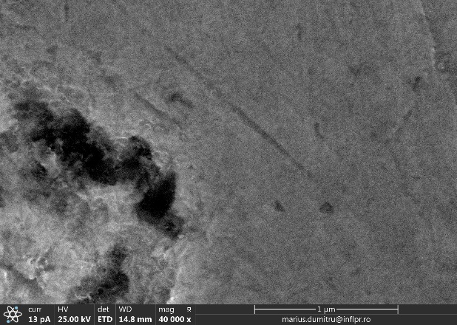
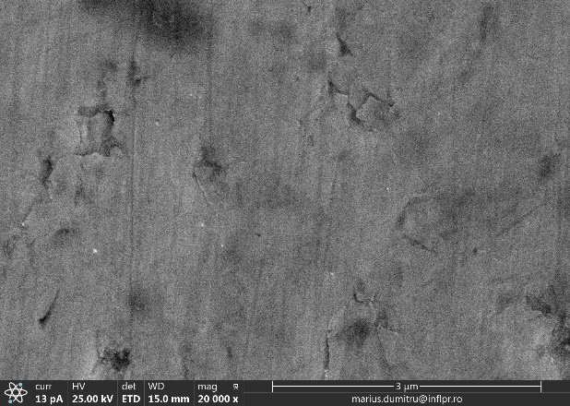
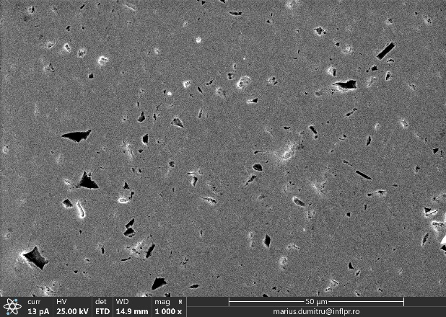
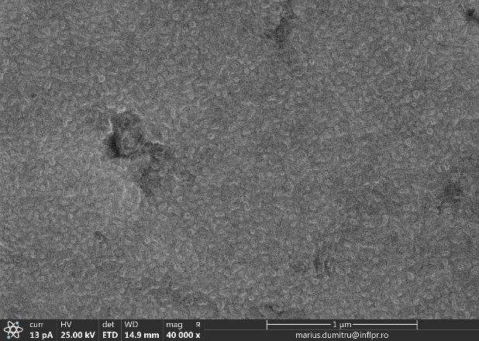
Boron-GD samples on W substrates
SEM image GD boron films onto W substrate- measured after 6 month
Conformal film
No delamination
are observed
GD-H on W in Ar/B₂H₆ at 1000/5 layers (about 84 nm onto Si) :
SEM image of the polished W substrate
GD-L on W in Ar/B₂H₆ at 200/5 (layers of about 40 nm onto Si)

Slide 28
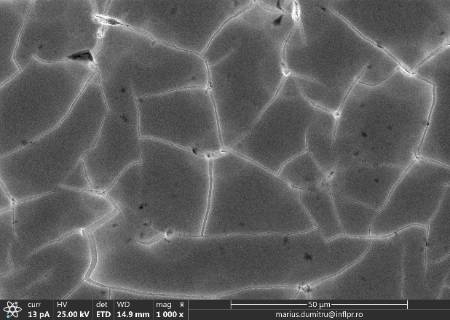



Boron-J samples on W substrates
SEM image Jet boron films onto W substrate- measured after 6 months
cracks in the film are observed , however the layer does not completely delaminate
J-H pe W 1000/5: layer thickness 4 μm
Delamination or flakes deposition?
We have SEM only after 6 month for J-L on W
J-L on W 300/5: layer thickness 240 nm

Slide 29








Boron-J-H samples obtain for various temperatures
Room Temp.
400 C
600 C
700 C
Room Temp.
400 C
600 C
700 C
SEM images of J-H (Ar/B2H6 at ratio 1000/5 sccm, 100 W for 10 minutes at various temperatures.
The boron films are nanostructured at high temperatures. Nano-flakes and nanotubes are observed after 400 C and sponge like nano-structures are visible at 600 and 700 C.

Slide 30
XPS investigation- survey spectra and elemental composition
Table with relative atomic concentration of elements in the samples
Boron, carbon, nitrogen and oxygen elements;
Boron is dominant element;
High Ar flow rate led to a smaller B content and samples oxidation compared to L-rate;
Lower Nitrogen and Carbon content in Jets sample;
Oxides and nitride from air leaks and exposure.
 | GD-H | GD-L | J-H | J-L
B 1s | 34.1 | 39.8 | 31.4 | 46.6
C 1s | 20.1 | 19.5 | 8.2 | 18.3
N 1s | 17.6 | 25.4 | 2.6 | 6.7
O 1s | 28.2 | 15.2 | 57.8 | 28.5

Slide 31
XPS investigation- High resolution in
C1s and B1s regions and bonding types
High resolution XPS spectra in the C1s and B1s region.
After calibration to C1s peak we observed various bond type of Carbon and Born atoms in the PECVD sample.

Slide 32
Boron bonds type - B1s region deconvolution
Bond type | Binding en.[eV]
(B-B), | 187.2 ±0.1
(B-C); | 188.5±0.1
(B-N), | 190.8±0.1
(B-O subox.) | 192.4±0.1
B₂O₃ | 193.5±0.1
Deconvolution of high resolution XPS spectra in B1s region (binding energies found in the literature)

Slide 33
XPS investigation- High resolution in B1s regions and bonding types and their percentage
High resolution XPS spectra in the B1s region
Diagram with percentages of B1s components
J-L contain metallic boron and J-H shows the most oxidized boron.
GD samples presents boron nitride bond type because of poor vacuum - mechanical pumps.

Slide 34
Composition of boron PECVD samples for various temperatures
Table with elemental composition from survey spectra for boron at various temperature
 | RT | 400C | 600C | 700C
B 1s | 34.9 | 34.9 | 32.6 | 34.0
C 1s | 6.1 | 13.1 | 16.7 | 14.9
N 1s | 2.7 | 6.3 | 8.2 | 13.0
O 1s | 56.4 | 45.7 | 42.5 | 38.1
High resolution XPS spectra in the B1s region of samples deposited at various temperature.
Samples present oxidized boron.

Slide 35
Time stability of composition in time
(after 6 months, substrates Si)
Table with elemental composition of initial and after 6 months of boron samples obtained by GD and plasma Jet
 | GD-H | +6 m | GD-L | +6 m | J-H | +6 m | J-L | +6 m
B 1s | 34.1 | 34.0 | 39.8 | 31.8 | 31.4 | 31.1 | 46.6 | 39.8
C 1s | 20.1 | 27.2 | 19.5 | 28.6 | 8.2 | 26.4 | 18.3 | 30.9
N 1s | 17.6 | 19.7 | 25.4 | 18.7 | 2.6 | 7.4 | 6.7 | 6.3
O 1s | 28.2 | 19.1 | 15.2 | 21.0 | 57.8 | 35.1 | 28.5 | 23.0
High resolution XPS spectra in the B1s region of boron PECVD samples measure after days and 6 months.
We can observed variation in B, C, N and O concentration.
The GD samples that presents boron nitride bonds are quite stable because are difficult to oxidize over time.
In the J-L samples that contain B-B and B-C remains almost the same shape.

Slide 36
Conclusions
We demonstrated that we can obtain boron layers by PECVD in Ar/B₂H₆ mixture;
High deposition rate for jet (~400 nm/min) and low rate for glow discharge (4-8 nm/min);
Good adhesion of the thin B layers on W surface, and low adhesion on Si wafers;
For thin boron film the morphology remains stable in time (both GD-L and J-L at Low Ar);
The boron films are nanostructured at high temperatures;
The composition of boron layers deposited by PECVD from diborane contains in various concentrations B, C, N and O elements.
In the Jets samples we have metallic boron and oxide bonds type, while in the GD samples we found mostly boron nitride bonds type. The boron bonds type seems to be preserved after 6 months, except J-H samples which are quite spongy (not compact);
Modification of the composition of boron layers are observed in time.

Slide 37
Future plans
Infrastructure:
Improving the work safety by inserting higher sensitivity diborane detectors, new system for burning the pumps exhaust;
Optimization of the deposition setups ( high vacuum pumping systems, mass flow controllers, diborane bottles – also with He, or D₂, quartz windows for OES);
Development of new diborane discharge configurations relevant for fusion (we have know-how in designing of new plasma sources with injection for PECVD).
Research
Study of the boronization process (efficiency, species formed, influence of impurities) using diborane or other boron containing precursors by PECVD. Use diagnostics and characterization techniques for:
-Species formed during sputtering of boron layers in D2/H2 plasma (Optical emission spectroscopy and mass spectrometry available);
-Properties of Boron films deposited by PECVD using diborane (morphology, composition, adhesion, hardness, resilience to sputtering etc).
Identification of the critical issues in boronization, of interest for fusion technology: process, adhesion, time stability, behaviour in respect to sputtering;
Identification of the needs for PECVD preparation of thick/thin Boron layers for materials study (substrate types, pre-treatment, thickness, etc ).

