Slide 1
Update and Plans SPX
Ivo Classen
DIFFER

Slide 2
WP-PWIE SPX:
Plasma characterization, laser based diagnostic development
In 2025 SP X consists of 2 parts:
SP X.1: Atomic and molecular processes in attached/detached plasmas
SP X.2: Optimization of laser-based surface analysis diagnostics

Slide 3
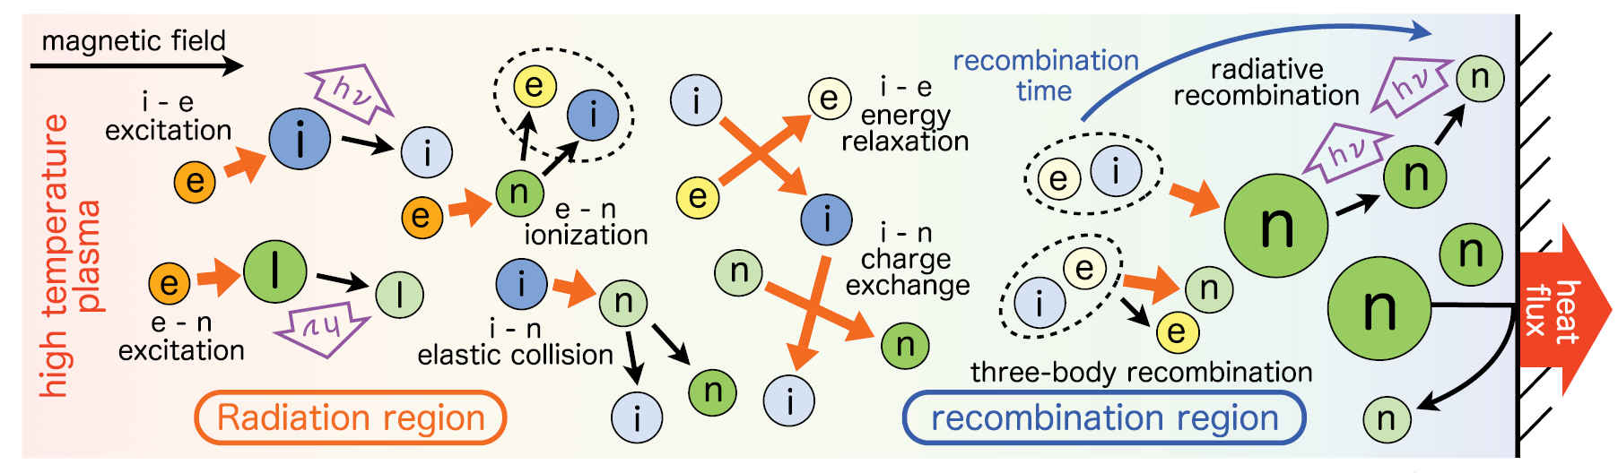
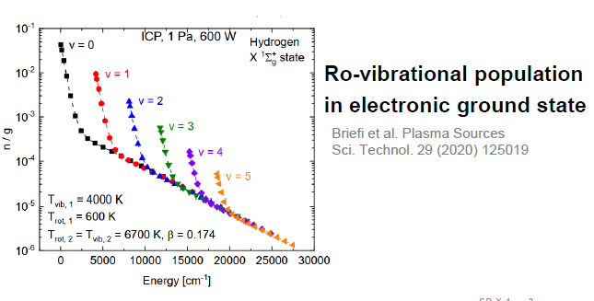
Motivation SP X.1
SP X.1
Neutrals (atoms and molecules)
play large role in detachment
Molecular processes (e.g. MAR) highly dependent
on ro-vibrational distribution of H₂/D₂
➔ Develop diagnostics to measure neutral properties of H/D and H₂/D₂ in detaching conditions
➔ Input to benchmark models (CR, SOLPS, …)

Slide 4
SP X.1
Deliverable ID | Beneficiary/ PM | Deliverable Title
D001 | DIFFER 8 | CARS results in Magnum-PSI. Flow velocity measurements with CIS and multispectral imaging using MANTIS on Magnum-PSI/UPP.
D002 | FZJ 4 | VIS/VUV molecular and atomic spectroscopy on H and D in PSI-2. Comparison of MANTIS to hyperspectral camera in UPP.
D003 | CU 2 | VUV OES measurements in MAGNUM-PSI/UPP with focus on H/H2
D004 | MPG 2 | Interpretation spectroscopy results using spectra simulation and (CR) modelling with YACORA and development VUV-OES
Device | Beneficiary | Days | Related Deliverable
MAGNUM-PSI | DIFFER | 12 | D001, D002, D003, D004
UPP | DIFFER | 12 | D001, D002, D003, D004
PSI-2 | FZJ | 9 | D002
JULE-PSI | FZJ | 0 | D002

Slide 5
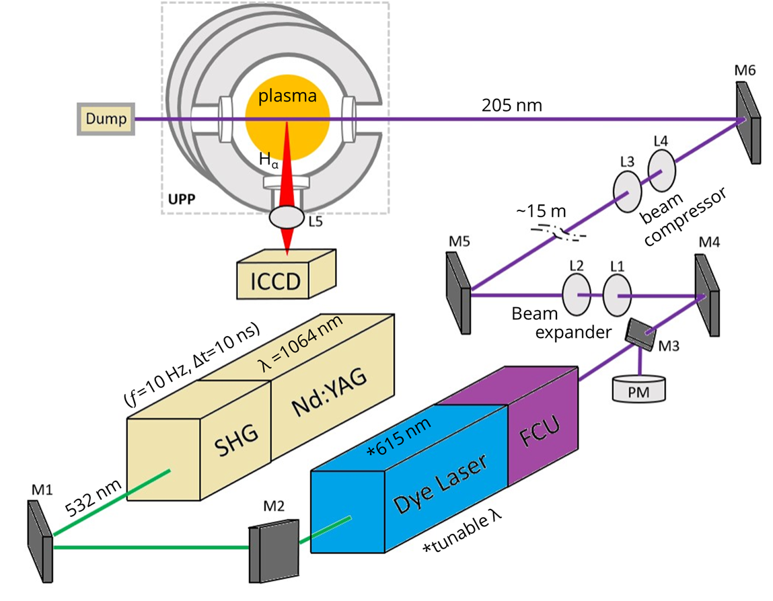
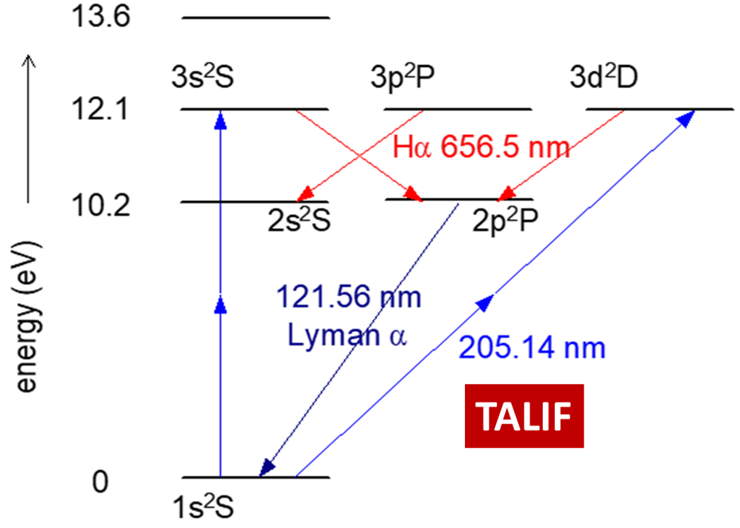

D001:
2024: Successful TALIF campaign on Magnum-PSI
SP X.1
D001
K. Loring, K. Schutjes, I. Classen, J. Vernimmen, E. Visser
Active spectroscopy technique to directly measure H atomic density
  Narrow collimated laser beam 205nm
  ICCD camera as detector
  ➔ Spatial (radial) profile of n_{H}

Slide 6
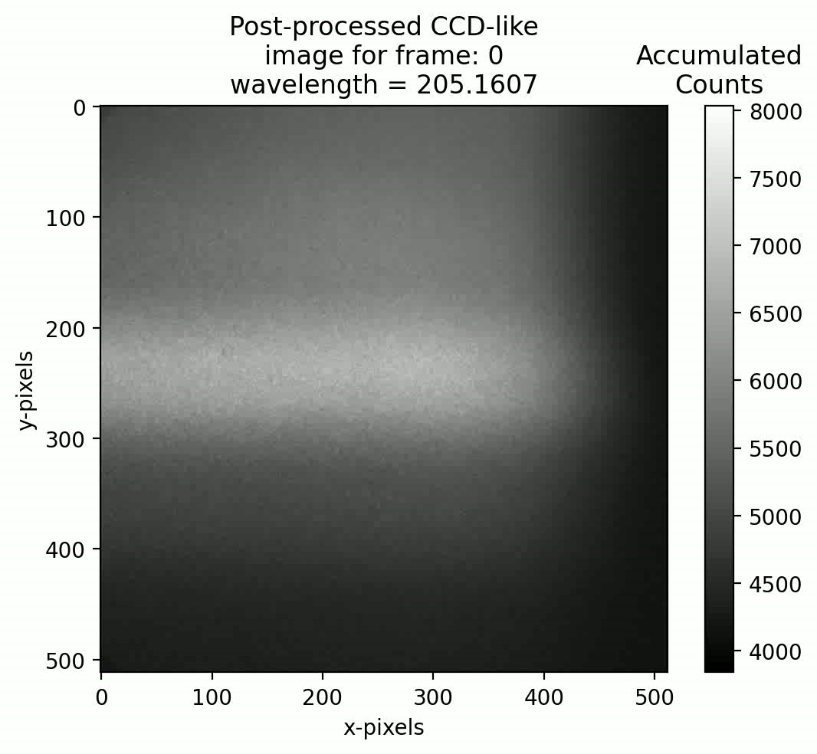
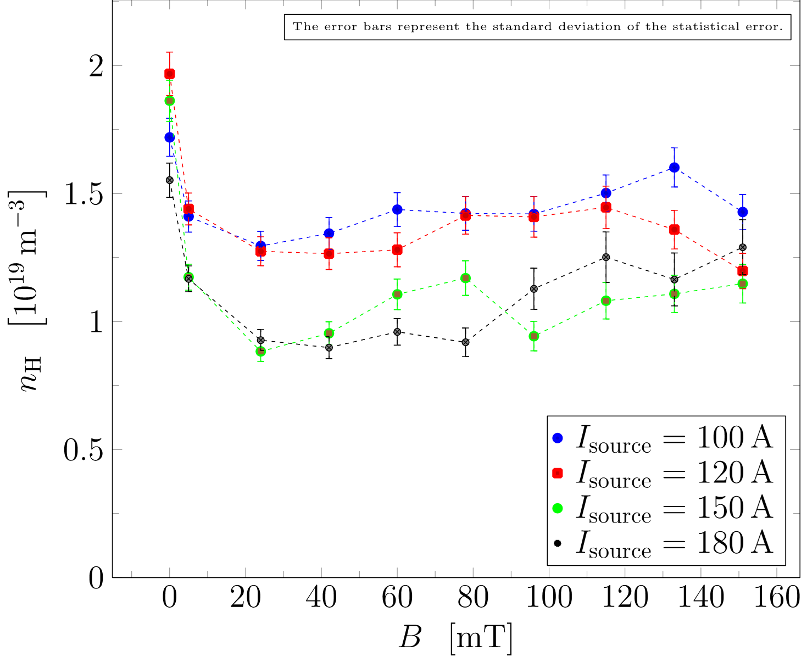
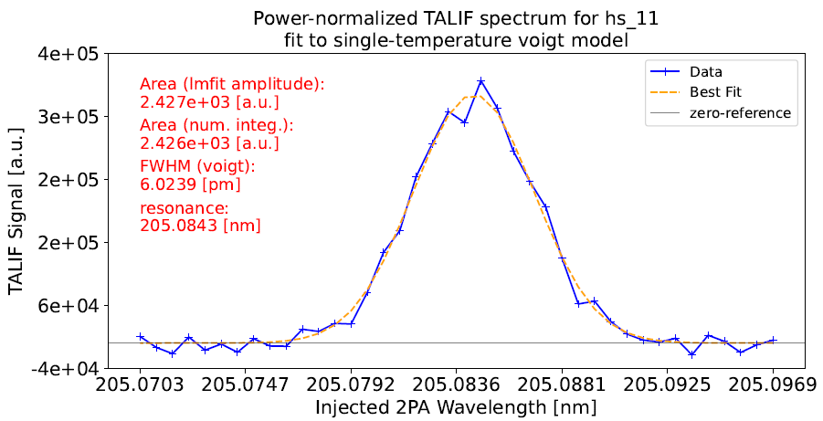
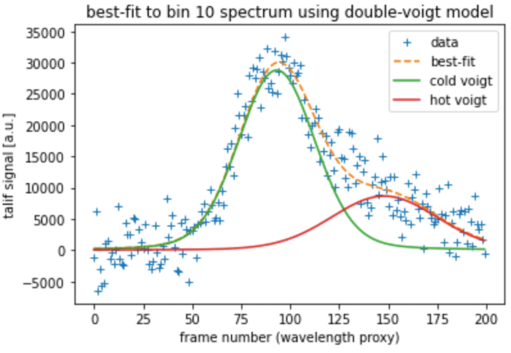
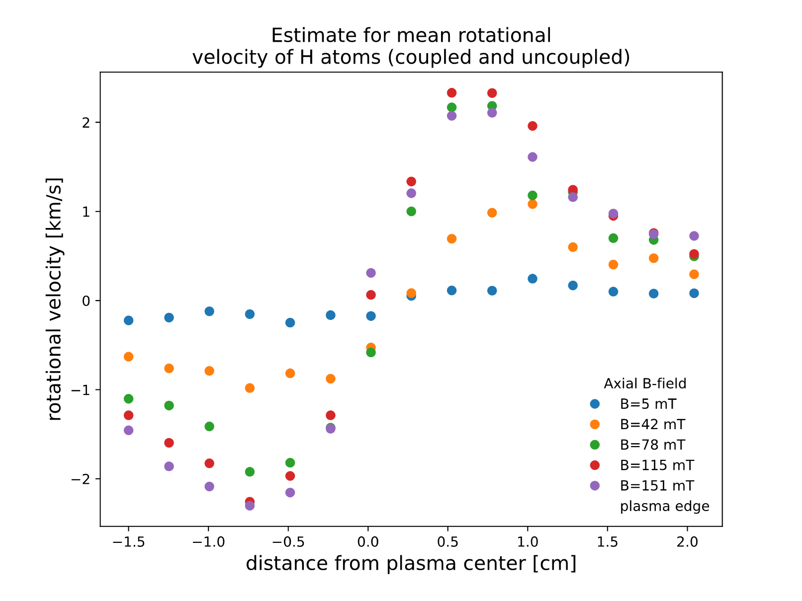
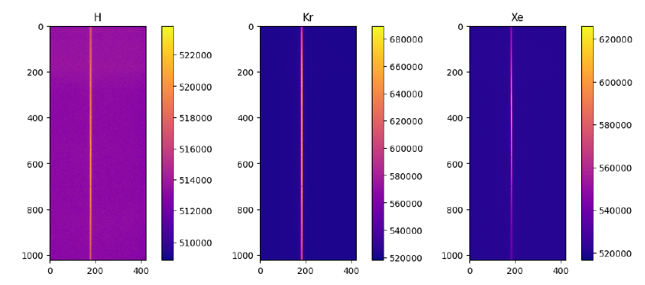
TALIF Data: H atomic density
SP X.1
D001
Data taken on wide parameter (detachment) scan
➔ Build database, include increasing number of diagnostics

Slide 7
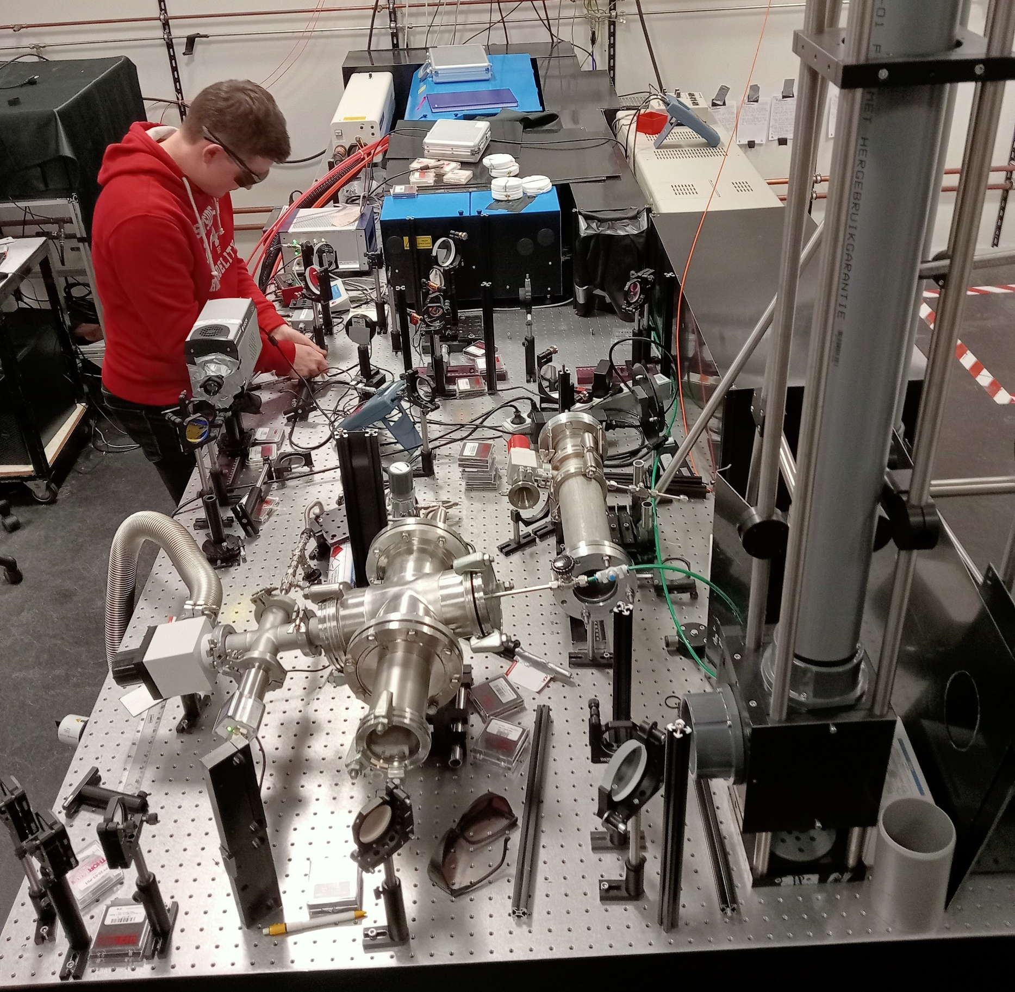
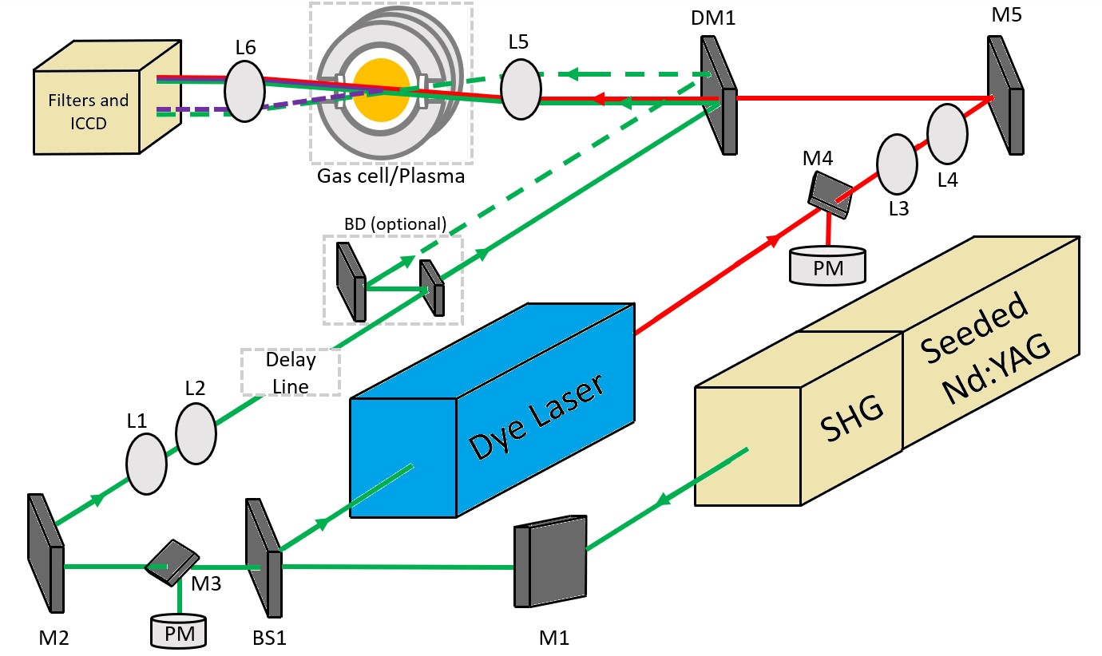
2025: CARS development, first data on Magnum-PSI
SP X.1
D001
Active spectroscopy technique to measure H₂ (lower) ro-vib state densities
➔ See highlight talk by Kay Schutjes

Slide 8
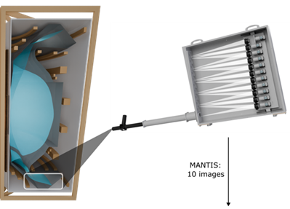
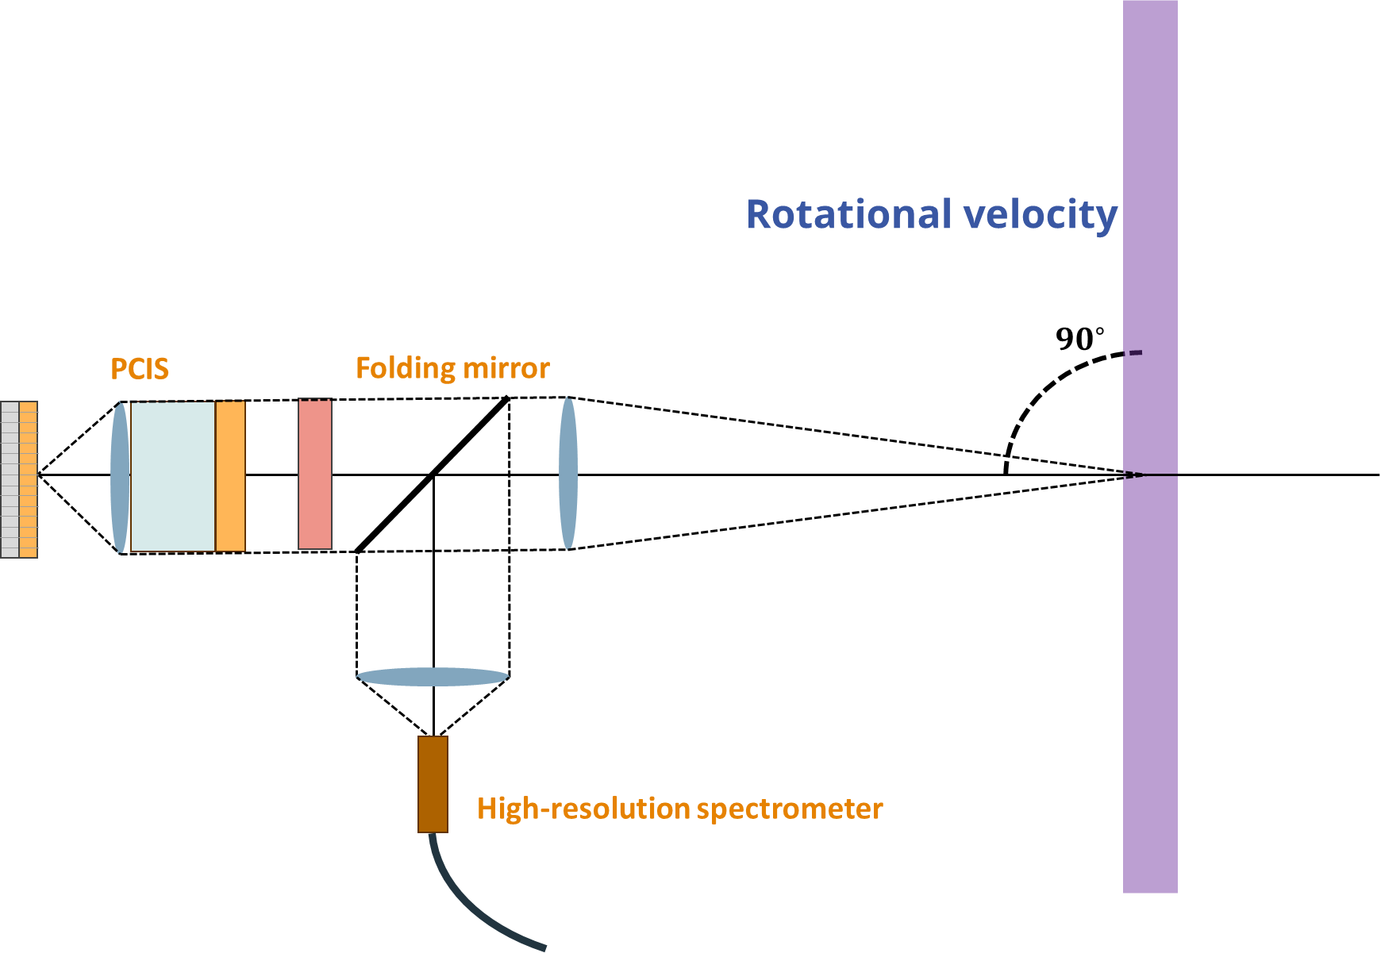
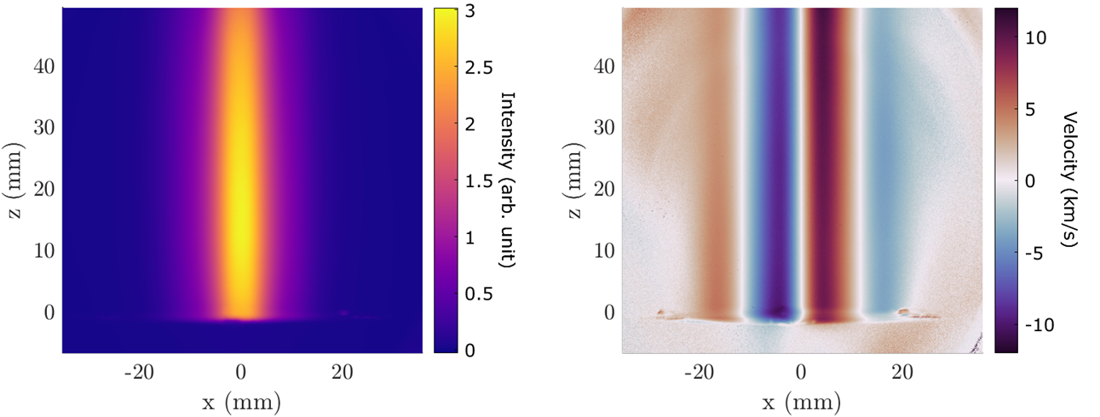
Two more diagnostics for plasma characterization
SP X.1
D001
MANTIS
  Multi-spectral Imaging
  Simultaneous 2D intensity of (line) radiation
  In spring available at Magnum-PSI/UPP
CIS
  2D flow velocity measurements
  Doppler shift ➔ polarization angle change
  H lines, Ar, C, …
  Ar shown to be a good proxy for ion velocity
➔ Adds to already extensive plasma characterization in Magnum-PSI

Slide 9
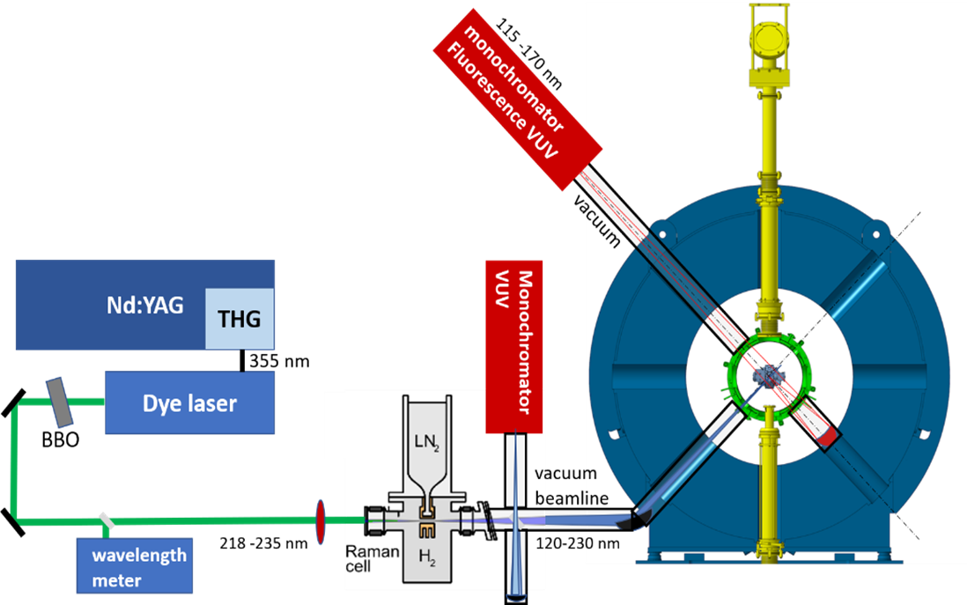
Future ambition: VUV-LIF
SP X.1
D001
CARS only covers lower ro-vib states
VUV-LIF needed for complete ro-vib spectrum
Two VUV spectrometers needed.
In 2025 only passive VUV planned. Active VUV-LIF in ≥2026.
Vankan et al.

Slide 10

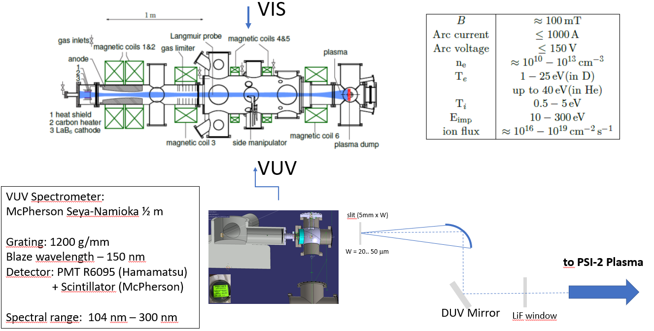
D002:
Atomic and Molecular Spectroscopy of Hydrogen and Deuterium
Plasma at PSI-2
O. Marchuk, M. Sackers, V. Kotov, G. Sergienko, M. Reinhart, S. Brezinsek and A. Kreter
SP X.1
D002

Slide 11
Hyperspectral camera vs MANTIS
SP X.1
D002
Small side project between D001 and D002:
Comparison between hyperspectral camera (FZJ) and MANTIS (DIFFER) on UPP.

Slide 12
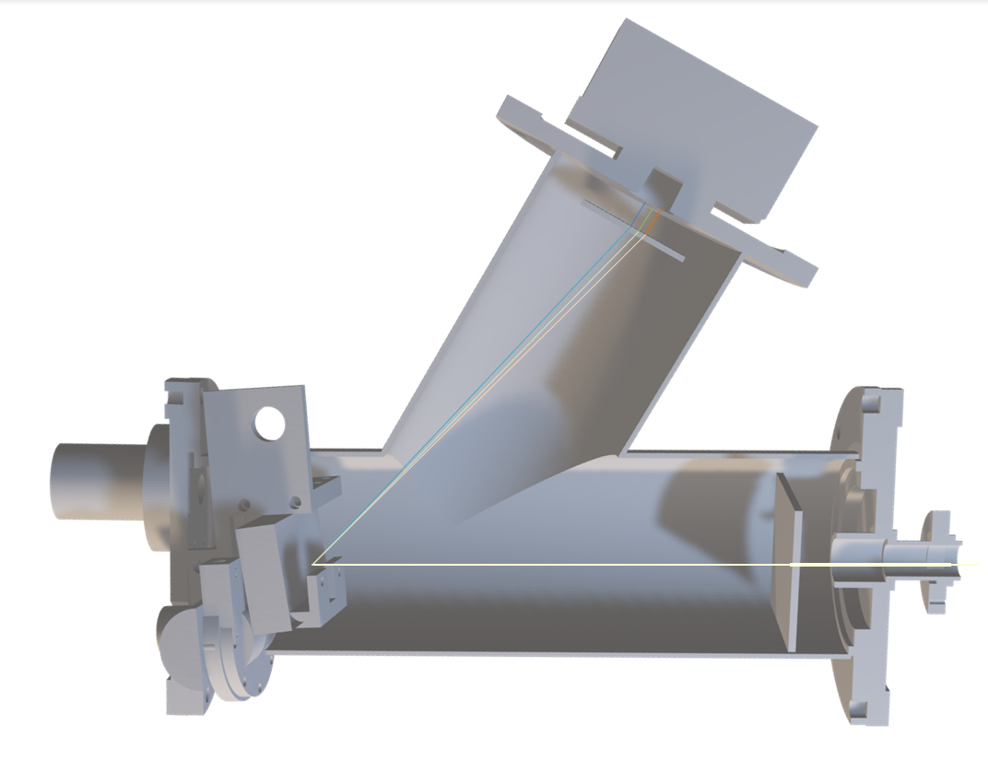
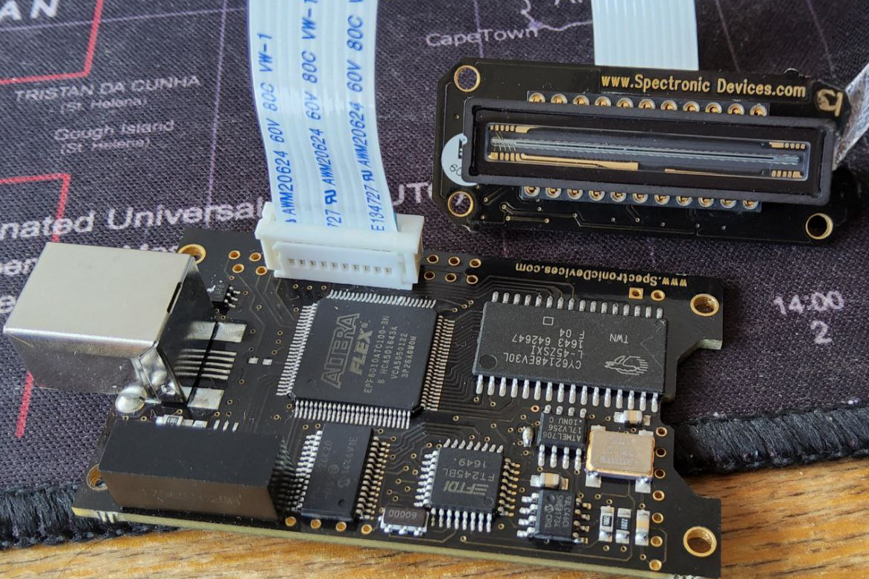

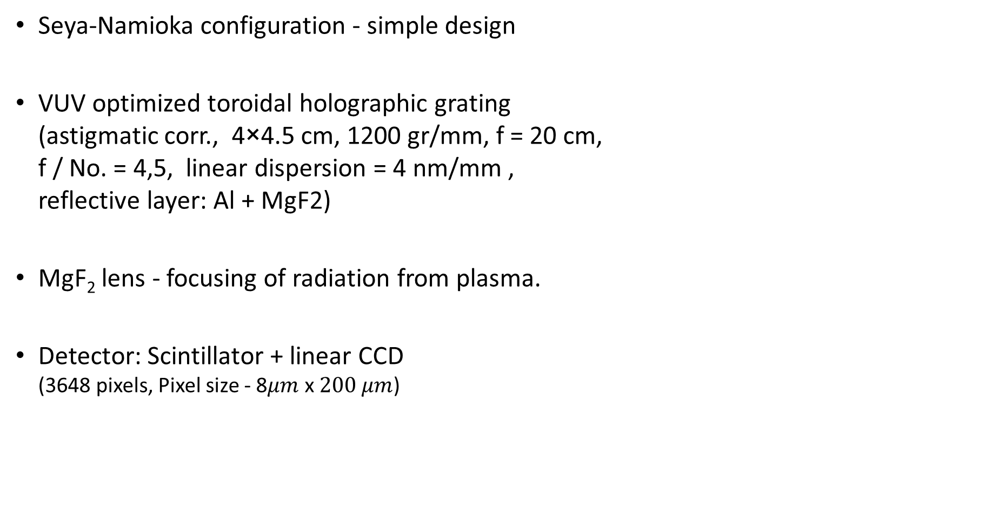
D003:
VUV-spectrometer for Magnum-PSI/UPP
SP X.1
D003
Pavel Veis, Sanath Shetty , Matej Veis, Sahithya Atikukke
Seya-Namioka configuration - simple design
VUV optimized toroidal holographic grating
(astigmatic corr., 4×4.5 cm, 1200 gr/mm, f = 20 cm,
f / No. = 4,5, linear dispersion = 4 nm/mm ,
reflective layer: Al + MgF2)
MgF₂ lens - focusing of radiation from plasma.
Detector: Scintillator + linear CCD
(3648 pixels, Pixel size - 8$μm$ x$200 μm$)

Slide 13
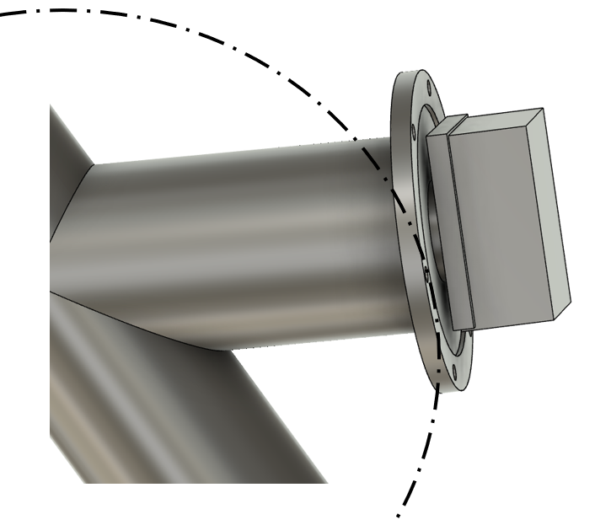
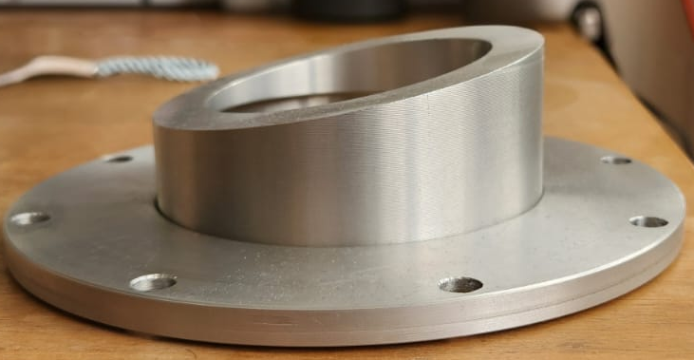
Plans for 2025
SP X.1
D003
Finalization of hardware:
  Integration to Magnum-PSI/UPP
  CCD is planar – adaption of detector
  plane to be tangential to Rowland Circle
  Focal length depend strongly on wavelength
  in the range 100-200 nm – tueable using bellow.
  Shielding against magnetic field (needed for Magnum, optional for UPP)
➔ Installation and Measurements of D₂ plasma in UPP

Slide 14
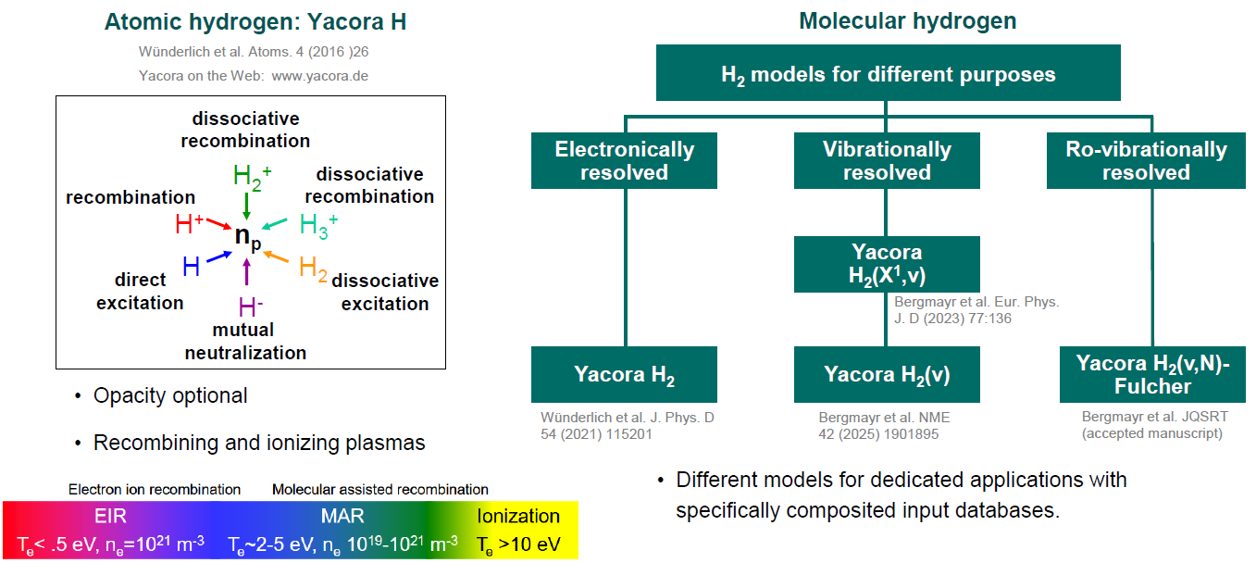

D004:
Interpretation spectroscopy results using spectra simulation and (CR) modelling with YACORA and development VUV-OES
SP X.1
D004
U. Fantz, R. Bergmayr, D. Wünderlich, R. Friedl

Slide 15
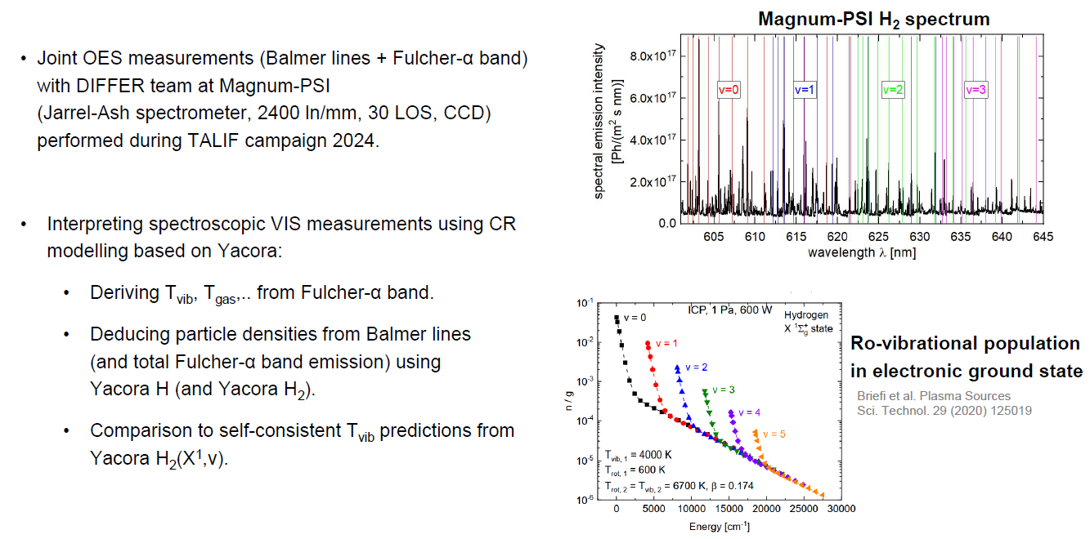
2024: Evaluating VIS spectra from Magnum-PSI
SP X.1
D004

Slide 16
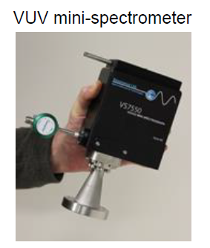
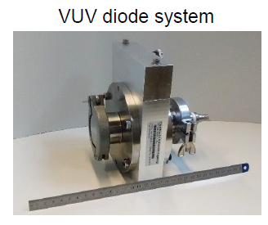
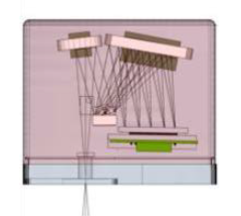
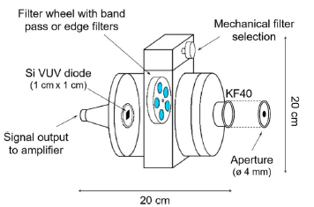
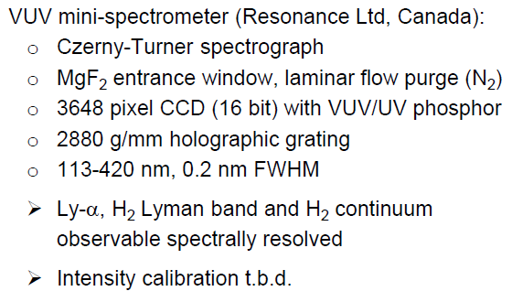
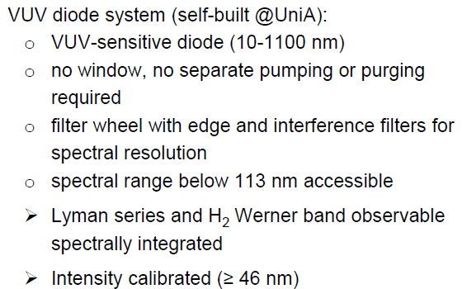
2025: VUV spectroscopy on UPP; 2 options
SP X.1
D004

Slide 17
SP X.2 still needs to be updated for 2025
Deliverable ID | Deliverable Title
D001 CEA | Comparison of ps vs. ns LIBS: absolute content and composition / Comparison SP vs. DP LIBS, or alternative LIBS signal enhancement methods: absolute fuel content in W samples and composition (CEA)
D002 DIFFER | Reference measurements of outgassing, recycling, and retention after D plasma loading: absolute content and composition in W and reference samples (DIFFER)
D003 ENEA | Comparison SP vs. DP LIBS, or alternative LIBS signal enhancement methods: absolute fuel content in W samples and composition / (CF)-LIBS results He loaded samples and surface modifications (ENEA)
D004 FZJ | Comparison of ps vs. ns LIBS: absolute content and composition / Comparison SP vs. DP LIBS, or alternative LIBS signal enhancement methods: absolute fuel content in W samples and composition / Reference measurements of outgassing, recycling, and retention after D plasma loading: absolute content and composition in damaged and undamaged Wsamples / LAMIS measurements and identification of C and N containing molecules /Explore TALIF and LIBS for W isotope identification (FZJ)
D005 IPPLM | Report on LIBS analysis by application of machine learning algorithm (IPPLM)
D006 CU | Comparison of ps vs. ns LIBS: absolute content and composition / (CF)-LIBS results He loaded samples and surface modifications. (CF-)LIBS on Be containing coatings with different type of fuel content (CU)
D007 UT | Analysis of B containing coatings and/or W coatings with (CF)-LIBS: absolute content and composition / (CF)-LIBS results He loaded samples and surface modifications / Reference measurements of outgassing, recycling, and retention after D plasma loading: absolute content and composition in W and reference samples. (CF-)LIBS on Be containing coatings with different type of fuel content (UT)
D008 ISSP UL | Comparison of ps vs. ns LIBS: absolute content and composition (ISSP-UL)
D009 VTT | (CF-)LIBS on Be containing coatings with different type of fuel content (VTT)

Slide 18
D002: Viability of ns – pulse LIBS
SP X.2
D002
J. van Kesteren, B. Tyburska-Pueschel, H. van der Meiden
Ablation by lasers with ns pulse duration are characterized by local melting due to heating effects which could lead to:
LIBS induced outgassing
Enhanced diffusion due to heat
Significance of this effect still under discussion [1], LIBS induced outgassing has been simulated [2]
However, ns pulse lasers are still frequently used in LIBS research
Goal: Test the viability of ns – LIBS
Experiment:
Expose 1μm of compact W on Mo substrate to deuterium
plasma in MAGNUM-PSI
Perform 1 LIBS pulse to create a large crater
Measure deuterium retention in and outside of large LIBS crater
using NRA

Slide 19
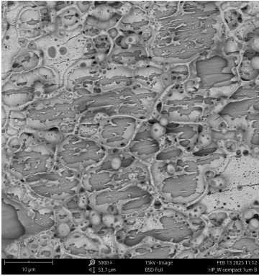
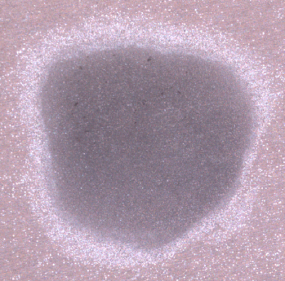
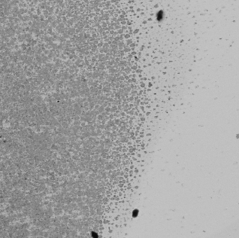
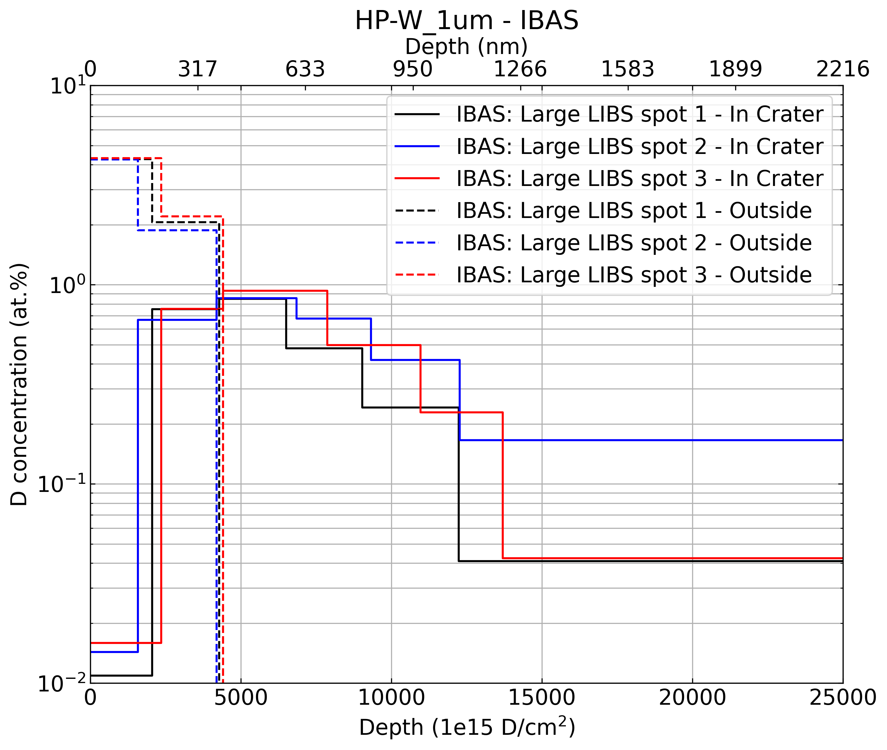


LIBS induces outgassing
10 $μm$
SEM and NRA analysis of inside and outside of the LIBS crater
W coating underneath the crater has melted and mixed with the Mo substrate
Deuterium outgassing of 100-200 nm observed
Porous substrate shows no melting but does observe the same LIBS induces outgassing effect
→ ns-LIBS is a highly perturbative measurement!
Diffusion
t
Outgassing

Slide 20
Thank you for your attention
3 highlight talks:
Oleksandr Marchuk, FZJ, VIS and VUV spectroscopy at PSI-2
Kay Schutjes, DIFFER, CARS in Magnum-PSI
Pavel Veis, CU, LIBS

