Slide 1

VIS and VUV Spectroscopy of Atomic and Molecular Hydrogen at PSI-2
O. Marchuk, M. Sackers, V. Kotov, G. Sergienko, M. Reinhart, S. Brezinsek and A. Kreter
Forschungszentrum Jülich GmbH – Institute of Fusion Energy and Nuclear Waste Management - Plasmaphysik,
Partner of the Trilateral Euregio Cluster (TEC), 52425 Jülich, Germany

Slide 2
Atomic and molecular hydrogen play fundamental role for plasma-surface interaction.
Visible and VUV Spectroscopy remain the most robust and reliable diagnostic to understand the processes (detachment, calculation of fluxes, etc.)
Linear Plasma Device PSI-2 represent an excellent tool to study the reaction kinetics for atoms, ions, molecular ions and molecules.

Slide 3
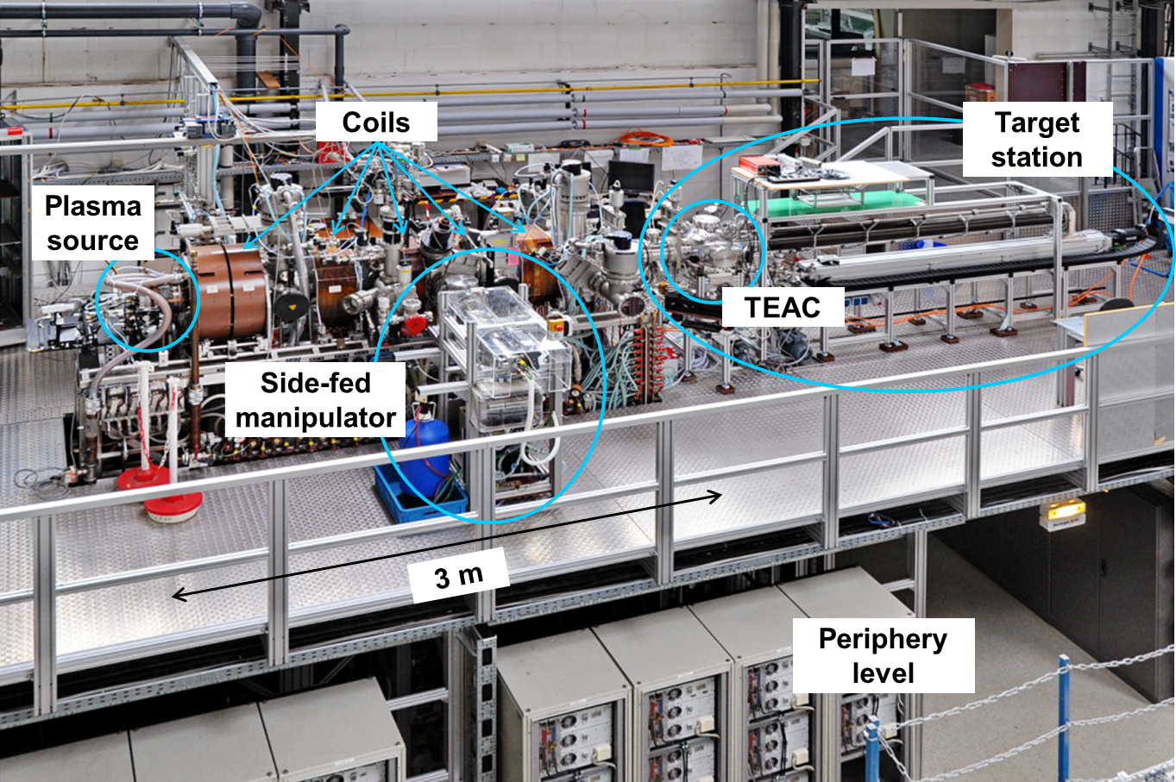
Setup of PSI-2

Slide 4
Spectroscopic studies at PSI-2
5
Plasma pressure : 0.01…0.1 Pa
Electron temperature: 1..20 eV
Electron density: 10¹⁰…10¹² cm⁻³
Magnetic field: 0.025…0.1 T
Ionization degree: 1-5%
(1-5 are the line-of-sights)
Visible spectroscopy use five line-of-sights
VUV Spectroscopy uses one line-of-sight ( # 4 )

Slide 5
High resolution spectroscopy (HRS)
a
photons
Fibers
spectrometer
b
Example of the spectra from H/D Lamp
D line
3p-2s
3d-2p
3s-2p
Spectral dispersion ~ 0.7 … 1.0 pm/ch
FWHM (Full Width Half Maximum) ~ 5-7 ch
H line
PSI-2
S. Ertmer , PhD thesis, High-resolution spectroscopy studies on sputtered atoms in the linear plasma device PSI-2
RUB Bochum, https://doi.org/10.13154/294-8580

Slide 6
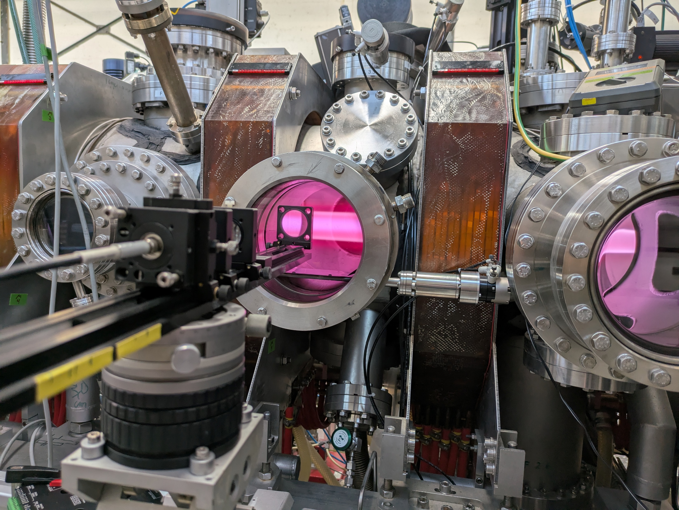
Measurements of
Balmer-lines at PSI-2 (ionizing plasma)
z=0 mm
Ti=3.3 eV
Hydrogen Lines consists at least
of two components :
- cold line ( not moving)
- hot line (moving)
z=24 mm
Line-of-sights
Ti=3.64 eV
z
Sp. res ~ 2mm

Slide 7
Measurements of
Balmer-lines at PSI-2 (Hγ) (ionizing plasma)
Hydrogen Lines consists at least
of two components :
- cold line ( not moving)
- hot line (moving)
Line-of-sights
z

Slide 8
Charge-exchange was considered for many years as the driving mechanism
of reaction.
However :
The similar effect is not observed in any other noble gases (Ar, Ne, He, ..)
There were no attempt to expaling the observed emission using reaction kinetics
  H + H⁺ → H⁺ + H* or H + H⁺ → H⁺ + H and H+ e → H*
  We tried to perform a simulation of the observed emission and
  come to the absolute different conclusion :

Slide 9
Impact of molecular ions on Balmer lines (one example)
Cold component :
H + e → H* + e
H₂ + e → H* + H + e
Hot compoment :
H₂⁺ + e → H + H* + e
H⁺ + H⁻ → H + H
Using new HRS data on hydrogen we able to fix the ionic and neutral components

Slide 10
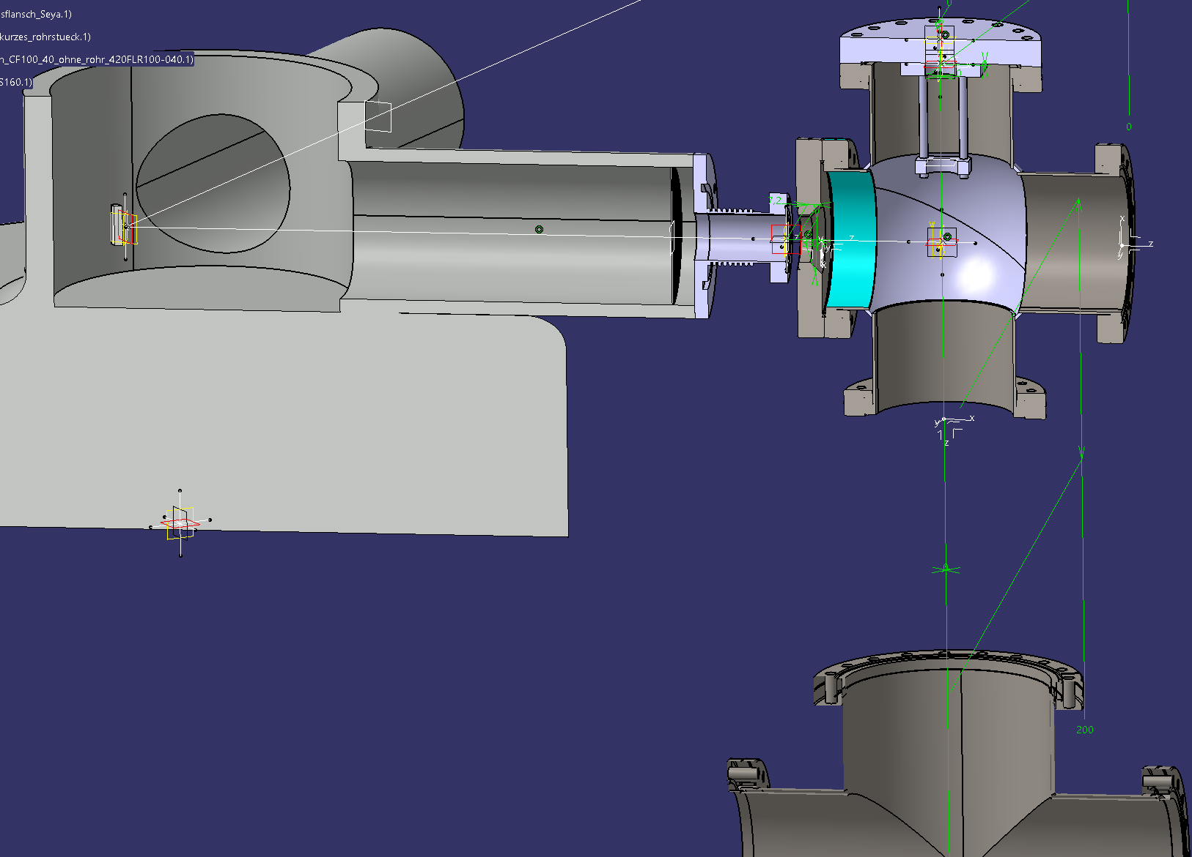
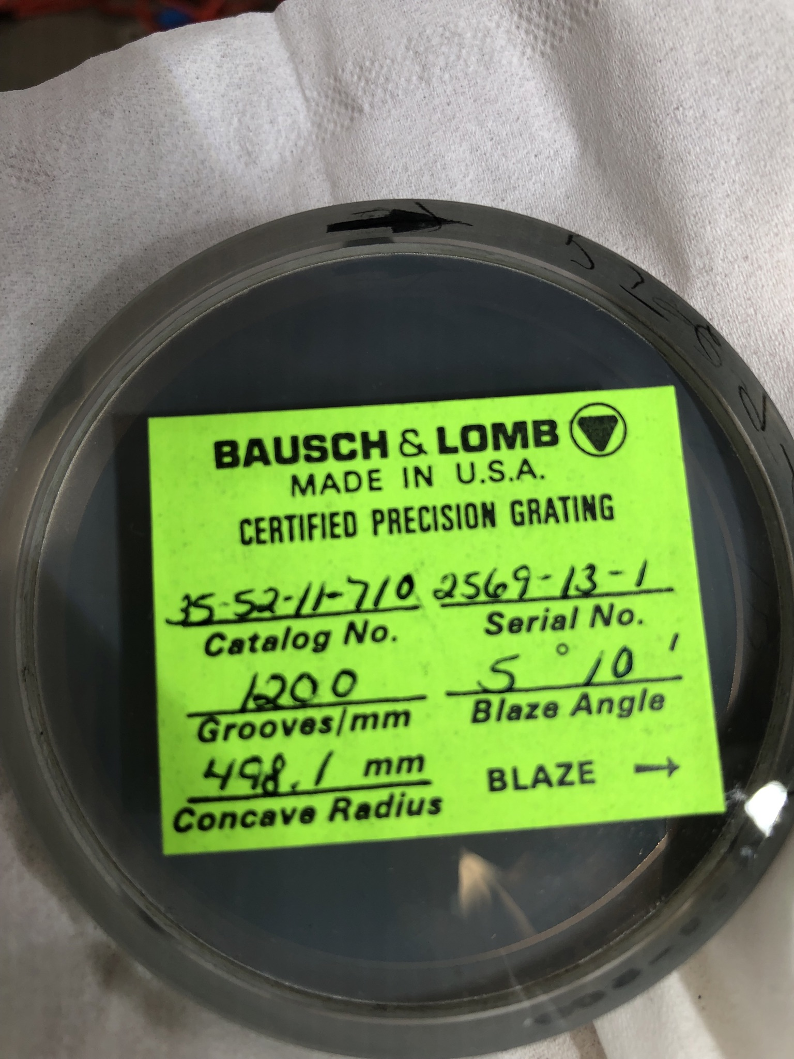
Progress in VUV spectroscopy at PSI-2
VIS
VUV
VUV Spectrometer:
McPherson Seya-Namioka ½ m
Grating: 1200 g/mm
Blaze wavelength – 150 nm
Detector: PMT R6095 (Hamamatsu)
+ Scintillator (McPherson)
Spectral range: 104 nm – 300 nm
slit (5mm x W)
DUV Parabolic Mirror, f = 8“
W = 20.. 50 μm
to PSI-2 Plasma
(edmond optics)
DUV Mirror
(movable)
LiF window
(to supress 2nd order and protect DUV mirror)
Optics size~ 1“

Slide 11
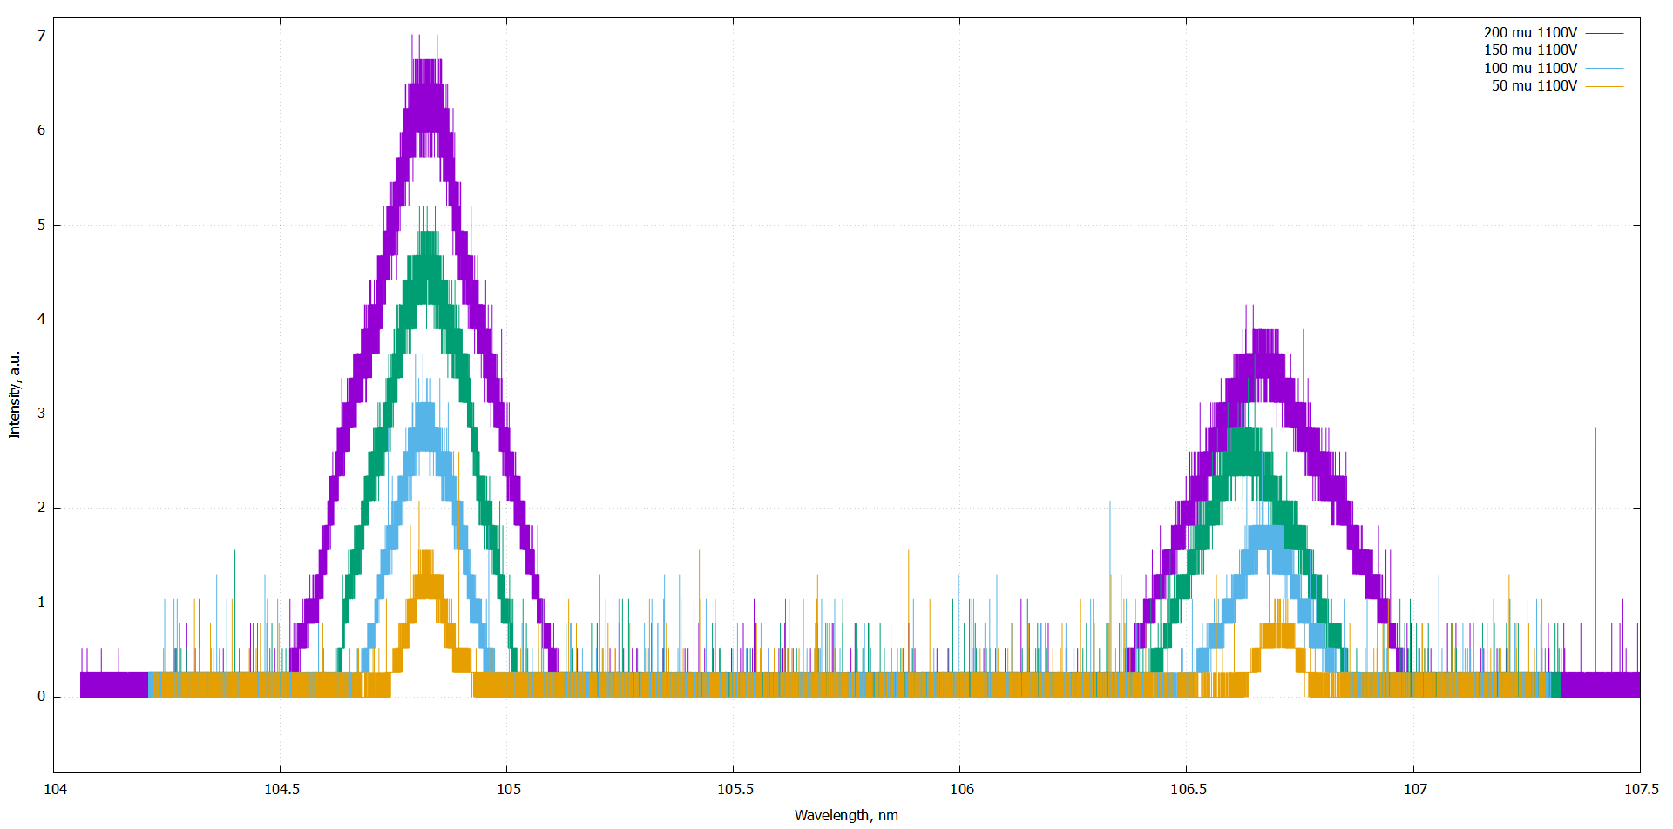
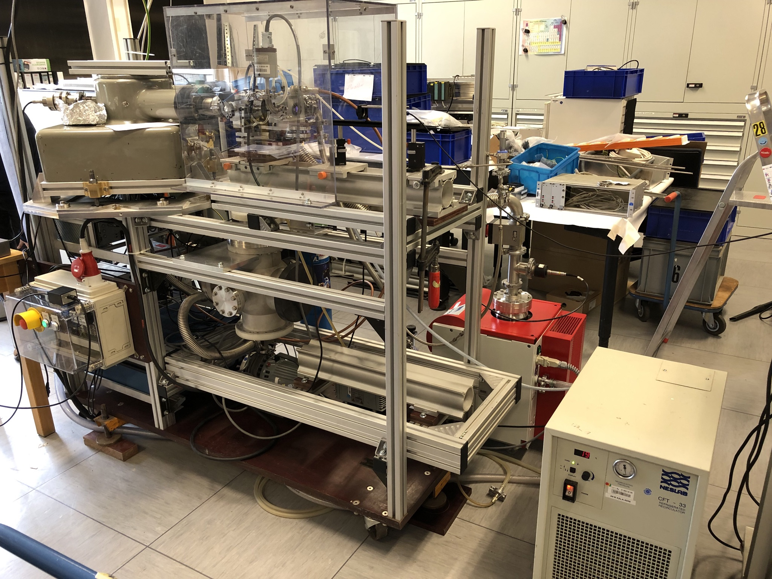
Exampe of the spectra Ar spectra from Hollow Cathode discharge
VUV monochromator
Ar I lines (104.8 and 106.67 nm) & 8-bit Picoscope
Hollow Cathode source
(box)
a)
b))
Testing the Dispersion, FWHM and the Linearity of the VUV and PMT.
NIST, „Self Study Manual on Optical Radiation Measurements“ (1979)
The problem with transmission during wavelength scan of VUV monochromator
was detected (see video). The problem was resolved.
(Secondary) Absolute calibration Source up to 146 nm (Ar, Ne, Kr and Xe)
The VUV spectrometer will be installed at PSI-2 in the 1-2 week of December
Measurements of H- and D-Plasma this year
J. Hollandt, M. Kühne and B. Wende, Applied Optics 33 68 (1994)

Slide 12
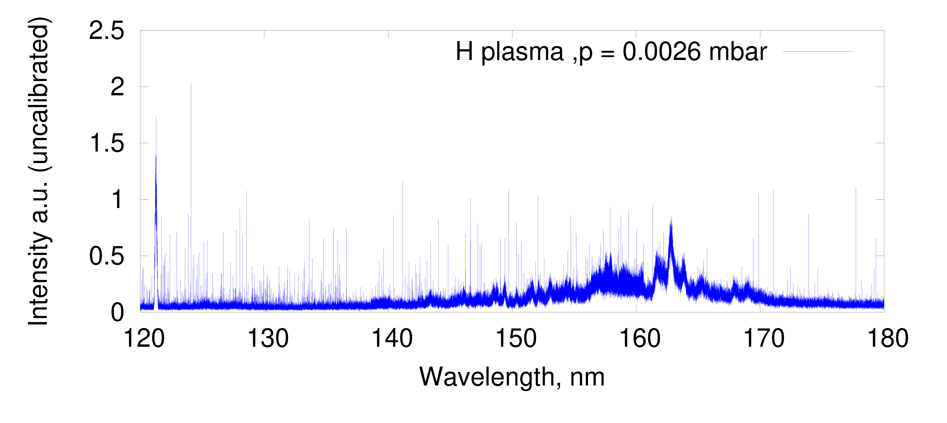
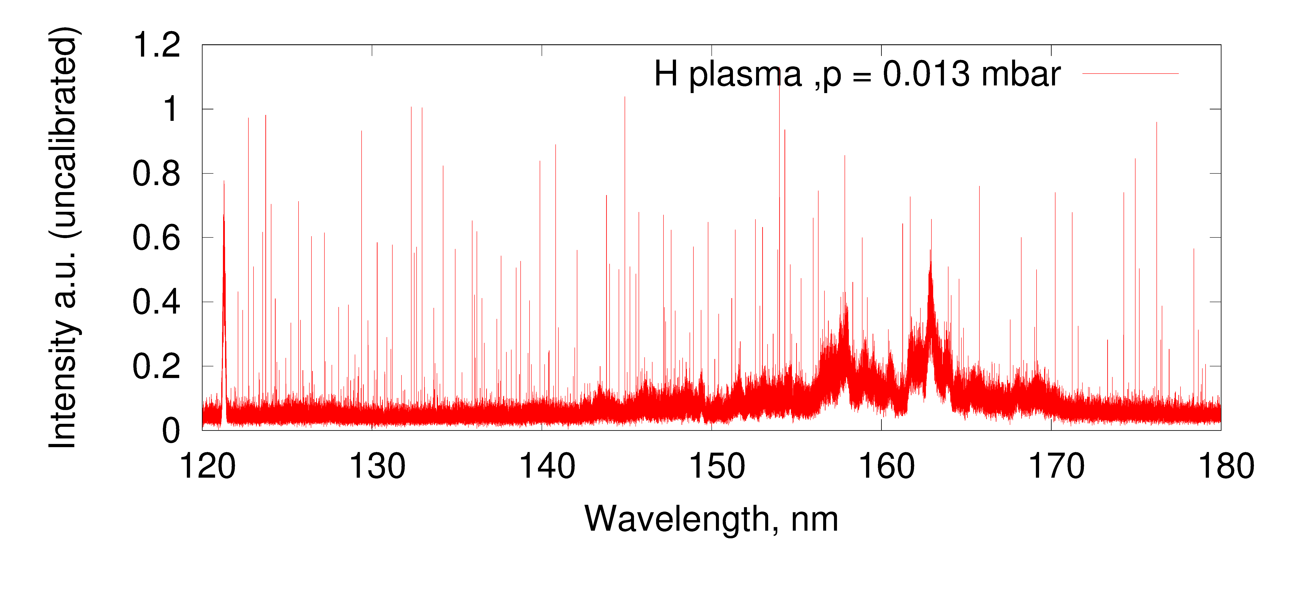
First VUV Spectra from PSI-2
First VUV spectra from the PSI-2 plasma
in December 2024
The relative calbiration of the spectra
has to be performed.
The alignment of the optics has to be performed
The focusing mirror has to be replaced with
the better one (R ~ 70-80% @ 120- 200 nm)

Slide 13
Imaging spectrometer.
Molecular and Atomic Spectra at the PSI-2 in the VIS range (350 – 660 nm)
A. Pospieszczyk et al, J. Nucl. Mat. 438 S1249 (2013)
VUV and VIS spectroscopy at the same positions (different optics)
Provide input for the modelling of the spectra

Slide 14
Modelling of the Molecular and Atomic lines using (Yacora, Sawada, …) codes
Measurements of concentrations and role of molecular ions in ionizing and recombined plasma of PSI-2
New experimental data from the VUV Lines
Relative calibration of the spectrometers
Radial scan using the different line-of-sights
A. Pospieszczyk et al, J. Nucl. Mat. 438 S1249 (2013)

Slide 15
Conclusion
Progress on atomic and molecular spectroscopy at the PSI-2
  Very accurate data on Balmer-lines were obtained in the 2024 & 2025.
  VUV Spectrometer was put into operation in 2024.
  (The new parabolic mirror should improve the spectra statistics in 2025)
The emission of lines is strongly impacted by presence of molecular ions . The impact of H₂⁺ was ingored in the past. Balmer-series in ionizing and recombined plasma was measured and is going to be investigated.

