Slide 1
Measuring H₂ molecules in divertor plasmas Development of a new CARS diagnostic for linear plasma devices
Kay Schutjes¹, Ivo Classen¹, Jordy Vernimmen¹, Hennie van der Meiden¹, and the Magnum-PSI Team¹
1. DIFFER, Eindhoven, Netherlands

Slide 2
Section 1
Motivation

Slide 3
Neutrals Crucial for Detachment
Neutrals determine plasma dynamics near divertor ^{1,2,3,4}
Only passive spectroscopy measurements performed → No accurate H₂(ν,J) electronic ground state information!
Ion sinks essential for detachment ^{2,4} Important example:
CX: H₂(ν,J) + H⁺ → H₂⁺ + H*
MAR: e⁻ + H₂⁺ → 2H
Endothermic reaction; ν≥4 needed ⁵
But what is H₂(ν,J) density?
1) N. Ohno, Plasma Phys. Control. Fusion (2017)
2) S.I. Krasheninnikov and A.S. Kukushkin, J. Plasma Phys. (2017) 3) A. Loarte, et al., Nucl. Fusion (2007)
4) K. Verhaegh, et al., ArXiv.org (2024)
5) M.J. De Graaf, et al., Phys. Rev. (1993)

Slide 4
Research Goal
Directly measure H₂(ν,J) populations in the electronic ground state
Full H₂(ν,J) overview requires two diagnostics This talk only discusses CARS (Coherent Anti-Stokes Raman Scattering)

Slide 5
Section 2
How CARS can measure H₂ (ν,J)

Slide 6
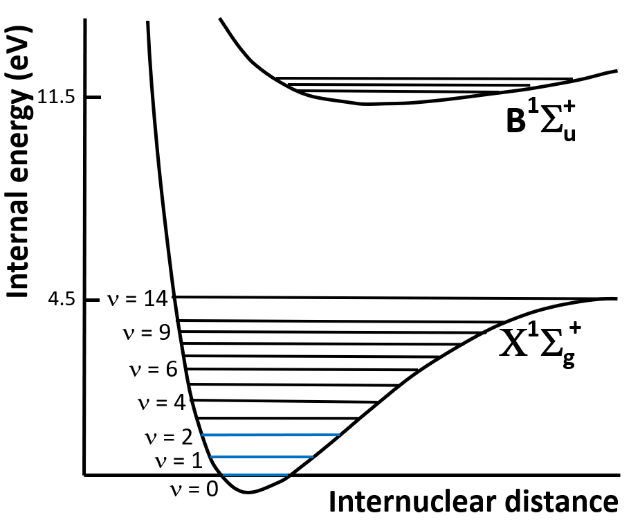
Measuring H₂ – States we focus on

Slide 7
Measuring H₂ - States we focus on

Slide 8
Measuring H₂ - States we focus on
J = 0,1,…
J = 0,1,…
J = 0,1,…

Slide 9
Measuring H₂ - CARS Explanation
CARS: Coherent Anti-Stokes Raman Scattering
ν₂=x+1
ν₁=x

Slide 10
Measuring H₂ - CARS Explanation
Virtual state
CARS: Coherent Anti-Stokes Raman Scattering
Two-step process:
1) Couple 2 vibrational states of H₂ Use 2 lasers: Pump and Stokes ω_{Pump} - ω_{Stokes} = ΔE_{vib}
Virtual state
ω_{Pump}
ω_{Stokes}
ν₂=x+1
ν₁=x

Slide 11
Measuring H₂ - CARS Explanation
Virtual state
CARS: Coherent Anti-Stokes Raman Scattering
Two-step process:
1) Couple 2 vibrational states of H₂ Use 2 lasers: Pump and Stokes ω_{Pump} - ω_{Stokes} = ΔE_{vib} 2) ‘Excite’ state Measure Anti-Stokes photons → Indication for population density → Larger intensity + coherent beam
Virtual state
ω_{Anti-Stokes}
ω_{Pump}
ω_{Stokes}
ω_{Pump}
ν₂=x+1
ν₁=x

Slide 12
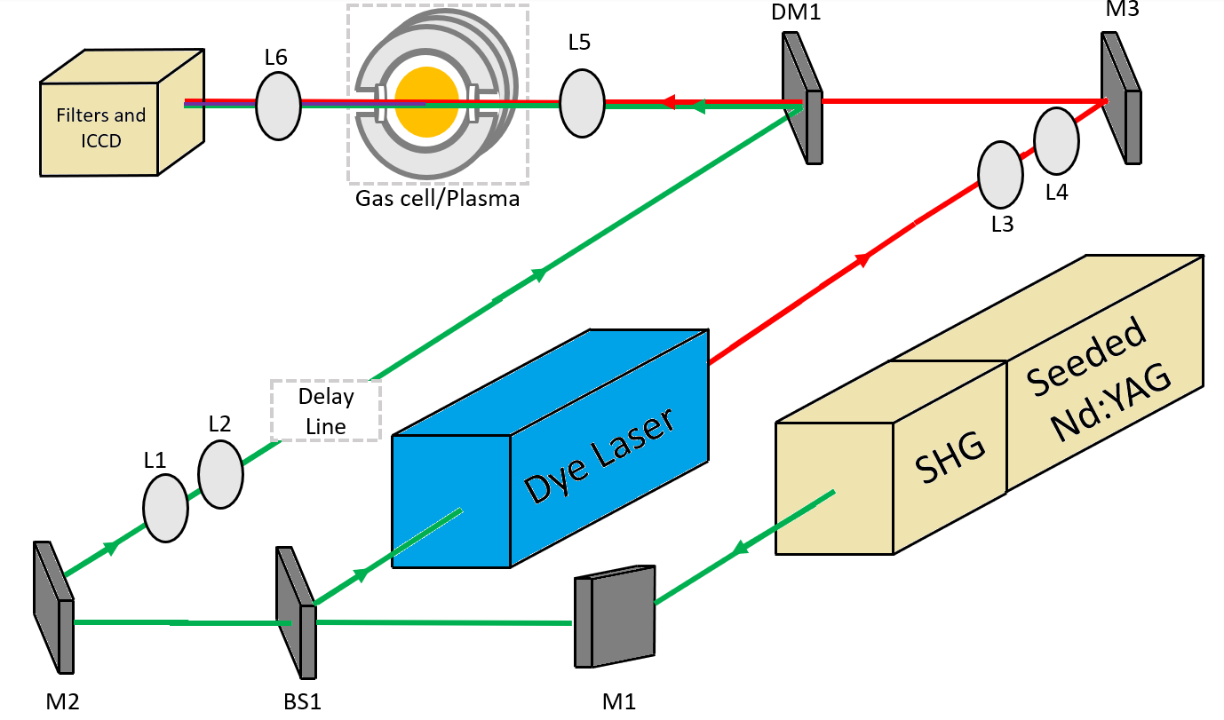
CARS Setup

Slide 13
Section 3
First CARS results on linear plasma device UPP

Slide 14
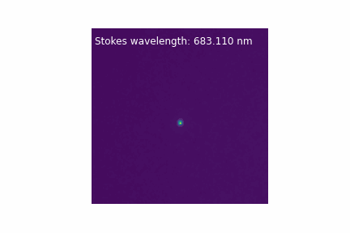
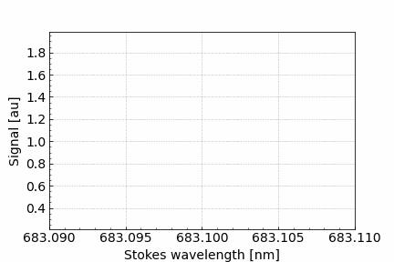
H₂(ν=0,J=1) Signal measured in UPP plasma

Slide 15
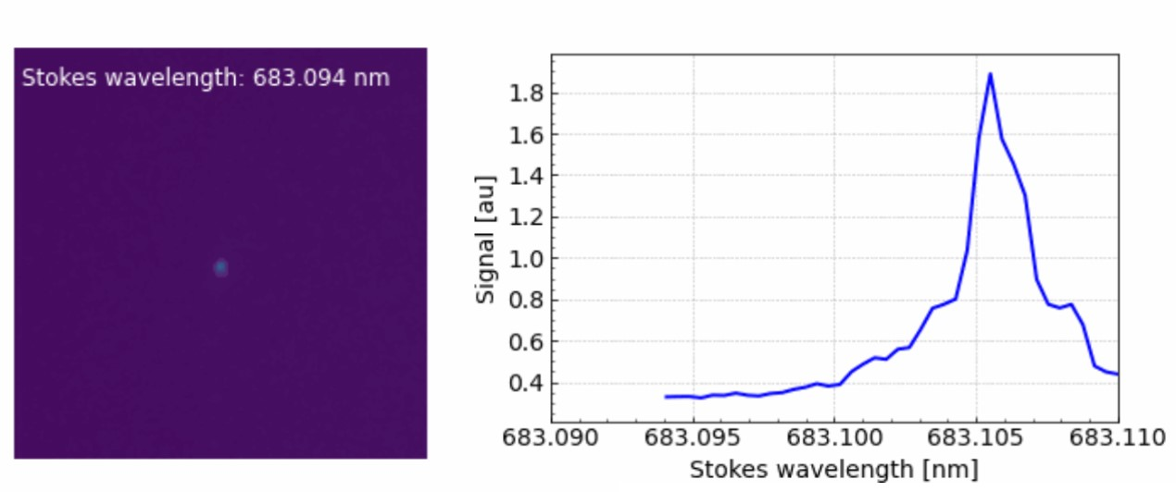
H₂(ν=0,J=1) Signal measured in UPP plasma

Slide 16
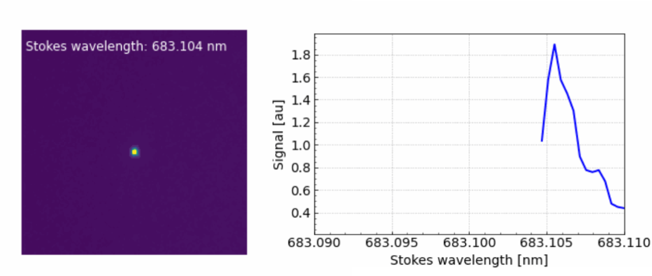
H₂(ν=0,J=1) Signal measured in UPP plasma

Slide 17
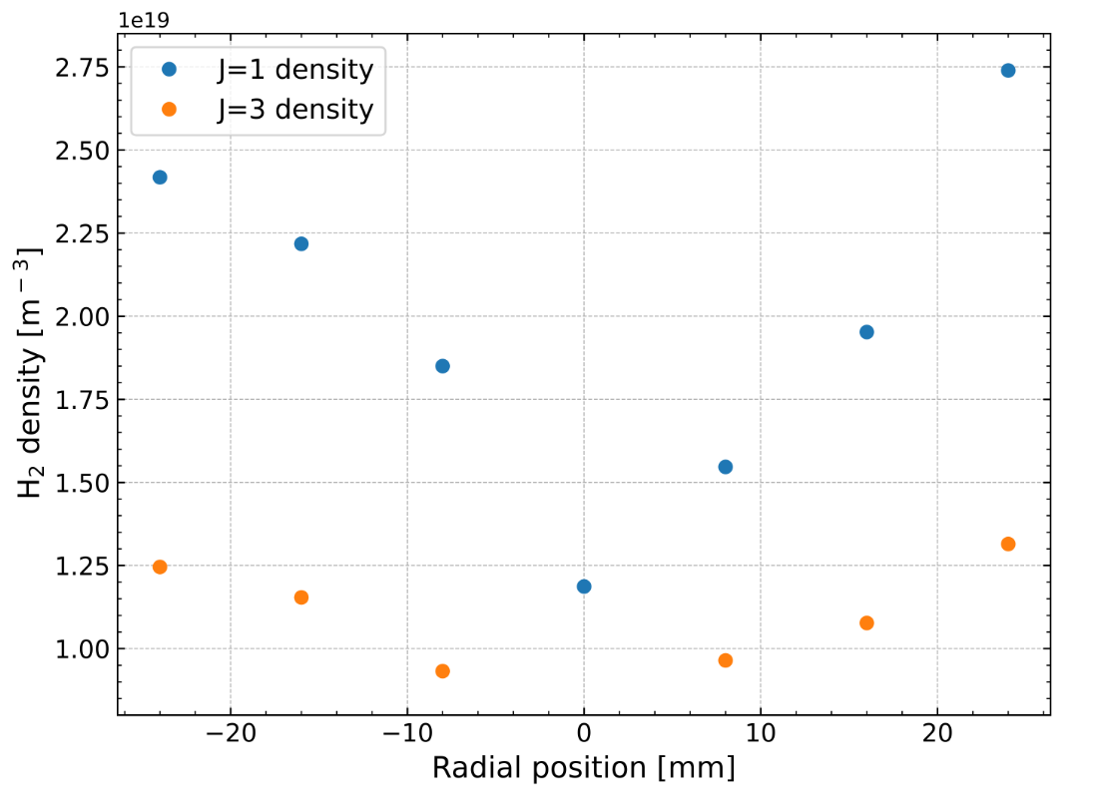
Measured radial density profiles for H₂(ν=0,J)

Slide 18
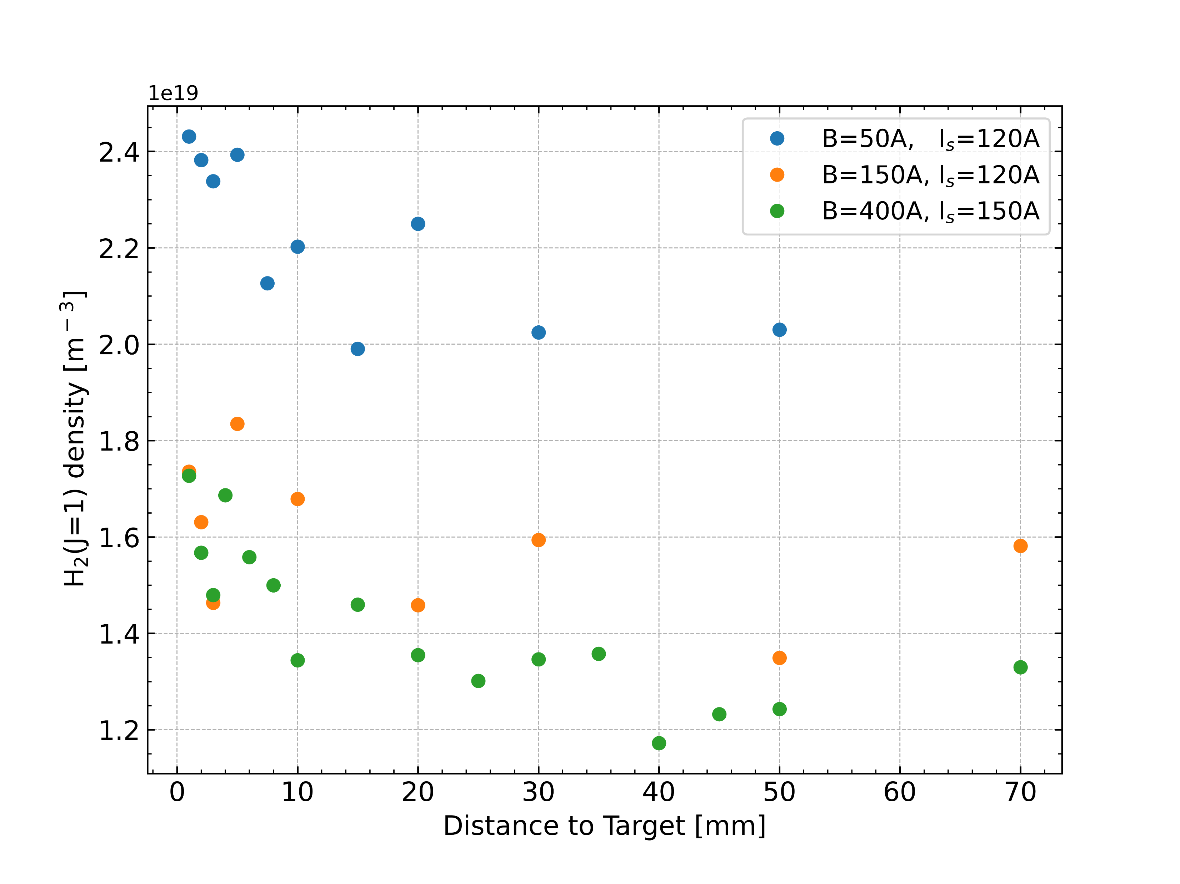
Measured axial density profiles for H₂(ν=0,J=1)

Slide 19
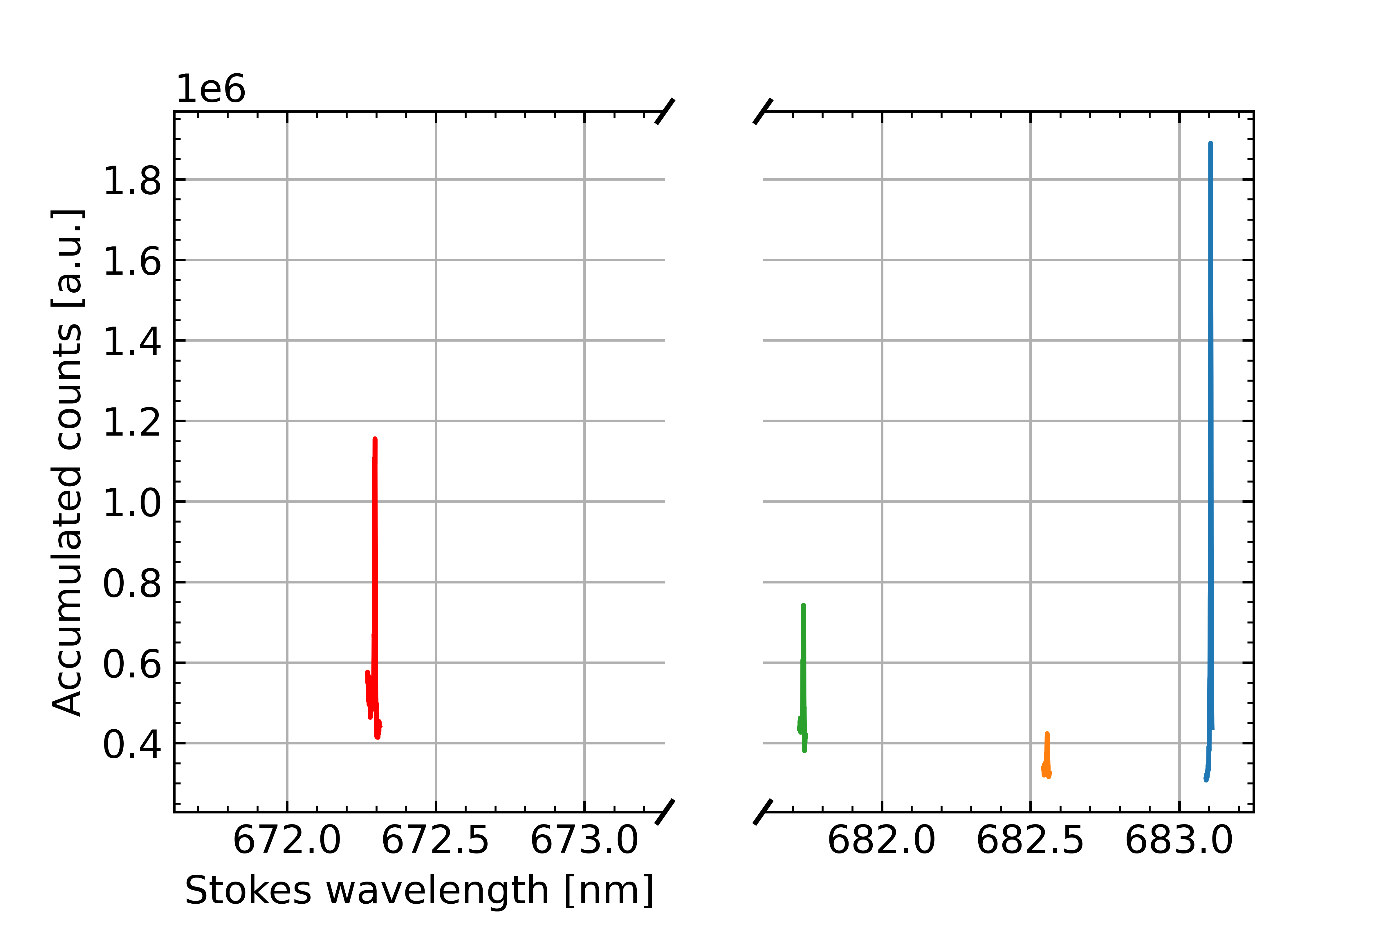
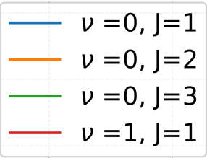
Multiple H₂(ν,J) states measured in plasma
Same as gif, but zoomed-out for several states
What causes detection limit?

Slide 20
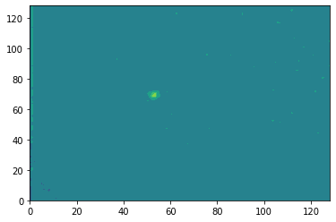
Background signal in UPP – Vacuum, no Plasma

Slide 21
Section 4
Improving CARS sensitivity

Slide 22
Ideal CARS vs reality
Virtual state
Virtual state
Virtual state
Virtual state
ω_{Anti-Stokes}
ω_{Anti-Stokes}
ω_{Pump}
ω_{Pump}
ω_{Stokes}
ω_{Pump}
ω_{Stokes}
ω_{Pump}
ν₁=x+1 Virtual state
ν₂=x+1
ν₁=x
ν₁=x

Slide 23
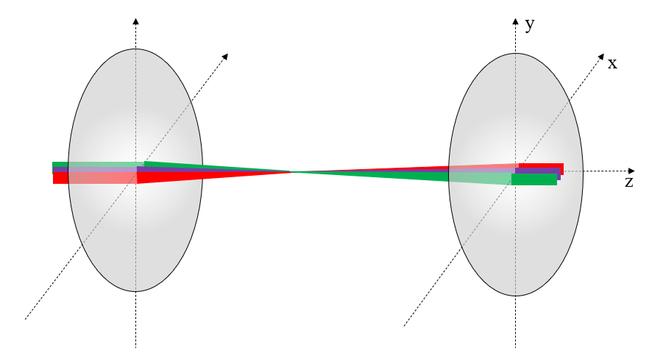
Colinear CARS Laser Configuration
Virtual state
Virtual state
ω_{Anti-Stokes}
ω_{Pump}
ω_{Stokes}
ω_{Pump}
Lens
Lens
ν₁=x+1 AND Virtual state
ν₁=x

Slide 24
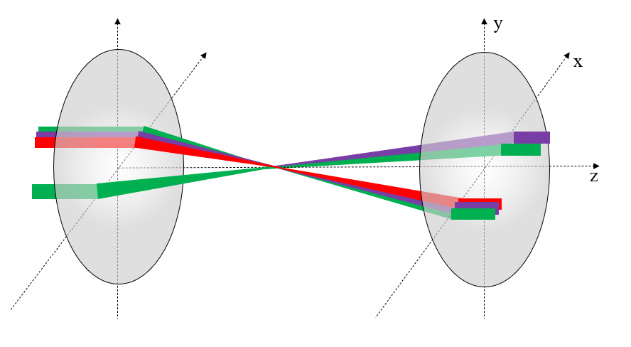
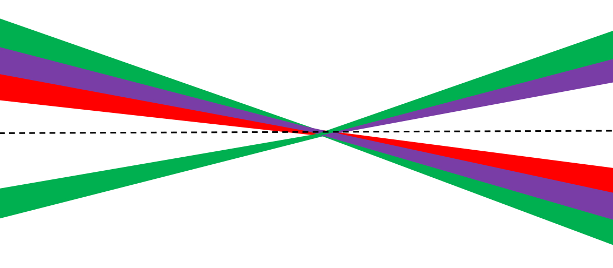
BOXCARS Laser Configuration
Virtual state
Virtual state
ω_{Anti-Stokes}
ω_{Pump}
ω_{Stokes}
ω_{Pump}
Lens
Lens
ν₂=x+1
ν₁=x

Slide 25
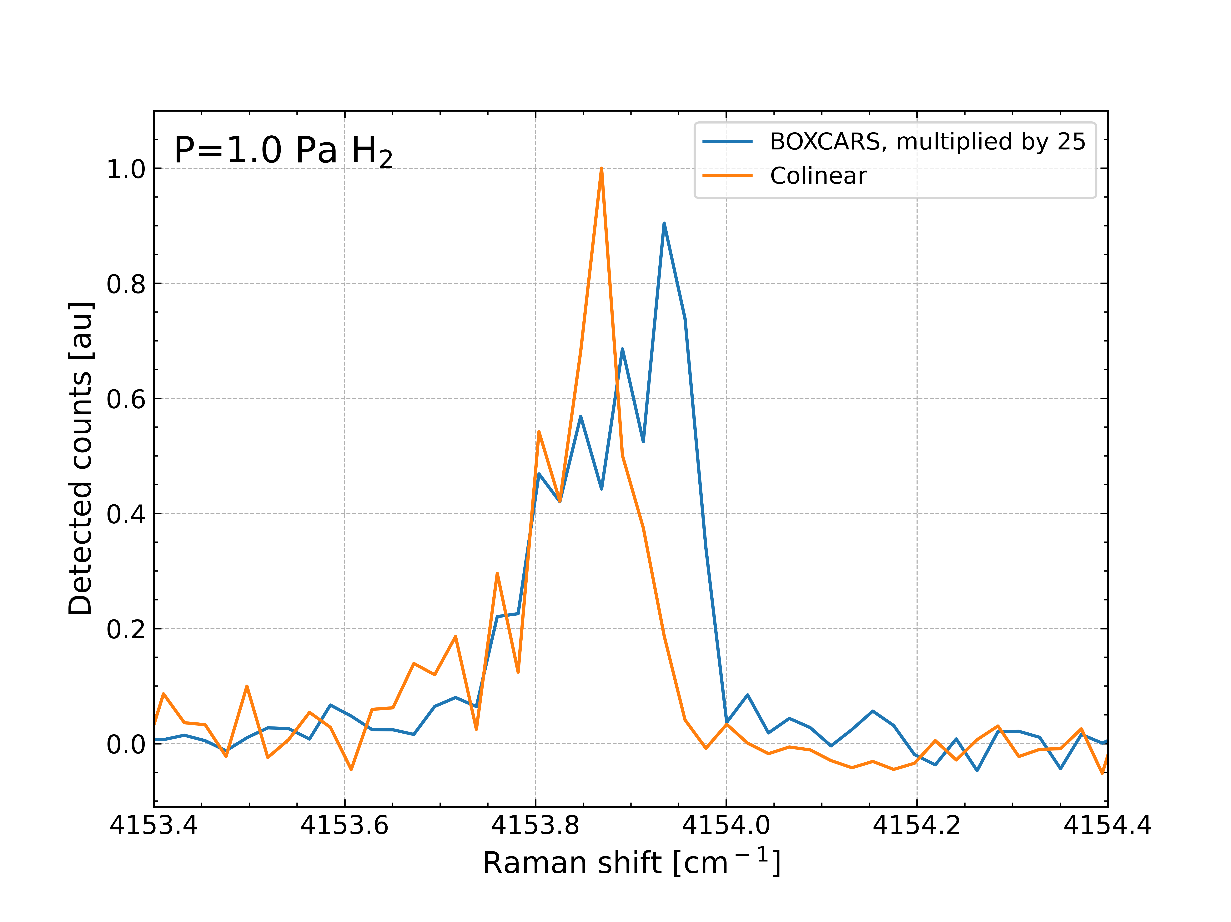
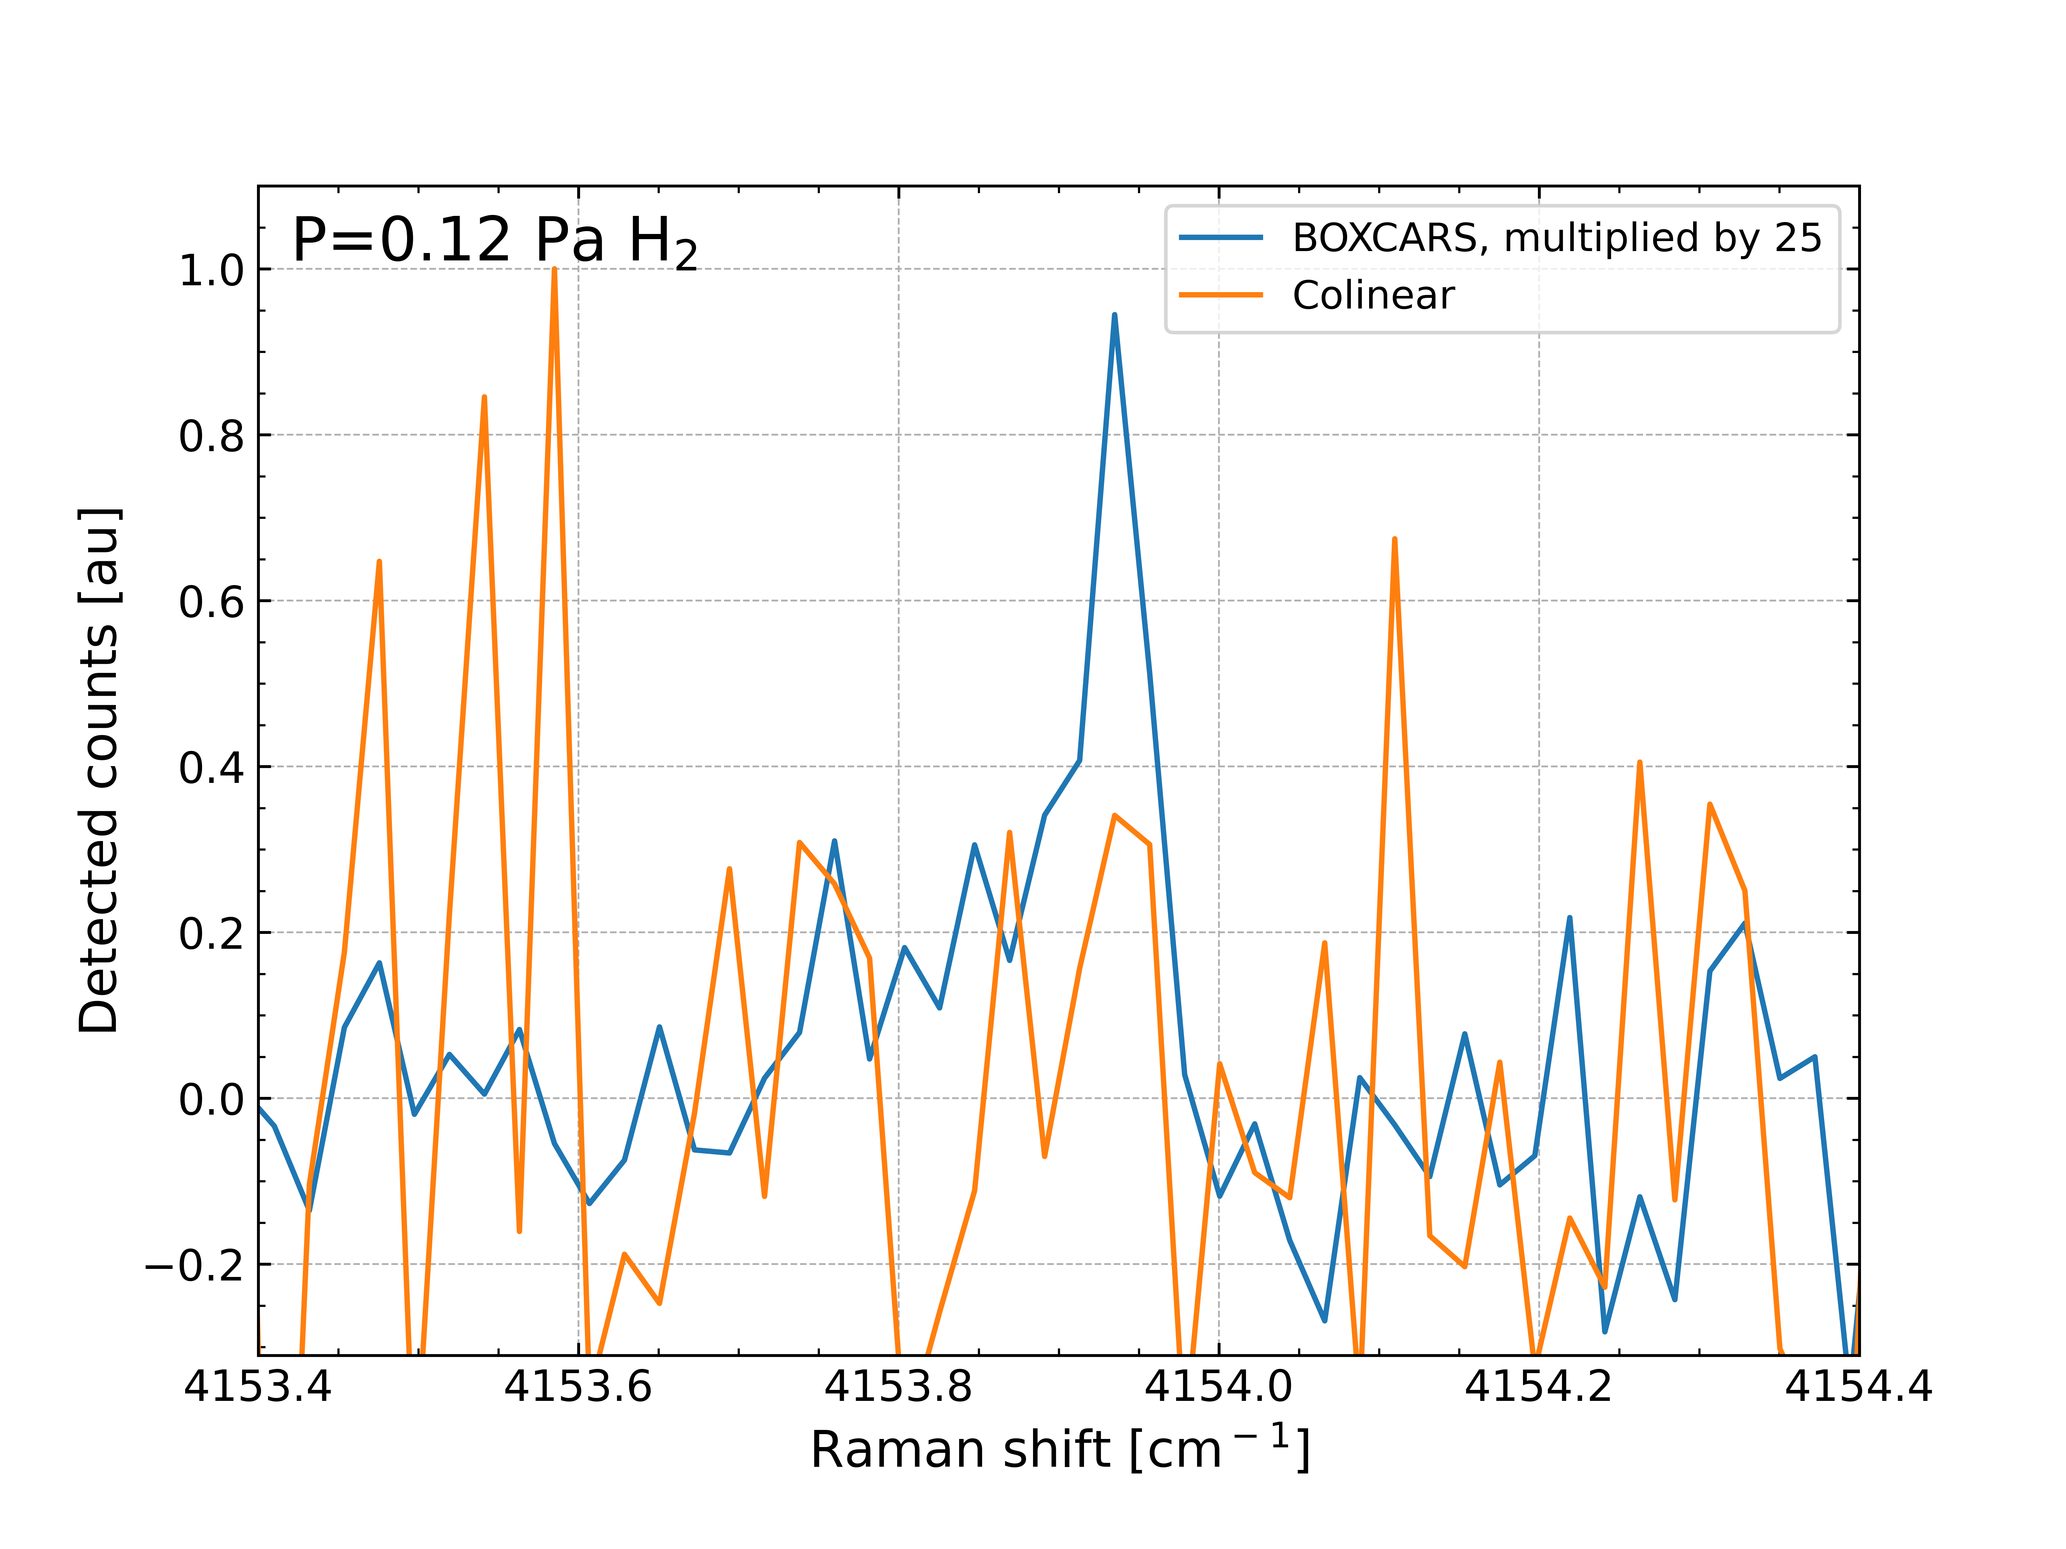
Comparison of Sensitivities in Lab
Notes:
1e19 m⁻³

Slide 26
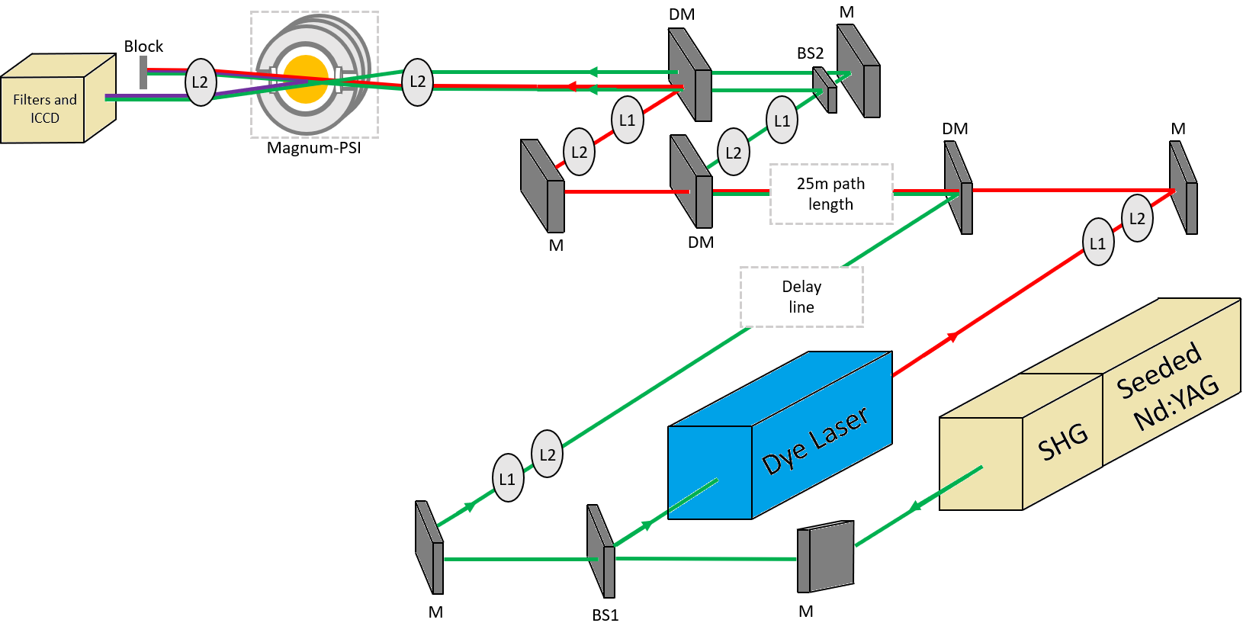
BOXCARS Setup

Slide 27
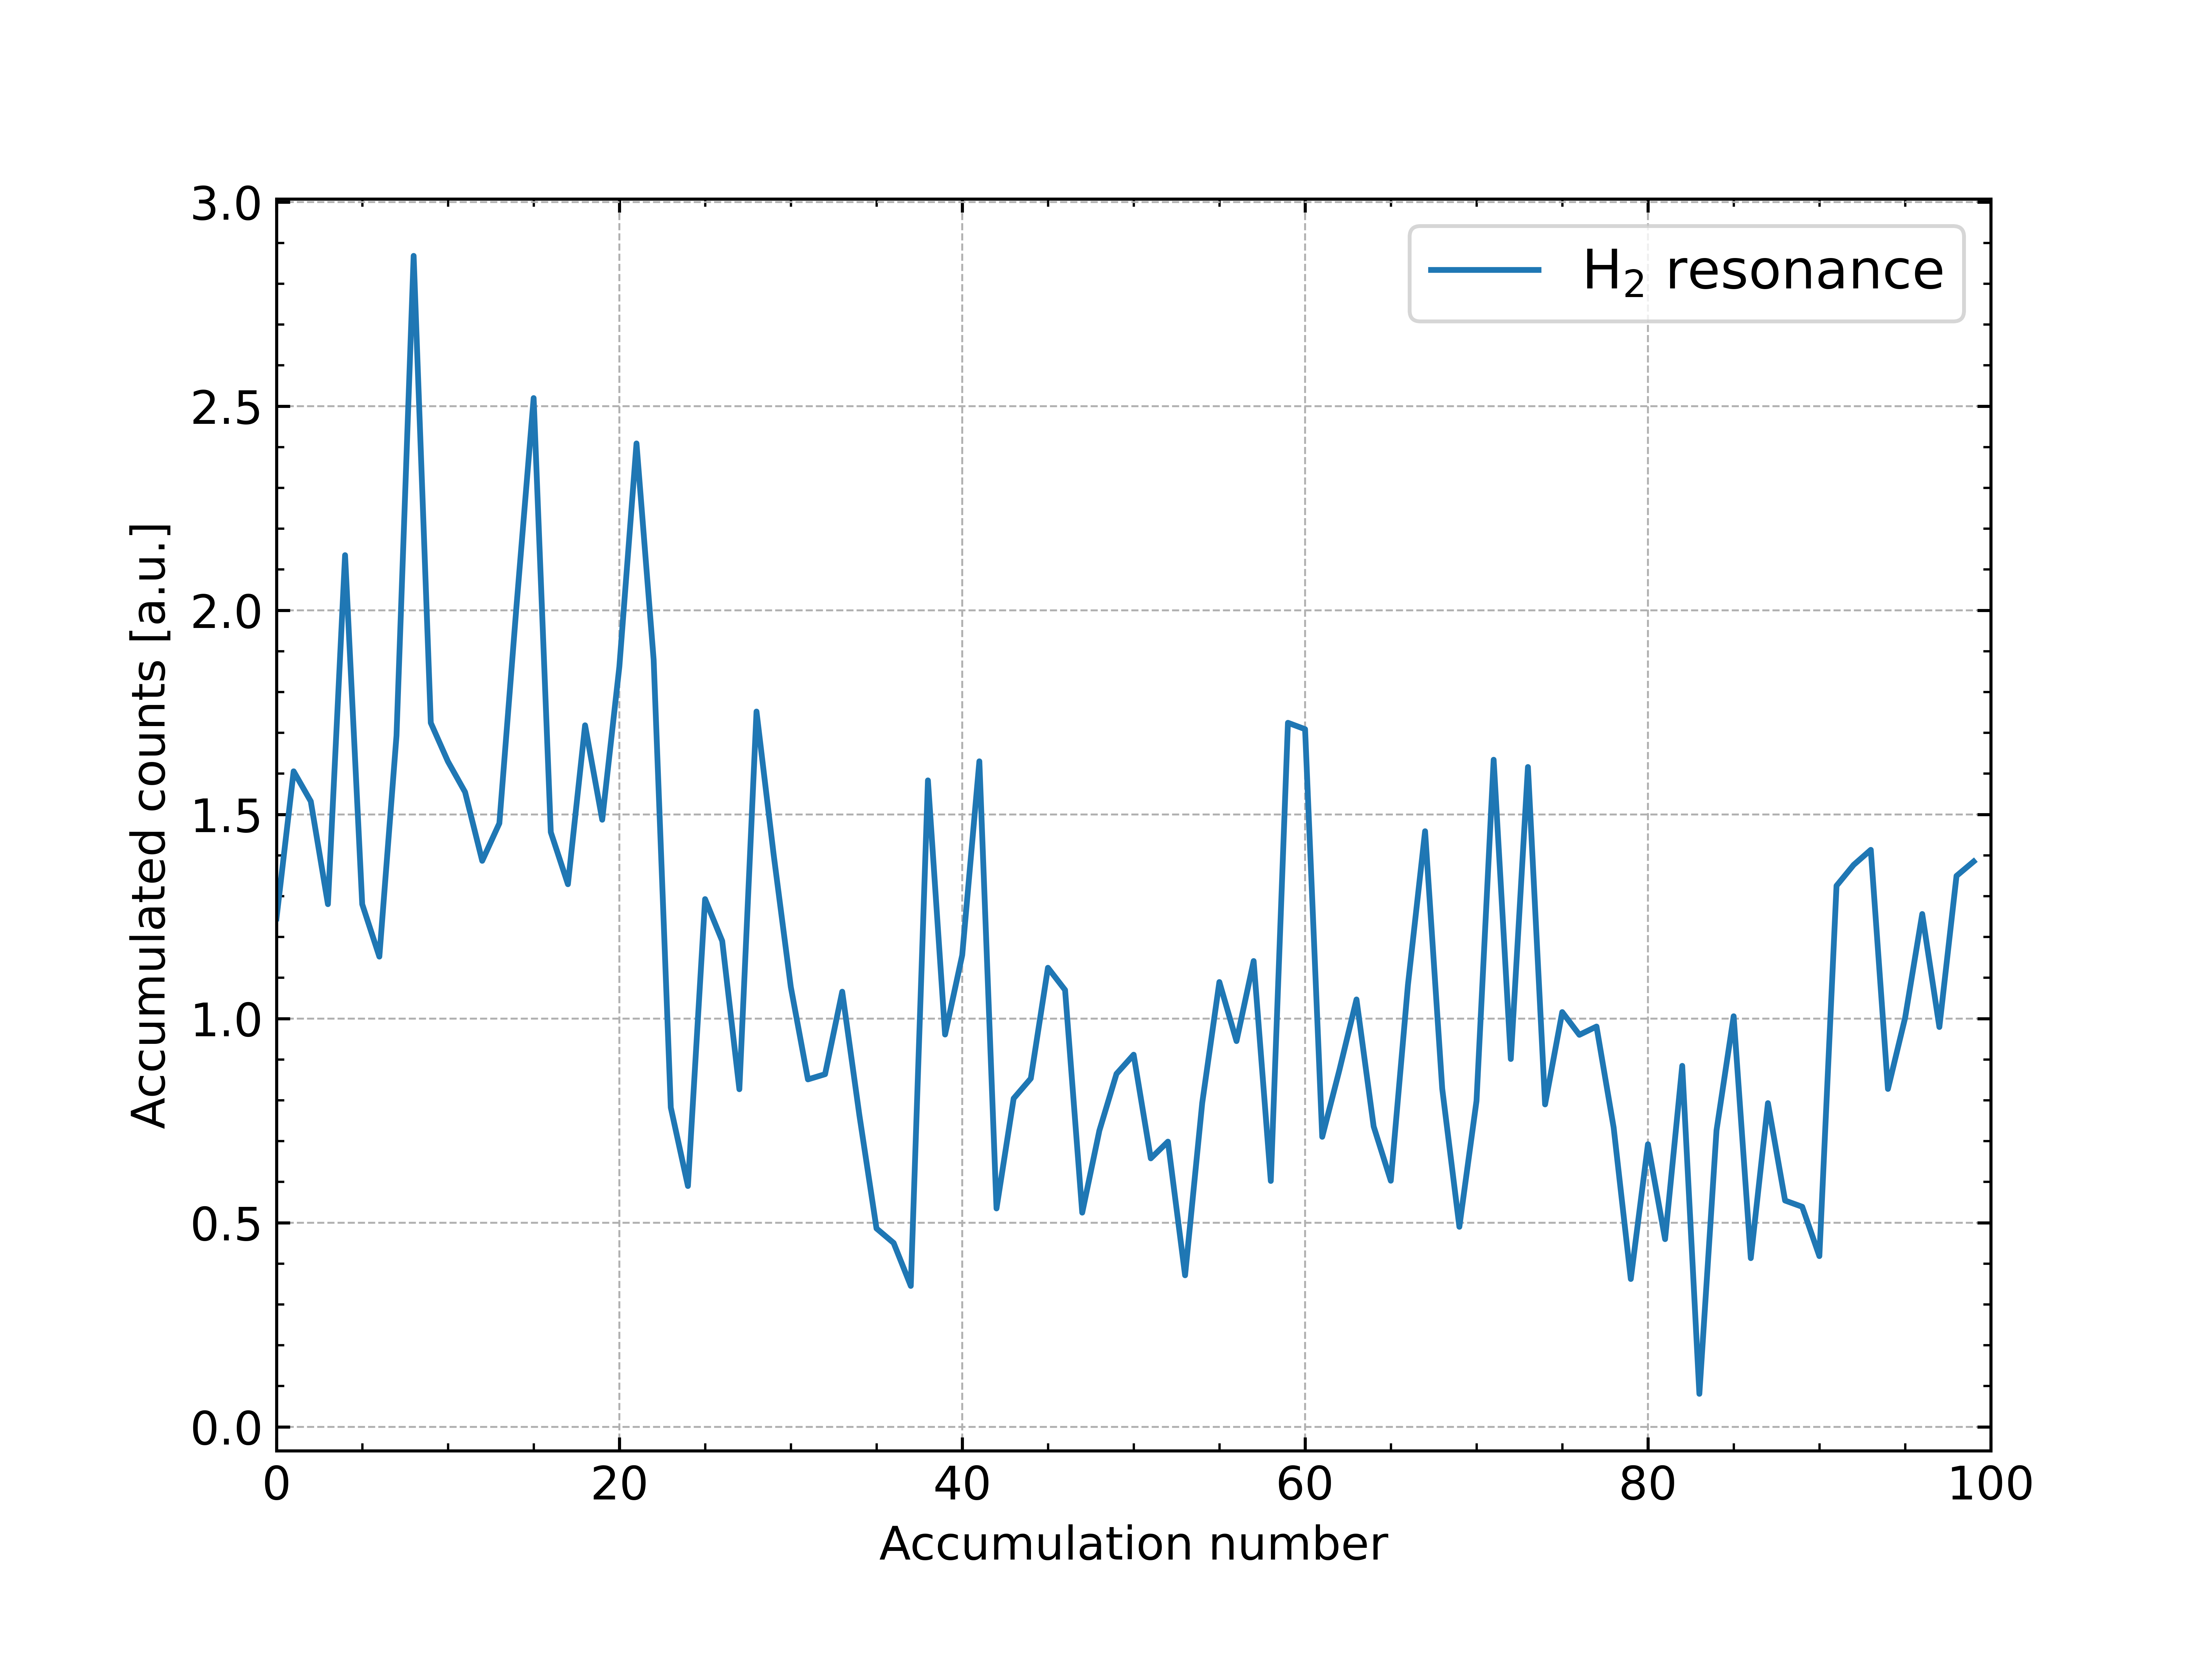
Signal fluctuations in CARS

Slide 28
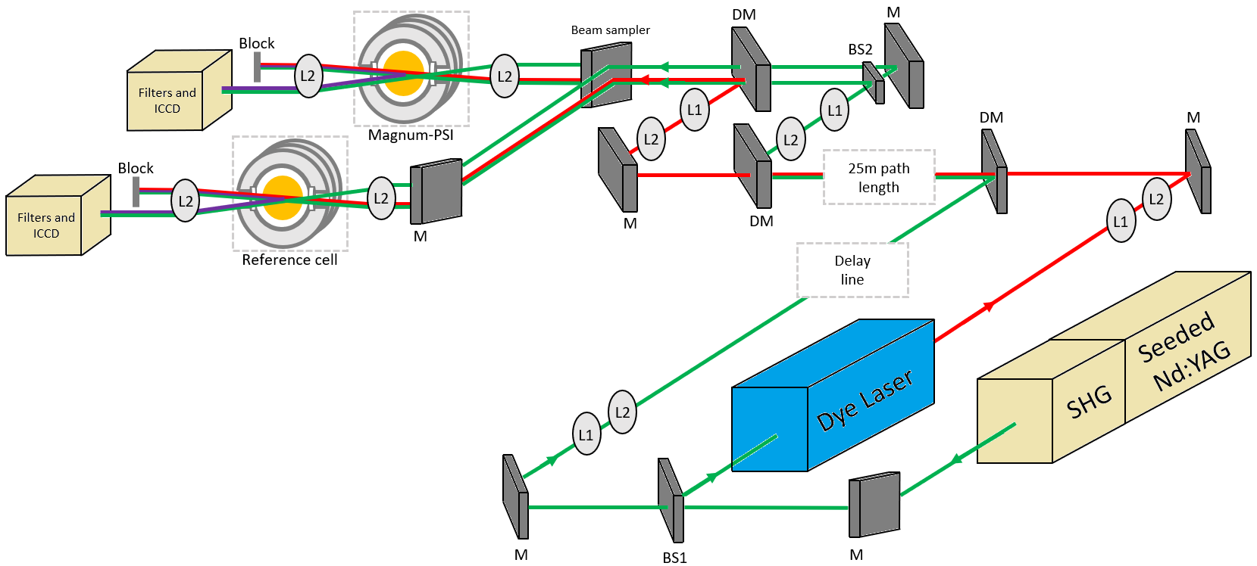
BOXCARS Setup – w. Reference cell to monitor fluctuations

Slide 29
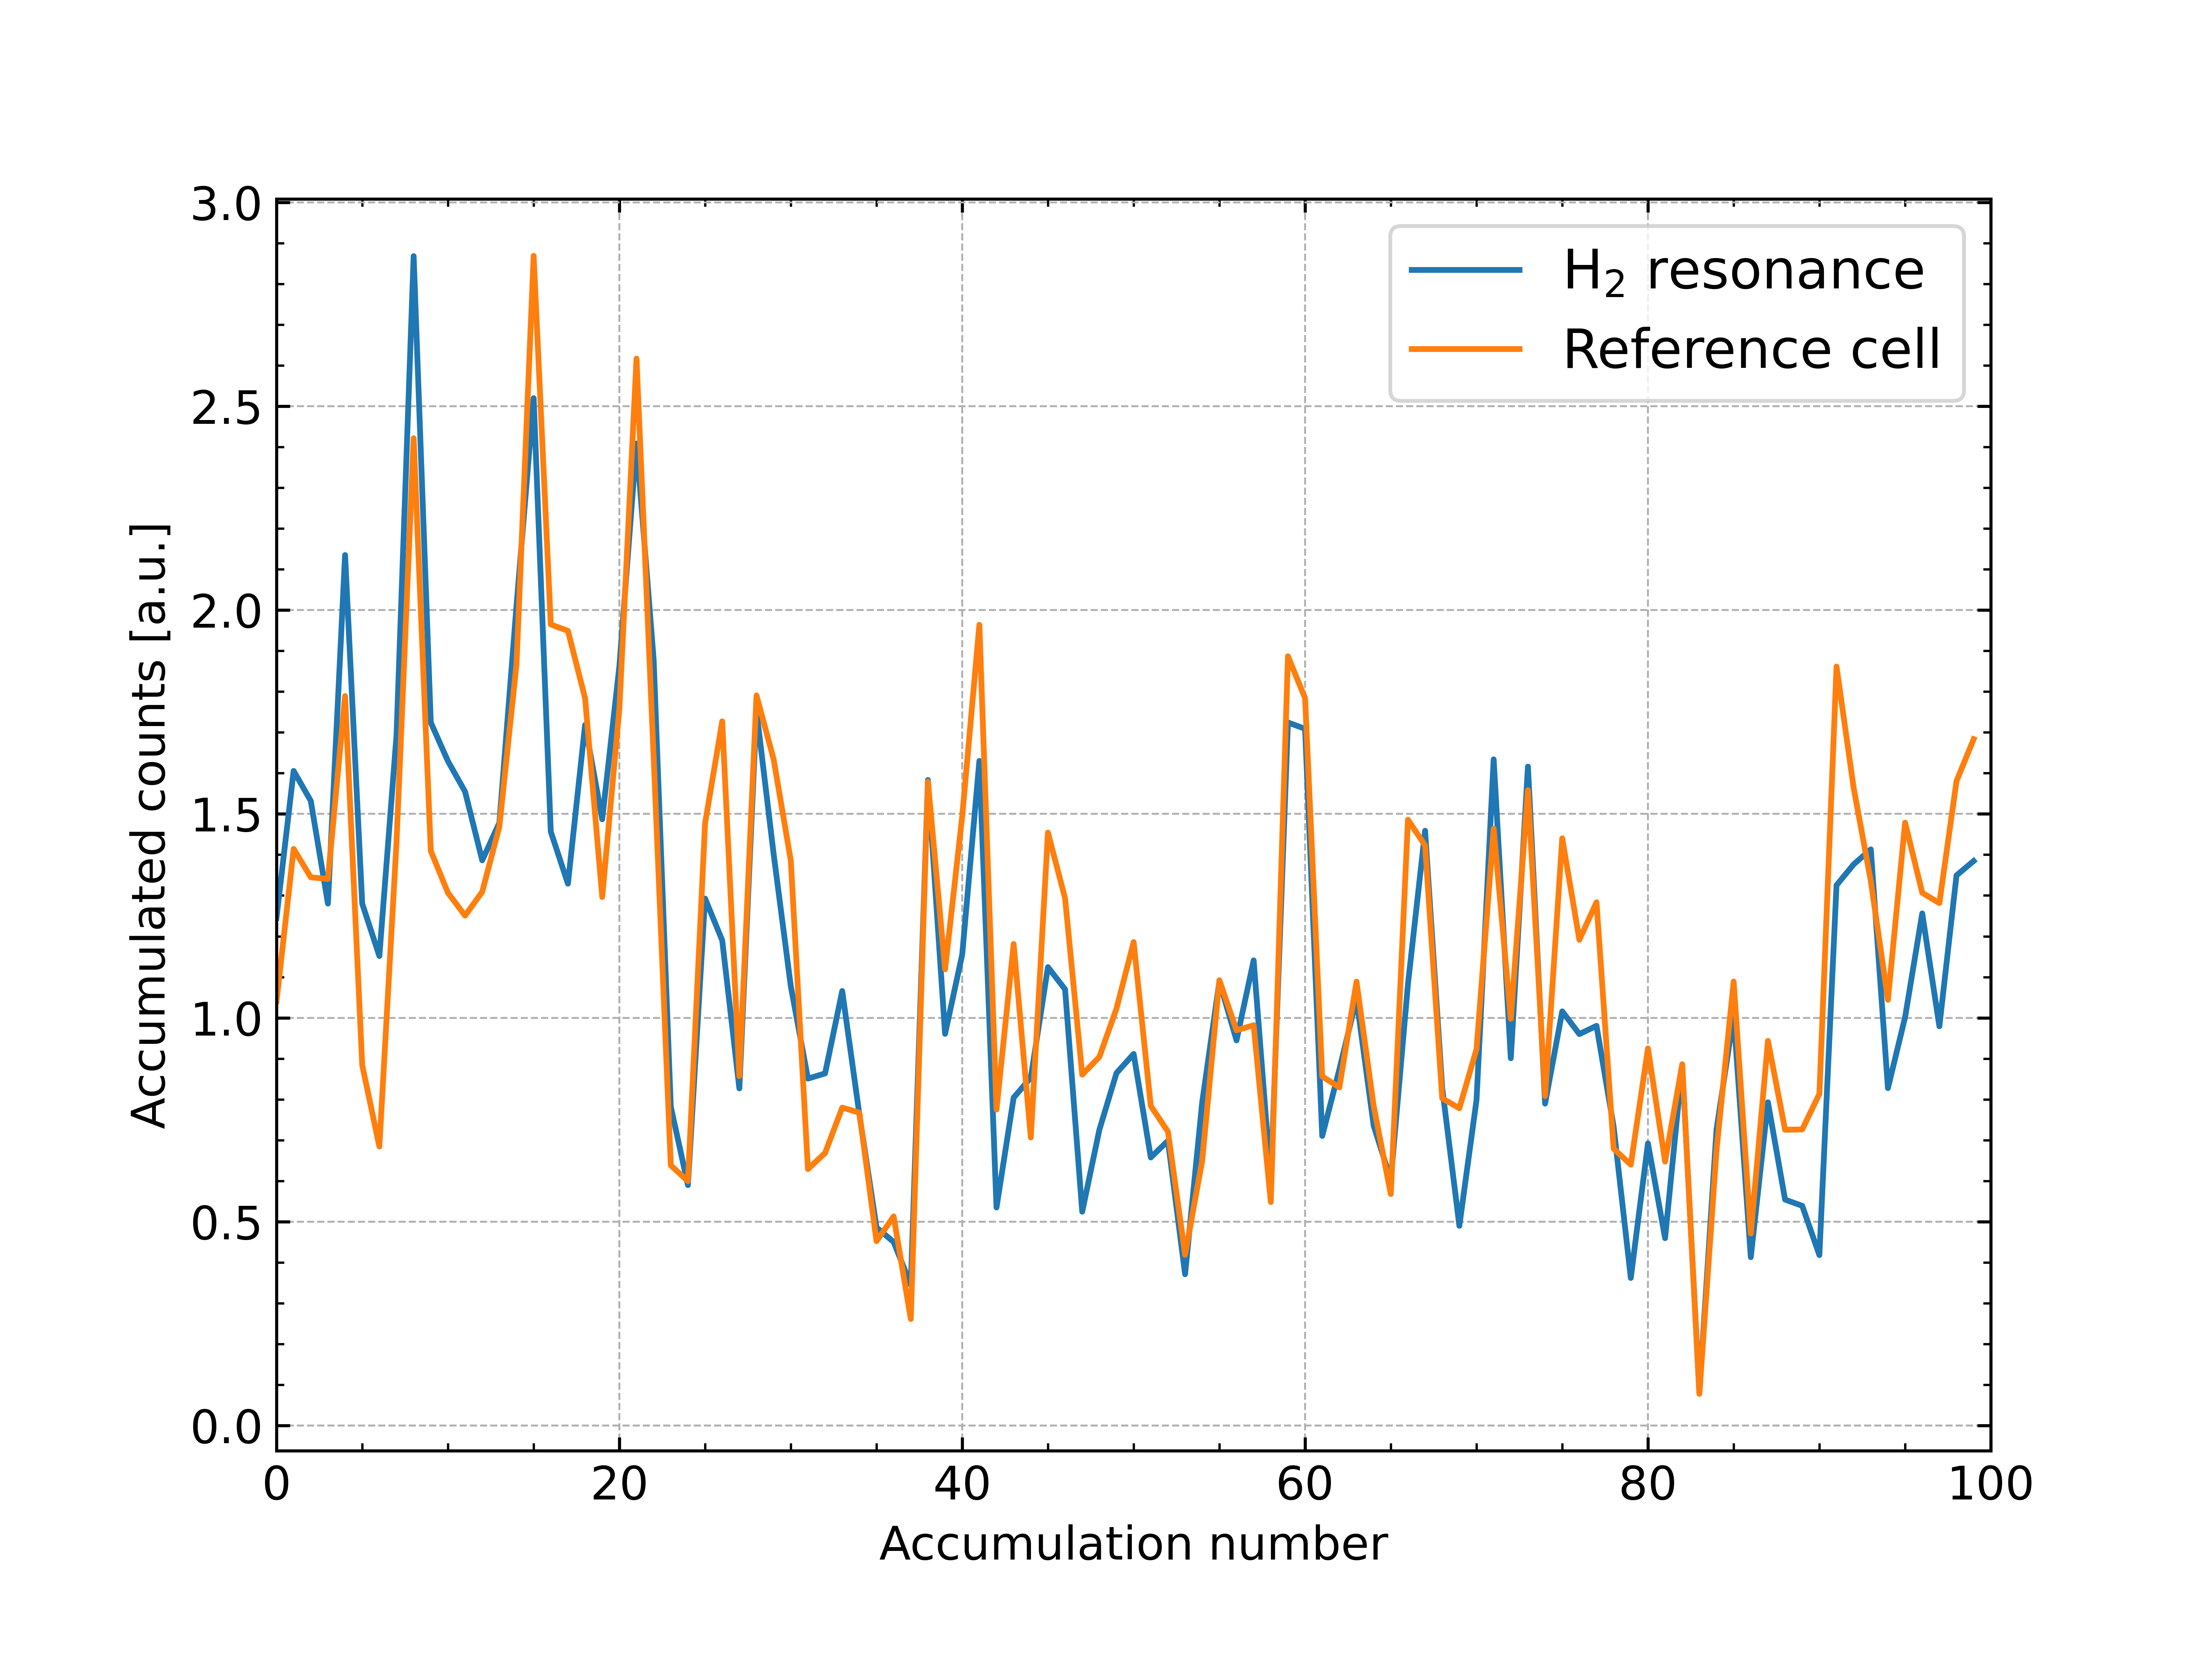
Signal fluctuations in CARS

Slide 30
Section 5
Preliminary BOXCARS results on Magnum-PSI

Slide 31
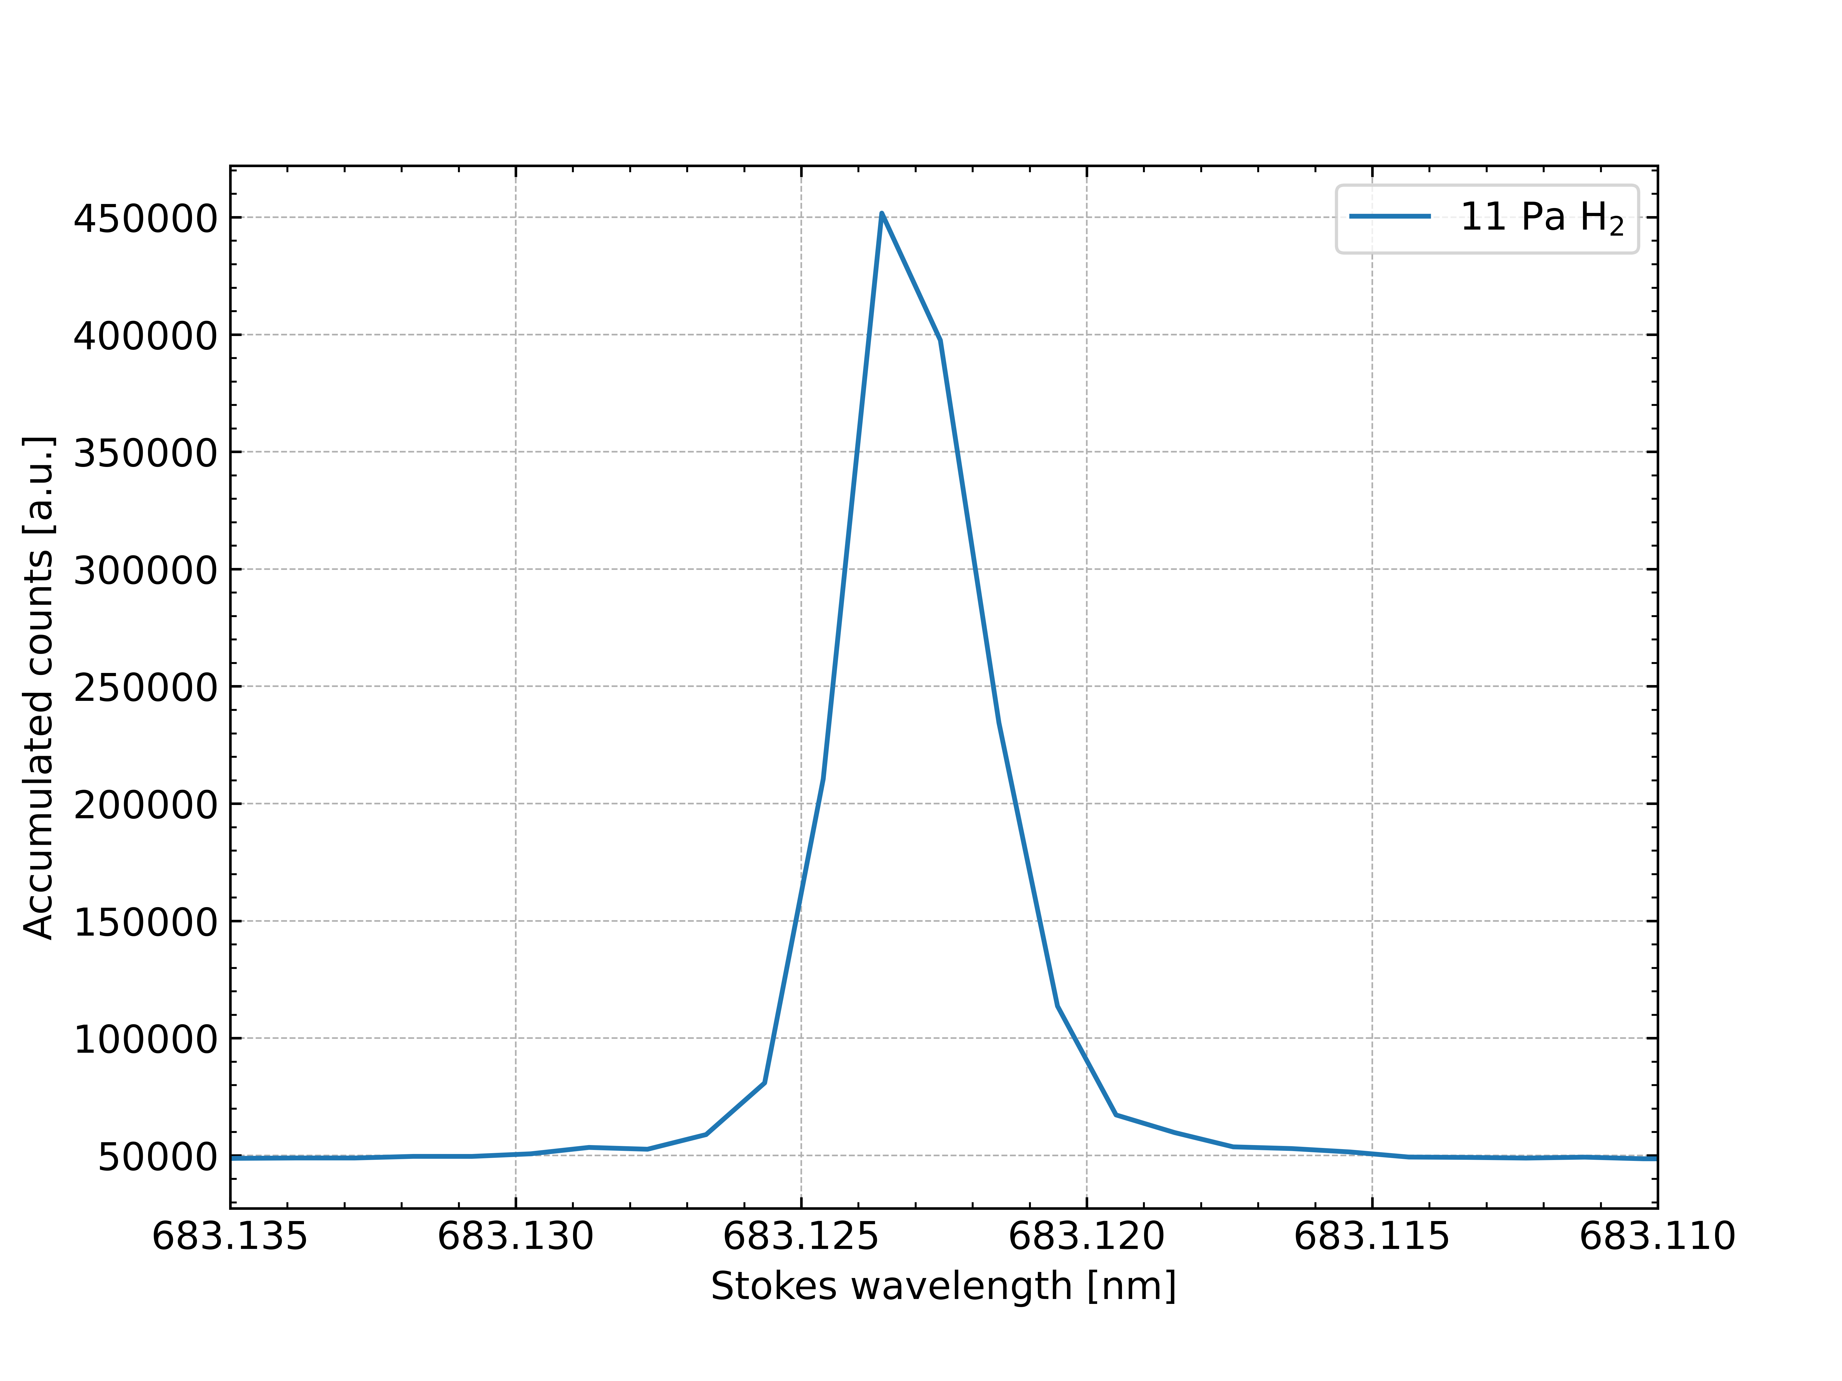
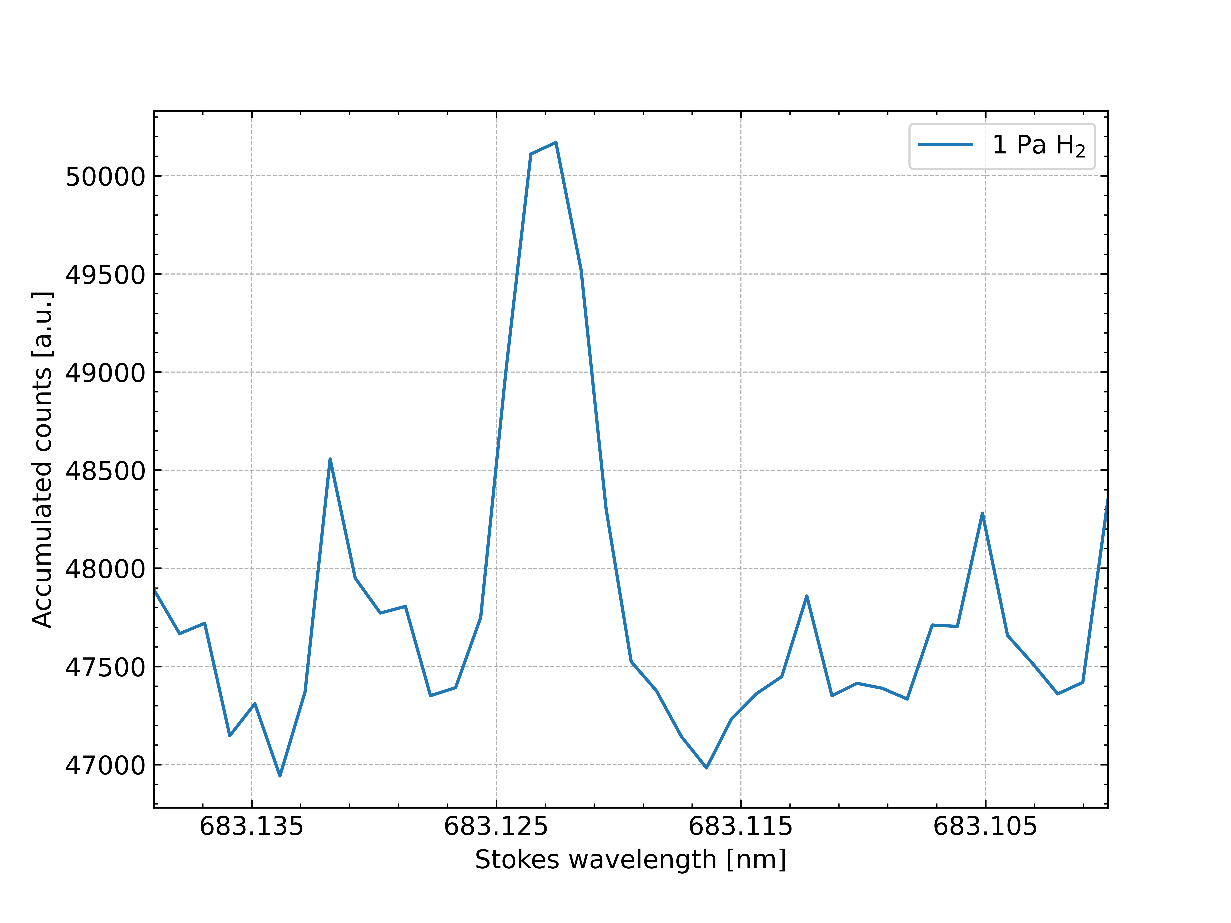
Good news: first H₂ data on Magnum!

Slide 32
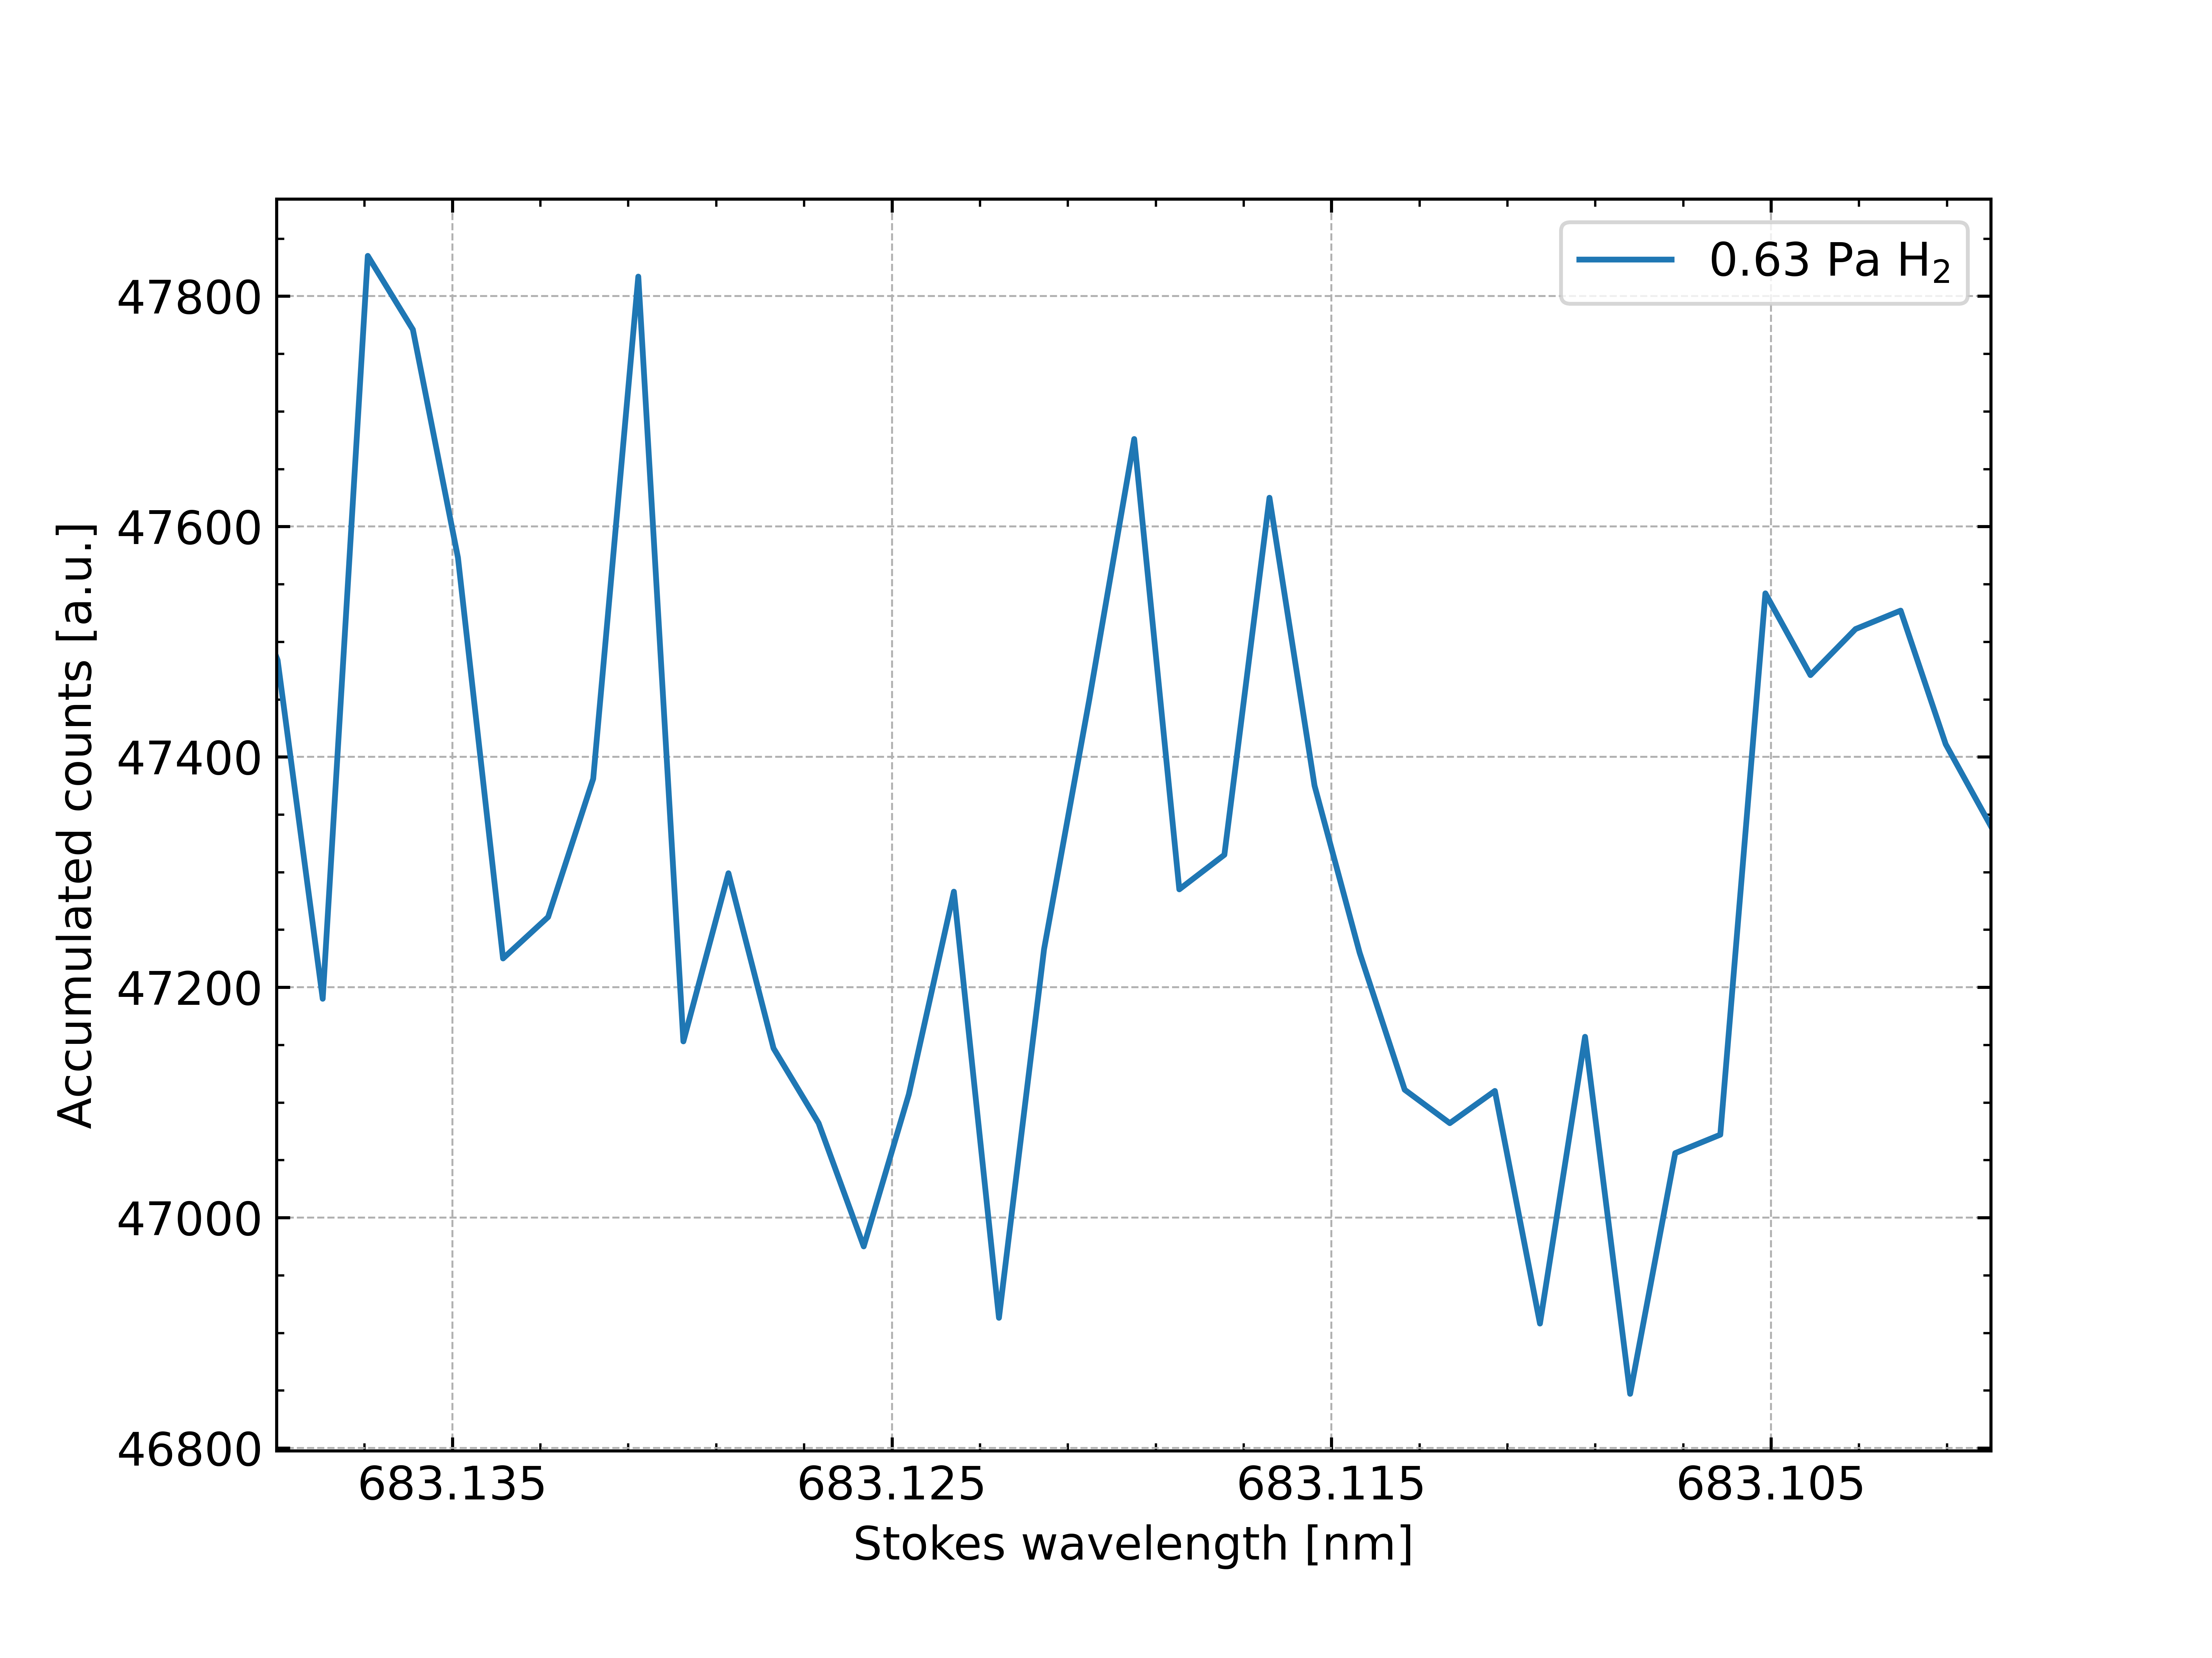
Bad news: unable to reach sensitivities from lab
Background signal observed in windows
Higher rovibrational states not measured

Slide 33
Bad news: unable to reach sensitivities from lab
Background signal observed in windows
Higher rovibrational states not measured
Background may be supressed with filters or filtered out with displacement prism
Use bandpass filters to remove lasers before fluorescence generation

Slide 34
Section 6
Conclusion and Outlook

Slide 35
Conclusion and Outlook
Goals: measure up to ν=2. Provide H₂(ν,J) population input for fusion modelling efforts
First experiments on UPP show CARS feasibility - Measured up to H₂(ν=1,J=1). Axial and radial scans possible
CARS sensitivity in lab environment increased with BOXCARS - Able to measure down to 0.1 Pa or 1e19 m⁻³
BOXCARS on Magnum only enabled measurements of higher densities - Supress background signal from windows using displacement prism or bandpass filters

Slide 36
Section 7
Extra Slides

Slide 37
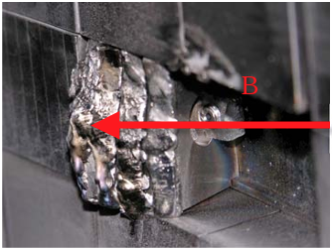
The Heat Exhaust Problem in Fusion
Heat load to ITER divertor must always remain under threshold value
Mitigation of loads essential. Use plasma detachment
Simulations disagree with experimental results. Impact on future devices?
Melted divertor tungsten tile Credit: B. Lipschultz et al. (2012)

Slide 38
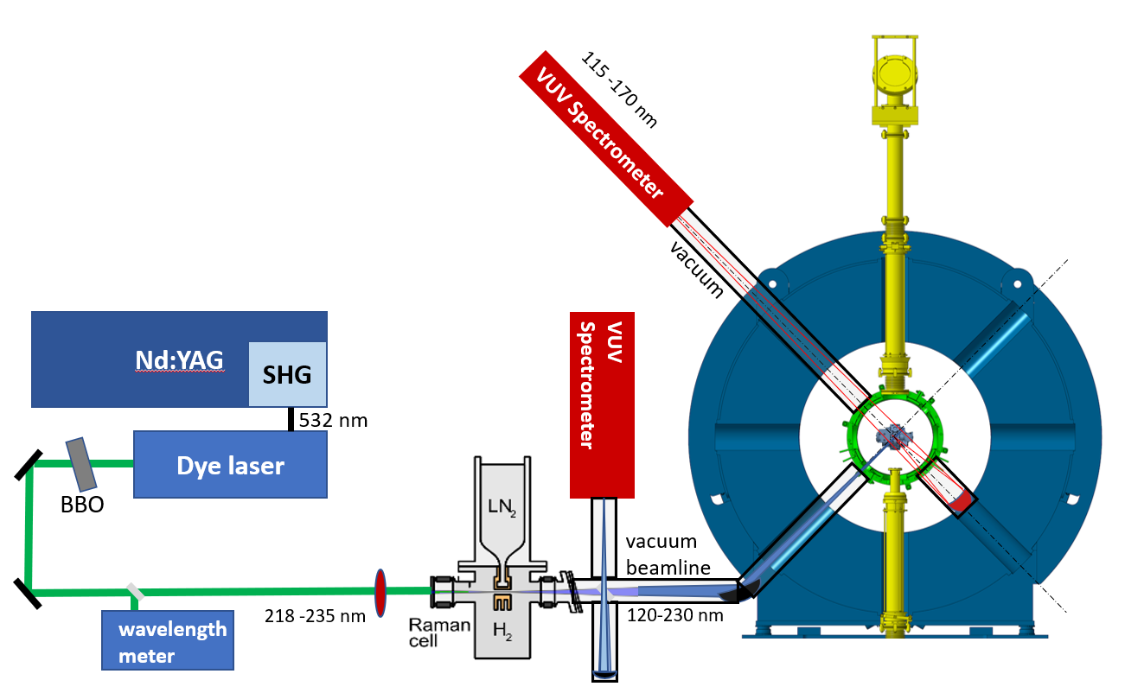
Measuring higher vibrational states: Future plans for a VUV-LIF setup
CARS: only up to ν=2
VUV-LIF: Vacuum UltraViolet LIF - Excite electronic ground states to higher states; measure fluorescence
Generate VUV light with a ‘Raman cell’ - N₂ cooled H₂ cell
All in vacuum!
Monitor signal with VUV spectrometers, calibrate with CARS

