Slide 1
Update on the of 2025 tasks within SP-C
Reporting Meeting PWIE 2024
K. Schmid
E. Bernard, T. Morgan, A. Houben , A. Manhard, S. Markelj, T. Schwarz-Selinger, L. Ciupinski, M. Fellinger, D. Primezhofer, Y. Ferro, M. Lavrentiev, R. Bisson, J. Zavaznik, A. Kärcher, V. Nemanic, E. Pitthan, A. Teimane

Slide 2
Tasks in 2025
Association | SPCToppic | Title
ISSP-UL | SP-C-1 | T-permeation experiments in 316L into gas and water
CEA | SP-C-1 | Permeation (D,T) through liquid/solid interfaces with interface characterization
CEA | SP-C-1 | Start developing W/Cu interatomic ML potentials for H transport studdies
JSI | SP-C-1 | Study of D location in tungsten single crystal containing single vacancy defects by NRA-C
MPG | SP-C-1 | Study importance of grain boundary diffusion
CEA | SP-C-1 | Test VnHk cluster binding energies from OKMC on experimental TDS and NRA spectra
JSI | SP-C-1 | D retention in displacement damaged Cu and CuCrZr
IPP_LM | SP-C-1 | TEM analysis of annealed, He implanted W. In cooperation with MPG
ÖAW | SP-C-1 | Systematic investigation of thickness dependence of re-deposited W layers on retention
VR | SP-C-1 | Systematic investigation of thickness dependence of re-deposited W layers on retention
CEA | SP-C-2 | Fluence dependence of D retention in B layers: Damage/Production vs Annealing
DIFFER | SP-C-2 | Evaluation of D/B ratio in co-deposited boron
FZJ | SP-C-2 | Formation of a-BH layers by co-depositon
FZJ | SP-C-2 | Permeation through B:D and B:W mixed layers on steel
JSI | SP-C-2 | Influence of B layer on permeation
JSI | SP-C-3 | Influence of surface He pre-implantation in EUROFER
MPG | SP-C-3 | Influence of surface He pre-implantation in EUROFER
JSI | SP-C-3 | Influence of rhenium presence on radiation damage and deuterium retention in tungsten
MPG | SP-C-3 | Influence of rhenium presence on radiation damage and deuterium retention in tungsten
FZJ | SP-C-4 | H-retention in CuCrZr and Cu
MPG | SP-C-4 | D retention in displacement damaged Cu and CuCrZr
JSI | SP-C-4 | H plasma exposure of deuterium loaded high-temperature self-ion irradiated W to study the retention in cavities in W
MPG | SP-C-4 | H plasma exposure of deuterium loaded high-temperature self-ion irradiated W to study the retention in cavities in W
23 Tasks for 108 PM

Slide 3
Outline
Overview of topics covered in 2025
Plans for 2026/27

Slide 4
Transport from Plasma to coolant
Transition of different sources of D/T through different interfaces
Ions/metal: Implantation source
Gas/metal: Sievert‘s law
Atoms/metal: Complex energy landscape
Metal/metal: Thermodyn. Equil.
Metal/water: Henry‘s law vs. Sievert‘s law?
Heat-sink
Plasma/gas/neutrals
Armor
Coolant
?Permeation barrier?
Green model & parameters available
Yellow model is there but parameters are „unclear“
Red: Not sure about model or parameters

Slide 5
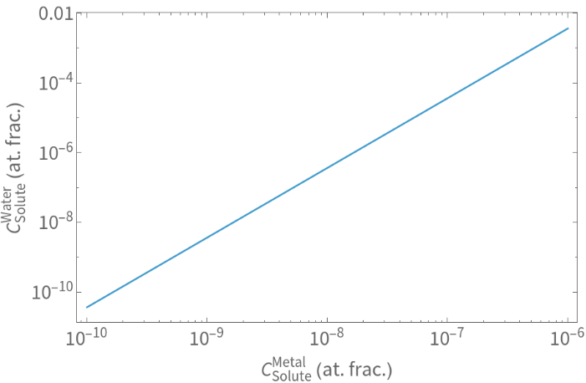
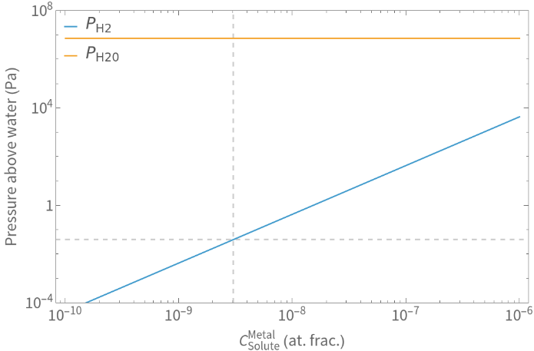
Transport from Plasma to coolant
Metal/Water equilibrium expectations: Solute concentration, Pressures
$C_{Metal}=S\left(T\right)×\sqrt{P}$ Sievert’s law
$C_{Water}=Henry\left(T\right)×P$ Henry’s law
Heat-sink
Coolant
$$C_{Water}=\frac{Henry\left(T\right)}{{S\left(T\right)}^{2}}{C_{Metal}}^{2}$$
$$C_{EUROFER}=\frac{S_{EUROFER}}{S_{PbLi}}C_{PbLi}$$
T = 600K
$S_{EUROFER}\left(T\right)={1.5}^{−6}exp\left({−0.238}/{K_{B}T}\right)$ [1]
$S_{PbLi}\left(T\right)={4.7}^{−7}exp\left({−0.092}/{K_{B}T}\right)$ [2]
$Henry\left(T\right)=2×1.8×{10}^{−7}exp\left(−500\left(\frac{1}{T}−\frac{1}{298.15}\right)\right)$ [3]
Expected from equilibrium with PbLi
H₂ in H₂O
During permeation $C_{Metal}$depends on interface kinetics
T = 600K
[1] Aiello FED 41 (2002) 872
[2] Chan JNM 123 (1984) 935
[3] H₂ in H₂O from NIST

Slide 6
Transport from Plasma to coolant
Metal/Water interface
We need an estimate on possible surface limits between metal & water
→ See talk by A. S. Teimane
ISSP-UL | SP-C-1 | T-permeation experiments in 316L into gas and water
CEA | SP-C-1 | Permeation (D,T) through liquid/solid interfaces with interface characterization

Slide 7
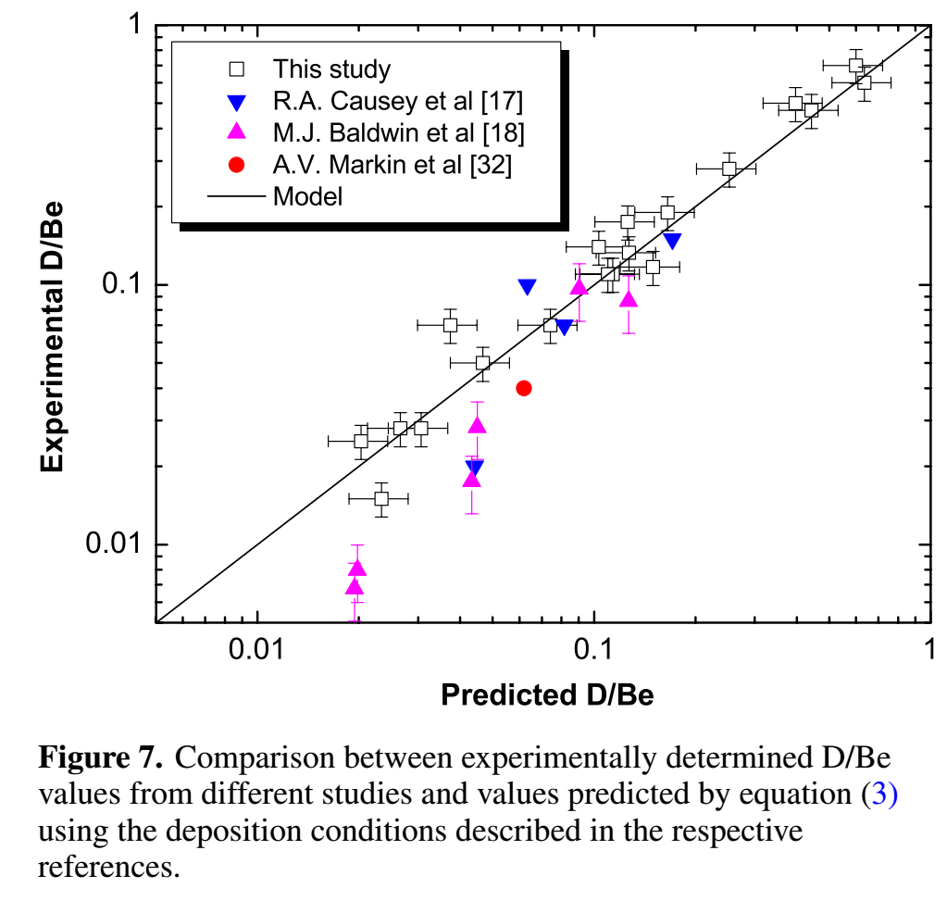
T retention Release from B layers
Ultimate goal: Scaling law for D/B like G. De Temmerman Nucl. Fusion 48 (2008) 075008
Example D/Be
a-BD layers differ greatly depending on deposition parameters: A. Annen Thin Solid Films 300 (1997) p.101
Need to co-deposit B and D not implant into B layers
Vary temperature, deposition rate and energy

Slide 8
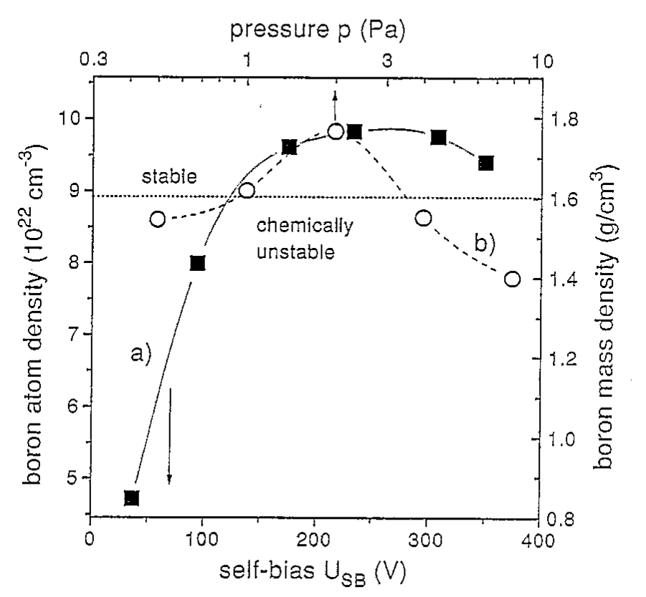
T retention Release from B layers
Ultimate goal is a scaling for the D/B ratio similar to what was available for Be
→ For this we need co-deposited layer and no pre-deposited B layers that are then exposed to plasma
Co-deposit B and D in a linear plasma device varying:
Deposition rate (vary upstream B source)
Temperature (heated catcher sample)
Particle energy (bias)
→ This produces very different layers
[1]
upstream B source:
Di-borane gas (→ challenging safety precautions necessary)
Erode a junk of B by the plasma (→ homogeneity of deposition? May be a feature?)
...
[1] A. Annen et al. Journal of Non-Crystalline Solids 209 (1997) 240–246

Slide 9
T retention Release from B layers
Ultimate goal is a scaling for the D/B ratio similar to what was available for Be
Don’t just focus on D content
B density determines layer properties
Particle energy is a key input that needs to be known
(Difficult to set for magnetrons)
CEA | SP-C-2 | Fluence dependence of D retention in B layers: Damage/Production vs Annealing
DIFFER | SP-C-2 | Evaluation of D/B ratio in co-deposited boron
FZJ | SP-C-2 | Formation of a-BH layers by co-depositon
FZJ | SP-C-2 | Permeation through B:D and B:W mixed layers on steel
JSI | SP-C-2 | Influence of B layer on permeation (moved from 2024)

Slide 10
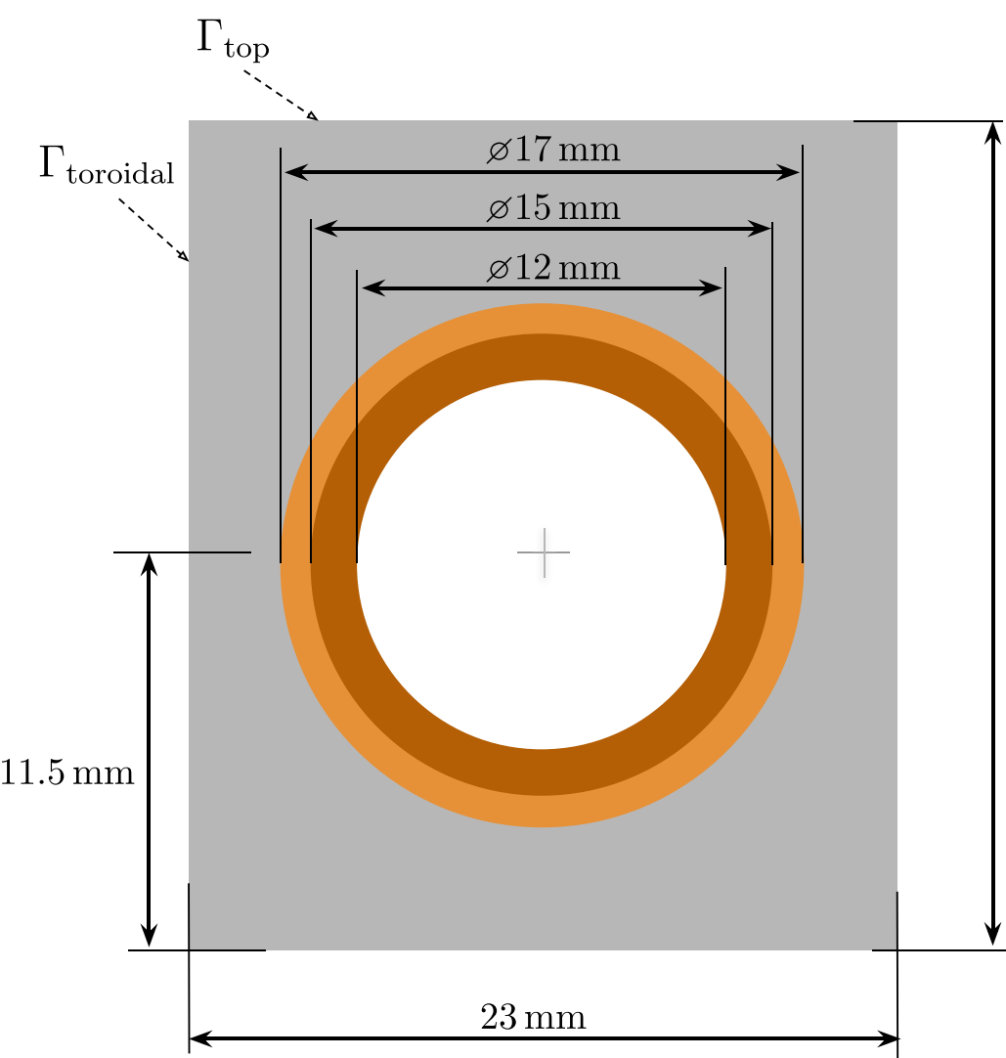
Retention in Cu and CuCrZr
W-monoblock divertor concept is based on a Cu, CuCrZr heatsink
Very little data is available on trapping in Cu or CuCrZr
NO data is available on trapping in displacement damaged Cu or CuCrZr
R. Delaporte-Mathurin et al, Nucl. Fusion 64 (2024) 026003

Slide 11
Retention in Cu and CuCrZr
CEA | SP-C-1 | Start developing W/Cu interatomic ML potentials for H transport studies
→ See talk by Y. Ferro
JSI | SP-C-1 | D retention in displacement damaged Cu and CuCrZr
FZJ | SP-C-4 | H-retention in CuCrZr and Cu
MPG | SP-C-4 | D retention in displacement damaged Cu and CuCrZr
What’s available in literature?
Nothing on displacement damaged Cu, Cu-alloys
Mainly permeation measurements → insufficient for predicting retention
I could only find very few TDS measurements

Slide 12
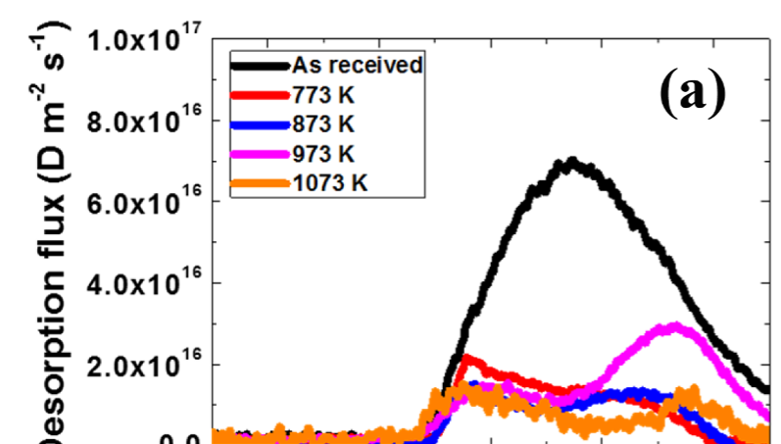
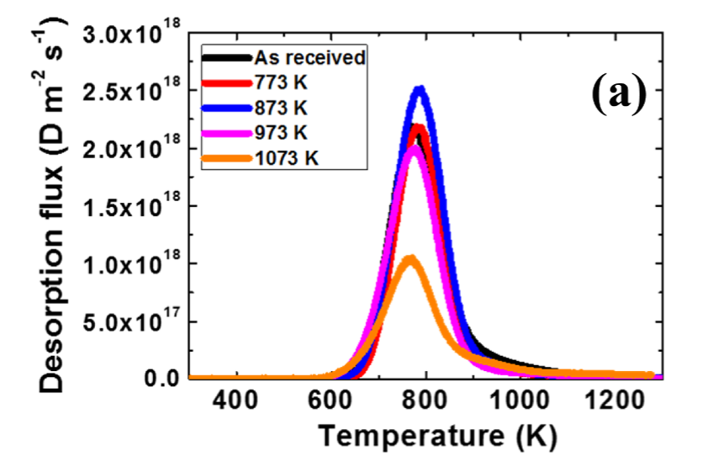
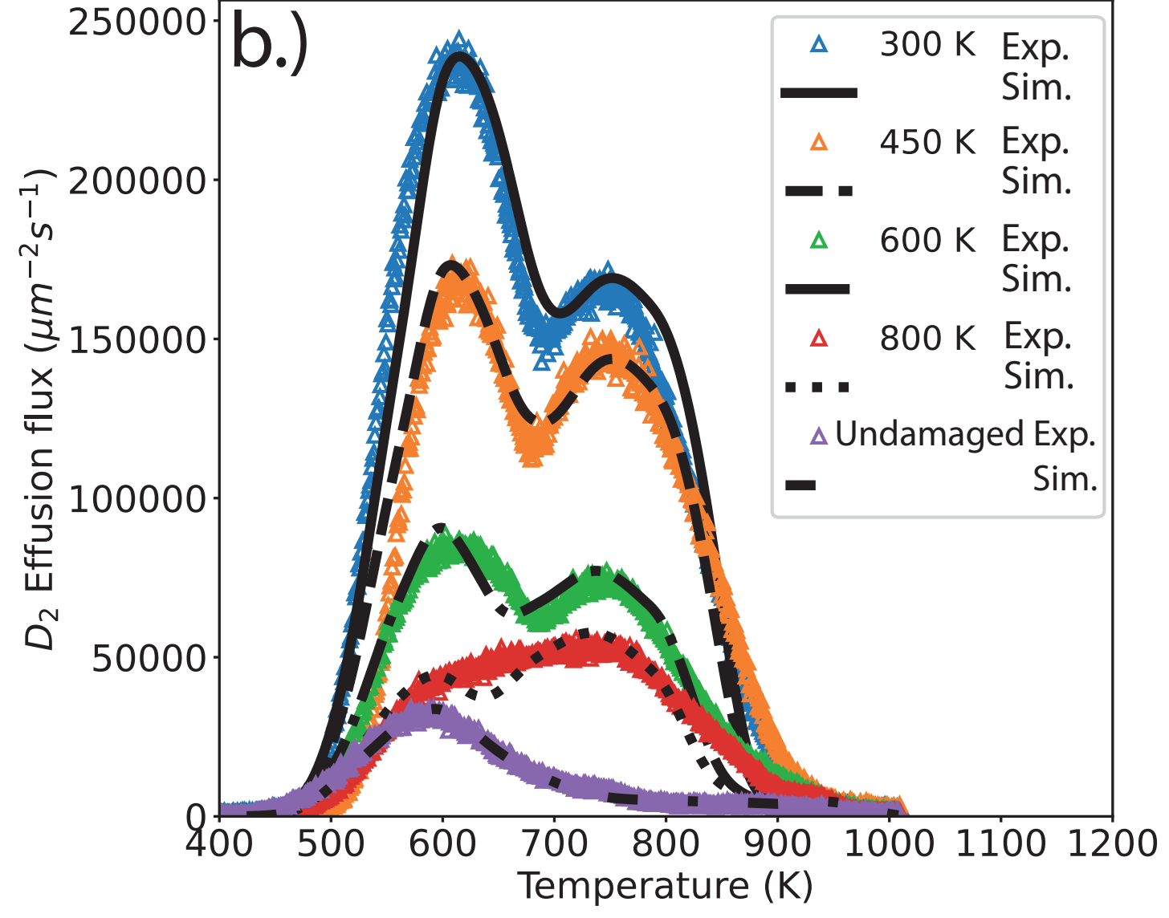
Retention in Cu and CuCrZr
H.-D. Liu, et al, Nuclear Materials and Energy 23 (2020) 100755
Cu
Literature data on undamaged Cu and CuCrZr suggest release up to very high temperatures
Retention in CuCrZr >> Cu
W-comparison
Cu releases at higher T than damaged W!?!

Slide 13
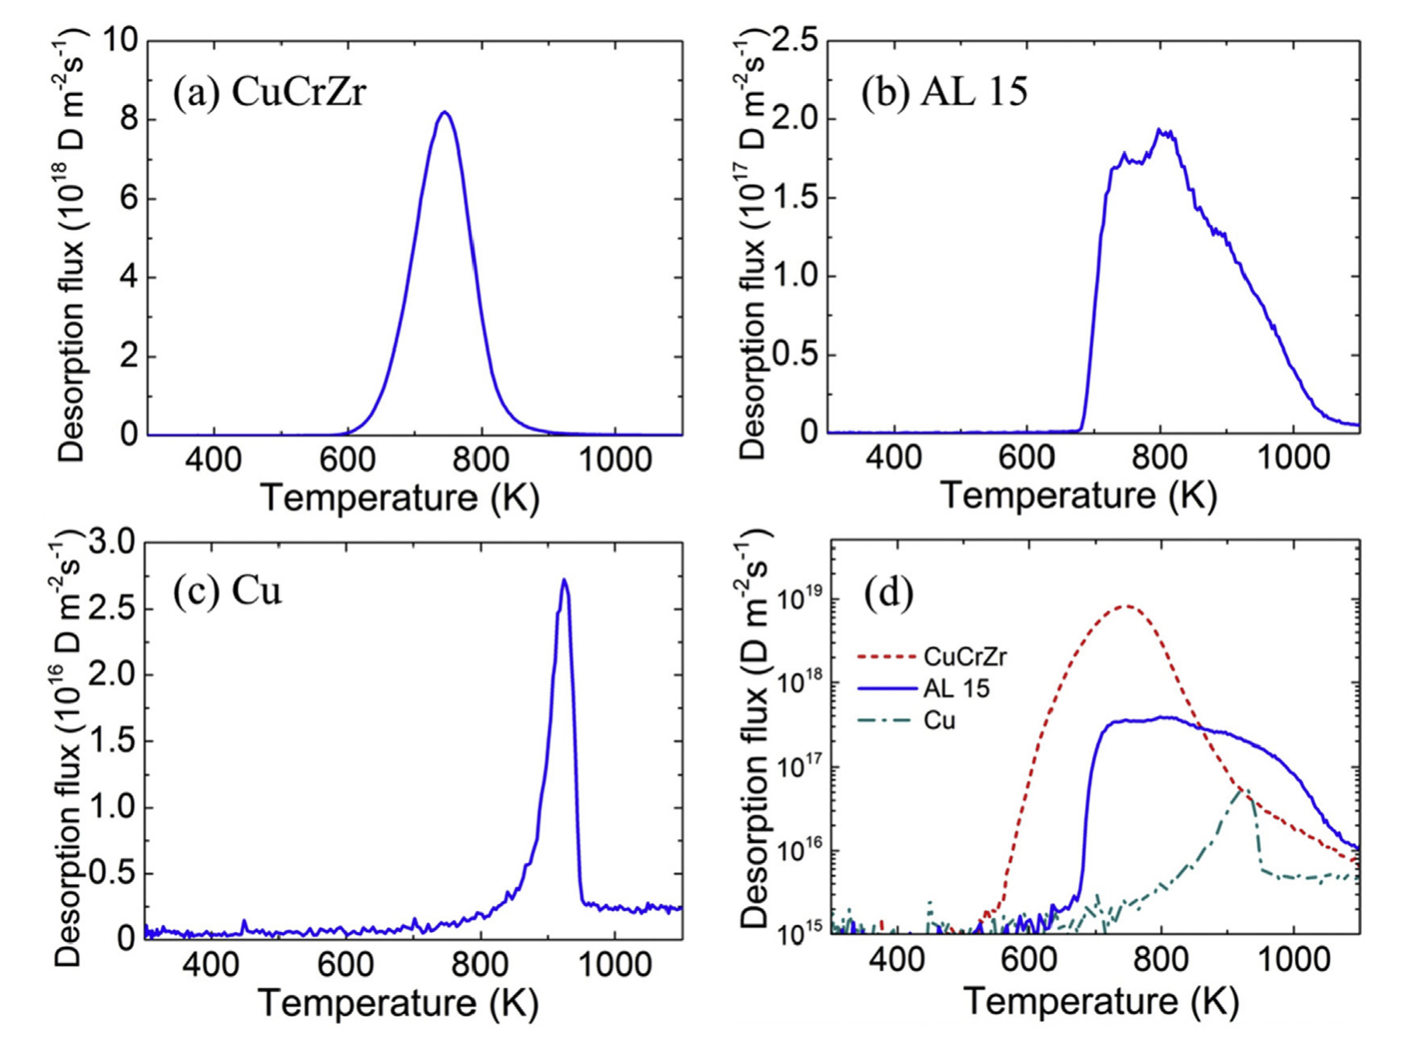
Retention in Cu and CuCrZr
H.-S. Zhou et al. / Journal of Nuclear Materials 493 (2017) 398
Literature data on undamaged Cu and CuCrZr suggest release up to very high temperatures
Retention in CuCrZr >> Cu
These are TDS from gas loaded membranes (thickness ~1/10 mm)
→ Is the high release temperature a transport artefact?

Slide 14
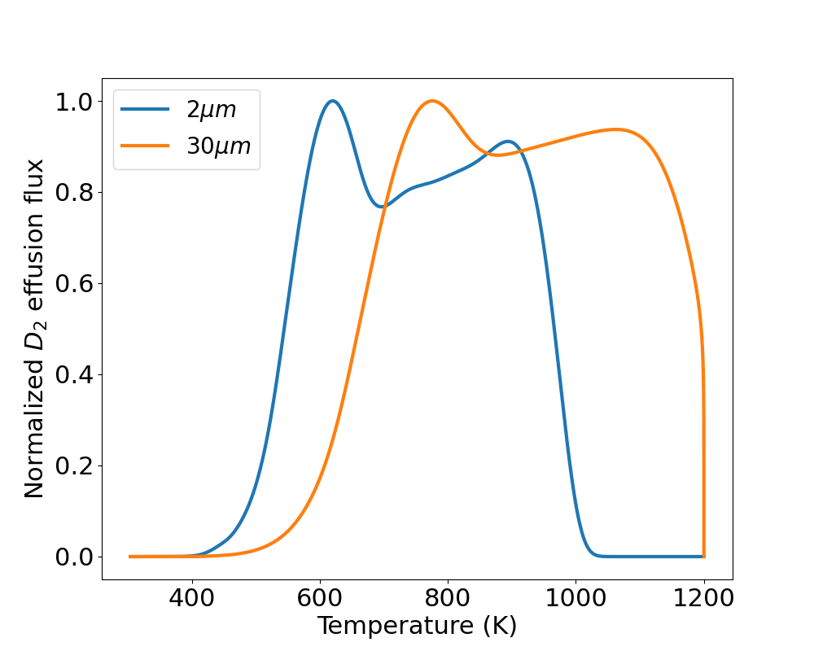
Retention in Cu and CuCrZr
These are TDS from gas loaded membranes → Is the high release temperature a transport artefact?
Qualitative example: W foil
Peaks do shift with thickness
But mainly it broadens towards high-T
High release temperature could also be surface effect?

Slide 15
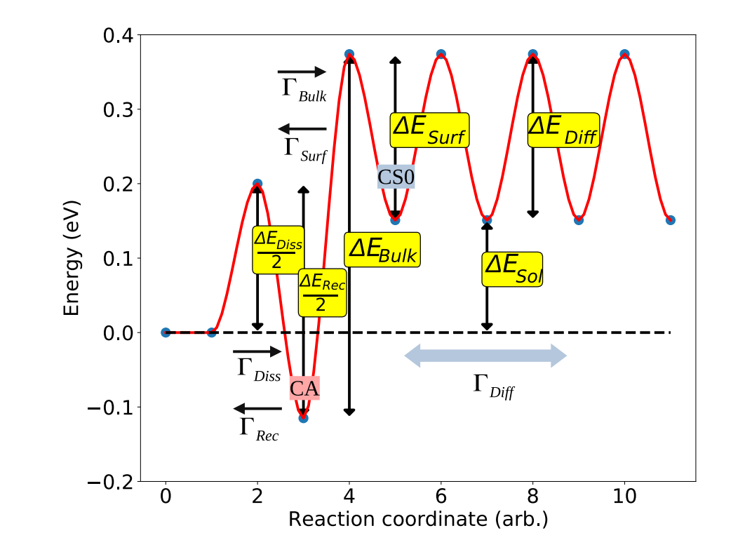
Near surface energy landscape
The uptake of H into metals is described by the Pick-Sonnenberg model J. Nucl. Mat. 131 (1985) p. 208
Energy landscape can kinetically hinder D-release
→ A surface limit for release can shift TDS spectra
Example: EUROFER
K. Schmid Nucl. Fusion 61 (2021) 086008

Slide 16
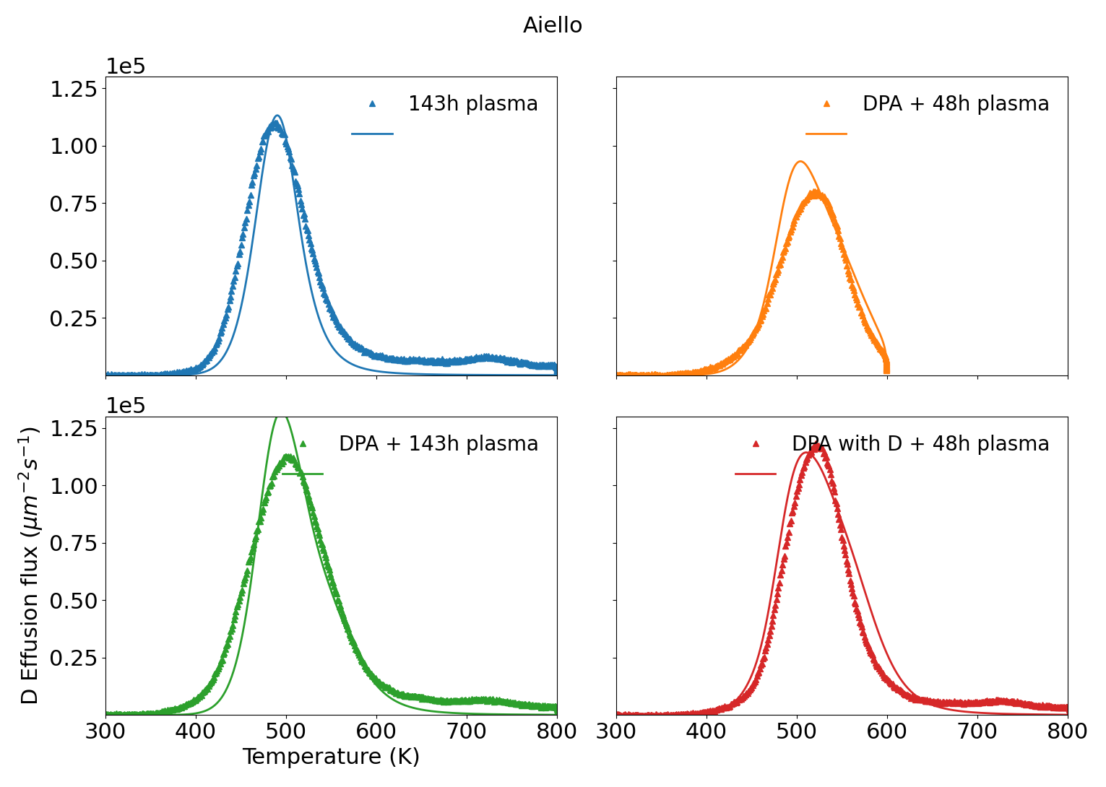
Near surface energy landscape
Material parameters are model dependent: Example surface model for EUROFER [1]
Complex kinetic surface model „Pick & Sonneberg“ needed to explain experiments
Not perfect but:
E_{Trap} = 1.1, 0.9 eV
Simultaneous fit of all TDS spectra
Same trap settings
Same surface settings
Explains lack of gas loading at 1Pa
Explains time depenence of plasma loading:
Damaged 48h vs un-damaged 143h
Follows Sievert‘s law in equilibrium!
[1] K. Schmid, NME 36 (2023) 101494

Slide 17
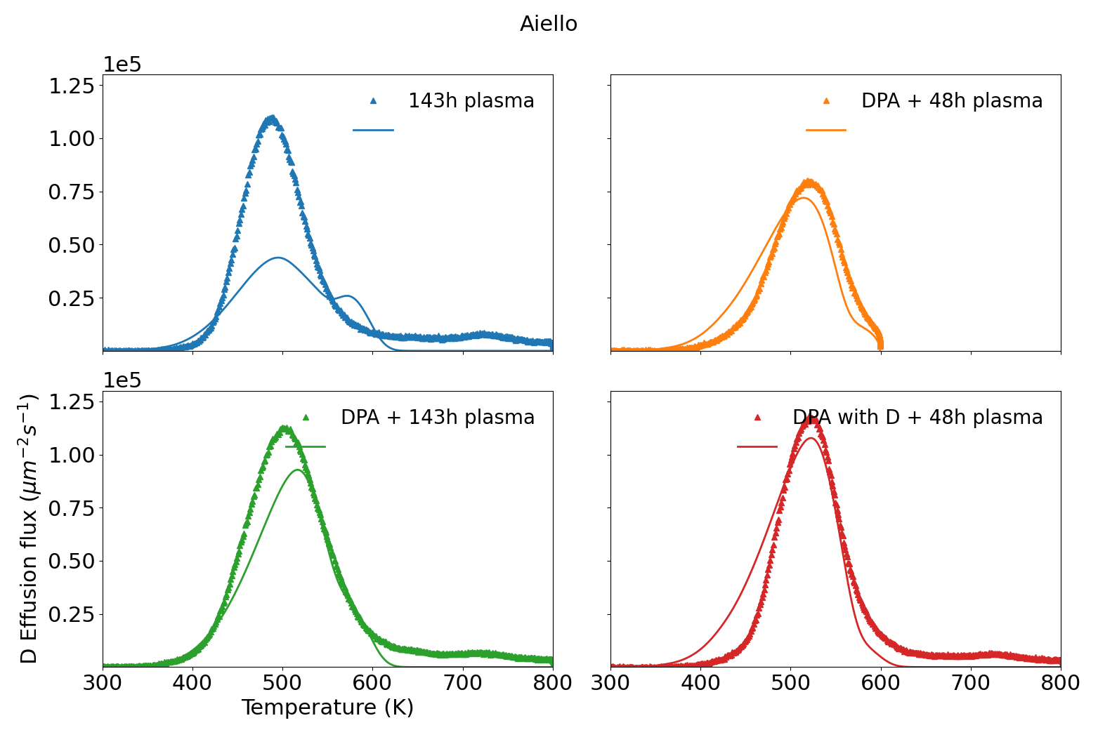
Near surface energy landscape
Material parameters are model dependent: Example surface model for EUROFER [1]
Swap surface model with simple diffusion limit and try to fit data with trapping only:
Removing surface model:
ETrap = 1.3, 1.1 eV
Can‘t simultaneously fit all experiements
Onset slope too flat
Needs different de-trapping energies
Trapping parameters depend on surface model assumptions
[1] K. Schmid, NME 36 (2023) 101494

Slide 18
Modelling needs
Predictions for ITER and demo require diffusion trapping parameters including surface models
Experiments needed:
Gas vs ions/plasma vs. atom loading → Probe surface model
Depth profiles and TDS spectra
See talk by S. Markelj
Experiments need to be modelled by diffusion trapping codes
Otherwise, no predictions for ITER/DEMO
Surface model was not too important for W
…but is very important for steels and Cu-alloys

Slide 19
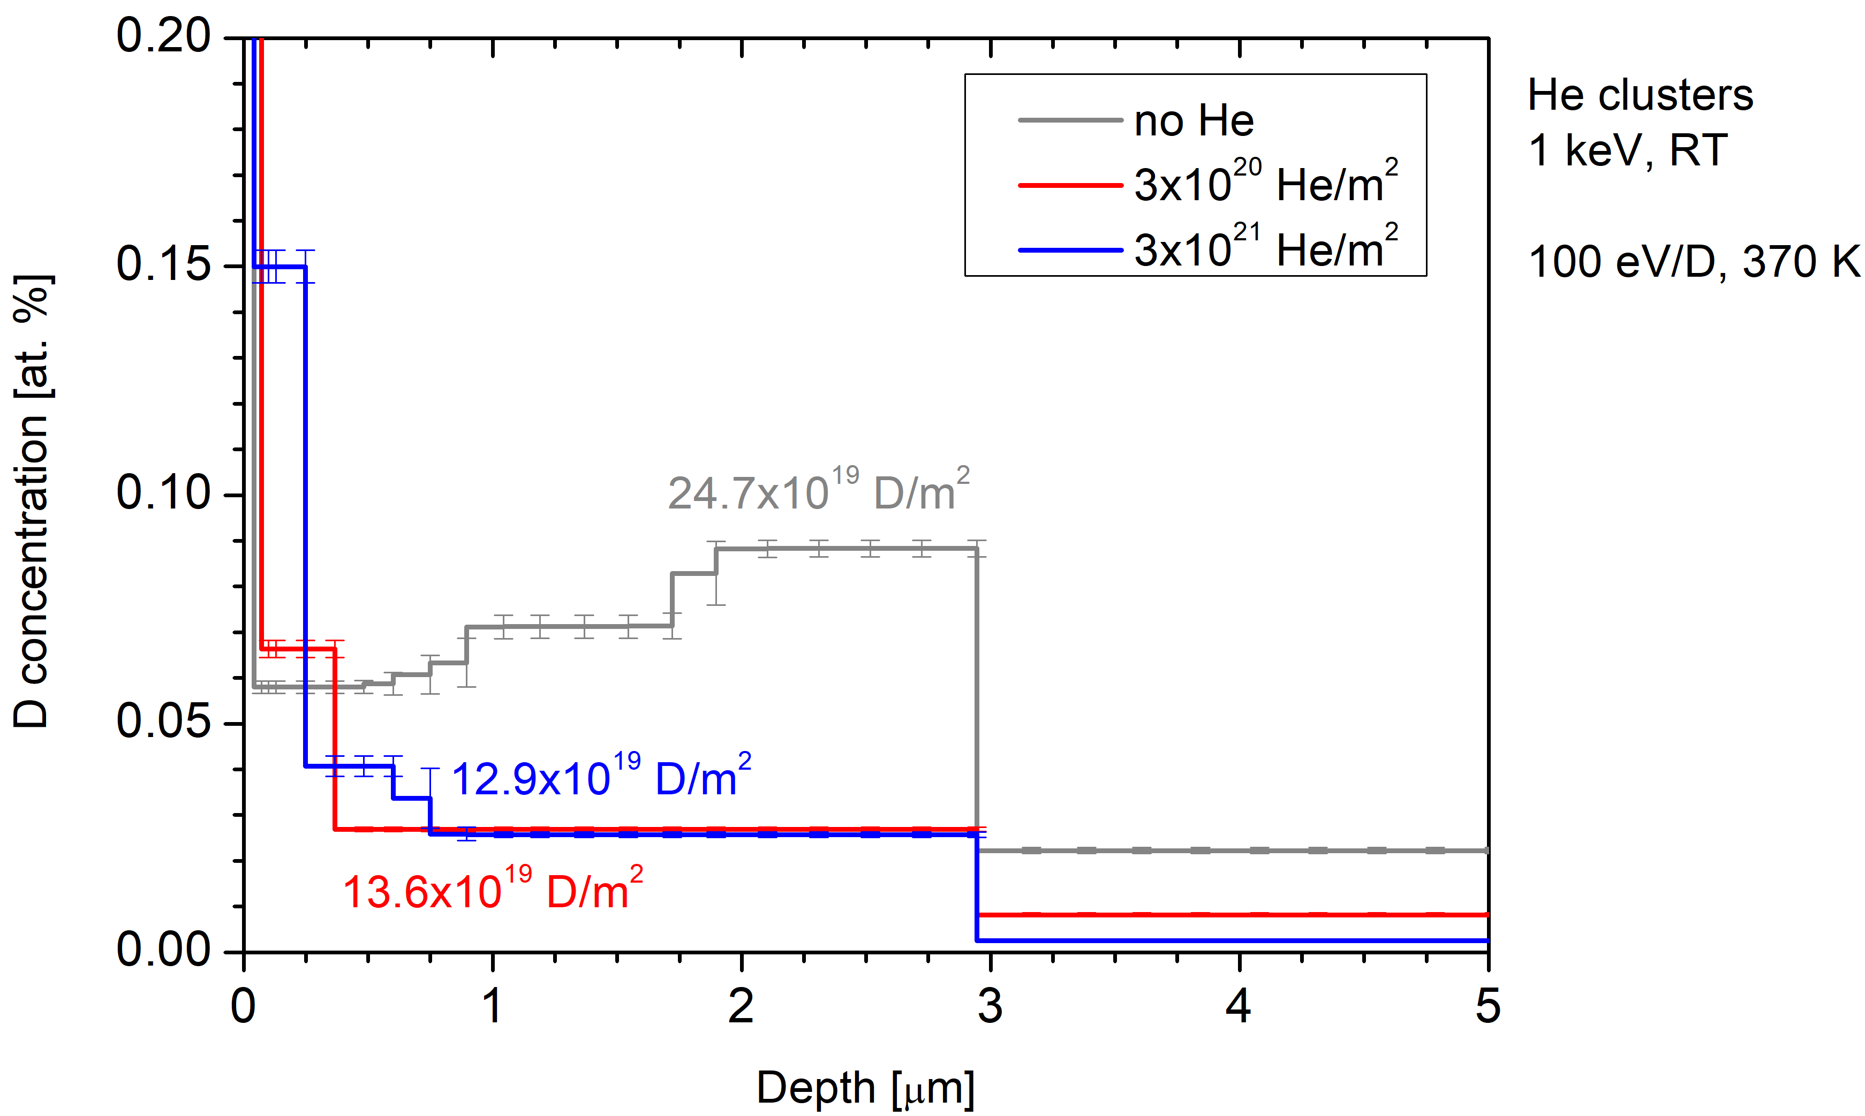
Influence of transmutation products He, Re
Taken from 2024 report by S. Mareklj
Similar to W, He implantation in EUROFER also limits uptake
What about high temperatures?
Apart for He also Re is produces in W by n-irradiation
Effect of Re on displacement damage creation: See talk by M. Zibrov
JSI | SP-C-3 | Influence of surface He pre-implantation in EUROFER
MPG | SP-C-3 | Influence of surface He pre-implantation in EUROFER
JSI | SP-C-3 | Influence of Re presence on radiation damage and deuterium retention in tungsten
MPG | SP-C-3 | Influence of Re presence on radiation damage and deuterium retention in tungsten

Slide 20
High temperature effects and transmutation products
Displacement damage at high temperatures leads to formation of extended defects
Presence of He or Re affects defect formation and annealing at high temperature
Need to continue high temperature experiments
Extend the scope from W to steels and Cu-alloys
JSI | SP-C-4 | H plasma exposure of deuterium loaded high-temperature self-ion irradiated W to study the retention in cavities in W
MPG | SP-C-4 | H plasma exposure of deuterium loaded high-temperature self-ion irradiated W to study the retention in cavities in W

Slide 21
Planning
Plans for the 2026/27 programme

Slide 22
Planning
Trapping- transport- and surface limit parameters for ITER materials Cu, CuCrZr, 316L and W.
Data lacking for displacement damaged Cu and Cu alloys
Needs TDS and depth profiles to pin down trapping parameters
Existing data is only partially interpreted by modelling
→ Basically, unusable for ITER predictions
→ Experiments + proper diffusion trapping modelling of results to obtain parameters

Slide 23
Planning
Retention in co-deposits: D/B, D/"Steel", D/W etc. D/X ratios
Typically, D/X depends on energy, temperature and growth rate
Particle energy hard to “guess” in Magnetrons
→ Try to produce co-deposits ideally in linear machines
Diagnose not just D but also B, W, Steel etc. areal densities

Slide 24
Planning
Influence of Neutron damage and the presence of transmutation products
Focus is on high temperatures
Synergies between He and Re and displacement damage.
Formation of “extended defects” (e.g. Bubbles etc.)

Slide 25
Planning
Permeation “reduction methods”
Reduce uptake by e.g. porosity in VPS-W, He-pre-implantation
Permeation barriers
A lot has been done on ceramic barriers, don’t want to repeat that.
→ Try metallic multilayers or nitrides which are mechanically less challenging

