Slide 1
Tritium Outgassing from SS316L: Behaviour in Air and Water Media
WP PWIE Meeting
Anete Stīne Teimane
University of Latvia

Slide 2
Goal
The goal of our research activities was to determine the difference (if any) between tritium diffusion/outgassing from SS316L with air versus water as the outbound media
Secondary goal was to quantify tritium concentration in each phase – sample, water, air

Slide 3
Experimental setup
Pre-treatment
Tritium loading
Tritium quantification
Goodfellow annealed 0.025mm AISI 316L foil was cut in 2x5cm samples, rolled in tubes, washed with ethanol and air-dryed
Whilst still hot, the system is opened and filled with He+HT mixture (1.02∙10⁹ Bq/m³), closed again and kept at 450℃ for 1.5 to 90h
Sample
Placed in a quartz tube, connected to 5L/h He and water bubbler, heated to 800 or 1100℃ for 2h
Air phase
Bubbler connected to water bubbler, purged with synthetic air, measured with liquic scint.
Afterwards quartz tube is thermally quenched to room temperature with water
Samples were placed in a quartz tube (d=2cm) and the tube filled with H₂ and closed. System is heated to 450℃ and kept at the temperature for 20h
Half of samples are placed in bubbler with water, whilst rest in synthetic air
Water phase
1mL alliquote removed, measured with liquid scint.
Surface analysis with scanning electron microscopy (SEM)
A.S.Teimane | WP PWIE Prague | 25th March 2025

Slide 4
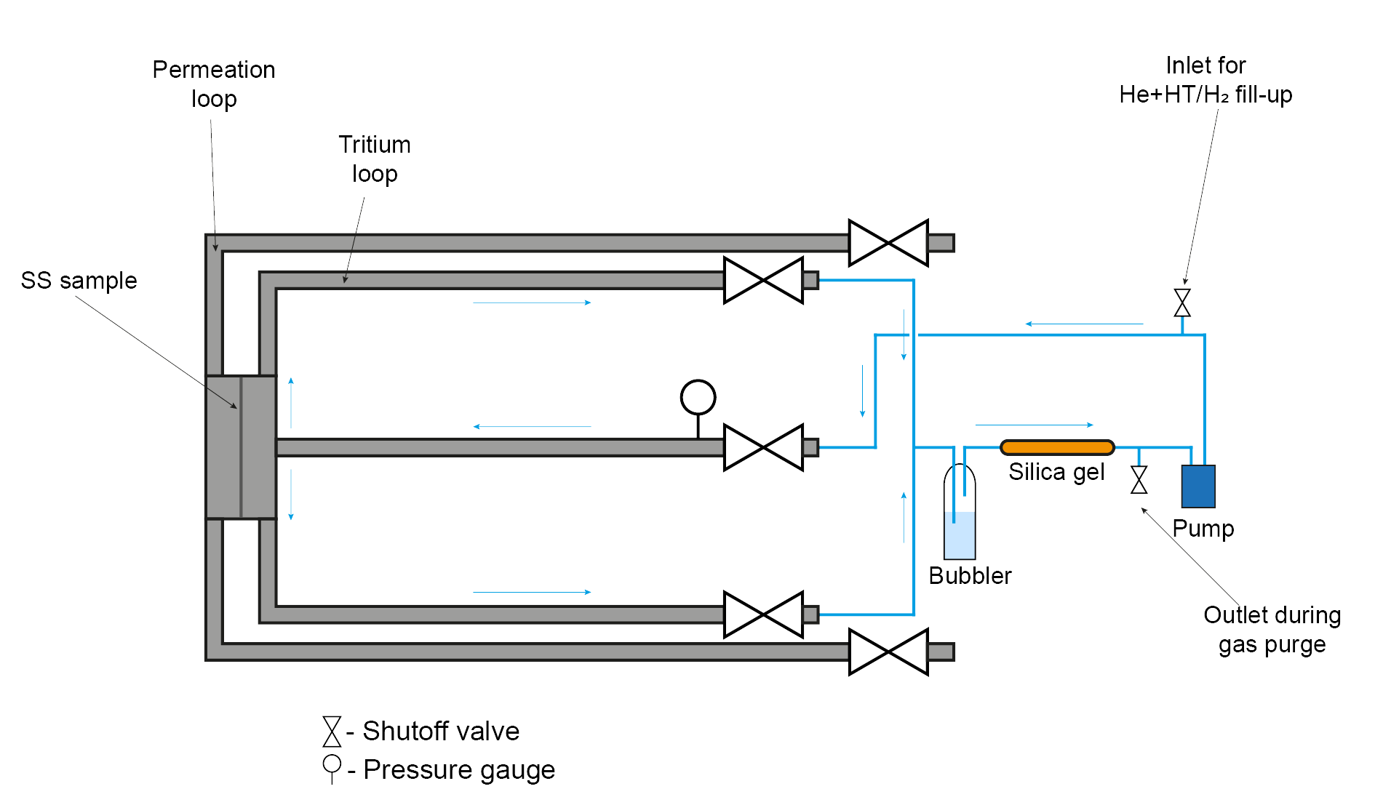
Why liquid scintillation?
HT → HTO reaction was noticed to take place. It was tracked at various temperatures (50-450℃) by performing permeation experiments with He+HT
Form of tritium was determined by proportional counter for HT and HTO with liquid scintillation
Proportion of HT/HTO was calculated with and without flow (0.5L/h)

Slide 5
Why liquid scintillation?
Results show that noticeable HTO production starts at around 200℃ and is shifted to lower temperatures by introduction of flow in the system
Results were compared to literature*
Since loading is done at 450℃, most of the HT introduced is expected as HTO
$$y= \frac{100}{({1+e}^{\left(−c_{1}\left(x−c_{2}\right)\right)})}$$
*On the fate of tritium in thermally treated stainless steel type 316L
R.-D. Penzhorn, Y. Torikai, K. Watanabe, M. Matsuyama, A. Perevezentsev. https://doi.org/10.1016/j.jnucmat.2012.03.012

Slide 6
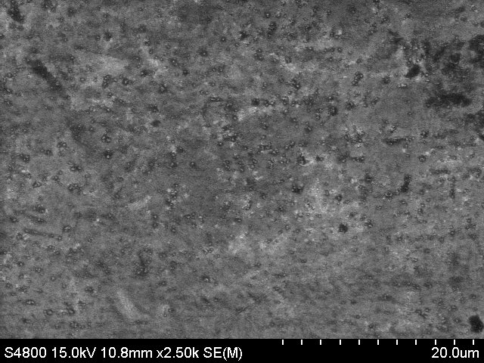
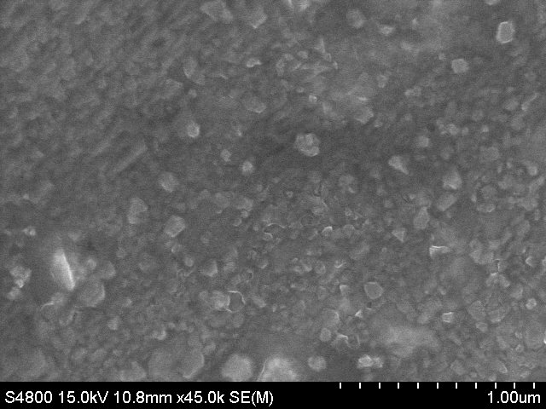
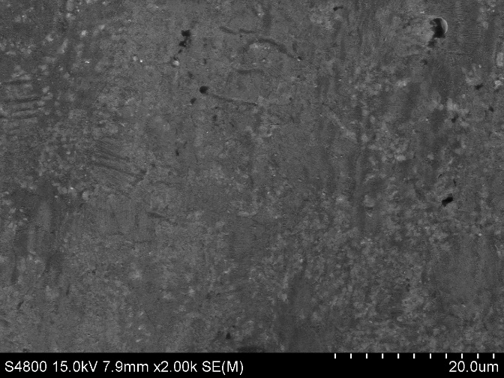
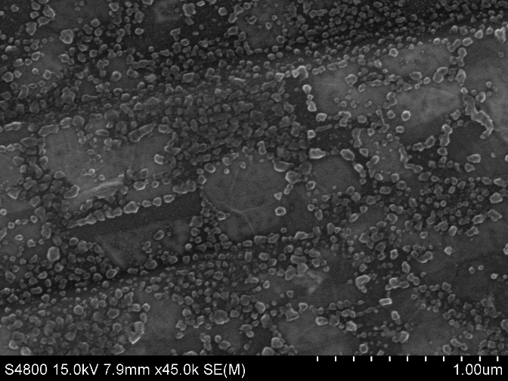
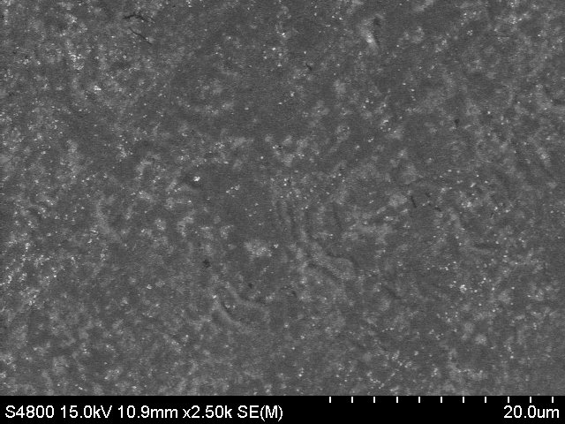
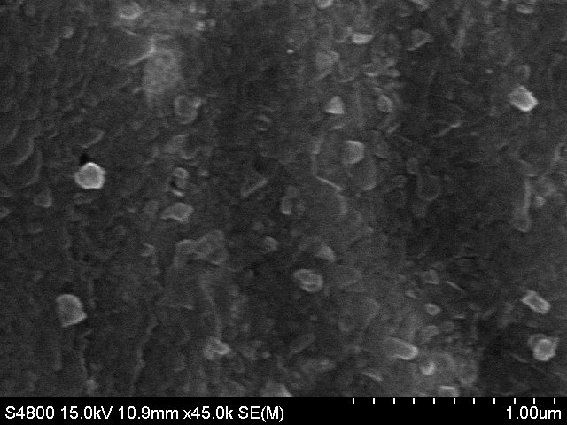
Surface analysis
6
After 40 days in air
Without pre-treatment
After pre-treatment
After 40 days in water

Slide 7
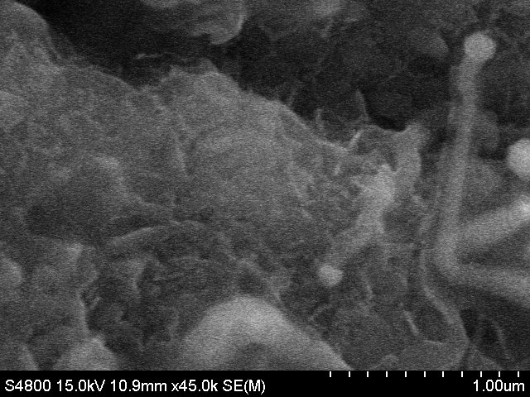
After 40 days in air
After TDS
After 40 days in water

Slide 8
Surface analysis
Loaded with pre-treatment
Pre-treated
After TDS
Loaded with pre-treatment
After 30 days of storage
Pristine
Loaded w/o pre-treatment

Slide 9
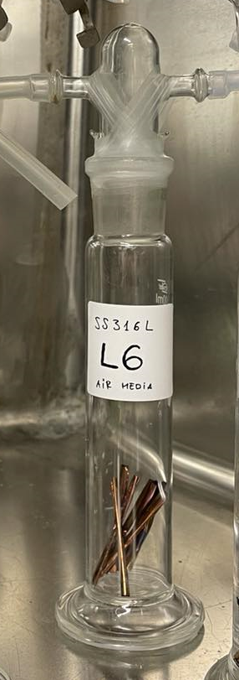
Experimental set-up
9
Outgassing experiments were performed in 2 different time scales
short (every 5 min for 120 min)
long (1-5 days for up to 20 days)
In long experiments tritium in sample and both water and air above water was measured
In short experiments only T in air for air samples and water for water samples was measured
Slight difference between all series in the experimental setup
Air
Water
SS316L

Slide 10
Tritium in the sample
10
First experiments focused on T change in sample – sample was heated to 800℃ and tritium collected in water bubbler
Large differences in T amount due to insuficient desorption, TDS temperature increased to 1100 ℃
Tritium in sample reaches a plateau value after ~20th day
Dropped for later experiments due to being time consuming and not very valuable

Slide 11
Tritium in the sample - TDS
TDS was performed for long experiment samples with heating rate of 10℃/min for selected samples
Desorbed T was collected in fractions not continuously, therefore only ranges are available
Large fraction of T is desorbed at temperatures higher than 800 ℃ which might explain large uncertainties for T in sample since first experiments were performed up to 800 ℃

Slide 12
Loading-outgassing times
12
To assess the time scale for the experiments, loading times were estimated with Eq.1
For outgassing similar trend was assumed (without the 2.7 multiplier)
Since not a lot of literature on D for T in 316L is available and available one has large deviations, it was hard to assess the time-scale for the process
Since for outgassing HTO is expected times may be larger than those calculated for HT
$$τ_{load}=2.7\frac{l^{2}}{6∙D}$$
(1)
↓
τ_{loading} = 0.4 to 84s
τ_{outgassing} = 6 to 120+h?
D₂₃ = ~ 5∙10⁻¹¹ - 7 ∙ 10⁻¹⁰ cm²/s
D₄₅₀ = ~ 2 ∙ 10⁻⁷ - 7 ∙ 10⁻⁶ cm²/s
L = 0.025 cm

Slide 13
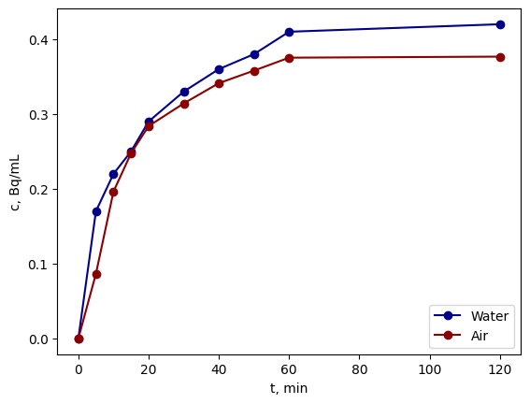
Tritium in air vs water media – short experiments
No difference between tritium outgassing between water and air medias can be seen
Air experiments were performed in a continuous gas flow whilst no flow for water samples – this may have an impact on the results
Additional experiments could be done with moisturized air instead of water as done previously by Torikai Y. et al in Effect of Water Vapor on Tritium Decontamination of Stainless Steel 316

Slide 14
Tritium in air vs water media – long experiments
Concentration increase in air for samples stored in air was compared to concentration change in samples stored in water (sum of T in water and air above water)
Time delay between tritium measured in water and measured in air above it can be seen – this must be explored more
T concentration in both water and air above it are similar

Slide 15
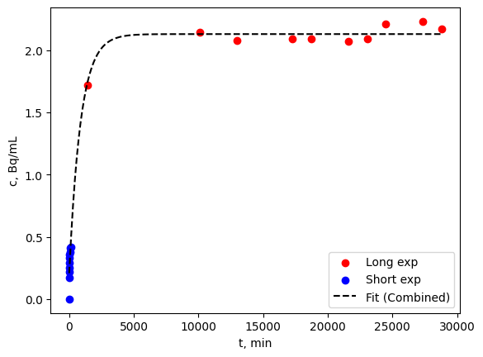
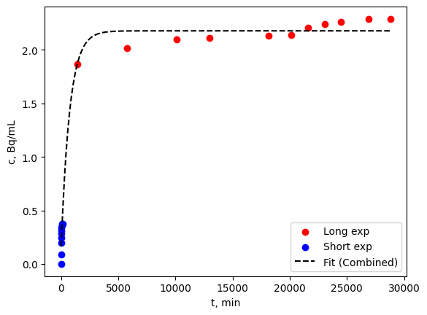
Combined short + long experiments
From combined short and long experiment data fit it looks like most of the tritium is outgassed in 5000min or 3.5 days
That would give a diffusion coefficient of ~2∙10⁻¹¹ cm²/s
No data for air above water for short experiments
Water
Air
$$y=L−a⋅e−bx$$

Slide 16
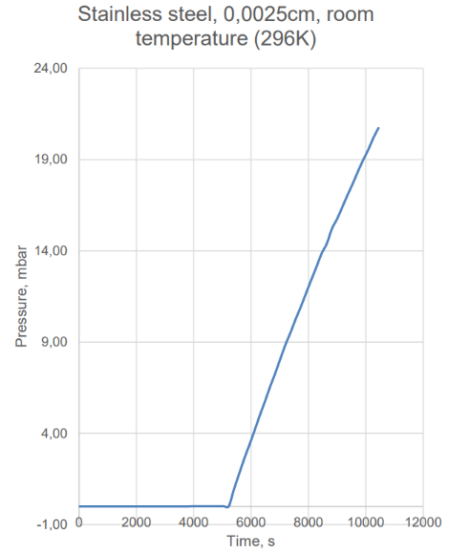
Further investigation
16
Additional outgassing series with more data points from day 1 to day 4
Permeation experiments with the same system as that used for HT/HTO ratio analysis
Diffusion coefficient based on pressure change has been determined for H₂ at room temperature
Effective diffusion coefficient was determined to be:
D_{eff} = (1,7±0,4)·10⁻¹⁰ cm²/s
and is similar to those found in literature
Experiments at temperatures other than room temp

Slide 17
Summary
All of the T desorbed from SS316L is found in the oxidized form of HTO rather than molecular form of HT
Two largest desorption temperatures have been measured at ranges 23-200℃ and 800-950℃
Most of the loaded T is expected to be desorbed from SS316L sample in ~3.5 days
No difference between HT/HTO outgassing kinetics can be seen in acquired results thus far

Slide 18
Thank you for your attention!
Anete Stīne Teimane
Institute of Chemical Physics
University of Latvia
Jelgavas 1, Riga, Latvia
anete_stine.teimane@lu.lv

