Slide 1
SP B update and plans for 2025
WPPWIE meeting, Prague, Czech Republic, 24-27 March 2025
Antti Hakola
On behalf of the SP B team and task holders

Slide 2
Overview of SP B in 2025 – high-level plans for activities
In 2025, SP B will continue work under the same activity areas (SP B.1-SP B.6) as in 2024:
SP B.1: Physics of erosion and deposition - focus on cross-machine investigations
  Impact of flux on erosion – work that was foreseen in 2024 but was partly or completely delayed into 2025
  Both W and B layers: sample production matrix compiled in late 2024 while the exposure parameters still not fully consolidated
SP B.2: Material migration in toroidal devices - concentrate on samples from AUG, WEST and W7-X experiments
  Analyses of WEST monoblock samples once available
  Analysis of boronization samples (AUG, WEST, W7-X) as well as manipulator samples (AUG, W7-X)
SP B.3: Characterization of plasma-exposed materials - samples coming from SP B.1 and SP B.2 (+ SP B.4)
  Now includes also LIBS as a characterization tool
SP B.4: Reference coatings for ITER and DEMO - production of B and W layers
  Large programme to compare B layers produced by different labs by different techniques – survey similarities/differences wrt. experimental layers
  Includes coatings simulating re-deposits following material migration
SP B.5: Production of metallic dust in toroidal devices – re-scoping to primarily deal with dust analyses
  Analyses of AUG, WEST (jointly with WPSAE), and W7-X dust following boronizations
  Continue studying the physics basis for the formation of B and W dust particles and their production via arcing/flaking
SP B.6: B deposition on diagnostics mirrors
  Post-exposure analyses of the mirrors for changes in their optical properties (AUG, W7-X)
No big changes to the PM levels (=envelope integrated over all SP B.x) compared to the situation in 2024 while resources may have been re-distributed between the various SP B.x

Slide 3
What has already been done?
2025 task descriptions and deliverables iterated with all the task holders and their contents approved in January
Master Excel for samples to be produced in 2025 consolidated in December 2024
Kick-off meeting held for all the SP B.x in 12 February, 2025 (remote meeting)
  Identified the need for follow-up meetings as follows: (i) update on sample production and exposure program for W reference layers in mid-2025, (ii) analysis chain for different WEST and W7-X samples in spring 2025, (iii) first results on B samples in mid-2025, and (iv) analysis needs and availability of dust samples → already scheduled in 31 March
  Discussed the optimal analysis sequence and transportation procedure for the different boronization samples, including repeating the measurements at regular intervals
Survey on the capabilities of different labs to analyze available (bigger) samples from WEST and W7-X

Slide 4
SP B.1 deliverables 2025
Activity | Deliverable ID(s) | Title
SP B.1 | D001 3 PM | Erosion rates of W/B model systems and re-deposited W with different morphologies and compositions as well as the formation and erosion rates of thick re-deposits in MAGNUM-PSI with flux and fluence (DIFFER)
SP B.1 | D002 4 PM | Erosion rates of W/B model systems and re-deposited W with different morphologies and compositions in GyM with flux and fluence (ENEA)
SP B.1 | D003 7 PM | Erosion rates of W/B model systems and re-deposited W with different morphologies and compositions in PSI-2 with flux and fluence (FZJ)
SP B.1 | D004 5 PM | Erosion rates of co-deposited W- and B-based model systems following exposure to controlled ion beams (ÖAW)
SP B.1 | D005 1 PM | Erosion rates following high-energy dust impacts on W model systems and comparison to data from tokamaks (ENEA)
Machine resources: 6 days on MAGNUM-PSI, 20 days on GyM, 10 days on PSI-2 + accelerator days (DIFFER 10 + FZJ 1)

Slide 5
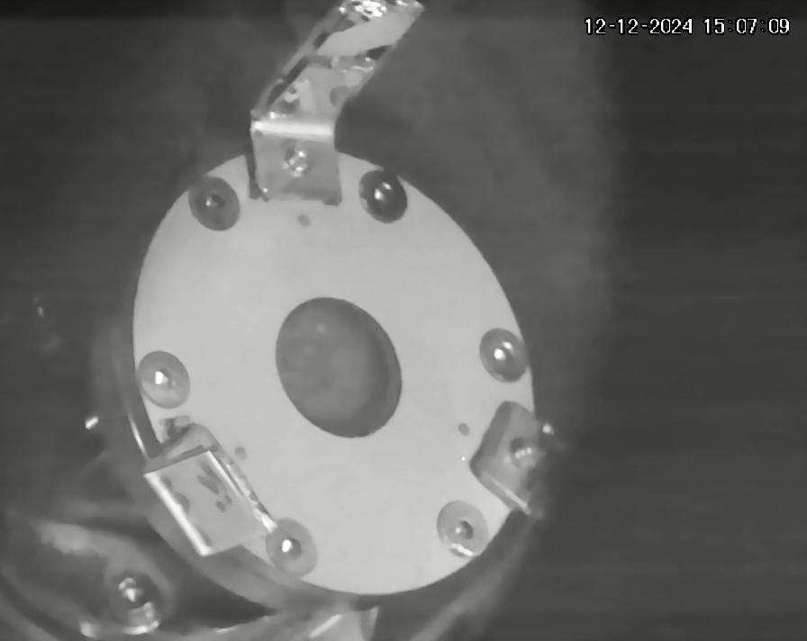
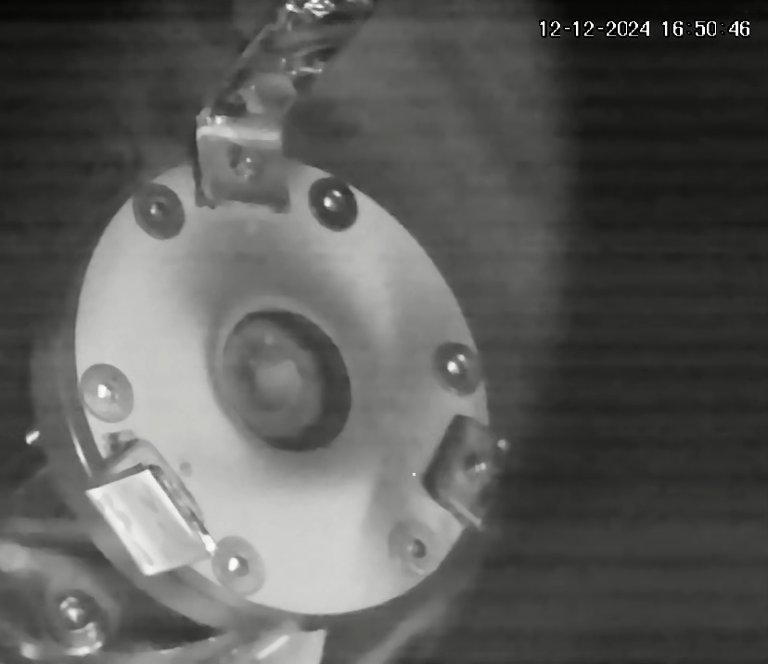
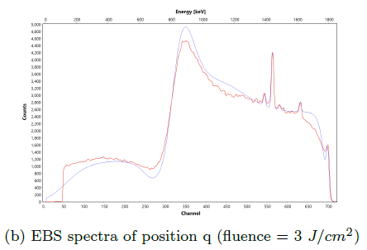
Experiments in linear devices (MAGNUM-PSI, PSI-2, GyM, dust gun)
DIFFER:
Cross machine study GyM, PSI-2 and Magnum-PSI for sputtering of Ar⁺ by W (standard case).
  Entrainment effects quantified in 2024, comparison study planned in 2025
  Characterize erosion rate using FIB-cut markers, mass change
Production of thick WEST-like deposits of mixed W-B layers as expected in ITER
  Thin ~100 nm layers already produced in-situ by PLD, powder dropping, evaporation at dep rates 2-3 nm/min
  Aim to produce layers 2-5 µm thick by improving on these techniques
  Characterization by EBS, NRA, FIB-SEM planned
Comparison of B erosion by samples grown by different methods
  Compare in-situ grown layers at DIFFER and pre-grown magnetron sputter layers (FZJ) ~100 nm thick
  Erosion monitoring in-situ via EBS (effect of O presence on erosion by D, He)
Before
After
¹¹B
¹⁰B
¹⁶O
¹²C

Slide 6
Experiments in linear devices (MAGNUM-PSI, PSI-2, GyM, dust gun)
ENEA:
  Study erosion of W model systems and re-deposited W - cross-machine experiment, GyM (continuation)
      Exposure of W model systems (available) and re-deposited W samples (once available) from SP B.4 to Ar plasma.
  Study erosion of B-based layers
    Characterizations in Milan for these activities: weighing, AFM and SEM-EDX.
    Please note: GyM is scheduled for shutdown in summer 2025 for its upgrade to BiGyM.
FZJ:
  Study 1: expose various B layers to PSI-2 plasmas
    Samples to be produced under SP B.4 and/or SP F
  Study 2: continue cross-machine experiments with different W layers in PSI-2
    Combined with post-mortem FIB/SEM investigations – also erosion FIB markers on the agenda
  Study 3: improved spectroscopic detection methods for studying W and B erosion in PSI-2 (see next slide)
ENEA:
  Repeat dust impacts on samples similar to the last ones provided last year by POLIMi
    5 μm W co-deposits on W and Mo substrates to compare co-deposit delamination
    Surface analyses by SEM/BSE.
  Investigate delamination of coatings for oblique dust impacts.
  Study delamination of coatings for normal and oblique impacts vs. target temperature (up to 400°C).
Follow-up meetings by mid-2025: (i) update on the exposure program of W samples – once first results are available; (ii) co-ordination with SP F for the exposure of B samples – SP F.2 wants to understand B erosion, deposition, and retention

Slide 7
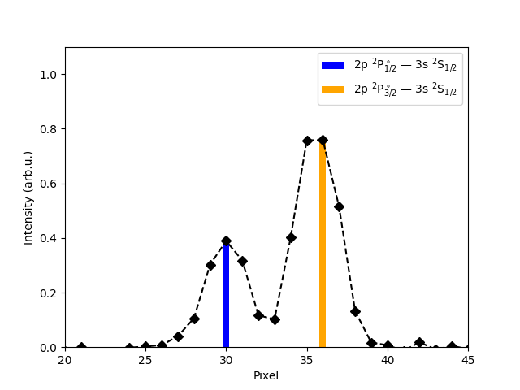

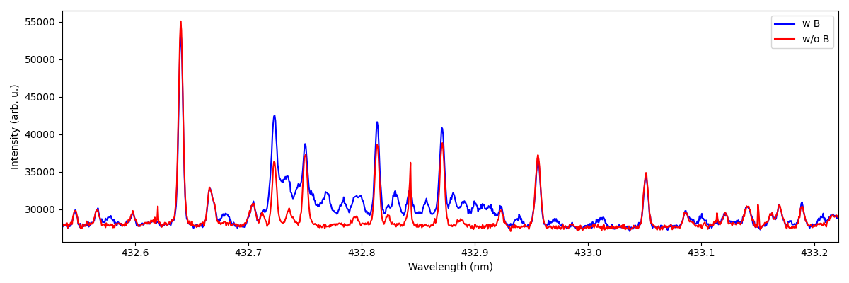
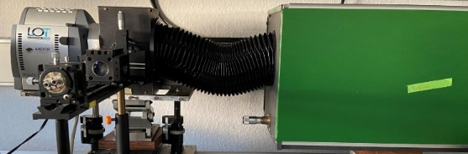
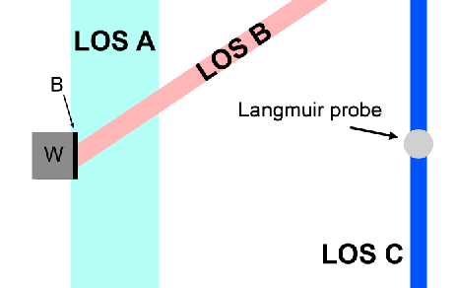
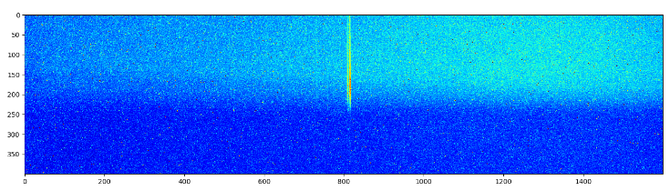
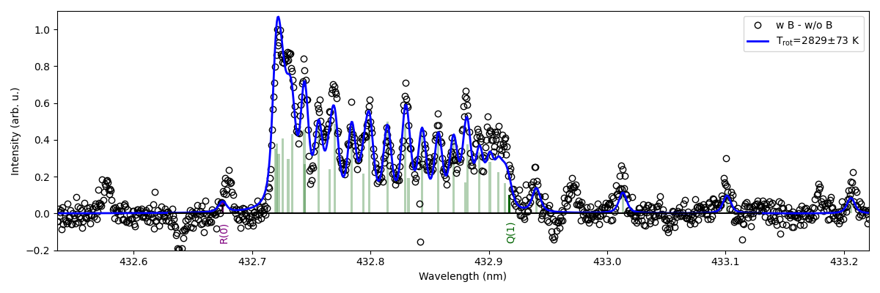
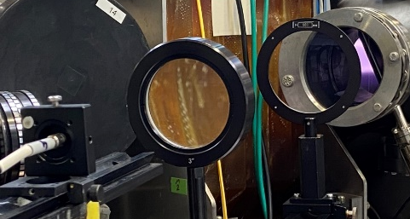
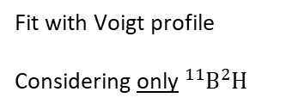
Example: improvements in spectroscopic detection in PSI-2 (FZJ)
Example of erosion of B on W layers
High resolution (HRS) and imaging spectroscopy (IS) for bulk and re-deposited W and B
VUV Spectroscopy for W and D atomic and molecular lines
B I and BD lines in UV and VUV at different D fluxes (physical vs. chemical sputtering)
  Measurements of energy and angular distribution of B I lines @ 250 nm
B I 250 nm lines
Data from 43 V (floating), 100 A, 100 sccm D
Blue: First 4min (Erosion of Boron layer)
Red: Last 4min (No Boron layer)
79 grooves/mm
Plasma on
W substrate
Fit with Voigt profile
Considering only ${}_{ }^{11}B{}_{ }^{2}H$
B I lines using imaging spectrometer
UV Optics (LOS B 35°)

Slide 8
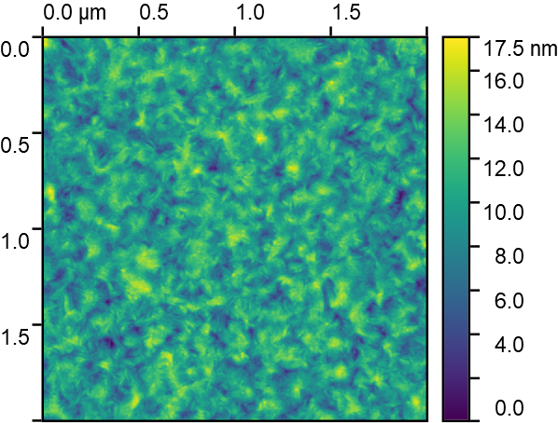
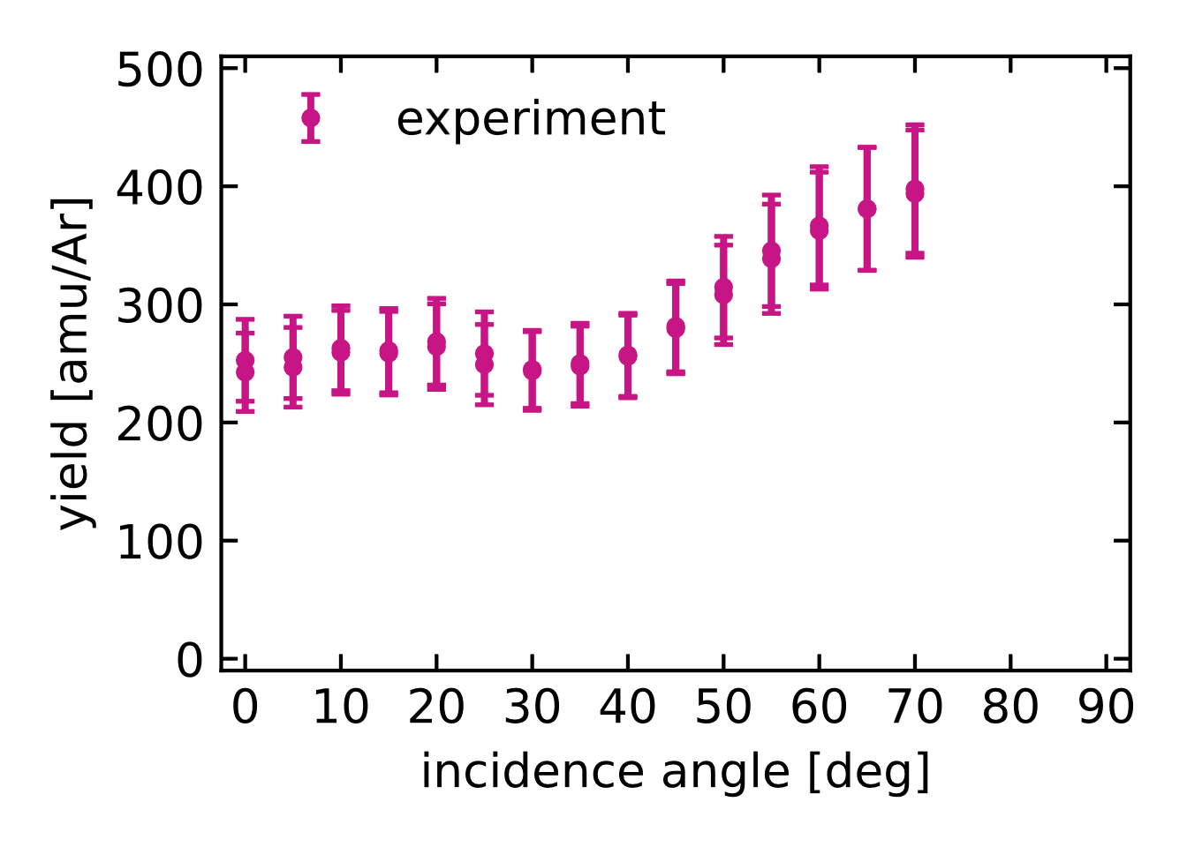
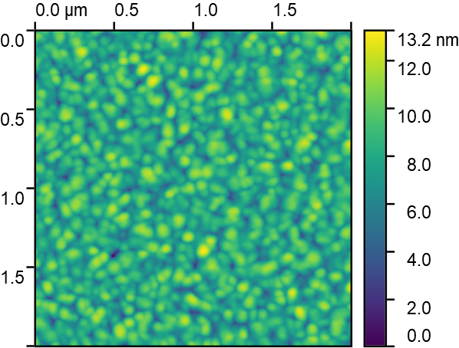
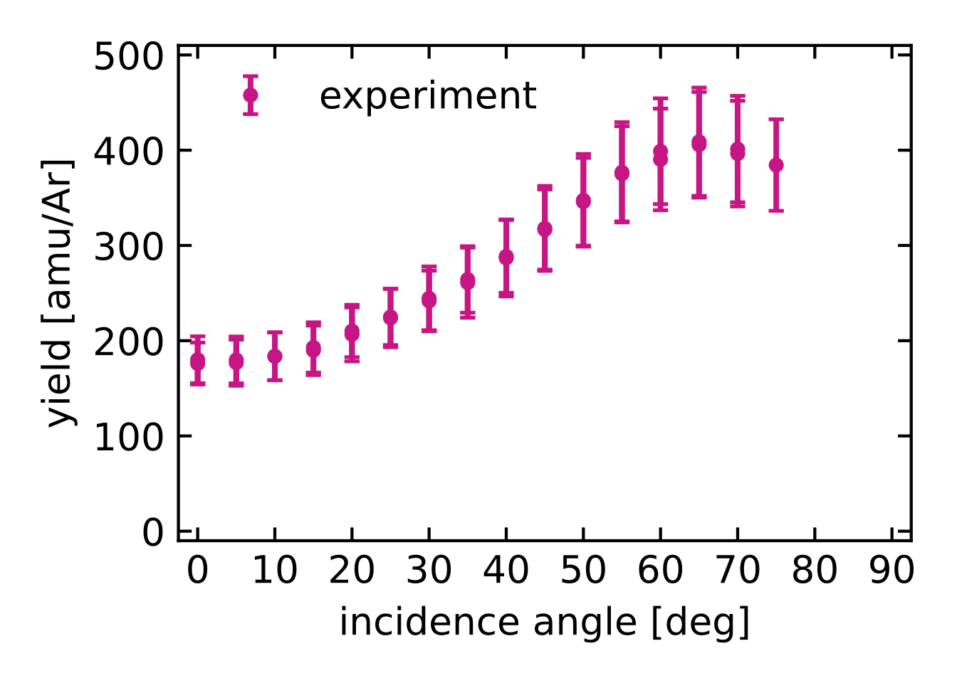
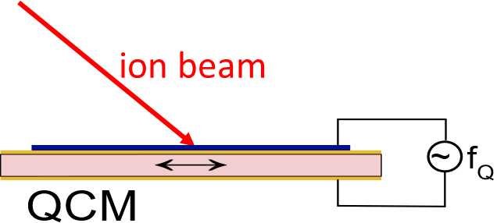
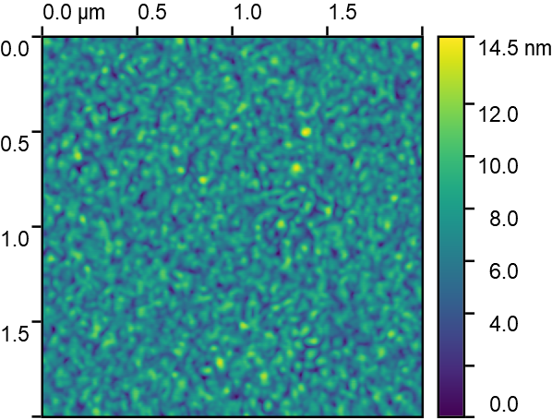
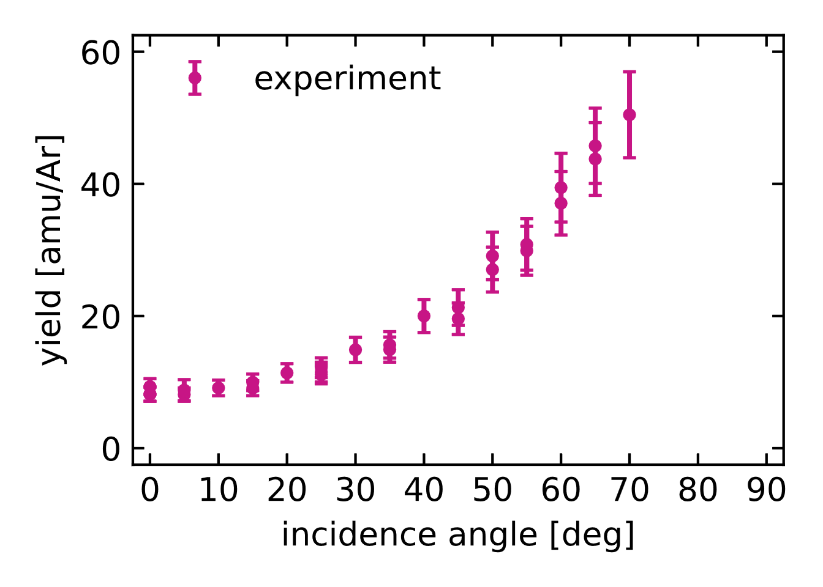
Laboratory erosion studies
sample topography
(pre irradiation)
(preliminary data)
sputter yield during
2keV Ar⁺ bombardment
(preliminary data)
ÖAW:
  Erosion measurements on pure W, pure B and mixed layers
    Apply the high sensitivity QCM technique
    Quantify sputter yields for various incidence angles and different projectile species
  Investigate the effects of pure B on the implantation of projectiles during irradiation
  Determine sputtering yield for W+B mixed layers
    Synergistic effects between erosion yield and B concentration
  Characterize surface morphology before and after irradiation
    Study if irradiation induced morphology changes are present and whether they are different for different B concentrations
pure W
RMS: 2.12 nm
δ_{m} = 8.73 deg
texture? under current investigation
W:B ≈ 1:1
RMS: 1.56 nm
δ_{m} = 4.74 deg
High-sensitivity QCM technique used to measure sputter yields at various incidence angles and for different projectile species
pure B
RMS: 1.69 nm
δ_{m} = 7.14 deg

Slide 9
SP B.2 deliverables 2025
Activity | Deliverable ID(s) | Title
SP B.2 | D001 6 PM | WEST campaigns: erosion and deposition patterns on PFUs after WEST Phase 1 (C1-C5) and Phase 2 (C6-C10) operations and thickness profile of layers originating from boronizations (CEA) + 25 k€ sample cutting
SP B.2 | D002 2 PM | WEST campaigns: microscopy investigations of He-exposed PFUs after Phase 1 and Phase 2 operations on WEST (CEA)
SP B.2 | D003 2 PM | WEST campaigns: detailed investigation of PFUs for their erosion, deposition, and surface-modification patterns at different locations with respect to magnetic ripple (MPG) + 2 days accelerator + 4 k€ SEM
SP B.2 | D004 5 PM | AUG manipulator experiments: pre- and post characterization of samples exposed to AUG plasmas and/or boronizations on AUG for their erosion and surface-modification patterns as well as boron deposition profiles (MPG) + 5 days accelerator + 10 k€ SEM
SP B.2 | D005 3 PM | AUG manipulator experiments: deposition profiles of B and D on samples exposed to AUG plasmas and/or boronizations on AUG at high spatial and depth resolution (VTT) + 2 days accelerator
SP B.2 | D006 2 PM | AUG campaigns: deposition profiles on samples originating from boronizations on AUG (RBI) + 2 days accelerator
SP B.2 | D007 2 PM | AUG campaigns: changes in the surface properties of samples exposed to AUG plasmas and/or boronizations on AUG (FZJ) + 1 day accelerator
SP B.2 | D008 2 PM | W7-X manipulator experiments: erosion and deposition characteristics on manipulator and other samples exposed to OP2 plasmas on W7-X (FZJ) + 1 day accelerator
SP B.2 | D009 3 PM | W7-X manipulator experiments: erosion and deposition patterns on manipulator samples and wall components from OP2 experiments and/or boronizations on W7-X (MPG) + 3 days accelerator + 6 k€ SEM

Slide 10
Largely connected to the WPTE and WPW7X experimental programs
Several manipulator experiments scheduled on AUG → pre- and post-characterization of samples under SP B.2
  Melting studies at the divertor: (i) samples with toroidal gaps to study sustained melting of W, (ii) new proposal to investigate melting of W heavy alloys (Densimet) → both in the early part of 2025
  Runaway electron (RE) impact in the main chamber: damages introduced on specific probe heads → in the end of July 2025
  W erosion at the divertor: (i) erosion of various (marker) samples in the presence of Ne plasmas, (ii) studying the role of prompt re-deposition in different B-fields → autumn 2025 or early 2026
  Erosion of Mo-coated marker tiles in ICRH limiters → status unknown
  Exposure of different samples to full or partial boronizations and further to plasmas → ongoing, follow-up analysis needs for samples to be discussed
Samples (~40+40) from boronization experiments on WEST → first batch available, analysis chain to be optimized
  Additional set of reference samples from FZJ most likely to be exposed in late 2025
Experiments on W7-X provide some interesting manipulator samples mainly for MPG and FZJ – but also complementary labs with targeted techniques (Raman, XPS, EELS,…) called for
  ¹³C deposition in forward vs. reversed magnetic field → benchmarking modelling
  Properties (thickness, homogeneity, composition,…) of boronization layers and sticking of B radicals
  General characterization of deposits on wall (baffle) tiles after each campaign phase (OP 2.2, OP 2.3)
Additional samples becoming available for analyses after the AUG, WEST, or W7-X campaigns – prefer non-destructive measurements

Slide 11
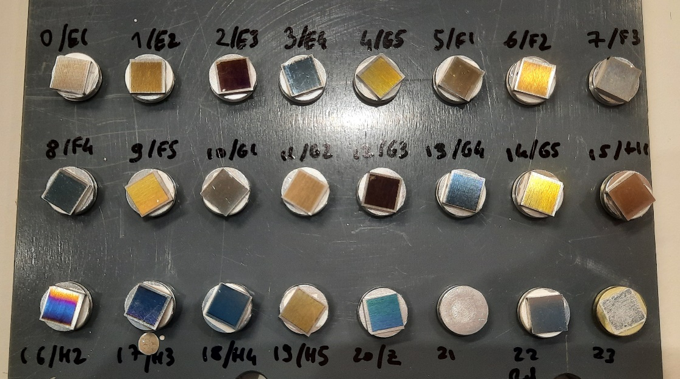
Huge number of WEST boronization samples requires coordinated analyses programme
In total there are about 40 samples (20 on 316L steel / 20 on W) to be characterized to check the efficiency of non-uniform boronization on WEST
40 more samples might follow if a uniform boronization is carried out at the end of C11 (April 2025)
Possible analysis programme – mainly under SP B.3:
Split the samples into 3 batches, aim at representative sets consisting of 10-15 samples each
IBA + microscopy for each of them + SIMS and XPS in the end
Measurements should be performed at regular intervals (2-3 times) before sending them forward in the chain
Candidates:
IBA: MPG, NCSRD, VR, (JSI, RBI – accelerator down in late 2025)
Microscopy: CEA/AMU, MPG, IPPLM, FZJ
SIMS: VTT, CIEMAT
XPS: FZJ, VR, NCSRD, JSI
TDS: CEA/AMU
Raman: CEA/AMU

Slide 12
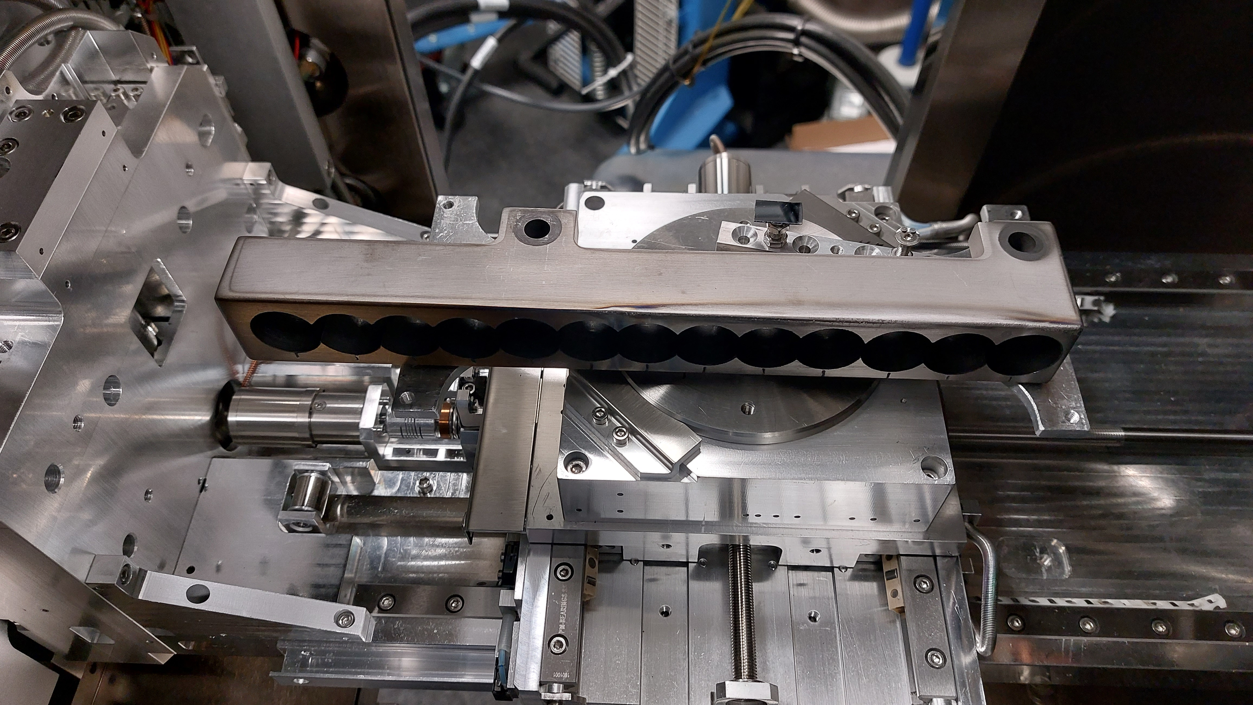
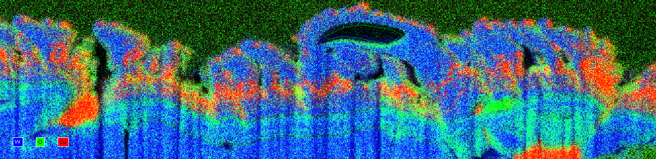
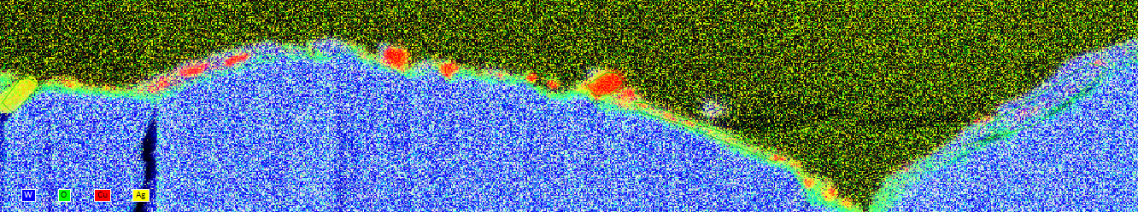
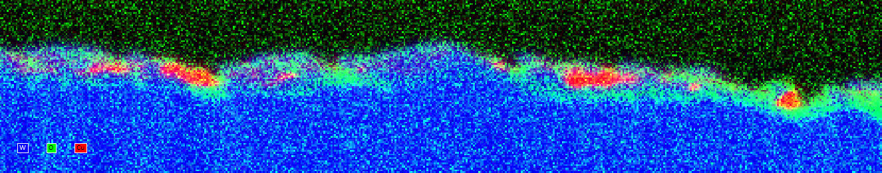
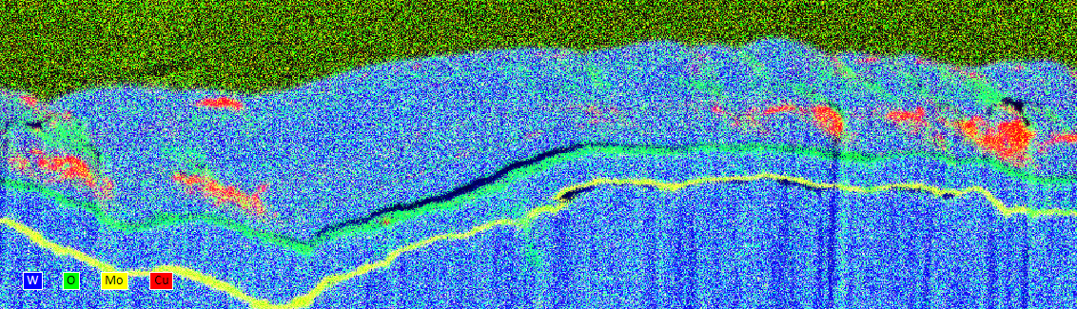
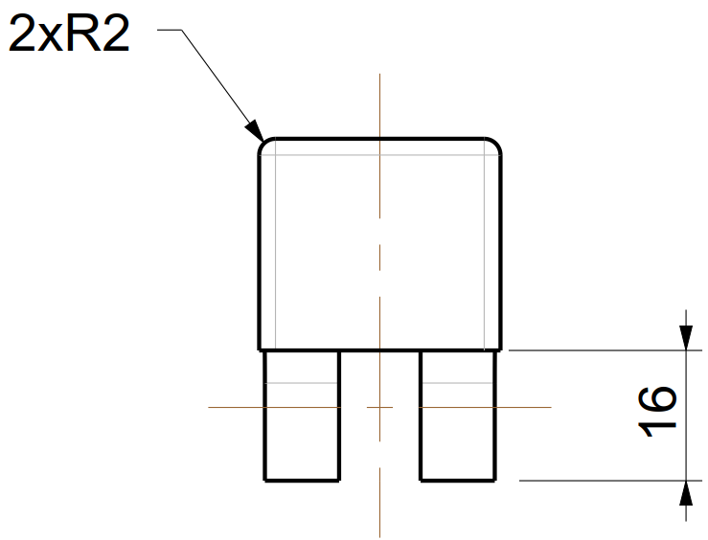
Example: deposition on the side faces of WEST marker PFUs (MPG)
W O Cu
4 mm into gap
2 mm into gap
WEST mounted in AURIGA after core drilling
Ag
300 nm
2.4 µm
Mo
2 µm
2 µm
400 nm
300 nm
Mo
2.4 µm
Deposition pattern:
- thickness
- composition
600 nm
2 µm
2 µm
First IBA measurements and SEM analyses made on the tiles – clear deposition patterns visible
FIB cuts show thickness of the deposits (yellow mark indicates position of the SEM images with EDX maps, right)

Slide 13
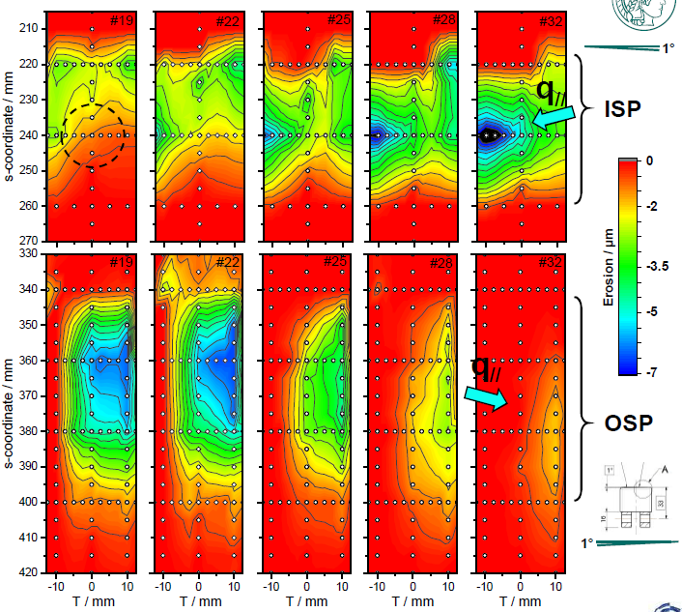
Example: erosion patterns due to magnetic ripple (MPG)
Contour plot of the interpolated data together with meas. positions
Strong ripple on the WEST magnetic field due to pre-existing arrangement of the toroidal coils → toroidal modulation of particle & power flux along strike lines
Maximum erosion not at the center but toroidally shifted probably due to beveling (+ misalignment)
Erosion varies with respect to the ripple
Overall highest erosion measured at the edge of the inner divertor tiles at ripple max
ISP: increased higher erosion at both toroidal edges (beveling + misalignment)

Slide 14
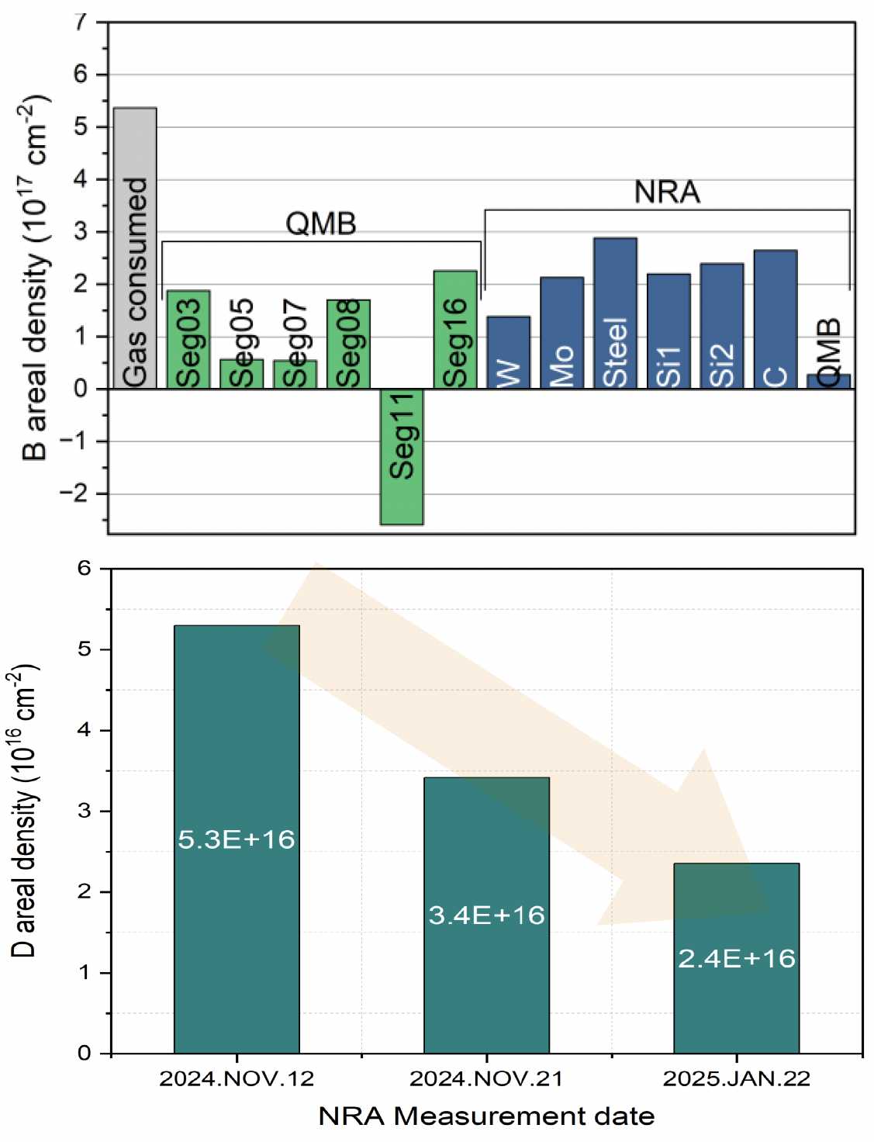
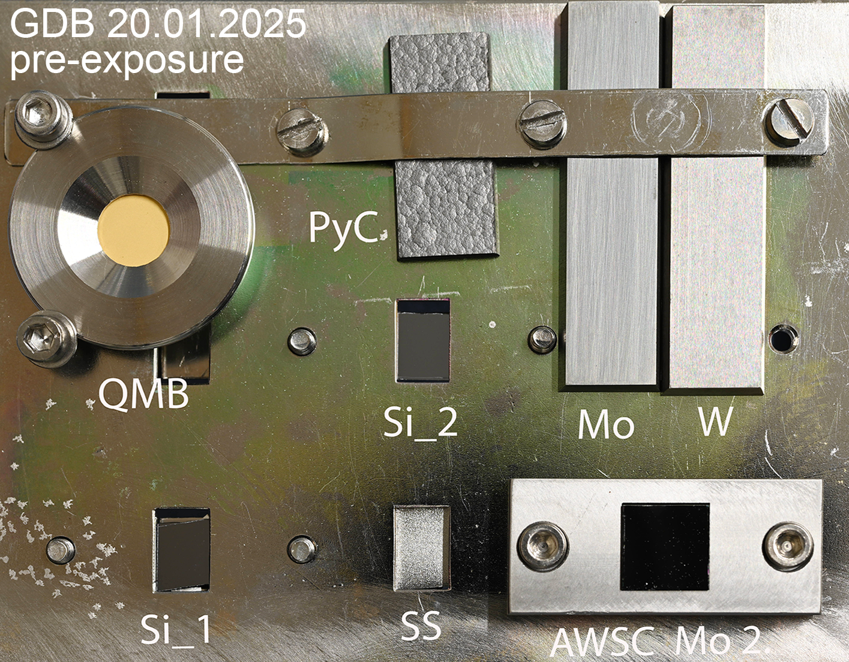
Example: analysis of AUG samples following boronizations (MPG)
High priority IO R&D request: Assess uniformity
and lifetime of wall conditioning by GDB
In AUG: combine in-situ diagnostics (QMB, RGA, ...)
with ex-situ analysis of exposed witness samples
Comparison RGA-QMB-NRA
Storage in Ar
Exposure to air
S. An
K. Krieger
V. Rohde

Slide 15
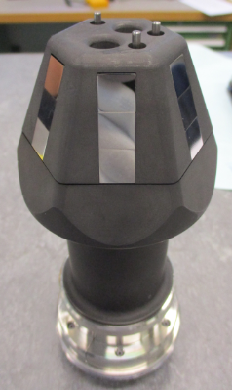
Priorities for W7-X analyses
MPG:
  Analyses and evaluation of cavity samples exposed during boronisations on W7-X
    Connected with the PFMC contribution of M. Mayer
  Analyses of entire baffle tiles (10 × 10 cm²) for their deposition patterns
FZJ:
  Analyses of samples exposed during OP2.1/2.2 + new samples from OP2.3 experiments
X1
W7X
X1
ref
W7X
X2
ref
Scheduled exposures in OP2.3
Erosion of B layers produced in FZJ
Erosion of W, Mo, steel and C in Ne seeded plasmas
50 nm
X2
SEM images of manipulator samples exposed in W7-X during OP2.2 (01.10.2024)
Follow-up meetings in the near future: discussion on (i) additional analysis needs for the ¹³C samples, (ii) capabilities for handling entire baffle tiles and (iii) possibilities for XPS, Raman, EELS etc. measurements

Slide 16
Example: sticking coefficients of B radicals on W7-X and AUG (MPG)
B_{x}H_{y}
B₂H₆
Boronisations are performed in a DC plasma in a mixture of B₂H₆ / B₂D₆ + He
formation of B_{x}H_{y} radicals / molecular fragments
cavity technique to determine the parameter β
0.8 mm
B_{x}H_{y}
B_{x}H_{y}
0.75 mm
γ
r
s
2.2 mm
s: sticking coefficient, r: reflection coefficient
γ: reaction probability
β = s + γ = 1 − r : surface loss probability
20 mm
W7-X cavity (left)
Top/Bottom: β = 0.37±0.02 (stat.)
Incident flux: 80% Ions + 20% Neutrals
Best fit: β = 0.2 (Ions), ~0.6 + ~1.0 (Neutrals)
W7-X
AUG
30 mm
AUG cavity (right)
Top/Bottom: β = 0.73±0.02 (stat.)
Incident flux: 52% Ions + 48% Neutrals
Best fit: β = 0.2 (Ions), ~0.7 + ~1.0 (Neutrals)

Slide 17
SP B.3 deliverables 2025
Activity | Deliverable ID(s) | Title
SP B.3 | D001 2 PM | Depth profiles and surface morphology of selected B or W layers (CIEMAT)
SP B.3 | D002 4 PM | Surface modifications and fuel content of selected AUG, WEST, W7-X, and PSI-2 samples (FZJ) + 1 day accelerator
SP B.3 | D003 2 PM | Composition of layers on selected WEST monoblock samples (IAP)
SP B.3 | D004 3 PM + 2 PM (AR) | Surface modifications of selected WEST, W7-X, MAGNUM-PSI, PSI-2, and GyM samples (IPPLM)
SP B.3 | D005 3 PM | Composition and fuel content of layers on selected WEST monoblock samples and on samples originating from SP B.1 or SP X experiments (IST) + 5 days accelerator
SP B.3 | D006 3 PM | Micro- and macroscale composition of layers on selected AUG, WEST, MAGNUM-PSI, PSI-2, and GyM samples (JSI) + 7 days accelerator
SP B.3 | D007 2 PM | Surface modifications and erosion/deposition profiles of samples and wall tiles from AUG, WEST, and W7-X (MPG) + 8 days accelerator + 3 k€ SEM
SP B.3 | D008 5 PM | Surface modifications and composition of layers on selected WEST, MAGNUM-PSI, PSI-2, and GyM samples (NCSRD) + 4 days accelerator
SP B.3 | D009 2 PM | Micro- and macroscale composition of layers on selected AUG, WEST, MAGNUM-PSI, PSI-2, and GyM samples (RBI) + 4 days accelerator
SP B.3 | D010 1.5 PM | Erosion and deposition patterns on selected WEST samples as well composition of plasma-exposed B and W layers (VR) + 2 days accelerator
SP B.3 | D011 2 PM | Depth profiles and composition of deposited layers of selected samples from AUG, WEST, W7-X, MAGNUM-PSI, PSI-2, and GyM (VTT) + 2 days accelerator
SP B.3 | D012 2 PM | Depth profiles for layers on selected WEST monoblock samples (UT)

Slide 18
Priorities for surface analyses (ion-beam analyses)
IST:
  Continue analysis of WEST samples, focus on comparison between SIMS (VTT) and NRA/EBS/PIXE (IST) – MB samples
  Analysis of D, C, B contents by NRA, erosion studies by RBS/EBS
  Analysis of main heavier contaminants by PIXE
JSI:
  Broad-beam analyses (NRA, RBS, PIXE) for samples from AUG, WEST, and GyM – list not exhaustive
  Micro-beam analyses (RBS, PIXE) for selected samples
MPG:
  Post-characterisation (IBA+SEM) of pre-characterised AUG tiles regarding boronisation layers
    pending for vessel opening during summer 2025.
NCSRD:
  Determination of composition, crystalline structure and surface analysis of MB samples from WEST and other plasma devices (such as GyM) using ion beam analysis (RBS/NRA, PIXE/PIGE, TOF-ERDA, SEM/EDS, XRD) – TOF-ERDA is a new capability
RBI:
  RBI - broad beam (RBS, NRA, TOF ERDA, PIXE) and micro beam (RBS, NRA, PIXE) analysis of samples from AUG, WEST, MAGNUM-PSI) samples
VR:
  Surface composition and depth profiles using ion beam analysis, with focus on TOF-ERDA and RBS
  Resonant-NRA at low energies combined with RBS will be performed in selected samples to obtain
  high-sensitivity and high-resolution boron depth profile (E. Pitthan et al. Surf. Coat. Tech. 417 (2021) 127188)
  Setups at Tandem Laboratory at Uppsala University (P. Ström and D. Primetzhofer, J. Instrum. 17 (2022) P04011)
WEST, MAGNUM-PSI
WEST, AUG, GyM
AUG, W7-X, WEST
WEST, GyM, PSI-2
WEST, AUG, MAGNUM-PSI
WEST, W7-X, PSI-2

Slide 19
Priorities for surface analyses (microscopy, LIBS, other methods)
CIEMAT:
  SIMS and SEM analyses for samples coming from SP B.1 cross-machine experiments
FZJ:
  SEM and LIBS analyses of selected samples coming from SP B.1 experiments
IAP:
  GDOES and XPS for WEST samples (similarly to C3-C5 marker tiles)
IPPLM:
  SEM and TEM analyses of WEST and W7-X tiles and samples coming from SP B.1 experiments
MPG:
  Post-characterisation (IBA+SEM) of pre-characterised AUG tiles regarding boronisation layers
VTT:
  TOF-SIMS analyses of samples from SP B.1 and SP B.2 experiments
UT:
  LIBS analyses of WEST samples
PSI-2, GyM
PSI-2, MAGNUM-PSI
WEST
WEST, W7-X, GyM, MAGNUM-PSI, dust gun
AUG, WEST, W7-X
WEST, AUG, MAGNUM-PSI
WEST

Slide 20
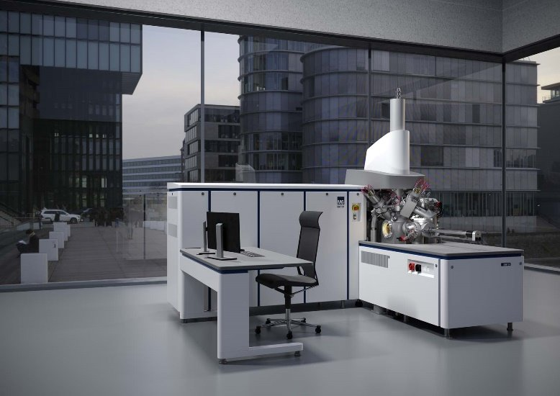
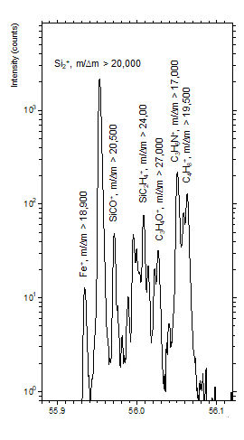
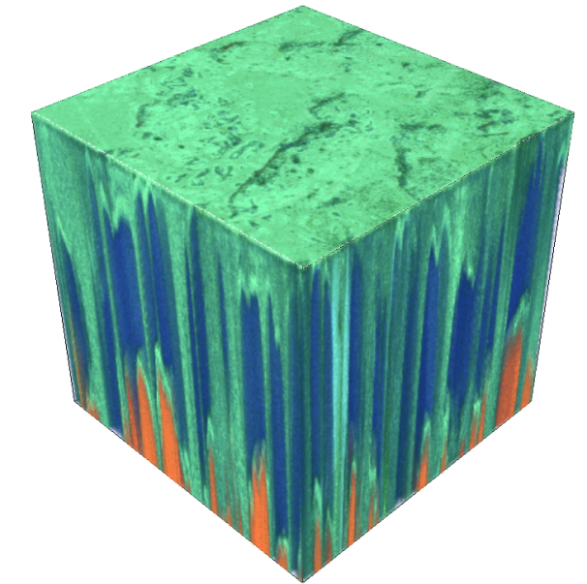
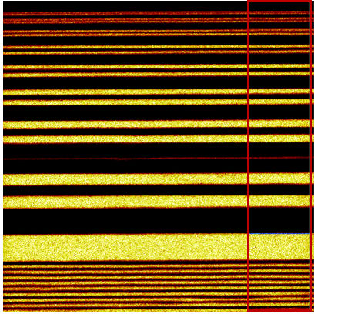
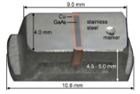
New TOF-SIMS system at VTT being commissioned
2. 3D analysis
3. Chemical information
Iron in silicon
ZnMgAl coated steel
354 µm
354 µm
6 µm
1. Lateral resolution
50 nm
Mg=green,
Al=blue,
Fe=orange
100 nm
20 nm
Looking forward to start applying the tool first to WEST and W7-X samples, then to AUG samples and other layers
Al signal, 8x8um² field of view

Slide 21
SP B.4 deliverables 2025
Activity | Deliverable ID(s) | Title
SP B.4 | D001 3 PM | W- and B-based coatings with pre-defined composition and morphology for experiments in linear plasma facilities (ENEA)
SP B.4 | D002 4 PM | W-based coatings with pre-defined composition and morphology for experiments in linear plasma facilities (IAP)
SP B.4 | D003 6 PM | B reference layers with pre-defined composition and morphology for comparison with data from tokamaks (IAP)
SP B.4 | D004 2 PM | Raman analyses of selected B reference samples (CEA)
SP B.4 | D005 1 PM | SEM and SIMS analyses of selected B and W reference samples (CIEMAT)
SP B.4 | D006 2 PM | LIBS and SEM analyses of selected B reference samples (FZJ)
SP B.4 | D007 2 PM + 1 PM (AR) | Microscopy investigations of selected B and W reference samples (IPPLM)
SP B.4 | D008 5 PM | Ion-beam analyses of selected B and W reference samples (IST) + 5 days accelerator
SP B.4 | D009 4 PM | XPS and TDS analyses of selected B reference samples (JSI)
SP B.4 | D010 5 PM | Ion-beam and structural analyses of selected B and W reference samples (NCSRD) + 3 days accelerator
SP B.4 | D011 1 PM | TOF-ERDA analyses of selected B and W reference samples (RBI) + 4 days accelerator
SP B.4 | D012 1.5 PM | Ion-beam analyses of selected B reference samples (VR) + 2 days accelerator
SP B.4 | D013 1 PM | SIMS measurements and ion-beam analyses of selected B and W reference samples (VTT) + 1 day accelerator
SP B.4 | D014 1 PM | Mechanical testing and crystallographic analyses of thick B and W reference layers (DIFFER)

Slide 22
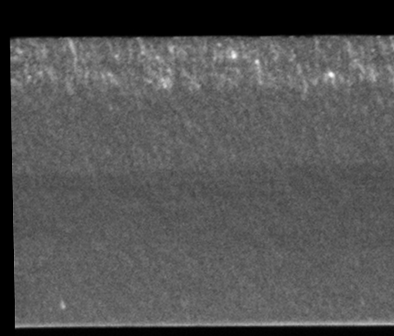
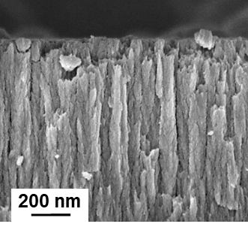
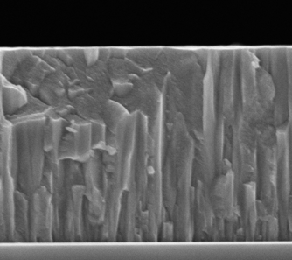
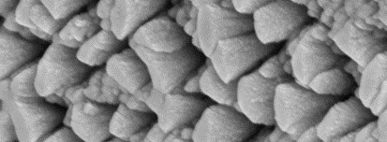
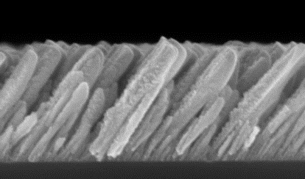
Production and analyses of B- and W-based reference coatings
ENEA:
  Deposition of several kinds of W layers by means of PVD techniques varying morphology and crystallinity of the coatings.
    Amorphous W films (by PLD), porous W films (by PLD) and compact W films (by PLD, HiPIMS or RF-MS)
    Nanocolumnar W films by tilted magnetron sputtering
    Thickness: from 10 nm up to 2-3 µm
    Substrate roughness: from flat to 100s of nm random or pyramidal-shaped
  Deposition of several kinds of B layers by means of PVD techniques (PLD and RF-MS) varying morphology and porosity.
    Deposition of compact or porous B films using both nanosecond and femtosecond PLD
    Thickness: up to 10 µm
    Substrate roughness: from flat to 100s of nm random or pyramidal-shaped
200 nm
Amorphous-W
Porous-W
Compact-W
Nanocolumnar-W

Slide 23
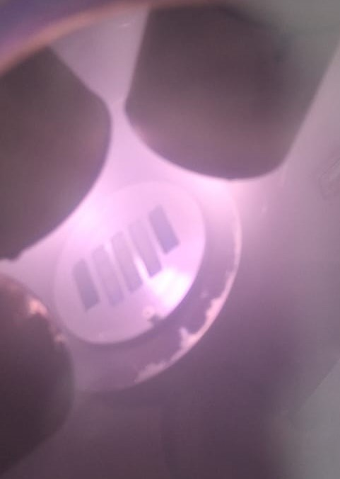
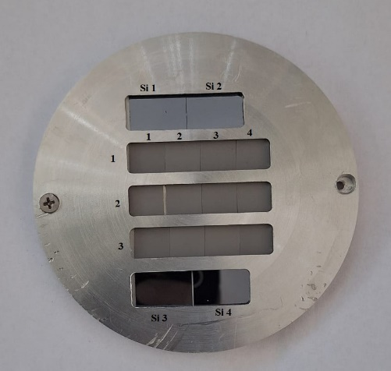
Production and analyses of B- and W-based reference coatings
IAP: production of W layers
  Production of reference coatings according to the agreed specifications – see Master Excel
  Analysis of produced coatings:
    GDOES + XPS + XRD
IAP: production of B layers
  Repeat the exercise performed with CEA in 2022 and 2023:
    BD and BH with high H and D content (more than 10%), thermally treated from 50 to 500°C + O₂ addition
  Samples for permeation studies under SP C
  B layers (100 nm) for round robin experiments and analyses
  For micromechanical measurements to check the delamination behavior of B surface layers exposed to boiling water
    B-coated W substrates, 12×15×1 mm³, 5 μm, dense and porous + boron with D 10 % of 10×10×1 mm³ samples
  Analysis of the produced coatings using SEM, TDS, XRD, Sputtered XPS and nanoindentation
  Investigate the oxidation behavior of B layers under annealing (up to 1000°C, from 1 h to 72 h) – together with IST
                Boron oxide B₂O₃ (4B + 3O₂ = 2B₂O₃)
                Crystalline B₂O₃ - melting point of 450°C
                Amorphous B₂O₃ - no definite melting point but softening temperature around 560-630°C
First samples (B, 100 nm thickness) recently shipped to the different labs according to the Master Excel

Slide 24
Example: influence of temperature on stability of thick W layers (IAP)
W coatings (thickness several μm) using 4-5 coating methods – simulate the co-deposits forming on WEST?
Combined Magnetron Sputtering with Ion Implantation (CMSII)
Thermionic Vacuum Arc (TVA)
High Power Impulse Magnetron Sputtering (HiPIMS )
ultra short - High Power Impulse Magnetron Sputtering (us-HiPIMS)
Bi-Polar High Power Impulse Magnetron Sputtering (BP-HiPIMS)
5 different temperatures: 50, 70, 100, 200 and 300 ºC.
2 different W fluxes towards the substrates (low and high)
Fluxes to be decided so that they will be similar for all coating methods
Substrates to be decided (Si, W, C, etc.)

Slide 25
Production and analyses of B- and W-based reference coatings
FZJ:
  Preparation of homogeneous, amorphous and pure B-layers and mixed layers by magnetron sputter deposition and characterization in house
    Analysis of the samples with LIBS, FIB/SEM/EDX and TEM when required; NRA for comparison
    Comparison to magnetron produced B-D films on W
VR:
  Production in-house (Tandem Laboratory at Uppsala University) of sputter-deposited layers from B and W targets (co-deposition) in Ar and Ar+D₂ atmospheres on different substrates (W, QCM, Mo, Si, C, and MgO)
    Followed by characterization (IBA, SEM, TEM+EDX).

Slide 26
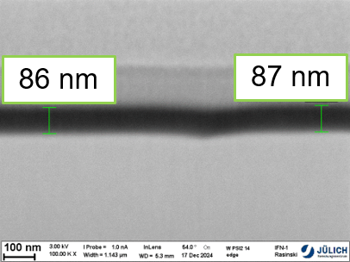
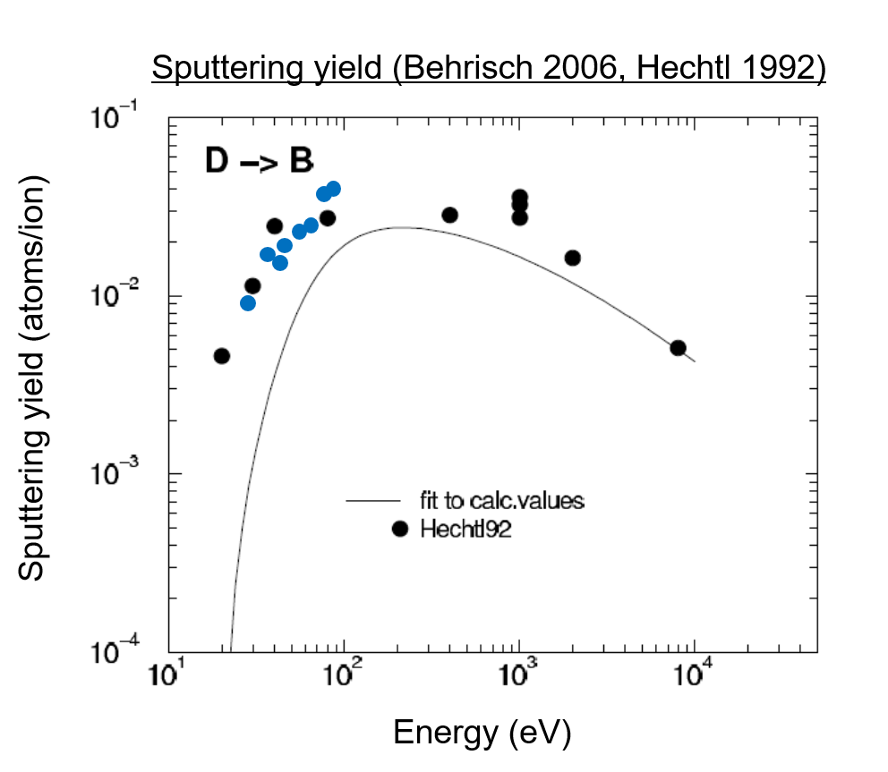
Example: erosion of B-based layers in PSI-2 (FZJ)
Deuterium plasma exposure at PSI-2 for B erosion studies:
‘Pure’ deuterium plasma: ion energy: ~40 eV, ~60 eV, ~80 eV, ~100 eV
Same flux, same layer thickness (115 nm B on W), 70 s exposure time
Layer thickness is studied afterwards by FIB/SEM
Next task: erosion studies on mixed layer: B:W
Good parameters have to be found (W much higher deposition rate in magnetron compared to B)
Studies at similar plasma parameter and varying ion energy as for pure B
Production of other mixed B layers: B:D
Studies for an ITER project are ongoing at the moment
Successful production and characterization of B:D layers with different D content on W (steel not performed so far)
One major conclusion for the B:D layers produced in the magnetron: very different B density compared to pure B layers (obtained by EBS and FIB/SEM cross section) → important for erosion rate and D/B ratio in layers!

Slide 27
Production and analyses of B- and W-based reference coatings
CEA: Raman analyses of B layers from IAP
CIEMAT: SIMS measurements of different B and W layers – including B layers for permeation studies
IPPLM: SEM, TEM, FIB, XRD, nano indentation measurements of different B and W layers
IST:
  Analysis of implanted W samples
  Analysis of samples from B oxidization studies (see previous slide)
JSI: TDS and XPS analyses of the produced W and B layers
  Specific set to be produced for permeation studies (influence of B layers on retention and permeation through W and Eurofer)
NCSRD:
  Analysis of B and W+B based reference samples as a function of their H/D content, fabrication parameters (deposition/annealing temperature, roughness, etc) using IBA, XRD, SEM/EDS. Capability to carry out in-situ (GI)XRD analysis to follow the crystalline structure, phase formation and crystallize size evolution – for annealing studies under vacuum/air
RBI: TOF-ERDA analyses of different B and W layers
VTT: TOF-SIMS analyses of different B and W layers
DIFFER: XRD and mechanical testing of different B and W layers – produced by DIFFER, coordination

Slide 28
SP B.5 deliverables 2025
Activity | Deliverable ID(s) | Title
SP B.5 | D001 1.5 PM | Database of the characteristics of produced W dust particles in the presence of different gas mixtures and comparison with data from tokamaks (IAP)
SP B.5 | D002 1.5 PM | Database of the characteristics of produced B dust particles in the presence of different gas mixtures and comparison with data from tokamaks (IAP)
SP B.5 | D003 2 PM | Surface analyses of dust generated on AUG, WEST, and W7-X and comparison to the data originating from laboratory experiments (MPG) + 3 k€ SEM
SP B.5 | D004 2 PM | Report on surface properties of boron dust on plasma-facing components and assessment for heat balance for boron powder injected into AUG plasmas (VR)
SP B.5 | D005 4 PM | Ion-beam analyses of dust samples originating from AUG, WEST, and W7-X (RBI) + 5 days accelerator
SP B.5 | D006 2 PM | Microscopy and LIBS analyses of dust samples originating from AUG, WEST, and W7-X (FZJ)
SP B.5 | D007 4 PM | Ion-beam analyses of B dust originating from AUG, WEST, and W7-X (VR) + 3 days accelerator
SP B.5 | D008 4 PM | Microscopy analyses of B dust originating from WEST and W7-X (IPPLM)
SP B.5 | D009 1 PM | Report on the properties, composition, and amounts of dust produced on WEST during the Phase 1 operations (CEA)
SP B.5 | D010 2 PM | Fracture and strentgh properties of B and W reference layers on W (UKAEA)

Slide 29
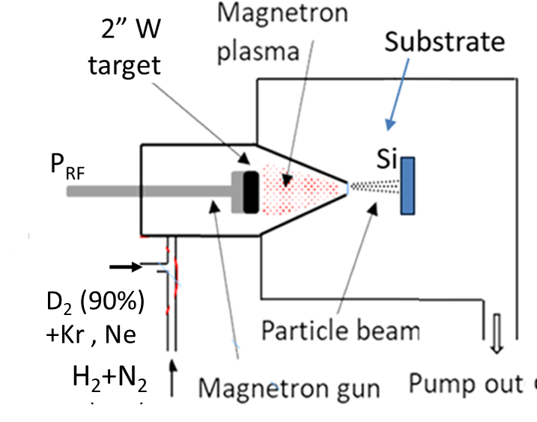
Dust production activities
IAP:
  Continuation of the W dust synthesis activities performed in 2024 by MSGA and plasma-arc device:
    W dust generation in the presence of radiative impurity gases
  Investigations for the synthesis of B dust using MSGA and plasma-arc device:
    Extend the studies initiated in 2024 to deal with varying gases and off-normal events (air/water leaks)
    Comparison with the dust collected from WEST and validation of the relevance and production capability
MSGA experimental setup:
W dust generation by MSGA in the presence of gases relevant for radiative cooling:
  Ne and Kr :
    Will be focused on: dust synthesis rate, morphology, chemical composition, and D₂ retention.
  Nitrogen:
    Exploratory parametric study regarding the synthesis of dust in H₂/N₂ discharges.
    Will be focused on:
      Identification of the experimental parameters for dust synthesis;
      Evaluation of the dust synthesis rate and properties (morphology, chemical composition) upon the N₂ content in discharge.
- Working gases:
  D₂ (90%) , Ne or (10%);
  H₂ +N₂ ( variable ratios).

Slide 30
Dust analysis activities
MPG:
  Restart AUG dust collector analyses with automated EDX data acquisition (campaigns 2017 to 2022)
  Compare W dust particle size distributions collected in lab arc device with those measured optically therein and with those observed on AUG
RBI:
  Microbeam analyses for selected dust samples – pending for sample delivery
FZJ:
  LIBS and SEM analyses – pending for sample delivery
VR:
  Microbeam analyses – pending for sample delivery
  Report on surface properties of B dust on PFCs and assessment for heat balance for B powder injected into AUG (VR)
IPPLM:
  SEM and TEM analyses – pending for sample delivery
CEA:
  Coordination of dust analysis performed in 2025 under WPSAE
    Activities to be moved under WPPWIE from 2026 onwards
Approach
    Dust collection using (i) dust boxes, (ii) double-sided carbon tape, and (iii) filtered vacuum technique
    SEM/EDX analyses and optical microscopy to characterize the shape, size, and composition of the dust particles
    Tritium loading of representative W dust particles @CEA Saclay

Slide 31
Example: B dust data and modelling activities (VR)
State-of-the-art semi-empirical descriptions based on reliable experiments as well as on Monte Carlo or on Molecular Dynamics simulations are utilized to characterize the boron surface processes, namely:
  secondary electron emission
  electron backscattering
  ion-induced electron emission
  thermionic emission
  thermal radiation
  ion backscattering
  physical sputtering
Temperature-dependent thermophysical and mechanical properties, that are important for heat transfer and dust-wall impacts, will be specified
First, boron dust ablation rates will be checked by running MIGRAINe in stationary plasma background with typical edge parameters in order to gain insight on the strength of all competing surface effects
Later, modelling with actual AUG profiles and B injection (location, size, speed) will be carried out by MIGRAINe
  Actual B powder injection experiment most likely only in 2026 (or in the autumn campaign in the best case)

Slide 32
SP B.6 deliverables 2025
Activity | Deliverable ID(s) | Title
SP B.6 | D001 3 PM | Preparation and post characterization of exposed Mo mirrors (FZJ)
SP B.6 | D002 2 PM | Handling and exposure of Mo mirrors using AUG LBO-manipulator during boronizations (MPG)
SP B.6 | D003 3 PM | Changes in the optical properties of the exposed Mo mirrors (EPFL)
All the experiments performed and analyses expected to be largely completed by mid-2025

Slide 33
Concluding remarks
SP B activities are proceeding relatively well at the moment
  Both W and B reference layers are being produced for round-robin studies (SP B.4) and experiments on linear devices (SP B.1)
  Several boronization experiments carried out on AUG, WEST, and W7-X → analysis programme ongoing (SP B.2, SP B.3)
  Other tokamak/stellarator samples expected to become available for analyses during the course of 2025
  ITER-relevant task on mirror exposure to be completed before the end of 2025 (SP B.6)
Potential issues identified in connection with the different dust tasks (SP B.5)
  Very few dust samples expected to become available in 2025 while labs have resources allocated to the analyses
  The complementary UKAEA activities require thinking time to make progress with assessing interfacial and bulk mechanical properties (strength and toughness) of reference B and W layers and how that converts to dust production
Coordination meetings needed to
  Update the sample production and analysis programme – target is to produce most of the samples in 2025 while analyses and experiments can extend into 2026-2027 (SP B.1, SP B.4)
  Discuss follow-up analyses for samples originating from SP B.1 and SP B.2 experiments → which other techniques are to be used beyond the standard ones (IBA, microscopy)?

Slide 34
Extra material

Slide 35
High-level objectives and milestones for SP B in 2025
Erosion and deposition patterns at the divertor and main-chamber structures of toroidal fusion devices following operations with and without boronizations
Reporting the role of fluence and pulse length in the erosion-deposition balance in toroidal fusion devices under reactor-relevant operational conditions
SP | Milestone description | Target date
SP B | Erosion rates of co-deposited/re-deposited W layers at reactor-relevant particle fluxes and fluences determined. (ITER+DEMO) | 31.12.2025
SP B | Material migration pathways elucidated for W and B in toroidal devices (AUG, WEST, W7-X) during and after boronizations. (ITER) | 31.12.2025
SP B | Erosion and deposition patterns on PFUs removed after Phase 1 and Phase 2 operations on WEST compared. (ITER) | 31.12.2025
SP B | Co-deposited boron layers with varying oxygen contents and surface morphologies delivered and characterized. (ITER) | 31.12.2025
SP B | W dust samples from toroidal fusion devices (AUG, WEST, W7-X) characterized and extrapolations made towards fusion reactors. (DEMO) | 31.12.2025
SP B | B contamination determined on diagnostics mirrors after AUG and W7-X boronization experiments. (ITER) | 30.06.2025

Slide 36
Priorities for WEST analyses
CEA:
  WEST PFCs :
    Continue cutting ITER-like PFUs from phase 2 and establish a characterization sequence → ongoing
    Continue investigating the formation of He bubbles (SEM, FIB, TEM, EBSD at Aix Marseille Uni.) → target PFMC
    Collect all the data for overviews (PFMC, IAEA FEC) on WEST post mortem analyses and material migration pathways → target PFMC and IAEA FEC
  Samples from boronizations:
    Pre-characterization and installation of samples on collecting probes → completed
    Exposing 40-80 samples to WEST boronizations (WPTE experiments) → ongoing
    Develop a protection procedure for samples and establish a characterization sequence → target spring 2025
MPG:
  Finalize analyses and prepare talk/poster for PFMC on IBA+SEM analyses on W-coated standard divertor tiles from different positions wrt. to the magnetic ripple
  Analyse and evaluate the sides of the skeletons of marker tiles (retrieved after C3, C4 and C5) and standard tiles → deposition into poloidal gaps (pending activity from 2024)
  IBA+SEM analyses of ITER-like PFU segments
Follow-up meetings in the near future: discussion on the elaborated plans for the analysis of WEST boronization samples (can be done via email unless severe issues encountered)

Slide 37
Priorities for AUG analyses
MPG:
  IBA analyses of collector samples to study boronisation efficiency
    exposure on DIM, (MEM), and LBO manipulators
  Pre- and post characterisation of DIM insert samples of the melting and RE experiments (under WPTE)
VTT:
  Production and exposure of new marker samples for the Ne-seeded plasma experiment (under WPTE, in 2025/2026)
    Additional set of samples to be used for modelling efforts under SP D
  Testing the capabilities of the new TOF-SIMS system for the analysis of boronization samples from AUG and WEST samples
    Commissioning of the device ongoing
FZJ:
  Characterize W samples with cross-section marking following exposure to Ne-seeded plasmas (under WPTE, in 2025/2026)
    SEM measurements, connected with a similar experiment under SP A: mixed plasma exposure in PSI-2
  Investigate the properties of B layers following boronizations
    SEM measurements
RBI:
  TOF-ERDA+PIXE analyses for selected AUG samples, incl. microbeam
    Detailed contents of the task to be discussed
Follow-up meetings in the near future: discussion on the analyses needs for the different samples, including the ones from boronizations

Slide 38
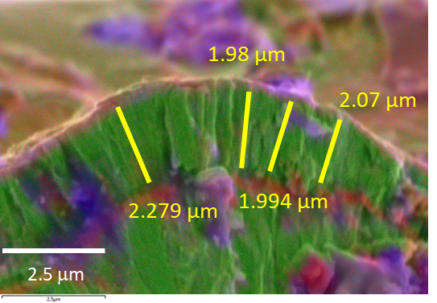
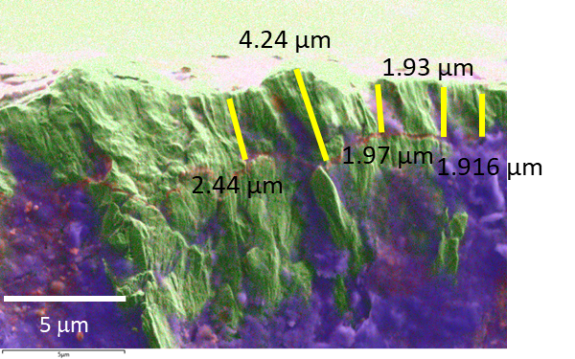
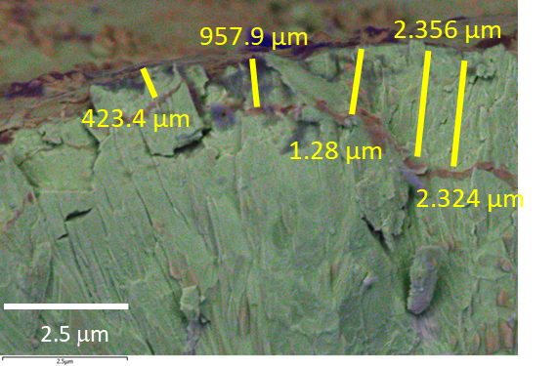
Example: depth profiles and cross sections of WEST C5 samples (NCSRD)
C5 21oG
C5 21oB
C5 33iQ
B
C
O
Fe
W
Mo
Clear differences in the elemental concentrations and thickness of the surface layers

Slide 39
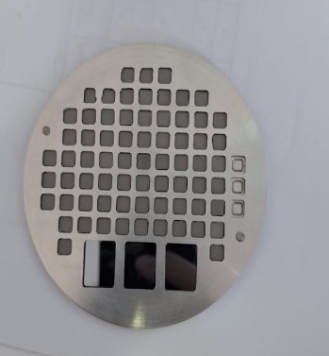
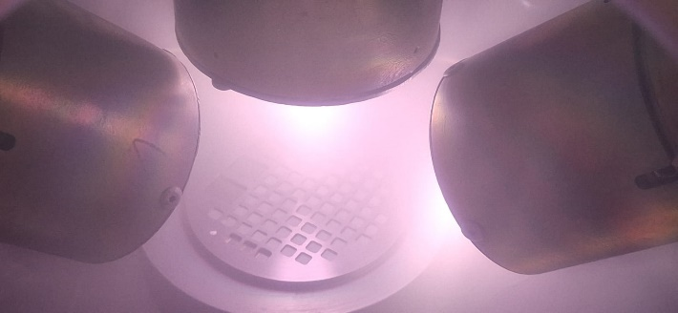
Example: production of B-D samples with thermal treatment (IAP)
TDS measurement during thermal treatment
Deuterium quantity as a function of the thermal treatment
Preparation of 5×5 mm² W samples (5 μm) coated with B+D₂(10%) and subjected to thermal treatment
Thermal treatment from 50°C to 500°C, ramp 5ºC/min
60 tungsten substrates 5x5 mm
2 RF sources opperated at 100W each
Working pressure: 1x10⁻²mbar
Ar flow= 20sccm
D₂ flow= 20 sccm
Temperature (ºC) | D released (at/cm²⁾ | D released during the TT (%)
50 | 7.45E+14 | 0.01
100 | 8.25E+15 | 0.08
150 | 2.21E+16 | 0.22
200 | 2.98E+16 | 0.29
250 | 2.82E+17 | 2.76
300 | 1.06E+18 | 10.39
350 | 2.22E+18 | 21.76
400 | 3.24E+18 | 31.76
450 | 4.95E+18 | 48.53
500 | 6.45E+18 | 63.24
1050 | 1.02E+19 | 100.00
TDS result on B+D2_1050ºC
Sample holder
In situ photo of the deposition
To be followed by Raman measurements

