Slide 1
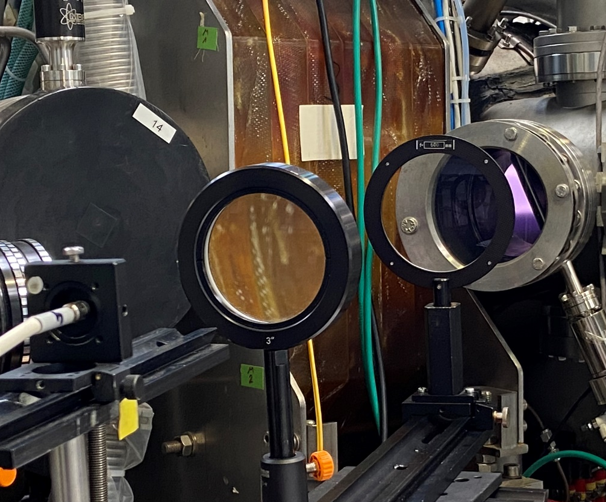
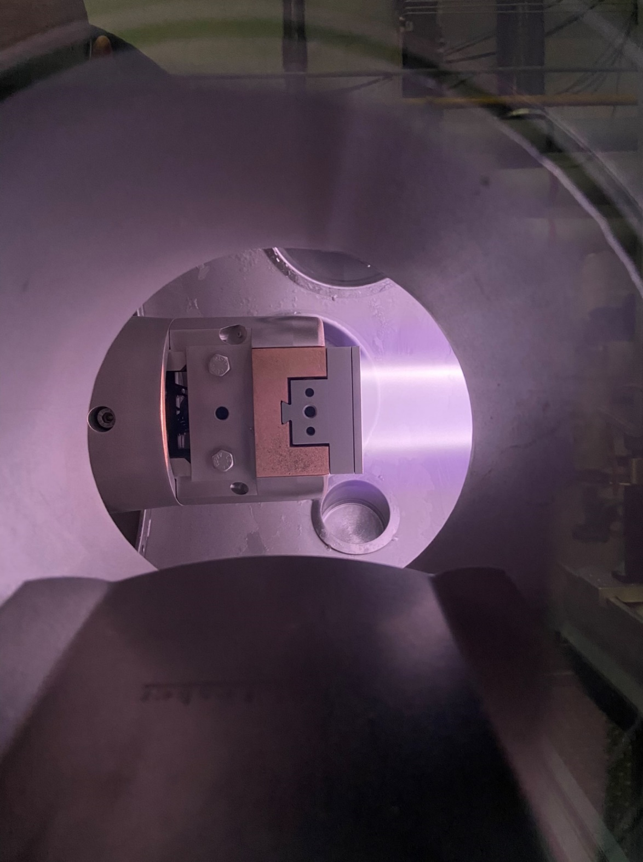
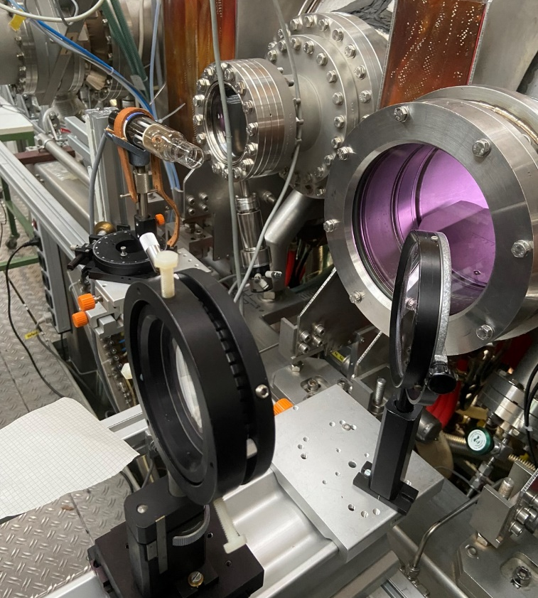
Sputtering of boron layers in PSI-2
$${\text{M}\text{. }\text{Sackers}}^{1}\text{, }{\text{O}\text{. }\text{Marchuk}}^{1,2}, {\text{A}\text{. }\text{Houben}}^{1}\text{,} {\text{E}\text{. }\text{Warkentin} }^{1,2},{\text{M}\text{. }\text{Rasinski}}^{1}, {\text{S}\text{. }\text{Brezinsek} }^{1,3}\text{,} \text{and} {\text{A}\text{. }\text{Kreter}}^{1}$$
$${}_{ }^{1}{\text{Forschungszentrum} \text{J}\text{ü}\text{lich} \text{GmbH}\text{, }\text{Institute} \text{of} \text{Fusion} \text{Energy}\text{ \& }\text{Nuclear} \text{Waste} \text{Management}\text{ − }\text{Plasma} \text{Physics}\text{, }\text{Germany}}$$
$$^{2}\text{Ruhr} \text{University} \text{Bochum}\text{,} \text{Faculty} \text{of} \text{Physics} \text{and} \text{Astronomy}\text{, }\text{Germany}$$
$$^{3}\text{HHU} \text{D}\text{ü}\text{sseldorf}\text{, }\text{Faculty} \text{of} \text{Mathematics} \text{and} \text{Natural} \text{Sciences}\text{, }\text{Germany}$$

Slide 2
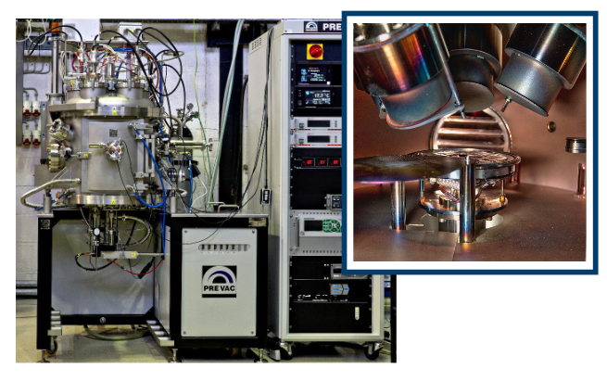
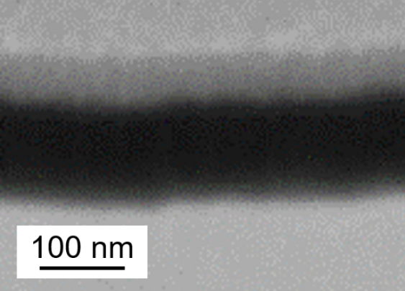
W-targets with boron layer – fabrication
SEM (FIB)
Pt
B
W
Mounted in PSI-2 sample holder
B
W
W
RF Ar discharge + B target, ~ 6 h deposition
~115 nm B layer on polished and annealed W PSI-2 substrates
W
Mo mask
W
W
W
W

Slide 3
Erosion channels of boron at PSI-2
Molybdenum mask
D plasma
$D_{ }^{+}$, $E_{kin}<100 eV$
BD formation
Resonant BD band spectrum at 432.8 nm
Chemical sputtering
~ 115 nm Boron
Dissociation
Tungsten
Physical sputtering of B
Resonant B I lines at 250 nm
Molybdenum mask

Slide 4
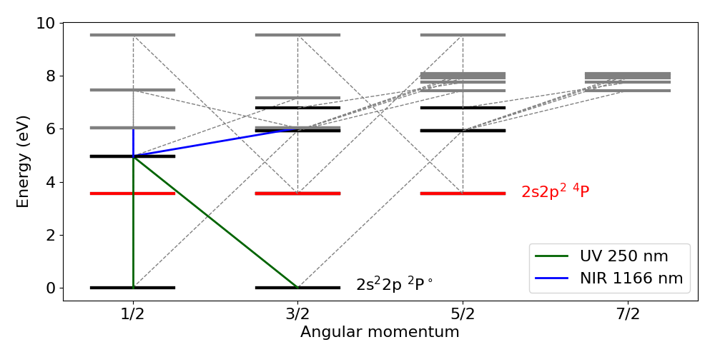
B I spectroscopy: line selection
Physical sputtering of B
$n_{e}≈2.8∙{10}^{17} m^{−3}$
$T_{e}≈11$ eV
Only B I 2s²2p
➔ Population in other states $|k>$ ➔ line emission
Grotrian diagram of B I
Level << 11 eV for sufficiently large $<σv>$
Resonant line with the longest wavelength:
UV 250 nm!

Slide 5
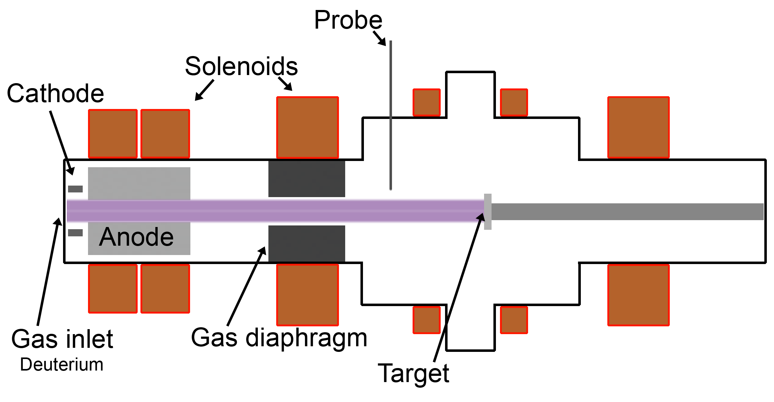
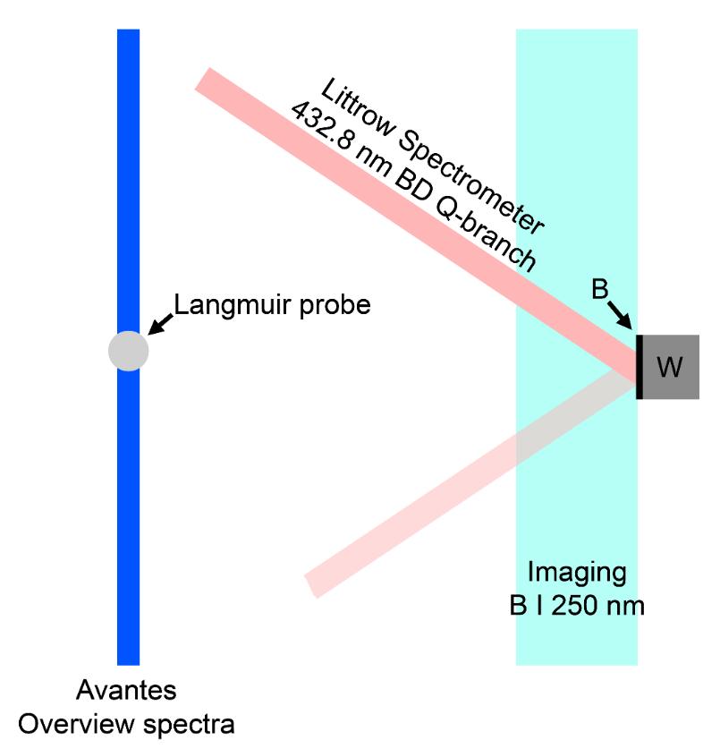
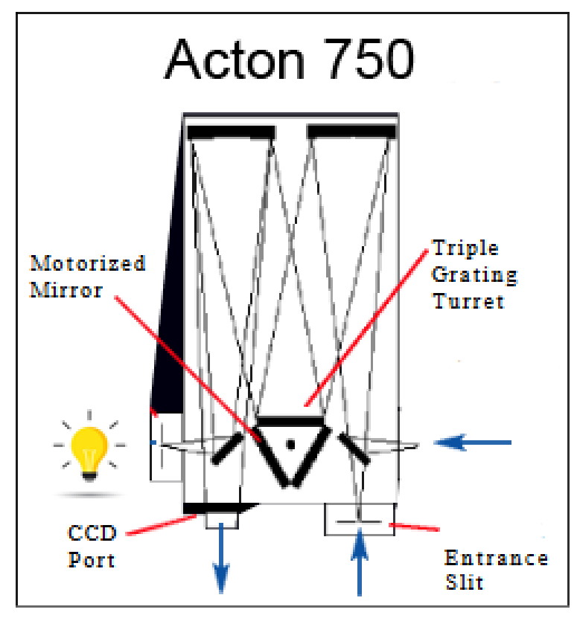
Plasma parameters and optical setup
Diagnostics
Deuteron flux density
$$φ_{D^{+}}≈{4∙10}^{21}s^{−1}m^{−2}$$
Deuteron impact energy
$$E_{kin,D^{+}}≈{40}^{∗}…100 eV$$
$^{∗}$ depends on the floating potential
Littrow: VIS
Czerny-Turner: UV
Pure deuterium plasma:
$T_{e}≈11 eV$
$n_{e}≈{2.8∙10}^{17}m^{−3}$

Slide 6
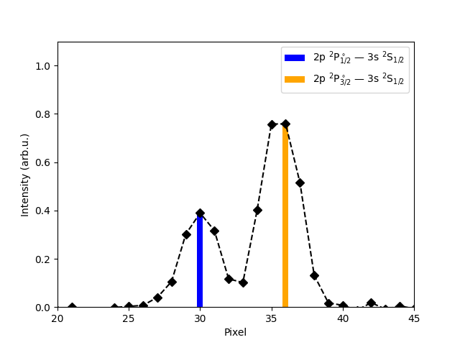
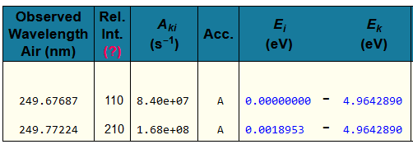
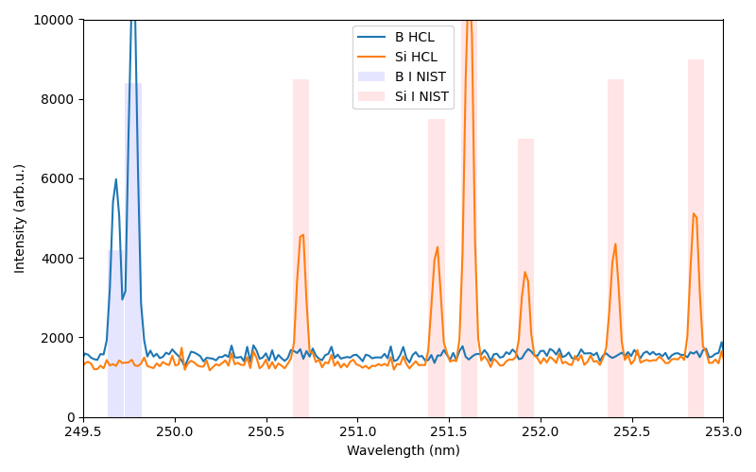
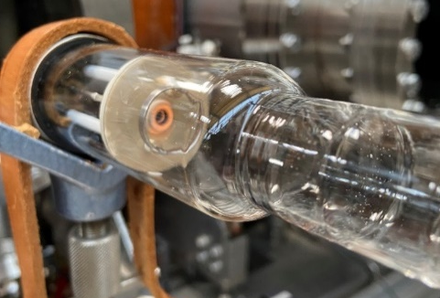
Calibration of the imaging spectrometer
UV
holographic grating
*
Ratio must be $\sim$ 4:2
PSI-2/ Hollow cathode lamp(HCL)
UV-Optics

Slide 7
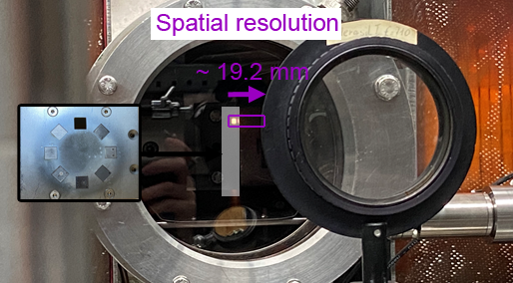
Spectroscopic time-of-flight measurements: B I 250 nm
Spectrum detect by the imaging spectromter @ 80 V Bias
Plasma on
B I 250 nm lines
Edge @ pos 2123 mm and 450 nm
Backlight illumination

Slide 8
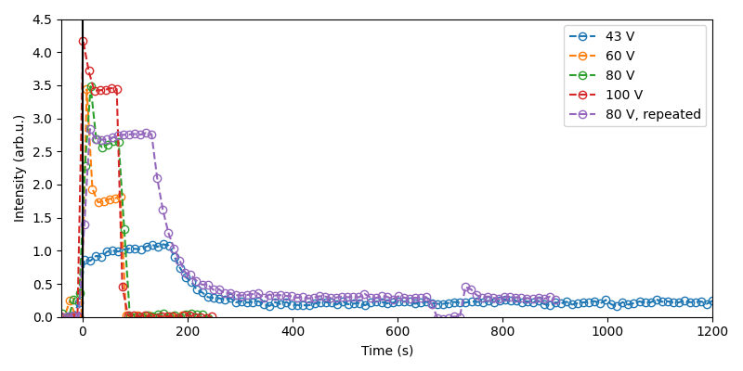
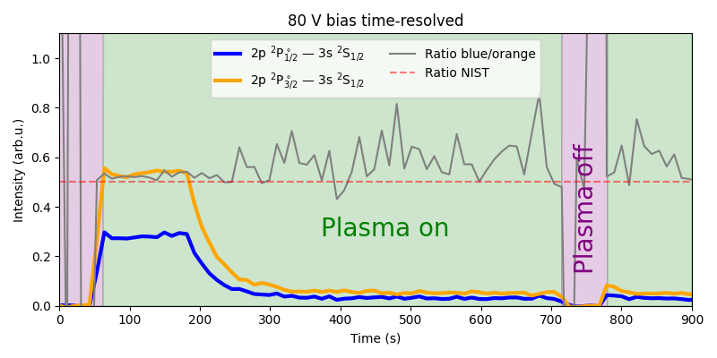
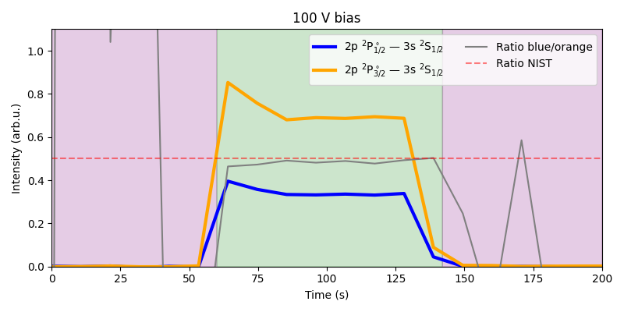
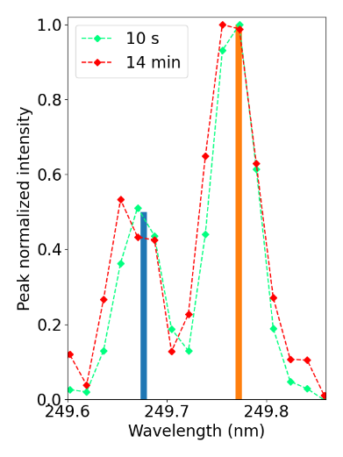
Erosion monitoring using B I 250 nm
Complete erosion ~ 20 min
Partial erosion: 70 s
Observations
Line intensity grows when increasing the bias
Experiments reproduce nicely (green, purple)
Sharp decay of line intensity after ~150 s
Weak B I signal remains even after 20 minutes!

Slide 9
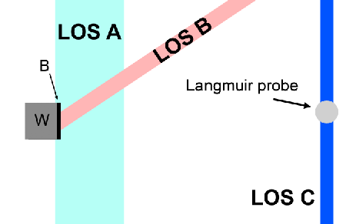
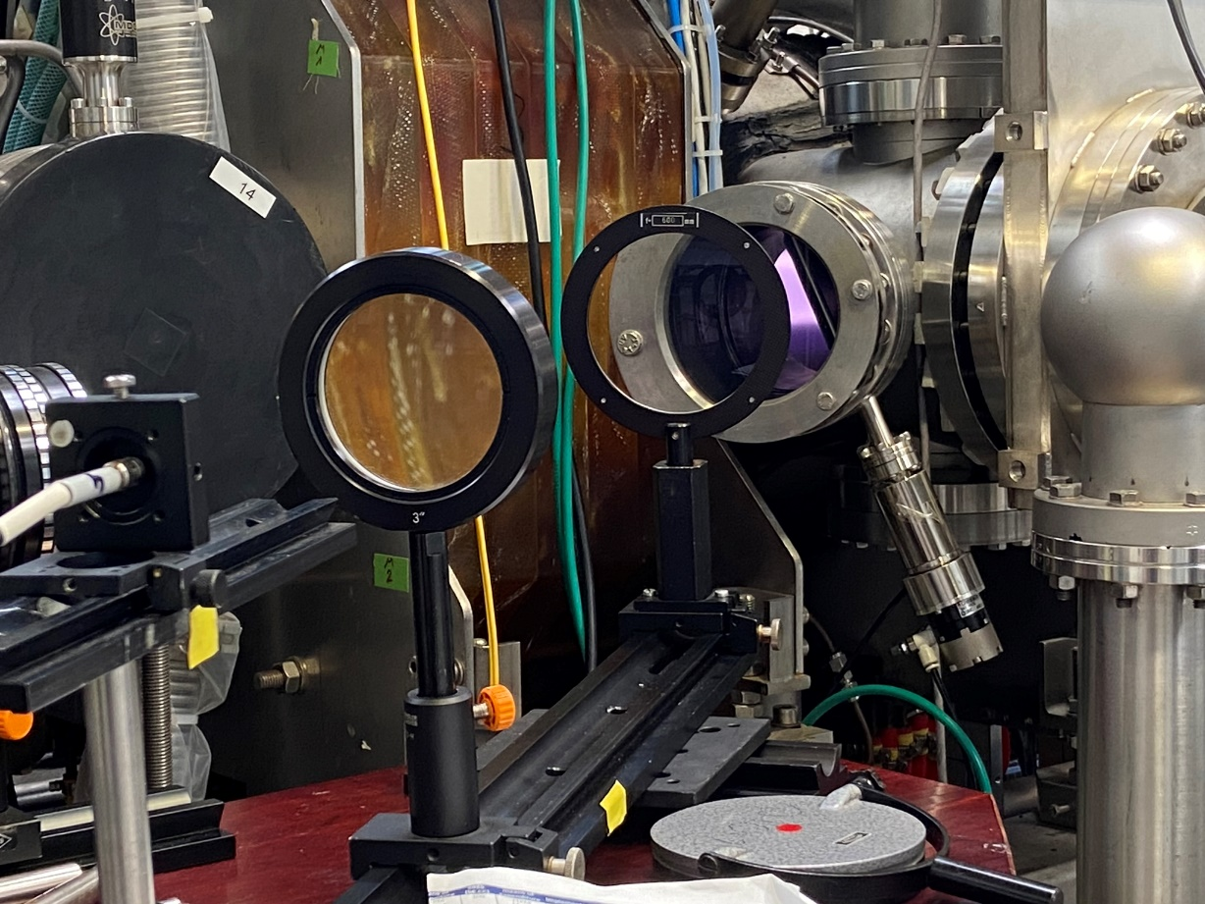
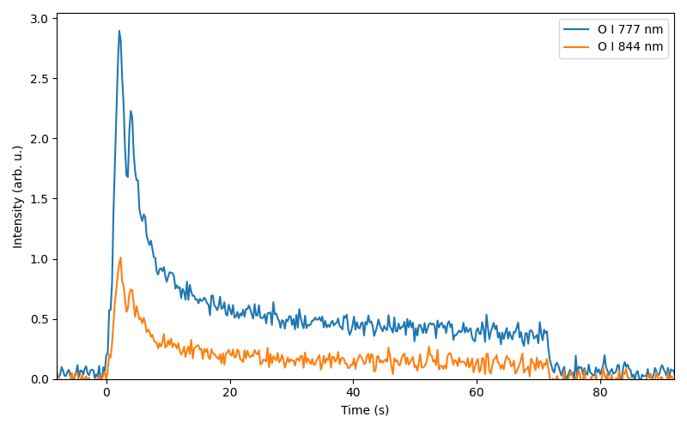
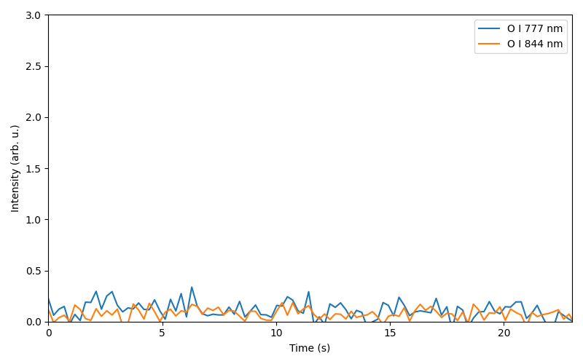
Measuring O I lines
LOS B
Avantes USB
Channel 4:
679 nm – 889 nm
Plasma on
Plasma off
Plasma off
Without boron

Slide 10
Molecular spectrum of BD: resonant $A{}_{ }^{1}Π−X{{}_{ }^{1}Σ}^{+}$ @ 432.8 nm
LOS B
79 grooves/mm
1200 grooves/mm

Slide 11
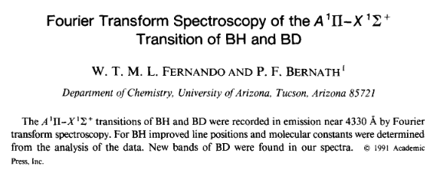
Molecular spectrum of BD: resonant $A{}_{ }^{1}Π−X{{}_{ }^{1}Σ}^{+}$ @ 432.8 nm
Blue: First 4min (Erosion of Boron layer)
Red: Last 4min (No Boron layer)
Molecular constants from
79 grooves/mm
Main isotopes of boron:
${}_{ }^{10}B$: 20%
${}_{ }^{11}B$: 80%
Accurate constants for ${}_{ }^{11}B{}_{ }^{2}H$
Considering only ${}_{ }^{11}B{}_{ }^{2}H$
Data on higher-order centrifugal terms missing for ${}_{ }^{10}B{}_{ }^{2}H$
Rotational temperature is high

Slide 12
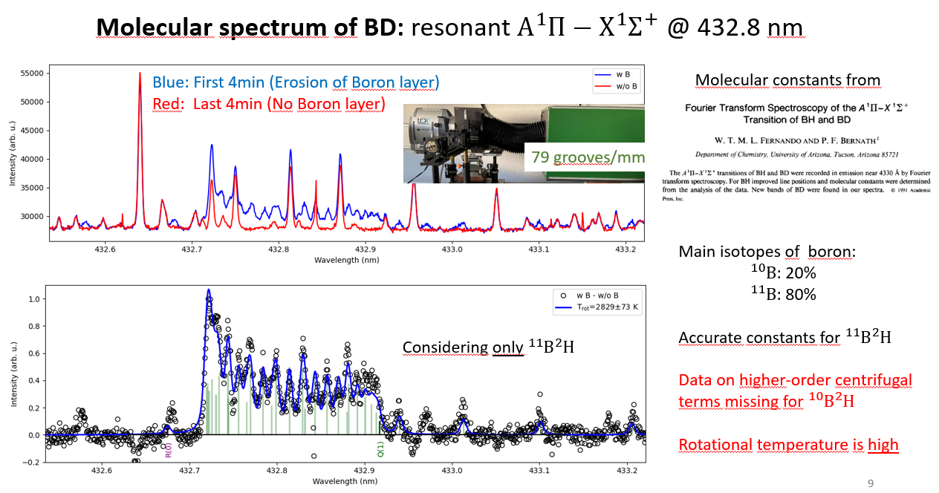
Molecular spectrum of BD: resonant $A{}_{ }^{1}Π−X{{}_{ }^{1}Σ}^{+}$ @ 432.8 nm
Blue: First 222 s (Erosion of Boron layer)
Red: Last 222 s (No Boron layer)
Spectral order m=2
10 s integration time gives sufficient BD signal!
$$D_{γ}$$
1200 grooves/mm
Rotational temperature differs by less than 3% compared to
Measurement of rotational temperature
Considering only ${}_{ }^{11}B{}_{ }^{2}H$

Slide 13
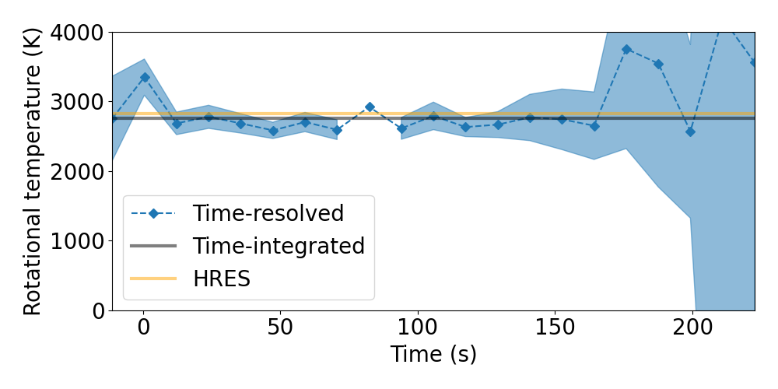
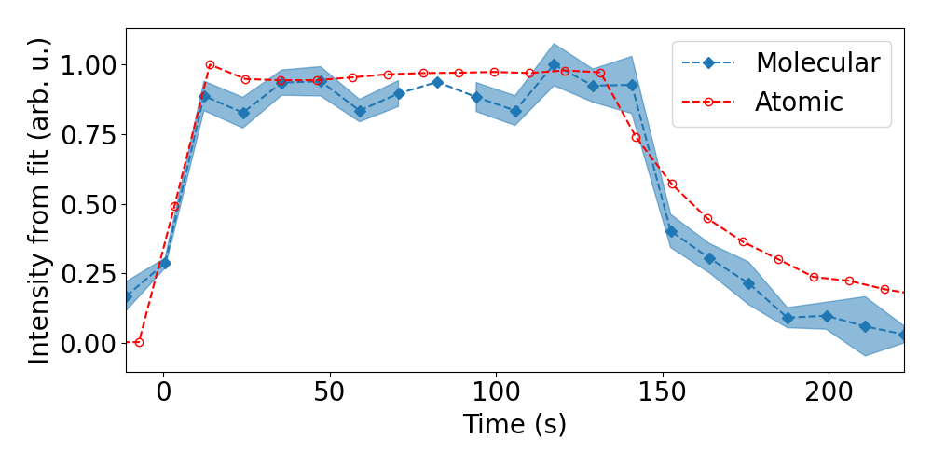
Molecular spectrum of BD: resonant $A{}_{ }^{1}Π−X{{}_{ }^{1}Σ}^{+}$ @ 432.8 nm
Time-resolved fit
Rotational temperature

Slide 14
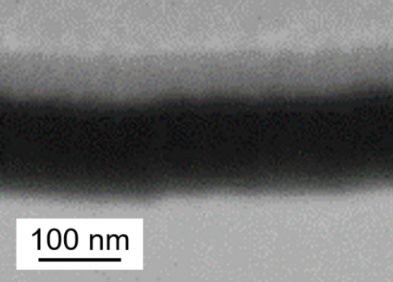
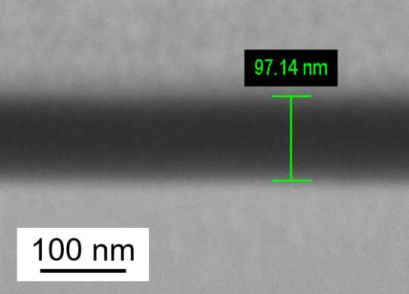
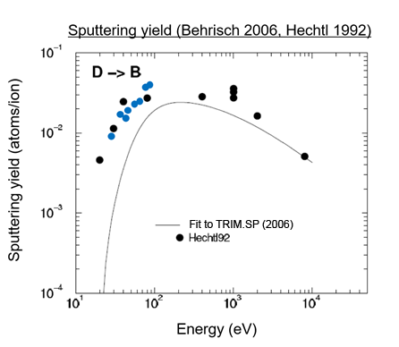
Erosion rates of thin boron layers in PSI-2
Before PSI-2 plasma
After PSI-2 plasma
SEM (FIB)
Pt
SEM (FIB)
B
W
@ Pos. 3
Behrisch 2006; TRIM.SP (binary collision approximation)
Hechtl 1992; graphite samples with plasma sprayed boron
mass loss
PSI-2 2024; Magnetron sputter deposited boron
Focused ion beam + Secondary electron microscopy
PSI-2 2024

Slide 15
Conclusion
Boron layers with ~ 115 nm thickness erode within approx. 150 s at PSI-2
Erosion rates agree well with those from Hechtl 1992
PSI-2 2024
Atomic (UV) and molecular (VIS) spectroscopy with time resolution of 10 s achieved!

Slide 16
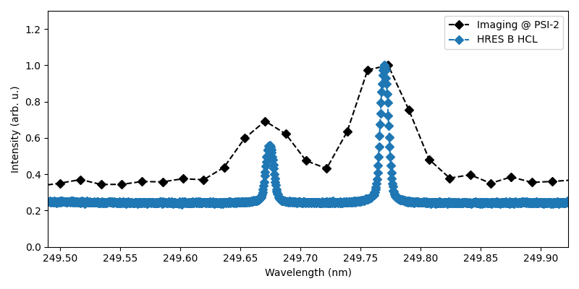
Outlook
Molecular spectroscopy:
Influence of target temperature on BD signal + rotational temperature
Atomic spectroscopy:
Upgrade Littrow to UV – first spectra of a B HCL
➔ Information on the velocity & angular distribution function
Attempt measuring the NIR line at 1166 nm
Can we distinguish the isotopes of boron @ PSI-2?
E.g. B HCL, BH Q-branch
BH and BD spectra during isotope exchange
Simulation:
BH and BD are distinguishable

Slide 17
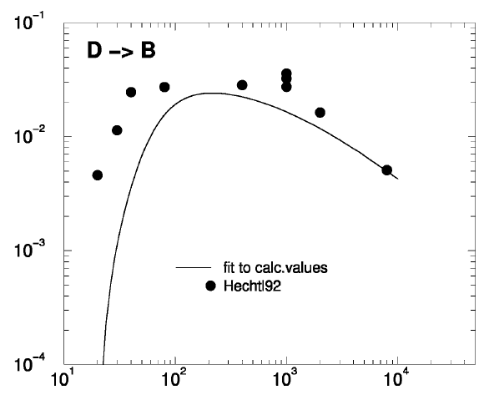
Initial estimate of the time scale
Behrisch @ 100 eV*:
Sputter yield 0.0$2−0.03$
Particle flux density of boron:
$$0.03× 1.1∙{10}^{22}m^{−2}s^{−1}$$
$$Φ_{B}=3.3∙{10}^{20}m^{−2}s^{−1}$$
Mass flux density of boron:
$$10.811 amu{ Φ}_{B}=5.9{∙10}^{−6}kg m^{−2}s^{−1}$$
Density of solid boron ~ $2.4 g cm^{−3}=2400 kg{ m}^{−3}$
Erosion rate: $\frac{5.9{∙10}^{−6}kg m^{−2}s^{−1}}{2400 kg m^{−3}}=2.5\frac{nm}{s}$
~ 40 s for 100 nm!
*the intent is to expose at the floating potential (~40 V). However we might have $D_{2}^{+}$ or other impurities within the plasma, so we chose 100 eV for the first estimate!
A Simple Sputter Yield Calculator
IAP/TU Wien Surface Physics Group
100 eV D -> B: 0.0321

Slide 18
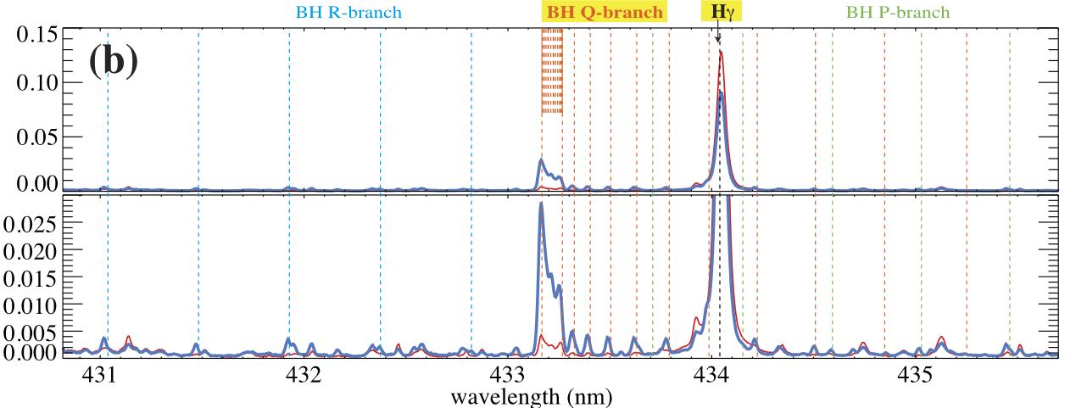
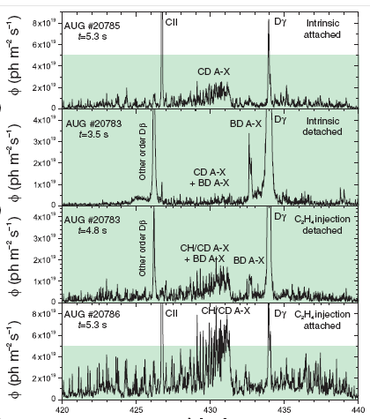
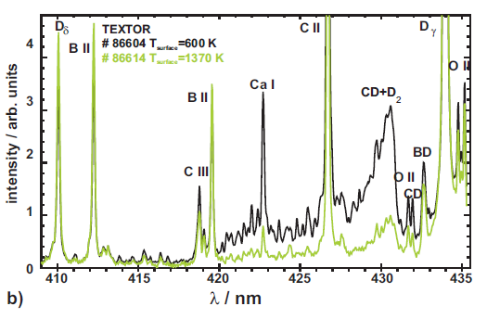
Molecular spectroscopy: BD
LHD: T. Kawate et al 2022 Nucl. Fusion 62 126052
S Brezinsek et al 2007 Phys. Scr. 2007 40
TEXTOR

Slide 19
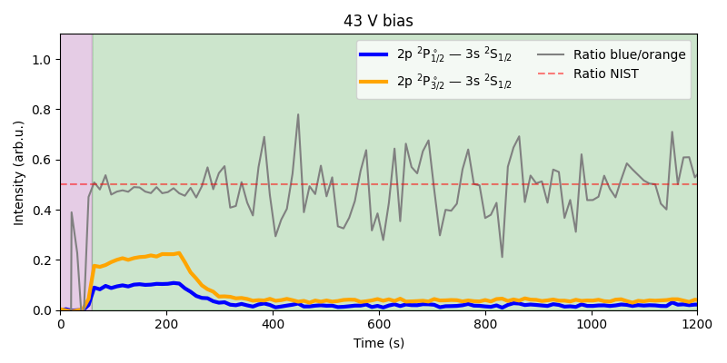
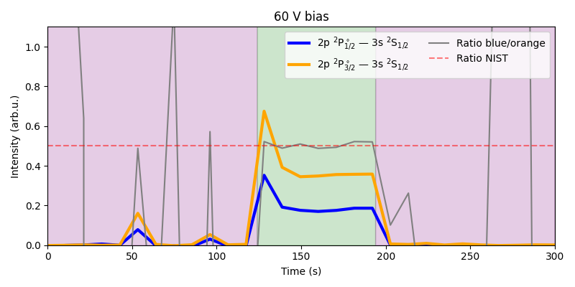
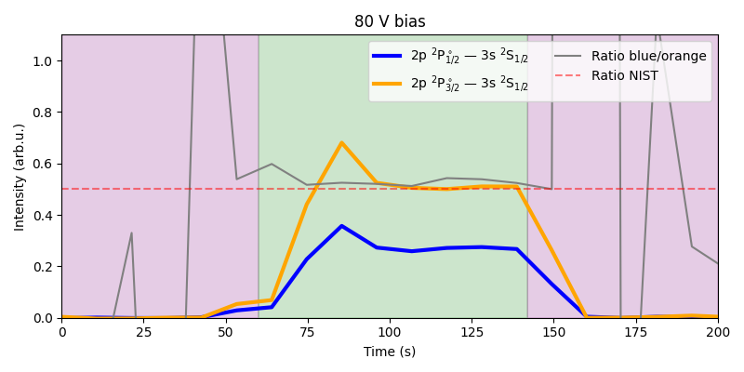
Boron signal appears even after ~ 12min
Potentially due to redeposition!

Slide 20
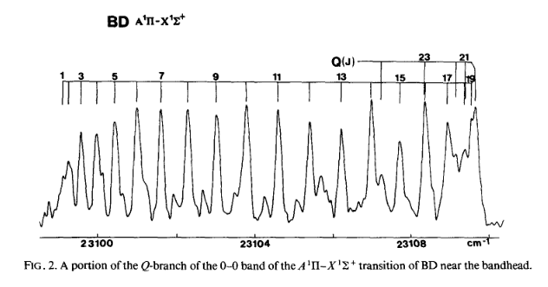
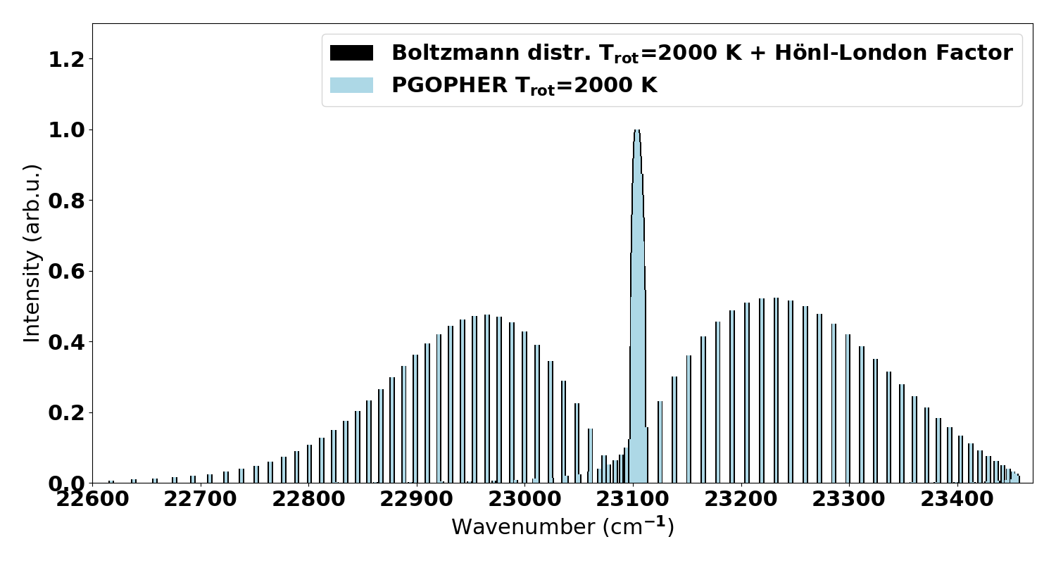
Issue: only ${}_{ }^{11}{BD}$ is reliable
Ground state
Boltzmann distribution & Hönl London factors
(E.g. Eqs. (IV,81 -83) Herzberg, Spectra of Diatomic molecules)
Q-branch
P-branch
R-branch

Slide 21
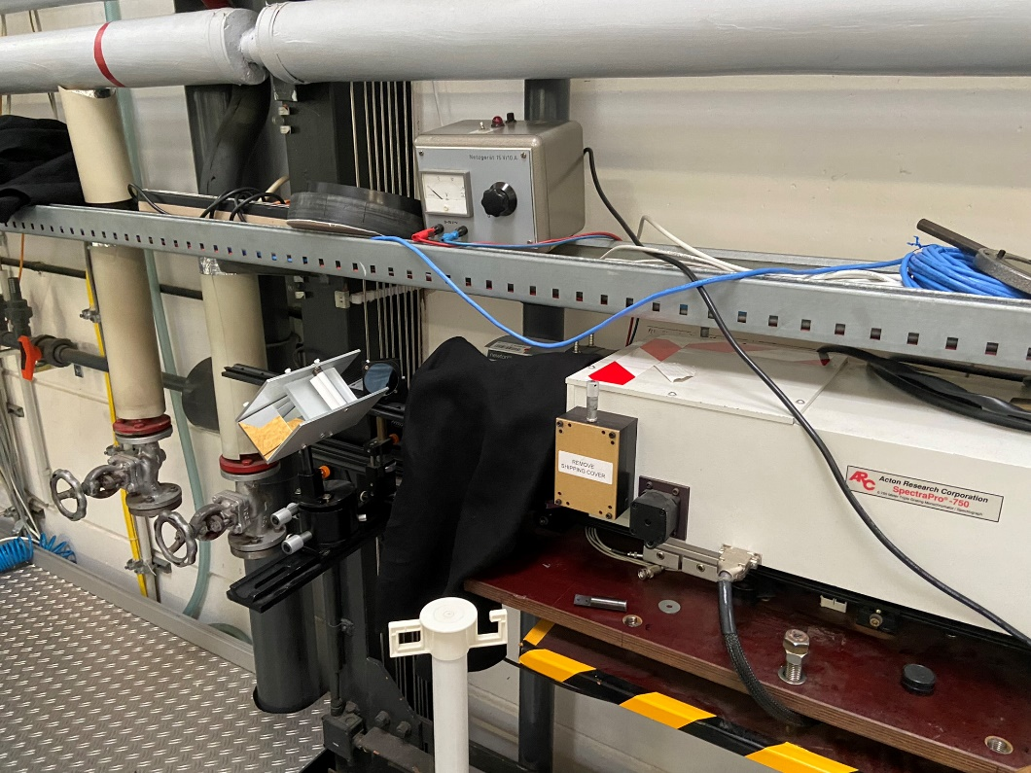
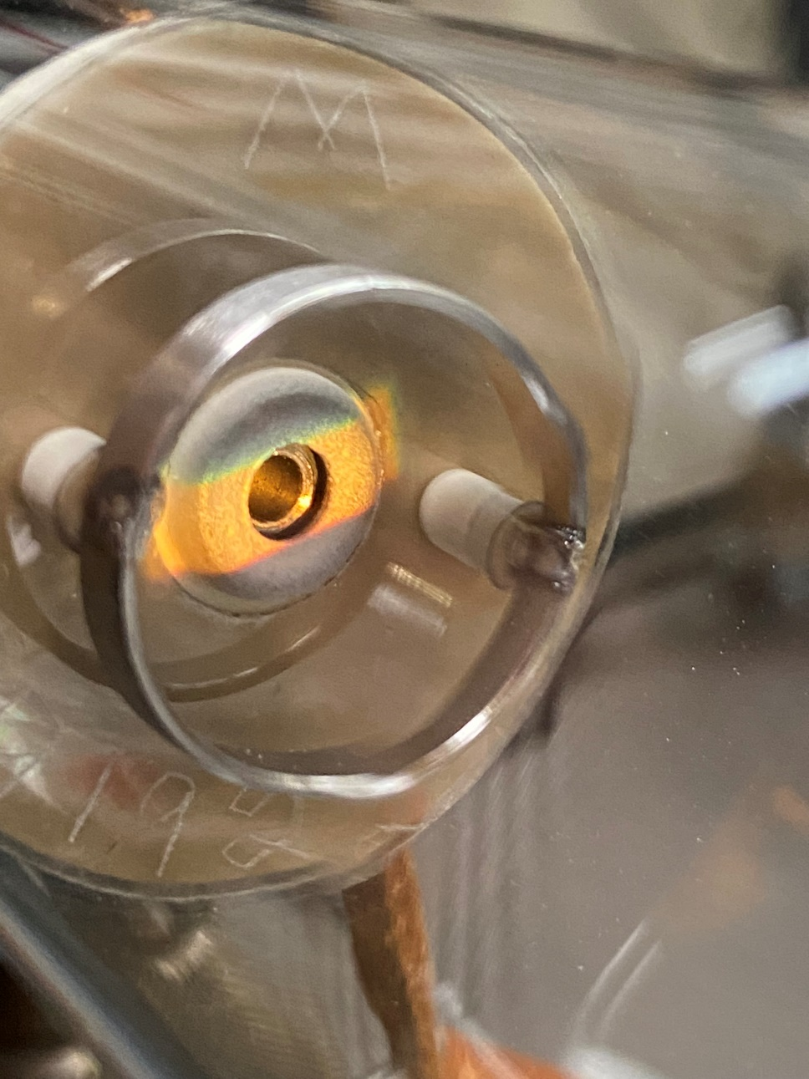
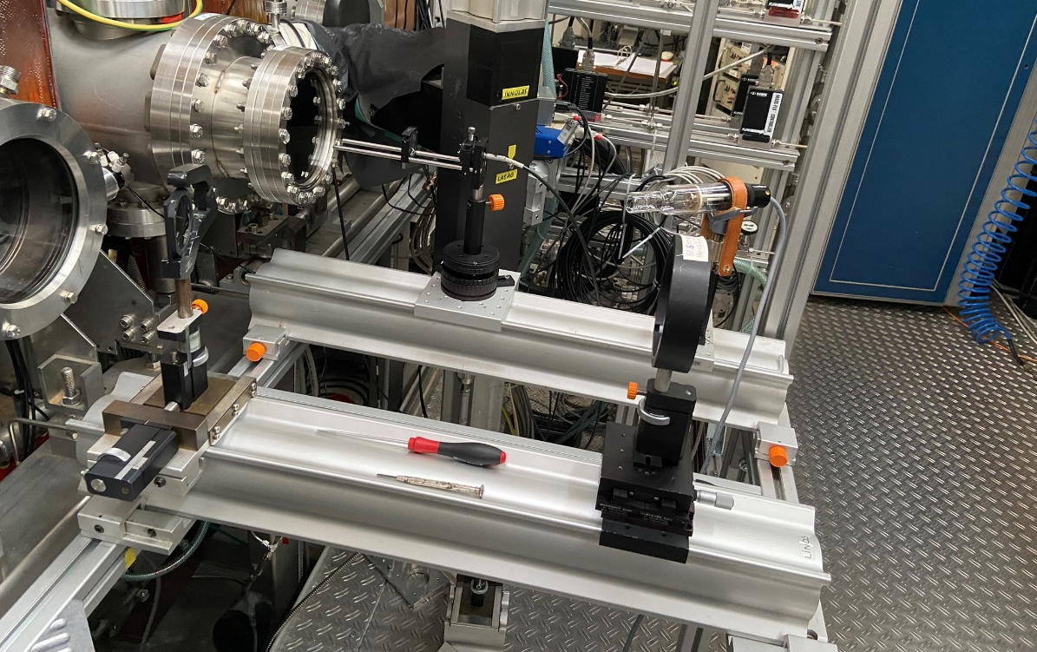
W HCL, backlight illumination
Chromatic abberation
UV mirror

Slide 22
Example BD in magnetron plasma

