Slide 1
Reporting Meeting PWIE-SPE 2025
Updates and Plan
Jari Likonen
On behalf of the SP E team and task holders

Slide 2
SP E focus points in 2025
I: LIBS on a Remote-Handling arm in JET→ SP E.1
II: Cutting of DTE3 tiles and sample distribution → SP E.2
III: Completion of ILW3 post-mortem analyses and first analysis of DTE3 samples→ SP E.3

Slide 3
SP E resources 2025
Deliverable Owner | Beneficiary | PM
P. Veis | CU | 4 | SP E.1
S. Almaviva | ENEA | 4 | SP E.1
R. Yi/T.Dittmar | FZJ | 8 | SP E.1-3
E. Grigore/C. Porosnicu | IAP | 6 | SP E.2-3
P. Gasior | IPPLM | 4 | SP E.1
E. Fortuna-Zaleśna | IPPLM | (1) | SP E.3
J. Butikova | ISSP-UL | 4 | SP E.1
E. Pajuste | ISSP-UL | 2 | SP E.3
N. Catarino | IST | (1) | SP E.3
P. Paris | UT | 4 | SP E.1
D. Primetzhofer | VR | (1) | SP E.3
J. Likonen | VTT | 9 | SP E.1-3
(Y. Zayachuk) | (UKAEA) | (15) | (SP E.1-2)
Total |  | 45 (63)
UKAEA contribution: 15PM
Reduced resources under SPE when compared with 2024 (89PM) due to
availability of DTE3 tiles and samples only in late 2025

Slide 4
SP E Tasks 2025
Activity | Deliverable ID(s) | Task Title
SP E.1 | D001-D008 | Initial results of spectral analysis, composition of co-deposited layers and fuel content(CU, ENEA, FZJ, IPP_LM, ISPP_UL, UT, VTT,UKAEA)
SP E.2 | D001 | Sectioning and preparation of samples from CFC divertor tiles. Distribution of samples to other laboratories. (VTT)
SP E.2 | D002 | Sectioning and preparation of samples from metallic components. Distribution of samples to other laboratories. (IAP)
SP E.2 | D003 | Metallography of Be castellation and W lamellae samples (FZJ)
SP E.2 | D004 | Provision of divertor and limiter tiles (UKAEA)
SP E.3 | D001 | Characterization of JET plasma facing components with LIBS, LID-QMS, TDS and metallography (FZJ)
SP E.3 | D002 | Analysis of JET plasma facing components with TDS and GDOES (IAP)
SP E.3 | D003 | (Electron microscopy (SEM, TEM, FIB) and nanoindentation of W lamellae) (IPPLM)
SP E.3 | D004 | Analysis of JET plasma facing components with TDS, FC and dissolution method (ISSP-UL)
SP E.3 | D005,D006 | (Characterization of JET plasma facing and diagnostics components using ion beam analysis RBS, NRA, HIERDA, μbeam NRA) (IST, VR)
SP E.3 | D007 | Characterization of JET plasma facing components using SIMS and TDS (jointly with UKAEA) (VTT)

Slide 5
SPE program 2025
SPE.1
LIBS experiment at JET (October 2024)
Data analysis of JET LIBS experiment on-going
SPE.2
Provision of divertor and limiter tiles
Sectioning and preparation of samples from CFC divertor tiles and metallic
components
Sectioning and preparation of samples will begin in ~August - September
Distribution of samples to other laboratories
Metallography of Be castellation and W lamellae samples
SPE.3
Analysis of JET plasma facing components (pre DT) with TDS, FC and dissolution method
First samples available in ~October - November
First analyses of DTE3 samples using LID-QMS, GDOES, TDS, metallography

Slide 6
SPE.1
SP E.1 - LIBS at JET (31PM)

Slide 7
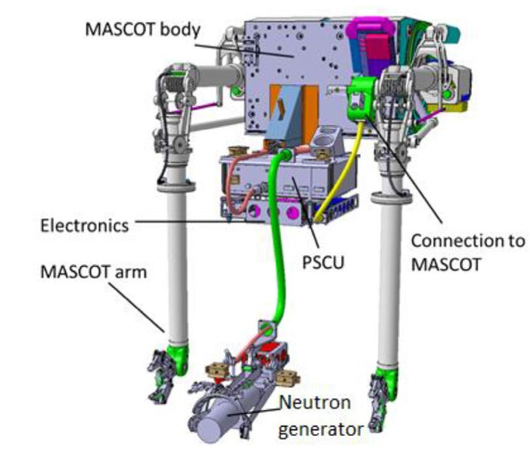


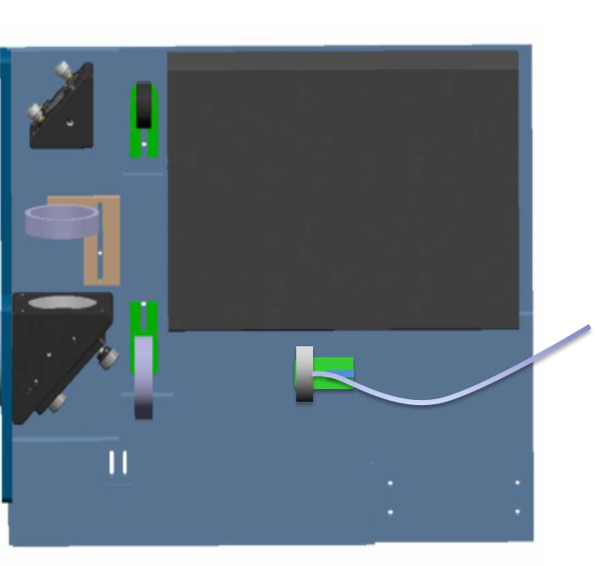












LIBS at JET
General Information
The aim is to perform in-vessel analysis of PFCs using LIBS on a remote handling arm at JET
Task and questions to be addressed
PWIE-SP E.1.T-T002-D001-D008
Approach
LIBS at JET
Experiment dates: October 2nd – 18th, 2024
Experiments at VTT
Reanalysis of samples analysed at VTT in Feb-March 2024, most likely in Oct-Nov 2025
Littrow spectrometer not available at VTT in 2024
Results
LIBS experiment was completed successfully
840 locations were analysed
JET wall
component
Laser
Plasma light
Laser beam

Slide 8
LIBS at JET
1st Data analysis meeting(Feb 6th, FZJ)
https://indico.euro-fusion.org/event/3397/
Aim was to discuss about various data analysis methods in the RUs
Wavelength shift (0.5-1.5nm) observed, calibration required
Ghosts of strong spectral lines was observed – the ghost has higher intensity up to 6x
MATLAB routines developed for processing large amounts of LIBS spectra (depth profiles, calibration free analysis, T+D+H/W ratios)
Implementation of machine learning and digital signal processing algorithms to facilitate data analysis
Fityk - has GUI and scripting possibility
Peak positions moved ~5pixels in Littrow spectra from the beginning of LIBS campaign to the end
Fitting of T peak very sensitive to peak position (even 1 pixel has a big effect)
Tradeoff between FWHM for H isotope peaks and signal to noise ratio
Rescaling the intensity of the emission lines through the spectra of the D lamp and the Integrating sphere
Coupling of plasma light to fibre depends on both plasma diameter and wavelength

Slide 9
LIBS at JET
1st Data analysis meeting(Feb 6th, FZJ)
JET LIBS calibration pulses (pure materials)
  Be calibration: 2XR8 pulse #492 (from C3 tile)
  Inconel (vessel wall) OCT1 middle: pulse no. #357
  Pure W (W-wedge – Lamellae): Stack A pulse #20 and repeated pulse (with setting changes) pulse #765
  W-CFC Top of tile 8: pulse no. #51 (250 shots)

Slide 10
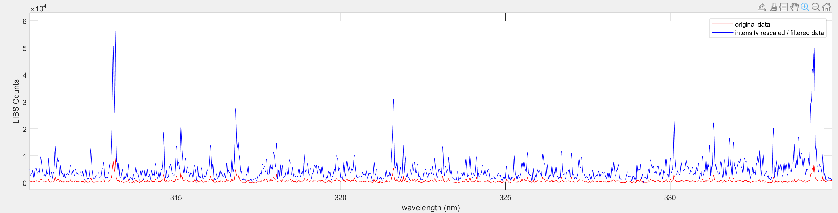
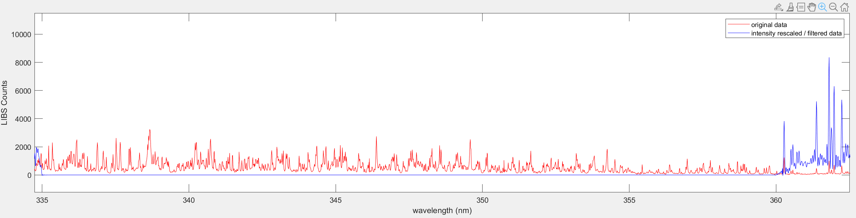
  Intensity calibration (Aryelle)
Theoretical intensity output of the optical setup was included in the intensity calibration file (LIBS plasma diameter 1 mm according to G. Sergienko’s Zemax calculation) through the following steps:
Experimental signal = (real signal)*Transmission → real signal = Exp signal / Transmission
Extrapolate the transmission signal for the Aryelle wavelengths of the spectra
Compute the “1/Transmission” file simply reversing the Transmission file from Gennady and FZJ
Cut the region between 335 and 360 nm affected by a deep hole in the transmission file
Recalibrate the intensity of each spectrum according to step 1 (real signal = Exp signal / Transmission)
Transmission (%)
1/Transmission (%)
Spectral region to cut
Rescale as in
formula in 1)

Slide 11
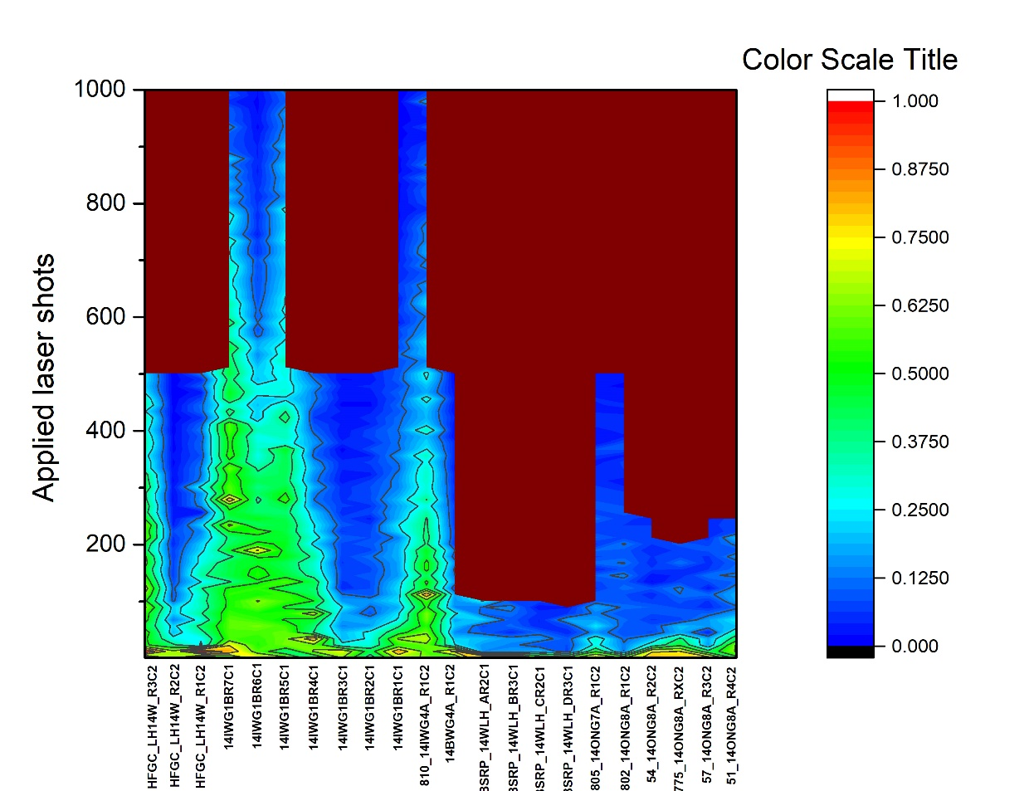
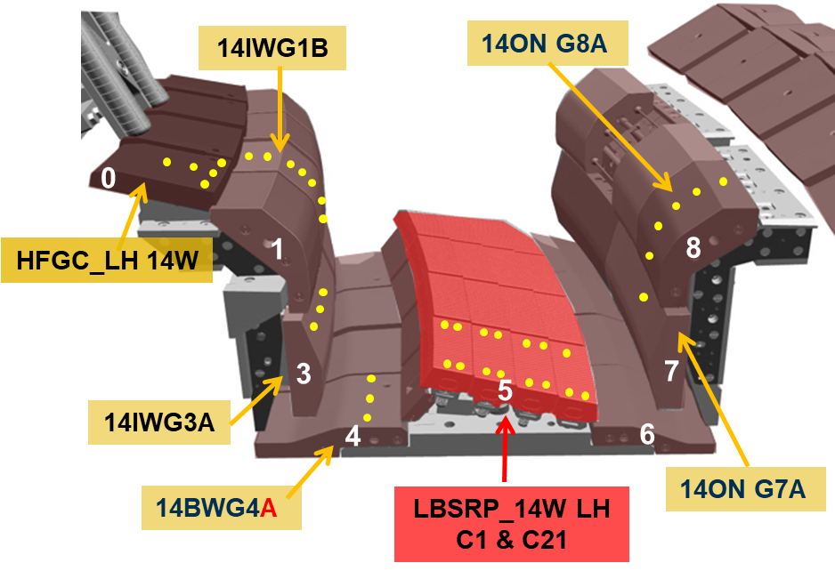
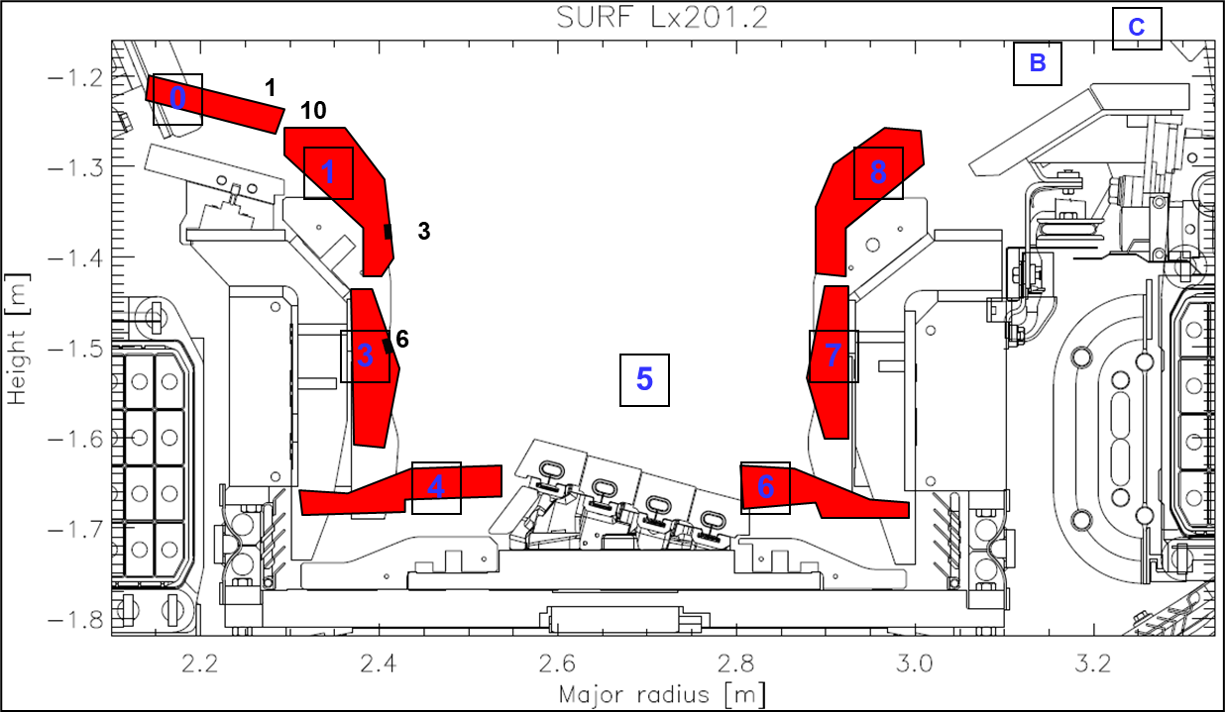
  Results: Be profile on the divertor
0
1
3
4
5
7
8
Be decreasing
Be as superficial layer (redeposition)

Slide 12
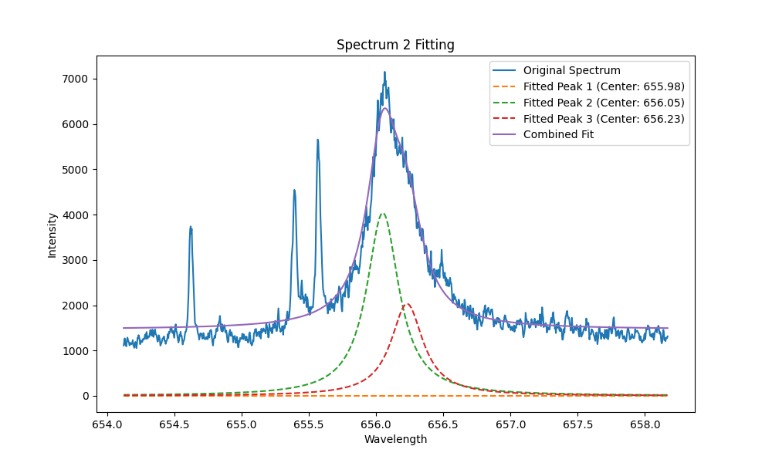
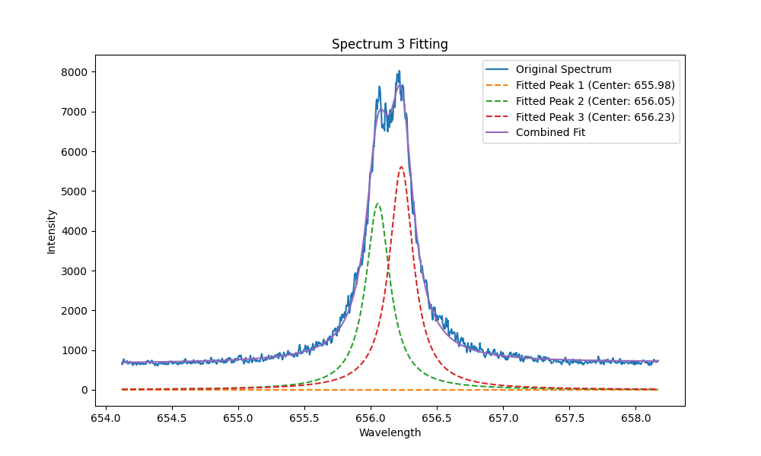
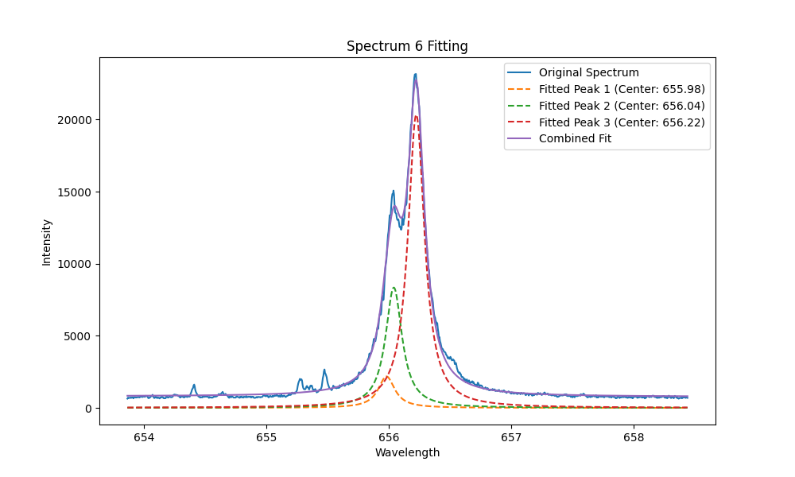
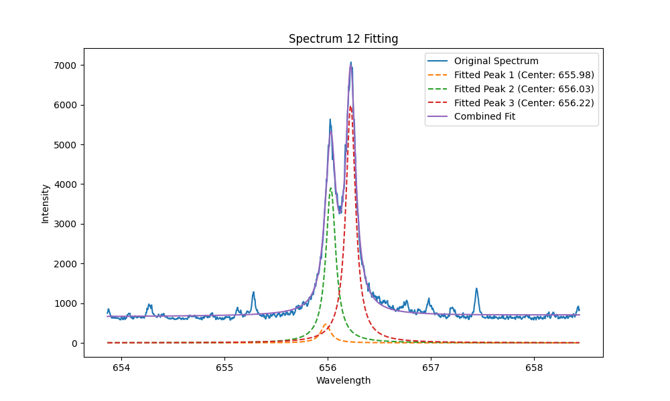
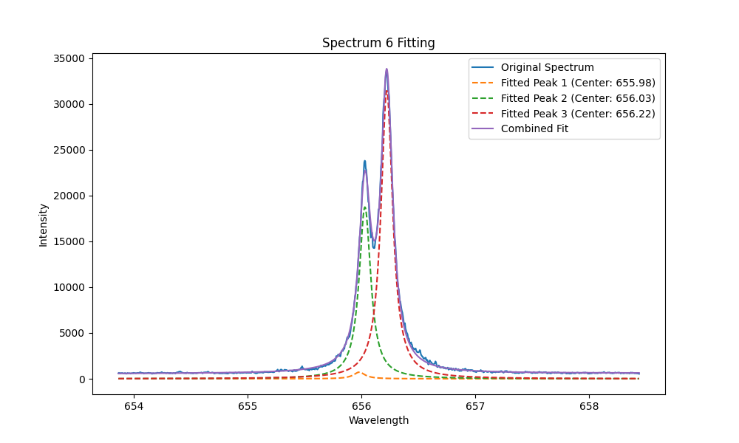
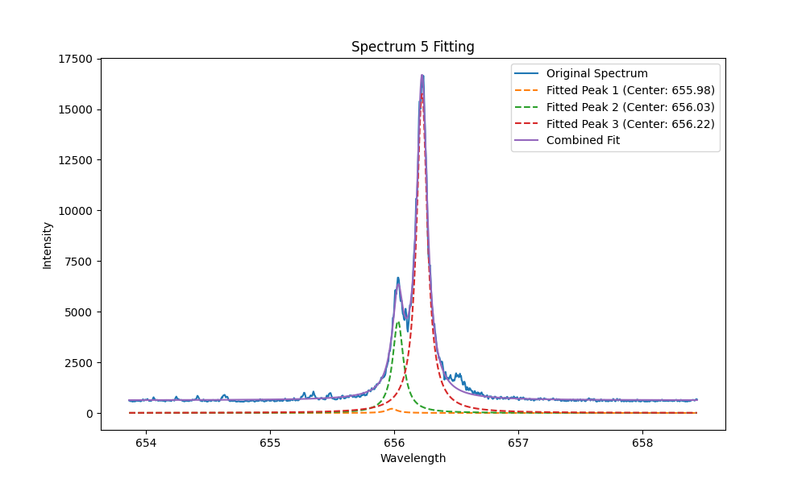
2. Results-H_{α} spectrum optimization
Different delay time in-vessel @JET
4us
8us
10us
12us
14us
18us
12

Slide 13
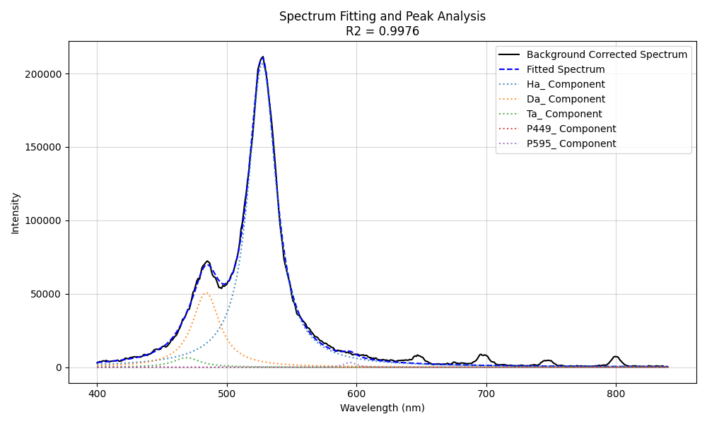
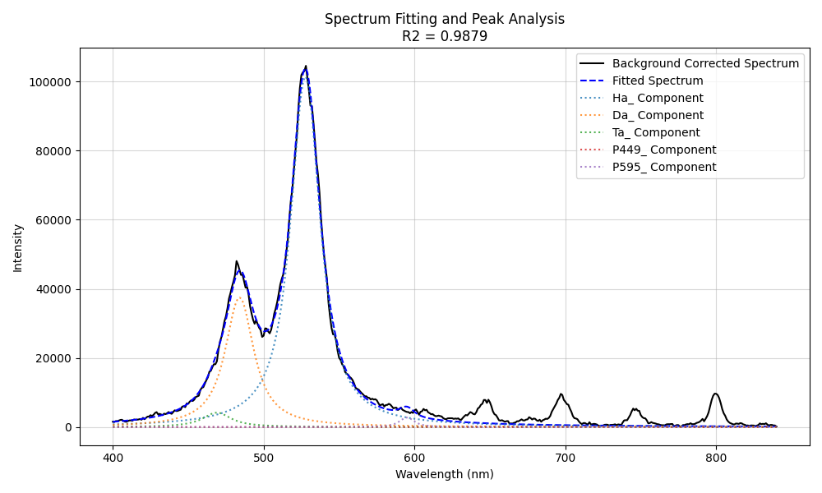
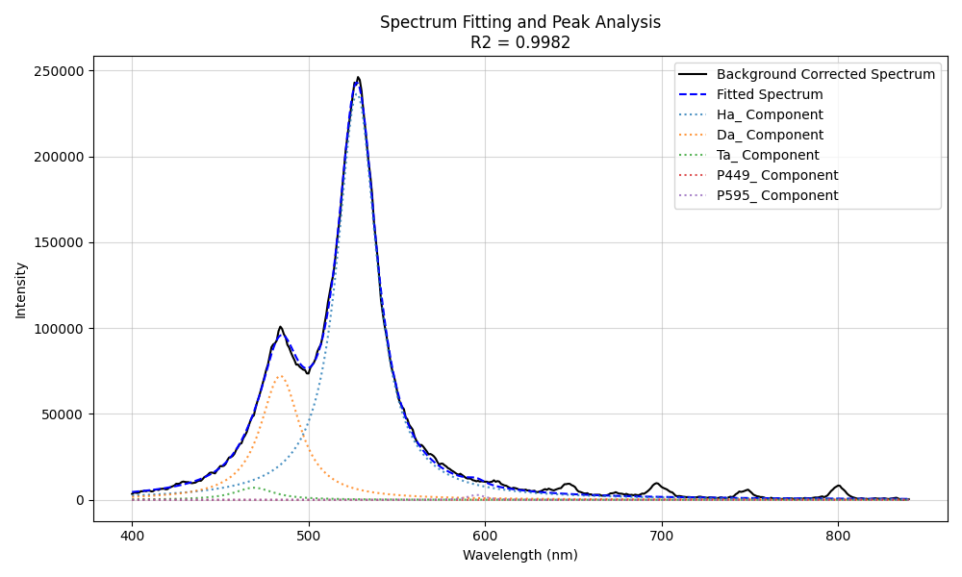
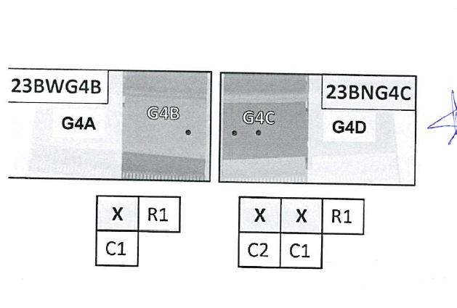
H_{α} wavelength optimized(D T fixed)
1
2
pixel
pixel
3
 | T/D
1 | 12.79%
2 | 11.11%
3 | 9.79%
3 2 1
pixel

Slide 14
SPE.2
SP E.2 - Cutting of DTE3 tiles and sample distribution (11+11PM)

Slide 15
Progress on tritium inventory assessments of JET tiles
Assessing tritium inventory of JET tiles for processing components, requirements for shipments and analysis
Discussions with Crofts regarding Type A containers ⇒ licensing takes ~3 months
Gathering information from tritium inventory estimates and initial measurements from JDR to progress with Crofts
Estimates from deuterium retention studies from previous JET operations
Effect of JET tritium clean-up on inventory
First results on tritium offgas and inventory from JDR

Slide 16
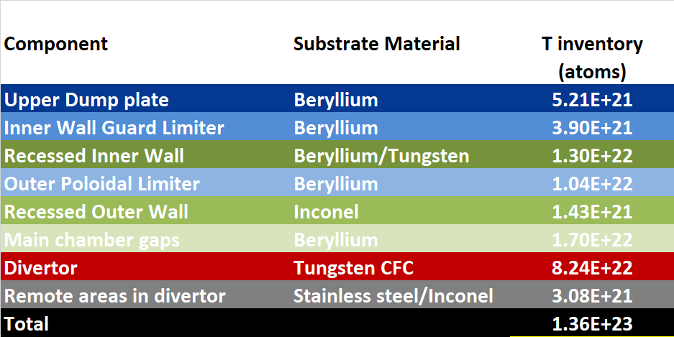
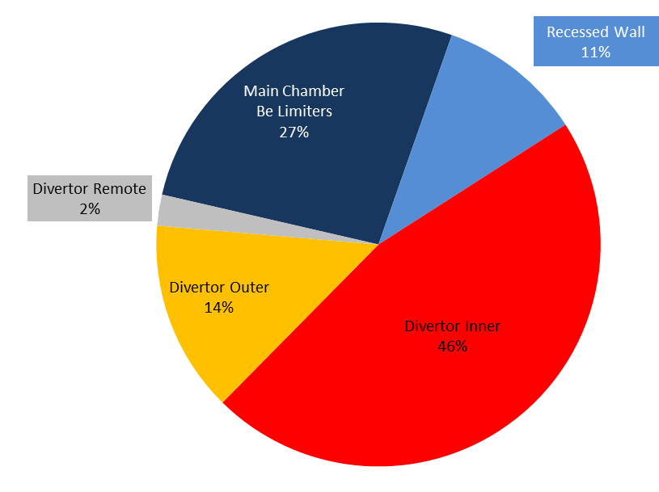
Tritium retention in plasma facing materials
Tritium retention after T, DTE2, DTE3 from ex-vessel assessment
T throughput 7.18x10²⁵ atoms, 360 g
NOTE: Removal of tritium in clean-up not considered therefore this estimate is worst case
Distribution of retention in plasma facing components from ex-situ post-mortem analysis from JET ILW deuterium operations 2011-2016
Retention in removed samples 0.19% of injected deuterium

Slide 17
Calculated Tritium retention in JET tiles & samples
7.18x10²⁵ T atoms injected between 2020-2023
0.19% retention fraction
 | Whole tiles |  |  | Samples
Tile type | T atoms/tile | Bq/tile | Specific activity (Bq/g) | Bq/sample | Specific activity (Bq/g)
Tile 0/HFGC | 2.14E+20 | 4.00E+11 | 3.08E+08 | 6.00E+09 | 1.07E+09
Tile 1 | 2.27E+20 | 5.00E+11 | 1.79E+08 | 5.00E+09 | 8.82E+08
Tile 3 | 2.30E+20 | 5.00E+11 | 1.19E+08 | 3.00E+09 | 4.47E+08
Tile 4 | 1.04E+20 | 2.00E+11 | 9.52E+07 | 2.00E+09 | 3.40E+08
Tile 6 | 6.35E+19 | 2.00E+11 | 9.52E+07 | 1.00E+09 | 1.96E+08
Tile 7 | 1.64E+20 | 3.00E+11 | 6.12E+07 | 2.00E+09 | 2.69E+08
Tile 8 | 4.44E+19 | 8.00E+10 | 2.29E+07 | 7.00E+08 | 1.33E+08
Tile 5 Tungsten lamella | 8.86E+16 | 2.00E+08 | 1.00E+06 | 4.00E+07 | 2.31E+06
IWGL (5 tile pieces) | 2.05E+19 | 4.00E+10 | 1.60E+07 | 3.00E+08 | 7.32E+07
OPL (7 tile pieces) | 5.03E+19 | 9.00E+10 | 3.10E+07 | 4.00E+08 | 1.07E+08
IWC | 3.04E+19 | 6.00E+10 | 4.29E+07 | 6.00E+08 | 5.89E+07
DP | 1.02E+19 | 2.00E+10 | 2.86E+07 | 2.00E+08 | 6.35E+07
Package limits (IAEA SSR-6):
Type A total T = 40 x10¹² Bq
Excepted package T
< 4 x 10¹⁰ Bq
Type A for W-CFC tile transport for cutting
“Excepted” likely for W lamellae
Type A/Excepted border for Be tiles

Slide 18
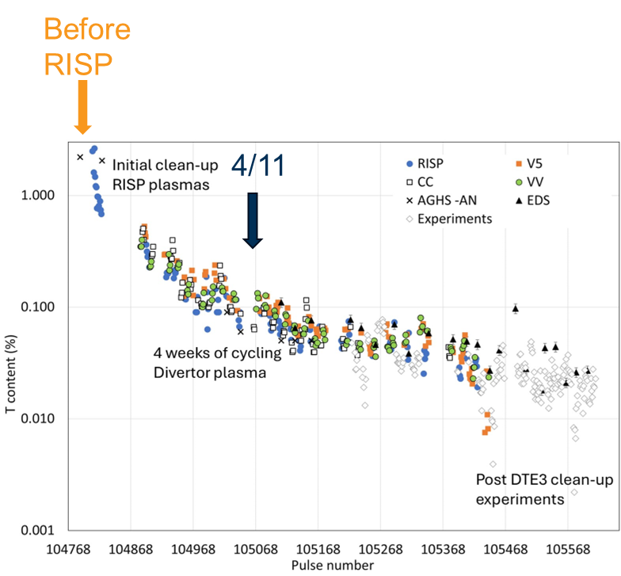
Effect of JET Tritium Clean-up on inventory
2 orders of magnitude reduction in 14 MeV neutron production (T content %) from end of DTE3 to end of T clean-up.
Factor 2 reduction would only bring inventory down to order 10⁹ Bq/tile for W-CFC divertor tiles
⇒ potential reduction in packaging requirements from Type A to Excepted.
T% in vessel during clean-up
From 14 MeV neutron data
Courtesy M-L. Mayoral, H. Weisen

Slide 19
New data from JET Decommissiong And Repurposing project: Off-gas and pyrolysis
Tritium off gas
One W-CFC tile has been measured
Offgas = 8x10⁵ Bq/day
Pressure build-up over 300 days not considered to be an issue
Gaseous tritium build-up over 300 days 24x10⁷ Bq is not likely to be an issue for transportation
Procedures for packing and unpacking needed for licensing and also to minimise exposure due to tritium offgas when handling
Pyrolysis – first tritium results
One Inconel sample has been measured
1.7x10⁷ Bq/g
Inconel tiles 1400g, therefore 2.4 x 10¹⁰ Bq in total
This is comparable with tritium inventory assessment without clean-up taken into account (6x10¹⁰ Bq/tile)

Slide 20
Summary and next steps
Whilst T clean-up offers some optimism for lower T inventories there is still a degree of uncertainty how much clean-up has reduced values for transport assessment
Given the length of time for licensing (3 months) we will continue with Type A as the requirement for W-CFC and Be tiles
Discussion with Crofts, Dangerous Goods Safety Advisor and EU Labs on Type A containers ongoing
Next steps to provide document to Crofts for licensing assessment:-
  Latest T estimates and new T measurements of off-gas and inventory
  Tiles that will be in each shipment
  Procedure for packing tiles in Type A container
Disassembly of JET tiles starts ramping up from this week and continues into August
  Delayed due to issue with facility used to handle and clean pressurised suits -> new facility now operational
W Lamellae will likely be Excepted package making this priority to demonstrate handling of components and first results from SPE relating to He interaction, LIBS measurements, T retention in Q3 – Q4

Slide 21
Analysis planning – First shipments – Type A
 | Tile | Tile history | Analysis plan | Calculated Tritium inventory (Bq) | Calculated Specific Tritium Inventory (Bq/g) | Calculated Offgas (Bq/day) | Calculated Activation (Bq) | Tile box size (mm3)
FZJ | Tile 1: 14IWG1A* 2019-2023 | LIBS LID-QMS lines during clean-up LID-QMS final toroidal and poloidal analysis | LID-QMS whole tile Then send for coring | 5e11 | 1.8e8 | 71.5e6 | 2.2e3 | 300x240x130
FZJ | HFGC: LH14W* 2019-2023 | LIBS LID-QMS lines during clean-up LID-QMS final toroidal and poloidal analysis LID-QMS Area 3 | LID-QMS whole tile Then send for coring | 4e11 | 3.1e8 | 57e6 | 1.8e3 | 300x240x130
FZJ | HFGC: RH14W* 2011-2023 | LIBS LID-QMS final toroidal and poloidal analysis LID-QMS Area 1 & 2 LID-QMS with GB 9 December | LID-QMS whole tile Then send for coring | 4e11 | 3.1e8 | 57e6 | 1.8e3 | 300x240x130
FZJ | HFGC: LH14N* 2019-2023 | LID-QMS Area 4 LID-QMS final toroidal and poloidal analysis (qualitative presented at PSI) LID-QMS during gas balance | LID-QMS whole tile Then send for coring | 4e11 | 3.1e8 | 57e6 | 1.8e3 | 300x240x130
*Might need to choose 2 or 3 depending on size of Type A

Slide 22
Analysis planning – First shipments – Type A
 | Tile | Tile history | Analysis plan | Calculated Tritium inventory (Bq) | Calculated Specific Tritium Inventory (Bq/g) | Calculated Offgas (Bq/day) | Calculated Activation (Bq) | Tile box size (mm3)
VTT | Tile 1*: 2IWG1B 2011-2023 | LIBS Fuel retention comparison with 14IWG1A (2019-2023) [Note 2IWG1A (2019-2023) not assigned from science] and LIBS. Tritium should be similar, D different. ITER Baking cycle. Effect of RISP on retention | Images of LIBS crater prior to shipping? Core: Fuel retention and deposition analysis D, T, ITER baking | 5e11 | 1.8e8 | 71.5e6 | 2.2e3 | 300x240x130
VTT | Tile 6*: 14IWG6B 2019-2023 | Tile 6 extension for IR camera in gap | Core: Fuel retention D, T Erosion, deposition, surface morphology - correlation with IR data | 2e11 | 9.5e7 | 28.6e6 | 1.4e3 | Need to check if this fits in standard box 300x240x130
VTT | Tile 3*: 14IWG3A 2011-2023 | LIBS - toroidal Fuel retention comparison with 2IWG3A (2019-2023) and LIBS. Tritium should be similar, D different. | Images of LIBS crater prior to shipping? Core: Fuel retention and deposition analysis D, T | 5e11 | 1.2e8 | 71.5e6 | 3.2e3 | 400x210x130
*Might need to choose 2 depending on size of Type A container
LIBS analysis of whole tiles at FZJ restricts initial coring activities of Tile 1s and HFGCs
All HFGCs, 14IWG1A & 14IWG1B – important for LID-QMS analysis – whole tile LID-QMS at FZJ

Slide 23
Analysis planning – First shipments - Type A
 | Tile | Tile history | Analysis plan | Calculated Tritium inventory (Bq) | Calculated Specific Tritium Inventory (Bq/g) | Calculated Offgas (Bq/day) | Calculated Activation (Bq) | Tile box size (mm3)
IAP | 2XR9* (2019-2023) | Full LIBS | Analysis of LIBS crater prior to shipping? Cut all castellations at IAP Row for fuel retention IBA Other rows… | 6e10 | 3.1e7 | 8.6e6 | 5.8e6 | 2 x (150x130x70) 2 x (140x70x70) 1 x (160x130x80)
IAP | 2XR8* (2011-2023) | Top row LIBS | Analysis of LIBS crater prior to shipping? Cut castellations (how many rows?) Row for fuel retention IBA Other rows… | 6e10 | 3.1e7 | 8.6e6 | 5.8e6 | 2 x (150x130x70) 2 x (140x70x70) 1 x (160x130x80)
IAP | 4D13* (2019-2023) | Full LIBS | Analysis of LIBS crater prior to shipping? Cut all castellations at IAP Row for fuel retention IBA Other rows… | 9e10 | 4.3e7 | 12.9e6 | 8.3e6 | 2 x (150x130x70) 4 x (140x70x70) 1 x (160x130x80)
IAP | 4D14* (2011-2023) | bottom row LIBS | Analysis of LIBS crater prior to shipping? Cut castellations (how many rows?) Row for fuel retention IBA Other rows… | 9e10 | 4.3e7 | 12.9e6 | 8.3e6 | 2 x (150x130x70) 4 x (140x70x70) 1 x (160x130x80)
Although RE melting also high priority, laser profilometry at UKAEA needed first therefore not likely to be in first shipment
*Depending on size of type A maybe only 1 or 2 complete tiles

Slide 24
SPE.3
SP E.3 - Completion of ILW3 post-mortem analyses and first analysis of DTE3 samples (7+3PM)

Slide 25
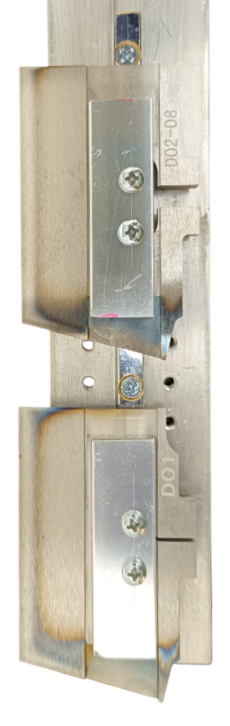
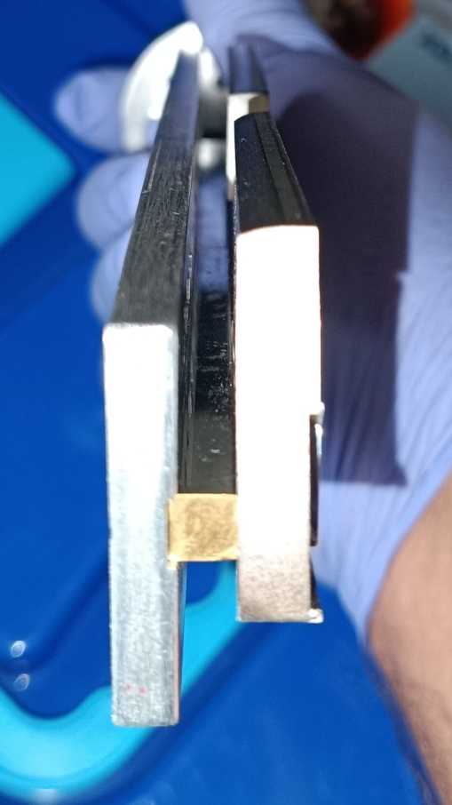
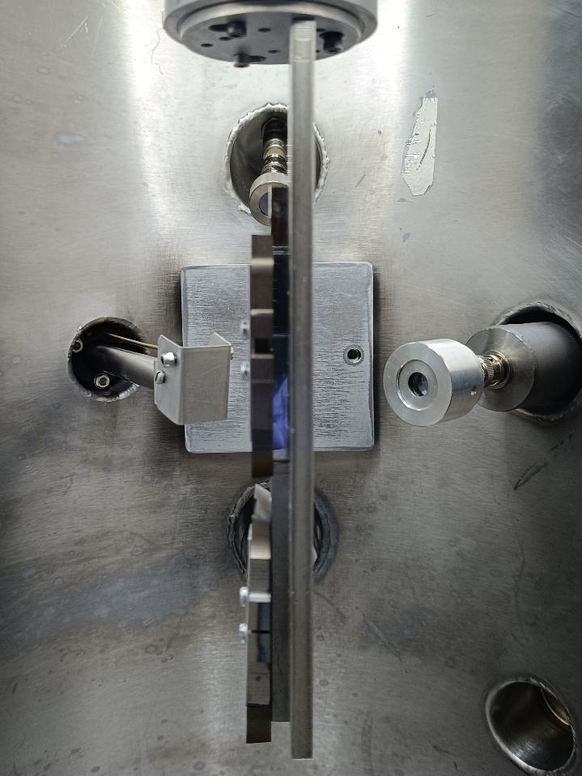
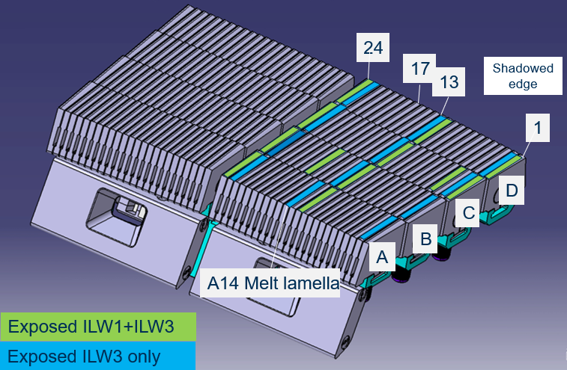
SPE.3 IBA analysis of W lamellae (IST)
W lamellae:
Shadowed area
Plasma wetted area
RBS
Stack B lamellae reported in 2023-24
D02(ILW3)
NRA
PIXE
D01(ILW1+3)

Slide 26
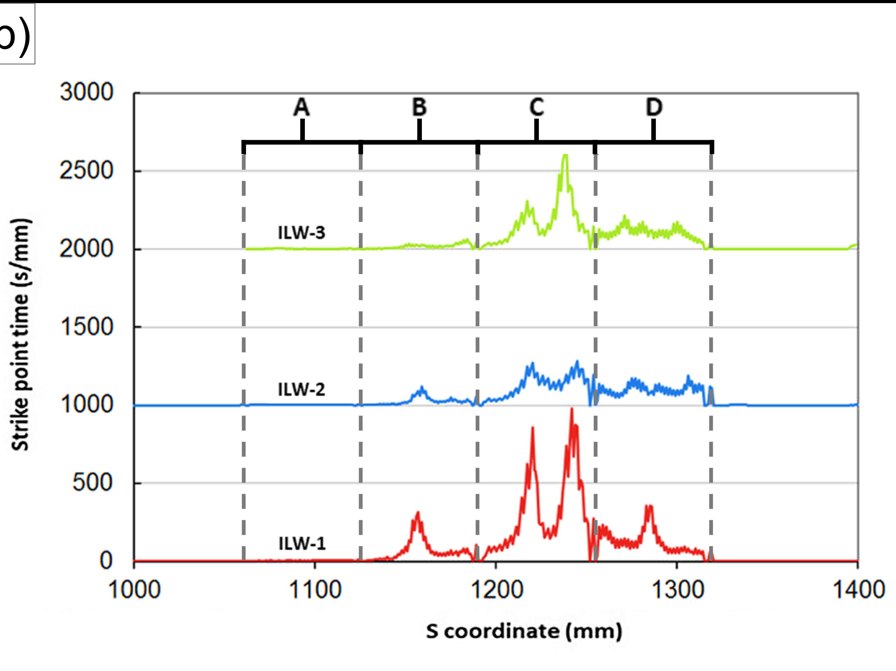
SPE.3 IBA analysis of W lamellae (IST)
³He-NRA at 2300KeV
W lamellae:
D(³He,p₀)⁴He
depth
¹²C(³He,p₀)¹⁴N
⁹Be(³He,p₂)¹¹B
⁹Be(³He,p₁)¹¹B
⁹Be(³He,p₀)¹¹B
⁹Be(³He,p₂)¹¹B
Stack D-1 (F71101161-D01)
proton-PIXE at 2300KeV
Cr K
Fe K
Ni K
W L
wetted area at 50.0 mm from the from inner wall facing marking
Deposit on the surface composed of Ni + C + Be + D.
Deposit growing from the inner wall
D01(ILW1+3)

Slide 27
Concluding remarks
LIBS experiment at JET was successfully completed in October (840 locations)
LIBS data analysis progressing
  1st Data analysis meeting at FZJ on 6th February
  Data analysis meetings twice a month
Some delays in JET shutdown
Shipment of first DTE3 tiles in July
Sectioning and preparation of samples will begin in ~August - September
First samples available in ~October - November
First analyses of DTE3 samples using LID-QMS, GDOES, TDS, metallography, IBA?
Discussion on Type A containers still on-going (with Croft), leasing perhaps more preferable solution
Additional reference LIBS measurements including few DTE3 samples to be made at VTT (October-November 2025)

