Slide 1
Plasma background and impurity migration modelling for COMPASS-U
D. Tskhakaya¹, D. ŠvorC¹, S. Lukeš¹, H. Kumpulainen², P. Tamain³, I. Borodkina¹, O. Shyshkin¹, ERO2.0 and IPP T@M Department teams
¹Institute of Plasma Physics of the Czech Academy of Sciences, Prague, Czech Republic
²Institute of Fusion Energy and Nuclear Waste Management, 52425 Jülich, Germany
³IRFM/CEA, Cadarache, 13108, St-Paul-Lez-Durance, France

Slide 2
COMPASS-U
R= 0.894 m, a = 0.275 m
High magnetic field (BT ≤ 5 T) and high-current (Ip ≤ 2MA)
ITER and DEMO relevant geometry;
advanced plasma configurations
n_{sep} ~ 10²⁰ [m⁻³]
Hot-wall operation (up to 500°C)
High power fluxes in the divertor (λ_{q} ~ 0.7 - 1 mm)
Metallic first wall and/or liquid metal divertor
Optimized for plasma edge study

Slide 3
Numerical / analytical tools (plasma edge)
The main toolbox
Equilibrium + core transport
In near future
Field line SOL codes
SOLPS-ITER
Plasma profiles
Edge turbulence codes
GBS, …
FIESTA, METIS, ASTRA, …
Kinetic (PIC MC) modelling of SOL and plasma sheath
BIT1, SPICE2,3
PWI codes
SDTRIM, …
External (PWIE)
SOLEDGE3X
Impurity transport
ERO2.0, Aurora

Slide 4
Outline
  Field line simulations
  SOLPS-ITER
  SOLEDGE2X
  ERO2.0 modelling of impurity transport in COMPASS-U
  Kinetic models of the COMPASS-U SOL

Slide 5
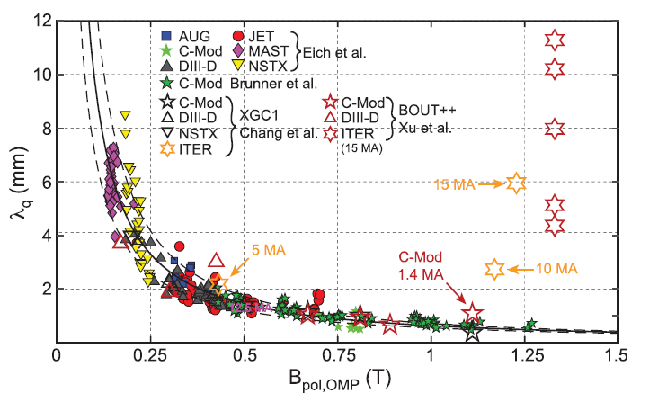
SOLPS-ITER modelling 2024
[K. Krieger, et al., Nucl. Fusion 65 (2025)]
λ_{q} ~ 0.6 - 1 mm
METIS / FIESTA (CUDB)
[F. Jaulmes, et al.]
Shot | Ip (MA) | B_{t} (T) | P_{in} (MW) | P_{SOL} (MW ) | N_{e,sep} (10²⁰ m⁻³) | Λ_{q} (mm)
#24300 | 1.2 | 4.3 | 3+1 | 3.0 | 1.72 | 0.79
#5400 | 1.6 | 4.9 | 4+2 | 4.6 | 1.90 | 0.65

Slide 6
Matching core profiles and λ_{q}
[I.Borodkina, et al., PSI (2024)]
  #24300
  #5400

Slide 7
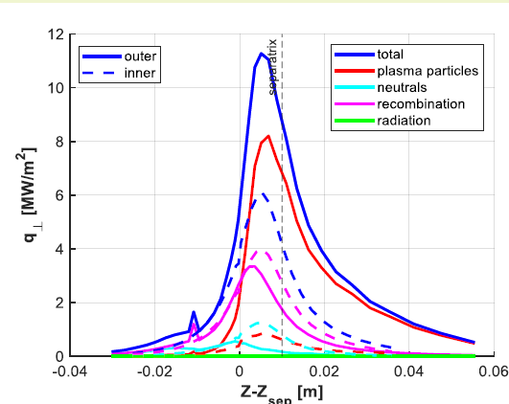
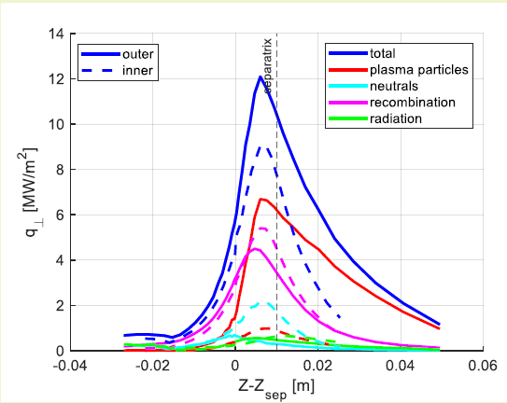
Divertor profiles

Slide 8
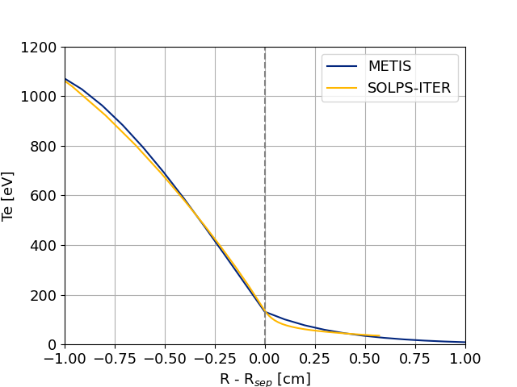
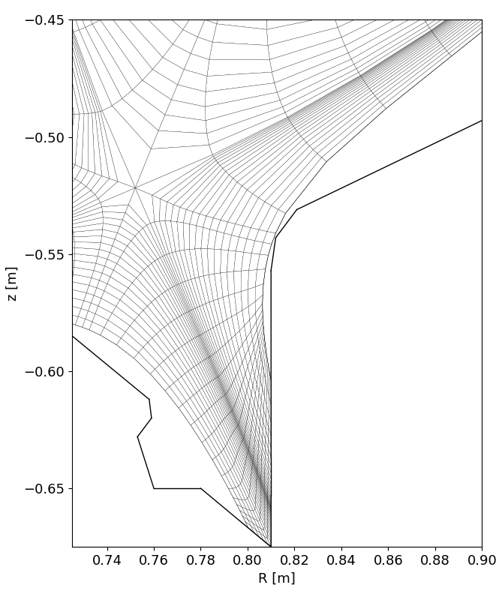
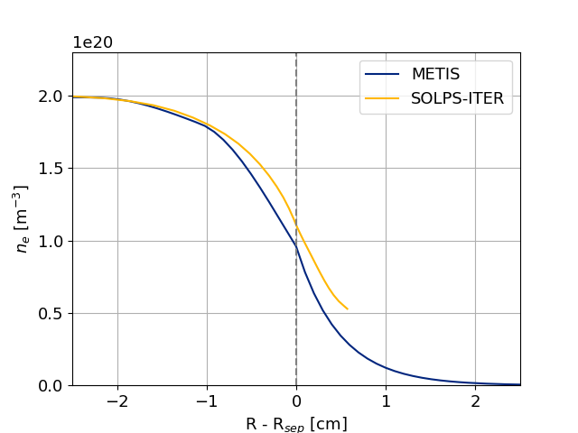
Identifying the problem (i)
[D. ŠvorC / O. Shyshkin]
#5400
Narrow gap
OMP
Te
λ
Divertor baffle
SOLPS-ITER version 3.0.9
Good match with METIS core profiles
B2.5 mesh extent limited by outer divertor baffle
OMP
ne
λ

Slide 9
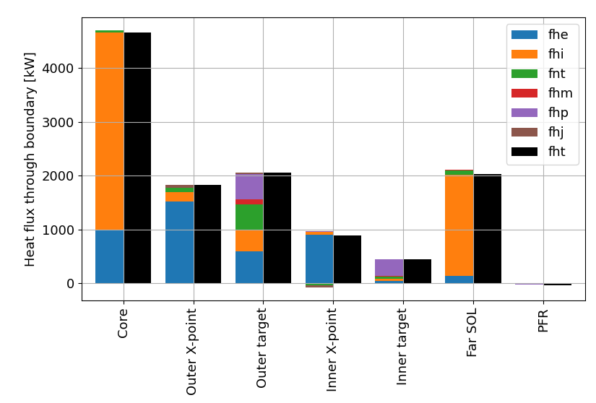
Identifying the problem (ii)
[D. ŠvorC / O. Shyshkin]
SOLPS-ITER non wide-grid for #5400
~ 45% of input power leaving through the outer B2.5 boundary
SOLPS-ITER wide grids version required
fhe,i - electron, ion thermal energy flux
fnt - convective heat flux - viscous correction terms for ions
fhm - kinetic energy flux
fhp - ionization energy flux
fhj - electrostatic energy flux
fht - total energy flux

Slide 10
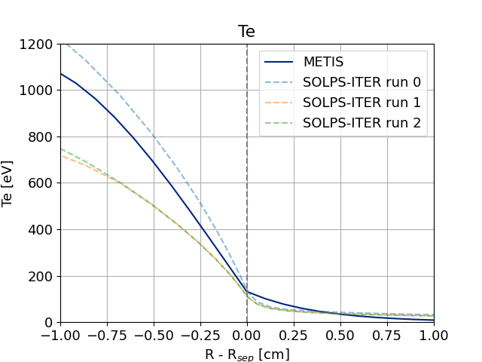
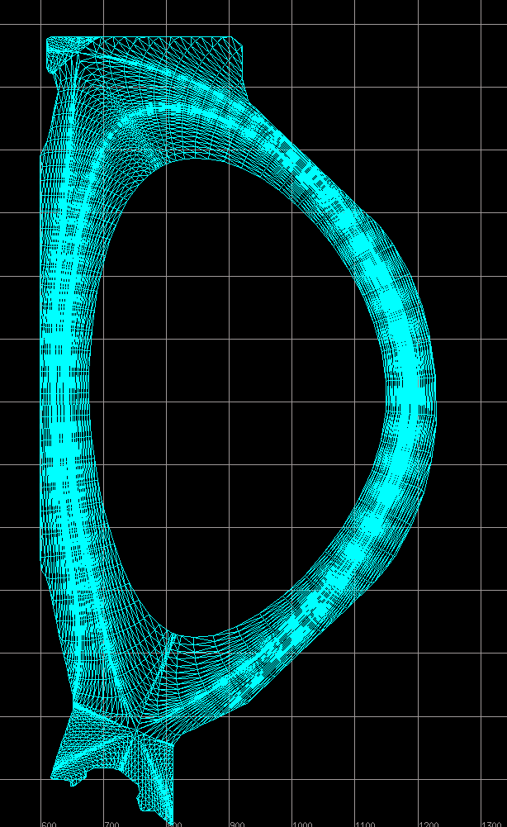
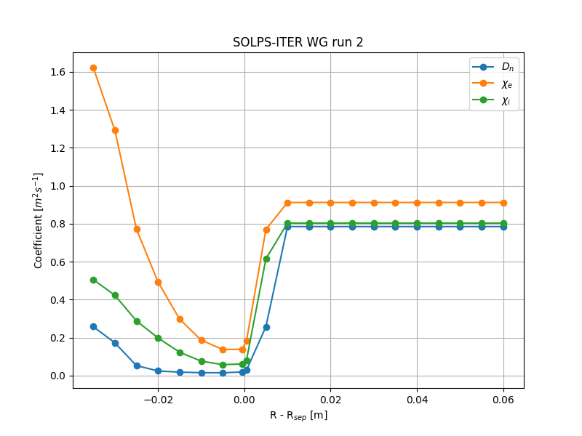
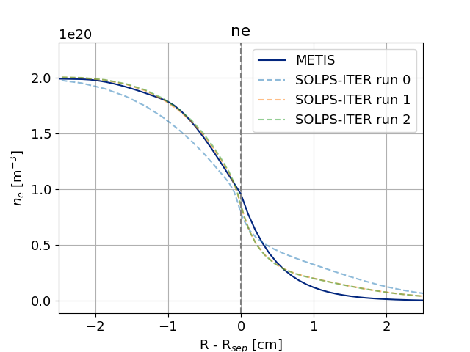
SOLPS-ITER wide-grid (wg-3.2.0-alpha)
#5400
[D. ŠvorC / O. Shyshkin]
Full vessel mesh, fluid neutrals
Good match with METIS separatrix values
SOL decay length (λ_{q}) not matched: adjustments to SOL transport coefficients needed
OMP
Te
OMP
ne

Slide 11
SOLPS-ITER modelling: future plans
Development/adoption of better analysis tools for the wide-grids unstructured mesh
Adjustment of transport to match λ_{q}
Move from fluid neutrals to kinetics (EIRENE)
Include impurities and drifts
Updates in manpower (SOLPS-ITER - COMPASS-U)
I. Borodkina (maternity leave)
O. Shyshkin (left)
Daniel ŠvorC

Slide 12
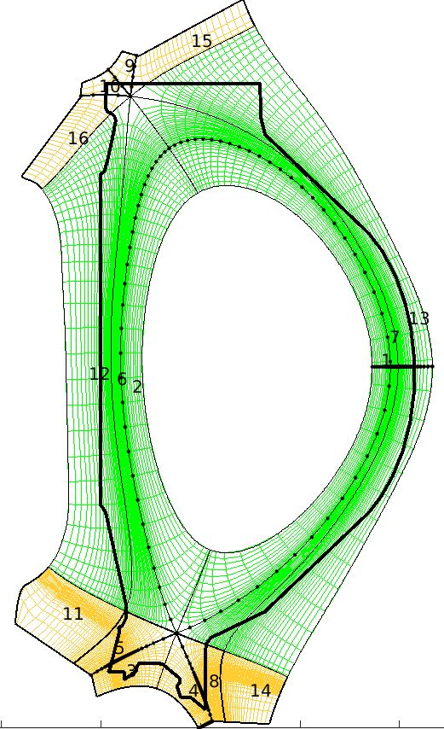
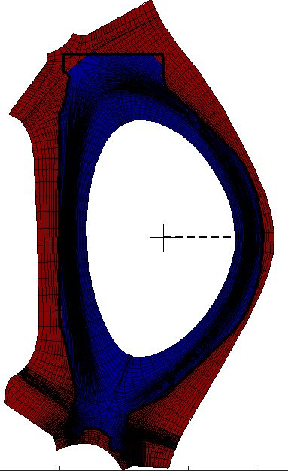
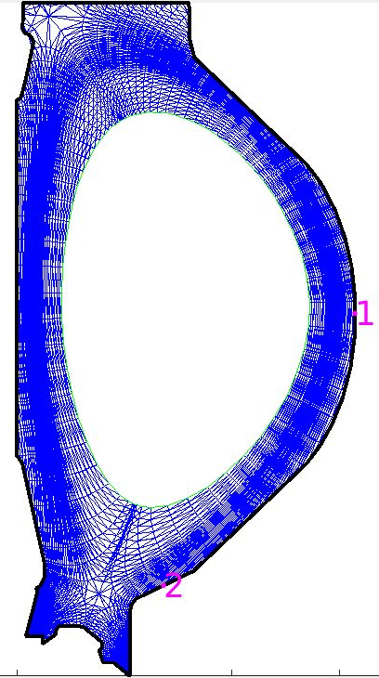
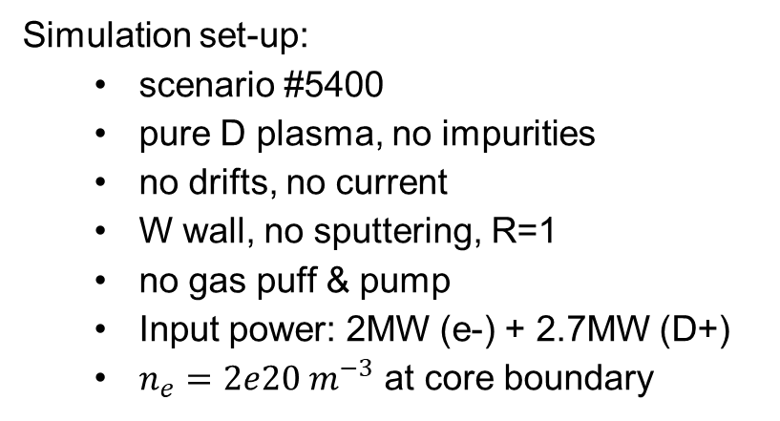
SOLEDGE3X COMPASS-U simulations
Objective: produce SOLEDGE3X up-to-the-wall backgrounds for COMPASS-U to
  compare with SOLPS-ITER solutions
  evaluate fluxes and conditions on the wall
Simulation set-up:
  scenario #5400
  pure D plasma, no impurities
  no drifts, no current
  W wall, no sputtering, R=1
  no gas puff & pump
  Input power: 2MW (e-) + 2.7MW (D+)
  $n_{e}=2e20 m^{−3}$ at core boundary
SOLEDGE3X mesh
Wall mask function
EIRENE
mesh

Slide 13
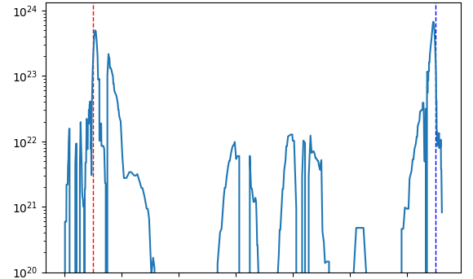
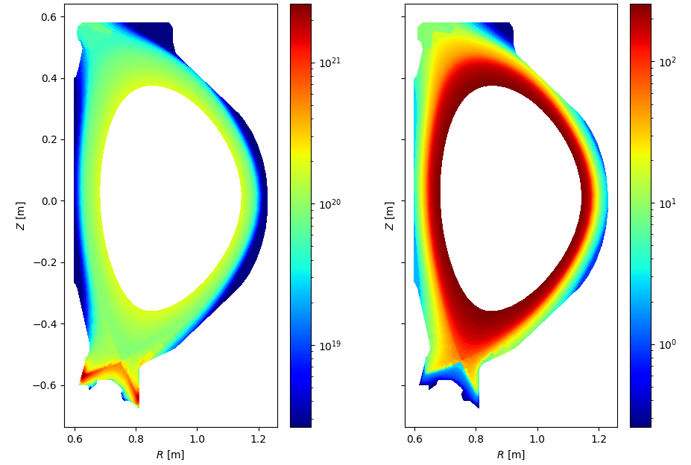
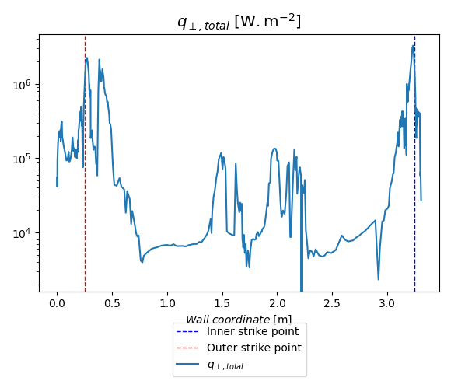



Preliminary results (not converged))
$$Γ_{D} [m^{−2}.s^{−1}]$$
Shoulder of outer target
Simulations up and running, not converged, but already:
  Plasma could detached at strike-point
  Significant flux and ion temperature at shoulder of outer target
  Power load to the wall << divertor + fuffle power loads
WIP - not converged
$$n_{e} [m^{−3}]$$
$$T_{e} [eV]$$
WIP - not converged
WIP - not converged
WIP - not converged

Slide 14
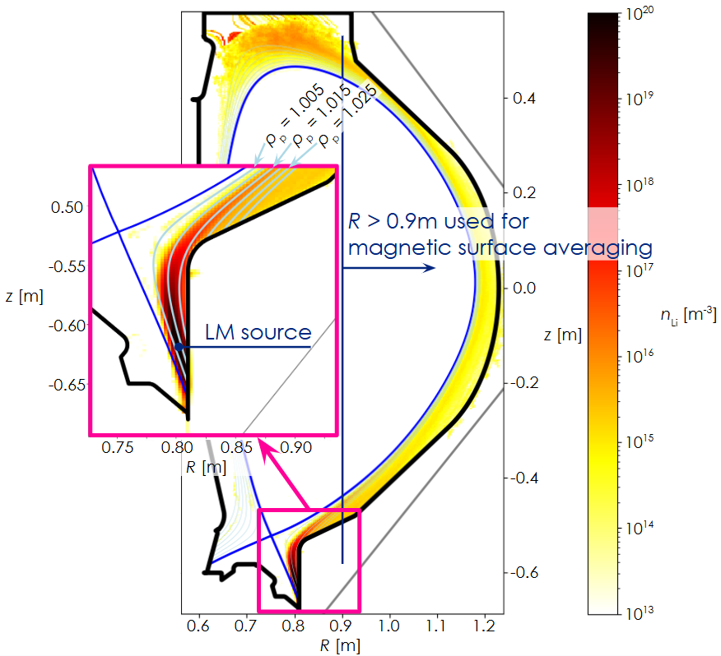
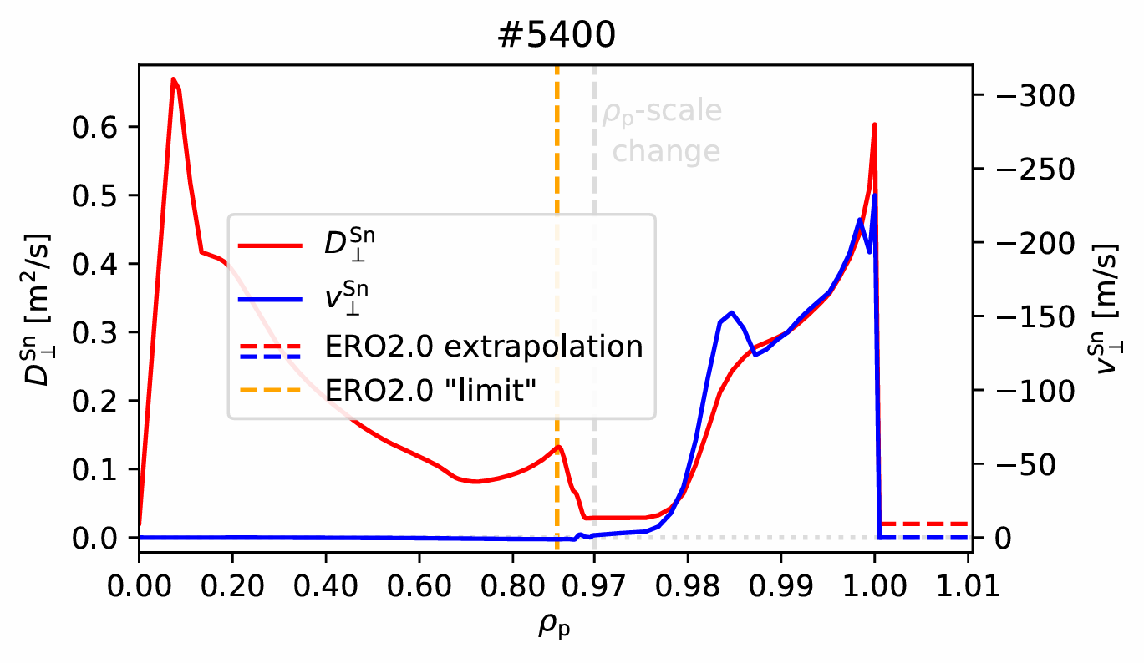
ERO2.0 simulations (LM)
First Li & Sn simulations [S. Lukes et al., PSI (2024)]
Li density profile for #5400
HeatLMD
LM erosion
rate
q⊥
ERO2.0
LM density
near separatrix
Aurora
Core radiation
SOLPS
2D plasma
FACIT transport coefficients for Sn (Li: the same anomalous coefficients as for D)

Slide 15
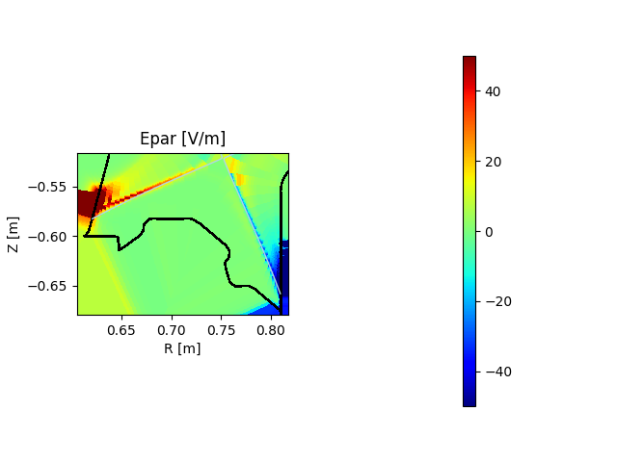

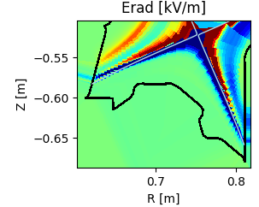

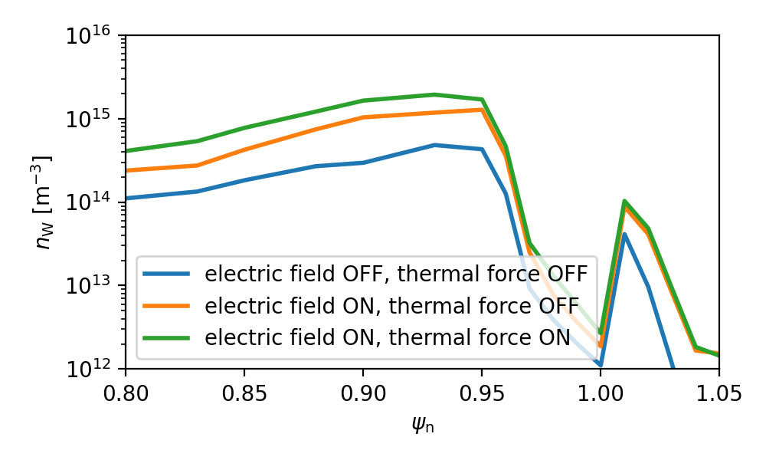

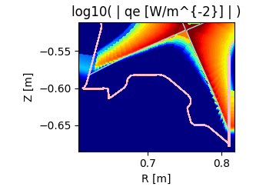
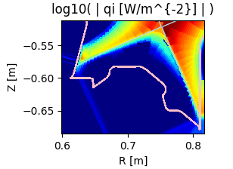

ERO2.0 simulations (updated approach)
Additions from SOLPS-ITER
global electric field
global thermal force: F_{th} ~ q||
increased time & spatial resolution,
Sheath is prescribed analytically
[simulations by S. Lukes]

Slide 16
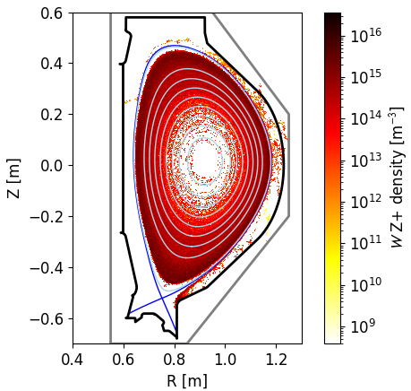
ERO2.0 simulations (W)
W density (#5400)
Outer Divertor Baffle can be the dominant source of W (lower prompt redeposition and higher anomalous diffusion than at the strike-points)
Average W core concentration < 10⁻³ %:
below the critical limit.
To be addressed in future runs:
updated background plasma
effects of core poloidal asymmetries & ELMs [H. A. Kumpulainen et al., Plasma Phys. Control. Fusion 66 (2024) 055007]
[simulations by S. Lukes]

Slide 17
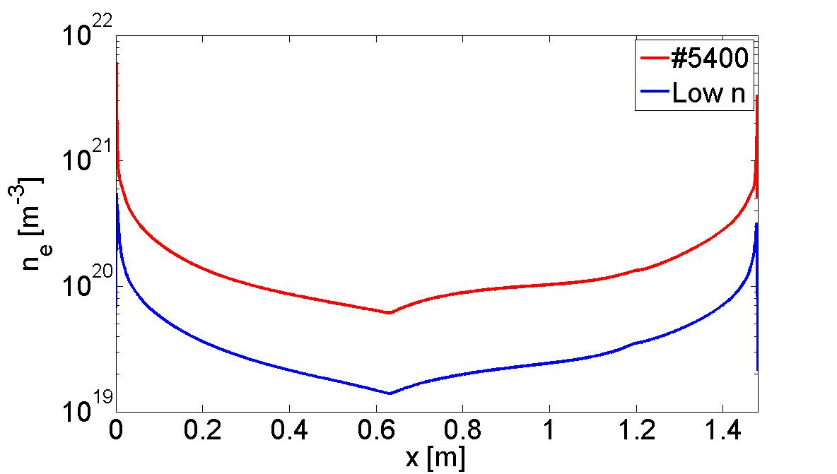
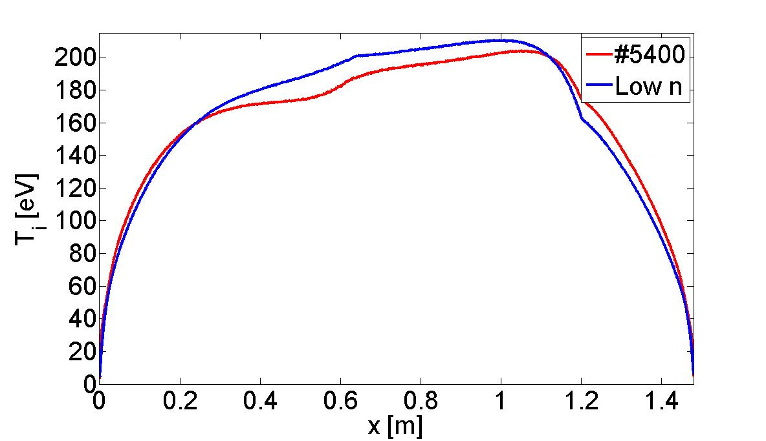
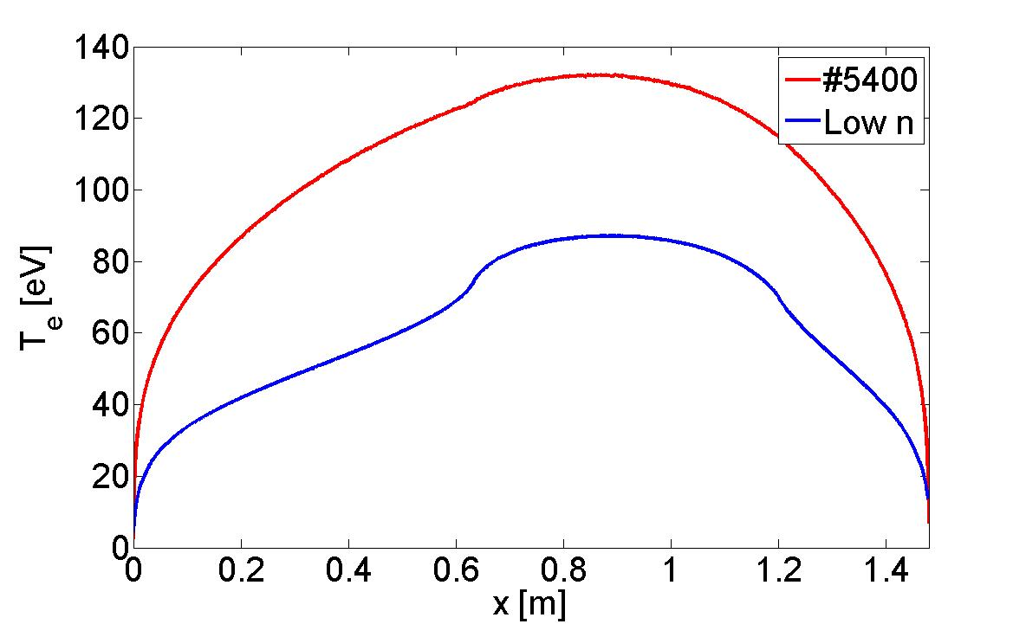
Kinetic (BIT1) simulations
synthetic diagnostic
Be/W sputtering
Inner
divertor
Plasma and heat source
Outer
divertor
D recycling
W sputtering
e, D⁺
Fueling, impurity seeding
Outer wall
No seeded impurity
Simulation “price”: ~200 M CPU hours

Slide 18
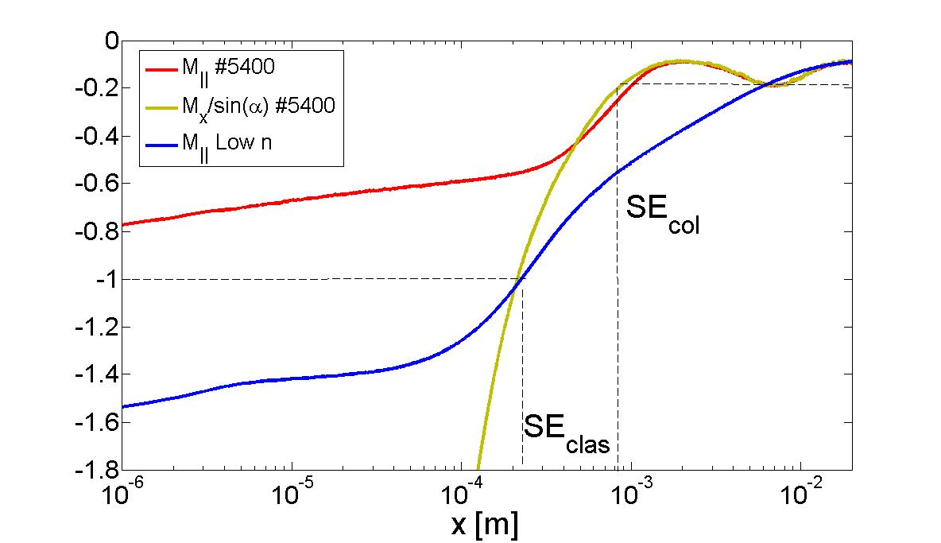
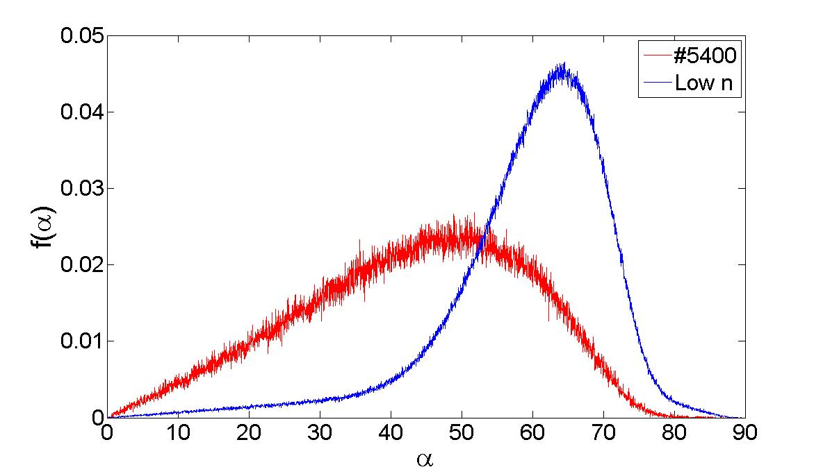
Kinetic simulations: results
 | Sheath | n_{e,div} [10²¹ m⁻³] | T_{e,div} [eV] | T_{i,div} [eV] | q_{pl, div} [MW /m²] | F_{div} [10²⁴ /m²s] | F_{W, gr} [10¹⁹ /m²s] | F_{W, net} [10¹⁹ /m²s]
#5400 | col. / col. | 6.0 / 3.3 | 6.5 / 11.3 | 5.6 / 7.1 | 25 / 68 + neutrals (<10) | 4.47 / 4.66 | 6.0 / 10 | 4.0 / 5.0
Low n | clas. / clas. | 0.32 / 0.15 | 4.8 / 13.7 | 5.1 / 6.6 | 5.3 / 10.1 | 0.47 / 0.35 | 5.3 / 5.6 | 0.0 / 1.3
Parallel Mach number profiles at the ID
Angular DF of D⁺ ions absorbed at the ID

Slide 19
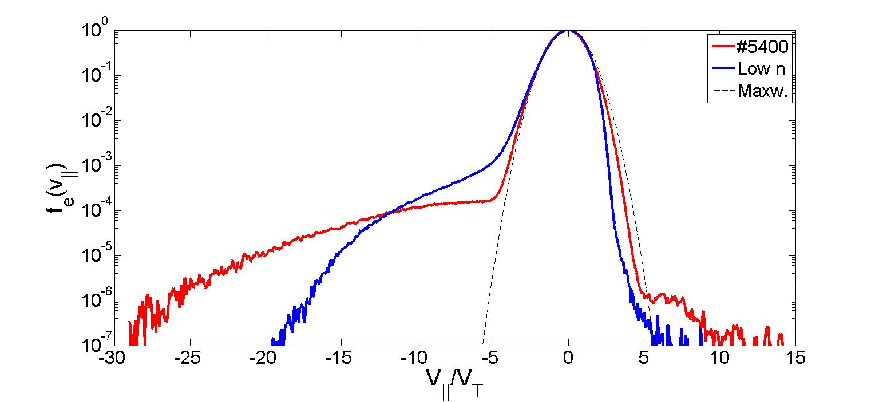
Electron VDF at the divertor plate
ID
Collision effect
Reduced sheath potential drop
Nonclassical VI characteristics?

Slide 20
Conclusions
  First set of field line code modelling of COMPASS-U has been completed. Simulations predict partial plasma detachment in high performance scenarios even without impurity seeding. Some results need revision, e.g. high wall heat loads.
  Updated models are under preparation / or started: SOLPS-ITER-wg, seeded impurity and drifts.
  ERO2.0 modelling: no W accumulation for #24300, #5400 (cases without ELMs, impurity and drifts); next steps: to use updated plasma background, include ELMs and core poloidal asymmetries.
  Kinetic models of the COMPASS-U predict formation of collisional sheath.
  New simulations are running /or under preparation (ELMs, seeded impurities). We have new BIT1 modelers at the IPP CAS: Jakub Hromadka and Simon Vrba.
  In one week we will host BIT1 Hackathon with more than 30 registered participants.

Slide 21
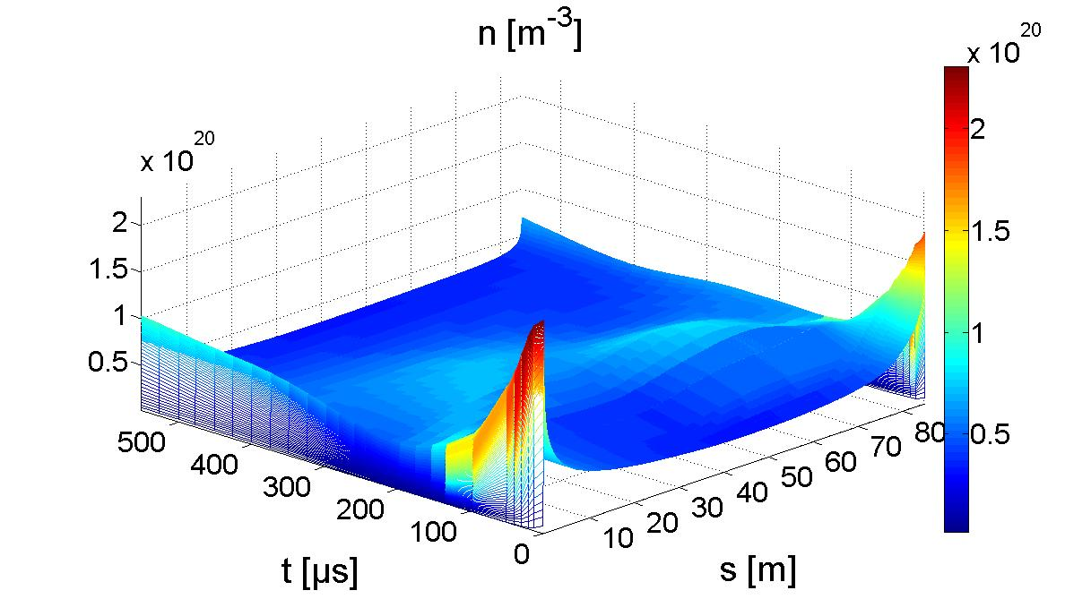
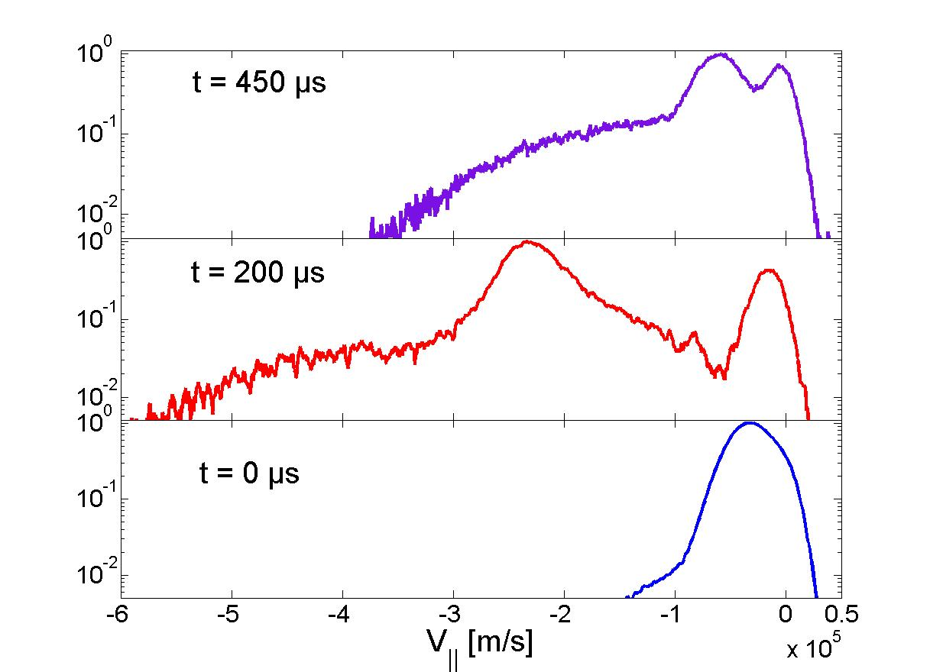
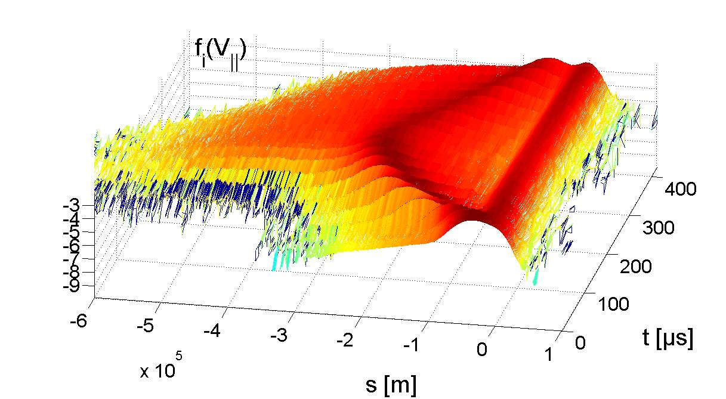
EDF of plasma particles during ELMs
EDFs are far from the Maxwellian at any time → kinetic modelling is required
ELM
Thermal
EDF for electrons and ions from ELMy SOL modelling of ASDEX-tokamak SOL with Type-I 60 kJ ELM (from PIC simulations)

